Slide 1



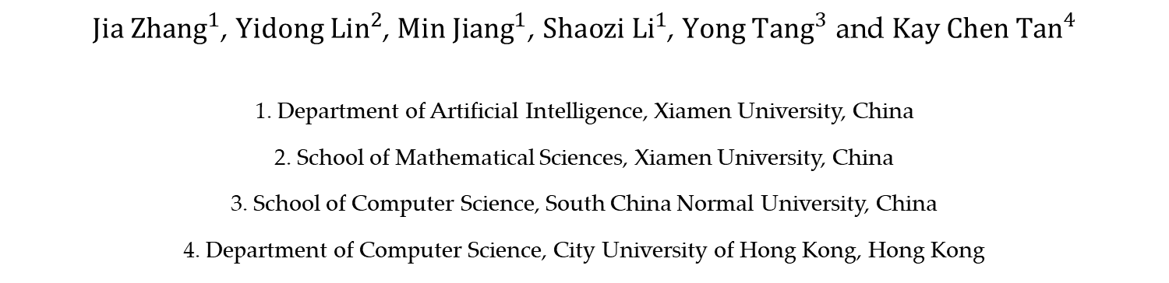
Multi-label Feature Selection via Global Relevance and Redundancy Optimization
${Jia Zhang}^{1}$, ${Yidong Lin}^{2}$, ${Min Jiang}^{1}$, ${Shaozi Li}^{1}$, ${Yong Tang}^{3}$ and ${Kay Chen Tan}^{4}$
1. Department of Artificial Intelligence, Xiamen University, China
2. School of Mathematical Sciences, Xiamen University, China
3. School of Computer Science, South China Normal University, China
4. Department of Computer Science, City University of Hong Kong, Hong Kong

Slide 2

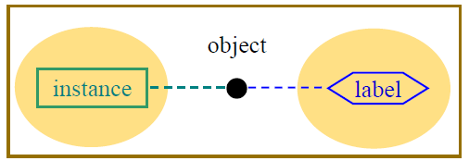
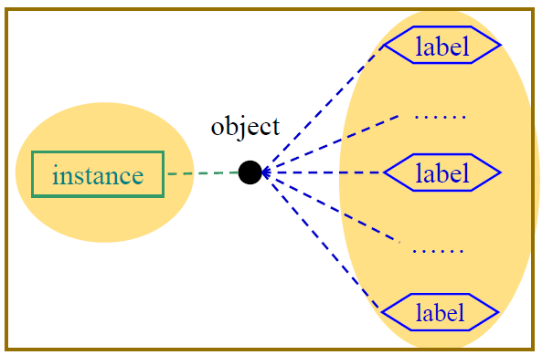
Multi-label Learning
For single-label learning, an instance is attributed with a single label characterizing its semantics.
Multi-label learning deals with examples which may be associated with multiple labels simultaneously.
M.-L. Zhang, Z.-H. Zhou: A Review on Multi-Label Learning Algorithms. IEEE Trans. Knowl. Data Eng. 26(8): 1819-1837 (2014)

Slide 3
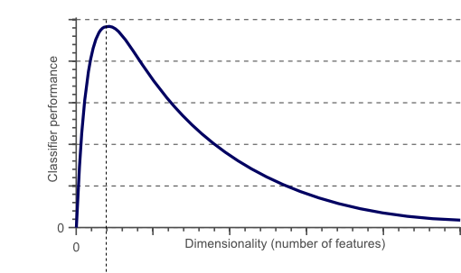
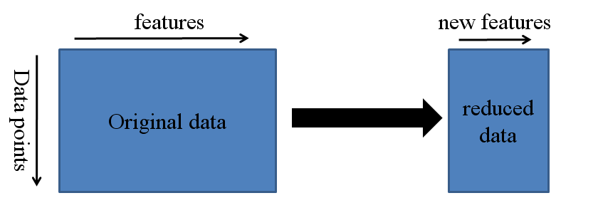
Multi-label Feature Selection
In practice, the curve of learning performance w.r.t. the feature dimension looks like this
http://www.visiondummy.com/2014/04/curs
e-dimensionality-affect-classification/
Optimal number of features
For a fixed sample size, there is an optimal number of features to use.
Y. Li, T. Li, H. Liu: Recent advances in feature selection and its applications. Knowl. Inf. Syst. 53(3): 551-577 (2017)

Slide 4
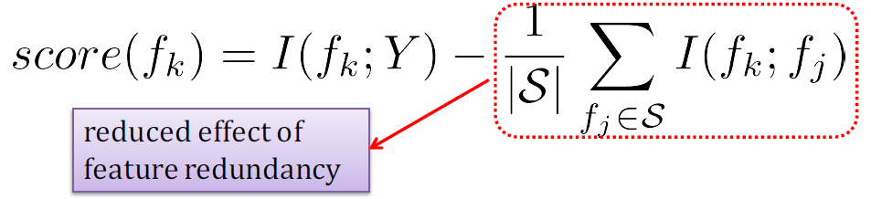


Information Theoretical based Methods
Intuitively, with more selected features, the effect of feature redundancy should gradually decrease;
Meanwhile, pairwise feature independence becomes stronger.
mRMR:
maximum relevance between features and labels
H. Peng, F. Long, C. H. Q. Ding: Feature Selection Based on Mutual Information: Criteria of Max-Dependency, Max-Relevance, and Min-Redundancy. IEEE Trans. Pattern Anal. Mach. Intell. 27(8): 1226-1238 (2005) Cited by 8119
Optimization Formulation for Minimum Redundancy Maximum Relevance:
mRMR-opt:
H. Lim, D.-W. Kim. Convex optimization approach for multi-label feature selection based on mutual information. In Proceedings of the 23rd International Conference on Pattern Recognition, pages 1512–1517, 2016
s.t.
Note: x is a feature weight vector, which can access the importance of all the features.

Slide 5
Challenges
Many information theoretical based methods select candidate features one by one using a heuristic search strategy, until obtain a size-specific feature subset.
These methods are easily trapped in local optima. Not surprisingly, they may be in trouble to find an optimal feature subset.
Heuristic search is time-consuming while a mass of ineffective and repetitive entropy calculations are involved in the criterion function.
Limitation of various mRMR-opt methods: It’s designed for multi-label feature selection, but unfriendly for multi-label data understanding.
Label relationship;
Extension like binary relevance: class-imbalance, relative labeling-importance…

Slide 6
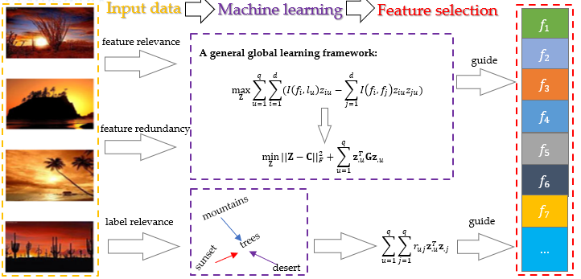
Global Relevance and Redundancy Optimization - GRRO
To address the challenges, we propose a general global optimization framework GRRO to conduct multi-label feature selection.
The core idea:
a. We provide an optimization scheme to model feature relevance and feature redundancy;
b. We learn label relevance by exploiting second-order label correlation.

Slide 7
Global Relevance and Redundancy Optimization - GRRO
The optimization objective function:
1
2
3
feature coefficient matrix
1
Feature relevance exploitation. C is the matrix which preserves the correlation between features and labels.
2
Feature redundancy exploitation. G is the symmetric matrix containing the correlation information of features.
3
Label relevance exploitation. R denotes the correlation between labels.
Computational efficiency: GRRO can be easily solved for generating the optimal solution, and only needs to go through the relevance and redundancy information one time for feature evaluation.
Scalability: GRRO achieves feature selection across all labels while feature selection result for each label is available. By virtue of this property, GRRO is easily scalable for multi-label data understanding.

Slide 8
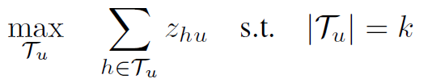
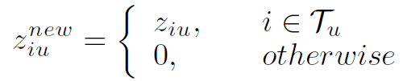
Extension to Label-specific Feature Selection
The global optimization result, i.e., feature coefficient matrix Z, is utilized as the priori knowledge to exploit label-specific feature selection locally.
Steps:
We analyze discriminative features for each label, and these features are specified as the label-specific features with respect to the corresponding label.
We update the weight matrix with the weight information of label-specific features.

Slide 9
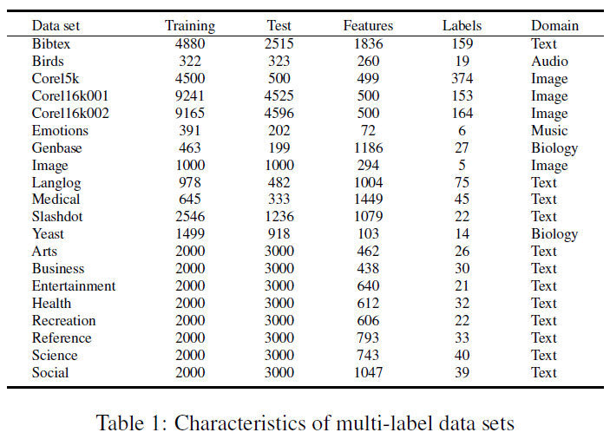
Experimental Setup
Twenty benchmark multi-label data sets are employed, which are mainly from the domains including text, multimedia, and biology.
Evaluation metrics:
-Label-based: macro-F1, micro-F1
-Example-based: Hamming loss,
Comparing methods:
ranking loss, coverage, average precision.
All of comparing methods are information theoretical based methods, including four heuristic methods PMU [Lee and Kim, 2013], MDMR [Lin et al., 2015], FIMF [Lee and Kim, 2015], and SCLS [Lee and Kim, 2017], and one optimization method MICO [Sun et al., 2019].

Slide 10
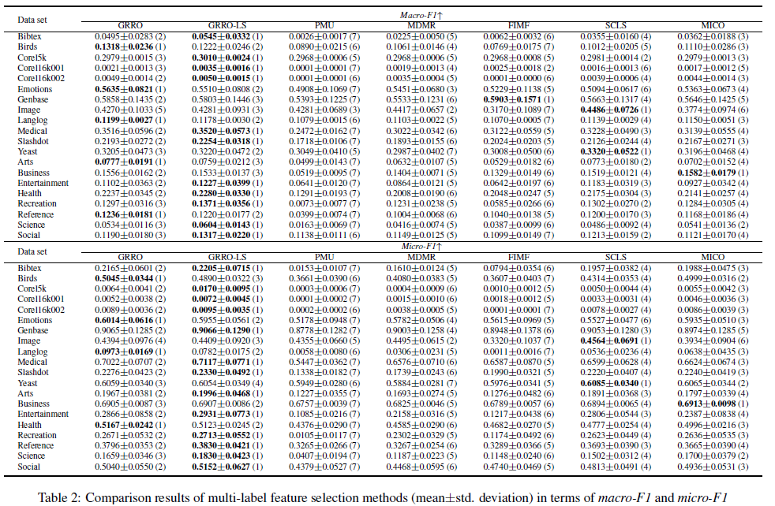
Performance Evaluation
Macro-F1
Micro-F1
Note: The details on the other metrics are available on the web: https://jiazhang-ml.pub/Supplement-GRRO.pdf

Slide 11
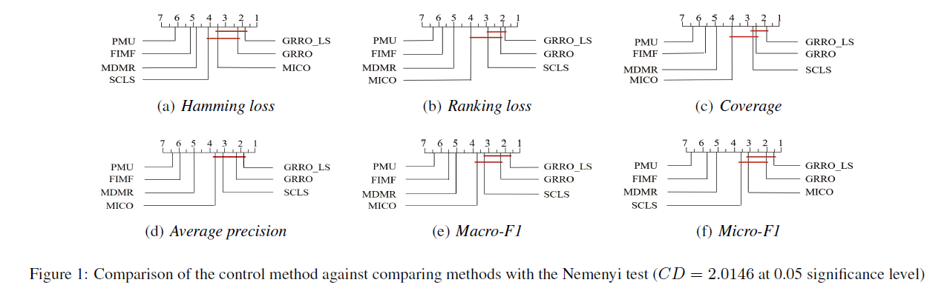
Performance Evaluation
The proposed methods. i.e., GRRO-LS and GRRO, rank 1st and 2nd respectively among all the methods, and GRRO-LS can achieve highly competitive performance against the selected comparing methods.

Slide 12
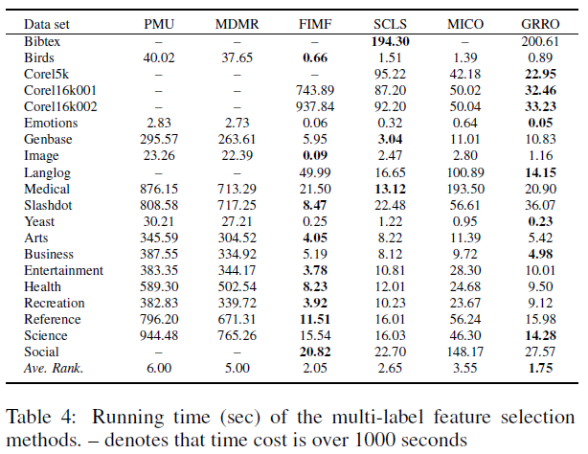
Efficiency Evaluation
GRRO performs the best in terms of average ranking (Ave. Rank.). Theoretically, the proposed methods GRRO-LS and GRRO have the similar result on running time.

Slide 13
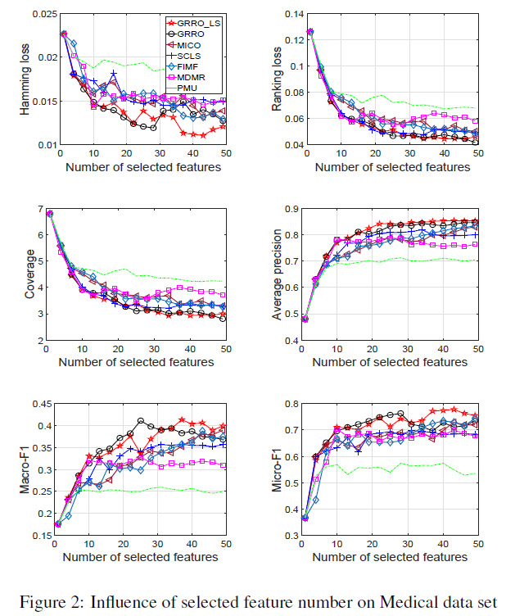
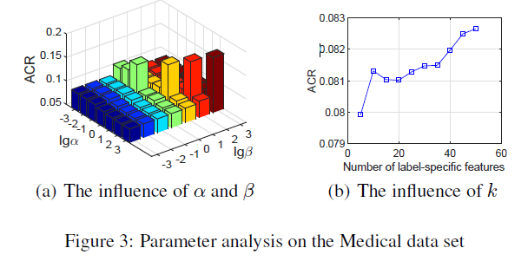
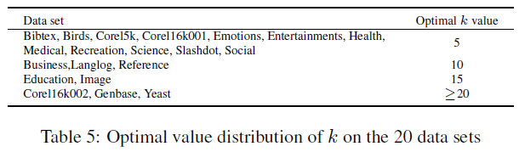
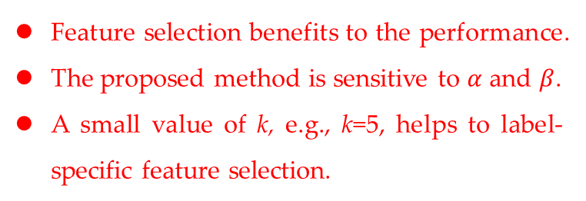
Parameter Analysis
Feature selection benefits to the performance.
The proposed method is sensitive to $α$ and $β$.
A small value of k, e.g., k=5, helps to label-specific feature selection.

Slide 14
Conclusion and Future Work
Our main contribution is to propose a general global optimization framework, in which feature relevance, label relevance (i.e., label correlation), and feature redundancy are taken into account.
Our proposal has an excellent mechanism for utilizing inherent properties of multi-label learning, specially, we provide a formulation to extend the proposal with label-specific features.
Future work:
Further study of labeling information exploitation considering the issues of the class-imbalance and the relative labeling-importance.
The analysis of genetic data with high dimensionality, such as the application on autism spectrum disorder.

Slide 15
THANK YOU FOR YOUR ATTENTION
This work is supported by the National Natural Science Foundation of China (No. 61876159, No. 61806172, No. 61572409, No. U1705286, No. 61571188, No. 61772211 & No. U1811263), the National Key Research and Development Program of China (No.2018YFC0831402), Fujian Province 2011 Collaborative Innovation Center of TCM Health Management, Collaborative Innovation Center of Chinese Oolong Tea Industry-Collaborative Innovation Center (2011) of Fujian Province.
Please pay your attention to our extended version of the conference paper entitled “Fast Multi-label Feature Selection via Global Relevance and Redundancy Optimization”. The extension focuses on large-scale multi-label feature selection, and the pre-print will come soon. Thank you!

