Slide 1
IES Project Presentation
Charging Stations
in Electric Car Sharing Systems
Group 9
王艺如 贾紫仪 贾冕 黄莫淋 张亚凯
2021.10

Slide 2
Problem description
Describe the problem
T -University plans to build charging stations to meet the needs of students and students. Through the evaluation, school leaders suggested some possible locations for charging stations.
Due to the limitation of actual area, the maximum number of charging poles that can be built in different locations is restricted accordingly. We factor in the cost of student and faculty convenience and satisfaction, which means that if a person lives too far away from a charging station, the cost increases.
Now our task is to determine the location of charging stations and the number of charging piles in each charging station, so as to minimize the cost of construction.
Notes:
Contribution

Slide 3
Problem description
Describe the problem
Assumptions
Students will choose the charging locations according to the school allocation.
The fixed cost of a charging station will be effected by its position.
The cost of building a charging pole candidate is a fixed constant.
We don't need to consider operating and maintenance costs.
The maximum capacity of charging poles in the students dormitory area. are less than those in other areas.
Notes:
Contribution

Slide 4



Problem description
Describe the problem
Model:
Min $Σ_{l=1}^{L}\left(Z_{l}f_{l}+cX_{l}\right)+Σ_{l}Σ_{m}Y_{ml} f\left(D_{ml}\right)$
Subject to
$$X_{l}≤V_{l}, l=1,2,…,L$$
$$X_{l}≥Σ_{m=1}^{M} Y_{ml}, l=1,2,…,L$$
$$Σ_{l=1}^{L}Y_{ml}=N_{m}, m=1,2,…,M$$
$$Y_{ml}≥0, l=1,2,…,l m=1,2,…,M$$
# of charging poles $≤$ maximum capacity
The l-th station meets demands of students
The demands of students in m-th dormitory can all be meted
M: number of dormitories in TU
L: number of feasible locations
Notes:
Contribution

Slide 5

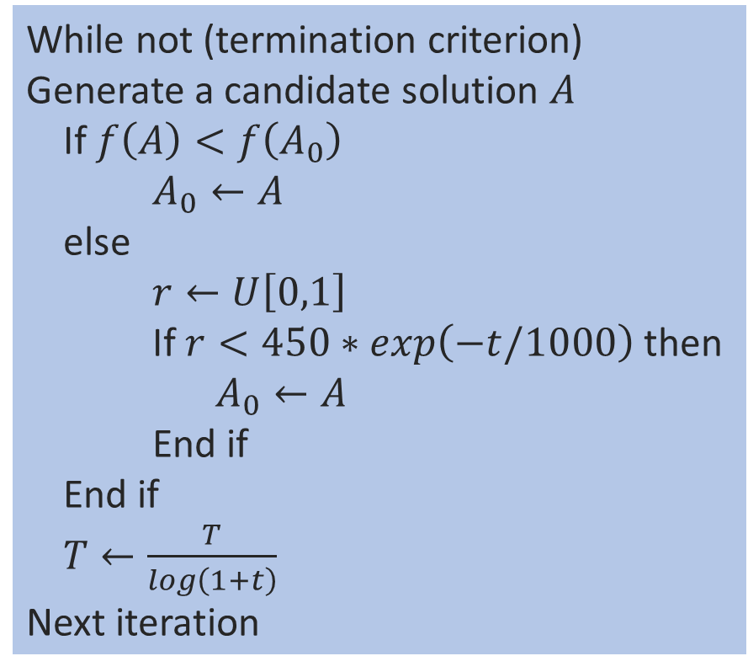
Algorithm implementation
Initialization candidates
While not (termination criterion)
Generate a candidate solution $A$
If $f\left(A\right)<f\left(A_{0}\right)$
$A_{0}←A$
else
$r←U\left[0,1\right]$
If $r<450∗\exp\left(−t/1000\right)$ then
$A_{0}←A$
End if
End if
$T←\frac{T}{\log\left(1+t\right)}$
Next iteration
Initialization：
T = initial temperature > 0
$$α\left(T\right)=\frac{T}{\log\left(1+t\right)}$$
t = the iteration times
Initial solution: $A_{M∗L}$
$$Σ_{j} a_{mj}=Demand_{m}$$
$$a_{ml}≥0$$

Slide 6

Algorithm implementation
Initialization candidates
While not (termination criterion)
Generate a candidate solution $A$
If $f\left(A\right)<f\left(A_{0}\right)$
$A_{0}←A$
else
$r←U\left[0,1\right]$
If $r<450∗\exp\left(−t/1000\right)$ then
$A_{0}←A$
End if
End if
$T←\frac{T}{\log\left(1+t\right)}$
Next iteration
Generate $A:$
$a_{ml}←a_{ml}+e$
where $e∈\left\{0, 1, −1\right\}$ randomly
s.t.
$Σ_{j} a_{mj}=Demand_{j}$

Slide 7
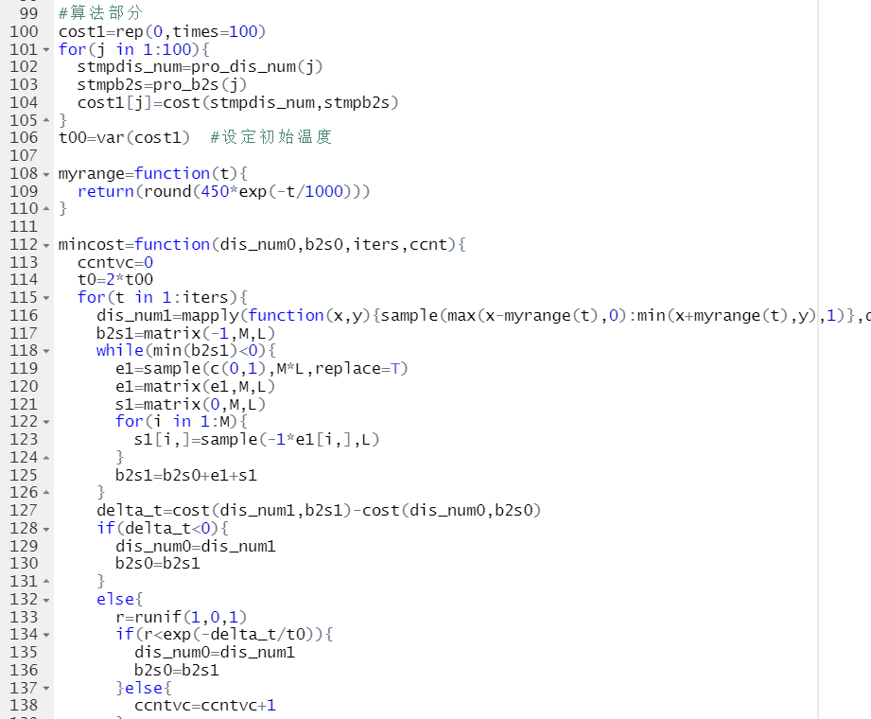

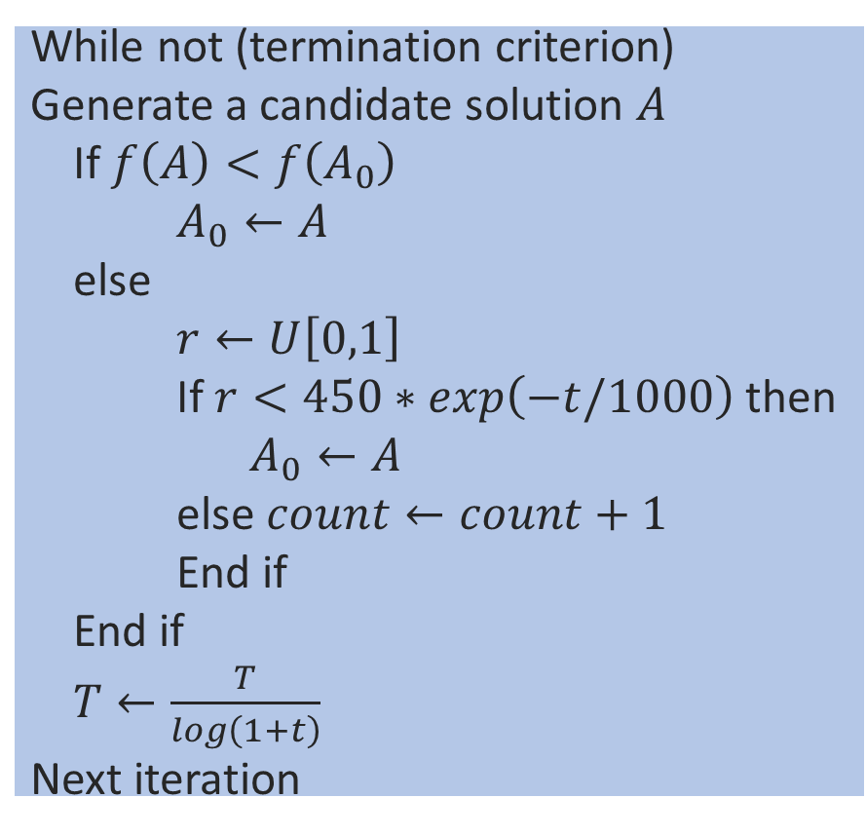
Algorithm implementation
Initialization candidates
While not (termination criterion)
Generate a candidate solution $A$
If $f\left(A\right)<f\left(A_{0}\right)$
$A_{0}←A$
else
$r←U\left[0,1\right]$
If $r<450∗\exp\left(−t/1000\right)$ then
$A_{0}←A$
else $count←count+1$
End if
End if
$T←\frac{T}{\log\left(1+t\right)}$
Next iteration
Termination criterion:
$t≥$ sup_iteration
Or
$count≥$ sup_same

Slide 8
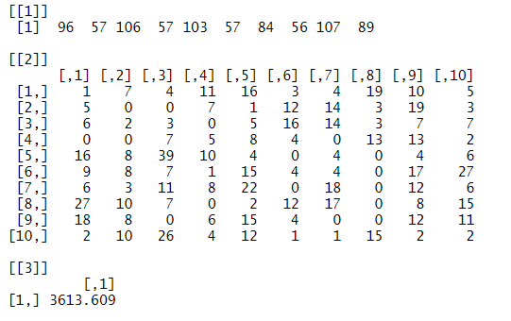
Numerical results
Notes:
Contribution

Slide 9
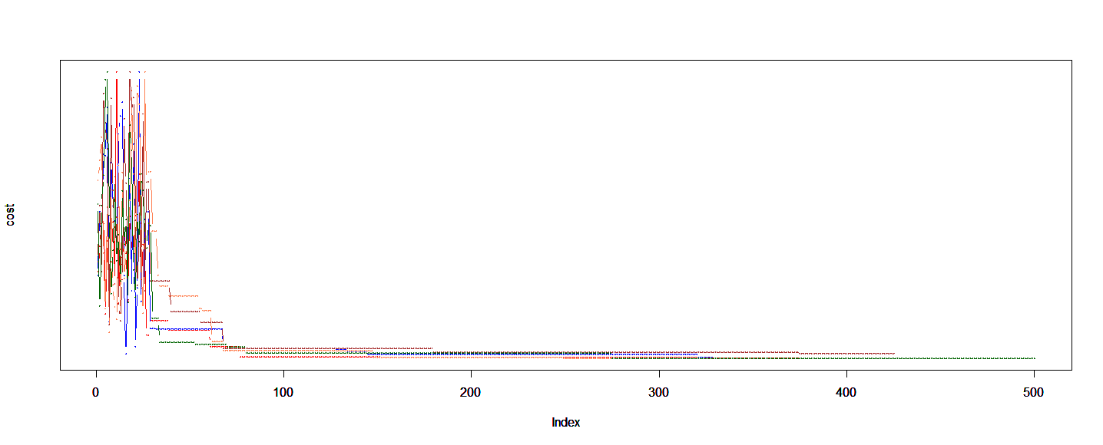
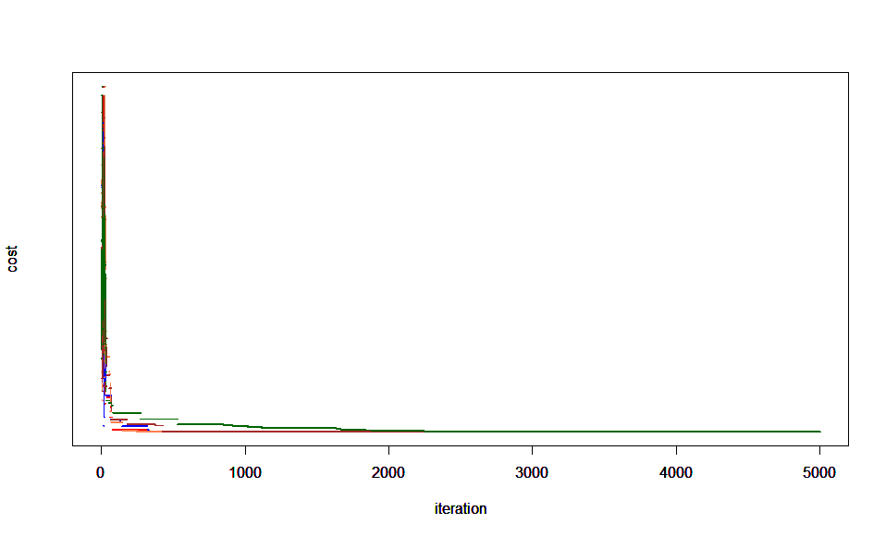
Numerical results

Slide 10
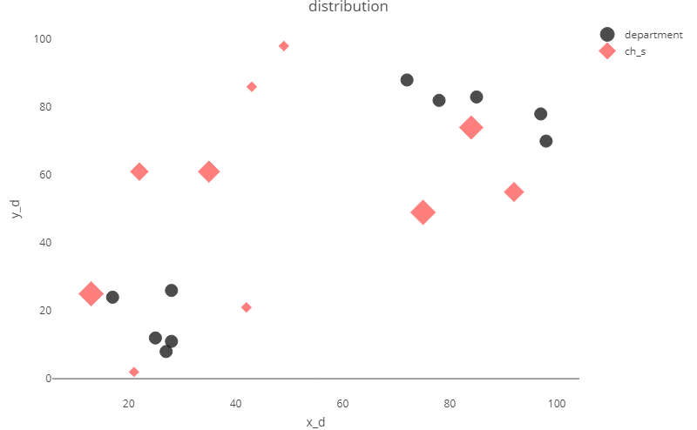
Numerical results

Slide 11
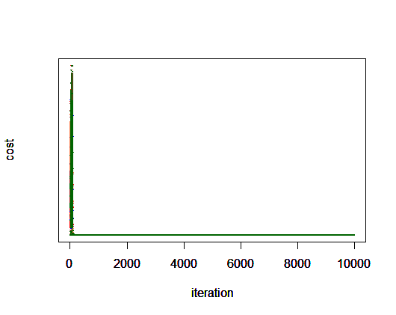

Numerical results
$$T=T∗0.8$$

Slide 12
Conclusion
Summarize
The vectorization of R language is useful;
Whether can get the optimal solution is greatly effected by the definition of penalty function.
The algorithm efficiency and obtaining of global optimal solution are greatly effected by the definition of disturbance function.
Making the disturbance function a little more random might give you a better result, not limited to (-1,0,1).
Maybe we can tweak the parameters to get better results.
we can try to use other algorithms to solve the problem and compare the advantages and disadvantages of different algorithms.
Notes:
Contribution

Slide 13
Conclusion
Pros
SA is easy to implement and has strong robustness;
Less constrained by initial conditions;
High operating efficiency.
Cons
The convergence speed is slow and the execution time is long
The performance of the algorithm is dependent on the initial value
Parameter sensitivity
Notes:
Contribution

Slide 14
Reference
张曦. 新能源汽车充电站选址随机优化模型[D].重庆大学,2019.
Georg Brandstätter,Markus Leitner,Ivana Ljubić. Location of Charging Stations in Electric Car Sharing Systems[J]. Transportation Science,2020,54(5):
潘龙. 基于充电选择行为的电动汽车充电设施布局优化研究[D].北京交通大学,2019.
Lee Jiwon,An Midam,Kim Yongku,Seo JungIn. Optimal Allocation for Electric Vehicle Charging Stations[J]. Energies,2021,14(18):
Lin Haiyang,Bian Caiyun,Wang Yu,Li Hailong,Sun Qie,Wallin Fredrik. Optimal planning of intra-city public charging stations[J]. Energy,2022,238(PC):
Notes:
Contribution

Slide 15
Roles of group members
Describe the role and the task of each group member
Preparation stage:
Literature research: 贾紫仪
Topics and Algorithms discussion: 全组
Algorithm implementation stage:
Coding: 王艺如，贾冕，贾紫仪
Summary stage:
Data visualization: 王艺如，张亚凯，黄莫淋
Making PPT: 张亚凯，黄莫淋
Notes:
Contribution

Slide 16
Thanks for listening

