Slide 1
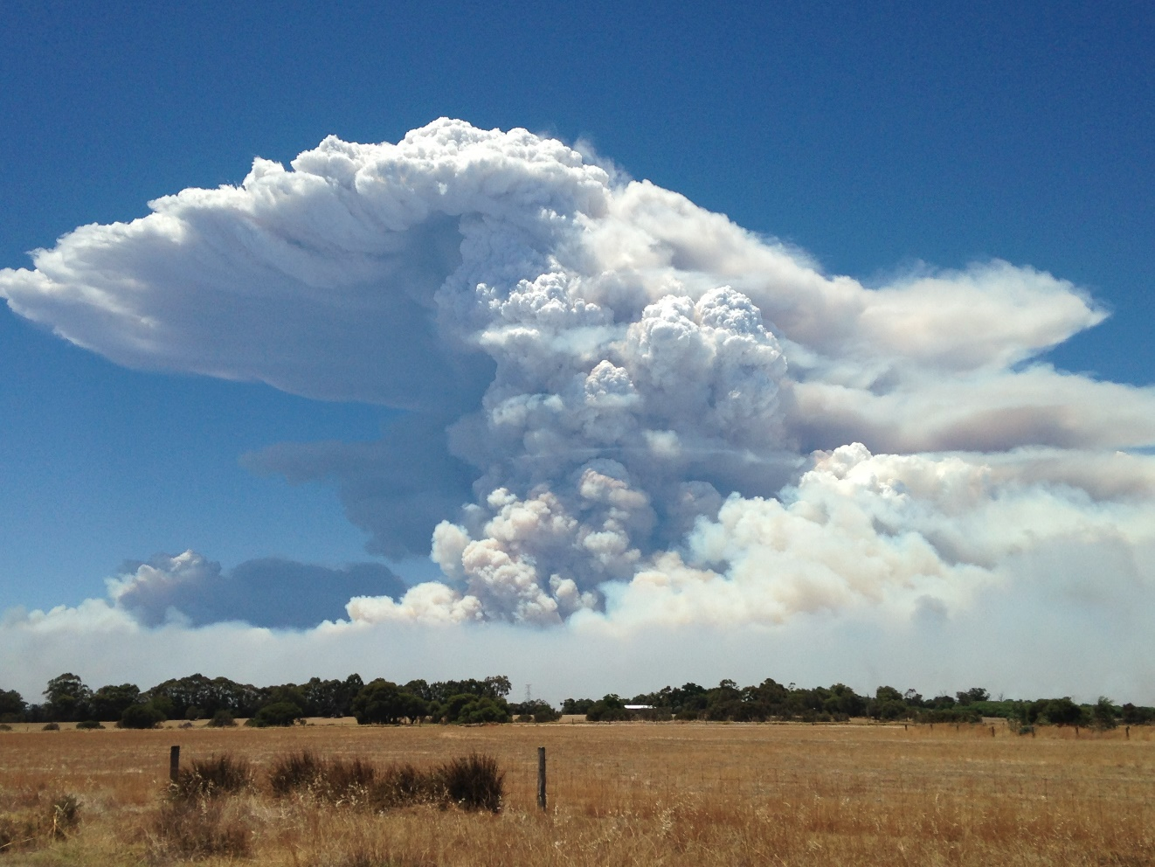
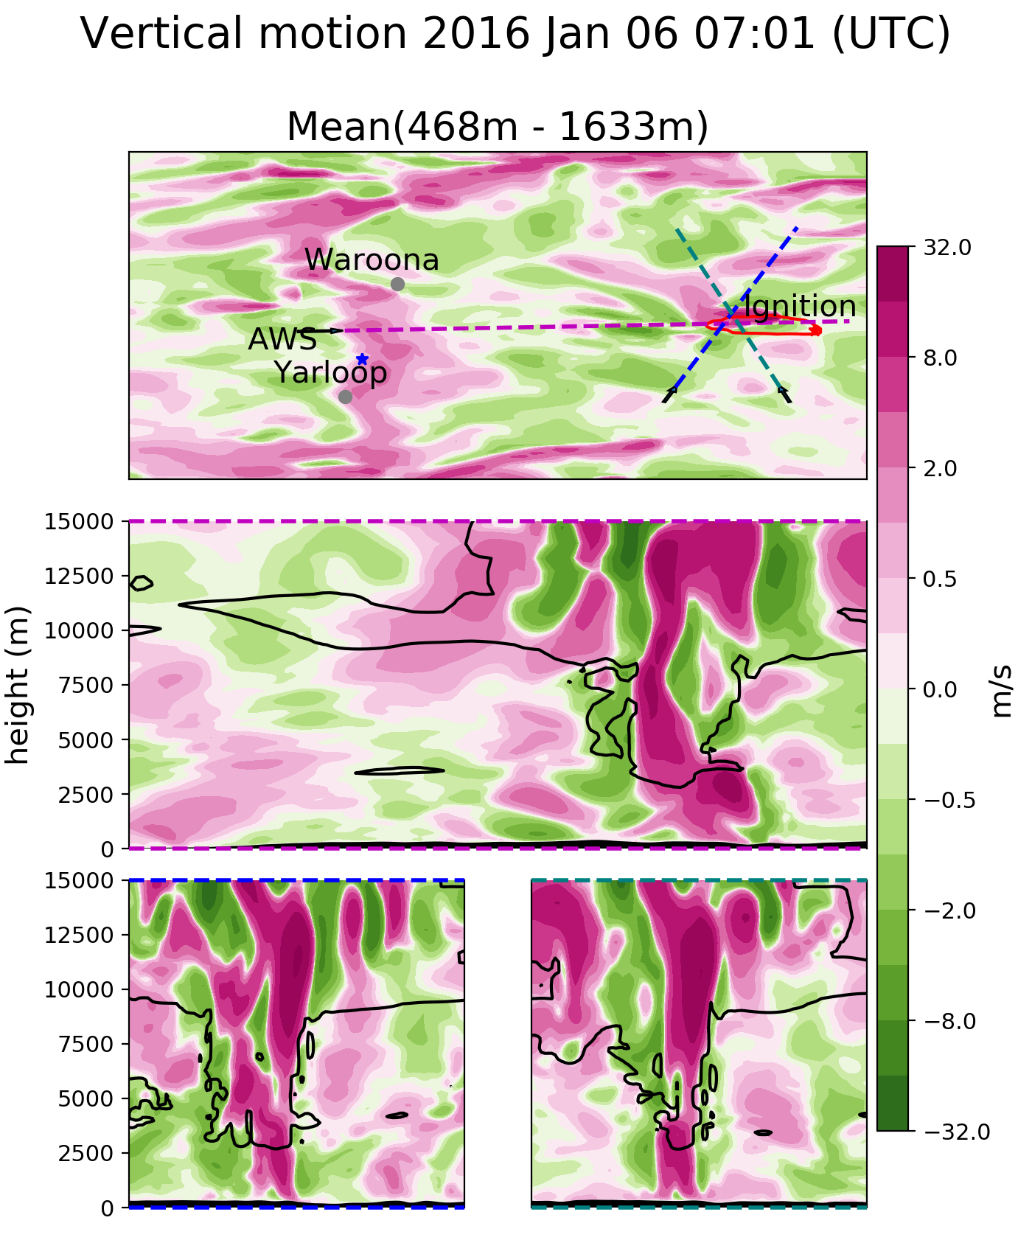
findings
Coupled modelling can provide the next level of value for fire danger forecasting, if it can be developed to the point where it is both faster than real time by enough to matter, and the underlying fuel loads are available in all high risk areas.
ACCESS-Fire: a case study
Jesse Greenslade¹, Mika Peace^{1,2}, Jeffrey D Kepert^{1,2}, Harvey Ye¹, Kevin Tory¹
¹ Bureau of Meteorology
² Bushfire and Natural Hazards CRC, Victoria
This work examines fire spread and related weather phenomena in a large-scale high-intensity fire over complex topography using a coupled atmosphere and fire spread model ACCESS-Fire. The fire simulated occurred in 2016, igniting ~20 km East of Waroona.
Tables and figures
Introduction
ACCESS is the Australian Community Climate and Earth-System Simulator - Australia's premier numerical weather prediction model. Coupled to a fire model developed at BOM it allows pyrogenic heat and moisture to feed back into the simulated atmosphere.
Summary of how fire-spread compares to estimated spread TODO: add isochrones vs modelled contours picture.
Simulated spread does not have fire-breaks or suppression efforts applied to it. Ignition points (including spotting) are prescribed in the model.
Pyrocumulonimbus (PCB)
The coupled model captured several PCB that were seen (e.g. top-right). These often cause strong surface winds and lightning, both of which lead to unexpected fire spread.
Figure 1: Top panel shows low level vertical motion, and the transect lines. Bottom panels show vertical motion along transects and cloud outlines (black lines).
Figure 2: Description of 3D cloud stuff or else downslope wind plot
Discussion
Coupled modelling can clearly capture complex phenomena such as PCB and downslope fire spread. This is a step towards improved understanding and forecasting of these deadly events.
Fire spread is accurate but requires realistic estimation of potential downwind spotting.
PCB Formation and impacts could add value to danger warnings for fire suppression crews.
Complex topography can lead to complex weather phenomena, which are difficult to accurately forecast using traditional FDI.
Modelling needs to be faster than real time to provide warning, the simulations in this work were faster but would require some more improvements.
PCB near Waroona, 2016
Figure 1: Simulated vertical motion.
For more information, please email jane.doe@abcd.edu.au
Figure 2: 3D figure or else downslope analysis shot

