Slide 1


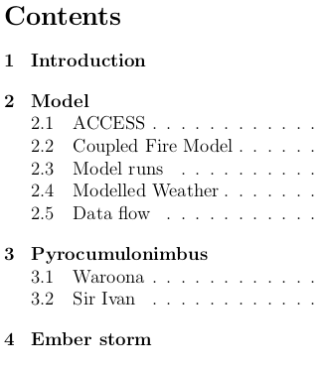
Fire simulation:
case studies
Project outline (Brief reminder)
Fires simulated (Brief notes on two fires)

Slide 2
Presentation
Intro to models
- Strengths/limitations
- Metrics and analyses
Waroona
- Weather outline
- PCB (video here)
- Emberstorm 1
- Emberstorm 2?
Sir Ivan
- Weather outline
- PCB ( another video)
- Weather station comparisons
Summary
- Modelling outcomes
- Science progression
- Firepedia additions

Slide 3
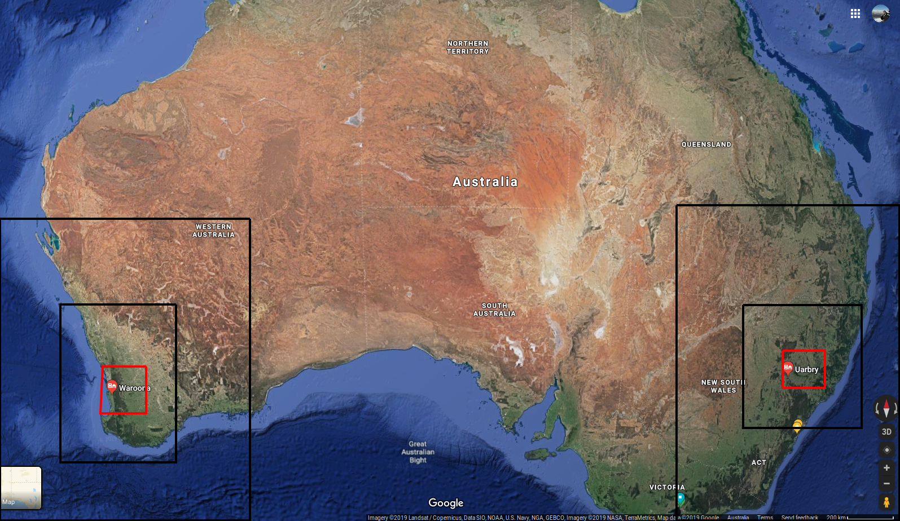
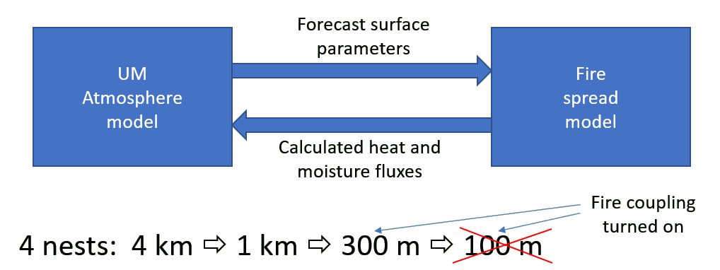

ACCESS-Fire modelling
Several model iterations leading to final analysis
Simulations for the Waroona fire (2016, Jan) and Sir Ivan fire (2017, Feb)
Fire intensity and spread based on prescribed fuel loads and modelled meteorology
Modelled meteorology affected by heat flux from the fire
Model CAN reproduce PyroCB (fire driven storm creation)
Process is sensitive to modelled boundary layer stability
Realistic fire spread is also achievable

Slide 4

Rate of spread
On day 1
  escarpment reached, due to spotting (likely) driven by PyroCB
  quick westward run at the base of the scarp in the late evening
What do we see in the model?

Slide 5
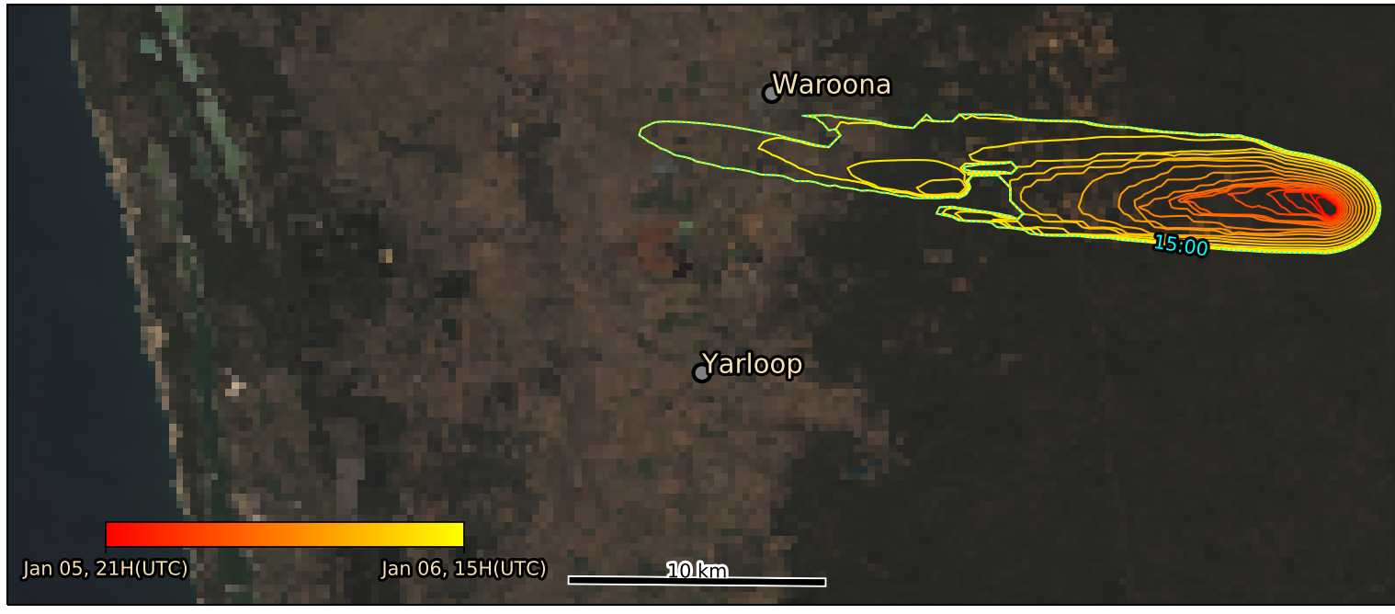
Rate of spread
15 hours of burning (Jan 6: 0900-2300)
Spotting is prescribed (not built into fire model)
Shape is relatively well represented
Fire spread affects and is sensitive to surface winds, which require careful tuning
Too much instability causes runaway fire dynamics (spread is too fast)
Too much resistance to instability can dampen physical effects (e.g., PyroCB)

Slide 6
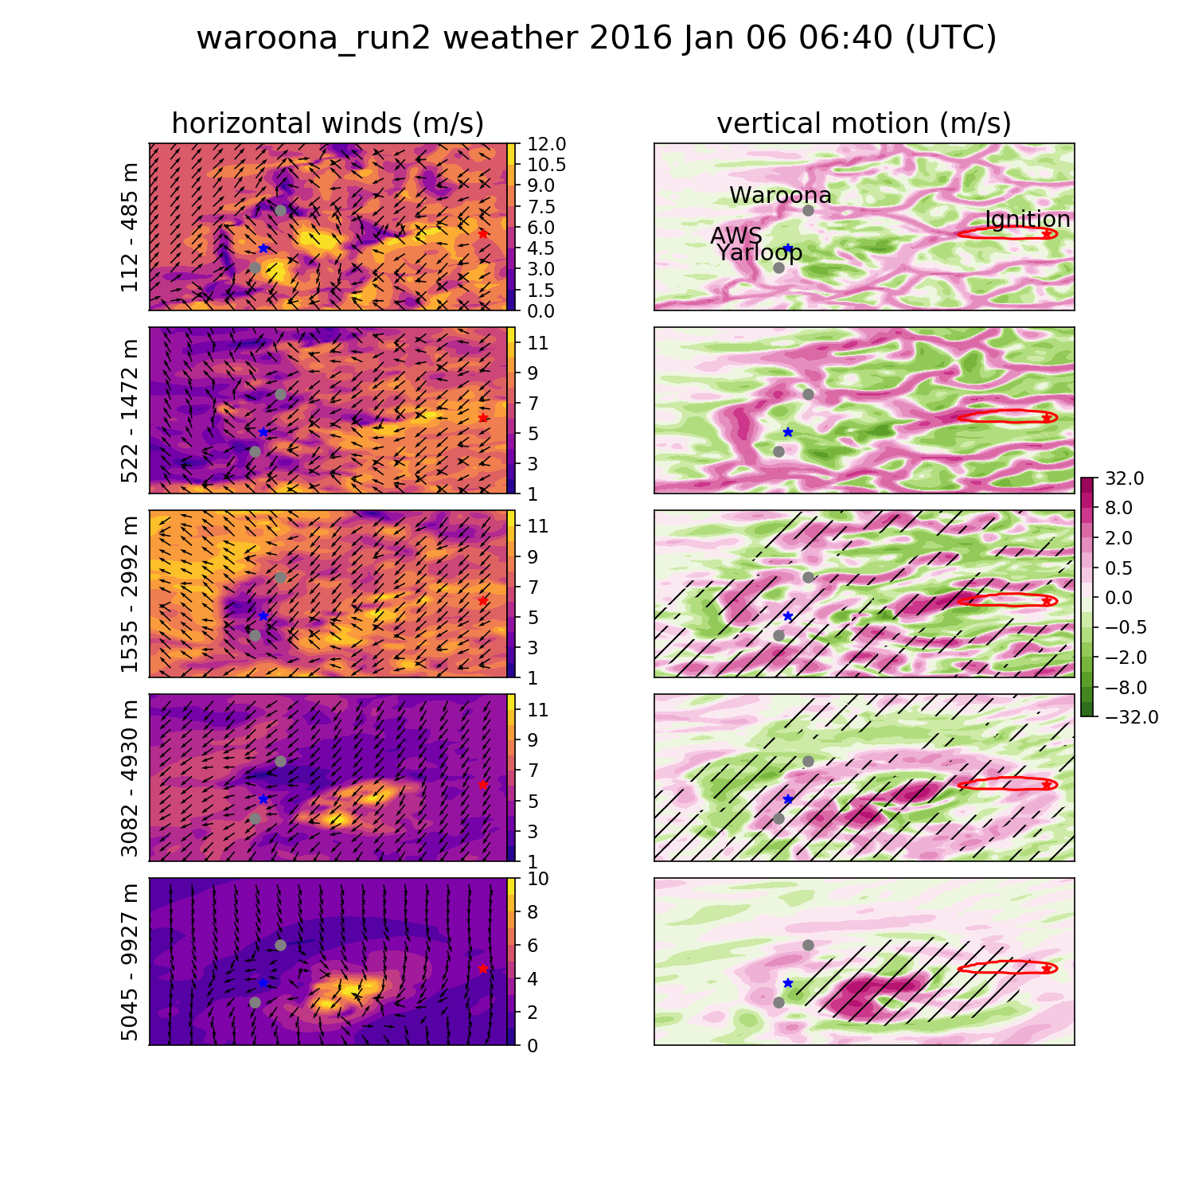
Weather summary

Slide 7
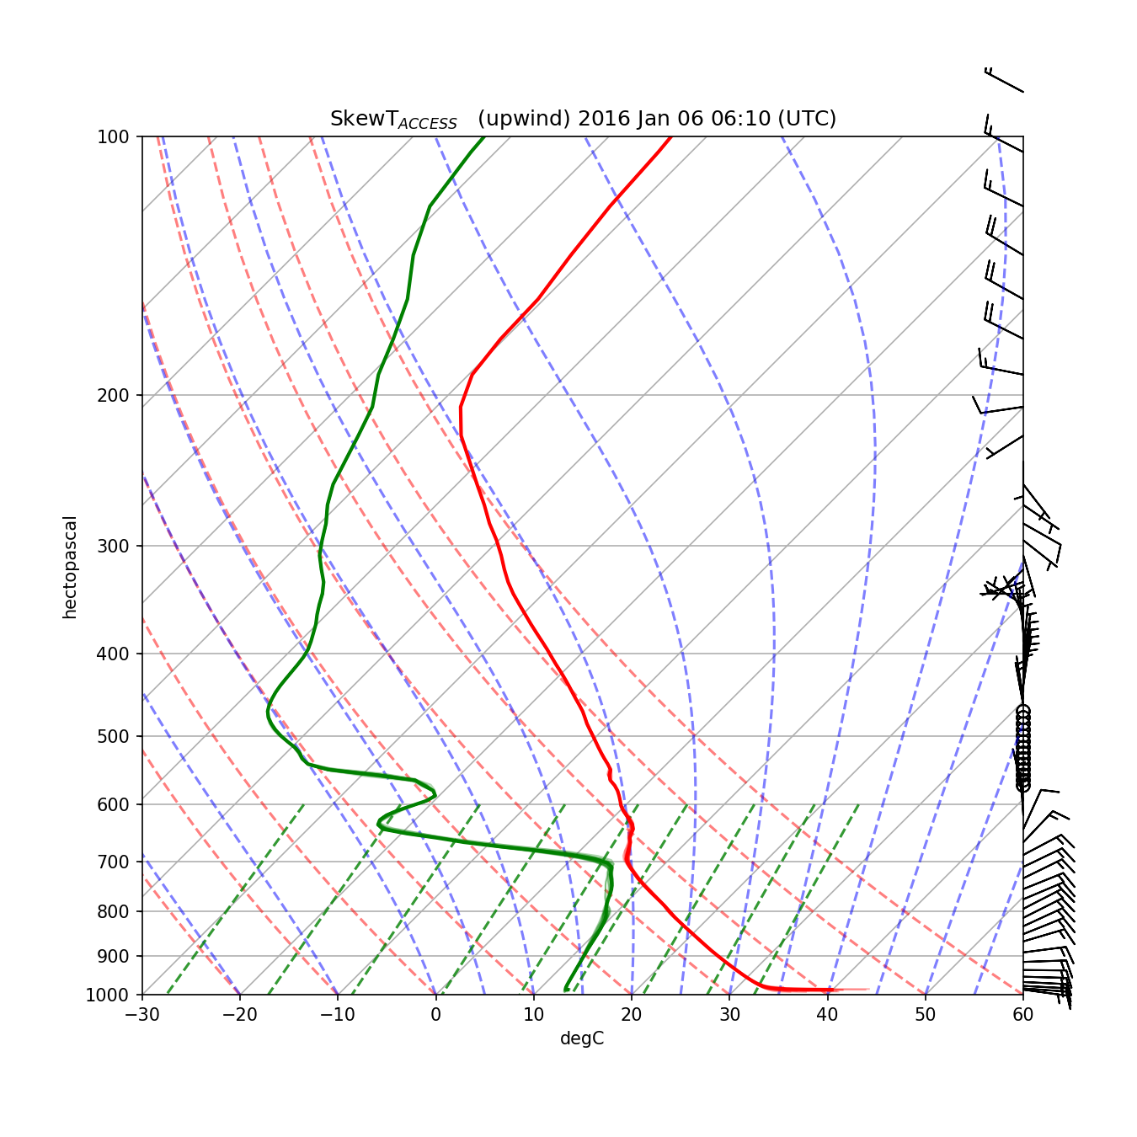
Skew T log P
PFT = C (Z_{fc})² U b_{fc}
PFT: PCB Fire power Threshold
C : constant
Z_{fc} : free convection altitude
U : wind speed
b_{fc} : Plume escape threshold

Slide 8
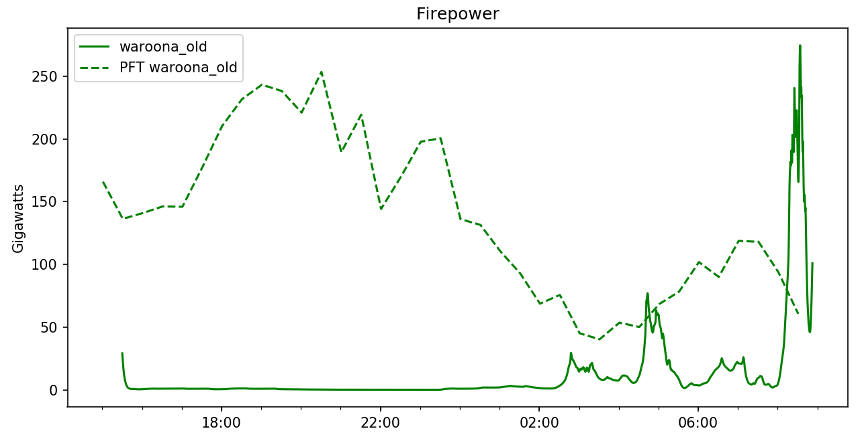
Firepower vs PFT
Original run (lower BL stability) overshoots PFT threshold at 12:30 and 1630 LT

Slide 9
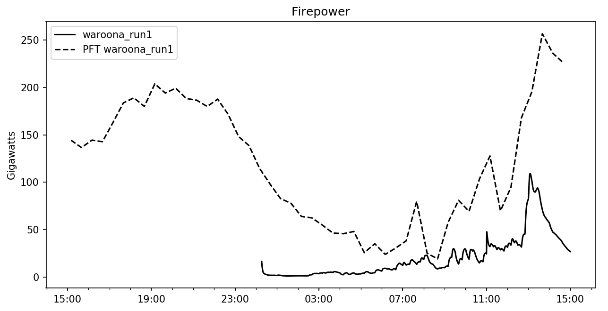
Firepower vs PFT
Newer run (higher BL stability) does not overshoot PFT
PyroCB can be seen in the original run from about 1200

Slide 10
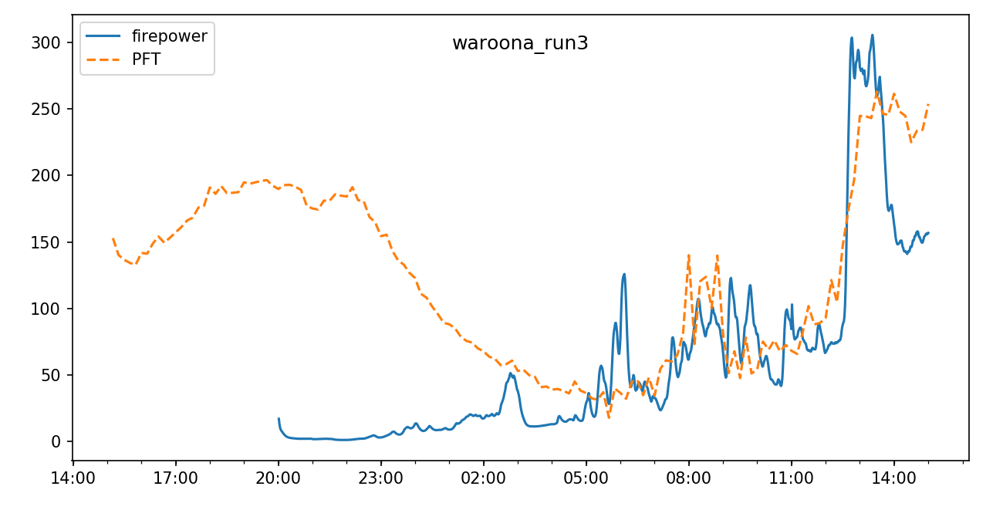
Firepower vs PFT
Latest run (higher BL stability, fewer limitations on fire spread)
PyroCB again could be expected from overshoots

Slide 11
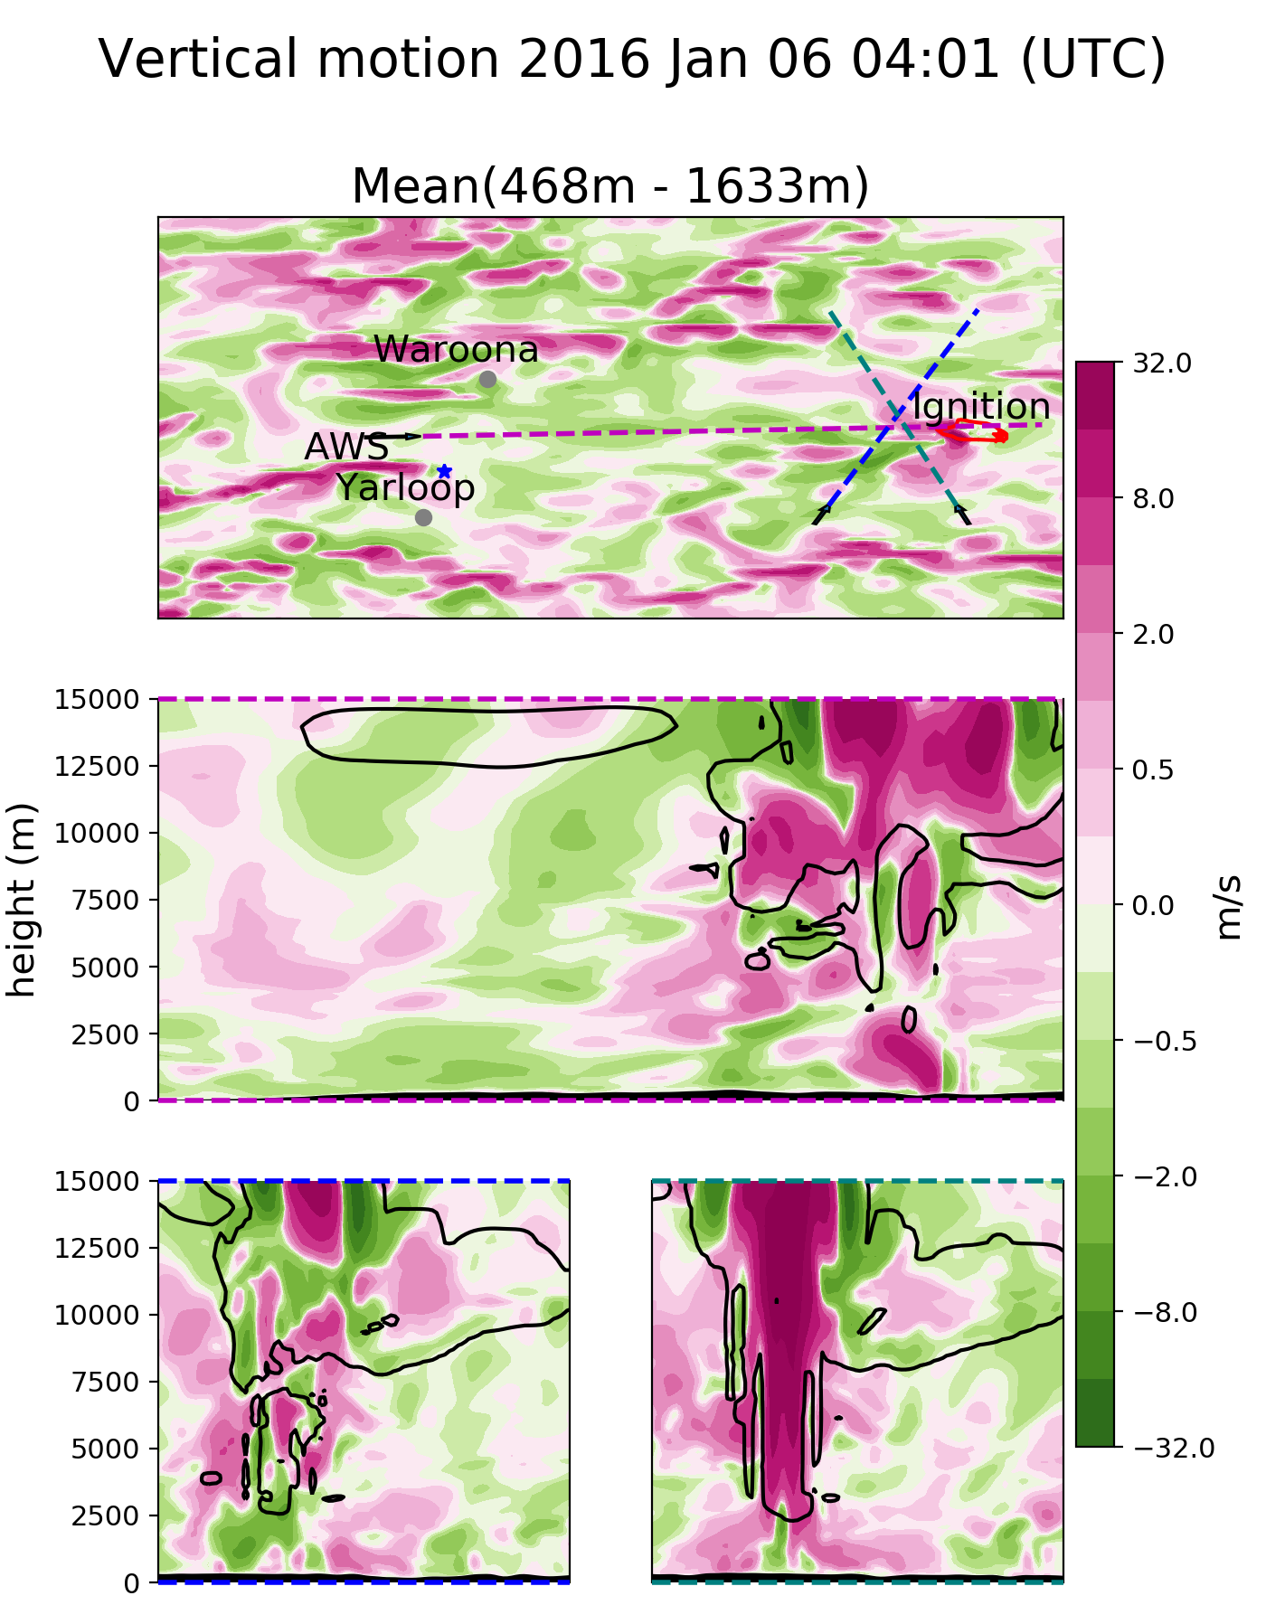

PyroCB
Strong vertical updraft throughout the troposphere over the fire front
Cloud formation and downdrafts can be seen nearby

Slide 12
PyroCB
Strong
Updraft
Strong
downdrafts
Strong vertical updraft throughout the troposphere over the fire front
Cloud formation and downdrafts can be seen nearby

Slide 13
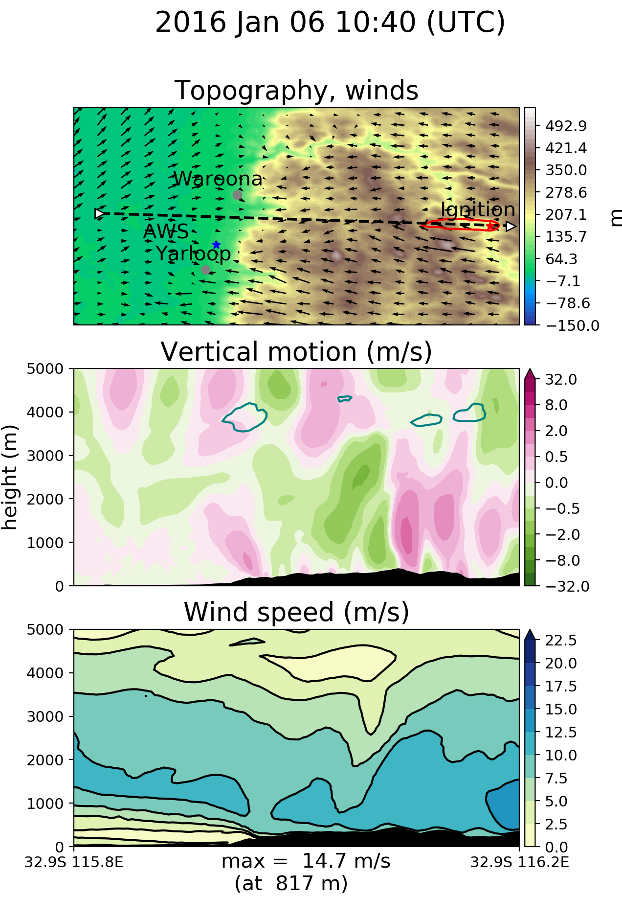
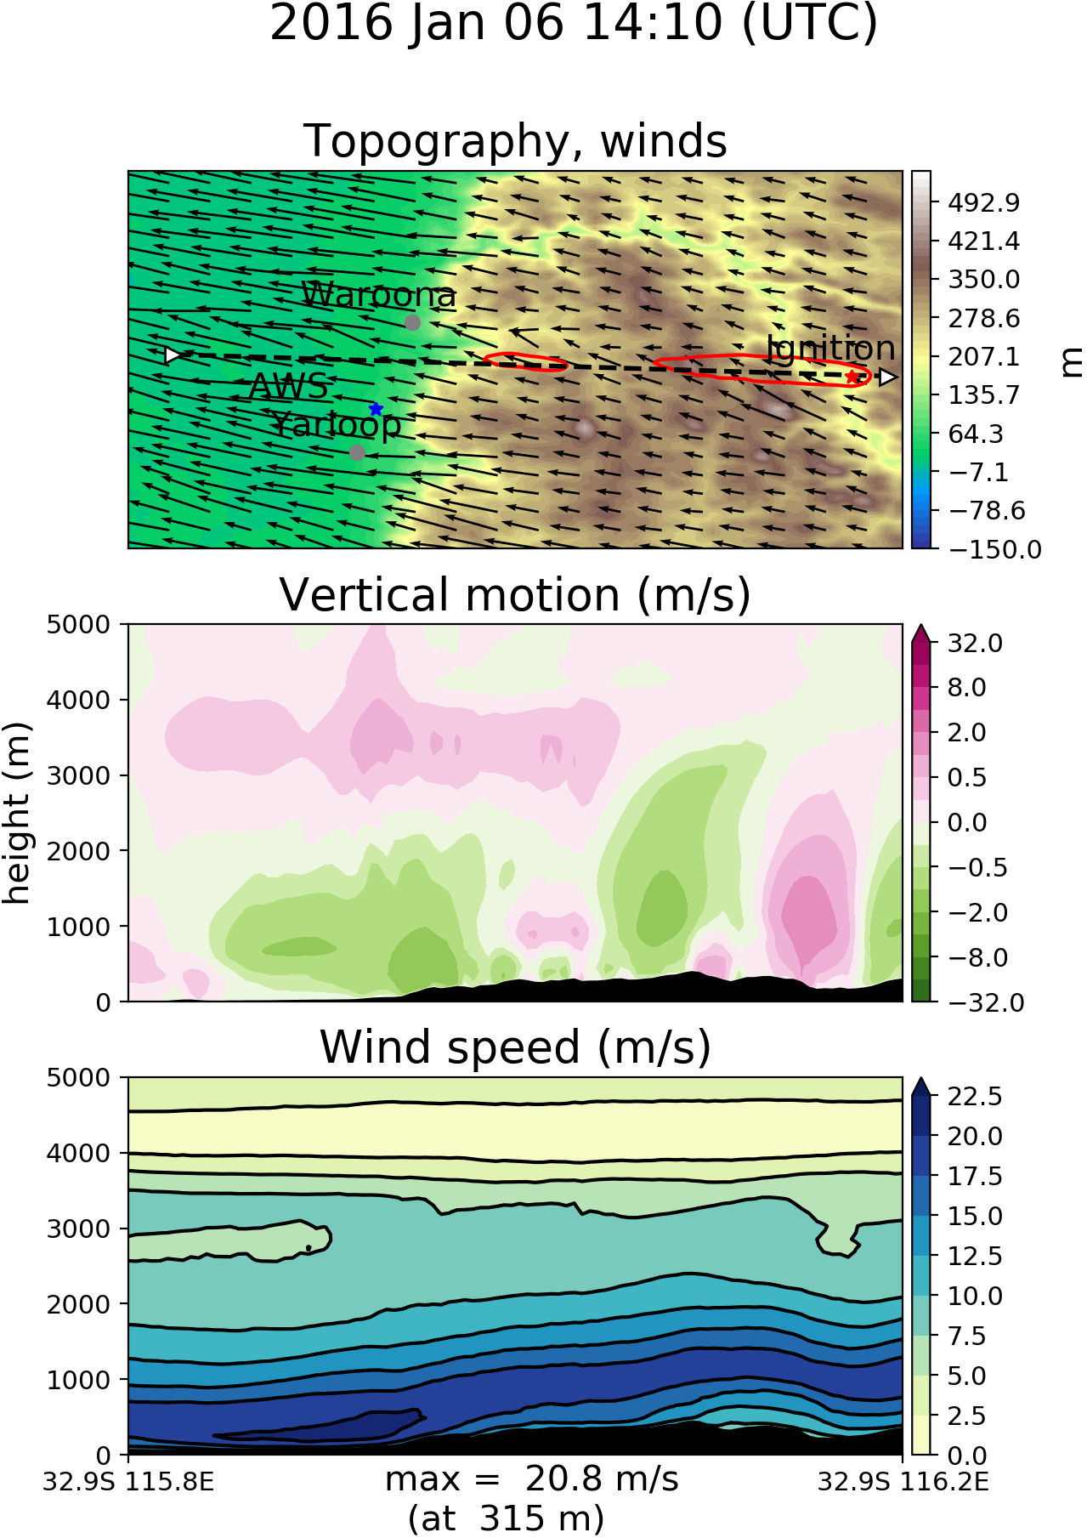
Emberstorms?
Vertical wind speeds are affected by the fire
High horizontal wind speeds seen at base of scarp

Slide 14
Ember storm

Slide 15
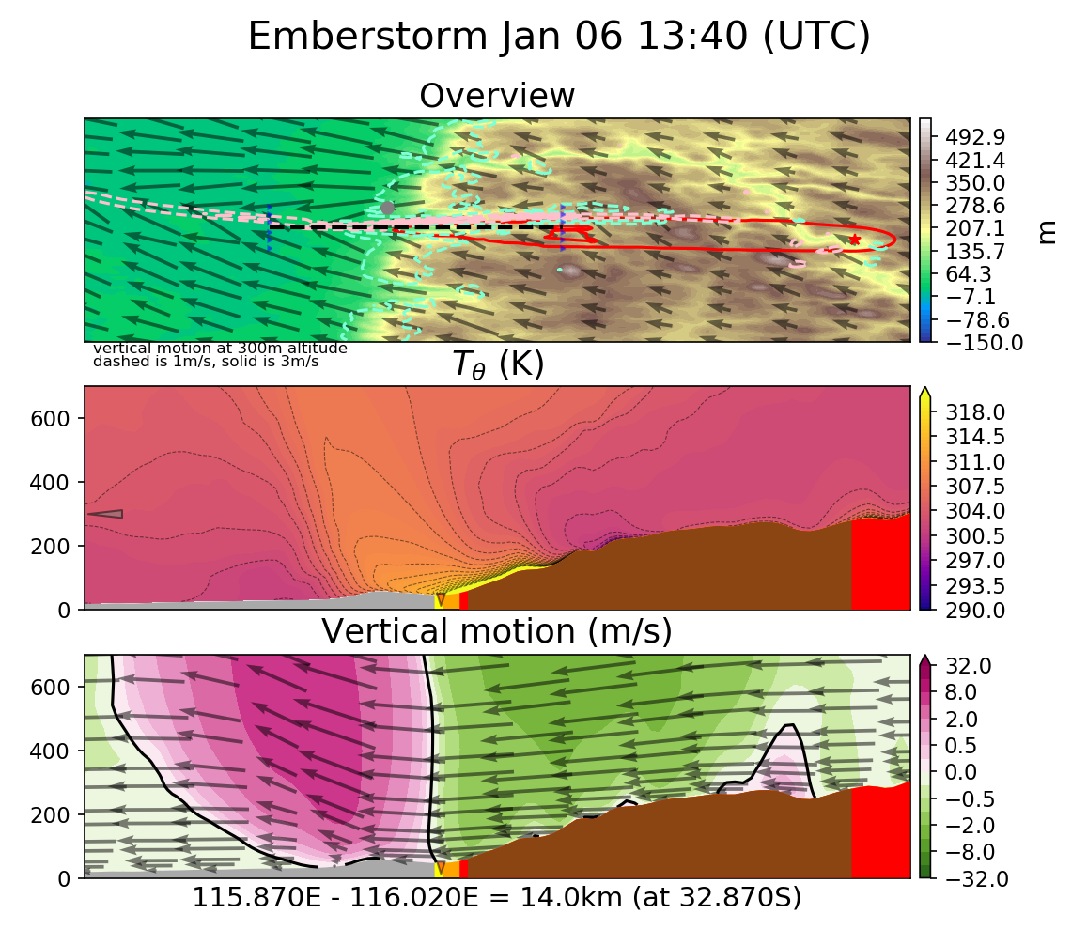
Clear Jump

Slide 16
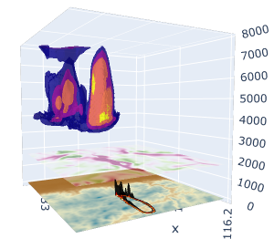
Cool

Slide 17
Other opportunities
Talk: RFS client meeting
Poster: ACCOMC CGASM
Attendance:
  BOM R&D conference
  ACAWSI summer institute
  AFAC fire conference
Seminars and webinars:
  ACCESS
  NWP validation
  NCI data product access
  …
Knowledge leeching:
  NCI productivity experts are everywhere
  Fire/Met/Modelling experts too

Slide 18
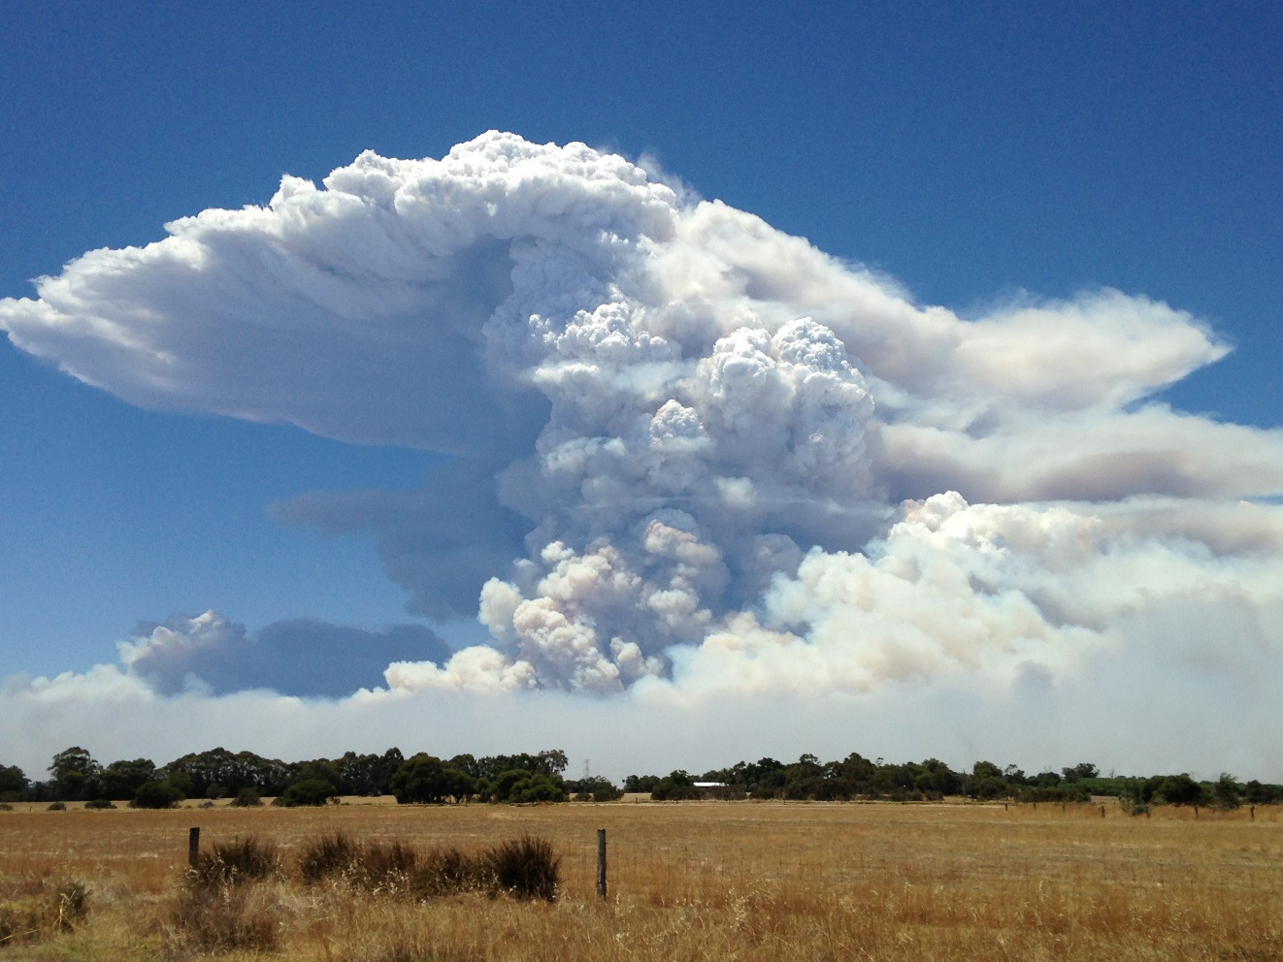
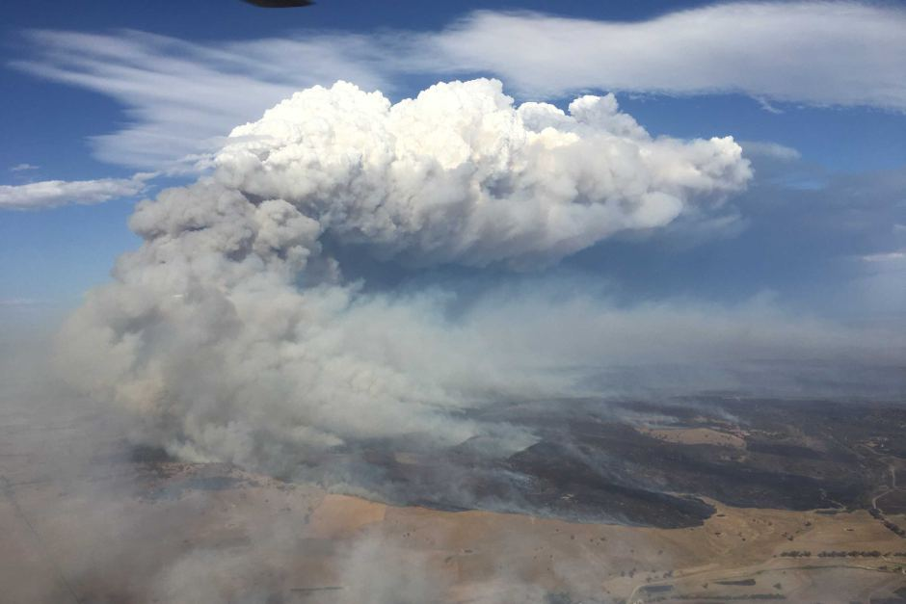
Thanks
Mika Peace,
Jeff Kepert,
Harvey Ye,
Jenny Fisher,
Kevin Tory

Slide 19
Title

