Slide 1


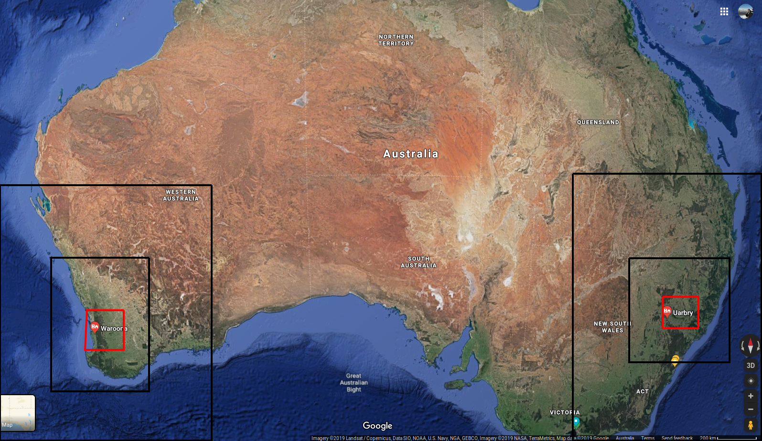
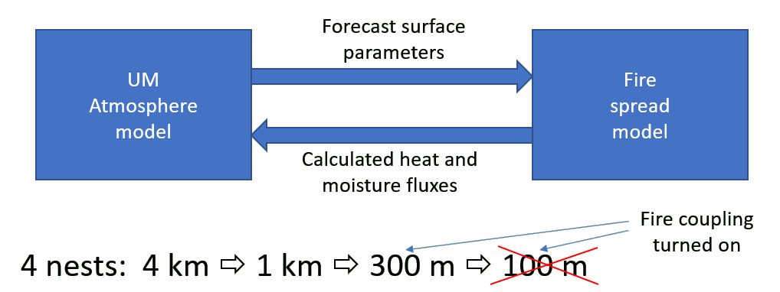
ACCESS-Fire modelling
Three model runs currently under analysis
Two of the Waroona/Yarloop fire, one of the Sir Ivan fire
Fire intensity and spread based on prescribed fuel loads and modelled meteorology
Modelled meteorology affected by heat flux from the fire
Model CAN reproduce PyroCB (fire driven storm creation)
Process is sensitive to modelled boundary layer stability
Realistic fire spread is also achievable

Slide 2

Rate of spread
On day 1
  escarpment reached, due to spotting (likely) driven by PyroCB
  quick westward run at the base of the scarp in the late evening
What do we see in the model?

Slide 3
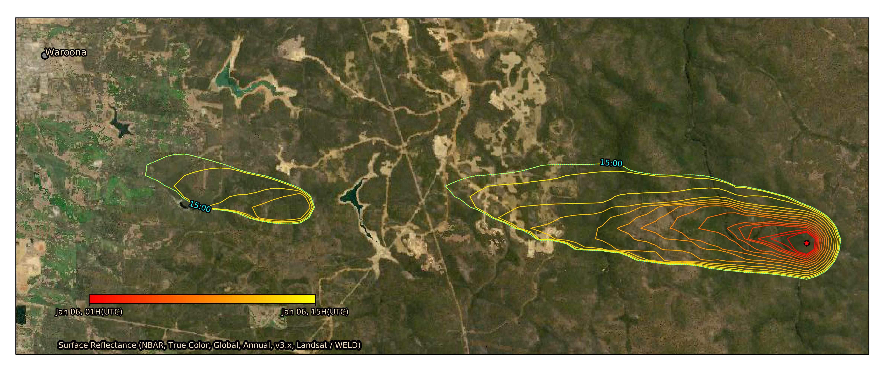
Rate of spread
15 hours of burning (Jan 6: 0900-2300)
Spotting is prescribed (not built into fire model)
Shape is relatively well represented
Fire spread affects and is sensitive to surface winds, which require careful tuning
Too much instability causes runaway fire dynamics (spread is too fast)
Too much resistance to instability can dampen physical effects (e.g., PyroCB)

Slide 4
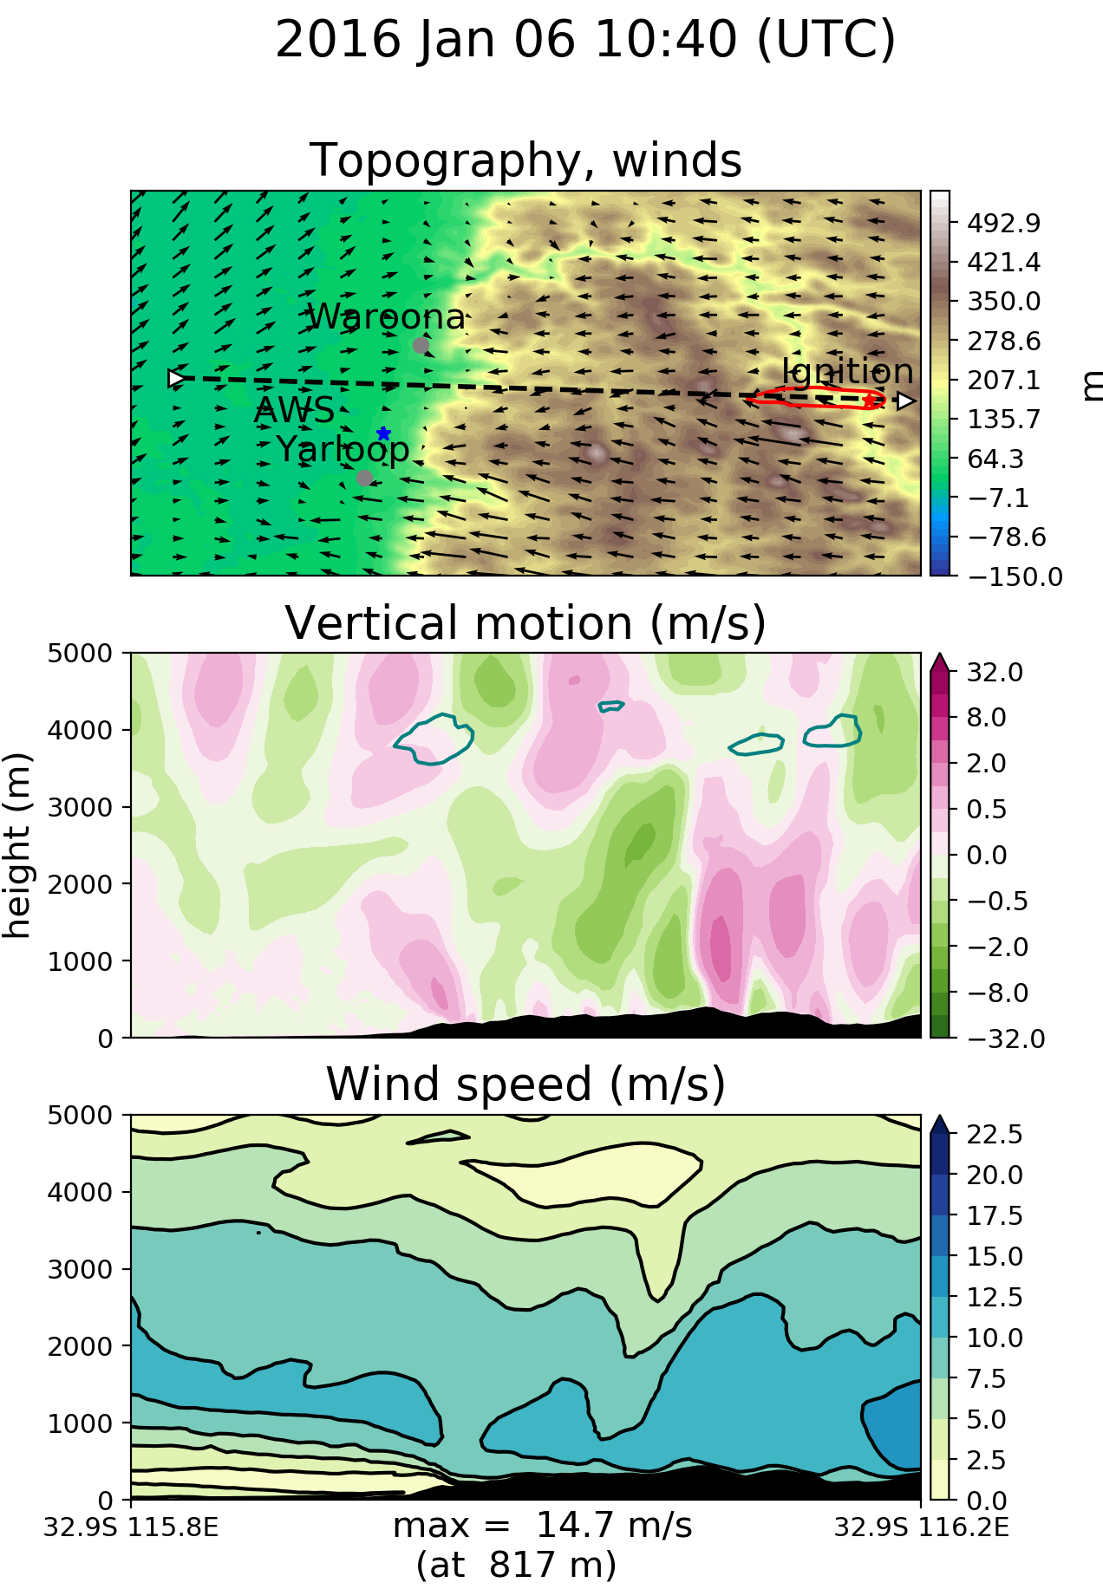
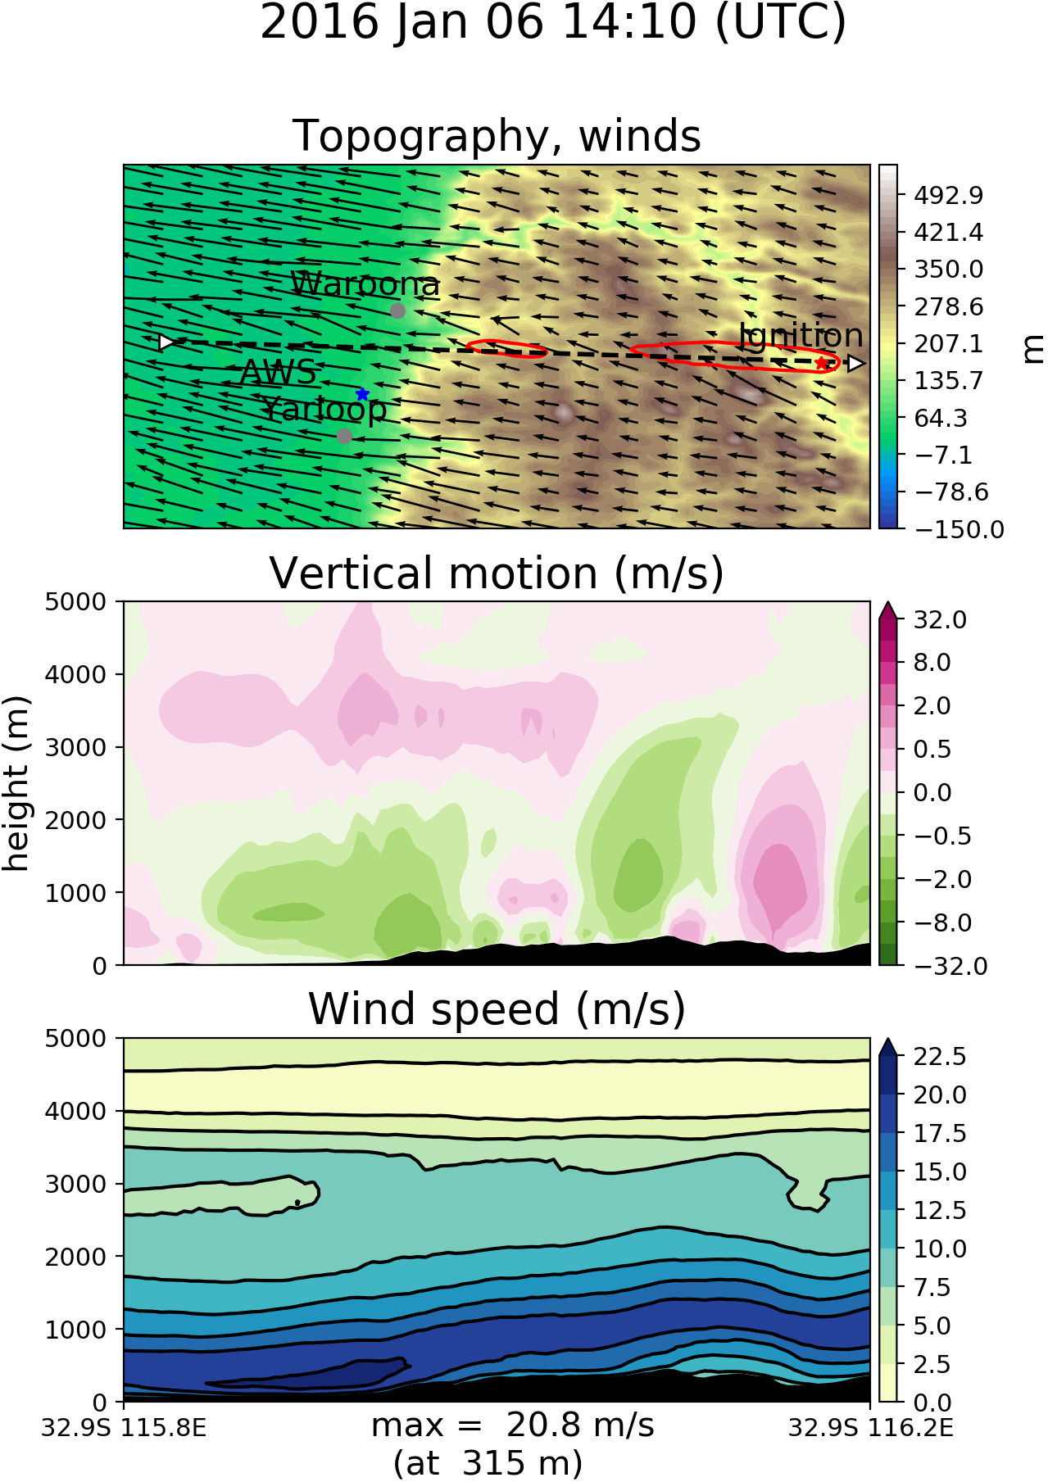
Wind speeds
Vertical wind speeds are affected by the fire
High horizontal wind speeds seen at base of scarp

Slide 5
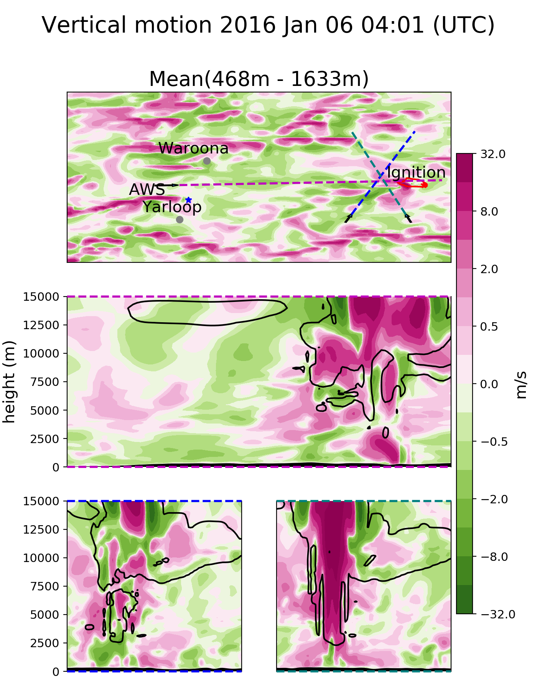

PyroCB
Strong vertical updraft throughout the troposphere over the fire front
Cloud formation and downdrafts can be seen nearby

Slide 6
PyroCB
Strong
Updraft
Strong
downdrafts
Strong vertical updraft throughout the troposphere over the fire front
Cloud formation and downdrafts can be seen nearby

Slide 7
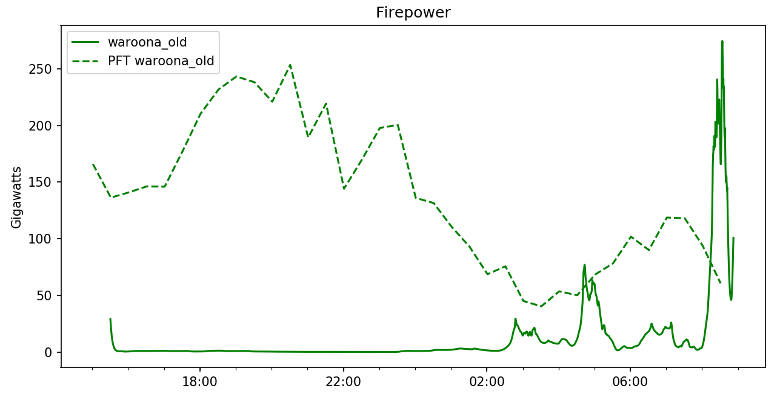
Firepower vs PFT
Original run (lower BL stability) overshoots PFT threshold at 12:30 and 1630 LT

Slide 8
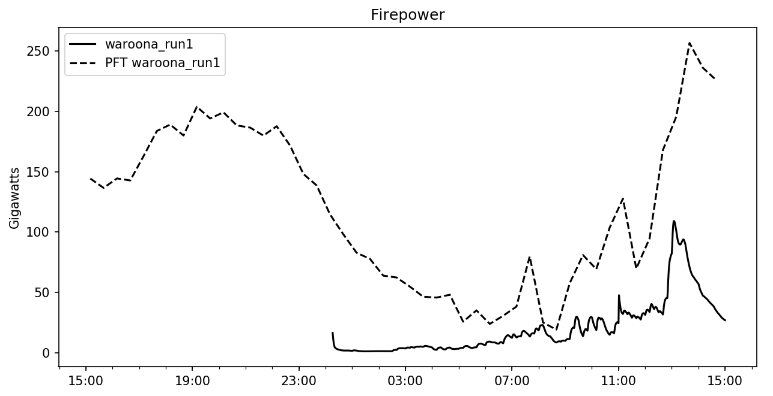
Firepower vs PFT
Newer run (higher BL stability) does not overshoot PFT
PyroCB can be seen in the original run from about 1200

Slide 9
Upcoming
Tweaked model runs
Determine best BL and fire spread parameterisations
Capturing downslope wind effects
Extended run times (second day)
Model PFT analysis
Entrainment analysis using model meteorology
Verify PFT estimation utility
PyroCB prediction could help inform FDI
Analysis of potential ember storms and firebrand transport
Dispersion modelling based on ACCESS winds
Visualisation of potential transport
Publication and case studies
Inform FDI
Highlight model sensitivities

