Slide 1

Waroona Fire
Emberstorms Downslope run PyroCB
Farmland and
rural towns
State forest and
mining areas
Escarpment (~300m)

Slide 2
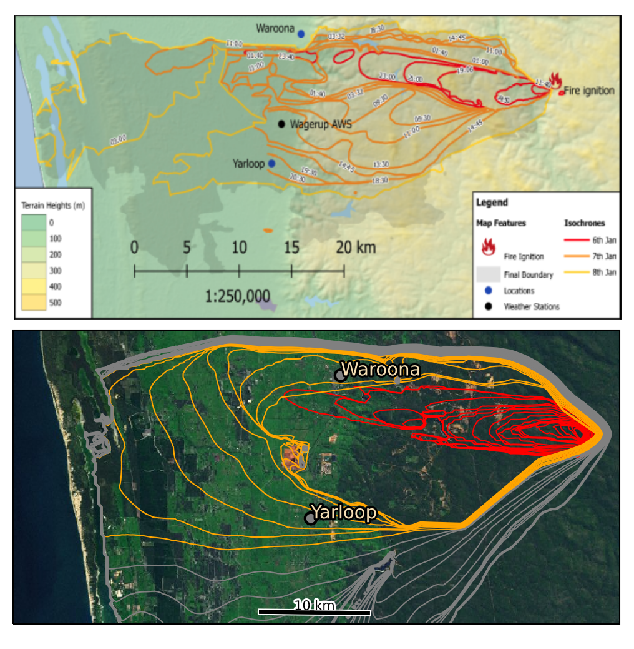
Simulated Fire
Initial polygon and spotting added by Harvey
Downslope run on first evening can be seen
Second day coverage not unreasonable.
Model does not include impacts from control attempts.

Slide 3
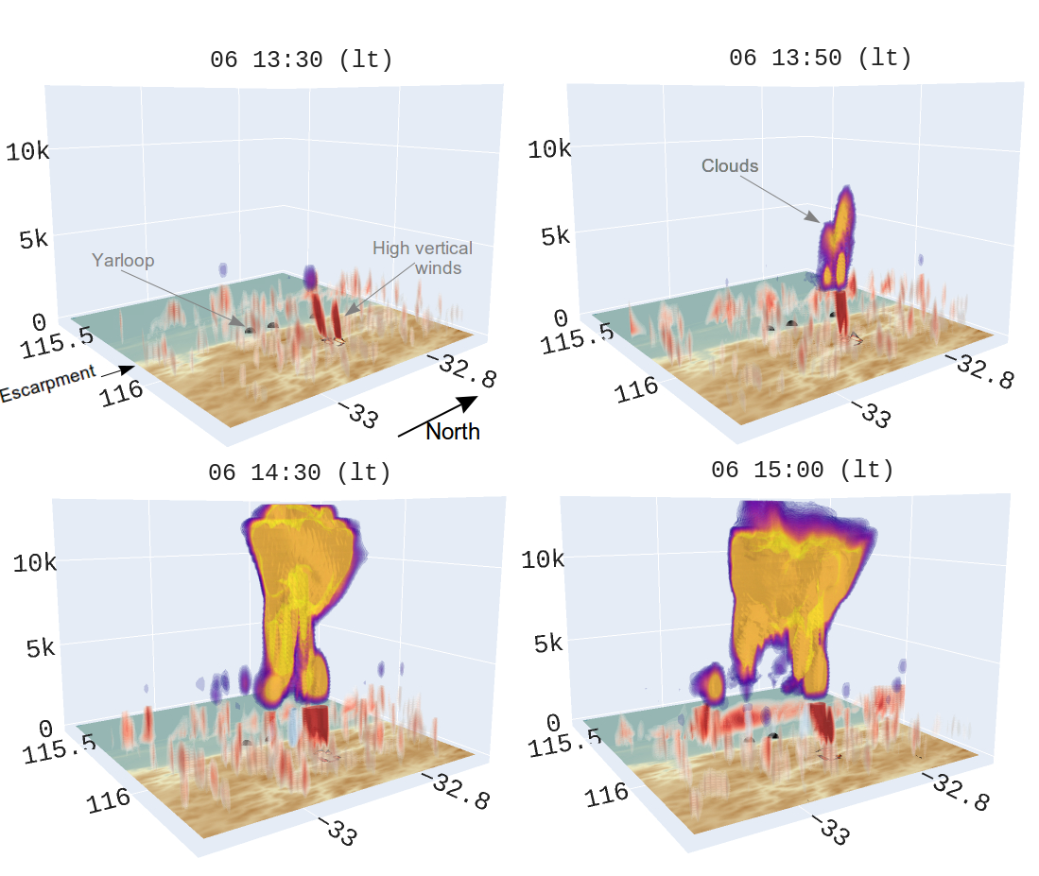
Pyrocumulonimbus (PyroCB)

Slide 4

PyroCB Transect
Strong
Updraft
Strong
downdrafts
Notes:
Update with your own Facebook and Twitter handles

Slide 5
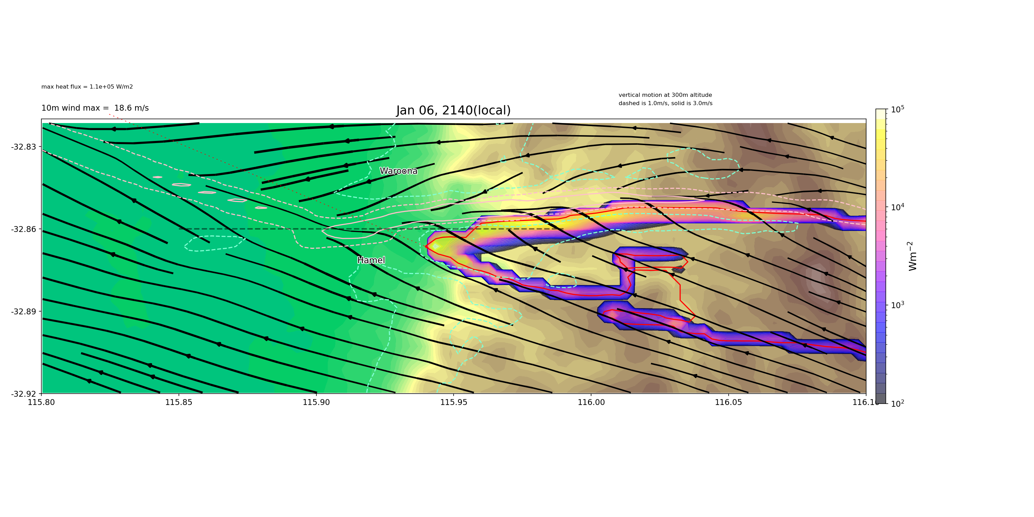
Emberstorm
Driven by high down slope winds with strong entrainment.

Slide 6
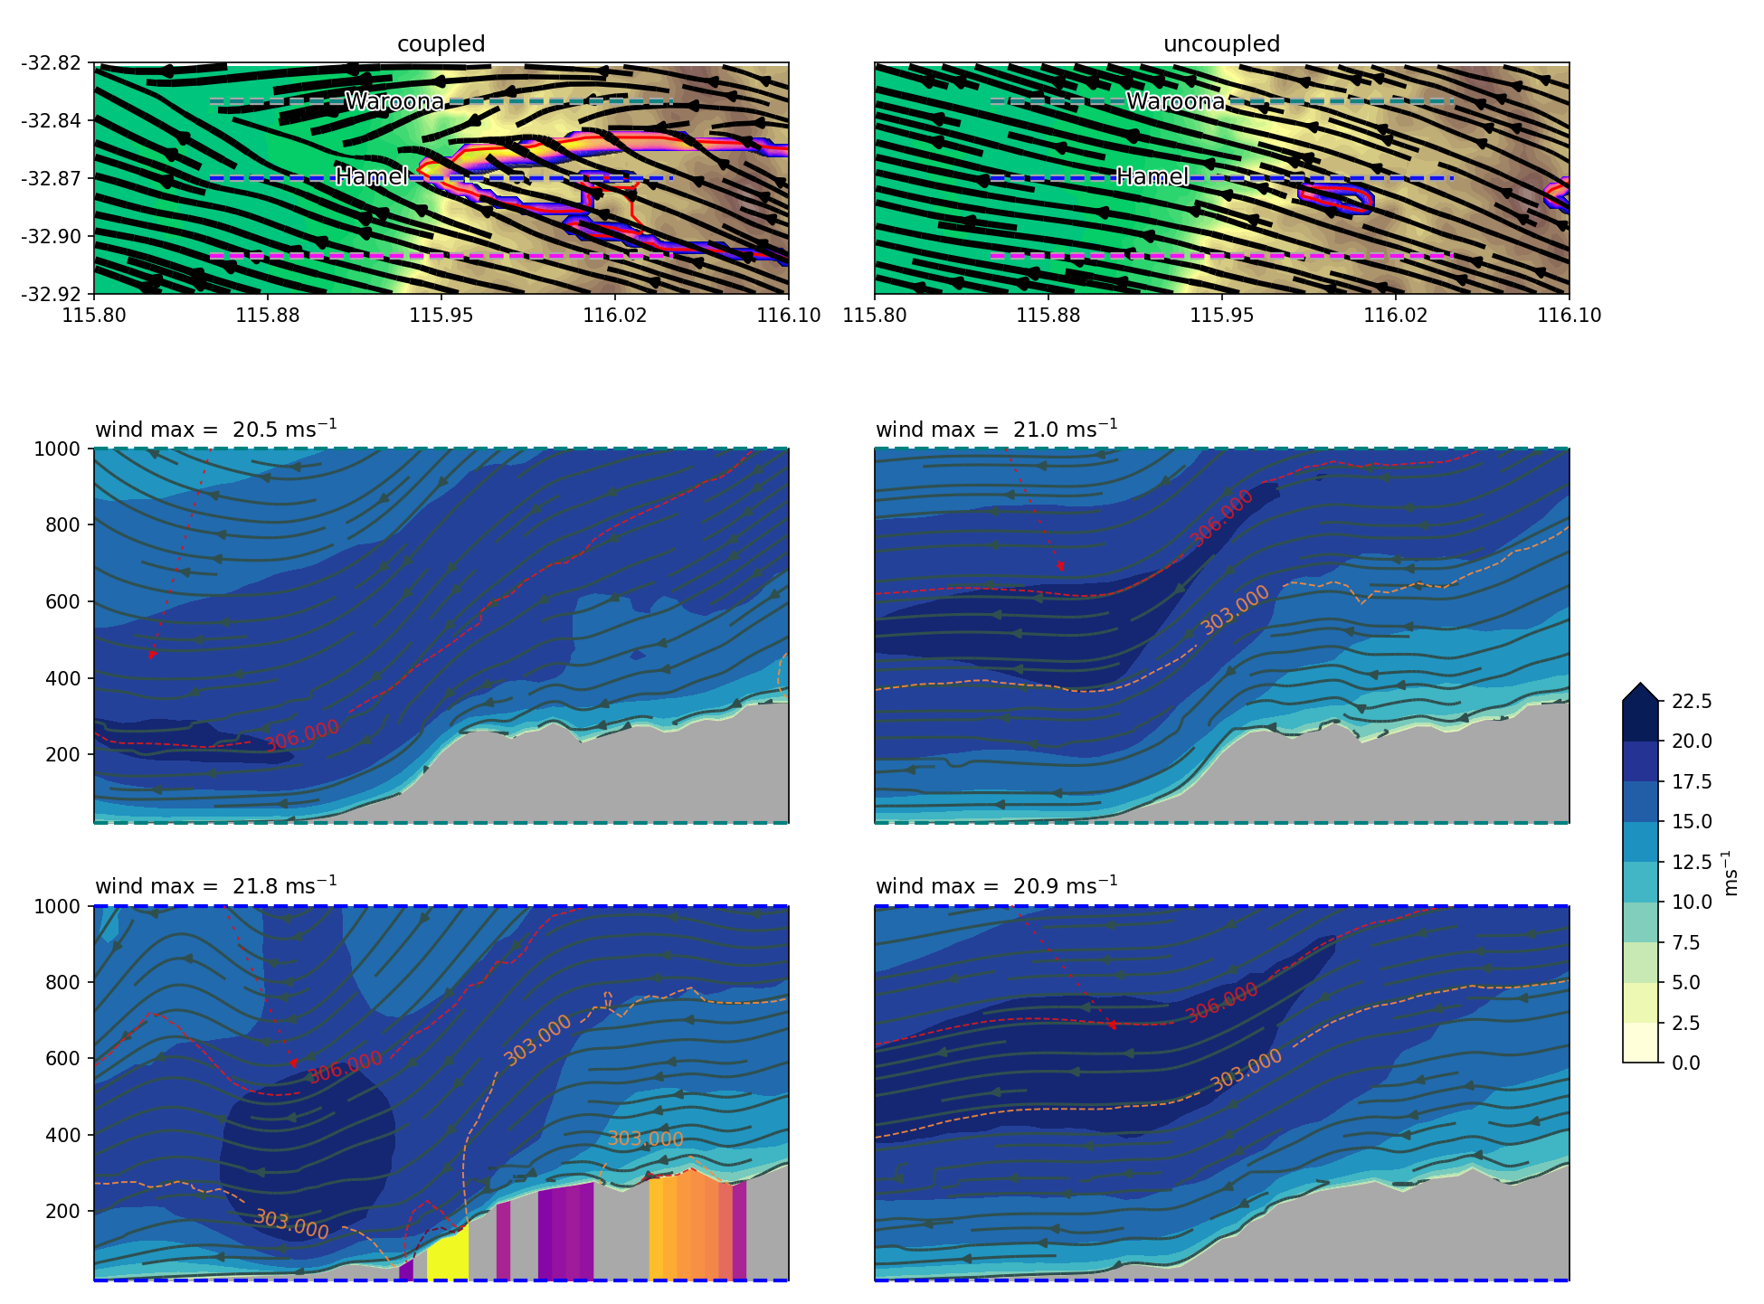
Coupled run Uncoupled run
Horizontal wind Transects

Slide 8
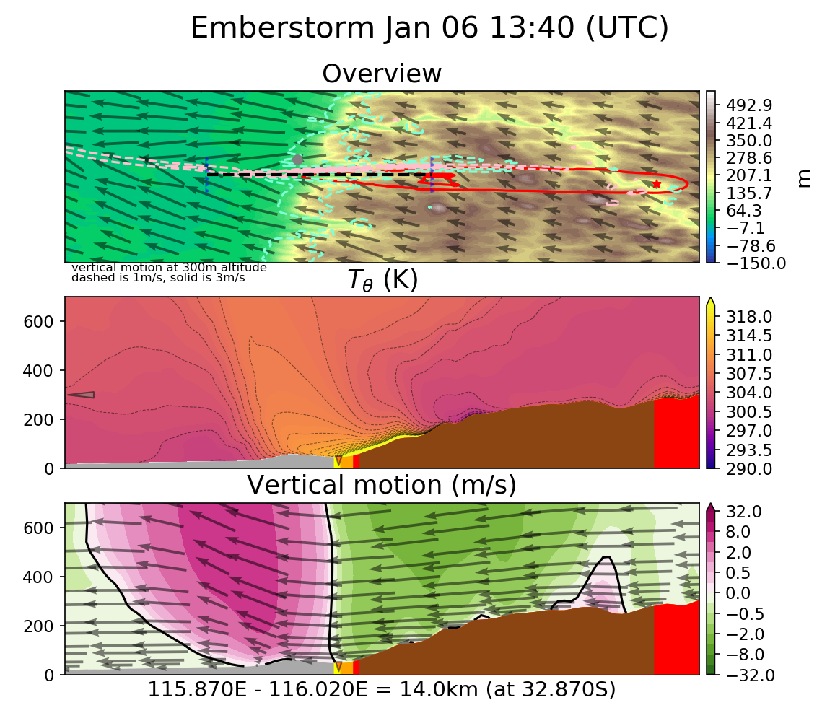

Slide 9
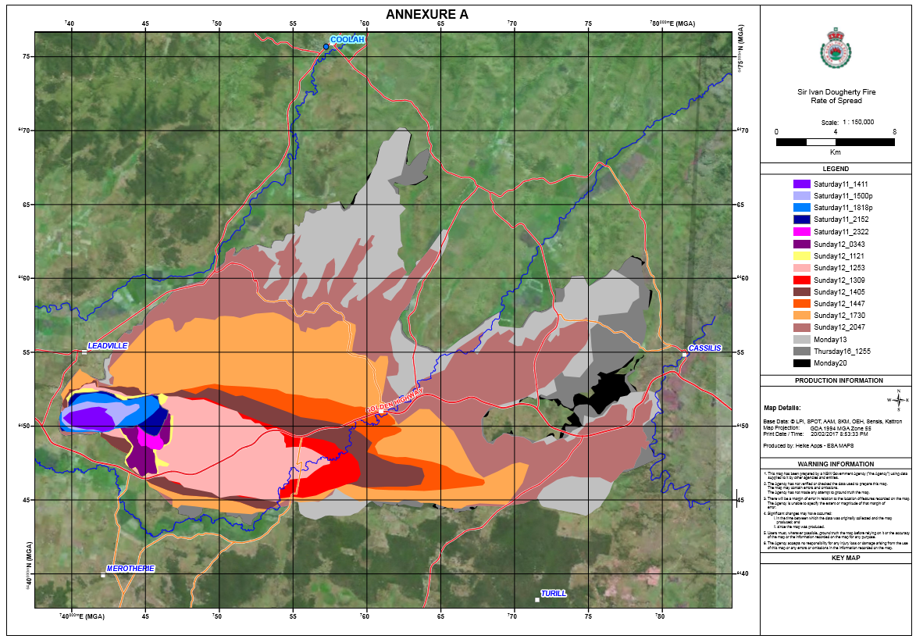
Sir Ivan Spread

Slide 10
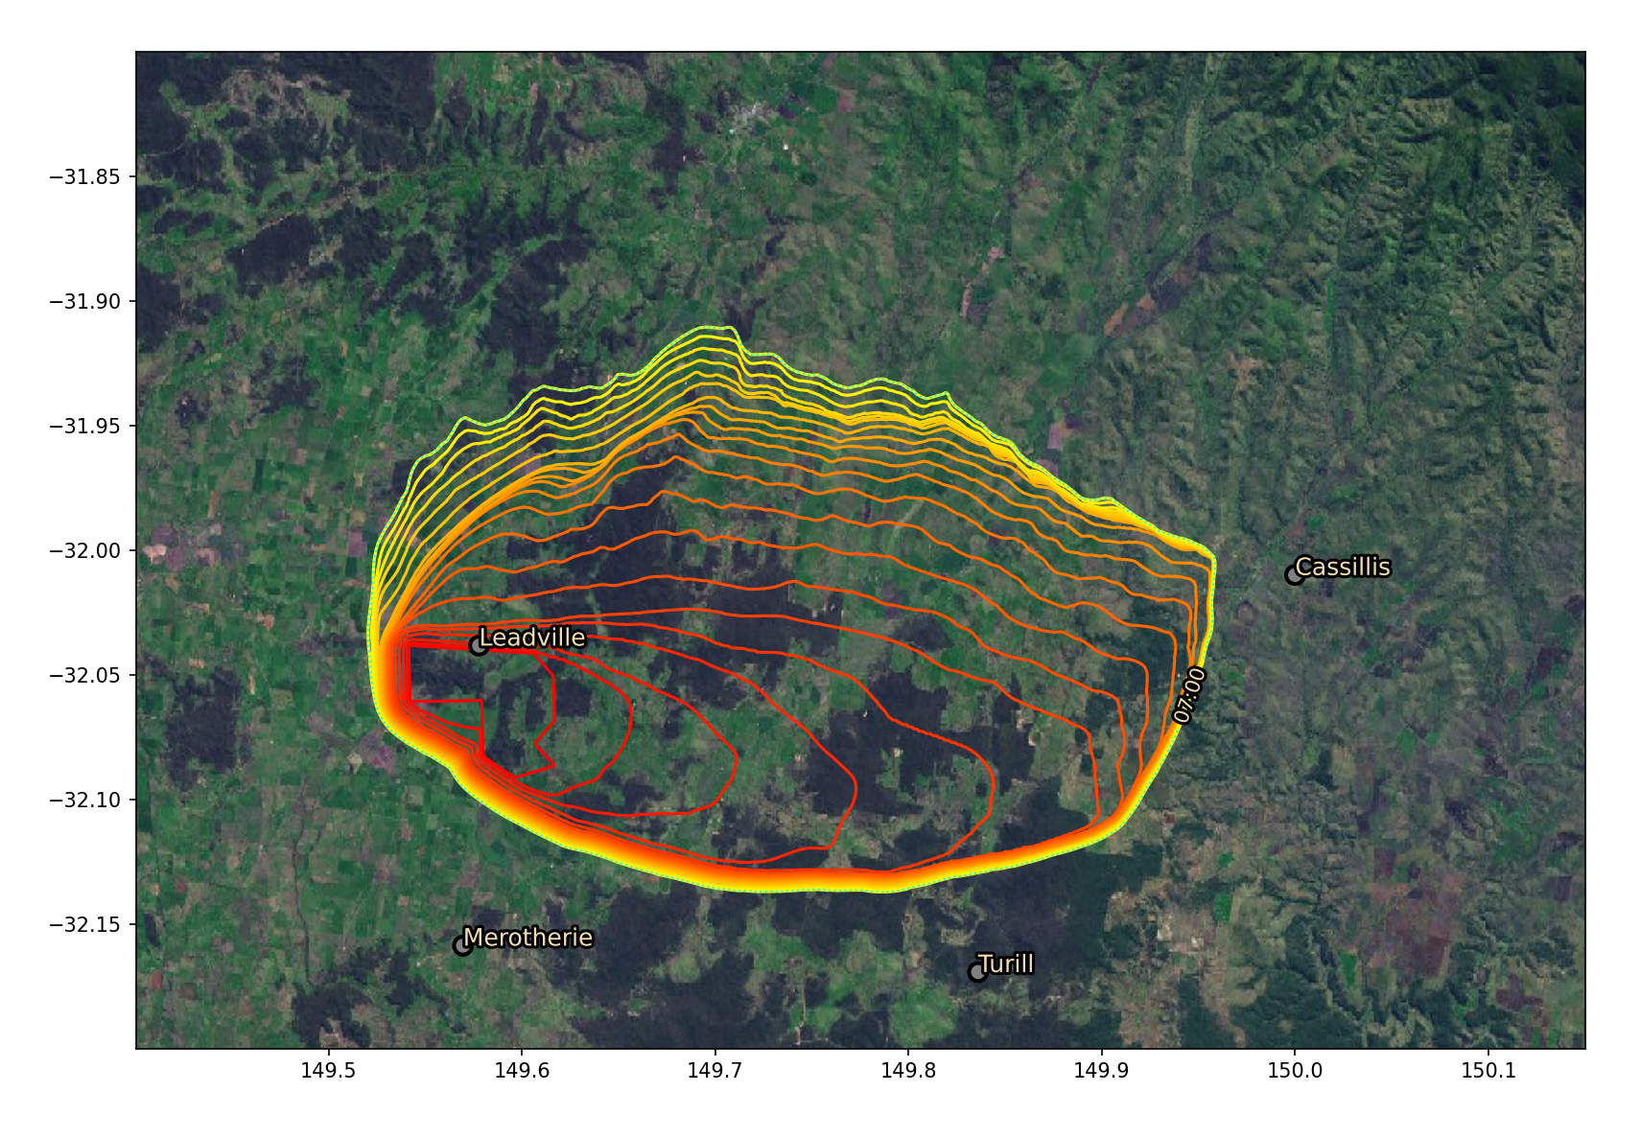
Sir Ivan Spread
Spread is reasonably well captured
Bottom left: hourly firefront contours
Bottom right: intensity
~ 40 km

Slide 11
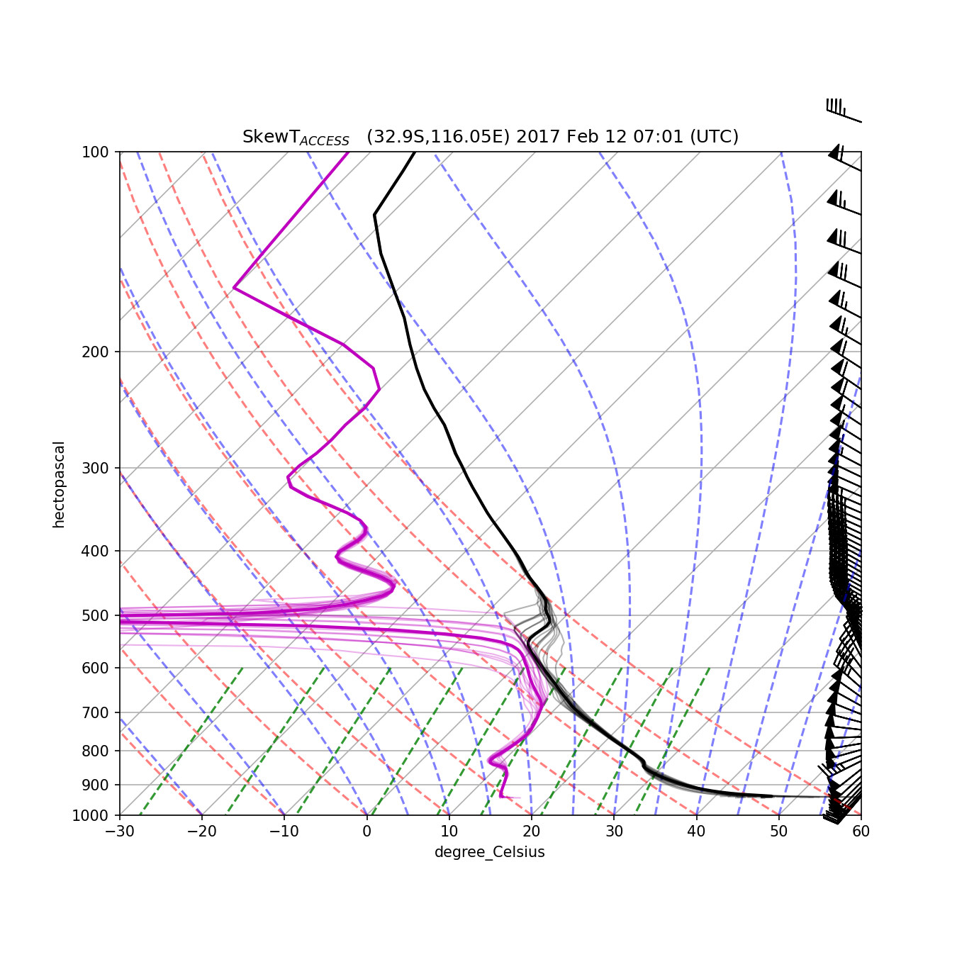
Kevin’s PFT
Theoretical energy requirement to form PyroCB
PFT = C (Z_{fc})² U b_{fc}
PFT: PyroCB Firepower Threshold
C : constant
Z_{fc} : free convection altitude
U : wind speed
b_{fc} : ML escape energy required

Slide 12
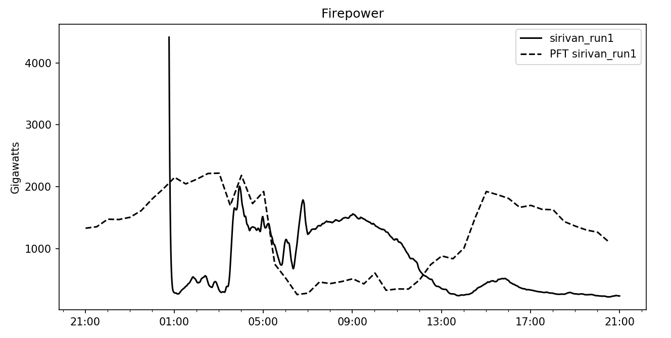
Model PFT calculated upwind of the fire, compared against integrated model firepower.
Fire initialisation (fixed in more recent versions)
PyroCB window of opportunity
Model PyroCB occurrence at 6PM (local time)

Slide 13
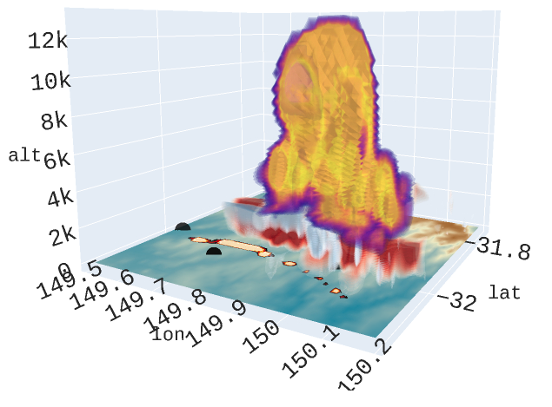
Brief PyroCB
Intense fire

