Slide 1
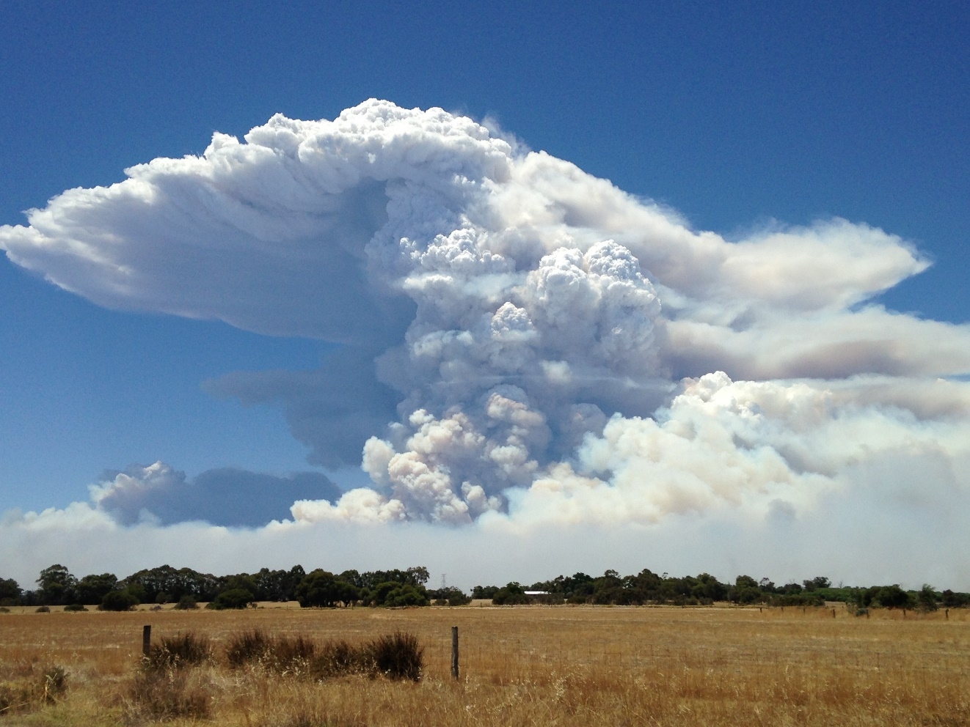
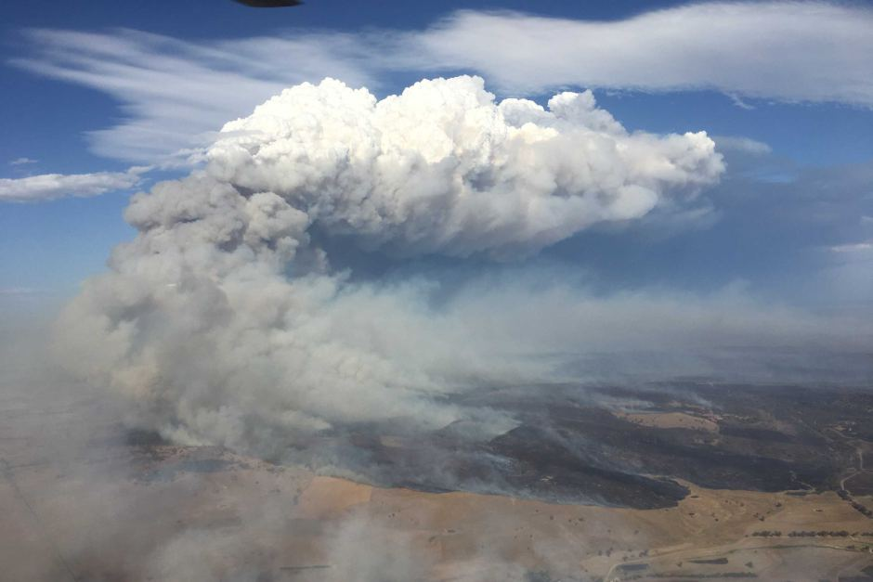
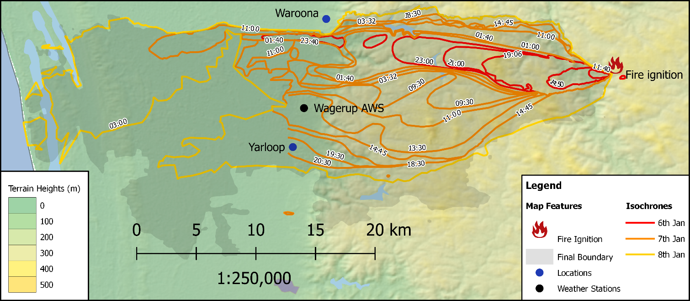
▌Waroona fire
▌Sir Ivan fire
6-7 January 2016.
166 homes destroyed.
Did not reconcile with FDI's.
12 February 2017
55 homes lost.
NSW worst fire conditions ever
'Catastrophic' conditions identified several days in advance.

