Slide 1
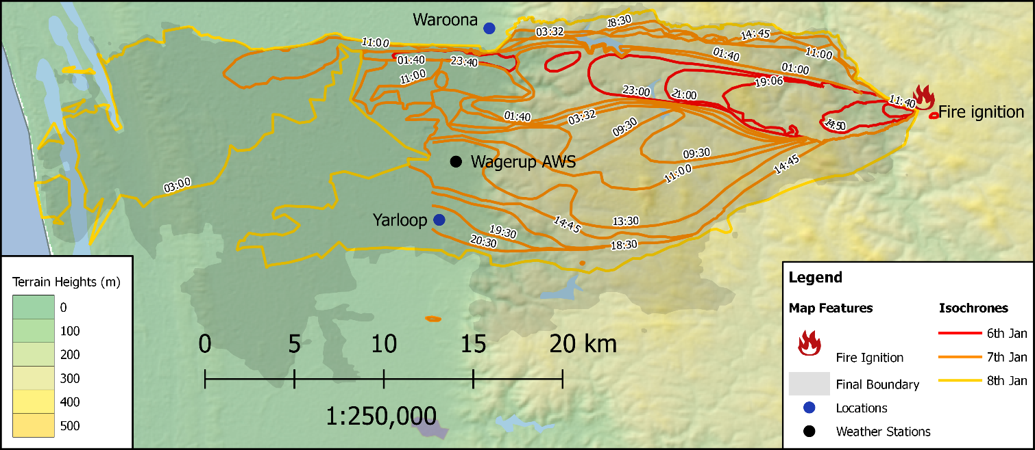
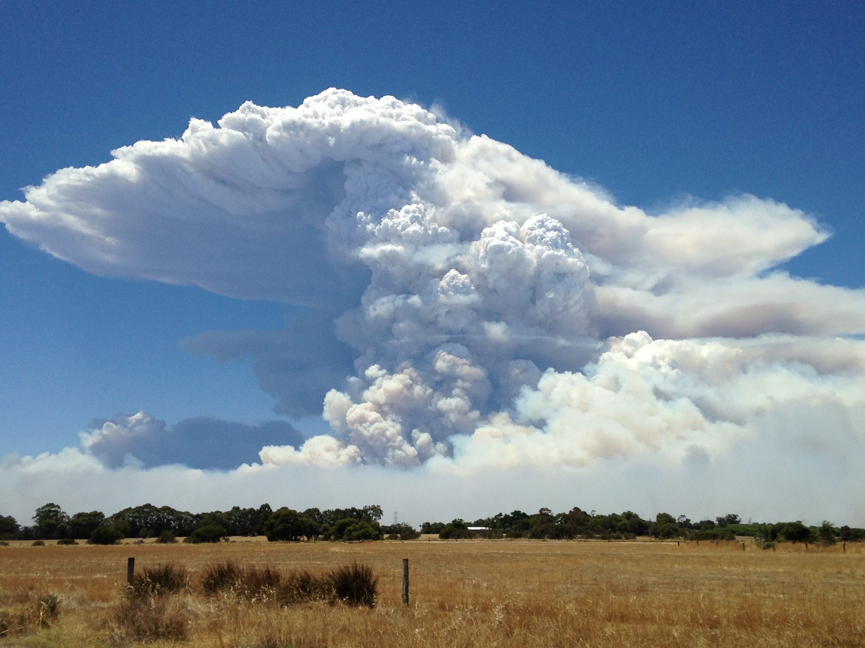
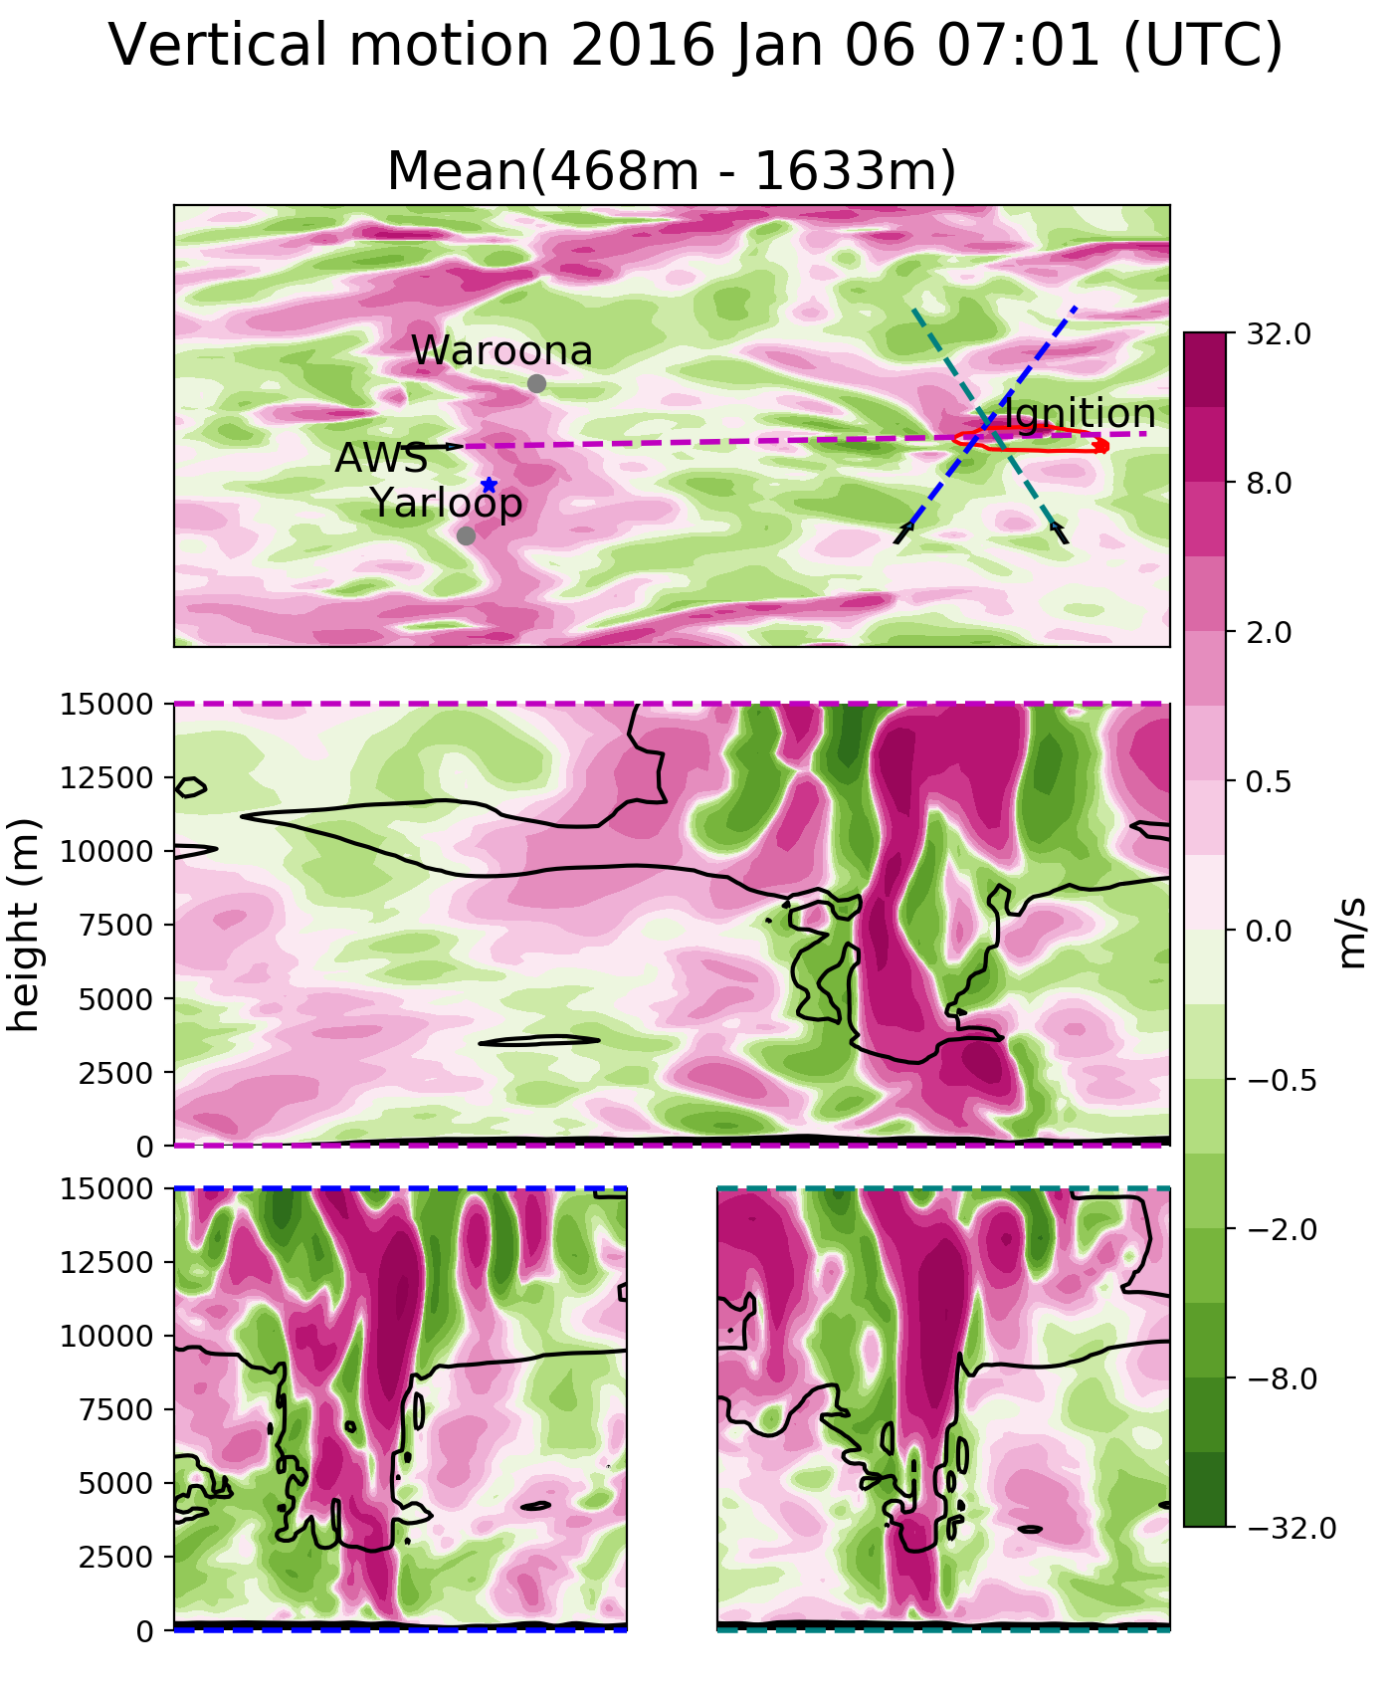
Coupled fire-atmosphere research: Outcomes from an ACCESS-FIRE case study, and implications for operational fire modelling
Jesse Greenslade¹, Mika Peace^{1,2}, Jeffrey D Kepert^{1,2}, Harvey Ye¹, Kevin Tory¹
¹ Bureau of Meteorology, ² Bushfire and Natural Hazards CRC
Project:
This work examines fire spread and related weather phenomena
in a large-scale high-intensity fire over complex topography.
The fire simulated occurred in 2016, igniting ~20 km East of
Waroona.
ACCESS-Fire:
ACCESS is the Australian Community Climate and Earth-System Simulator - Australia's premier numerical weather prediction model. Coupled to a fire model developed at BOM allows pyrogenic heat and moisture to feed back into the simulated atmosphere.
Summary of how fire-spread compares to estimated spread (if isochrones used in comparison – remove them from banner intro section.
Simulated spread does not have fire-breaks or suppression efforts applied to it. Ignition points (including spotting) are prescribed in the model.
Pyrocumulonimbus (PCB)
The coupled model captured several PCB that were seen (e.g. top-right). These often cause strong surface winds and lightning.
Analysis
Description of transect showing downgusting and formation.
Description of 3D PCB transect figure
Downslope winds
Topography drives many meteorological phenomena, such as the downslope winds that occur on most evenings near Waroona. In this case these winds both drove the fire-front and caused an ember-storm.
Analysis of downslope emberstorm figure
Summary
What is the overall message we want to give to AFAC audience?
Coupled modelling can provide the next level of value for fire danger forecasting, if it can be developed to the point where it is both faster than real time by enough to matter, and the underlying fuel loads are available in all high risk areas. This is achievable with some investment

