Slide 1

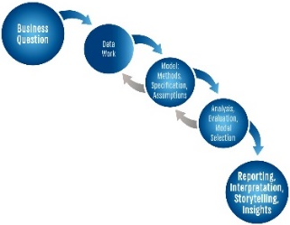


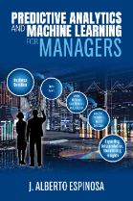



Leadership Initiatives
AI & Emerging Technology Internship
Machine Learning & Artificial Intelligence for Business: Key Concepts and Trends
Prof. J. Alberto Espinosa, PhD
Dept. of Information Technology & Analytics
alberto@american.edu https://jibe4fun.github.io
July 27, 2026
Slides: https://tinyurl.com/EspinosaLead
PAML4M Book
Amazon Ch1 R: GitHub

Slide 2
J. Alberto Espinosa, Ph.D. Professor Emeritus of Information Technology & Analytics Kogod School of Business, American University, Washington, D.C.
Prof. Espinosa holds a Ph.D. and Master of Science in Information Systems from the Tepper School of Business at Carnegie Mellon University, a Master of Business Administration from Texas Tech University, and a Mechanical Engineering degree from Pontificia Universidad Catolica del Peru. He is the architect and implementor of Kogod's MS Analytics Program and the undergraduate specialization in Business Analytics. He is also the curriculum architect for the IT&A programs and specializations. He has over 70 published journal articles, conference proceedings, books, and book chapters. He has co-authored two research books, one on work coordination across time zones and a 2-volume book on big data and analytics for service delivery. He has also written a book titled “Predictive Analytics and Machine Learning for Managers” with practical applications in R. His research focuses on coordination and performance in technical projects across global boundaries, mainly distance and time zones. More recently, he has developed social network and graph analytics methods to represent team knowledge quantitatively and visually. He has 70 peer-reviewed articles, many of them published in leading scholarly journals, including Management Science, Organization Science, Information Systems Research, the Journal of Management Information Systems, IEEE Transactions on Software Engineering, IEEE Transactions on Engineering Management, Communications of the ACM, Human Factors, Information, Technology and People, and Software Process: Improvement and Practice. His work has also been featured in leading academic conference proceedings. He teaches predictive analytics with machine learning, social & organizational network analytics, R programming, information technology foundations, business process analysis, and programming for business applications. He has received multiple service, research, and teaching awards, including “American University 2025 Outstanding Teacher”, “2022 Kogod Graduate Professor of the Year”, and “American University 2022 Green Teacher”. He has several years of work experience, first as a mechanical design engineer and later as a senior manager, VP, and CFO with international organizations, directly supporting, supervising, and formulating policy for finance and global IT, data management, and analysis, where he designed and developed many software applications to support geographically distributed work.

Slide 3
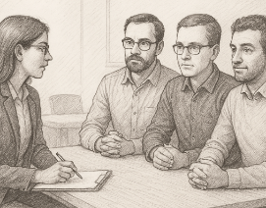

A Story about Estor – AI is Not New
🧠 What was Estor? It is one of the earliest expert systems applied to software effort estimation, developed by Steven Vicinanza, a Carnegie Mellon PhD student in 1990, and published in MIS Quarterly in June of 1992, “Examining the Feasibility of a Case‑Based Reasoning Model for Software Effort Estimation”
It was built by analyzing how experienced software project estimators reasoned when estimating time to completion (i.e., effort) in real software projects.
⚙️ How did it work? When estimating new projects, these experts retrieved similar past cases and applied adaptation if-then rules. These rules were coded into a rule database to be queried by the Expert System, mirroring the expert’s thought process.
📊 Results: Estor was tested on 15 real software projects, comparing its estimates against those of the experts and various quantitative estimation methods. Estor was as accurate as the human experts and more accurate than the traditional estimation methods.
🧩 Importance: Demonstrated the feasibility of expert system AI for software estimation back in the early 1990s, when machine learning was not mainstream, which inspired over three decades of follow-up research using machine learning, neural networks, regression, and fuzzy systems to improve estimation accuracy.
In summary, Estor was a groundbreaking early AI software effort estimator using insights from expert estimators. It proved that capturing expert thinking in a structured rule base could match human-level estimates, setting the stage for decades of research in this field.

Slide 4
Main Branches of AI
What-If Logic (programming)
Expert Systems (e.g. Estor)
Machine Learning
Generative Artificial Intelligence (e.g., ChatGPT)
Statistical Learning
Predictive Analytics
Cross Validation
(key to ML)
Supervised Learning
Deep Learning: Neural Networks, Boosted Trees, etc.
Large Language Models
Regression Models (quant or categorical outcomes)
Other Models (e.g., K-Nearest Neighbors, Cluster Analysis)
Natural Language Processing (text)

Slide 5
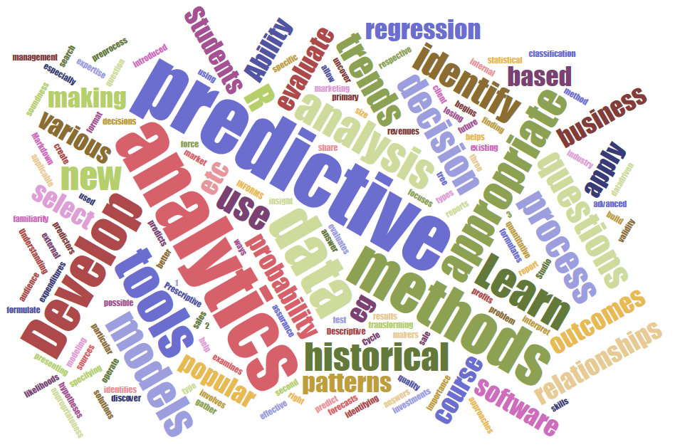
Predictive Analytics
5

Slide 6
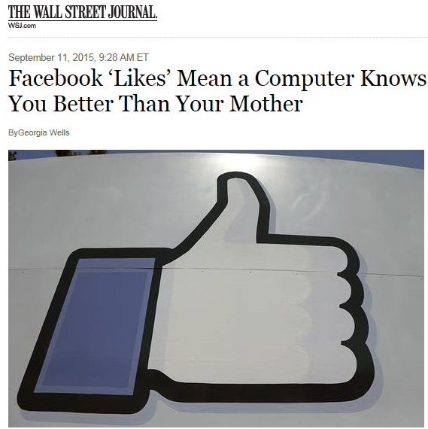
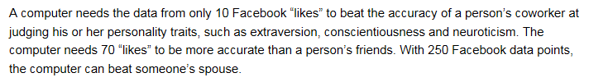
Multiple studies over the years have confirmed that “likes” can predict traits, preferences, personality, etc., with 85% to 95% accuracy.
The Social Dilemma

Slide 7
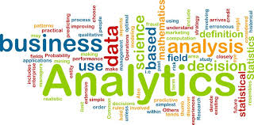

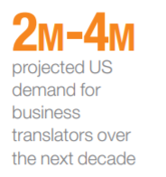
Business Analytics
Moneyball (2003)
“It is the scientific process of transforming data into insights for making better decisions” (INFORMS)
Lack analytical talent – by 2018, the US would face a shortage of 140,000 to 190,000 people with deep analytical skills and 1.5 million managers with analytical skills to make decisions with data (McKinsey Global Institute, 2011)
The Age of Analytics McKinsey Global Institute 2016
Projected US demand for “business translators” in the 2020 decade
High demand for business translators → people who serve as the link between data science talent and business applications and managers, who are business-savvy and can answer business questions.
In 2025 McKinsey issued their “AI in the Workplace” report, stating that employers are eager to adopt AI, but leadership and readiness in this area lag behind → Almost all companies invest in AI, but just 1% believe they lack leaders who understand AI.
7
Notes:
7

Slide 8





The Predictive Analytics Process
Data Science
Business
Predictive Analytics Goals
Interpretation or explainability (e.g., what drives sales) and/or
Predictive Accuracy (e.g., detecting a red traffic light)
Model Outcomes
Quantitative (e.g., sales volume)
Classification (e.g., Covid positive/negative)
Business
8

Slide 9

Analytics Body of Knowledge
Learn how ML & AI are used in your business domain of interest
Business Domains
Social Networks
Business
Healthcare
Marketing
Accounting, Fraud Detection & Forensics
Data Governance
Cyber Security
Financial Analysis
Sports
Analytics & Data Science
Artificial Intelligence
Descriptive Analytics
Prescriptive Analytics
Text Analytics
Large Language Models
Machine Learning
Business Intelligence
Data Visualization
Predictive Analytics
Foundations (IT & Math)
Math & Statistics
Information Technology
Software & Tools
Database & Big Data
Data Warehousing
Programming R, Python
9

Slide 10
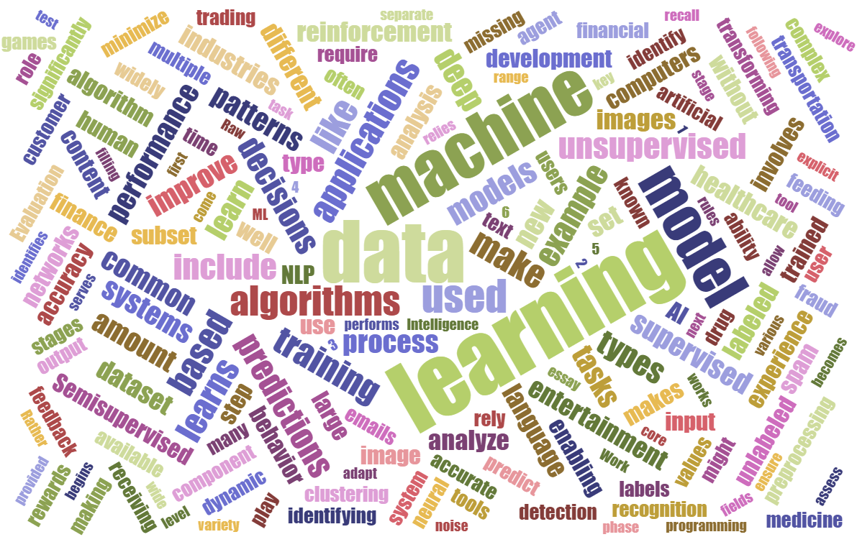
Machine Learning
10

Slide 11
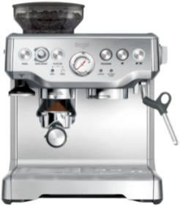

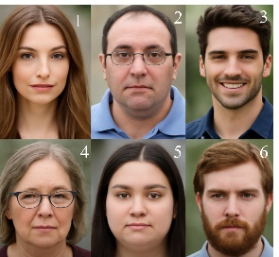
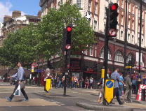





Machine Learning
Is method of data analysis that uses algorithms that learn from data iteratively, allowing computers to find hidden insights without being explicitly programmed (SAS: http://www.sas.com/en_us/insights/analytics/machine-learning.html)
Unsupervised learning → data exploration without specific goals (closely associated with descriptive analytics and data mining, e.g., clustering, correlation analysis, histograms)
Supervised learning → data analysis with specific goals in mind (closely associated with analytics, e.g., regression) → not much different than predictive modeling
$600
$5,300
11
Notes:
11

Slide 12

Classify each person as “hot” or “not” to you:
LooksMapping app by a 22-year old developer to rate restaurants on a “hotness” scale
12
Notes:
12

Slide 13
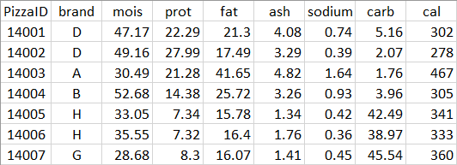
Predictive Analytics Model Without Machine Learning or Cross Validation
Predictors →
Outcome

Slide 14
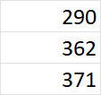

Machine Learning w/Cross-Validation → Split data set + Train model + Test it
Training Subset: Train Model →
Outcome
Test Subset: Test Model’s Accuracy →
Outcome
Actual Predicted Error
Mean Squared Error: 1187.7 RMSE = 34.5
Selected Model
Predict:
Values
Classifications
Words
Images, etc.
New Data
Uses: test and compare models, tune model parameters, train deep and supervise learning models, etc.

Slide 15
The Simplest Neural Network → The Perceptron
The perceptron is the simplest model of a computational neuron and constitutes the basic component of a neural network. All neural networks are composed of one or many perceptrons. A perceptron contains input features, weights, an adder, an activation function and an output.
Weights
Outcome
1
w₀
Classification: 0 or 1 Quantitative: Identity
Bias
Activation Function
X₁
w₁
Adder Function
∑
W₀ + W₁X₁ + W₂X₂ + W₂X₂ + etc.
A
Input Features
w₂
X₂
w₃
A perceptron is similar to a regression model:
Input Features → Predictors
Weights → Regression Coefficients
Bias → Intercept
Adder → Regression Equation
Activation Function →
Sigmoid (reverse Logit), if classification
Identity, if quantitative
X₃
w_{p}
X_{p}

Slide 16
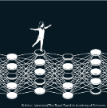
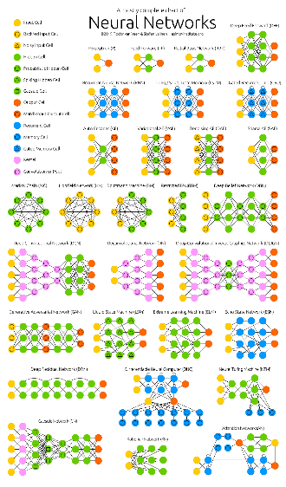
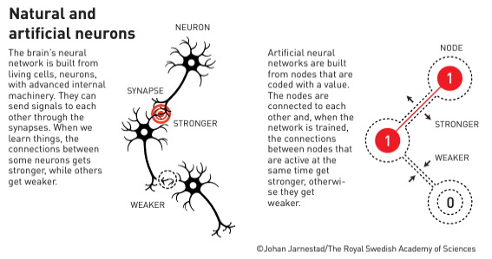

Machine Learning Models (e.g., Neural Networks)
Neural Network → a collection of connected perceptrons
Simple learning → simple linear relationships & 1 or 2 layers
Deep learning → linear or non-linear relationships & multiple layers
ex. recognize hand-written zip code numbers
Input Layer
x₁
w_{1i}
Neurons
Activation Function
x₂
h₁₁
w_{2i}
e.g., if prob > 50% → Yes
Is this 4?
h₂₁
h₁₂
Yes
x₃
h₁₃
h₂₂
A
y
x₄
h_{2n}
h_{1m}
Outcome
Values
Classifications
Words
Images, etc.
Stop?
x_{p}
ex., recognize a traffic light & decide to stop or not
Hidden Layer 1
Hidden Layer 2
Black Box

Slide 17

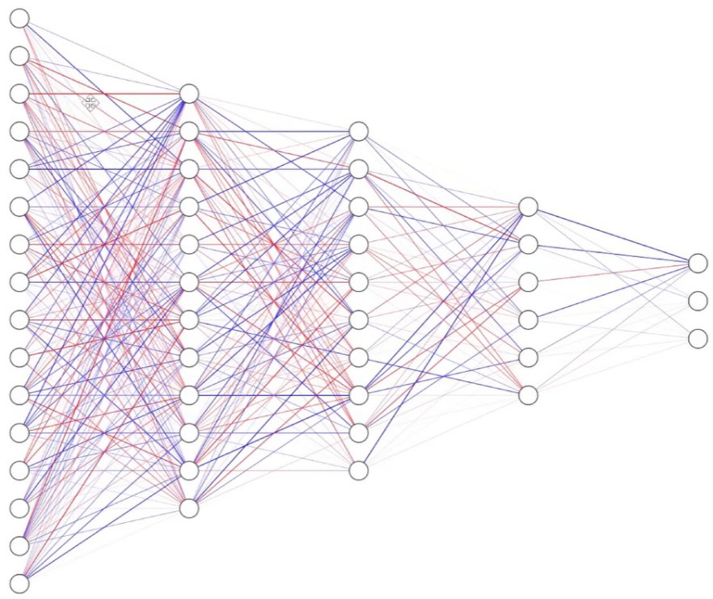
Neural Networks
Biological
Artificial

Slide 18
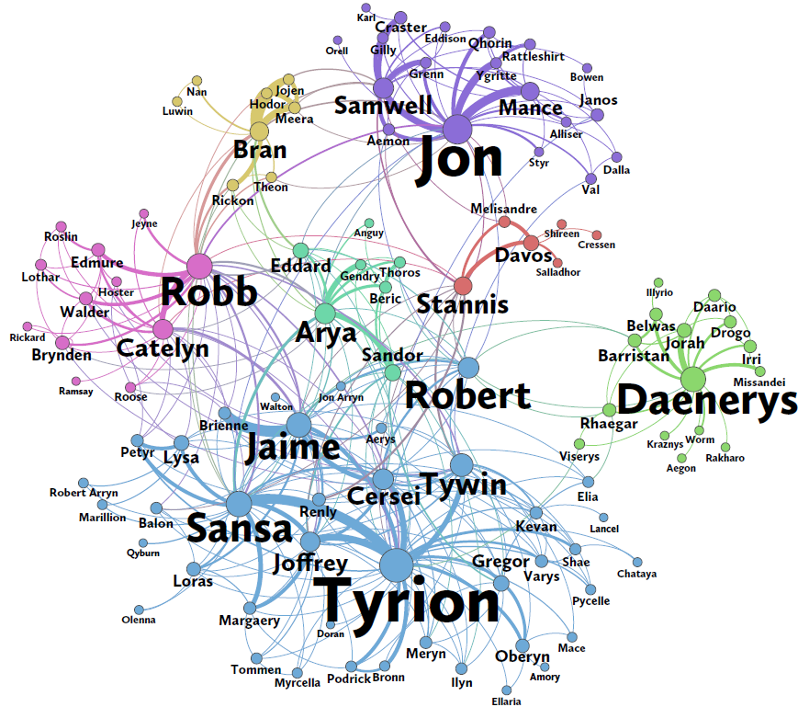
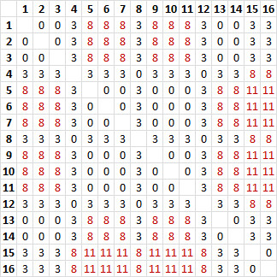
Illustration: Network of Thrones Tie weighs: the number of times the pair appeared within 15 words in the GoT book
The colors depict communities identified with network analytics, which roughly coincide with the communities in the book.
Sansa
16
Tyrion
9
Source: https://networkofthrones.com
Notes:
Relate to SW engineering context

Slide 19
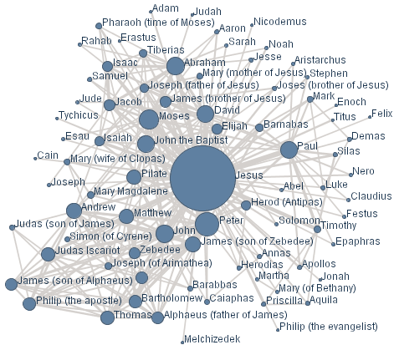
Illustration: Social network constructed with text and visual analytics of the Bible (IBM)

Slide 20
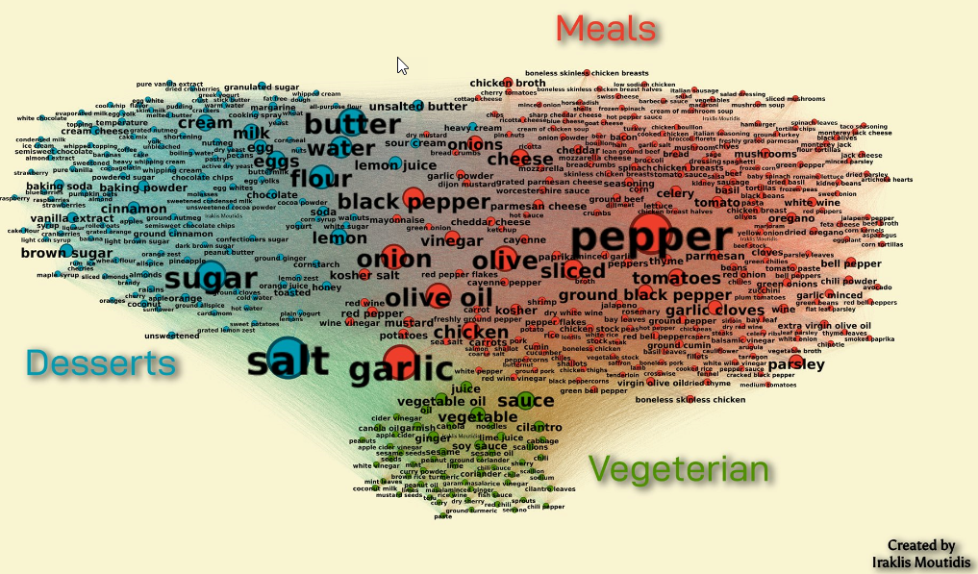
Illustration: Food Ingredient Network
Notes:
Relate to SW engineering context

Slide 21
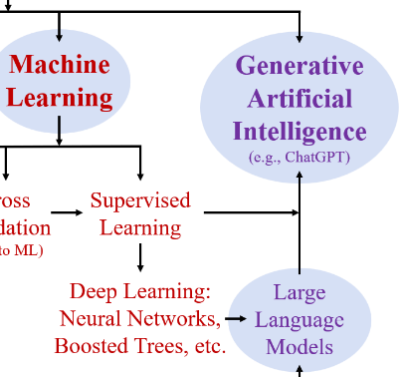
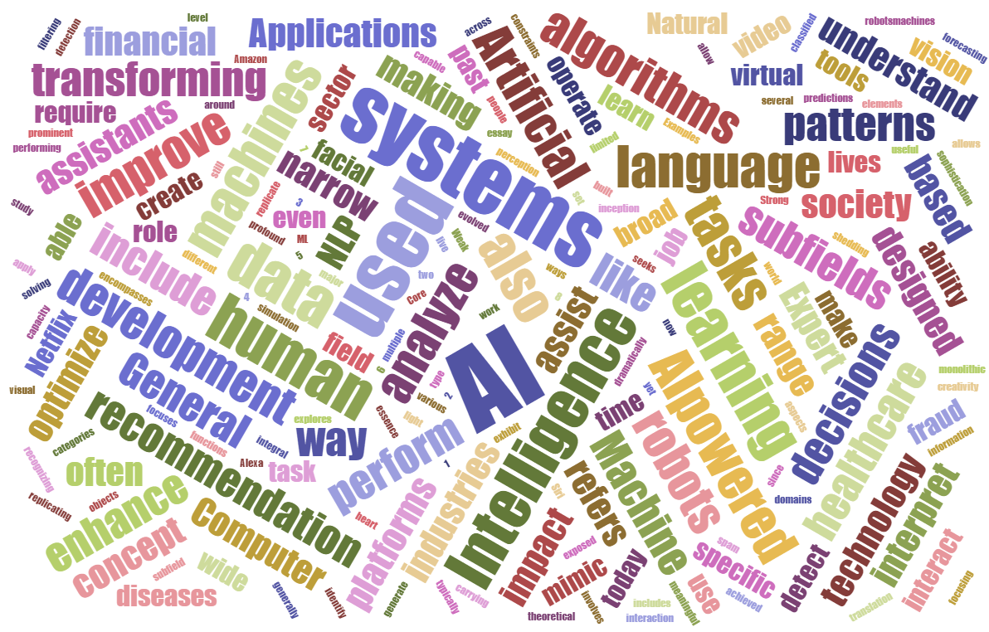
Artificial Intelligence
21

Slide 22
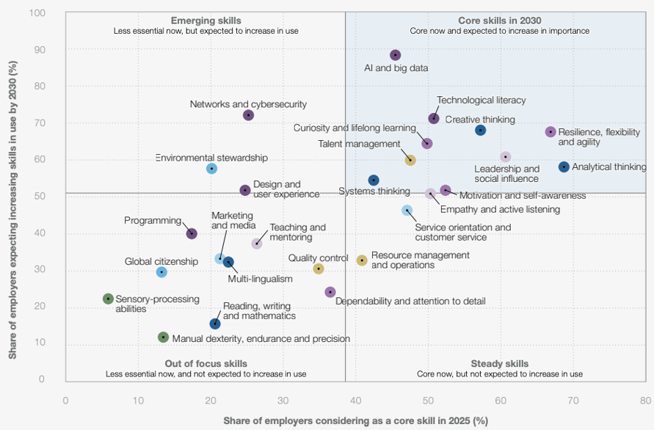
(> 14.1 M workers worldwide from 1,043 companies)
22

Slide 23
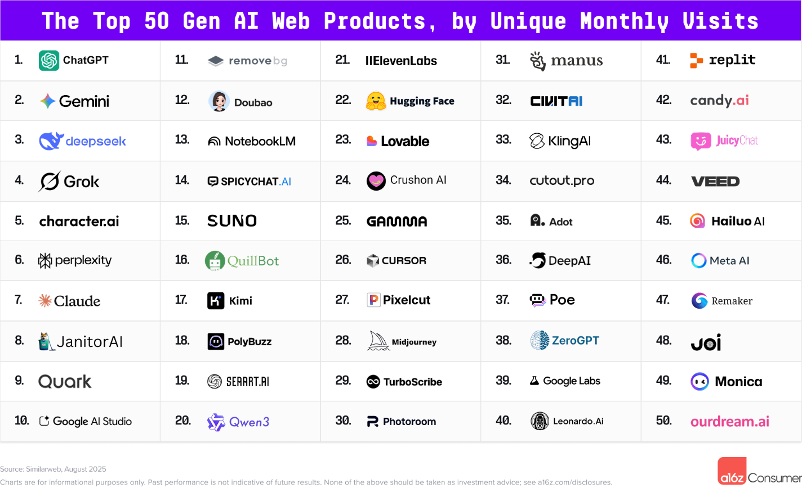
Source: Andreessen Horowitz, August 2025
https://a16z.com/100-gen-ai-apps-5/
23

Slide 24
Artificial Intelligence (AI)
Current consensus: AI will not replace jobs, people who know AI will !!
AI is an old discipline – started in 1956 (Dartmouth Prof. John McCarthy)
Defined as: "the science and engineering of making intelligent machines that behave in ways that would be called intelligent if a human were so behaving " → Learning, Reasoning and Self-Correcting.
There are many branches of AI, such as:
Logic-Based – programs that follow rules, facts and human logic
Expert Systems – logic-based → decision rules elicited from experts
Machine Learning (ML) – systems that learn mostly from historical data, without explicit programming
Generative AI (GAI) – “deep learning models that can generate high-quality text, images and other content based on data they were trained on” (IBM) → generate content from user prompts.

Slide 25
Current Trends in AI
Large Language Models: generate human-like text, images, etc. from words (tokens) you prompt and use supervised learning trained (with >1.5 trillion parameters) to predict the next word based on patterns it sees, over and over, sequentially.
Generative AI (GAI): responds to prompts and generates responses as text, images, sound, video, etc.
Retrieval-Augmented Generation (RAG): the prompt is first queried on factual, specific, and/or proprietary information (e.g., a company’s product catalog or corporate policy), and the output is used to augment the original prompt sent to the GAI, thus improving quality and accuracy of the response, and reducing hallucination.
Agentic AI: Programming (with code or visually) a process of running a prompt (ad-hoc or automatic) through a GAI tool, using the output to feed as input to another (or the same) GAI tool, then again multiple times to accomplish a goal (e.g., booking a vacation)
Multimodal Models: Can process and combine data from different sources (text, image, video, audio, etc.) → Key role of “transformers”.

Slide 26

Superagency in the Workplace
Survey of 3,613 employees and 238 C-level executives
https://www.mckinsey.com/capabilities/mckinsey-digital/our-insights/superagency-in-the-workplace-empowering-people-to-unlock-ais-full-potential-at-work
i.e., human performance augmented by AI
92% of companies plan to invest in AI over the next 3 years
1% believe investments have reached maturity
Employees are more ready for AI than their leaders are or imagine

Slide 27
Prompt Engineering
It is the process of designing, refining, and optimizing prompts when interacting with AI models like GPT (Generative Pre-trained Transformer). Key aspects:
Clarity and Specificity → ensure the model understands what’s asked
Contextualization → general context (e.g., who are you? what are your needs?)
Instructions for Tasks → state what’s expected (e.g., summary, detailed response)
2 Approaches: (1) long, thorough prompt; or (2) short prompt & iterate
Prompt:
“I am a machine learning professor at a business school. How do I explain what prompt engineering is to an audience of young students?”
ChatGPT Response:
“To explain prompt engineering to an audience of young students, you can draw parallels between how employees optimize business processes and how prompt engineers optimize AI outputs. Here’s an example: Prompt engineering is the process of crafting precise, specific instructions for an AI model to ensure it provides accurate and relevant results, much like how you would design a financial query to get the correct data from a business database. In the same way that vague or poorly structured inputs can lead to incorrect human reports, unclear prompts can lead to less useful AI responses. By refining these prompts, we help the AI deliver exactly what we need, whether it’s a financial summary, analysis, or any other task.”
27
Notes:
27

Slide 28

Prompt Engineering Example
Provided by an AI artist who creates images art in the style of known artists, describing what the image should contain along with key characteristics of the author’s style.
Prompt (short version):
Generated with ideogram.ai, by Arnold Millet
“In the muddy field, a man and a woman wearing traditional clothing stand near a wheelbarrow filled with hay. The man wears a brown jacket, while the woman is dressed in a mauve dress and a matching headscarf, seemingly in prayer. A picturesque backdrop features a landscape with a church, open fields, and a sky displaying hues of blue, orange, and purple, indicating either dawn or dusk. The pitchfork’s tines are thicker.”
28
Notes:
28

Slide 29
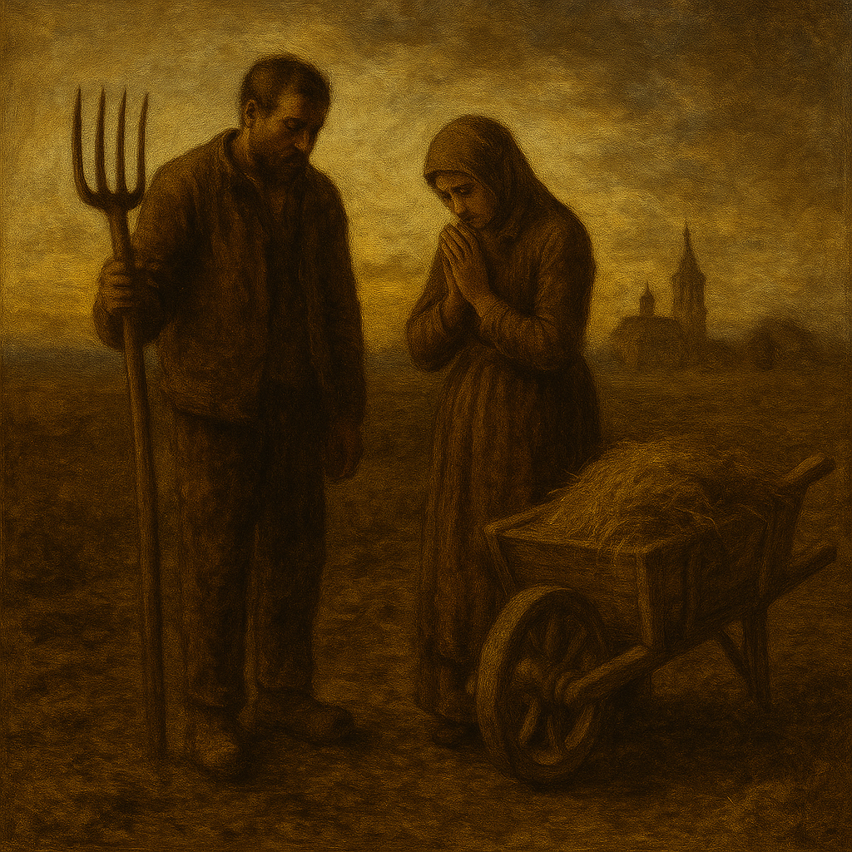
Prompt Engineering Example
Same prompt, done by me with ChatGPT, but adding “in the style of Jean-Francois Millet”
Prompt:
Generated with ChatGPT, by me, same prompt
“In the muddy field, a man and a woman wearing traditional clothing stand near a wheelbarrow filled with hay. The man wears a brown jacket, while the woman is dressed in a mauve dress and a matching headscarf, seemingly in prayer. A picturesque backdrop features a landscape with a church, open fields, and a sky displaying hues of blue, orange, and purple, indicating either dawn or dusk. The pitchfork's tines are thicker. Render the image in the style of Jean-Francois Millet.”
29
Notes:
29

Slide 30
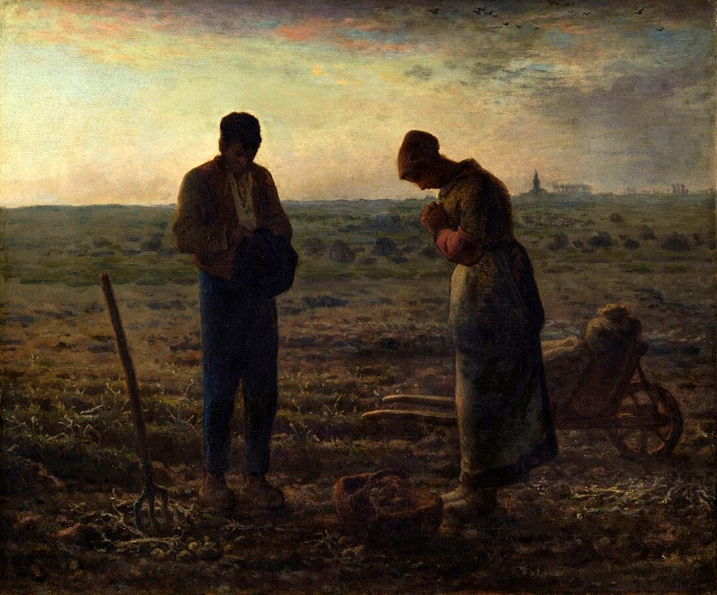
Prompt Engineering Example
Original famous painting: “The Angelus” by Jean-François Millet How would you improve upon the previous prompt to render a more accurate drawing?
30
Notes:
30

Slide 31
Final Words of Wisdom
Learn AI → Take AI courses and/or enroll in AI programs; AI won’t take your job, but someone who knows AI will !! AI is here to stay. Find out how professionals in your domain of interest (e.g., accounting, finance) are using AI and learn their practices.
Learn to code → Programming in Python & R is key.
The future → Nobody can predict what you’ll need to know in 10 years. What you’ll learn today will probably not be in use in 10 years, but it will give you a knowledge base and help you learn future technologies.
Tech vs. Biz → Figure out where your interests lie in the spectrum from technical (e.g., programming, data science, AI developer, etc.) to business (e.g., AI applications and uses, privacy, governance).
Personal use → Don’t ask AI to do the work for you !! → If AI can do your work, why would anyone hire you; AI can hallucinate → Use AI to enhance your work and productivity (e.g., writing, research, copilot).
Use responsibly and ethically → there is great potential for unethical and harmful uses of AI → use AI for good and report unethical uses
31
Notes:
31

Slide 32

Questions?

Slide 33
Reference Information

Slide 34
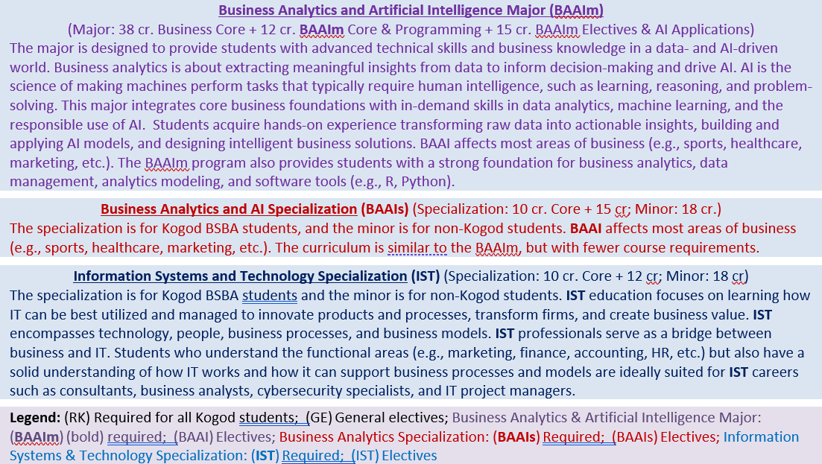
Kogod School of Business @ American University
Information Systems, Analytics & AI Specializations & Major

Slide 35
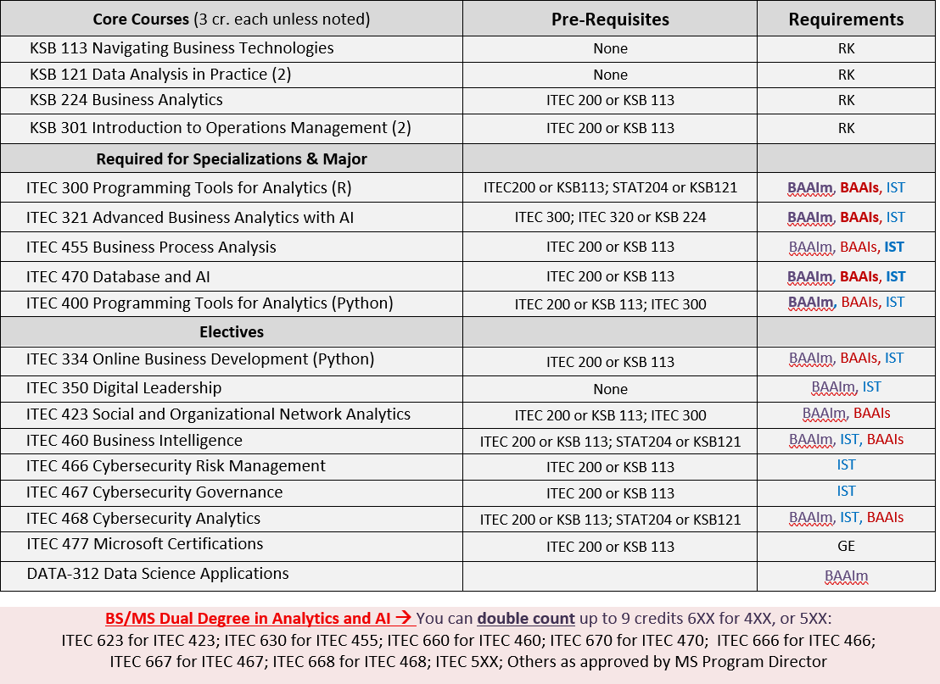

Slide 36

American University, Kogod MS Analytics
KSB 620 & 621 Capstone Experience Practicum (2 x 1.5 cr)
Electives & Functional Specialization (12 cr)
ITEC 643 Project Management
ITEC 630 Business Process Analysis
ITEC 623 Organizational & Social Network Analytics
ITEC 724 Advanced Text Analytics w/AI and Machine Learning
ITEC 668 Cyber Security Analytics
Plus, specializations in:
Cybersecurity
Accounting Forensics
Quantitative Financial Analysis I and II
Marketing
Accounting
Data Science, etc.
Analytics Core (9 cr)
ITEC 621 Predictive Analytics w/Machine Learning
ITEC 610 Managerial Statistics
ITEC 620 Business Insights Through Analytics
ITEC 616 Managing the Digital Organization
IT Core (9 cr)
Tools: KSB 999 R; ITEC 600 Python
ITEC 670 Database & Big Data
ITEC 660 Business Intelligence
BS/MS Option → Double-count 9 credits Further details: https://jibe4fun.github.io/analytics/msanalytics.pdf

Slide 37
A Few Useful General AI Tools
GhatGPT (https://chatgpt.com/): conversational Generative Pre-Trained Transformer AI model. GPT-3.5 is free, ChatGPT Plus is $20/month.
Perplexity (https://www.perplexity.ai/): Conversational AI, similar to ChatGPT, but very accurate and yields useful citations
GROK (https://grok.com/): Conversational AI chatbot developed by xAI, similar to ChatGPT
Copilot (https://www.microsoft.com/en-us/microsoft-copilot/personal-ai-assistant): Microsoft AI tool with free and paid versions.
Gemini Notebook (https://notebooklm.google.com/): By Google, good for generative AI on local documents like Word, Powerpoint and PDF. Was called NotebookLM before.
Gemini (https://gemini.google.com/app): Gemini’s chat tool with free and paid versions.
Dall-E (https://openai.com/index/dall-e-3/): generates graphs in ChatGPT
MidJourney (https://www.midjourney.com/home): Generates images from text.
Pearl.ai, AI Code Editor, Claude, Cursor: generative AI tools with advanced features for software programming.
DeepL Translate (https://www.deepl.com/en/translator): for accurate translation between multiple languages
Grammarly (https://www.grammarly.com/): Excellent AI writing tool

Slide 38
Artificial Intelligence (AI) & Machine Learning Applications by Industry
Healthcare: diagnostics, personalized treatment, robotic surgery, AI-driven diagnostic tools, drug discovery, predictive analytics for patient management.
Finance & Accounting: risk management, fraud detection, accounting forensics, algorithmic trading, personalized banking services, and AI-driven compliance.
Retail: personalized marketing, inventory management, sales forecasting, e-commerce, chatbots, recommendation engines.
Manufacturing: production line optimization, predictive maintenance, quality control, automation.
Transportation: self-driving cars, route optimization, logistics, traffic management, autonomous systems.
Energy: energy use optimization, predicting equipment failure, managing grids, efficient energy consumption.
Advertising & Media: content creation, targeted advertising, media analytics

Slide 39
Popular Uses of Generative AI
Research → Search papers, summarize articles, find citations, etc.
Writing → Write first drafts, edit writing, change styles (e.g., academic)
Local Knowledge Base → Chat and generate from your own materials
Local Coach/Tutor → Support learning and content creation
Advanced Searches → Generate content, not just website links
Create Presentations → Generate slides and graphics
Generate Creative Content → Images, Music, Video, etc.
Software Programming → Learn how to code, generate code, etc.
Language Translation → Text or audio from/to any language
Power Computer User → Tools (ex., Copilot for Excel, PowerPoint)
Voice Applications → Voice assistants, transcriptions
Face Recognition → Tagging photos, device security, etc.
39
Notes:
39

Slide 40
Backup Slides

Slide 41
CRISP-DM Cross-Industry Standard Process for Data Mining
CDM-1
CDM-2
Business Understanding
Data Understanding
CDM-3
Data Preparation
Data
CDM-6
CDM-4
Deployment
Modeling
CDM-5
Evaluation
41

Slide 42
Model Explainability
Interpretable Models
Explain how the model works and what the results mean → e.g., OLS regression, logistic regression, decision trees → good for interpretability and inference
Black Box Models (non-interpretable)
The complexities of the internal model are difficult to explain → e.g., neural networks, deep learning → good for predictive accuracy
Sales ~ Ad Spending + Store Size
Stop?

Slide 43
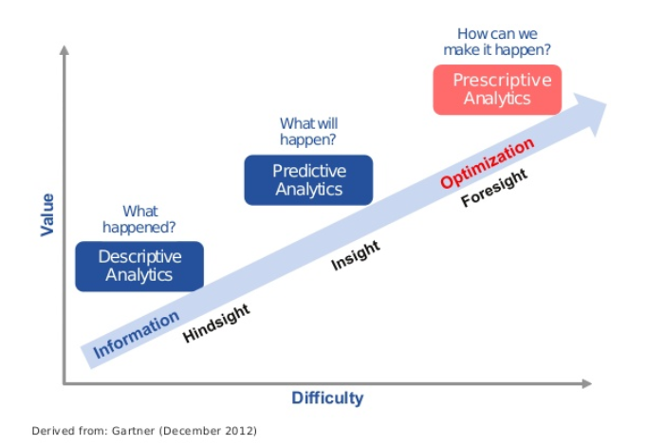
Analytics Types
Descriptive: getting meaning from the data – e.g., descriptive statistics, data mining, cluster analysis, market basket analysis, etc.
Predictive: using some data to predict outcomes (quantitative or classification) – e.g., projecting sales/profits, decease survival prognosis, probability of losing/gaining a client, probability of a security breach, etc.
Prescriptive: decision models that use predictive models to make/automate recommendations – e.g., optimal pricing, where to drill for oil, selecting job applicants, market products based on purchase history, etc.
43

Slide 44
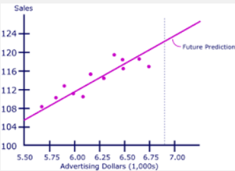
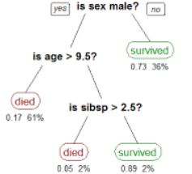
Predictive Analytics Question → Outcome → What are you predicting?
Values: → predict quantitative outcomes – e.g., how much does annual income increase with each year of additional university education; how much sales increase for each additional dollar of advertising expenditures?
Classification: predict categorical outcomes or the likelihood that an observation will fall in a particular class – e.g., yes/no, positive/negative illness diagnosis, loan default/no-default, cyber security breach/no-breach, etc.
44
Notes:
Frank 9:35 – 11:15 AM

Slide 45
Extras

Slide 46
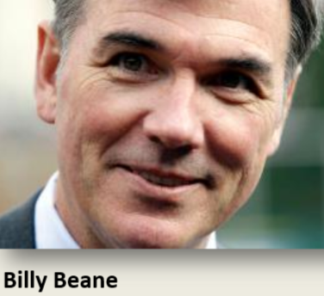

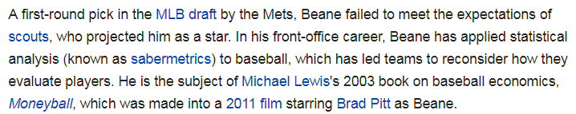


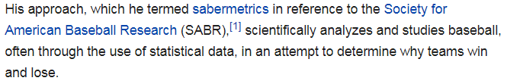
Moneyball book author: Michael Lewis Billy Beane (Oakland A’s) incorporated (“sabermetrics”) analytics and statistics, reaching record profits in baseball
Moneyball (2003)

Slide 47



AI & Data Science Zoo
Mathematics & Statistics
Programming: R, Python, Julia, Auto ML tools, etc.
Data Science
Machine Learning
Business Analytics
Predictive Analytics
Business Intelligence
AI
Data Mining
Computer Science & Large Language Models
Database & Big Data
47

Slide 48
Main Components of Analytics
Insights
Report
Meaning & Interpretation
Storytelling
Models
Model Specification
Model Method
Interpretable vs. Black Box
Large Language Models
Model Assumptions
Machine Learning
Artificial Intelligence
Data
Structured (Tables)
Unstructured
Data Pre-Processing & ETL
Big Data
Text
Business Question / Problem / Case
Quantitative Outcome
Classification Outcome
48

Slide 49
The Analytics Life Cycle
Step 1 – Business Understanding (CDM - 1)
Formulate Business Problem and Case
Translate into Analytics Question: outcome + predictors
Step 2 – Data Work (CDM - 2, 3)
Identify & Gather data: structured, unstructured, visual, etc.
Pre-process data: cleanse, prepare, transform, format, etc. Descriptive Analytics: e.g., correlation, descriptive stats, etc.
Step 3 – Modeling Method (CDM - 4)
Predictive Analytics → predict outcomes
Goals: Interpretability vs. Accuracy
Model Type: Explainable (e.g., regression) vs. Black Box (e.g., neural network)
Prediction Type: Quantitative vs. Classification Outcome
Model Evaluation: Model assumptions, fit statistics, cross validation testing
Model Specification: Predictors or features? Linear, non-linear, log?
Step 4 – Analysis (CDM - 5)
Interpret effects, test hypotheses and/or make predictions
Step 5 – Reporting (CDM - 6) Written, interactive, visual → ”storytelling”

Slide 50
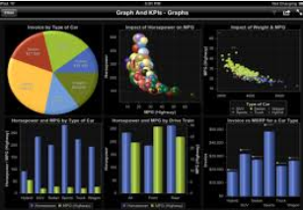


Analytics Approaches
Quantitative: statistical, association, correlation, regression, machine learning, etc. models based on how variables co-vary with the outcome – e.g., how much does annual income increase with each year of additional university education?
Visual: e.g., Tableau, R, Python
Network Analytics: relationships (e.g., friendship, communication, co-memberships, etc.) → social, organizational, professional networks, etc.
Unstructured Data Analysis: text mining, natural language processing, social media, etc.
Large Language Models (LLMs): predict the next word based on the current set of words in the text → generate text responses, e.g., ChatGPT
50
Notes:
Frank 9:35 – 11:15 AM

Slide 51
Network & Graph Analytics Illustration: The Bible (by IBM) Tie weight: number of times the pair appeared in the same passage.
4
Sociogram
Ex. Adam
Ex. Jesus
16
Sociomatrix

Slide 52
Illustration: Ingredient Co-Appearance Network https://www.reddit.com/r/dataisbeautiful/comments/dor6l8/oc_ingredients_coappearance_in_one_million_recipes/
Notes:
Relate to SW engineering context

Slide 53
Statistical Models
Regression → predicting by statistical association using variables in the data to predict quantitative outcomes or classifications.
Tree → partitioning the data at specific values of variables to differentiate quantitative outcomes or classifications
Predictors
Model
Outcomes
e.g.,
Vehicle Weight
Horsepower
Miles per Gallon
Quantitative
Engine Size
Gas or Electric
Will Sell this Week?
Classification: Yes / No
Price

Slide 54
Ordinary Least Squares
Weighted Least Squares
Generalized Linear Model
Ridge Regression
LASSO Regression
Principal Components Regression
Partial Least Squares
Non-Linear Models
Piecewise Linear Regression
Step Regression
Linear, Cubic, Smoothing Splines
Neural Networks
Etc.
Analytics Modeling Options
 | Modeling Method
 | Structured |  | Visual, Text, Unstructured, etc.
Descriptive | Cluster analysis, correlation, market basket analysis, sample statistics, ANOVA |  | Bubble charts, network diagrams, natural language processing, clustering dendograms, etc.
Predictive | Association | Decision Tree | Charts
Quantitative Value | Regression | Regression Trees | Regression plots, scatter plots, Tableau diagrams, trend charts, etc.
Classification | Logistic Regression; Other Categorical Regression Models | Classification Trees | Tree maps, interactive diagrams,
Prescriptive | Operations research, decision modeling, optimization, linear programming |  | Simulations, etc.
Regression Trees
Classification Trees
Bootstrap Aggregation
Random Forest
Boosting Trees
Etc.
Binomial Logistic Regression
Multinomial Logistic Regression
Linear Discriminant Analysis
Quadratic Discriminant Analysis
Neural Networks
Etc.

Slide 55
ML: Key Concepts
Again, ML is about maximizing predictive accuracy →
Split the data set into train and test sub-samples
Train subset → part of the data selected randomly to fit models and estimate parameters (e.g., regression coefficients)
Test subset → part of the data, not in the train subset, used to evaluate the trained models
Cross-Validation (CV) → Evaluate the trained model’s predictive accuracy with the test subset, → CV Test Error
Re-Sample and repeat 1-5 many times

Slide 56
Current Trends in Machine Learning
Large Language Models: use supervised learning to predict the most likely words to add to text based on the input submitted.
AutoML: Automate model selection, feature engineering, and parameter tuning.
Multimodal Models: Can process and combine data from different sources (text, image, video, audio, etc.)
Foundation Models: models like GPT that can be adapted to a wide range of applications.
Explainability for Complex Models: Tools and methods are being developed to make models more transparent and to explain their predictions to non-experts.

Slide 57
Machine Learning
Cross-Validation → Split, Train, Test, Re-Sample
Machine Learning
Predictive Model
Dataset
Outcome
Train
Train Sub-Sample
Predict
Test
Test Sub-Sample
Actual Predicted Error Mean Squared Error: 1187.7 Mean Error = 34.5
Select Model
New Data
Predict:
Values
Classifications
Words
Images, etc.
Uses: test and compare models, tune model parameters, train deep and supervise learning models, etc.

Slide 58
Artificial Intelligence (AI)
Current consensus: AI will not replace jobs, people who know AI will !!
AI is an old discipline – started in 1956 (Dartmouth Prof. John McCarthy)
Defined as: “the science and engineering of making computers behave emulating human intelligence” → learning, reasoning and self-correction.
Gartner → AI is the application of advanced analysis, logic-based methods and machine learning (ML) to interpret events and automate decisions.
There are many branches of AI, such as:
Logic-Based – based on logical rules
Expert Systems – “if-then” decision rules are elicited from experts
Machine Learning (ML) – systems that learn mostly from historical data, without explicit programming
Generative AI (GAI) – “deep learning models that can generate high-quality text, images and other content based on data they were trained on” (IBM) → generate content from user prompts.

Slide 59
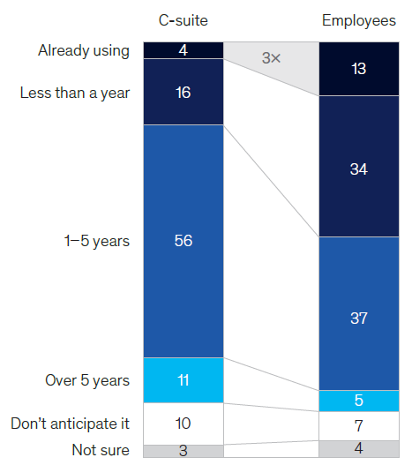
Employees vs. Leadership

Slide 60
Current Trends in Artificial Intelligence
Generative AI (GAI): ChatGPT and other tools that respond to a prompt and generate content based on it. The content can be text, images, videos, software code, etc. resulting in innovation and more efficient work processes.
Augmented Intelligence: copilot decision makers, doctors, manufacturers, artists, etc.
AI in Predictive Analytics: fraud detection, cybersecurity analysis, healthcare predictions, trend and financial forecasting trends, decision making, resource allocation and optimization.
AI in Personalization and Marketing: personalize customers’ experience, product and service recommendation engines.
Responsible AI and Ethics: creating transparent, explainable and unbiased AI systems.

Slide 61
Agentic AI
No or little human intervention→ a programmed AI agent performs multiple tasks in sequence with various AI tools to achieve a goal
It takes a prompt into one AI tool, passes the results to another AI tool, then another, etc.,
e.g., Ask ChatGPT → Send to Perplexity → Send to ChatGPT to Summarize → Output
An AI agent can be programmed with tools like LangChain (requires Python skills) or visually with tools like Autogen Studio (free by Microsoft) and Flowise AI.
Examples:
User inputs "Schedule a call with team" → AI Agent checks team members' calendars → Finds best times → Confirms with users → Schedules meeting and sends calendar invite
User inputs “Find best wireless headphones” → AI Agent searches Amazon, Reddit, and other review sites → Extracts top picks → Summarizes pros/cons → Output list with links
Email received → Agent reads and classifies intent (e.g., complaint, inquiry) → Drafts response using company policy + ChatGPT → Human approves → Agent Sends reply.
61
Notes:
61

