Slide 1
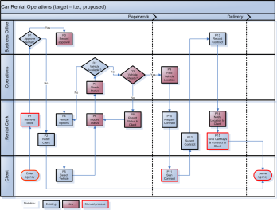


Leadership Initiatives
AI & Emerging Technology Internship
Business Process (Analysis & BPA) Improvement (BPI)
Prof. J. Alberto Espinosa, PhD
Dept. of Information Technology & Analytics
alberto@american.edu https://jibe4fun.github.io
July 29, 2026
Slides: https://tinyurl.com/EspinosaLeadBPI

Slide 2
J. Alberto Espinosa, Ph.D. Professor Emeritus of Information Technology & Analytics Kogod School of Business, American University, Washington, D.C.
Prof. Espinosa holds a Ph.D. and Master of Science in Information Systems from the Tepper School of Business at Carnegie Mellon University, a Master of Business Administration from Texas Tech University, and a Mechanical Engineering degree from Pontificia Universidad Catolica del Peru. He is the architect and implementor of Kogod's MS Analytics Program and the undergraduate specialization in Business Analytics. He is also the curriculum architect for the IT&A programs and specializations. He has over 70 published journal articles, conference proceedings, books, and book chapters. He has co-authored two research books, one on work coordination across time zones and a 2-volume book on big data and analytics for service delivery. He has also written a book titled “Predictive Analytics and Machine Learning for Managers” with practical applications in R. His research focuses on coordination and performance in technical projects across global boundaries, mainly distance and time zones. More recently, he has developed social network and graph analytics methods to represent team knowledge quantitatively and visually. He has 70 peer-reviewed articles, many of them published in leading scholarly journals, including Management Science, Organization Science, Information Systems Research, the Journal of Management Information Systems, IEEE Transactions on Software Engineering, IEEE Transactions on Engineering Management, Communications of the ACM, Human Factors, Information, Technology and People, and Software Process: Improvement and Practice. His work has also been featured in leading academic conference proceedings. He teaches predictive analytics with machine learning, social & organizational network analytics, R programming, information technology foundations, business process analysis, and programming for business applications. He has received multiple service, research, and teaching awards, including “American University 2025 Outstanding Teacher”, “2022 Kogod Graduate Professor of the Year”, and “American University 2022 Green Teacher”. He has several years of work experience, first as a mechanical design engineer and later as a senior manager, VP, and CFO with international organizations, directly supporting, supervising, and formulating policy for finance and global IT, data management, and analysis, where he designed and developed many software applications to support geographically distributed work.

Slide 3

Hungry anyone?
Describe the process to prepare a turkey dinner – i.e., all the necessary steps, decisions, and the proper sequence (i.e., workflow).
p.3

Slide 4
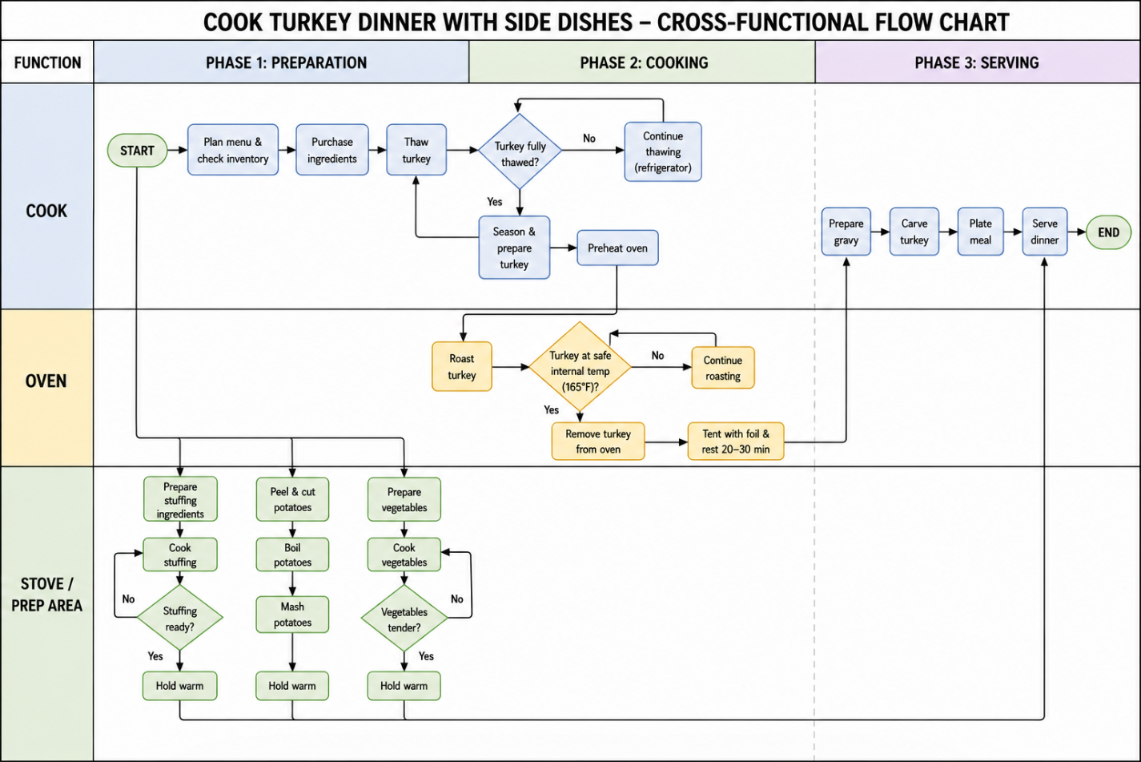
ChatGPT Solution
Phases
Process Step
Decision
Swimlanes
Prompt: Please draw a business process model in a cross-functional flowchart that contains the steps and decisions to cook a turkey dinner, including a few side dishes. The diagram needs to be properly constructed, with all steps, decisions, start and end symbols, swimlanes, and phases.
p.4

Slide 5

What is a Process?
System = Input → Processes → Outcome
Process = the steps, decisions, and workflows to convert inputs into outcomes.
There are many types of systems and processes: e.g., an internal computer, biological, combustion engine, cooking dinner, voting election, business, etc.
A Business Process (BP) is “a set of logically related tasks performed to achieve a defined business outcome." (Tom Davenport) Big Bang Theory
Inputs
Outcomes
Process

Slide 6
Business Process Examples
Business Domain | Client Facing | Internal
Sales | Point of sales, returns | Inventory management
Online orders | Shopping, checkout | Fulfillment, deliveries
Air travel | Reservations, check-in | Baggage handling
Hotel management | Check-in, check-out | Housekeeping services
Restaurant | Reservations, food orders | Food preparation
Banking | ATM transactions, instrument sales (e.g., CDs) | Account management, cash management
Loans | Applications, payments | Evaluation, underwriting
Insurance | Policy purchases, claims | Underwriting, claim processing

Slide 7
Business Process Analysis (BPA) & Business Process Improvement (BPI)
Business Process Analysis (BPA) is the study of the process steps, decisions, and workflows involved in a current (i.e., baseline) business process,
Undertaken to document and understand it
And then conceptualize and formulate a new or revised (i.e., target) business process → resulting in Business Process Improvements (BPI).
Baseline Process
Analysis
Target (Improved) Process

Slide 8
BPA Objectives
Identify and understand a client’s business problem
Elicit, discover, gather & document client or product requirements
Analyze/understand the baseline BP (i.e., the present work)
Conceptualize business process improvements and solutions
Formulate a target BP
Also, often:
If some improvements will be handled by a system (or application), specify its functionality to support the target BP
Identify and specify the basic data requirements to support the target BP and system functionality
Document the target BP with descriptions, diagrams, and models → important to achieve common ground with your client

Slide 9
Drivers of Business Process Improvement
Process improvements, extensions or enhancements do not happen in a vacuum.
What drives a process improvement project?
Need to get the perspective of anyone affected (i.e., stakeholders)
The business case & problem → provide the focus of attention
Process improvement goals → general improvements are OK, but they are most effective when they are targeted to specific process improvement goals:
Outcome goals → what we get from the process (e.g., increased output, improved products/service quality, etc.)
Process goals → how we achieve the outcomes (e.g., efficiency, speed, low cost, better HR utilization, etc.)

Slide 10
Process Improvement Goals
Improvements must be driven by specific process improvement goals discussed with your client.
Which can of many types, including:
Outcomes:
Increased revenues
Increased profits
Reduced operational costs
Improved client service or product quality
Process:
More effective human resource utilization
Increased efficiencies
Improved responsiveness and agility to change

Slide 11
Tom Davenport’s: 5 Steps to Business Process Improvement
BPI is driven by a business vision driven by specific objectives (e.g., cost reduction, quality improvement, etc.)
It’s important to establish and measure the baseline (as-is) process so that the extent of the improvement can be compared and quantified.
Improvement is not a one shot deal, but is iterative and evolutionary. Focus initially on low hanging fruit, high impact areas, customer satisfaction
Develop the business vision and process objectives
Identify the processes to be redesigned
Understand baseline processes
Identify IT levers
Design and develop target (i.e., improved) process
High Impact Approach: focus on most important parts of the process with potential to reach the vision;
Exhaustive Approach: identify all areas of process improvement and prioritize.
Awareness of IT capabilities are key in improving implementation speed, effectiveness and efficiency. Focus on the information content of the process.

Slide 12

Business Process Modeling
A BP model (BPM) is a diagram with a visual representation of the business model
A BPM is the vision of “the work” – i.e., how it is done (baseline) and how it will be done (target).
It fosters communication among the consulting team members and with the client – a picture is worth a 1000 words.
It is necessary to validate the baseline and describe/document target BP solutions with the client.

Slide 13
Cross-Functional BPM Main Symbols
Terminator: all processes must have ONE Start and ONE End point/symbols. Start symbols have NO input and exactly 1 output; End symbols have 1 or more inputs and no output.
Process step: a specific step in the process – it can have 1 or more inputs, but it can ONLY have 1 output (if more than 1 output is needed, use a decision or fork symbol). Steps cannot stand alone, i.e., there cannot be a step without at least 1 input and without 1 output.
Pre-defined process step: a group of steps and flows grouped into a sub-process. They are useful to simplify the diagramming of complex processes.
Decision: a question or a branching in the process flow it CAN have 1 or more inputs and MUST have 1 labeled output for EACH possible decision outcome. There cannot be a decision without at least 1 input and without at least 1 output.

Slide 14
Cross-Functional BPM Main Symbols (cont’d.)
Process flow: a directed arrow that specifies the process sequence. A flow MUST come from a symbol and connect to another symbol, i.e., flows CANNOT be disconnected.
Functional bands or swim lanes: show which departments, units or functional roles are associated with different parts of the process
Phase separators: differentiate different phases of the process sequence (i.e., timing)
Parallel Processing: use these to branch out into multiple parallel flows or to merge them into a single flow.
A Fork splits a flow into 1 or more parallel flows. Needed when the flow splits without a decision to process different paths in parallel.
A Join merges one or more parallel flows into 1
Fork
Join

Slide 15
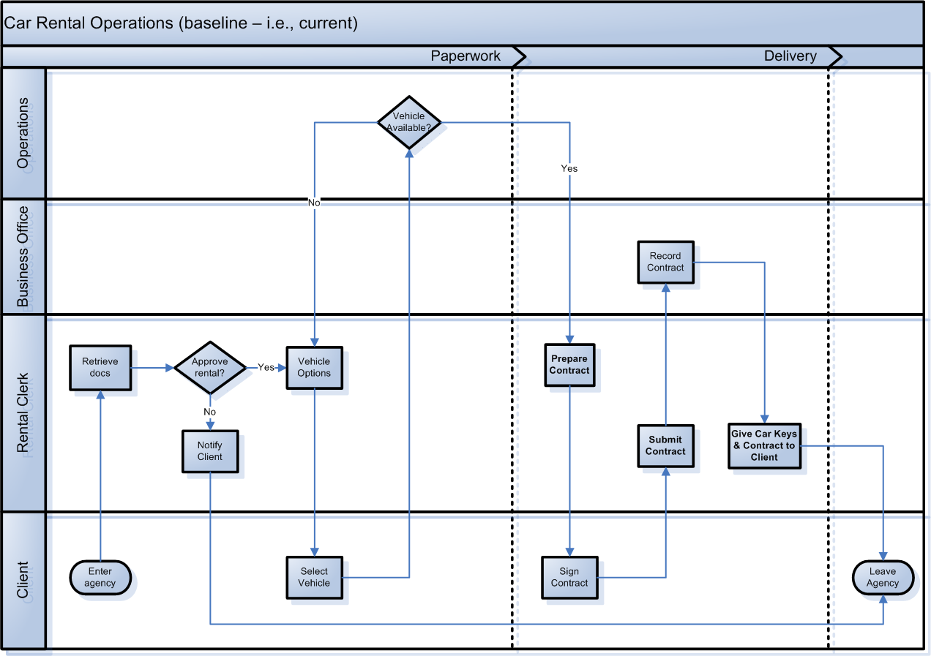
BPM Example - Current Cross-Functional Flowchart

Slide 16

BPM Example – Proposed

Slide 17

BPM Example – Proposed
Vehicle Prep
Paperwork
Vehicle Delivery

Slide 18
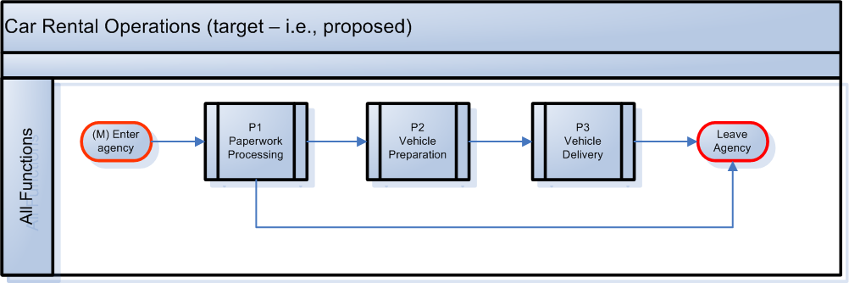
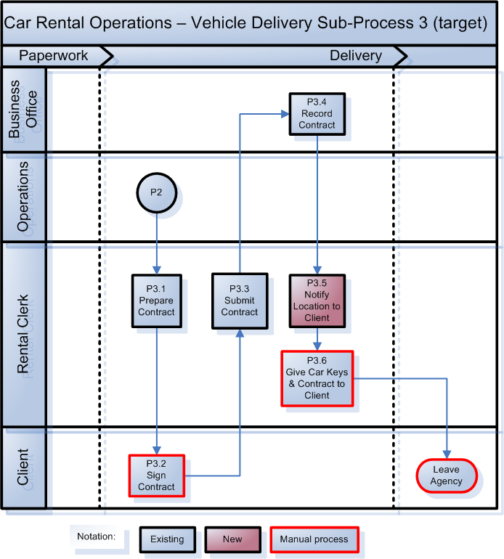
BPM Example – High Level Diagram

Slide 19
BPM Example: Defined Process Details
Connector

Slide 20
Tools
diagrams.net (https://app.diagrams.net/)
Free, simple and intuitive business diagramming
Not just for BPMs but many other diagrams
Online, no need to create an account
Lucidchart (https://lucid.co/lucidchart)
Free (with substantial limitations) and paid versions
Need to create an account
Microsoft Visio (https://www.microsoft.com/en-us/microsoft-365/visio)
Excellent diagraming tool, paid w/free trial versions
Smart Draw (https://www.smartdraw.com/)
Excellent diagraming tool, paid w/free trial versions

Slide 21
BPM Examples

Slide 22
BPM Example: Westin Lima Hotel Management

Slide 23
BPM Example: Check-In Process Improvement

Slide 24
BPM Example: Energy Assistance Process

Slide 25

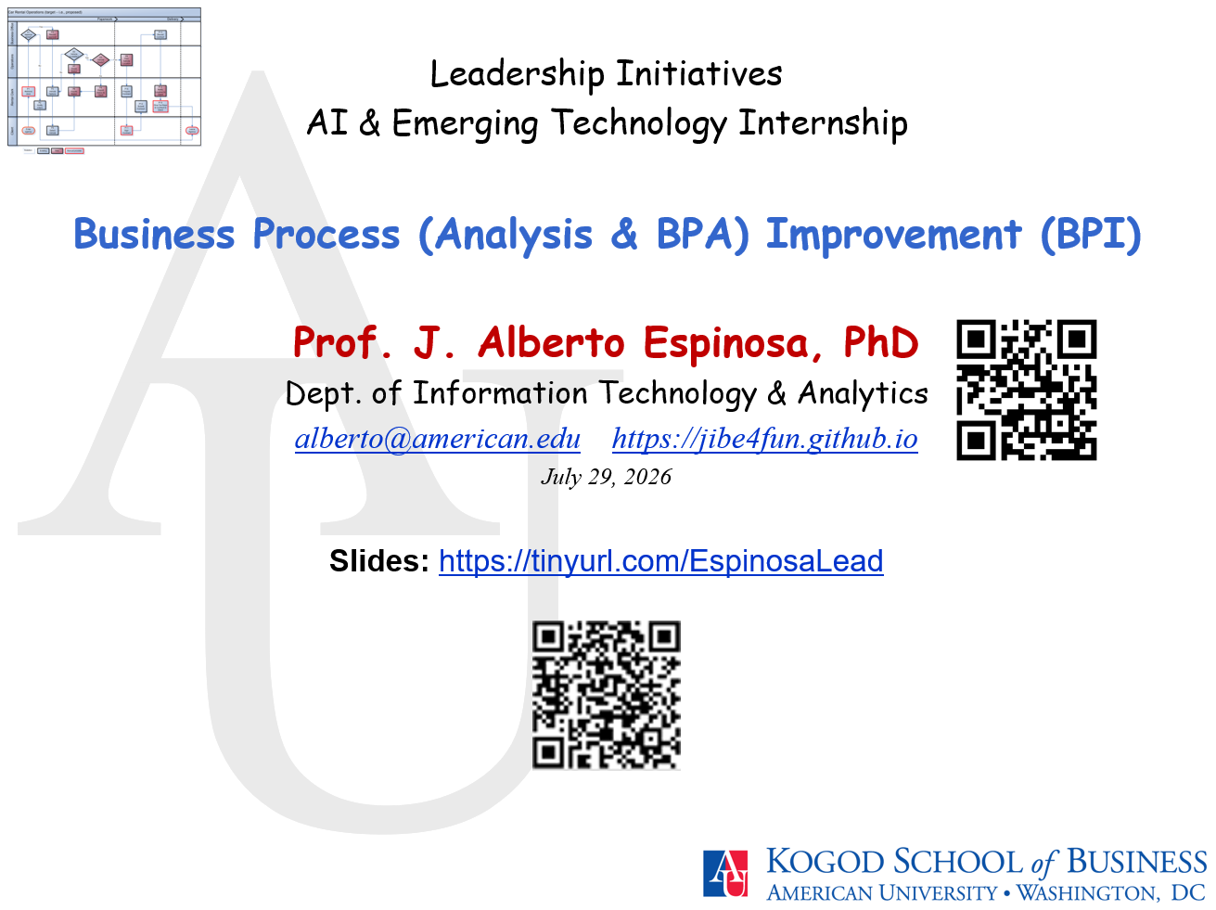

Questions
25

