Slide 1

Measuring Team Mental Models
J. Alberto Espinosa
PhD Candidate, Information Systems
Graduate School of Industrial Administration josee@andrew.cmu.edu
Prof. Kathleen M. Carley
Dept. of Social and Decision Sciences
Carnegie Mellon University
Academy of Management Conference 2001
Washington, D.C., August 8, 2001

Slide 2
Introduction
Motivation:
Team coordination studies: needed SMM measures
  Simulated management decision teams (done)
  Large-scale software developers (in progress)
Empirical work lags theory
Not much agreement on measures [Mohammed & Dumville 2001]
Outline
Theoretical foundations: coordination & SMMs
Propose SMM measures: SMMTask and SMMTeam
Preliminary empirical validation results

Slide 3
Coordination: and Old Problem
Explicit coordination mechanisms
Coord by "programming"
[March & Simon 1958; Thompson 1967]
Impersonal mechanisms
[VanDeVen & Delvecq 1976]
Team/Task
Programming
More routine aspects of the task
Management of interdependencies among
= members, sub-tasks & resources
[Malone & Crowston 1994]
Coordination
Less routine aspects of the task
Coord by "feedback", "mutual adjustment"
[March & Simon 1958; Thompson 1967]
“Personal” mechanisms
[VanDeVen & Delvecq 1976]
How teams communicate matters
[Kraut & Streeter 1995; Sproull & Kiesler 1991]
Team
Communication

Slide 4
Coordination: Newer Concepts
Implicit coordination mechanisms
Team/Task
Programming
Implicit coordination through:
Team mental models
  [Cannon-Bowers et. al. 1993,
  Klimoski et. al. 1994]
Team situation awareness
[Endsley 1995; Wellens 1993]
Transactive memory
[Wegner, 1986, 1995;
Liang et. al. 1995]
Group mind [Weick 1990; 1993], distributed cognition, schema similarities, etc.
Implicit Coordination Mechanisms
Coordination
Team
Communication

Slide 5
Team/Shared Mental Models
Mental Models
  Organized knowledge structures that help individuals interact with their environment (i.e., describe, analyze and anticipate)
  [Johnson-Laird 1983; Rouse & Morris 1986]
Team/Shared Mental Models (SMMs)
  Organized knowledge shared by team members that enable them to form accurate explanations and expectations about the task, team members, etc.
  [Orasanu et. al. 1993; Cannon-Bowers et. al. 1993; Klimosky et. al. 1994]
  Will use "shared" & "team" mental models interchangeably
Main Types
  About taskwork & teamwork
  [Klimosky et. al. 1994; Cooke et. al. 2000]

Slide 6
Previous Measures Used for SMMs
All methods are based on some form of intra-team knowledge similarity measure [Cooke et. al 2000; Mohammed et. al. 2001]
  Similarities in word sequences [Carley 1997]
  Correlation between individual mental models [Mathieu et. al. 2000]
  Within-team response similarities [Levesque et. al. 2001; James et. al. 1984]
  Multidimensional scaling [Rentsch et. al. 2001]

Slide 7
Proposed SMM Measures
Also based on knowledge similarities
At the dyad level [Klimosky et. al. 1994]
Network analysis methods: ideal to study dyadic relationships
Sociomatrices: facilitate computation of SMM measures
Distribution of shared knowledge: centralities, isolates, cliques, etc.
Analyze SMMs at different levels of abstraction
Sociograms: visual representation
Method:
Knowledge similarity sociomatrices KS_{t}(nxn)
One for each task aspect or area t
One row and one column for each of the n team members
Cell ks_{tij} contains knowledge similarity in task area t between members i and j
Aggregate across dyads and task areas

Slide 8
SMM Measures Proposed
SMMTask
  Knowledge similarity within the team about the task =
  Average task knowledge similarity among all dyads
  From task knowledge similarity (TKS) sociomatrices
SMMTeam
  Knowledge similarity within the team about each other = Average team knowledge similarity among all dyads
  From member similarity (MS) sociomatrices

Slide 9
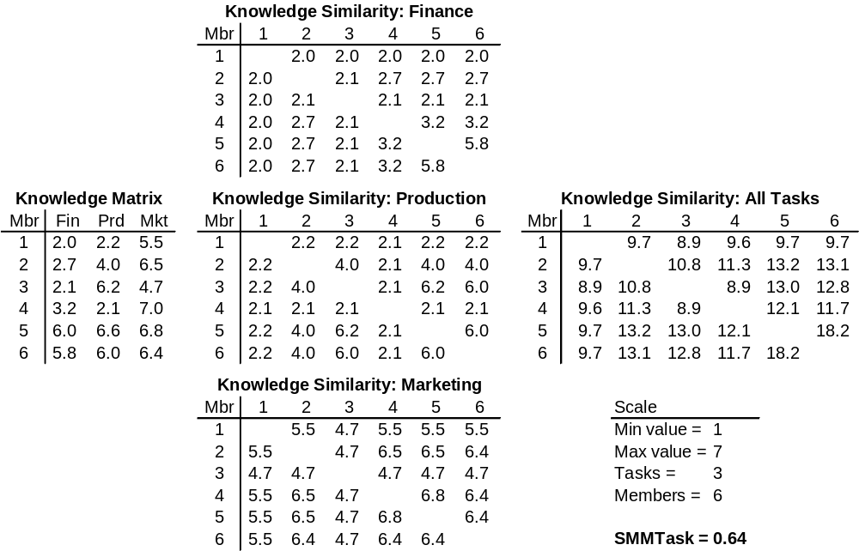
SMMTask Measure a) When member's task knowledge can be evaluated
tks_{tij} =
min(k_{it},k_{jt})
[Cooke et. al 2000]
TKS_{t}
TKS = Σ TKS_{t}
K(nxt)

Slide 10
Visual Representation:
SMMTask Sociograms
1
1
1
1
2
3
2
3
2
3
2
3
4
5
4
5
4
5
4
5
6
6
6
6
Finance Production Marketing Aggregate
Cutoff x*=4 Cutoff x*=4 Cutoff x*=4 Cutoff x*=12

Slide 11
SMMTask Measure b) Member's task knowledge cannot be evaluated
Instead of having knowledge ratings in T task areas
Need to ask Q task-relevant questions [Levesque et. al. 2001]
Use an ordinal rating scale for the answers
Use similar method to a) but instead of task areas
Compute distance (i.e., dissimilarity) of responses
d_{qij} = |r_{qi} – r_{qj}| for each dyad (i,j) & question q
Similarity (reverse scale) = scale range – distance
Alternatively: compute similarities using correlation in responses
Then model all dyadic values into TKSq matrices
Aggregate (and normalize to 0-1) into TKS

Slide 12
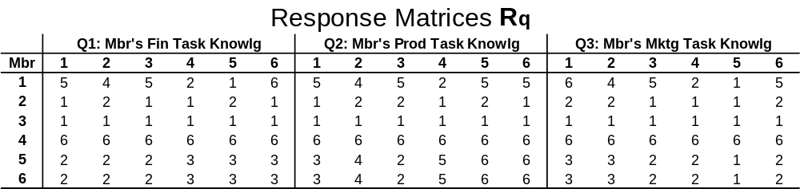
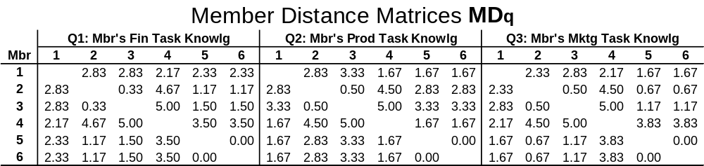
SMMTeam Measure
md_{qij} = avg(|r_{qi}- r_{qj}|) = average distance (dissimilarity) on question q
between members i and j on their knowledge ratings of all members

Slide 13
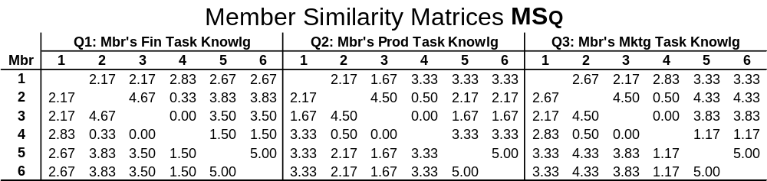
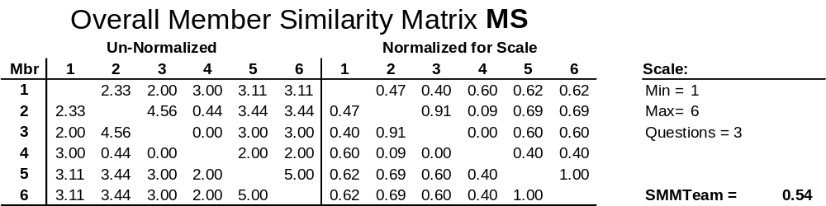
Method: SMMTeam Measure (cont'd.)
ms_{qij} = scale range - md_{qij} → max/0 dist = 0/max similarity
MS = Avg(MS_{q})
Alternative: similarities based on correlation values
Notes:
A

Slide 14
Visual Representation:
SMMTeam Sociograms
1
2
3
4
5
6
Average member rating distance of 2 scale points or less
Average member rating distance of 1 scale point or less

Slide 15
Preliminary Internal Validity Testing
Data
57 teams from CMU's Management Game Course (n=4-6)
Teams manage simulated companies for 10 weeks +
No lectures in course, just team competition via simulation
Teams report to a board of directors (external)
3 surveys + financial performance data + 3 board evaluations
Validity
Convergent and concurrent validity [Ghiselli et. al. 1981]

Slide 16
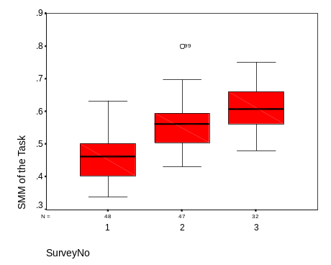
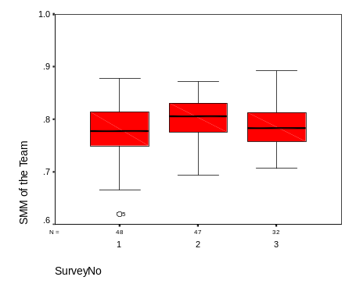
Convergent Validity Results
It measures what we wish to measure [Ghiselli et. al. 1981]
1. SMM's should increase over time through team interaction
[Cannon-Bowers et. al. 1993;
Klimosky et. al. 1994]
SMMTask, F=50.902, p<0.001
SMMTeam, n.s., marginally T1-T2
Team interaction: indiv comm frequency rating w/each member
SMMTask, ρ=0.58, p<0.001
SMMTeam, ρ=0.27, p=0.002
2. Stronger SMM's should be associated with more knowledge overlap
3 questionnaire items on perceived knowledge overlap, α=0.75
SMMTask, ρ=0.51, p<0.001
SMMTeam, ρ=0.22, p=0.011

Slide 17
Concurrent Validity
Correlation with variables SMM should affect [Ghiselli et. al. 1981]
SMMs should affect performance by improving team process (e.g., strategy and task coordination) [Klimoski et. al. 1994]
Cohesive Strategy: 6 questionnaire items, α=0.84
  SMMTask, ρ=0.59, p<0.001
  SMMTeam, ρ=0.22, p=0.012
Task Coordination: 9 questionnaire items, α=0.79
  SMMTask, ρ=0.40, p<0.001
  SMMTeam, ρ=0.21, p=0.020
Performance: BOD evaluations, 11 questions, α=0.97
  Cohesive Strategy, ρ=0.373, p<0.001 (more visible to BOD)
  Task Coordination, ρ=0.228, p<0.010

Slide 18
Conclusions
Measures proposed:
Computationally simple
Can be used with correlation, distance or overlap metrics
Model SMM at different levels of detail
Visual representation
Some internal validity
SMMTask has better properties than SMMTeam, possibly:
Not enough time in task for SMMTeam to develop
SMMTeam not as important for this type of task
SMMTeam is strong, but not accurate
Limitations:
Need more thorough validity and mediation testing
Need to test in other contexts
Only two types of SMMs explored
Knowledge (not structure) similarity only

Slide 19
Questions ?

