Slide 1
The Effect of Task Knowledge Similarity
and Distribution on Asynchronous
Team Coordination and Performance:
Empirical Evidence from Decision Teams
J. Alberto Espinosa
American University
Kathleen M. Carley, Robert E. Kraut,
F. Javier Lerch, Susan R. Fussell
Carnegie Mellon University
IS Cognitive Research Exchange Workshop
IS CoRE Barcelona 2002

Slide 2
Motivation
Research interest
IT Support for collaborative work separated by:
  Distance (i.e., geographically dispersed) and/or
  Time (i.e., asynchronous)
Importance
Work is becoming increasingly more separated by time and distance, meditated by IT
Know little
  What are the most effective coordination mechanisms in asynchronous collaborative work
  How can IT help asynchronous teams coordinate their work

Slide 3
Theoretical Foundations
Task
Programming
Coordination by “programming”
Coordination by “feedback”
(i.e., team communication):
  [March et. al. '58;Thompson '67;
  VanDeVen et. al. '76]
Team
Communication
Coordination
Team Cognition:
Experience with the task & each other
Develop team cognition
(e.g., team mental models)
Implicit coordination: members can better plan their actions [Cannon-Bowers et. al. '93; Klimoski et. al. '94]
More mutual knowledge & common ground
[Clark et. al. '91; Krauss et. al. ‘90; Cramton ‘01]
Team
Cognition

Slide 4
A View of Team Cognition
Team Cognition [Cooke et. al. '00]
For individual tasks
Unshared Task Knowledge
Team Knowledge
Team Mental Models
To work as a team
Similarity of Knowledge Content
Similarity of Knowledge Structure
[Cannon-Bowers et. al. '00]
Shared Task Knowledge
Patterns
Task Knowledge Distribution
Team Situation Models
Other Team Cognition

Slide 5
Main Research Question
How does task knowledge similarity and task knowledge distribution affect team coordination and performance?
A Related Question
Does IT have an effect on how shared task knowledge develops in asynchronous teams?

Slide 6
Coordination and Performance
Coordination is the “management of dependencies among members, sub-tasks & resources” [Malone et. al. '90 '94]
Tightly coupled dependencies = coordination helps performance
[Thompson '67; VanDeVen et. al. '76]
If things can be done independently = no need to coordinate
Important to understand which dependencies are key to performance
And how to manage these dependencies more effectively
Management decisions = tightly coupled dependencies among:
  General team activities (e.g., workflow, no duplication of work)
  Functional strategies (e.g., finance, marketing, operations)

Slide 7
Team Mental Models
Team mental models are organized knowledge shared by team members about the task, goals, strategies, team members, etc.
[Rouse et. al. '86; Cannon-Bowers et. al. '93; Kraiger et. al. '97; Klimosky et. al. '94]
Little empirical evidence on the effects of team mental models [Mathieu et. al. '00; Stout et. al. '99]
Little agreement on the construct and how to measure
[Cooke et. al. '00; Cannon-Bowers et. al. '00; Mohammed et. al. '01]
All constructs and measures are based on similarity of:
  Knowledge structure (how knowledge is organized) or
  Knowledge content

Slide 8
Task Knowledge Similarity and Coordination
Team members with similar task knowledge:
Have more shared work familiarity (i.e., similar knowledge members have about task related things) – helps performance in complex tasks [Goodman et. al. '88 '91]
Have more accurate explanations and expectations about the task and about each other [Cannon-Bowers et. al. '93]
Can plan and synchronize their own actions with the team based on “unspoken assumptions about what others are likely to do”
[Wittenbaum et. al., '96]
Are more coordinated [Kanki '89; Espinosa '02]
Have more mutual knowledge and common ground
[Clark et. al. '91; Krauss et. al. '90; Cramton '01]

Slide 9
Task Knowledge Distribution:
The Leader’s Centrality
Too much knowledge sharing may be inefficient
(e.g., overload, misinformation, redundancy, groupthink, etc.)
[Sproull et. al. '91, Wellens '93]
Some knowledge distribution patterns may be more efficient
(e.g., concentrated vs. widely distributed; even vs. uneven)
Leaders tend to pool more unshared task information from other members [Larson et. al. '96]
Knowledgeable leaders act as exchange hubs for knowledge, information, and communication [Wittenbaum et. al. '96]
And can help filter good information before it is exchanged making communication more efficient
[Cohen et. al. '90; Hambrick et. al. '96; Argote et. al. '96; Williams et. al. '98]

Slide 10
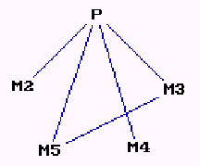
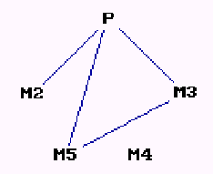
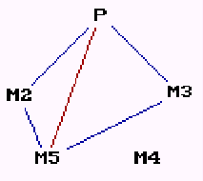
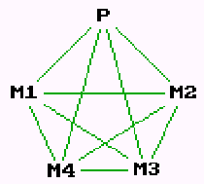
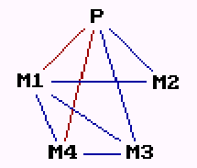
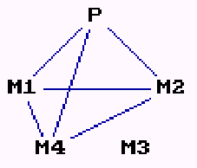
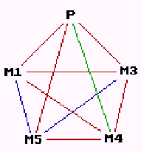
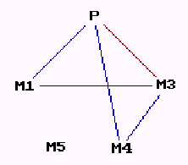
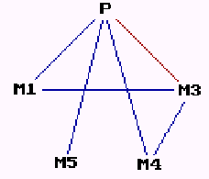
Knowledge Sharing Structures (Hi coord)
T1
T2
T3
Coord Rank= 19
Coord= 5.47
ShTskKn= 4.58
35
5.06
4.50
1
6.89
5.67
Team 1
Coord Rank= 13
Coord= 5.72
ShTskKn= 4.50
40
4.92
5.50
2
6.67
6.68
Team 2
Coord Rank= 3
Coord= 6.25
ShTskKn= 6.00
5
6.19
6.08
3
6.63
6.08
Team 3
1
2
3

Slide 11
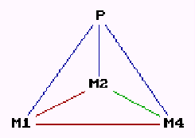
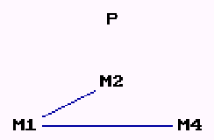
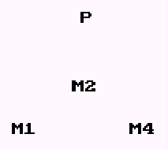
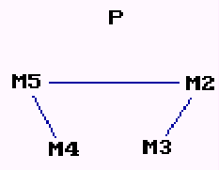
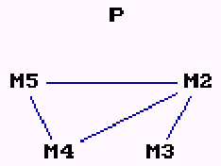
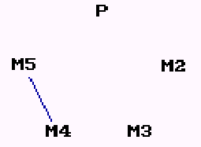
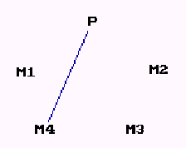
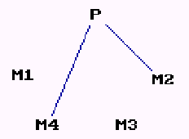
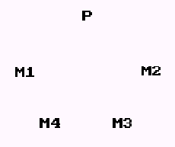
Knowledge Sharing Structures (Lo coord)
T1
T2
T3
Coord Rank= -25
Coord= 5.30
ShTskKn= 4.61
-5
4.47
4.42
-1
4.00
3.67
Team 1
Coord Rank= -14
Coord= 4.89
ShTskKn= 4.00
-14
5.00
4.42
-2
4.22
4.17
Team 2
Coord Rank= -6
Coord= 4.47
ShTskKn= 3.83
-1
3.74
4.74
-3
4.33
4.67
Team 3
1
2
3

Slide 12
Research Framework
Team Communication
Task
Programming
Activity Coordination
Strategy Coordination
Firm Financial Performance
Board Evaluation
Unshared Task Knowledge
H1 (+)
Task Knowledge Similarity
H2 (+)
Leader’s Knowledge Centrality
H3 (+)

Slide 13
Context and Data
Carnegie Mellon’s Management Game 1998
  Decision making task: 14 weeks, multidisciplinary
  MBA student teams managing a simulated company
  Moderate sub-task dependencies
Survey data (3 waves: T1 Apr, T2 Sep, T3 Oct)
  Coordination, communication, task knowledge, etc.
  Approx. 70% response rate, 74% teams w/+3 responses
  Team performance: 3 board evaluations
Objective data
  Team performance: Firm financial performance for 10 simulated quarters (i.e., ROI, profits, stock price)
Close observation of one MG 1998 team

Slide 14
Variables: Performance
Firm Financial Performance
From simulation results
Stock price, ROI and profits
Highly correlated, Cronbach-α=0.90
Average of standardized z-scores
Board Evaluations of the Team
11 team evaluation items completed by each board member
Reliability: Cronbach-α=0.97

Slide 15
Variables: Activity Coordination
9 questionnaire items
Some items from the literature [Kraut et. al. '95]
Some constructed from discussions with MG instructors
Reliability: Cronbach-α = 0.79
Examples:
  Team members often disagreed about who should be doing what task
  Team members did their jobs without getting in each others’ way
  Team members often duplicated each others’ work
  I always received the information I needed from others on time

Slide 16
Variables: Strategy Coordination
6 questionnaire items
Constructed from discussions with MG instructors
Reliability: Cronbach-α = 0.84
Examples:
  My team has a clear idea of what our financial strategy should be
  My team members have a clear idea of what our team’s goals are

Slide 17
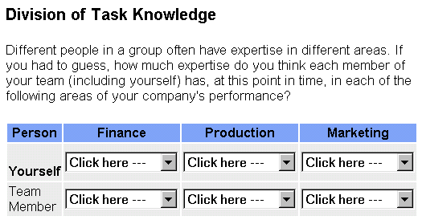
Questionnaire Items
Task Knowledge

Slide 18
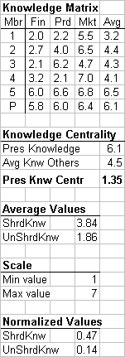
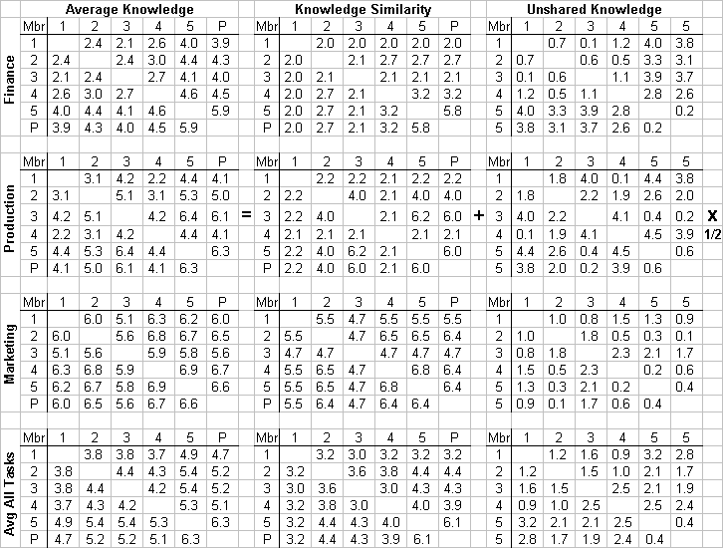
Computation Example:
Shared and Unshared Knowledge
tks_{tij} = min(k_{it},k_{jt})
[Cooke et. al '00]

Slide 19
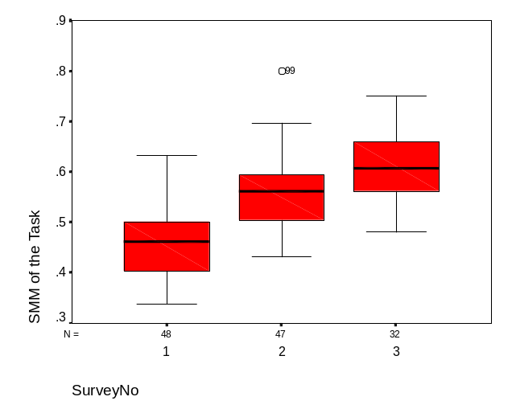
Convergent Validity
[Ghiselli et. al. 1981; Espinosa et. al., AoM 2001]
Shared task knowledge should increase over time through team interaction
[Cannon-Bowers et. al. 1993; Klimosky et. al. 1994]
F=50.902, p<0.001
Team interaction: shared task knowledge develops from frequent communication and interaction ρ=0.58, p<0.001
Shared task knowledge should be associated with team members perception of knowledge overlap
  3 questionnaire items on perceived knowledge overlap, Cronbach-α=0.75; ρ=0.51, p<0.001

Slide 20
Variables: Task Programming and Team Communication
Task Programming
Importance of file sharing system
(# WP & PPT files, ρ=0.349, p<0.001)
Division of labor
(extent to which the member played each of 4 roles: leadership, operations, finance, marketing)
Team Communication
Communication frequency, w/each member, aggregated
(30% of actual e-mail, ρ=0.456, p<0.001)
Importance of face-to-face communication, within team, aggregated
Importance of electronic mail communication, within team, aggregated (30% of actual e-mail, ρ=0.381, p<0.001)

Slide 21
Results
Random Effects Regression
Face-to-Face
Communication
(+) p=0.055
Communication
Frequency
(-) p=0.023
Unshared Task Knowledge
(+) p=0.001
(+) Lag
p=0.031
(+)
p<0.001
Activity
Coordination
(-)
p=0.023
(+)
p=0.049
Task Knowledge Similarity
Firm Financial Performance
Board
Evaluation
(+) p<0.001
(+)
p=0.013
Strategy
Coordination
(+)
p=0.002
(+) Lag
p<0.001
Leader’s Knowledge Centrality
(+) Lag
p=0.075
(+) p=0.011

Slide 22
Conclusions
General
Importance of task knowledge (shrd, unshrd & distrib) for coordination
Need to learn how IT can foster effective task knowledge schemes
Coordination and board evaluation lags are (+) and significant
Important: (1) develop coordination early; (2) first impression on board
About Shared Task Knowledge
Sharing task knowl is good
Efficient knowl distr is important too, it may lower cognitive load
Centrally knowledgeable leader helps coordinate strategies, but not activities
Unshared knowledge helps coordinate activities, but not strategies
About Coordination
Not all types of coordination help performance
Important to know which dependencies are key to the task
Strategy coordination helps performance, but
Activity coordination, beyond what is needed to coordinate strategies hurts performance

Slide 23
Limitations
Context:
  On-going and multidisciplinary decision-making task
  MBA student participants
  Mid-term duration of teams
Possible common method variance in some models
Applicability to leaderless teams?
Need better data on use of task programming and team communication tools
More research on other team cognition mechanisms
  Transactive memory & shared knowledge of the team
  Situation awareness: task, presence, workspace
More research on antecedents of shared task knowledge development and how IT affects this

Slide 24
QUESTIONS

