Slide 1
Navigation Group
Week six progress and tasks

Slide 2
Members
Members;
Dennis Bundi.
Charles Otieno.
Kiragu Maina.
Omar Waka.

Slide 3
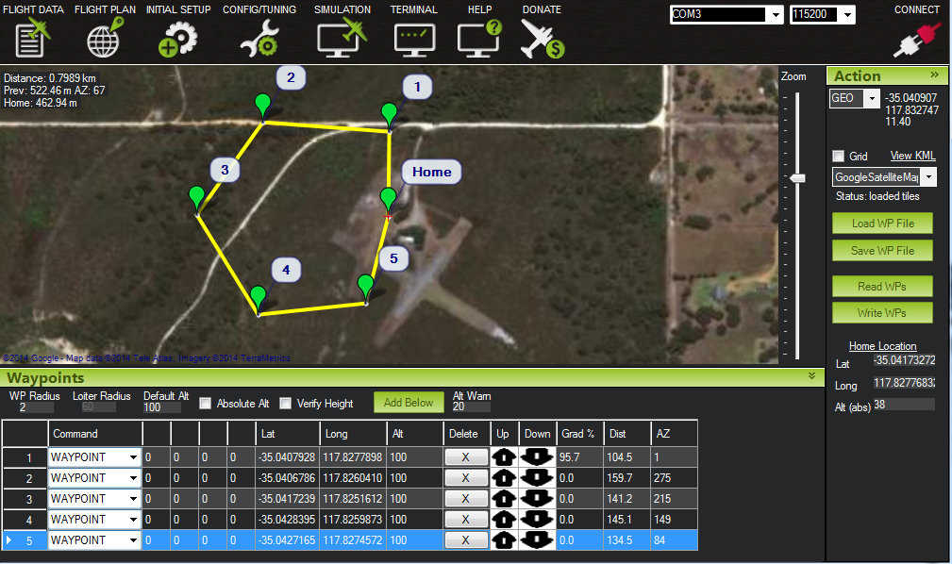
Path Generation Software

Slide 4
Motor Signal generation
Use of GPS coordinates as target points to be fed into the tractor from the internet or via LAN.
Tractor capturing its own GPS signals and generation of the path of best fit between the destination and the current location.
Determine any form of deviation in its current course and adjusts appropriately.
It uses PID (Proportional Integral Derivative) Control loop feedback mechanism for error compensation to get to its final point.
The RaspberryPI microprocessor module will handle most of the calculation and processes and use the Arduino microcontroller to carry out the task.

Slide 5
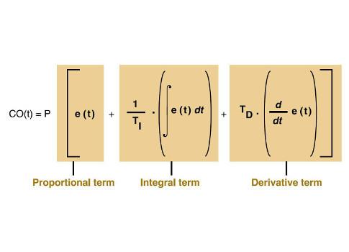
Motor Signal generation

Slide 6
PID links
Link to concept:
https://www.youtube.com/watch?v=IlSaijwwmpQ
https://www.youtube.com/watch?v=wkfEZmsQqiA highly recomended
Unfortunately its not a very easy process.

Slide 7
Agreement on Operation with Agrics team

Slide 8
Necessary items
We’ll control the voltage directly from the analog output of the arduino controller to vary the speed.

Slide 9
Challenges
PID code generation and formulation.

Slide 10
THE END

