Slide 1
Navigation Group
Week Two progress

Slide 2
Members update
We resumed the third week with Eucabeth dropping from the project but got Waka joining us.
Updated list of members;
Dennis Bundi.
Charles Otieno.
Kiragu Maina.
Omar Waka.

Slide 3
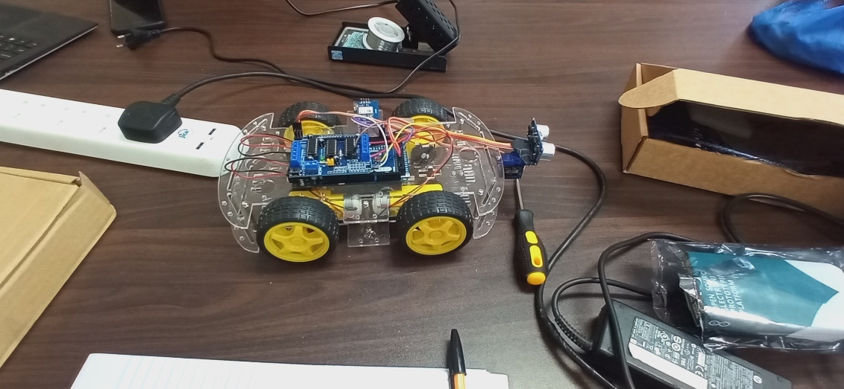
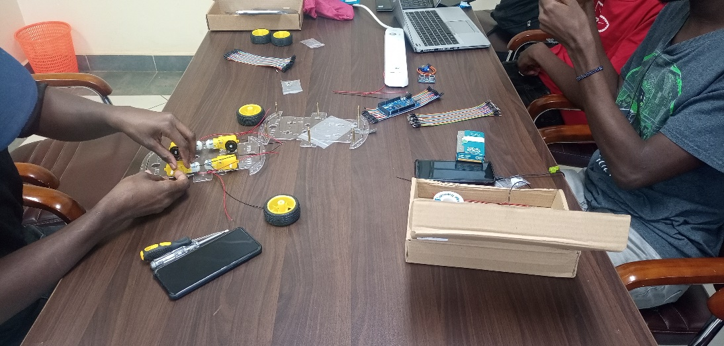
Project test robot assembly
We successfully assembled the test robot and performed tests on the obstacle avoidance course. Uploading of code. And sensor calibration as well as motor driver speed control.

Slide 4
Project Progress
We have successful completed the obstacle avoidance crash tests and moving to the GPS geo-positioning. It is needed to have a magnetometer to give the exact orientation of the robot before inputting of the X,Y,Z co-ordinates.
Hence for the following week progress will be made on the positioning of the robot as the initial instruction and replacement of the obstacle avoidance ultrasonic sensor with the computer vision sensor.

Slide 5
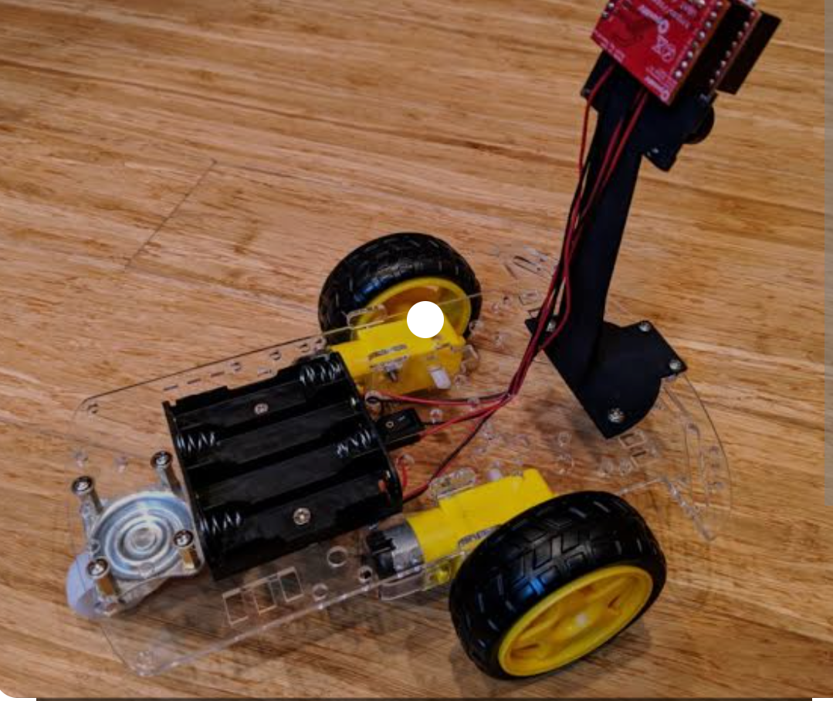
Expected result of the following week.
We expect to include the computer vision after finishing tests on the GPS path finding. Computer vision is an obstacle avoidance sensor program that implores the use of infrared signals to identify objects that have been set in its database.

