Slide 1
Navigation Group
Week Two progress

Slide 2
Members update
We resumed the third week with Eucabeth dropping from the project but got Waka joining us.
Updated list of members;
Dennis Bundi.
Charles Otieno.
Kiragu Maina.
Omar Waka.

Slide 3
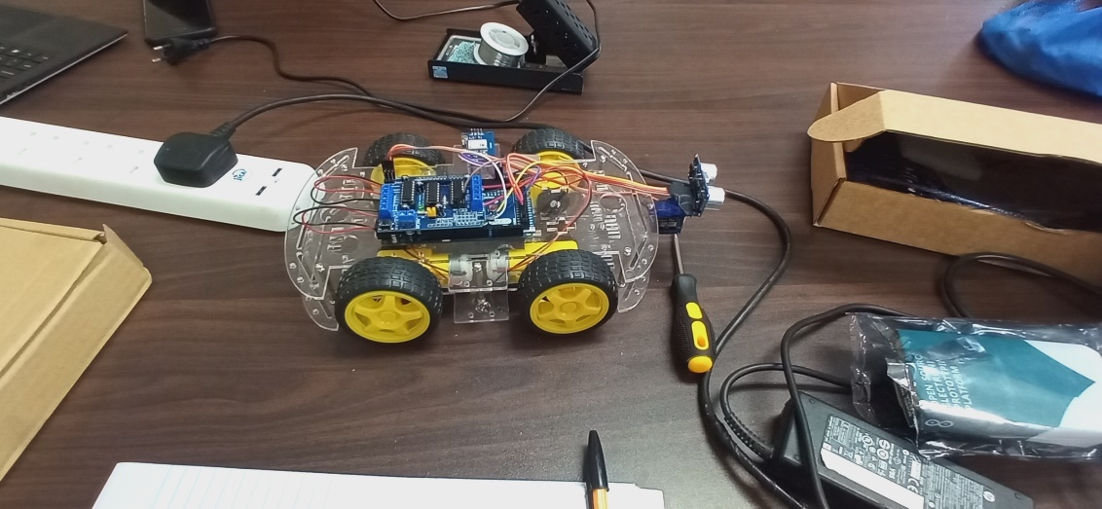
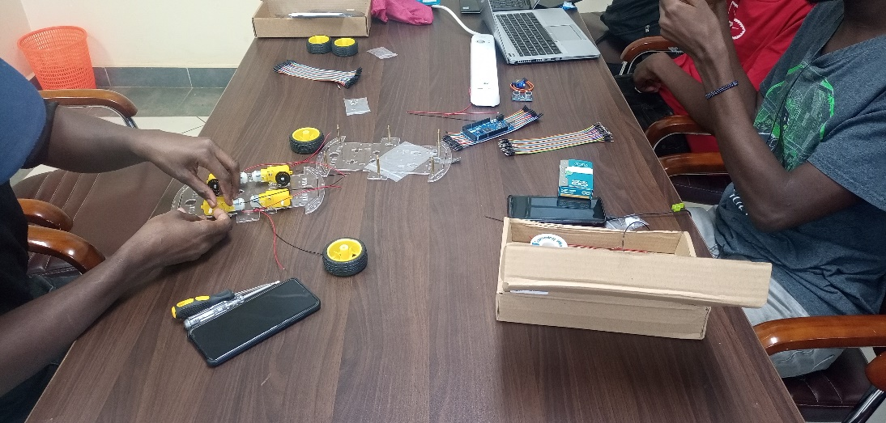
Project test robot assembly
We successfully assembled the test robot and performed tests on the obstacle avoidance course. Uploading of code. And sensor calibration as well as motor driver speed control.

Slide 4
Project Progress
We have successful completed the obstacle avoidance crash tests and moving to the GPS geo-positioning.
It is needed to have a magnetometer to give the exact orientation of the robot before inputting of the X,Y,Z co-ordinates.
Hence for the following week progress will be made on the positioning of the robot as the initial instruction and replacement of the obstacle avoidance ultrasonic sensor with the computer vision sensor.

Slide 5
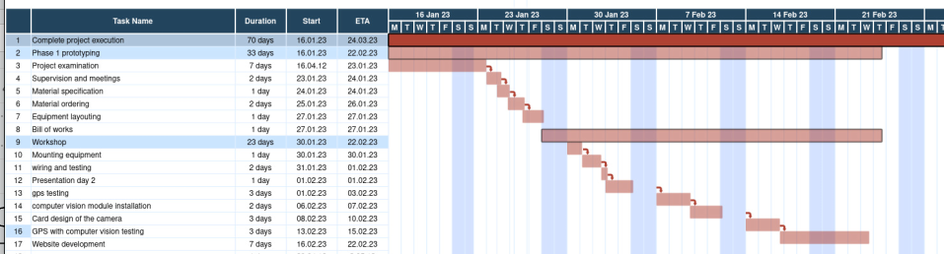
GANTT CHART

Slide 6
Challenges
We could not work with the gps as the magnetometer was missing
We realised the ultrasonic sensor could not work in the area of application.
A more appropriate obstacle detection device would be a camera.
Power. For testing we used a power adapter which limited the robots movement. Rechargeable would be more suited to the task.

Slide 7
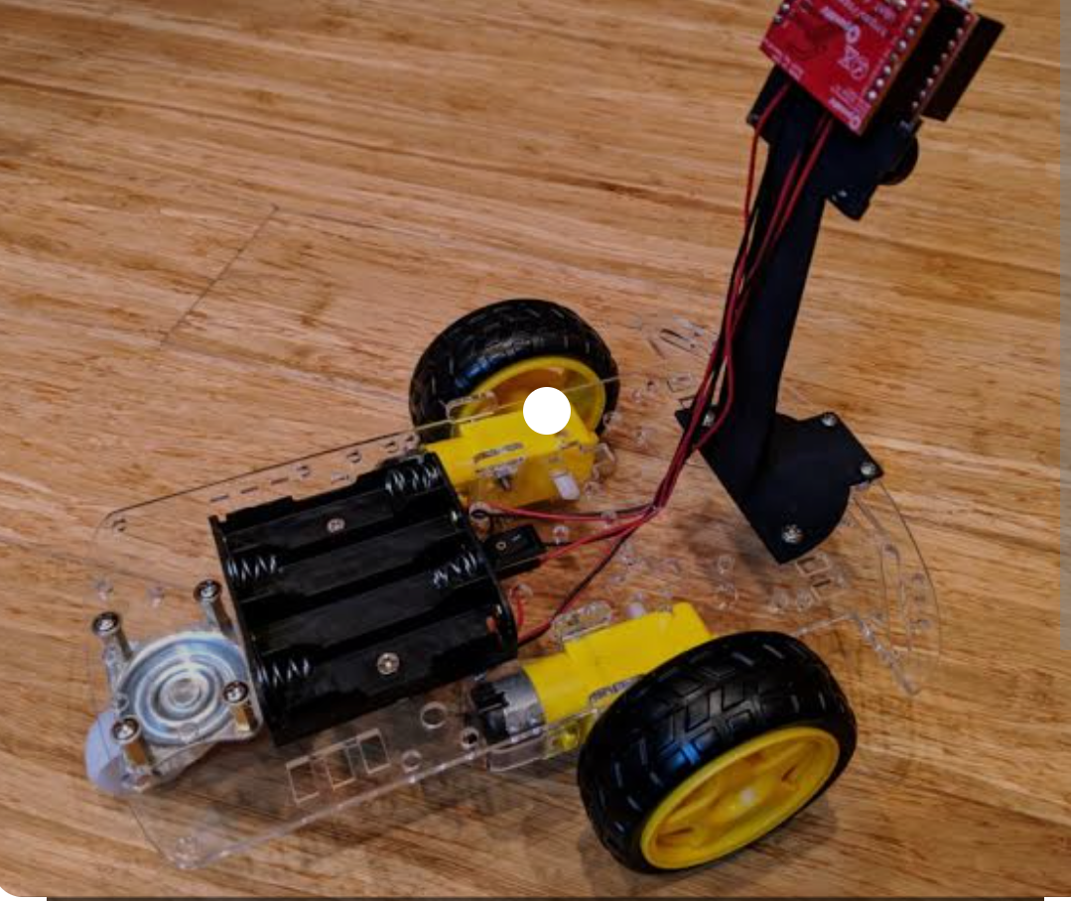
Expected result of the following week.
We expect to include the computer vision after finishing tests on the GPS path finding. Computer vision is a field of artificial intelligence(AI) enabling computers to derive information from image and video inputs.

