Slide 1
Navigation Group
Week SEVEN progress and tasks

Slide 2
Members
Members;
Dennis Bundi.
Charles Otieno.
Kiragu Maina.
Omar Waka.

Slide 3
Objectives:
PID algorithm and solution PID (proportional integral derivative control algorithm) .
Actuators and motor decision...
-Brake
-clutch
-steering
-hydraulic valve

Slide 4
Code Illustration
Due to the complexity of PID (proportional integral derivative control algorithm) ,we sought to find alternatives while still working on PID and eventually came up with:

Slide 5
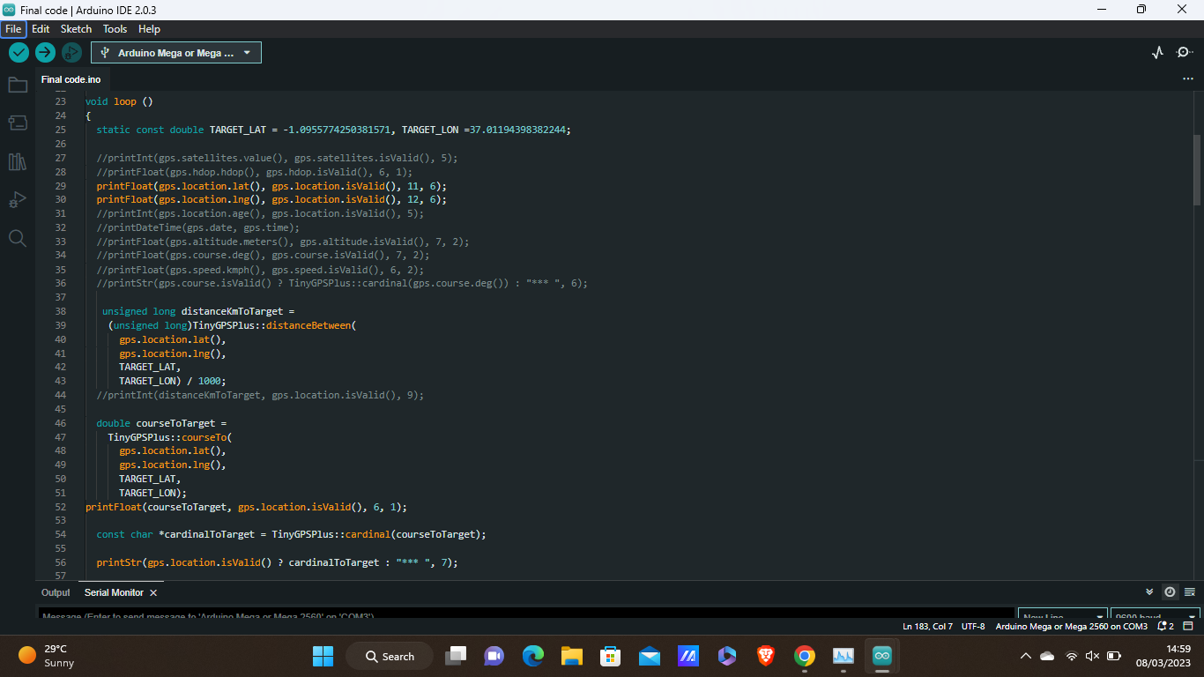
Code Illustration:

Slide 6
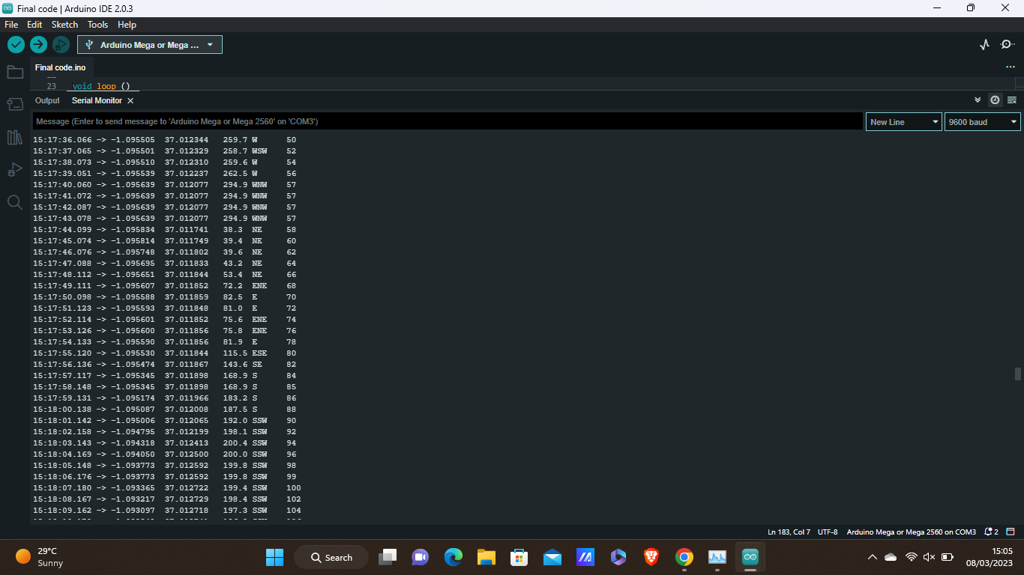
Code Illustration:

Slide 7
Code Explanation
From the first picture, we have the code details of the algorithm of subtracting the two locations to achieve the distance to set TARGET.
The code works around its own algorithm to calculate both the distance and cardinal orientention from the current position to the set TARGET location.
From the second picture, we can observe the reduction of distance and change in orientation from the serial monitor. Upon further increase and maintaining the same coordinates, the distance and orientation remians constant showing the the GPS module is working and actively calculating the distance.
The tests were done within the room and gives improved understanding on how to both stabilise and maneuvre the GPS location within buildings and structures.

Slide 8
Agreement on Operation with Mechanical team
The mechanical team is to do the necessary calculatios for the determination for the properties of our:
1:Braking System implementation...
we concluded to use an electromechanical pneumatic mechanism,pending calculation on the necessary force needed to push the pedal.

Slide 9
Agreement on Operation With Mechanical Team
2:Clutch necessity,This was also concluded that we will use another electro-mechanical pneumatic mechanism.
Pending the necessary calculations.
3:Steering:
based on the mechanical teams calculations ,the general consesu for the necessary force needed to work on the steering while both stationary and in motion,a force generation of atleast 156N/M was needed.
This will be implemented using a 17kg servo-motor.

Slide 10
Necessary items
We will potentially need 3 electro-mechanical Actuators,to be determined after liasing.
A 17kg Servo motor.
List will be ammended again before end of day.

Slide 11
Challenges
PID algorithm code generation and formulation.

Slide 12
Finale
THE END

