Slide 1


Bank of Baroda Hackathon - 2022
Technology Partner
Your Team Name : INFERIO
Date :22/08/22

Slide 2
Problem Statement?
The word “cheque” was evidently originated in the 1700s as a common practice for monetary transactions, certain unique numbers were written on the piece of papers which were checked to keep track of and to proceed with the transaction. Financial transactions using cheques is still one of the widely accepted way across the globe. Almost in every continent, banking institutions have provision for their customers to use cheques for any financial transaction. In 2018, people in techniques. United Kingdom used 346 million cheques for payments and to acquire cash with totalling a value of $442 billion . Although cheque systems in banks for transactions is one of the most powerful tool, primarily due to its slow processing time, considerable complexities in cheque clearing process and gradually with an immense growth in the technology, the electronic-transactions have created a big shadow on the cheque system to cater the need of the banking sector. Therefore, we have proposed a mechanism to make the entire process of bank cheque verification not only fast but also reliable by using deep learning methods and image processing

Slide 3
User Segment & Pain Points
This product will be more useful in the verification of details with costumer and where ever the identification of sign and match the identity of the users identity and sign

Slide 4
Pre-Requisite
OPEN CVV CNN SVM NMMETHODS ARE USED IN THIS PROJECT AND TUHIS CAN BE SEEM TO BE HAVING A COMPETION WITH GOOGLE IMAGES AND DIFFERENT VERIFICATION TOOLS LIFE FORTER ACCERTIFY

Slide 5
Azure tools or resources
AZURE DATABAS AND SECURITY

Slide 6
Any Supporting Functional Documents
The bank cheque verification tool required fulfillment of some key stages in sequential manner. At first, the tool ensured the genuineness of IFSC present on cheque then it verified the cheque number to ensure whether the cheque was from the set of cheque leaflets assigned to the account holder or not. After that, the amount was verified by checking whether the customer was having sufficient amount in his account for which he released the cheque, and finally the signature of the cheque issuer(s) were verified. Only after the completion of these necessary verification steps, the cheque clearance was passed for transfer or withdrawal of funds. The entire process of cheque clearance happened in a sequential manner and each step was mandatory for the next step. Different methods were used for extracting such information from the cheque leaflet that depended on the viability and level of accuracy. For example, to extract information from the machine typographic script, we use OCR method as it tends to produce results with higher level of accuracy whereas for hand-written words and numerical values, we can use deep learning based CNN. Similarly, for authenticating the signature(s), we extracted the features using SIFT algorithm and for classification, SVM produced optimum results. To implement these methods, we required noise free image therefore the better idea was to segment the image so as to acquire only the relevant information.

Slide 7
Key Differentiators & Adoption Plan
ACCORDING TO THE RESEARCH CONTACTED THE SPEED AND ACCURACY IS IMPORTANT BY THE PROPOSSED METHOD WE COULD GET AN ACCURACY OF ABOUT 99.5 % IN TOTAL AN PROCESS WITH A GREAT SPEED

Slide 8
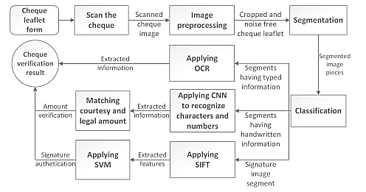
GitHub Repository Link & supporting diagrams, screenshots, if any

Slide 9
Thank You
Jibin Jose

