Slide 1
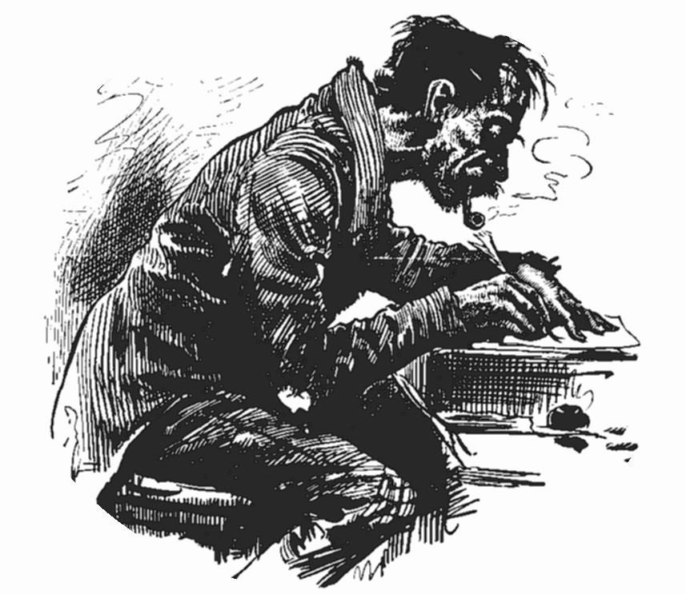
How to Write an Effective Research Article?
Dr. A.A. Mohamed Hatha,
Associate Professor, CUSAT

Slide 2

Research?
An investigation of a topic for the purpose of attaining knowledge
  This may be scientific research through experimentation, or informational research through the location of specific facts.
  In either case, the knowledge will prove or disprove the idea.
Research is looking into a topic with more detail.

Slide 3
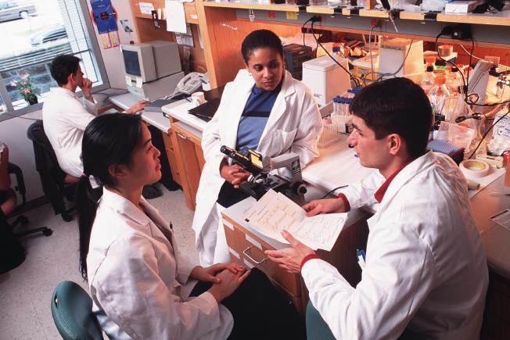
Components of Research
Thinking of the question
Answering the question
Communicating the answer

Slide 4

Research work is incomplete unless the results are disseminated to the wider community.
Publishing is important for
  The author
  His organisation
  His colleagues
  For funding body

Slide 5
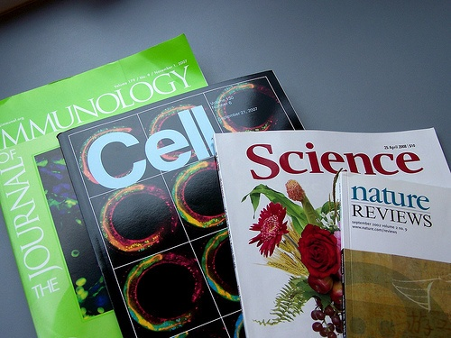
Why should We Publish?
It a good principle – almost a duty – to make results accessible
  It gives the scientific community a chance to find out about your work
  It is a way of paying back the funding body

Slide 6

Why should We Publish?
It improves the authors writing and analytical skills
  The author will attract useful comments and inputs that he may not have thought of
    This will help authors ideas progress and improve his future work

Slide 7
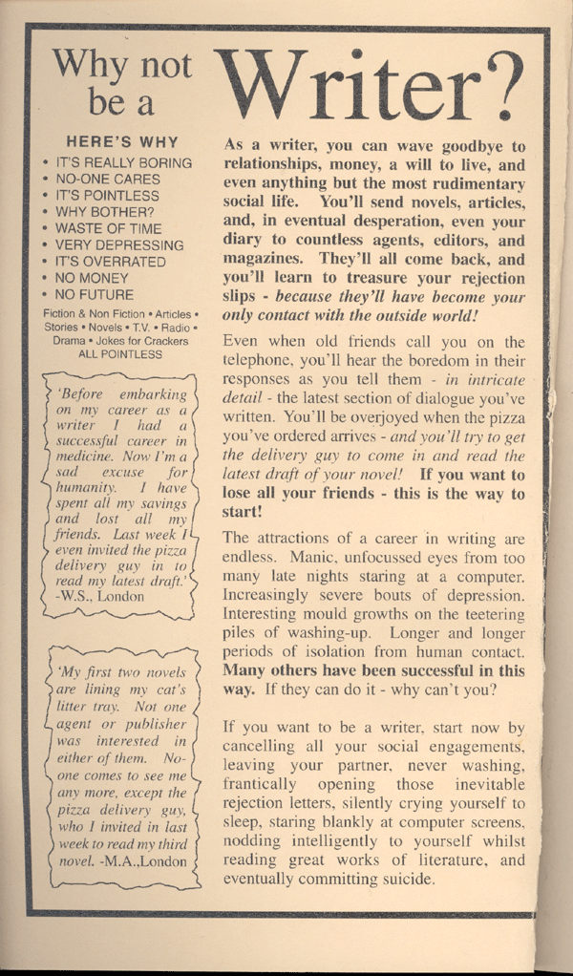
Why should We Publish?
The author and his work will be known in wider scientific community
  Good for his career
  Good for his organisation

Slide 8

Why should We Publish?
Having good track record of publication makes it easier to attract funds or collaborators who may have more funding back up
Publication may also the author to be invited to peer review the work of others or even to join boards

Slide 9
Experience sharing
Dear Mohamed Hatha,
Each year, the quality of articles published in our Ecological journals is secured by the contributions of reviewers such as yourself
Your dedication and commitment is very much appreciated by the Editors of the journals and Elsevier. As a token of our appreciation, should you be attending the 95th ESA Annual Meeting, 1-6 August, being held in Pittsburgh, Pennsylvania, USA, Elsevier and I would like to invite you to a reception we are holding there.

Slide 10

Where to Publish?
Peer reviewed journals
We can also write book chapters, newsletters, magazine articles and web pages
Occasional articles in news papers
  Need to be wise as media can misrepresent

Slide 11
Our Publications – List of few journals
Food Microbiology – Academic Press – Now Elsevier
International Journal of Food Microbiology – Academic Press – Now Elsevier
Journal of Applied Bacteriology – Blackwell Science
Letters in Applied Microbiology – Oxford Publications
Antimicrobial Chemotherapy
Microbes and Environment – Japanese Society of Microbiology
Journal of Water and Health – WHO

Slide 12
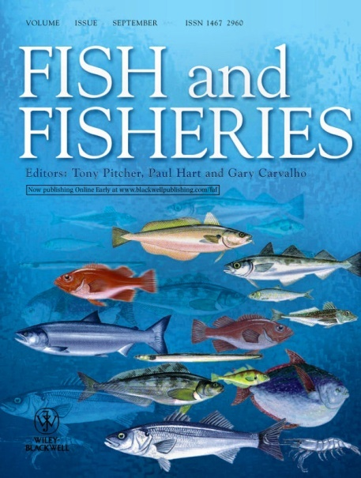


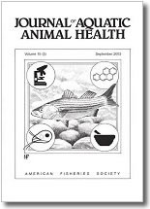
Choosing journal
Different journals cover different subject areas and regions
  Try and broaden horizons
    If published in national journal, then go for regional or international journal next time

Slide 13

Choosing journal
Read journals
  Keep up to date and keep an eye open for where you think your work might fit in

Slide 14
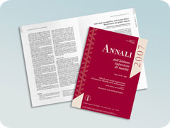
How to publish?
Publishing ones work is a challenge faced by every author
  Becomes easier with each new publication
Many journals will provide instructions to authors
  Follow them completely to the last detail or
  The editor will reject the article straight away

Slide 15
Tips
Study the journal
Use good English
Be realistic
Tell a coherent story
Don’t try too hard to sound important
Make sure the title matches the content
Read lots of papers and learn from them

Slide 16
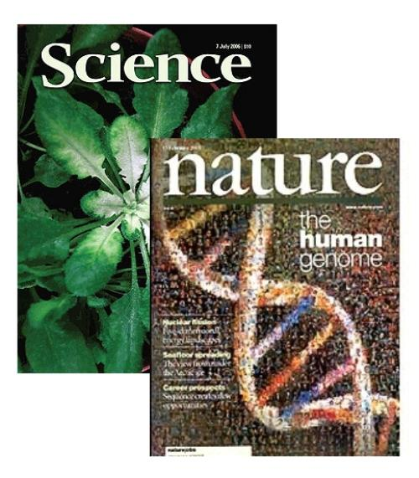
Writing a scientific paper
Why are you writing?
  You made a minor, but very interesting, observation
  You have made useful advance
  You are putting published information into a new context
  You are synthesizing information in a novel way that will be of interest to others

Slide 17
Experience sharing
Quality time required to read and write
  I think the standard of my papers have gone down when I look at my publications during the last few years
    I was busy attracting funds to develop my lab and set up my team
    I could not give quality time to review the manuscripts
    Reading was considerably less (affecting the quality seriously)

Slide 18
The structure of scientific papers
Very crucial aspect regarding scientific papers
Most scientific papers will have four sections at least
  Introduction
  Methods (may be split into field methods and statistical methods)
  Results
  Discussion (results and discussion may be combined)

Slide 19
Title
The title should embody either the aim or the conclusion
Should be catchy
Tip
90% readers will read only
the title and Abstract of your paper
(most people will only read title)
These are therefore the most
Important parts to get right

Slide 20

Abstract
Should summarize your entire paper
  Including your main findings and the importance of your results
  All this should be done using no more than 200 to 250 words

Slide 21
Abstract
The abstract
  Puts your work into context and presents your conclusions
  Tells us what you did
  Tells us what you found out (but doesn’t provide statistics)
  Clearly states the implications of your findings
  Must not exceed the word limit
  Doesn’t include references

Slide 22
Key words
These are what people use when searching for articles in literature indexes
    Some of the key words should be very specific to your topic
They should not be as broad
as ‘Ecology’ or ‘Conservation’

Slide 23
Introduction
This is the first thing that anybody will read
  Grab the readers attention and convince him or her that it is worth reading rest of the paper
  Intro should not be too long
  Should have a logical structure to it and should flow from paragraph to paragraph
Tip – it is very important to remember that the introduction (and indeed the whole paper) should be prepared with the reader in mind

Slide 24
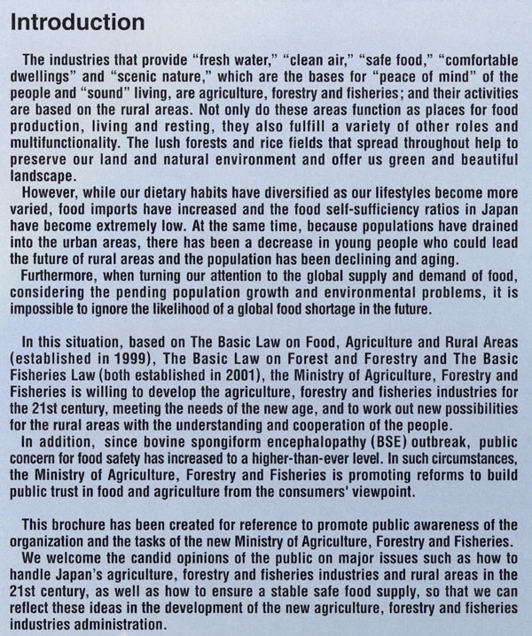
Introduction
If you are preparing for a journal with wide audience then the following pattern should be OK
  Introduce some general aspects in first paragraph
  Second paragraph can go to more specific issues relevant to your study
  Subsequent paragraphs may add more detail or outline particular problems
  Final paragraph should focus on the objectives of your study

Slide 25
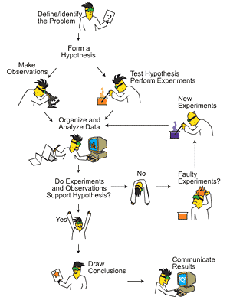
Methods
Should contain enough details to enable someone to repeat the work
  The study area can be a separate section before methods or can be part of introduction
  Maps should be simple, clear and informative
  Mention the statistics/ graphics package that you used to analyse your data

Slide 26
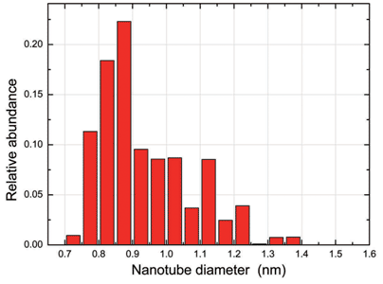
Results
This section presents your results but excludes any discussion
    Figures and tables are usually the clearest way of showing results, compared with text
    Avoid repeating data in table and figures or in tables and text
    Avoid three dimensional graphics

Slide 27
Results
As a rule of thumb
Figures are preferable
to tables

Slide 28

Discussion
This section tells us what your results mean, why they are important and how they fit in with existing knowledge.
Be clear and specific about the interpretation of your results and the interpretations of your work.
You can also point out alternative explanations for your findings and argue why you think your interpretations is the best

Slide 29
Discussion
The final paragraph should tell us your conclusions – what your take home message is
Avoid statements like
“further work is still needed”
in your conclusion

Slide 30

References
List the references that you have cited in the text
  Follow the exact format requested by the journal
  Use bibliographic software if possible

Slide 31
The submission and next steps
Before submission you should give it to
  several of your friends/ colleagues/ boss to read and give constructive criticism – an excellent way to improve your writing skills
Ensure that you followed journals instructions for contributors
  Page layout, tables, figures etc.
Submit electronically if possible
Recommend peer reviewers

Slide 32
The submission and next steps
Your first aim is to sell it to the editor
  Write a polite covering letter in which you summaries why the work described in the manuscript is important and why you are submitting it to the journal
  The editor will decide whether your work is suitable for the journal and then send the manuscript to two or three external reviewers who generally have the following responses
    Reject, accept with minor revisions, accept with major revisions

Slide 33
The submission and next steps
Suggest potential peer reviewers and why you are suggesting them
  Don’t be afraid to suggest people who you feel will be critical of your work. Such people are often most useful
Only 10% of the
manuscripts submitted
are accepted with
minor revision

Slide 34
Tip – What are the most common problems with scientific papers?
The paper is too long
The writing and figures are not clear
The subject matter is not suitable for the journal
It is not well structured
The author has not explained the general interest of the specific issues
The author assumes too much specific knowledge from the reader

Slide 35
Revision
If you are asked to resubmit your paper after revision, you are doing well!
  Take care to deal with every comment and correct everything you agree with
  If you disagree with any comments, state why, and indicate if you have not made the required changes
  If there is time limit set for the revision, don’t delay
  Place comments and responses in table form

Slide 36
Experience sharing
I have lost a valuable publication in International Journal of Food Microbiology by not revising it in time
Current revision in Annals of Microbiology need to be submitted within 30 days

Slide 37
What to do if your manuscript is rejected?
Rejection is fact of life – so don’t take it personally!
  In many journals approximately 30% of manuscripts are rejected without review and a further 20-30% are rejected following review
  Analyze where it went wrong, improve your work and submit it elsewhere

Slide 38
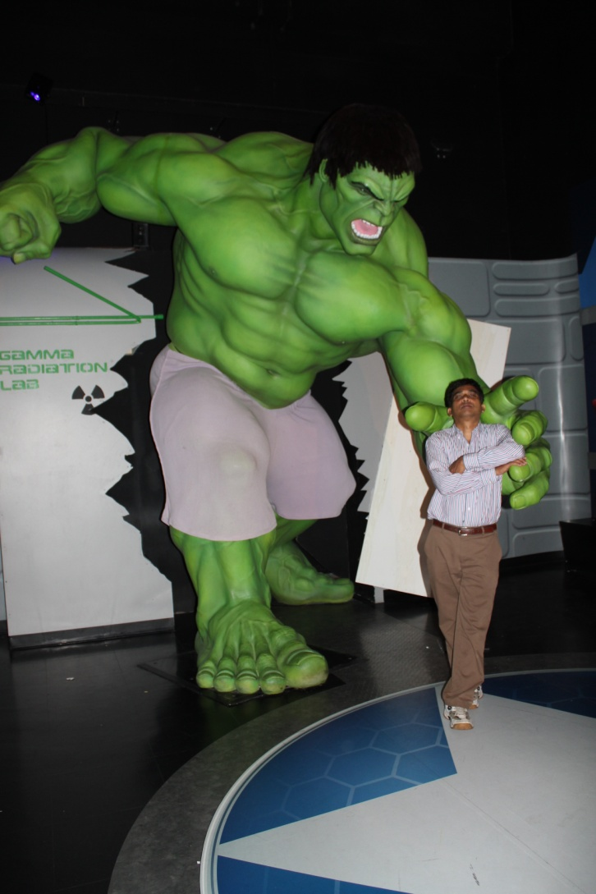
Experience sharing
I had experienced several rejections – but usually with useful tips for improvement
Some bitter experiences too – rejection after favourable recommendation from referees

Slide 39
Writing Skills
There is no correct way of writing and each individual has his or her own style

Slide 40
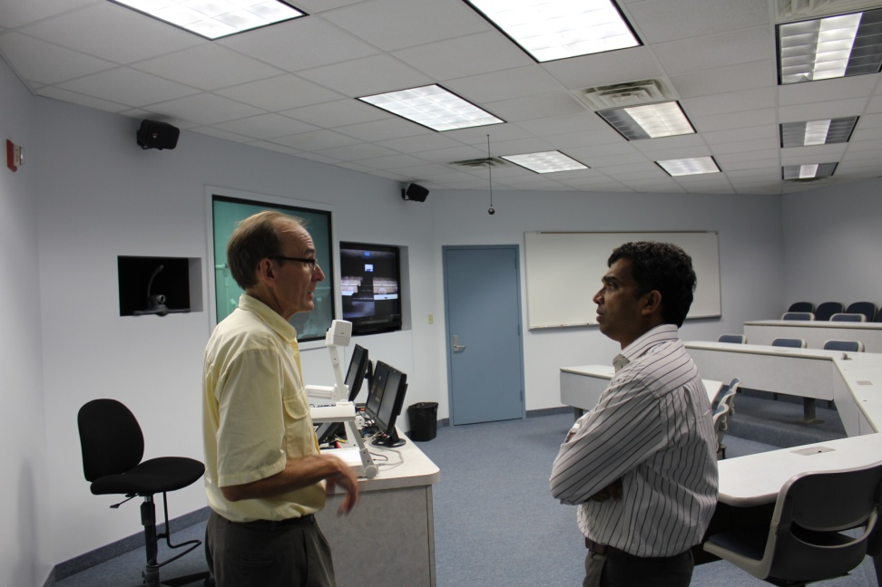
Writing aims
Writing is all about communication
  You are telling people about your ideas and results
Grab the readers attention
  Scientific writing does not have to be boring
There are several good ways to say the same thing
  Use the style that is easiest for you

Slide 41
ABC of writing style
Be accurate
  Science is precise
Be brief
  Use only as many words as you need
    Remove or replace words that are repeated or do ot add anything useful
Be clear
  You will not be there to explain to the reader what you mean
    Give your work to others to read to see if it makes sense

Slide 42
Planning your paragraphs
This is the key to writing logical, structured reports
  Start with generalities and then move towards more specific ideas
  There should be logical connection between paragraphs
  There should be one main theme for the paragraph

Slide 43
Language and Grammar
Use plain words
  Impress the reader with your project, not your knowledge of the dictionary
  Avoid jargon and abbreviations as they may not be widely known
Avoid long sentences
  Long sentences are hard to follow
  Shorter sentences help you write concisely
Be concise
  All journals have strict word limits

Slide 44
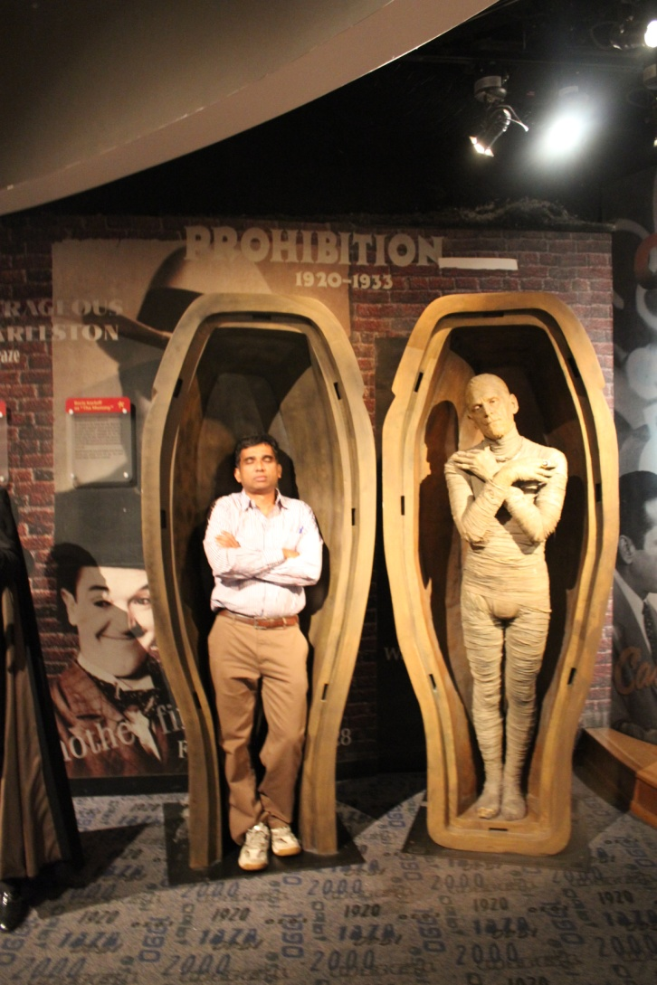
Language and Grammar
Grammar
  You can be good writer without knowing much about grammatical terms
    Simple writing is often easier to follow
  Remember to use the same tense throughout your paper
  Most problems occur in long, complex sentences
    A good reason to keep them short

Slide 45
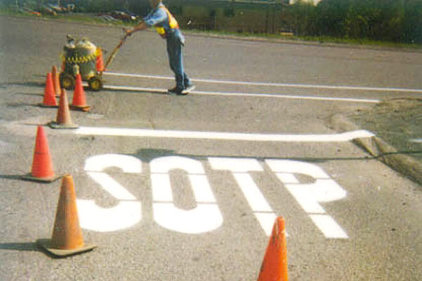
Make it look good
Get rid of all typing and spelling errors
  if your writing looks careless, people may not trust the accuracy of your work
  Use the same definitions throughout
    If you introduce a definition in the methods, then use the same term in the results and discussion

Slide 46
Writing skills – Summary
Concentrate on communicating your work and ideas
Structure your writing by planning your paragraphs
Be concise – use only as many words as you need and no more
Even experienced scientists give drafts of their papers to colleagues to comment on and point out bits that are unclear
  Your final report will be much better if you do this as well

Slide 47
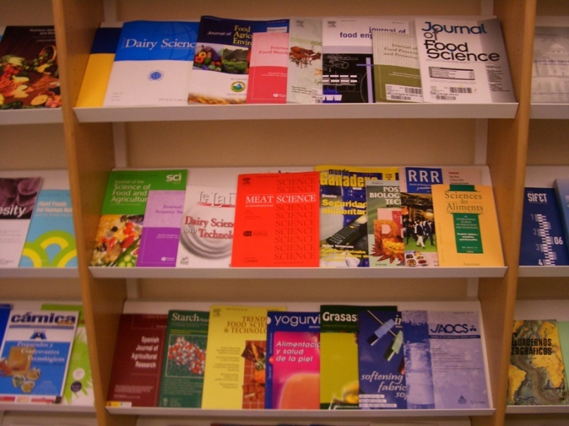
Journals in Fishery Science
Aquaculture
Aquaculture research
Diseases of Aquatic Organisms
Fishery Technology
Fisheries Science
Wild Fisheries Science
Journal of Aquaculture in the Tropics
Aquaculture Environment Interactions
Aquaculture Economics and Management

Slide 48
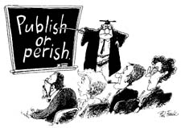
Take Home Message

Slide 49
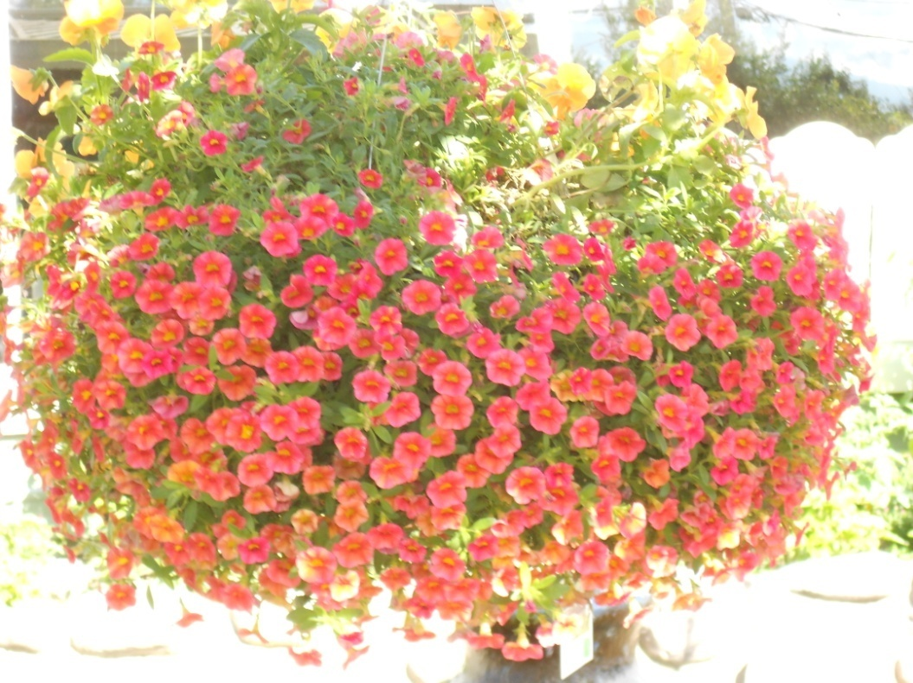
Thank you
Our Research Publications at
https://www.researchgate.net/profile/Mohamed_Hatha_Abdulla?ev=prf_highl
http://scholar.google.co.in/citations?user=oEKULDEAAAAJ&hl=en

