Slide 1

Online Quiz Site
Jibin Joseph
22pmc130

Slide 2

ABSTRACT
The project: ”Online Quiz” developed to overcome the time consuming problem of manual system. Apart from that in current system, checking the answer sheets after taking test, waste the examiners time, so this application will check the correct answer and save the examiner time and carry the examination in an effective manner. Its a collection of number of different types of quizzes like technical, games, sports, etc. User can access all of the quizzes. There is a limited number of questions , also user can see the results.

Slide 3
REQUIREMENTS
Login and registration
Admin Dashboard
Ability to add questions and view the questions
Storing of each results under each user
Previous quiz scores can be viewed on user page
Questions can be given a category
Multiple choice question type

Slide 4
FEATURES AND HIGHLIGHTS
Login and registration : The user will be able to register themselves using Django users. The user will be redirected to the user page after logging in. The admin adds the employee using the Django admin interface. Both admin and user will be redirected to their respective pages after logging in from the interface.
Add user details : The user will be able to add his/her details after logging in and can also update their details whenever they would like to using the interface.
Add questions and view the questions : Admin can add questions and view the questions
Storing results : Each results can be stored under each users
Previous quiz scores : The previous quiz scores can be viewed on user page
Category based : Questions can be given a category
Manage user : admin can see the user details and the results of each users, also admin can see the total number of users, courses and questions
Update user : Admin can update the user details

Slide 5
THIRD-PARTY LIBRARIES
Third-party applications and libraries in Django are pre-built components or packages developed by the community or other companies that you can use to extend the functionality of your Django projects.
Django Jazzmin: Django Jazmin is a customizable and modern admin interface for Django applications. It provides an alternative user interface for the Django admin site with a more visually appealing design and additional features.
Django-widget-tweaks: The primary purpose of Django-widget-tweaks is to enhance the control and customization options for form elements in Django templates. It provides a convenient way to add CSS classes, attributes, and other modifications to form fields without having to write extensive HTML markup or modify form definitions in Python code.

Slide 6
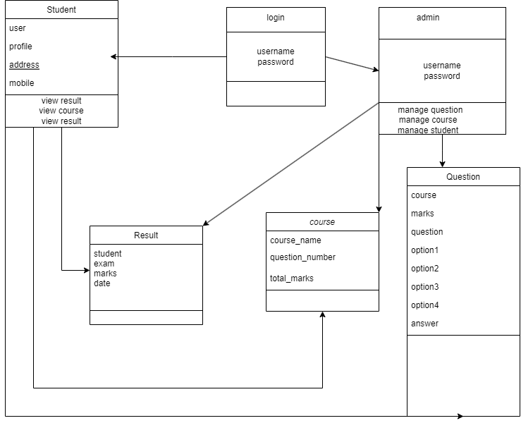
CLASS DIAGRAM

Slide 7

CHALLENGES FACED
The major challenge faced by me was to plan the process flow of the project. While coming to the coding part I had difficulties in adding the courses and questions
User interface design and usability
Testing and quality assurance
Validation Mechanisms
Database Management

Slide 8
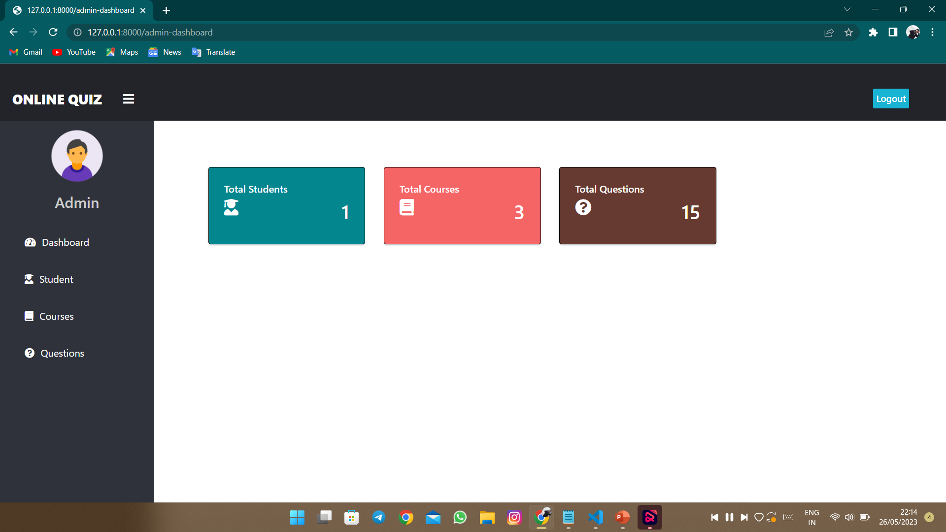
Screenshots

Slide 9
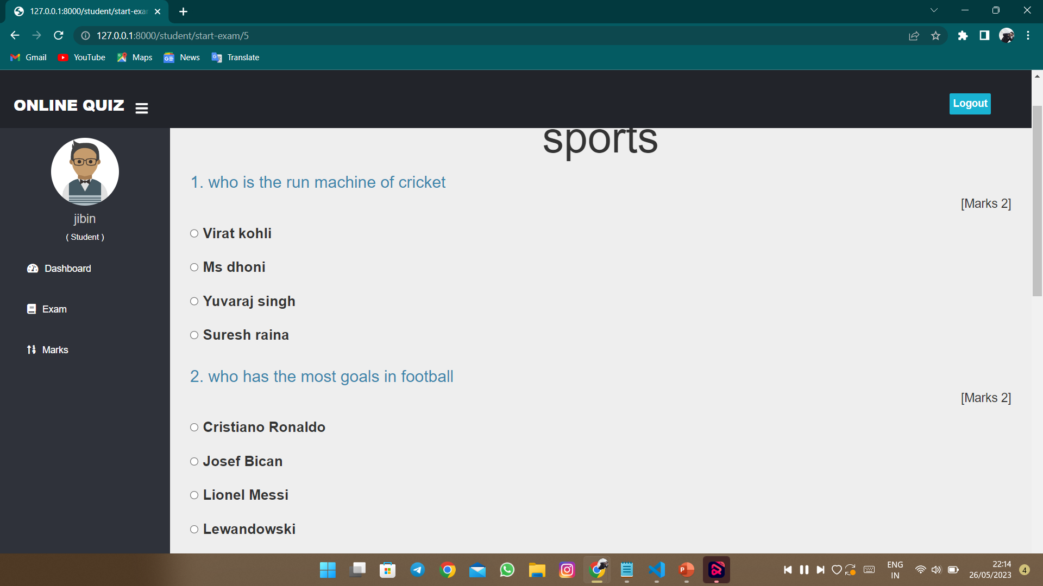
Screenshots

Slide 10
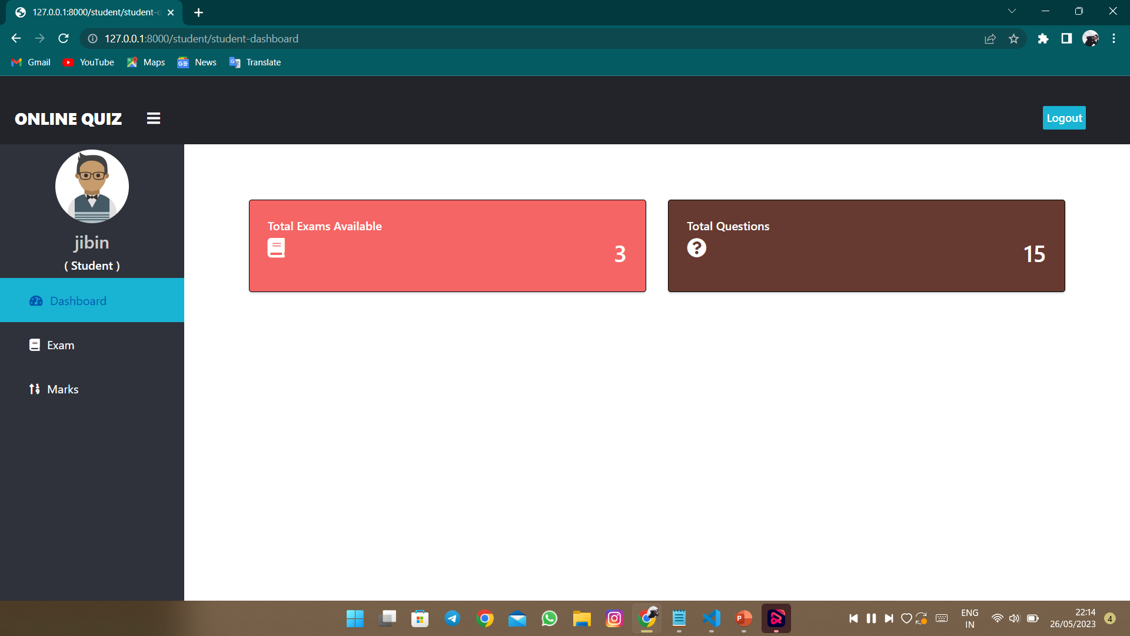
Screenshots

Slide 11
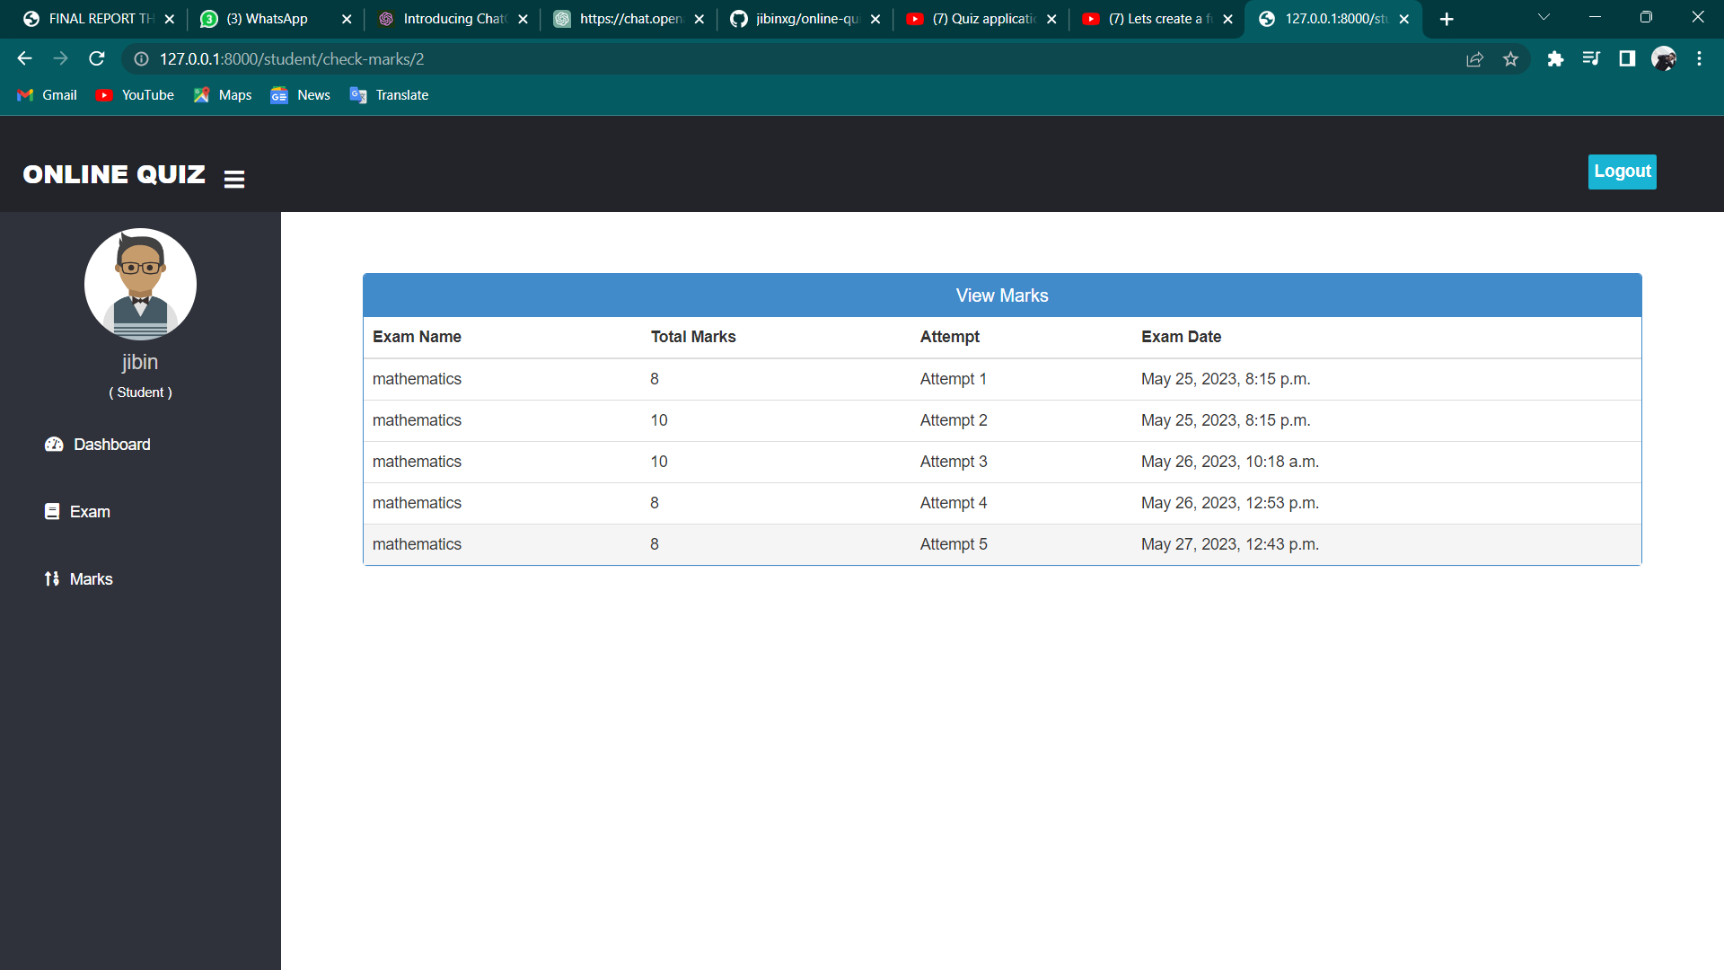
Screenshots

Slide 12
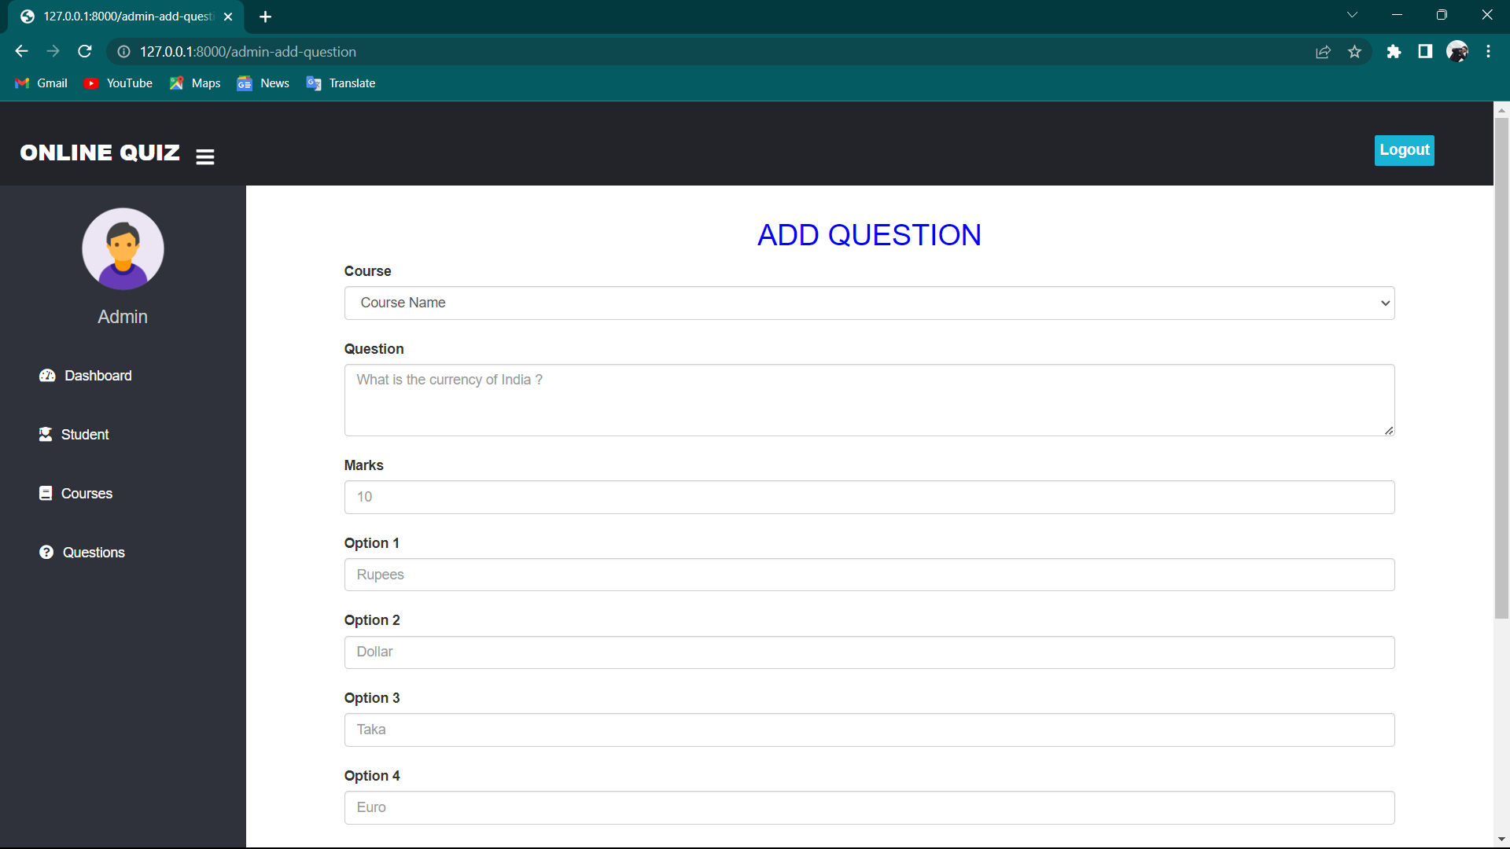
Screenshots

Slide 13
FUTURE ENHACEMENTS
Time-Limited Quizzes: Include the option to set a time limit for each quiz. Students must complete the quiz within the specified time, adding an element of time management and urgency.
Analytics and Insights: Build a comprehensive analytics dashboard for administrators to track and analyze quiz performance, including statistics such as average scores, top-performing quizzes, or student progress over time. This data can help identify trends, strengths, and areas of improvement in the learning process.
Social Interactions: Integrate social features, such as allowing students to share their quiz results on social media platforms or enabling them to challenge their friends to quizzes. This promotes engagement and friendly competition among users.
Mobile application: Introduction of a mobile application can also be done so that this system becomes more user friendly

Slide 14
CONCLUSION
In conclusion, the Django quiz app project presents a robust and customizable platform for creating and managing quizzes. The app allows administrators to add courses, questions, and options, providing flexibility in designing quizzes for different subjects and topics. Students can access the quizzes, attempt them, and receive instant feedback on their performance. This website consist of a user friendly interface from where he/she will be able to attend the quizzess. In summary, the Django quiz app project serves as a foundation for building an interactive and comprehensive platform for quizzes and assessments. With the provided code and suggested future enhancements, the app can be further developed to meet specific requirements and provide an enriched learning experience for users.

Slide 15
REFERENCES
https://www.youtube.com/watch?v=vXXfXRf2S4M&list=PLgjw1dR712jrkldk1GFPQkPsp1RsZ3K1u
https://www.youtube.com/watch?v=mL-G6LZ6ZVs&list=PLVBKjEIdL9buA8BUtYbAyXG9LCzBK7SIa
How to Create a Quiz Web Application with Python Django - DataFlair (data-flair.training)

