Slide 1
CANADIAN ANTI-FRAUD CENTRE · 2021 – 2025
Canadian Fraud &
Cybercrime Analysis
Uncovering patterns in reported fraud, financial losses, and victim demographics across Canada
350K+ reports · 39 fraud categories · 5-year span

Slide 2
PROJECT OBJECTIVES
Why we analyzed this dataset
01
02
03
04
Surface fraud trends
Segment the data
Quantify financial impact
Enable self-service exploration
Explore trends and patterns in reported fraud and cybercrime cases across Canada.
Break down reports by category, province, and demographic group to find where risk concentrates.
Examine reported dollar losses and identify the categories and regions with the highest impact.
Build visualizations and an interactive dashboard to explore fraud trends first-hand.
02

Slide 3
DATA SOURCE
The CAFC Open Government database
Fraud and cybercrime reports submitted to the Canadian Anti-Fraud Centre, published as open government data.
350K+
2021–25
39
Fraud & cybercrime
reports
Reporting window
(Jan 2021 – Sep 2025)
Distinct fraud &
cybercrime categories
FIELDS USED IN THE ANALYSIS
Date received
Complaint & complaint type (Victim / Attempt)
Country & province
Fraud / cybercrime thematic category
Solicitation method
Gender & victim age range
Language of correspondence
Number of victims
Dollar loss
03

Slide 4
METHODOLOGY
From raw reports to insight
01
02
03
Collect
Clean
Transform
Load the CAFC fraud & cybercrime dataset (350K+ records).
Fix data types, rename columns, normalize country / province naming, resolve nulls, duplicates & mis-tagged records.
Derive quarterly time periods and grouped summaries for trend analysis.
04
05
06
Explore (EDA)
Visualize
Dashboard
Investigate distributions, top categories, and links between category, geography & loss.
Build static charts — bar, line, pie, stacked area — to communicate trends.
Ship a filterable Dash web app so KPIs & charts can be explored dynamically.
04

Slide 5
HEADLINE NUMBERS
What the data says, at a glance
$1,500
39
Ontario
30–39 & 60–69
Median dollar loss
(excluding $0 reports)
Distinct fraud &
cybercrime categories
Largest share of reports &
above-average median loss
Most frequently reported
victim age ranges
Source: CAFC Open Government fraud & cybercrime reports, 2021–2025.
05

Slide 6
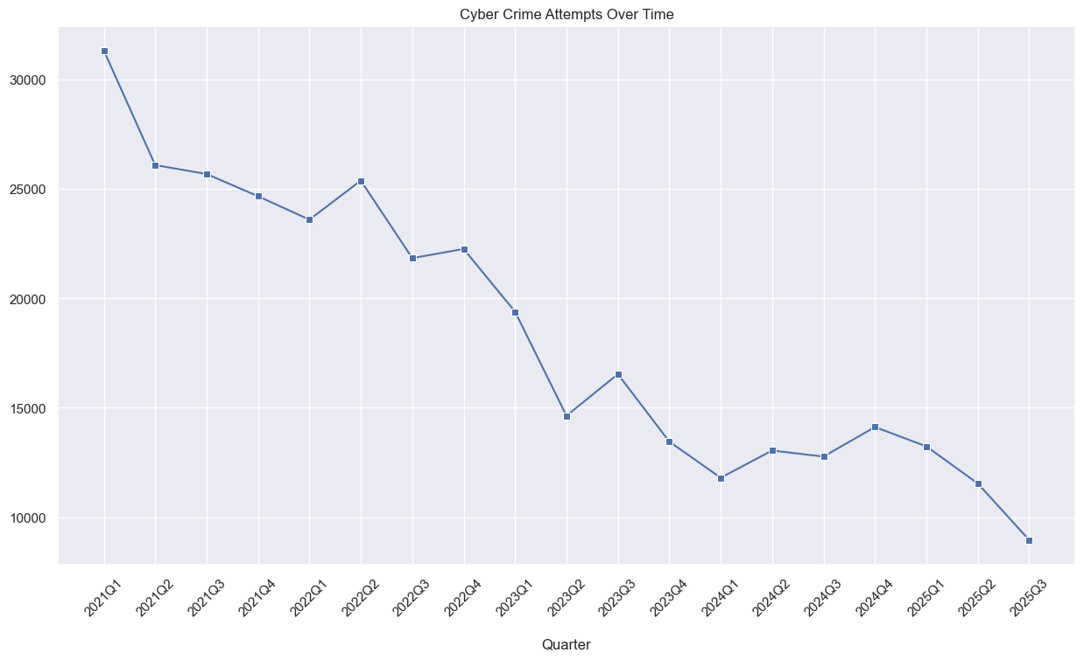
FRAUD TRENDS
Cybercrime attempts, quarter by quarter
INSIGHT
Reported attempts fell sharply from over 30,000 a quarter in early 2021 to under 10,000 by late 2025. The decline has leveled off since 2023, but volumes remain high enough to warrant continued monitoring.
06

Slide 7
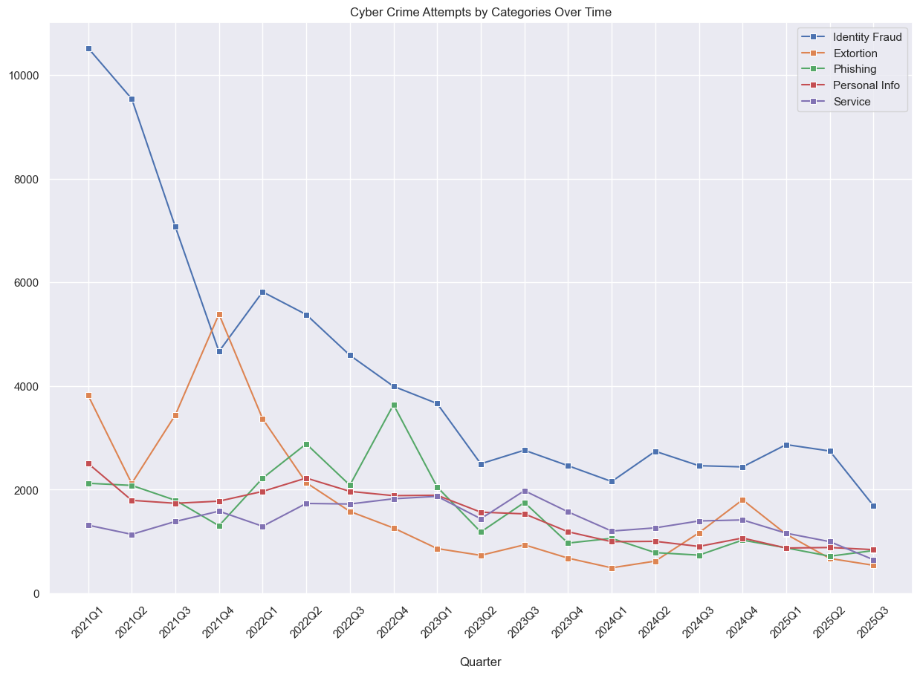
FRAUD TRENDS
The five leading categories, over time
INSIGHT
Tracking the top five fraud categories by quarter shows which threats are accelerating fastest and which have plateaued — critical context for prioritizing awareness campaigns.
07

Slide 8
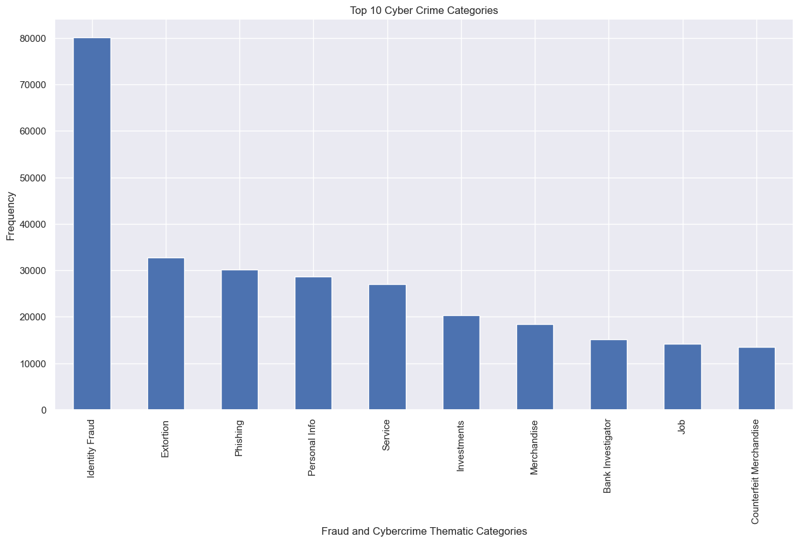
FRAUD CATEGORIES
Which categories generate the most reports
INSIGHT
A small number of categories dominate report volume. Ranking them by frequency highlights where public-awareness resources have the greatest potential reach.
08

Slide 9
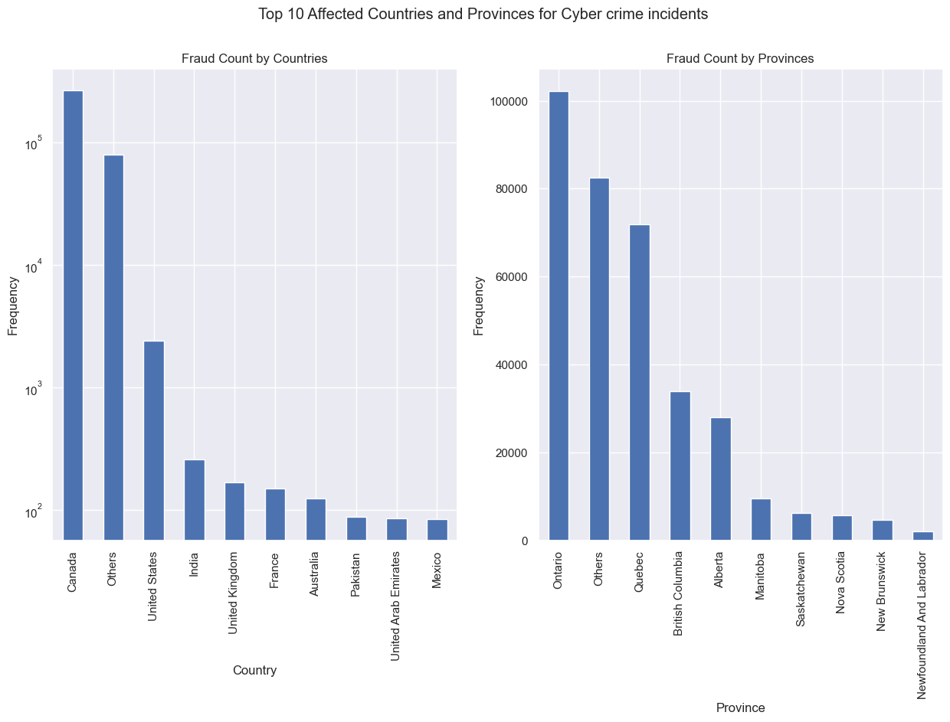
GEOGRAPHIC DISTRIBUTION
Where reports originate
INSIGHT
Canada accounts for the overwhelming majority of reports, with Ontario alone contributing the largest provincial share — and a higher-than-average median dollar loss per report.
09

Slide 10
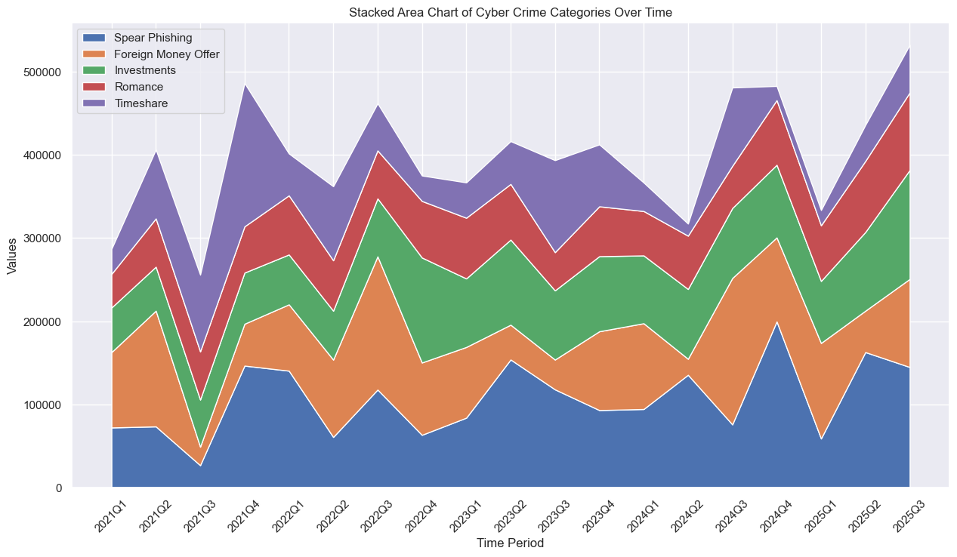
FINANCIAL IMPACT
Financial losses by category, over time
INSIGHT
Investment fraud and foreign money offers drive the largest and most volatile share of reported losses, while romance fraud contributes a smaller volume but consistently high per-victim impact.
10

Slide 11
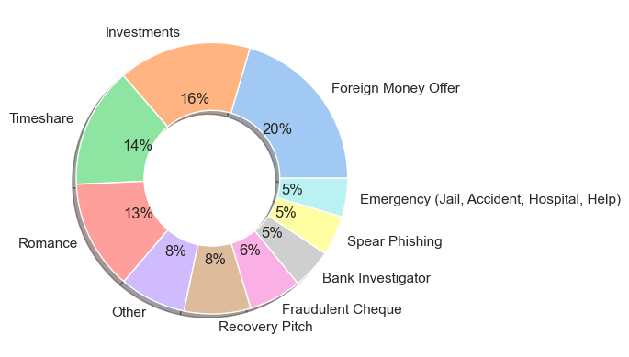
FINANCIAL IMPACT
Highest median financial loss by category
INSIGHT
Foreign Money Offers carries one of the highest median losses of any top category, well above the overall $1,500 median — despite a comparatively lower report volume, making it disproportionately costly per victim.
11

Slide 12
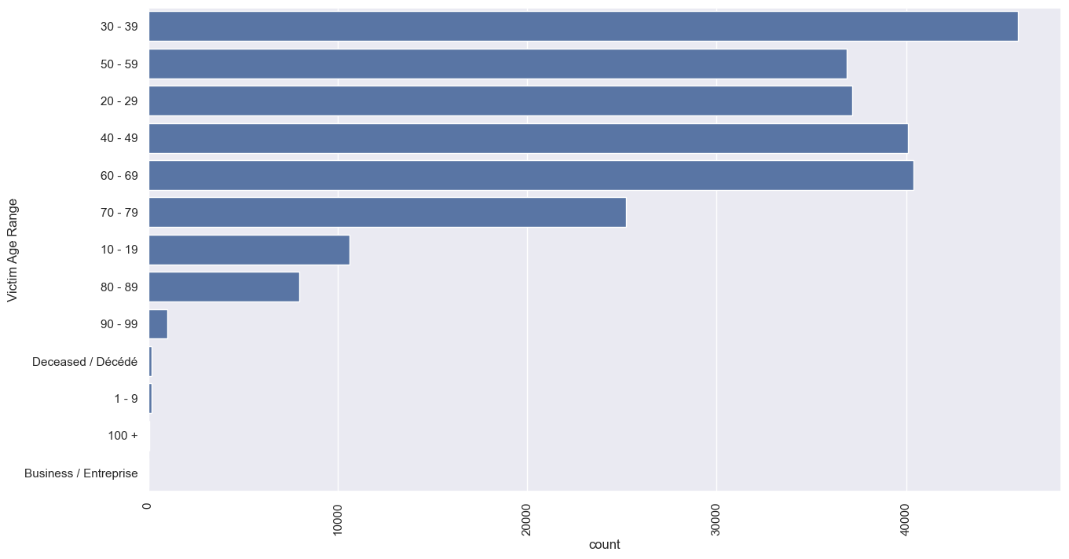
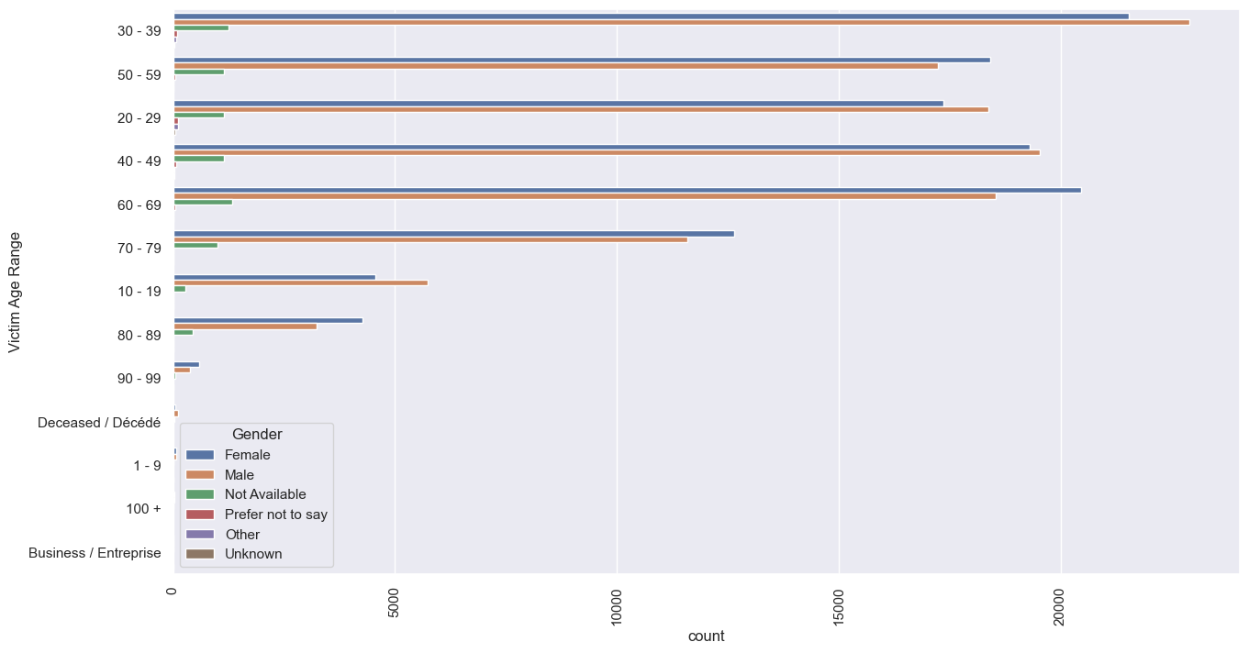
VICTIM DEMOGRAPHICS
Who is being targeted
Reports by victim age range
Reports by age range, split by gender
Insight: Victims most frequently fall in the 30–39 and 60–69 age ranges, with reporting volume and gender split varying notably between them — suggesting different fraud tactics target different life stages.
12

Slide 13
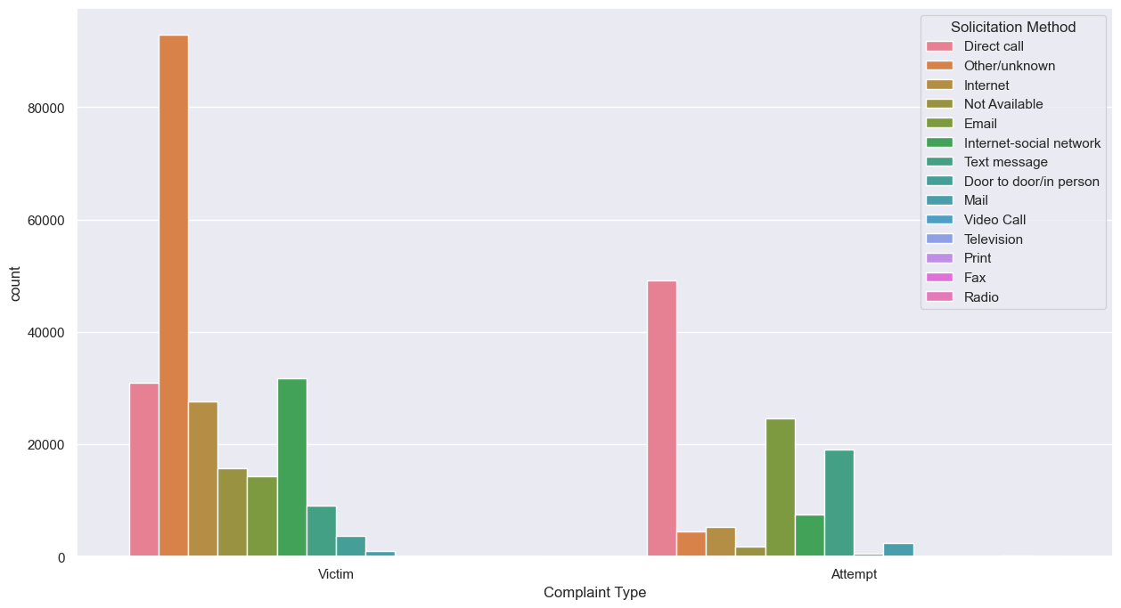
COMPLAINT PATTERNS
Victim vs. attempt, by solicitation method
INSIGHT
Comparing confirmed "Victim" complaints against "Attempt" complaints by solicitation method reveals which outreach channels — phone, email, text, social media — most often succeed versus get caught in time.
13

Slide 14
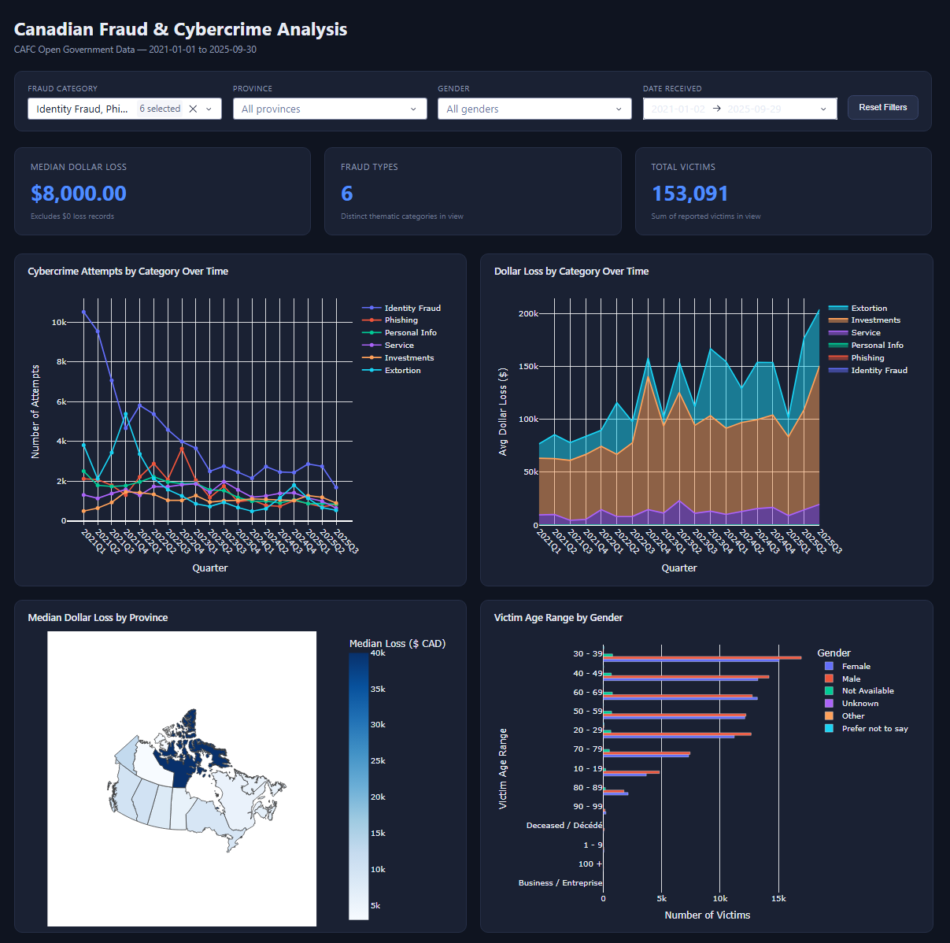
INTERACTIVE DASHBOARD
Explore the data first-hand
KPIs at a glance
Median dollar loss (excl. $0 records), number of distinct fraud types, and total victims.
Cross-filtering
Filter bar — category, province, gender, date range — drives every KPI and chart from one filtered dataset.
Attempts over time
Cybercrime attempts by category, tracked by quarter.
Loss by category
Stacked area chart of dollar loss by category over time.
Provincial map
Choropleth of median dollar loss by Canadian province.
Age × gender view
Horizontal count plot of victim age range, split by gender.
14

Slide 15
SUMMARY
Key insights
1
Losses are highly skewed by category
2
Ontario leads in both volume and loss
Foreign Money Offers carry one of the highest median dollar losses among top categories — well above the overall $1,500 median — despite lower report volume.
Ontario accounts for the largest share of Canadian reports and a higher-than-average median dollar loss, making it a focal point for prevention efforts.
3
Two age bands drive most reports
4
Reported volume has declined since 2021
Victims most frequently fall in the 30–39 and 60–69 ranges, with losses and volumes varying notably by gender within each range.
Quarterly attempts fell from over 30,000 to under 10,000 by late 2025, leveling off since 2023 — a trend worth continued monitoring, not a one-time read.
15

Slide 16
THANK YOU

