Slide 1
PAPER REVIEW · FOUNDATIONS OF INTERPRETABLE DEEP LEARNING
Concept-Based Interpretability
Three Papers, One Throughline
Concept Bottleneck Models -- Koh et al., ICML 2020
Concept Activation Vectors / PCBM -- Kim et al. 2018 / Yuksekgonul et al. 2023
Concept Embedding Models -- Espinosa Zarlenga, Barbiero et al., NeurIPS 2022
X
Z
C
Y
the shared pipeline every paper edits
Prepared by Jibran -- based on the AAAI 2026 tutorial by Barbiero & Espinosa Zarlenga

Slide 2
Roadmap
Every paper below edits the same pipeline -- a raw input x is mapped to a latent z, then to concepts c, then to a task label y. The three papers differ only in how they build c.
X
Z
C
Y
01
02
03
Concept Bottleneck
Models
Concept Activation
Vectors / PCBM
Concept Embedding
Models
Koh et al., ICML 2020
Kim et al. 2018 / Yuksekgonul et al. 2023
Espinosa Zarlenga, Barbiero et al., NeurIPS 2022
Concepts as a bounded scalar bottleneck. Fully transparent, fully expensive.
Concepts as directions already living inside a frozen, pretrained model.
Concepts as a mixture of two learned embeddings -- accuracy and intervenability, together.
Each section ends on a “My Take” slide -- Strengths, Weaknesses, and Modifications -- as the basis for discussion.

Slide 3
01
Concept Bottleneck Models
Koh et al. -- ICML 2020
X
Z
C
Y

Slide 4
01 CONCEPT BOTTLENECK MODELS
The Three Assumptions CBM Is Built On
A CBM routes every decision through k human-named concepts. That guarantee only holds if three conditions are met.
1
2
3
Concept labels are available
Concepts are independently predictable
Concepts are complete
Every training image needs k independent concept labels, not just the final task label -- e.g. Sclerosis, Bone Spurs, Osteophytes, Narrow joint space, each marked yes/no.
Each concept must be determinable from the input alone -- without first knowing the value of any other concept.
The task label must be perfectly recoverable from the concepts alone. The raw input adds nothing once the concepts are known.
Why this matters
Break assumption 1 and concept labels become impossibly expensive to collect. Break assumption 2 and no amount of training fixes a concept that genuinely isn't visible in the input. Break assumption 3 and accuracy hits a hard ceiling no matter how well the label predictor is trained -- compressing a rich input into k discrete scores is a lossy transformation, and lossy compression discards real signal by definition.
Concept Bottleneck Models -- Koh et al., ICML 2020

Slide 5
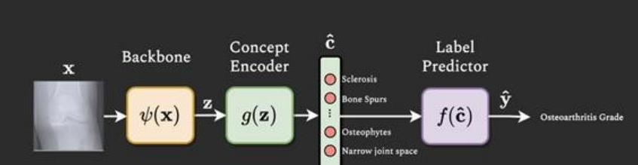
01 CONCEPT BOTTLENECK MODELS
Architecture: Three Back-to-Back Networks
Three ways to train
Why the bottleneck enables intervention
Independent:
concept encoder and label predictor trained on separate, ground-truth-only problems.
Sequential:
encoder trained first, frozen, then predictor trained on its real (imperfect) outputs.
Joint:
one combined loss = task loss + lambda x concept loss, trained together end to end.
The label predictor f sees only c-hat -- nothing from the raw input reaches it any other way. A radiologist can directly overwrite one wrong concept score, and the final prediction updates completely and consistently, because c-hat is the entire story as far as f is concerned. A standard black-box classifier has no equivalent operation available at all.
Concept Bottleneck Models -- Koh et al., ICML 2020

Slide 6
01 CONCEPT BOTTLENECK MODELS
My Take
Koh et al., “Concept Bottleneck Models,” ICML 2020
Strengths
Weaknesses
Modifications
Concept-level transparency --
every input to the final decision is a named, human-understandable concept, never a raw latent feature.
Concept unavailability --
needs k+1 independent label types per example, a categorically more expensive annotation burden.
Centerpiece -- Extend the bottleneck with unsupervised capacity.
= the “Hybrid CBM” (Mahinpei et al. 2021), independently re-derived here. Fixes incompleteness -- but intervenability suffers, since there's no assigned meaning to correct an unnamed dimension toward. Sets up the next paper's question directly: can supervised extra capacity get this fix without the cost?
Decision-level transparency --
with a simple label predictor, the learned weights show exactly how much each concept mattered.
Assumption-2 failure --
some concepts are genuinely undeterminable from a single input alone, however well the encoder is trained.
Intervenability --
a human can directly edit a wrong concept at test time and get a fully updated, consistent prediction.
Concept incompleteness --
compressing to k discrete scores is lossy -- real predictive signal is permanently discarded.
Secondary -- Ensemble of random concept subsets.
Structurally analogous to the Random Subspace Method behind Random Forests. Improves robustness to noisy or inconsistently labeled concepts (not missing ones) -- at the cost of intervention precision, since a correction only reaches the sub-models containing that concept.
Modularity --
errors localize to either the concept predictions or the concept-to-label mapping, not just “wrong, unexplained.”
Computational constraints --
a full concept encoder is trained from scratch each time, rather than reusing pretrained representations.
Concept Bottleneck Models -- Koh et al., ICML 2020

Slide 7
02
Concept Activation Vectors
Kim et al. 2018 / Yuksekgonul et al. 2023
X
Z
C
Y

Slide 8
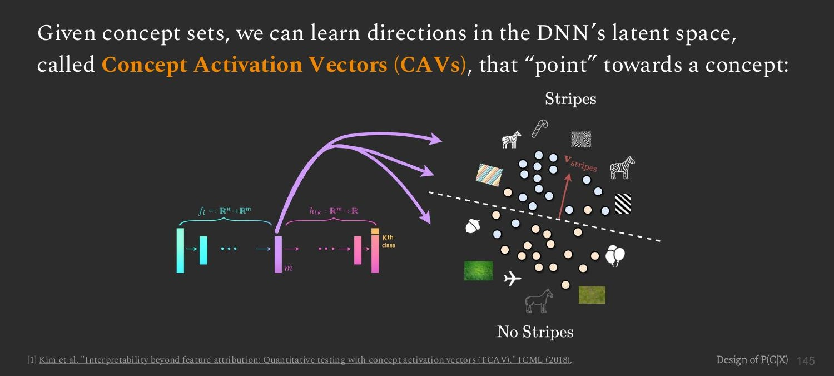
02 CONCEPT ACTIVATION VECTORS
Concepts as Directions, Not Outputs
CBM's computational-constraints weakness motivates a different philosophy: instead of training a concept encoder from scratch, find where a concept already lives inside a frozen, pretrained network.
This is a philosophical break from CBM: a concept is no longer something the network is trained to output -- it's a direction the network already contains, discovered rather than learned.
Concept Activation Vectors (TCAV) -- Kim et al., ICML 2018

Slide 9
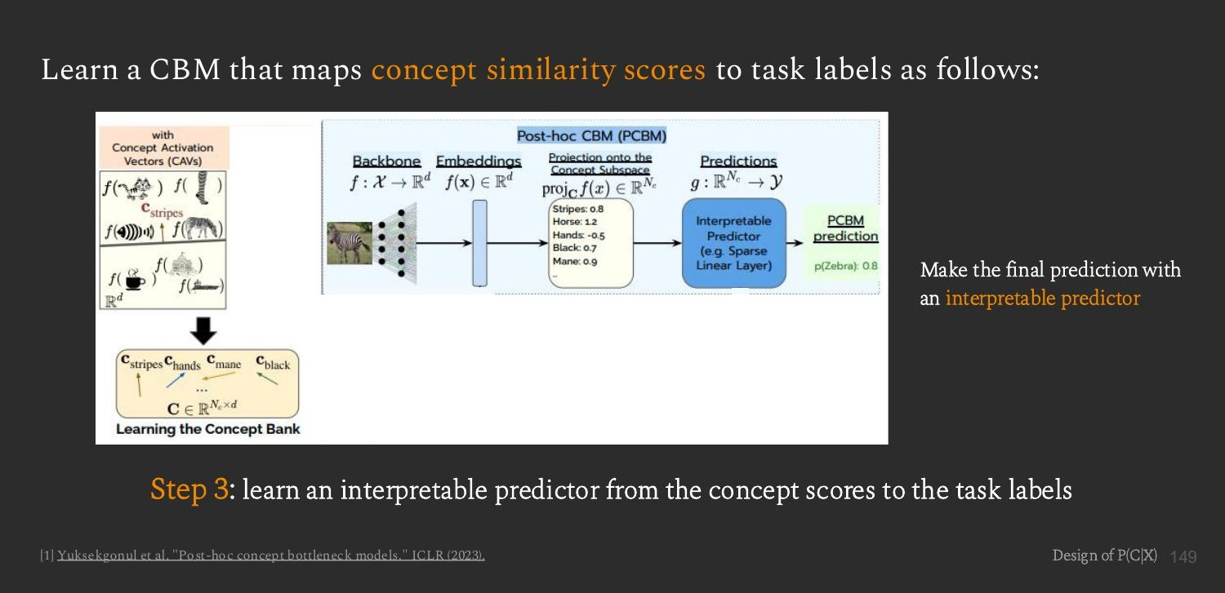
02 CONCEPT ACTIVATION VECTORS
Post-hoc CBM: A Full Pipeline on Top of CAVs
Limitation, stated by the deck itself
Because concept scores are unbounded (not a clean 0-to-1 probability), intervention has to work off the empirical distribution of scores rather than a simple flip to 1.0 -- “interventions are less effective than in bounded scalar representations.”
Post-hoc Concept Bottleneck Models -- Yuksekgonul et al., ICLR 2023

Slide 10
02 CONCEPT ACTIVATION VECTORS
My Take
Kim et al. 2018 (TCAV) / Yuksekgonul et al. 2023 (PCBM)
Strengths
Weaknesses
Modifications
Constant per-concept cost --
a small representative example set defines a concept once; cost doesn't scale with dataset size.
No anchor for intervention --
unbounded scores have no fixed reference point -- correction becomes a fuzzy, distribution-relative nudge.
Sigmoid-calibrate the scores.
Nearly free -- logistic regression already computes this internally. Fixes the anchor problem only.
Exploits existing structure --
concepts are discovered as directions already present in a trained network, not learned from scratch.
Silent failure on nonlinear concepts --
the classifier always fits some direction, even a tangled one, with no signal it's unfaithful.
Balanced, curated example sets.
Targets known confounds; costs the cheap-labeling strength; can't rule out an unanticipated confound.
Retrofittable --
new concepts can be added to an already-trained, frozen, even opaque model after the fact.
Frozen-backbone ceiling --
if the pretrained network never learned the relevant distinction, no projection recovers it.
Swap in a nonlinear classifier.
Fixes linearity -- but breaks TCAV's directional-derivative test, which needs one fixed direction.
Non-invasive auditing --
TCAV probes an already-deployed model's reliance on a concept without touching its predictions.
Confound contamination --
small example sets can bake in incidental shared features, e.g. “outdoors-ness” leaking into “stripes.”
Lightly fine-tune the backbone.
Closes the domain gap -- but gives back the zero-retraining property that made CAV cheap.
Concept Activation Vectors / PCBM -- Kim et al. 2018, Yuksekgonul et al. 2023

Slide 11
03
Concept Embedding Models
Espinosa Zarlenga, Barbiero et al. -- NeurIPS 2022
X
Z
C
Y

Slide 12
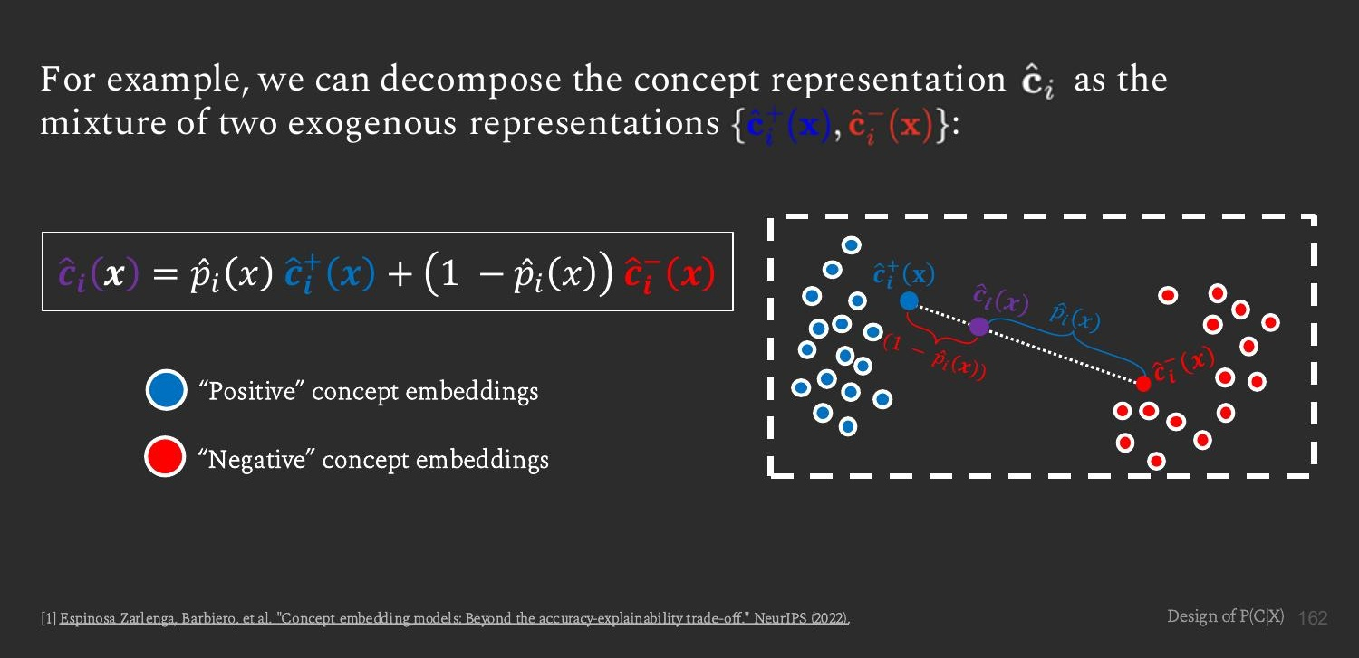
03 CONCEPT EMBEDDING MODELS
Supervised Capacity, Instead of Unsupervised
Recall the Hybrid CBM tension: unsupervised extra capacity fixes incompleteness but breaks intervenability. CEM asks -- can the extra capacity stay tied to real concept semantics instead?
p-hat-i(x) stays a clean, bounded, human-readable number -- but the label predictor now consumes the full mixed embedding, not just that scalar.
Concept Embedding Models -- Espinosa Zarlenga, Barbiero et al., NeurIPS 2022

Slide 13
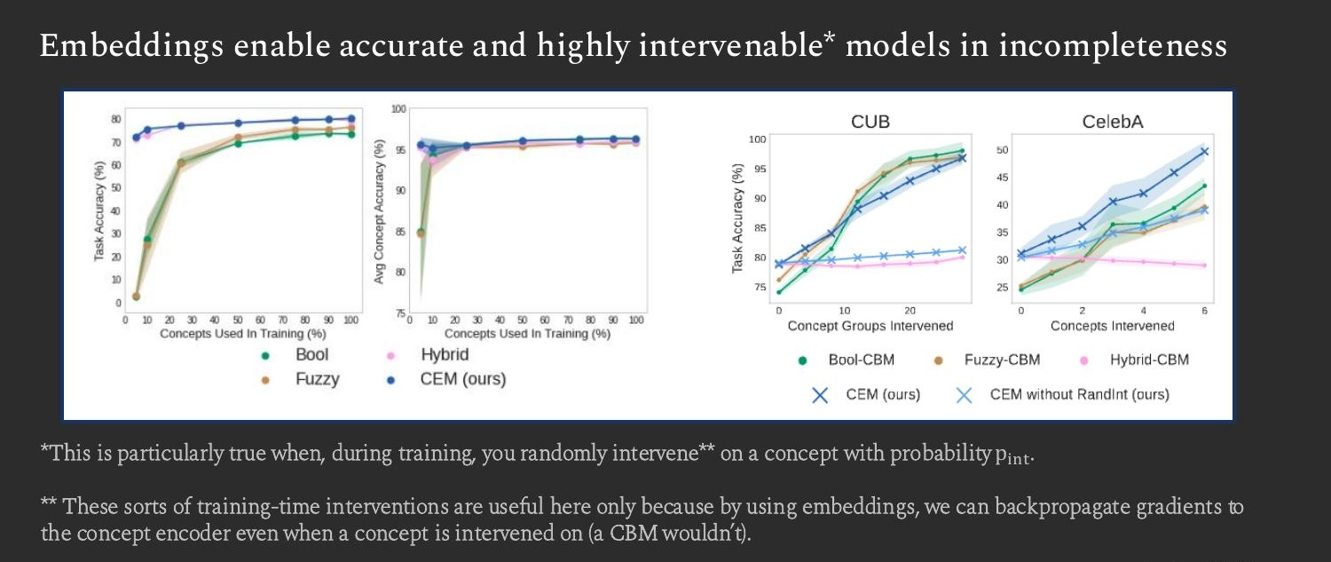
03 CONCEPT EMBEDDING MODELS
The Empirical Payoff
CEM (blue) dominates Bool-, Fuzzy-, and Hybrid-CBM on task accuracy under concept incompleteness, and its accuracy keeps climbing as more concepts are intervened on -- while Hybrid-CBM's intervention curve stays flat, confirming exactly the failure mode predicted earlier in this deck.
Concept Embedding Models -- Espinosa Zarlenga, Barbiero et al., NeurIPS 2022

Slide 14
03 CONCEPT EMBEDDING MODELS
My Take
Espinosa Zarlenga, Barbiero et al., “Concept Embedding Models,” NeurIPS 2022
Strengths
Weaknesses
Modifications
Solves incompleteness without breaking intervenability --
beats Bool-, Fuzzy-, and Hybrid-CBM on accuracy AND intervention-response, not a trade.
Higher parameter and compute cost --
two full embedding networks per concept, not one scalar output.
Open for discussion --
Given CEM's own weaknesses -- cost, reduced transparency, leakage, still-dense labels -- what would you try next?
No answer locked in here on purpose.
Keeps a clean, readable probability per concept --
despite carrying a full embedding forward, each concept still has one bounded, checkable number.
Reduced decision-level transparency --
the predictor now reads high-dimensional embeddings -- CBM's “just read the weights” property is gone.
Training-time interventions become real signal --
random interventions during training actively teach the model to use corrections well.
Still needs dense concept labels --
doesn't touch CBM's labeling-cost weakness, and interventions add a new dependency on labels.
A principled reason it works --
gradients still flow through the concept encoder during intervention -- it's a selection, not a substitution.
Concept leakage --
flagged as an open problem in the tutorial itself: embeddings can absorb information beyond the named concept.
Concept Embedding Models -- Espinosa Zarlenga, Barbiero et al., NeurIPS 2022

Slide 15
The Throughline
Each paper fixes the previous one's weakness -- and introduces a new one.
CBM
CAV / PCBM
CEM
Concept representation
Bounded scalar (learned)
Unbounded scalar (direction)
Mixture of two embeddings
Labeling requirement
Dense, per example
Small representative sets
Dense, per example
Backbone
Trained end to end
Frozen, pretrained
Trained end to end
Intervenability
Strong, exact
Weak, distribution-relative
Strong, exact + trainable
Main open problem
Incompleteness
Frozen-backbone ceiling
Concept leakage
Reading left to right along any row is reading the field's actual research history, one fix at a time.

Slide 16
Discussion
X
Z
C
Y
Which of the three failure modes -- unavailability, incompleteness, leakage -- is hardest to actually fix?
Where would you place a fourth paper on this same throughline?
What would CEM's open “Modifications” column look like, in your view?
Prepared by Jibran -- based on the AAAI 2026 tutorial by Barbiero & Espinosa Zarlenga

