Slide 1
Volunteer Organizer with Management Entity (Vowme)
Supervisor : Sir Muhammad Shahzad.
Jibran Tariq.
ROLL # 14K-3408.

Slide 2

Why Volunteering ?
This act offers a chance to give something back to the community or make a difference to the lives of people around them – for some, it provides an opportunity to develop new skills or gain experience or knowledge that they didn’t have before.

Slide 3
Problem Statement
No. | Problem
1 | Unable to find registered campaigns.
2 | Organizer is getting difficulty to archive the purpose of campaigns.
3 | Volunteer unable to join campaigns due to unavailability of resources.
4 | Unable to get more volunteers for campaigns.
Some people face obstacles in joining campaigns and difficult to find registered campaigns for volunteering.
There is no platform where organizers can register their campaigns and monitor them.
Volunteer unable to complete campaigns due to limited or unavailability of resources.
Unable to Capture more volunteers.

Slide 4
Volunteer’s Campaign Survey

Slide 5
Solution
Organizers
Create campaigns
Monitor Volunteers
Broadcast messages
Volunteers
Able to register in campaigns within their locations
Notification of new registered volunteers
Send request to peer within campaign

Slide 6
Scope of the project
Website interface.
Mobile interface.
Campaigns Creational Feature.
Monitor volunteer thought feedback.
Reporting.
Notification to Volunteers.
Send invitations of registered campaigns.
Track campaigns within area.
Link peer volunteer within campaigns.
Notification to peer volunteer and about new campaigns within area.
Track volunteer hours.
Feedback of Campaigns and peer volunteer.

Slide 7
Project Planning
Phase 1
Requirement gathering
Phase 2
Completed construction work is planned to be rolled out in the final phase of the project including all features
Some provision for Website interface
Remaining Documentation
Build System Architecture

Slide 8
Hardware and Software Specifications
Hardware
Android mobile devices with minimum 1GB ram.
Software
< Android 4.1.x (Jelly Bean) OS
Server least 3.2 GHz processor and 4 GB ram.
XAMPP
Android Studio/Eclipse

Slide 9
Phase 1
Requirement
Documentation
SRS
Discussion with NGOs
Website Interface
Discussion with Supervisor
Create Campaigns
SDS
Approval Volunteers
Report of Current Campaigns.
System Architecture
Design REST based service
Framework Integration with interfaces.

Slide 10
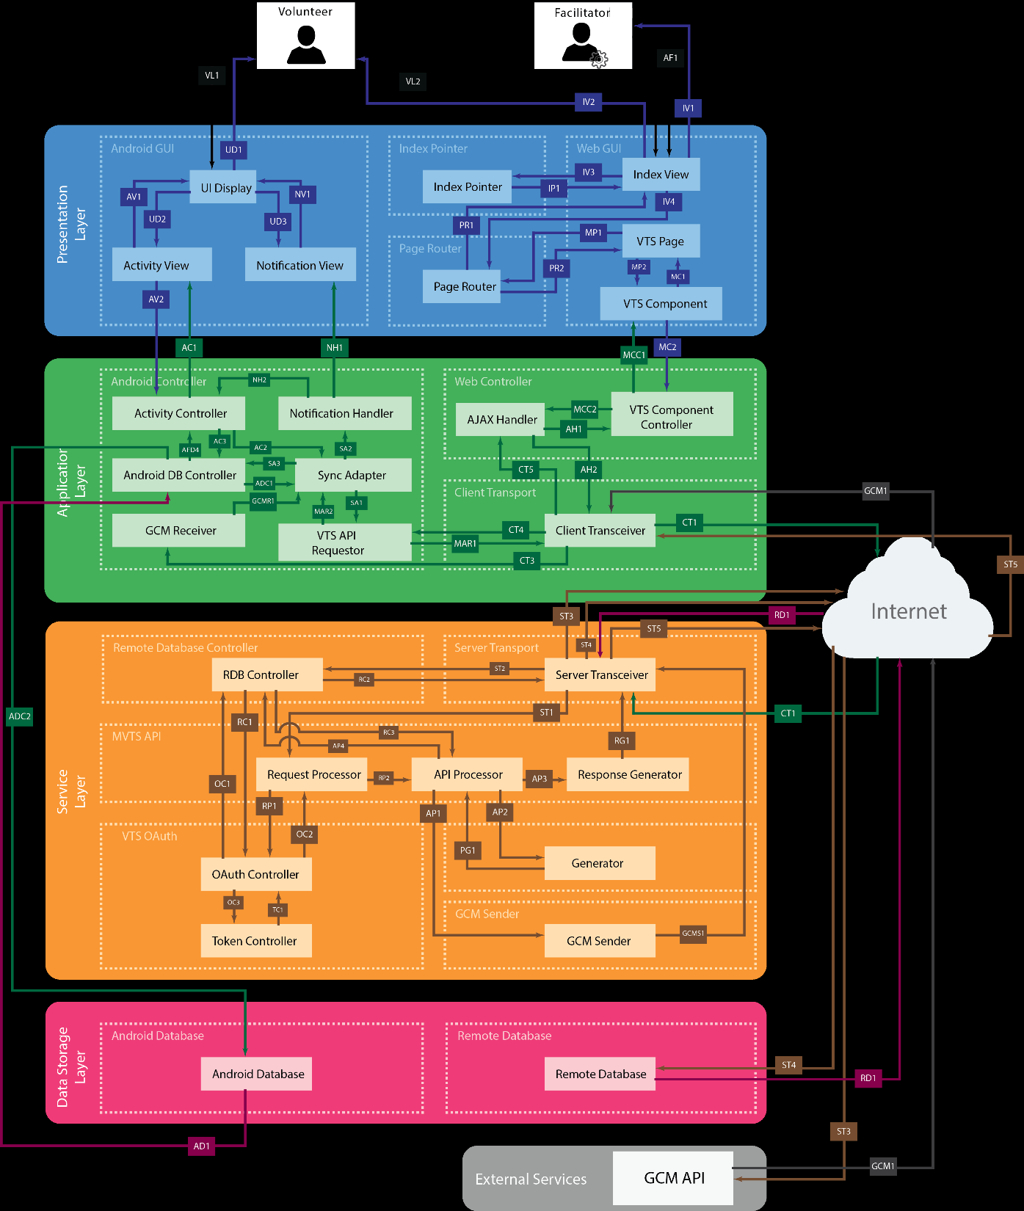
Proposed System
Architecture - 1

Slide 11
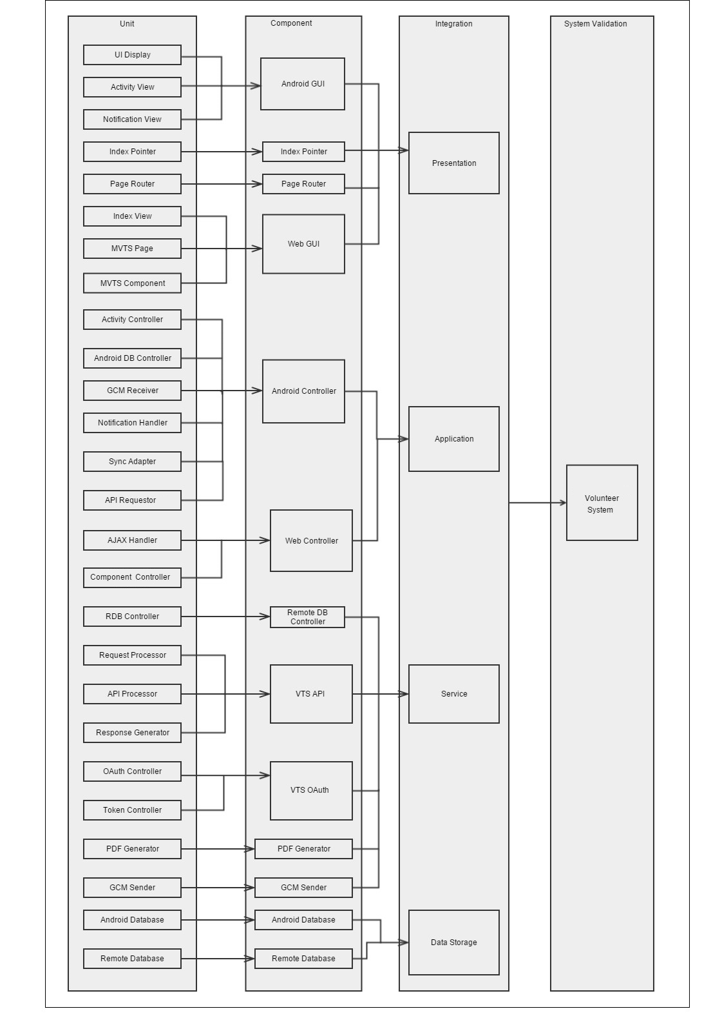
Proposed System
Architecture - 2

Slide 12
Risk Analysis
Risk | Impact | Severity | Mitigation Strategy
Web Server connection fails | User will not be able to connect to the website and the Android App will not be able to connect to the website | High | Ensure UTA’s server is live and functioning
Database access fails | Service is unable to connect to the database to retrieve or send information. | High | Ensure that database connection is properly set up and each request is authorized
Inaccurate Data | Incorrect data being sent to the database can result in inaccurate data being represented | Medium | Ensure the data being passed is accurate by allowing the admin to verify the input
GCM Server connection fails | Android App may not be able to accurately send notifications to the device | Medium | Verify if the App is able to properly connect to the GCM server to send notifications to the device
Adding new requirements towards the end of the project | Can result in new bugs in the system | Medium | Test all affected functions and continue the component and integration testing after each change

