Slide 2
v4

Slide 3
MEET THE LOGO
Our logo represents simplicity, vivacity, agility, scalability and reliability; Values that we believe them as a company.
These guidelines are here to help ensure that your use of the Jibres logo is consistent with the way we present ourselves.

Slide 4
STANDARD LOCKUP
logo
icon
wordmark
Our standard horizontal lockup is our official logotype, consisting of the icon and our wordmark. If you aren’t sure which logo to use in your materials, use this one.

Slide 5
VERTICAL LOCKUP
The vertical lockup can be used when the provided space is square and use of the horizontal lockup will make the logo look too small.

Slide 6
ICON BY ITSELF
Use the icon only when “Jibres” has been well established elsewhere on the page or in the design. When in doubt, use the full logotype.

Slide 7


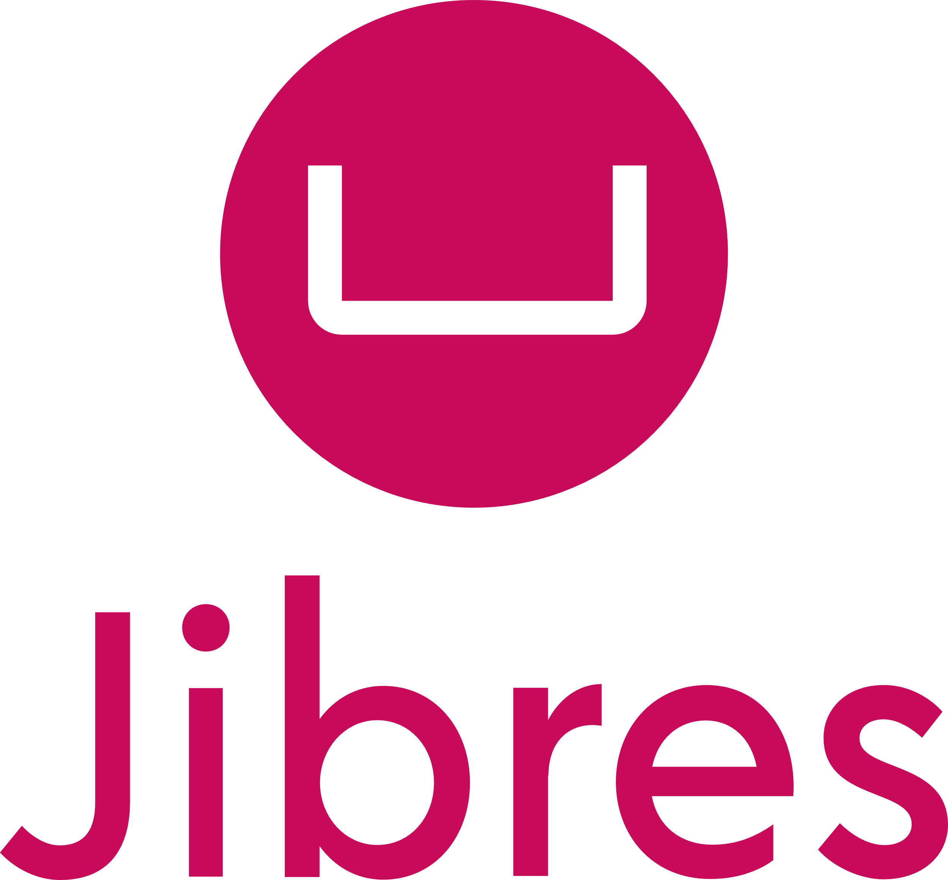
SAFE SPACE
x
x
Safe space acts as a buffer between the logo and other visual elements on a page, including text.
This space is the minimum distance needed and is equal to third the height of the icon.
x
x

Slide 8


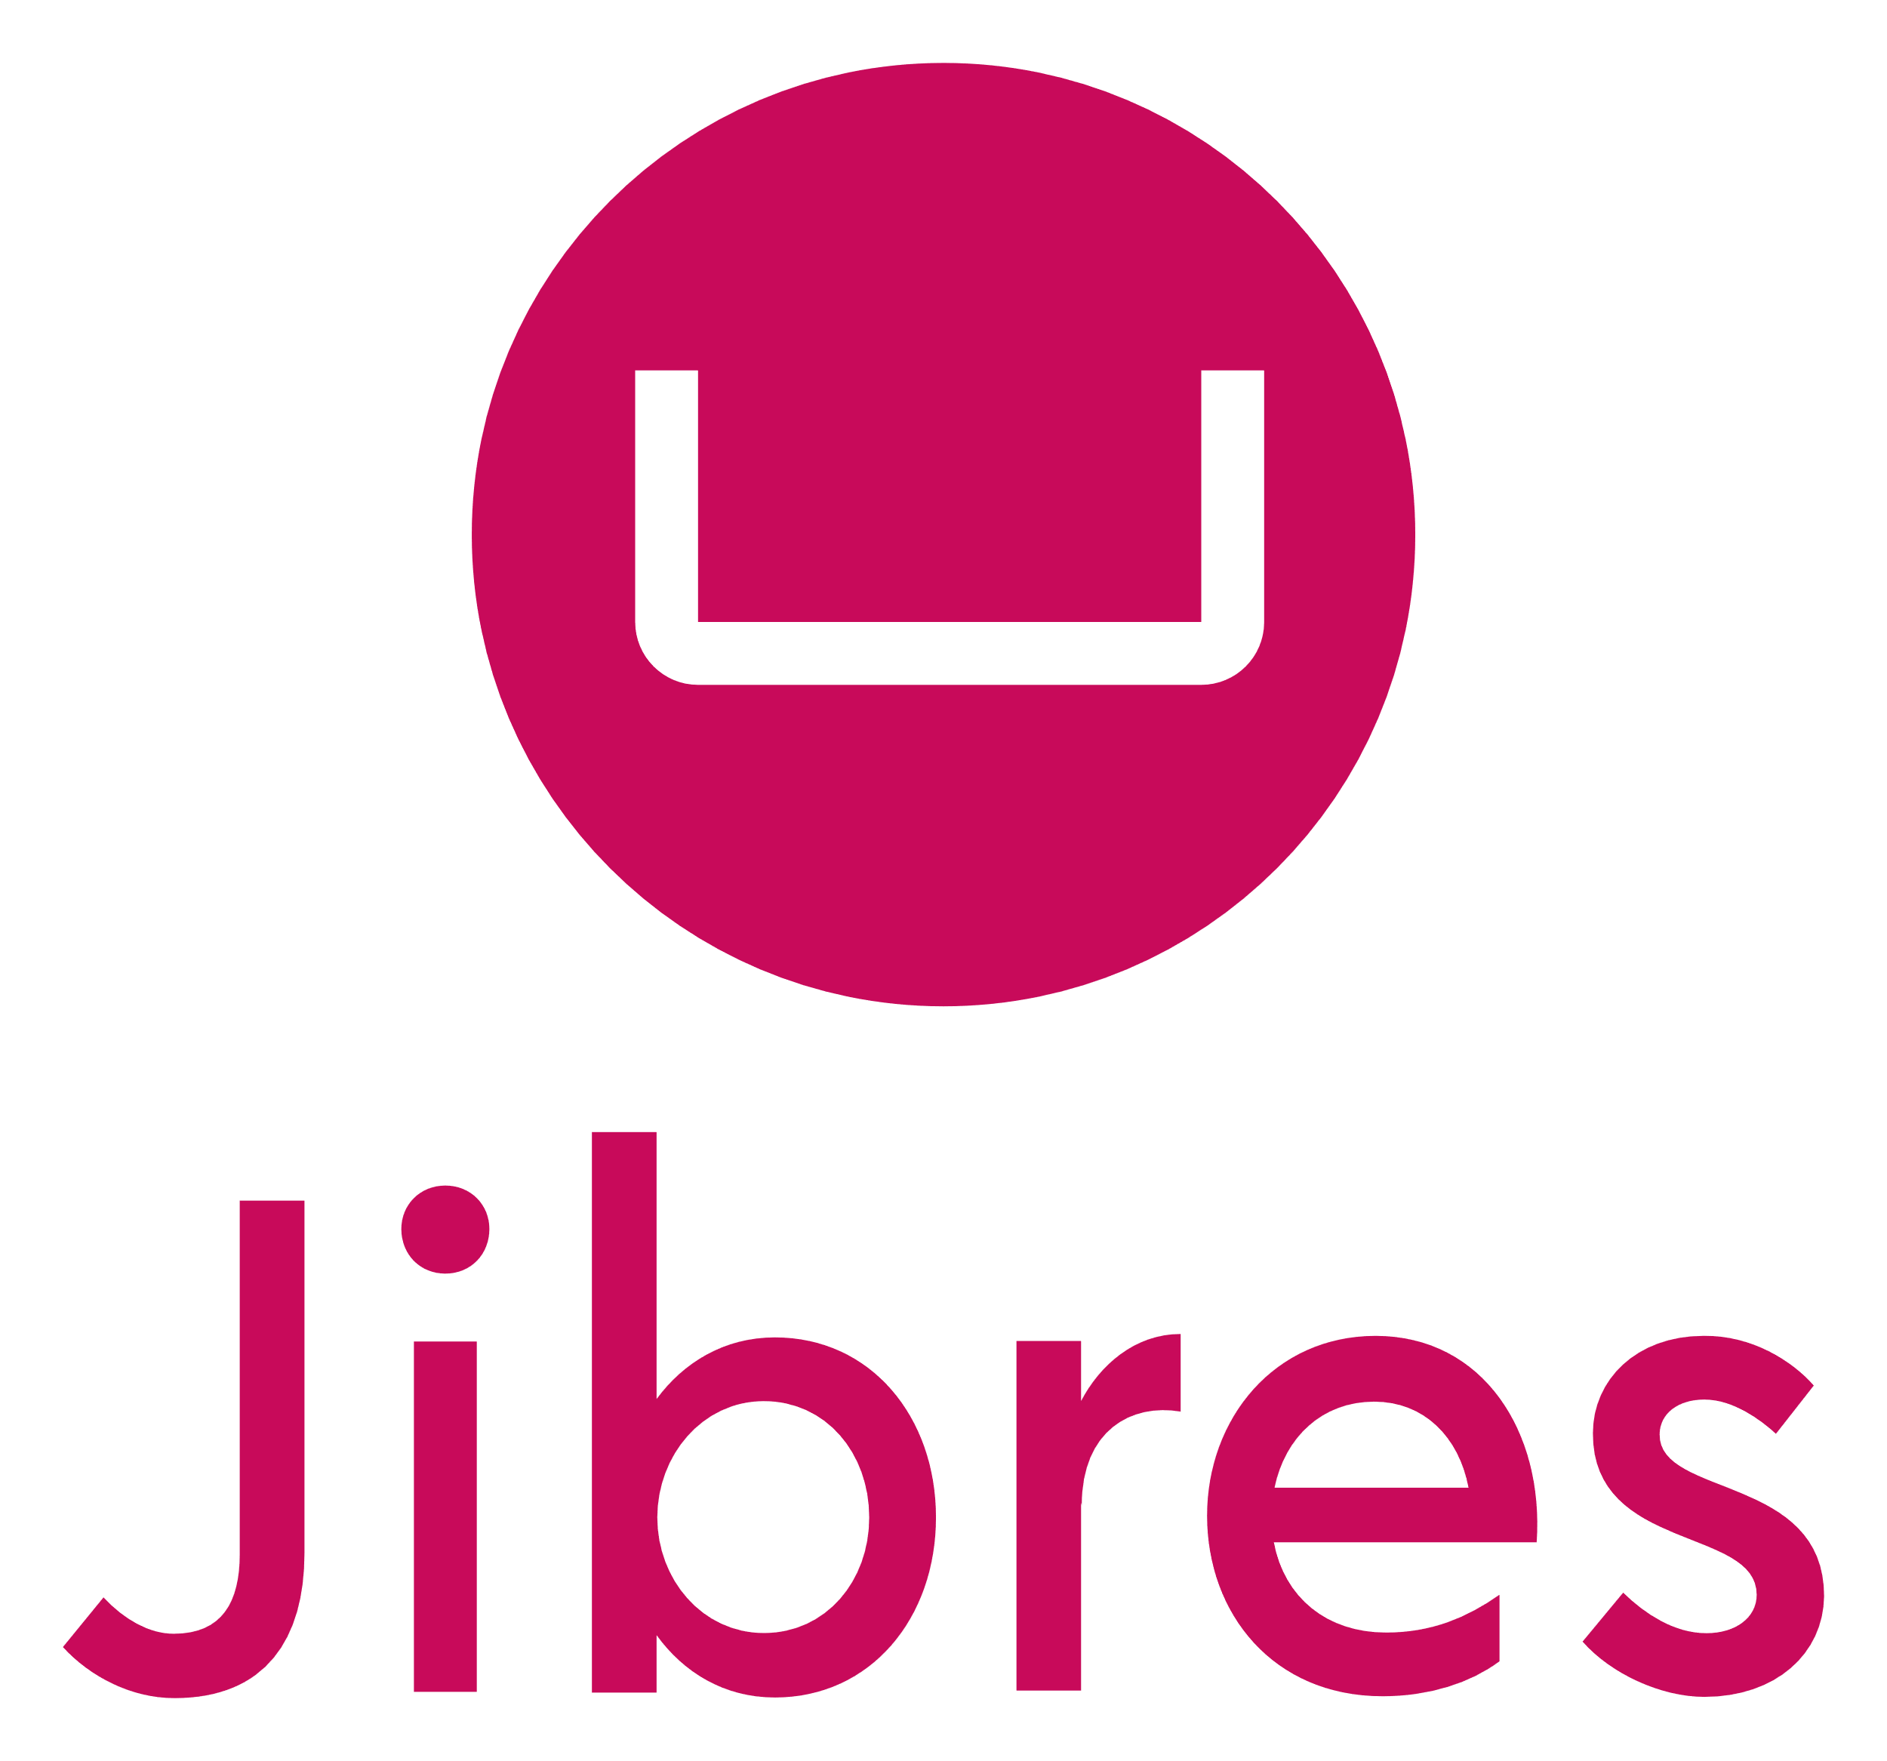
MINIMAL SIZE
Print size 1 cm wide
Digital size 32 pixels wide
Here’s the recommended minimum size at which the logo may be reproduced. For legibility reasons, we ask that you stick to these dimensions.
Print size 2.5 cm wide
Digital size 96 pixels wide
Print size 1.7 cm wide
Digital size 64 pixels wide

Slide 9
JIBRES RED
HEX #C80A5A
RGB 200, 10, 90
CMYK 17, 100, 50, 2
HSL 335, 90%, 41%
The Jibres red is bright and vibrant and we want it to stand out clearly. To that end, here are the color values you can use for both digital and print.

Slide 10
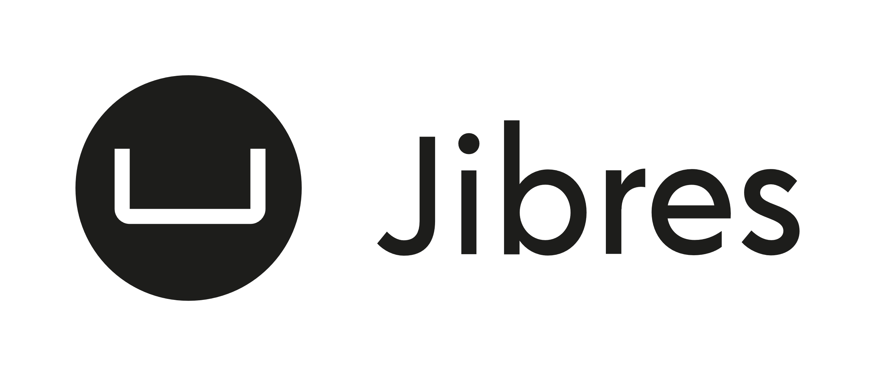


USING GRAYSCALE
If the color logotype isn’t an option for technical reasons, use the black or white versions instead.
You can create a version using any value on the grayscale.

Slide 11
BACKGROUND COLOR
Our logo must always have good contrast with the background to ensure maximum impact and accessibility.
Use the black or white versions if the logo is to be presented on a background color.
If you’re going with grayscale, make sure you choose a version where the contrast between the logo and the background is strong.

Slide 12
WORDMARK
Acre Medium
ABCDEFGHIJKLMNOPQR STUVWXYZ
abcdefghijklmnopqrstuvwxyz
Here’s what you need to know about the wordmark:
The font used for the wordmark is Acre Medium.
This font is only used in the logo.
“Jibres” is written as one word, with the letters “J” capitalized in all instances.

Slide 13


LOGO DON’TS
Jibres
Do not change the typography.
Use the Jibres logos as provided and please do not make any changes to them :)
Do not change the color.
Do not add gradients, strokes or any other effects.
Do not stretch the logo!

Slide 15
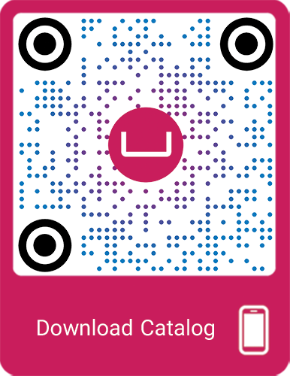
Jibres.com
Sell and Enjoy
#1 World Sales Engineering System

