Slide 1
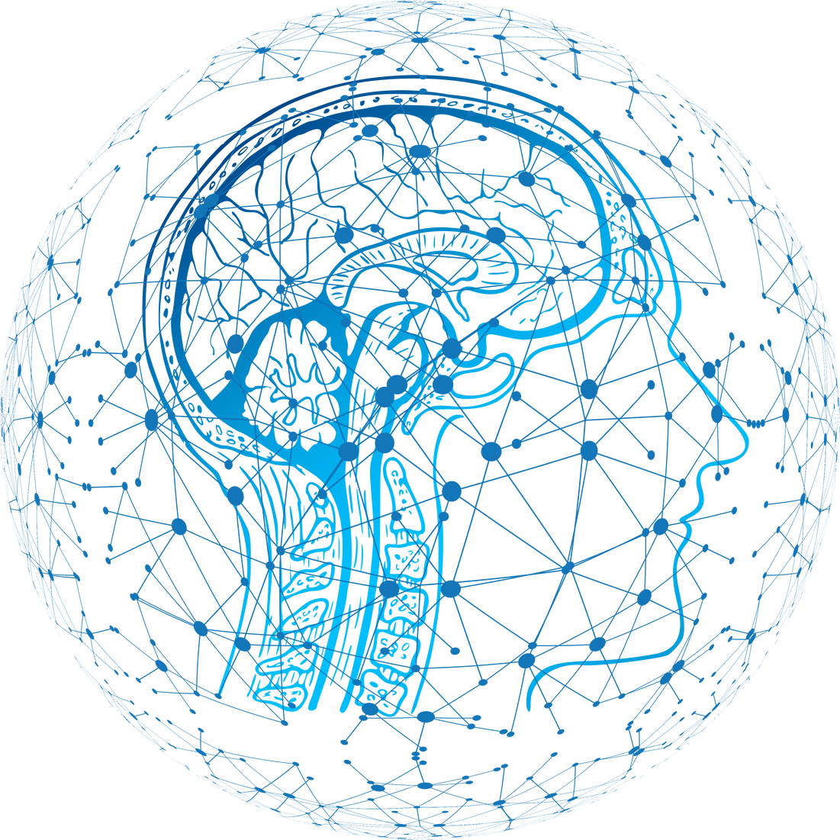
Discord Bot
RAG-Based Question Answering System
Jibin Kunjumon
01

Slide 2
Problem & Objective
🎯 What It Does
An intelligent Discord bot that answers user questions using Retrieval-Augmented Generation (RAG) with real-time context understanding.
💡 Why It Matters
Provides instant, accurate responses by combining document retrieval with AI language models, enabling seamless knowledge access through a familiar chat interface.
02

Slide 3
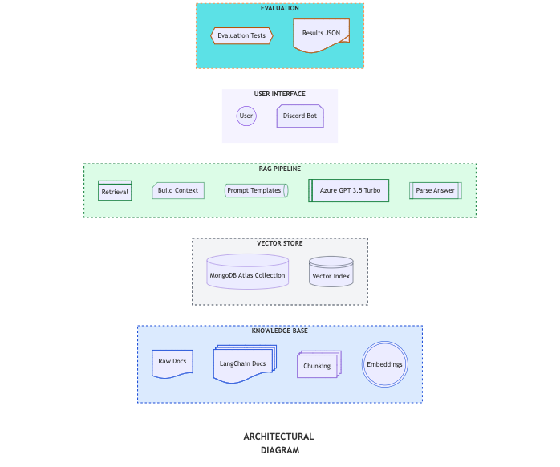
Architectural Diagram
02
03

Slide 4
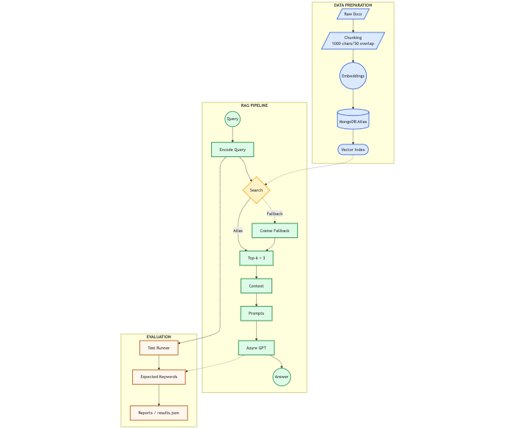
Workflow Diagram
📁 Data Preparation
- Raw documents are chunked into manageable pieces
- Embeddings generated using sentence transformers
- Stored in MongoDB Atlas Vector Database
🔄 RAG Pipeline
01
- User query is encoded into vector format
- System performs vector similarity search
- Top-3 relevant documents retrieved as context
- Context + query sent to Azure GPT-4
- AI generates accurate, context-aware answer
02
💬 Deployment
- Integrated with Discord bot interface
- Real-time query processing
- Seamless user experience
03
04

Slide 5
Tools & Technologies
🐍 Python + VS Code + Colab
☁️ Azure OpenAI GPT-3.5 Turbo
Backend development environment
Integration and orchestration
Colab noetbook - experimentation
Language model for answer generation
Context-aware responses
🔤 Sentence Transformers
💬 Discord.py
Model: all-MiniLM-L6-v2 (384 dimensions)
For document and query embeddings
Bot framework with token authentication
Real-time user interaction
🗄️ MongoDB Atlas
02
Vector database for semantic search
Efficient similarity retrieval
05

Slide 6
Folder Structure
📁 discord-rag-data-scientist/
│
├── backend/ → Core Python modules
│ ├── chatbot.py → Entry point for RAG chatbot logic
│ ├── discord_bot.py → Connects model to Discord
│ ├── embeddings.py → Sentence embeddings (MiniLM / OpenAI)
│ ├── llm.py → LLM configuration and responses
│ ├── RAG_pipeline.py → Retrieval-Augmented Generation pipeline
│ └── retrieval.py → Context retrieval logic
│
├── diagrams/ → System design visuals
│ ├── architectural_diagram.png
│ └── workflow_diagram.png
│
├── docs/ → Research & documentation
│ ├── EMBEDDING_MODELS_RESEARCH.md
│ ├── IN_SCOPE.md
│ ├── learning_guide.md
│ └── VECTOR_BASES_RESEARCH.md
│
├── notebooks/ → Model training & evaluation
│ └── Discord_Chatbot_Lab.ipynb
│
├── reports/ → Evaluation outputs
│ ├── evaluation_report.md
│ └── results.json
│
├── config.py → Configuration variables
├── evaluation.py → Model evaluation script
├── .env → Environment variables (API keys)
├── .gitignore → Git ignore rules
├── BLOCKERS.md → Issues tracked during development
└── requirements.txt → Python dependencies
01
02
04
06

Slide 7
📈 RESULTS & EVALUATION
🎯 SYSTEM PERFORMANCE
💬 RESPONSE QUALITY
✓ 4/4 test queries passed
✓ 69.2% average token overlap
✓ 100% expected keyword match rate
• High accuracy: 90-96% token overlap
• Context-aware answer generation
• Graceful handling of out-of-scope queries
(e.g., "Who is Elon Musk?" → "My knowledge base contains information about Python, Machine Learning, Web Development, and Discord.")
🔍 RETRIEVAL ACCURACY
• Top-3 document retrieval working
• Relevant context successfully extracted
• Source attribution included in responses
⚡ KEY ACHIEVEMENT
Fully functional RAG system with robust evaluation framework
07

Slide 8
Thank You! 🙏
Key Takeaways:
✓ Built end-to-end RAG system with 100% test accuracy
✓ Integrated Azure GPT-3.5 with MongoDB Atlas
✓ Deployed functional Discord bot interface
08

