Slide 1
Alternatives to Openstack to use FIWARE.
José Ignacio Carretero Guarde
FIWARE Cloud & Platform Expert
joseignacio.carrretero@fiware.org
@jicarreterogu

Slide 2
Motivation
Questions of the Users regarding Openstack
    Run my VMs on my premises (or somewhere else).
    Installation of Openstack to “install” FIWARE Locally.
    Install Openstack to provide FIWARE Services for several users.
The short answer is no. FIWARE does NOT depend on Openstack
    FIWARE is vendor independent.

Slide 3
For Users and for Service Providers
Users: Willing to run FIWARE Lab images somewhere else
    Run my VMs on my premises (or somewhere else).
    Deploy my VMs in another Openstack
    Run my Vms in another Hypervisor
Service Providers: Create FIWARE based solutions for customers
    Interesting to have a platform to create these services.
    Interest in multitenancy.

Slide 4
1# For users: Run your VMs in other Hypervisor.

Slide 5
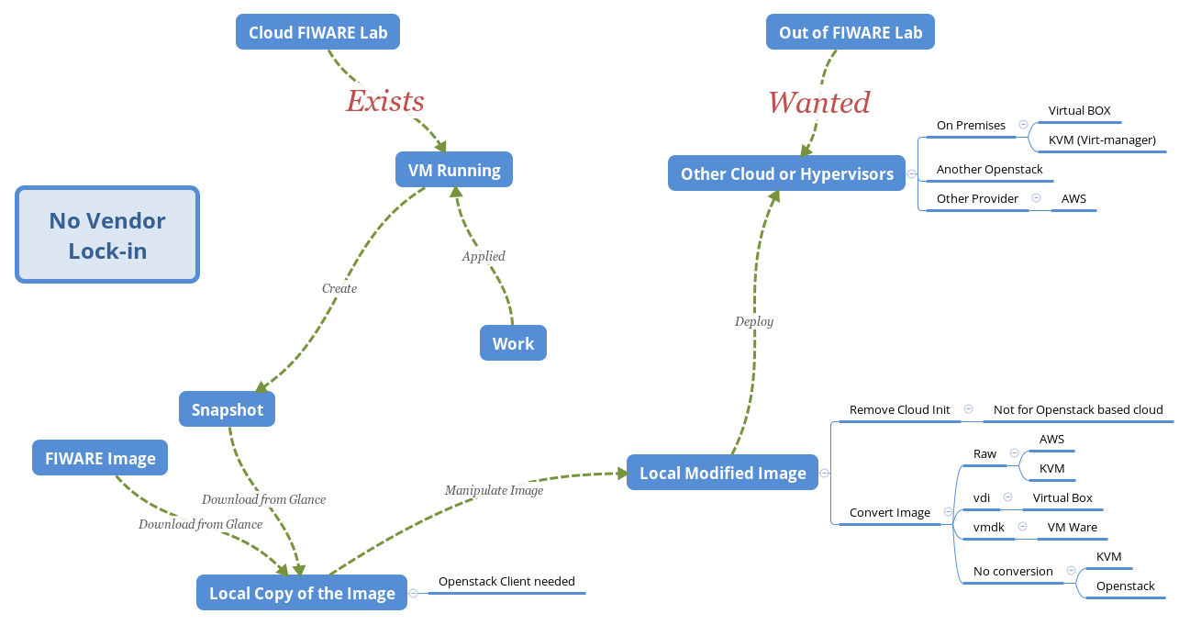
Schema

Slide 6
Inside the Creation of an Instance in Openstack
DHCP Network Configuration.
    Network is configured using DHCP protocol for new Instances.
Cloud Init: Preinstalled Software
    Retrieves Metadata from Openstack Metadata Server.
        Retrieves Public Key and injects for user.
        Retrieves and run configuration scripts.

Slide 7
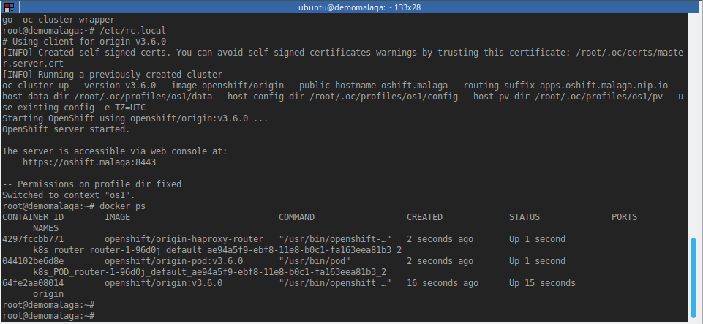
Working with the VM

Slide 8
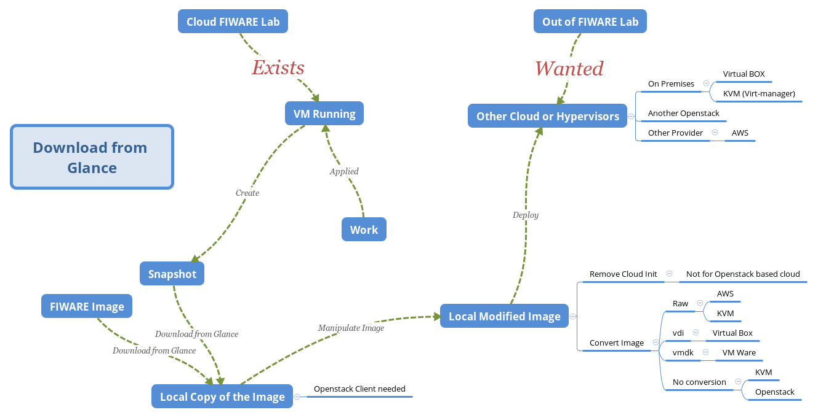

Slide 9
How to locally install the CLIs
# Assuming Python 2.7, python-dev, pip and virtualenv installed
virtualenv osdemo
source osdemo/bin/activate
pip install python-openstackclient

Slide 10
Define the OS_ variables
# So they can be used later by the Openstack CLI tools
unset OS_TENANT_ID
unset OS_TENANT_NAME
export OS_REGION_NAME="Spain2"
export OS_USERNAME='joseignacio.carretero@fiware.org'
export OS_AUTH_URL=http://cloud.lab.fiware.org:4730
export OS_PROJECT_NAME="jicarretero cloud"
export OS_PROJECT_DOMAIN_ID=default
export OS_USER_DOMAIN_ID=default
export OS_IDENTITY_API_VERSION=3
echo -n password: ; read -s OS_PASSWORD
export OS_PASSWORD

Slide 11
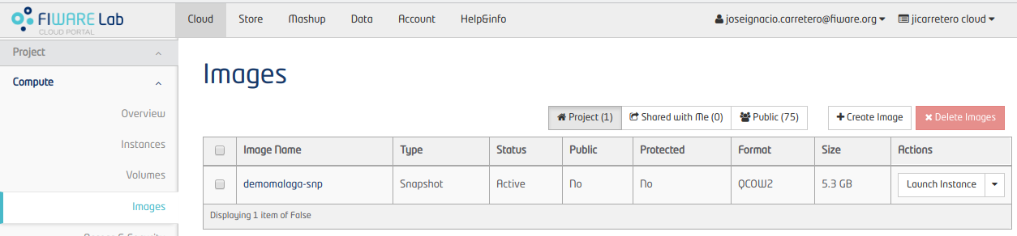
Download the Snapshot of the Running VM
# Download the Snapshot locally – This example’s snapshot
# name is demomalaga-snp
# This can take a little long time...
openstack image save demomalaga-snp > demomalaga-snp.qcow2 &

Slide 12
The Downloaded Image
Will be in QCOW2 Format
    It will work (almost) out of the box on KVM, Openstack.
    It will need to be converted in order to work in other Hypervisors like Virtuabox
Cloud Init: Preinstalled Software
    It might be better to have this removed in order to make the instances boot faster (Not for Openstack)

Slide 13
The Downloaded Image (II)
Will be accesible using the same private key as the original instance (If it is built from a Snapshot)
    Since the file is not deleted in the Snapshot, it’ll be there.
    If a Base Image is downloaded the Public Key must be injected manually.
Will NOT have any Keypair at all if a Base Image from FIWARE Lab is used.
    Maybe the password must be changed before running a new instance.

Slide 14
Locally manipulate the Image
… Image Conversions

Slide 15
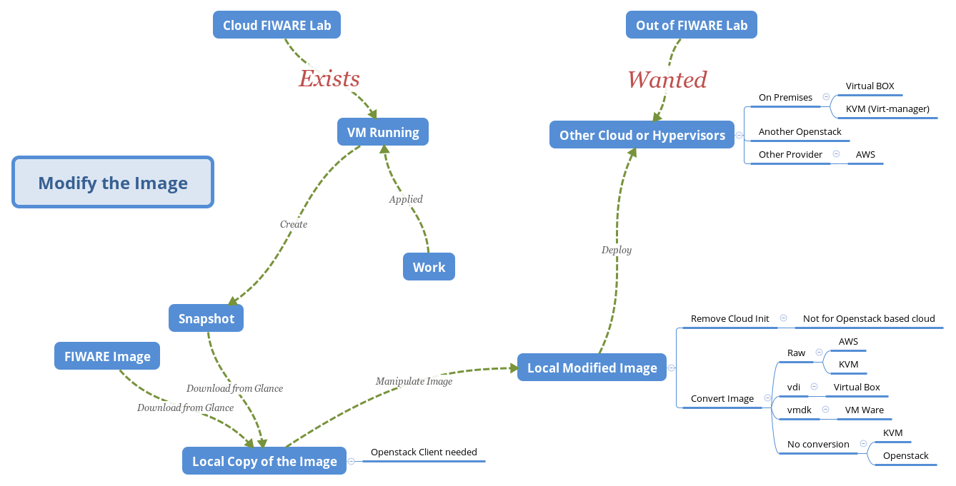

Slide 16
Why modify the Image.
Cloud Init: Preinstalled Software
    This is the Major Software. It’ll search for an Openstack Metadata Server and the VM wont be ready until it is done.
      If the Metadata server is not found, It’ll take a long time to boot before Cloud Init scripts quit from retrying.
    This is not a problem if the target Hypervisor is in another Openstack Based Cloud.
      This does not apply for Openstacks

Slide 17
Locally Manipulate the image:
The image must be locally mounted first
    Libguestfs-tools needed in order to do this - guestmount
Next manipulate the image
    Remove cloud-init, add a password for user, .
Don’t forget to umount the image
Convert the image with qemu-utils to the desired format

Slide 18
Image conversions (II)
Convert raw Image to VDI (VirtualBox Format)
# qemu-utils must be installed:
qemu-img convert -O vdi ${qcow2_or_raw_imagefile} ${vdi_imagefile}
Convert raw or qcow2 Image to vmdk (vmware Format)
# qemu-utils must be installed:
qemu-img convert -O vmdk ${qcow2_or_raw_imagefile} ${vmdk_imagefile}
Convert raw or qcow2 Image to qcow2 (KVM Format)
# qemu-utils must be installed:
qemu-img convert -O vmdk ${qcow2_or_raw_imagefile} ${qcow2_imagefile}

Slide 19
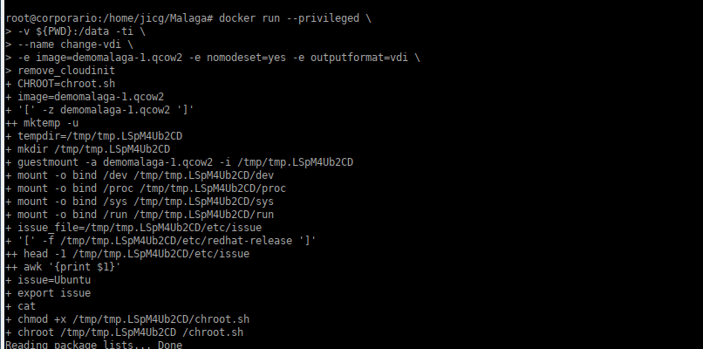
Image conversions (Docker)

Slide 20
Examples Creating new Vms:
VirtualBox (almost Universal)

Slide 21
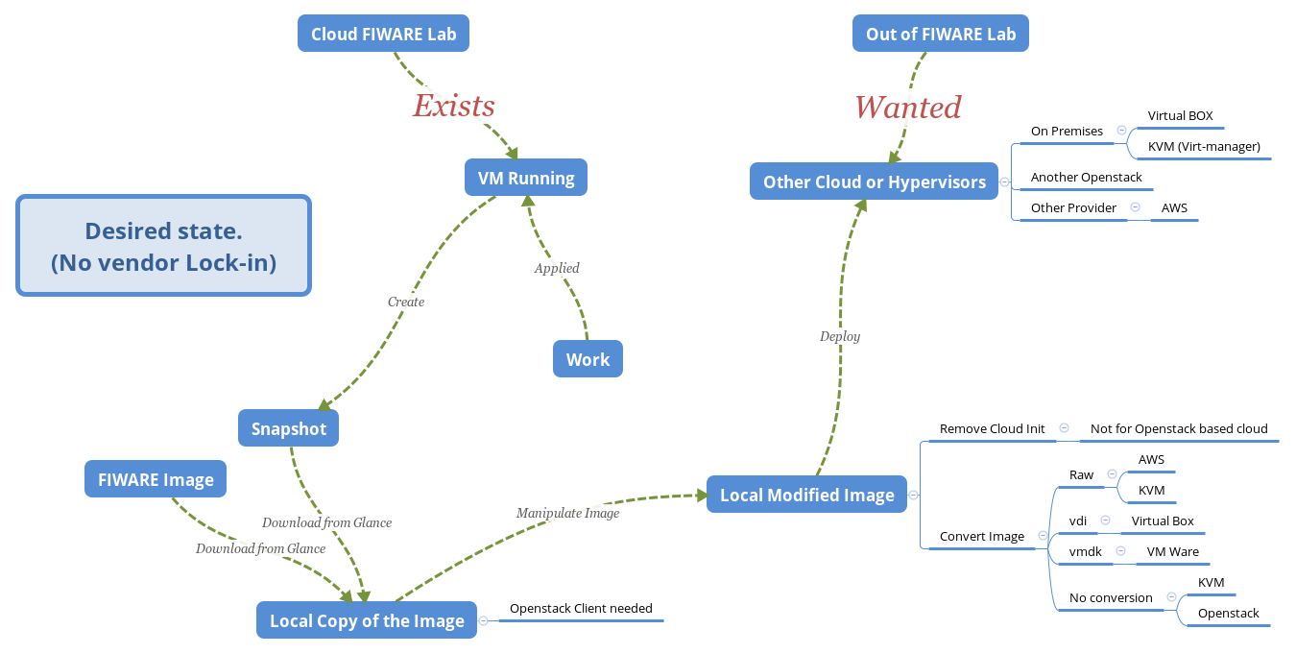

Slide 22
Virtual Box
Oracle Virtual Box
    It is free to Use – GPL V2.0
    It is available in the most used Operating Systems.
    It needs qcow2 to vdi conversion.
Quite Tricky migration to Virtual Box, but possible.
    Create password for the user (ubuntu/centos/debian)
    Modify grub.cfg – nomodeset
    Modify network configurations – Maybe “eth0” is not appropiate

Slide 23
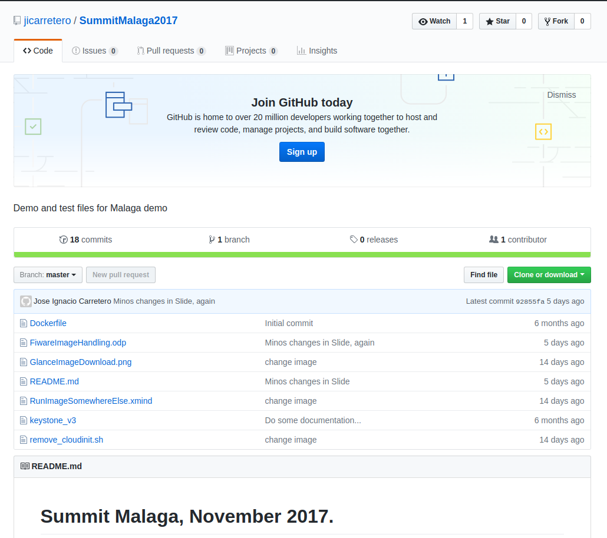
https://github.com/jicarretero/SummitMalaga2017

Slide 24
2# For FIWARE based Service Providers

Slide 25
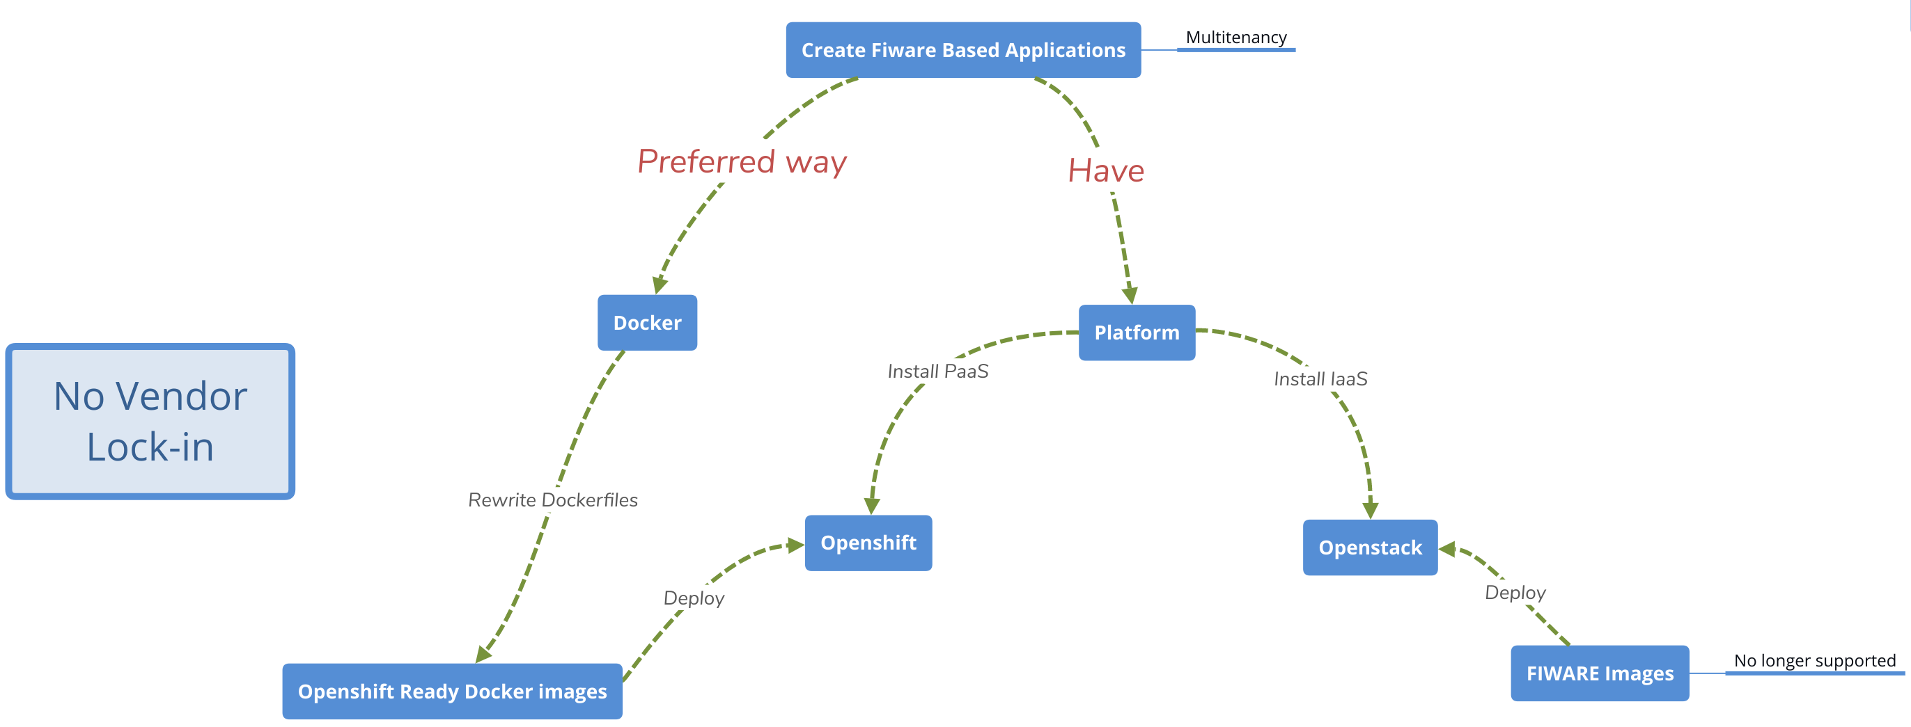
Schema

Slide 26
Openshift

Slide 27
Openshift: PaaS – Container Platform
Platform as a Service
    Built arround Docker Containers
    Orchestration with Kubernates

Slide 28
Rewrite Docker Files
Fiware Docker Images
    May not be specially suitable for Openshift
Guidelines for docker images.
  Keep in mind all good practices for creating Docker images.
  Specially be aware of these 2:
    Avoid multiple processes.
    Support arbitray user IDs:
        No root user allowed
        root group mandatory (chmod g+rwx ...)

Slide 29
Thank You!
http://fiware.org
Follow @FIWARE on Twitter

