Slide 1
Deploy Mediawiki using FIWARE Lab Facilities
José Ignacio Carretero Guarde
Telefónica I+D
joseignacio.carreteroguarde@telefonica.com
@jicarreterogu
(Slides: https://github.com/jicarretero/SummitMalaga2016)

Slide 2
Content
Mediawiki and FIWARE Lab APIs
The installation Process.
Automate
  Images
  Persistent disks
  Object Storage
Reference Information

Slide 3
Mediawiki and FIWARE Lab APIs (Openstack)
(Slides: hhttps://github.com/jicarretero/SummitMalaga2016)

Slide 4


Mediawiki and FIWARE Lab APIs
What Mediawiki has to do with FIWARE Lab?
Nothing?

Slide 5

Mediawiki and FIWARE Lab APIs (ii)
… But it could be good vehicle to show some things about FIWARE Lab IaaS reference Implementation GE.

Slide 6

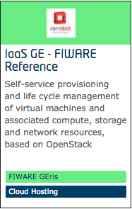

IaaS GE – FIWARE Reference Implementation
https://catalogue.fiware.org/enablers/iaas-ge-fiware-reference-implementation/documentation
  “We are using OpenStack Vanilla release for the IaaS GE.”
Openstack APIs work:
  Compute APIs
  Image APIs
  Block Storage APIs
  Object Storage APIs
  ….
There are CLIs writen in Python...

Slide 7
How to locally install the CLIs
# Assuming Python 2.7, pip and virtualenv installed
virtualenv osdemo
source osdemo/bin/activate
pip install python-openstackclient
pip install python-swiftclient

Slide 8
The installation process
(Slides: https://github.com/jicarretero/SummitMalaga2016)

Slide 9
Installing an Application: MediaWiki
Why MediaWiki? – It has nothing to do with FIWARE
  It has a Backend Database (MySQL)
  It has a Frontend Apache.
  It allows me to show... some tools
I Know how it works – I can automate it!!!
  Images/Files are Stored in Apache (…/wiki/images)
  Data in database /var/lib/mysql

Slide 10



Installing an Application: MediaWiki (i)

Slide 11
Create a VM for Database
Virtual machines (instances)
  The instances managed by Nova.
We need a few things before deploying our instances.
  A keypair
    In order to be able to ssh our Instances
  Security groups / rules
    Because Openstack acts like a fully closed firewall for every instance.

Slide 12
Nova: Keypair and Security groups
# Creating the keypair
nova keypair-add summitkp | tee summitkp && chmod 400 summitkp
# Creating the security group and rules
nova secgroup-create openthings opens_some_ports
nova secgroup-add-rule openthings tcp 22 22 0/0
nova secgroup-add-rule openthings tcp 80 80 0/0
nova secgroup-add-rule openthings icmp -1 -1 0/0
# Creating the security group and rules (What I did!):
nova secgroup-create allopen open_everything
nova secgroup-add-rule allopen tcp 1 65535 0/0
nova secgroup-add-rule allopen ucp 1 65535 0/0
nova secgroup-add-rule allopen icmp -1 -1 0/0

Slide 13
Create a VM for Database (ii)
Boot our Database Instance with some parameters:
  (At least) One Network ID (allows networking)
  Flavor (size of the VM)
  Our security group (opens firewall)
  Ourt Keypair (allows ssh)
Assign a floating IP to our Instance
  You might need a floating IP because you might not be able to ssh a private IP.
  Only 1 Floating IP is allowed per user.

Slide 14
Nova: Keypair and Security groups
# Find the network ID
NETUUID=$(openstack network list | awk '/ node-int-net-01 / {print $2}')
# Boot Virtual Machine
nova boot --nic net-id=$NETUUID --image base_ubuntu_14.04 \
--key-name summitkp \
--security-groups allopen \
--flavor m1.small mydatabase
# Creating a floating IP:
PUBLIC_EXT_NET=public-ext-net-01
openstack floating ip create $PUBLIC_EXT_NET
# Associate the IP to our instance:
nova list floating ip create $PUBLIC_EXT_NET
openstack floating list
nova floating-ip-associate mydatabase 130.206.112.0

Slide 15
Nova: Consoles
# Get console URL
nova get-vnc-console mydatabase novnc
# Creating the security group and rules
nova console-log mydatabase

Slide 16
Ephemeral disks vs Persistent Disks
Compute is thought to compute
  When VMs die, Ephemeral disks will die.
Persistent disks.
  Cinder is used to manage persistent disks.
  The disks, once created, can be attached to instances
  Instances must format and mount the disk before using it.
  Persistent disk will survive instances.

Slide 17
Persistent disks creation.
# Create a Persistent disk
openstack volume create --size 1 myvolume
openstack volume list
VOLUMEID=$(openstack volume list | awk '/ myvolume / {print $2}')
# Attaching the volume to the instance
nova volume-attach mydatabase $VOLUMEID
# Or attaching at boot time…
nova boot --nic net-id=$NETUUID --image base_ubuntu_14.04 \
--key-name summitkp \
--security-groups allopen \
--block-device-mapping vdb=$VOLUMEID
--flavor m1.small mydatabase

Slide 18
Automate!!!!
(Slides: https://github.com/jicarretero/SummitMalaga2016)

Slide 19
Automate: Why?
Increase productivity
  Automated processes reduce defects
  Reduce human errors
  Processes are run effortlessly
  Flexible processes => Make changes is easier
  Increase in satisfaction
  ….
You can write down many other things here...

Slide 20
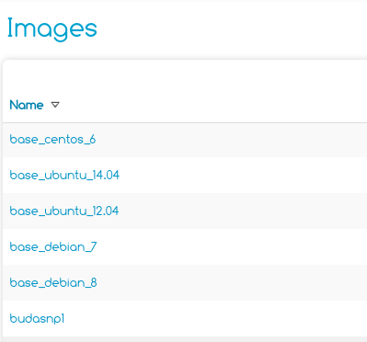
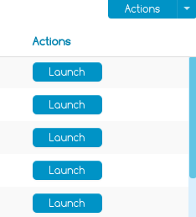

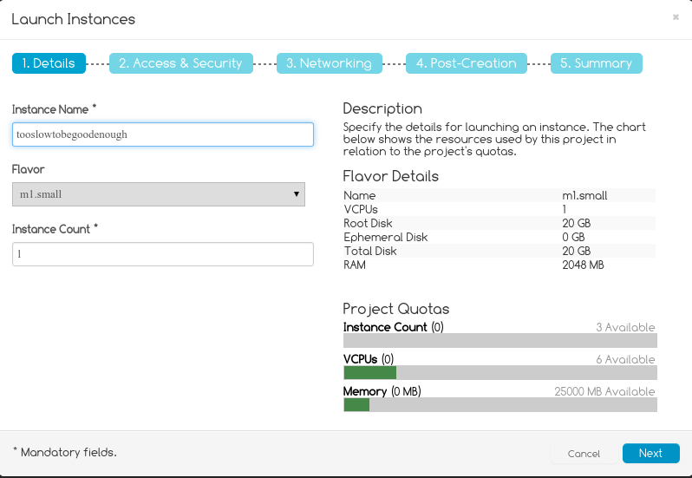
Automate: Using GUI (cloud-portal)?
Portal is really easy to use...
(maybe... )
Too many clicks
(maybe)...
Too error prone
(almost)...
Impossible automation

Slide 21

Installing an Application: MediaWiki (ii)
apache-vol
kmysql-vol
/var/www/html/wiki/images
/var/lib/mysql

Slide 22
One installation Process: Database
Create the Persistent Disk (it it doesn’t exist)
I boot the VM attaching the Persistent Disk and a Sript.
The script:
  Formats the persistent disk and mounts it
    /var/lib/mysql
  Installs mysql-server software
  Creates database wiki and user wiki

Slide 23
One installation Process: Apache
Create the Persistent Disk (it it doesn’t exist)
I boot the VM attaching the Persistent Disk and a Sript.
The script:
  Formats the persistent
  Installs Apache, php5, libs, etc.
  Downloads wikimedia and untars it /var/lib/html/
  Downloads SyntaxHighLight_plugin and untars it
  Mounts the disk
Creates a Floating IP and associates it to the instance:

Slide 24
The new boot command
# Or attaching at boot time…
nova boot --nic net-id=$NETUUID --image base_ubuntu_14.04 \
--key-name summitkp \
--security-groups allopen \
--block-device-mapping vdb=$VOLUMEID
--user-data oneScript
--flavor m1.small mydatabase

Slide 25
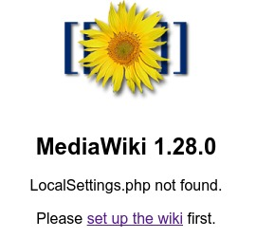
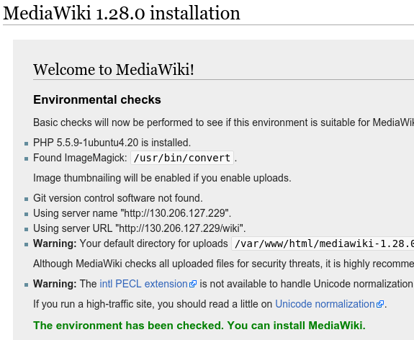
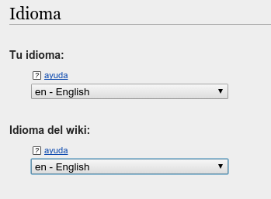
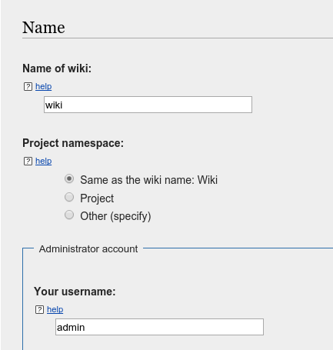
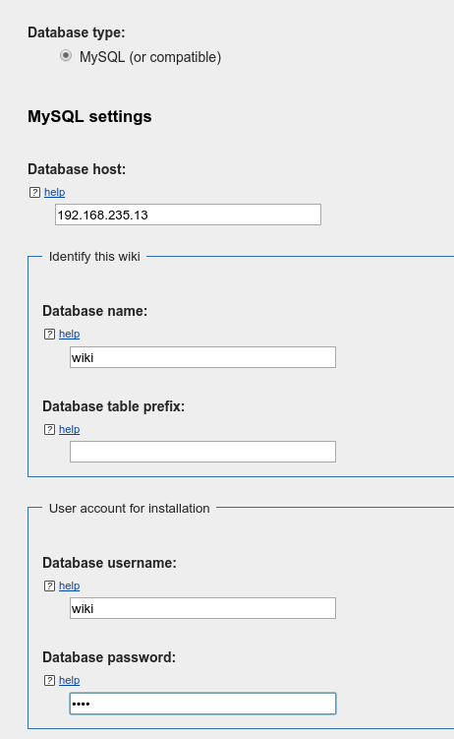
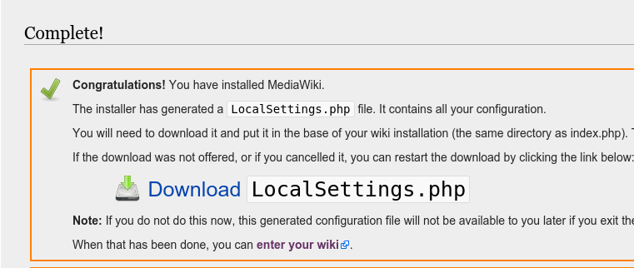
The Mediawiki Wizard
It creates databases and....

Slide 26
If you have any question or problem email to:
fiware-lab-help@lists.fiware.org
You ask in stackoverflow questions with the tags fiware and/or filab.
https://ask.fiware.org

Slide 27
(Slides: https://github.com/jicarretero/SummitMalaga2016)

