Slide 1
Deploy Mediawiki using Fiware Lab facilities
José Ignacio Carretero Guarde
R&D Engineer at Telefonica I+D. In charge of Spain FIWARE Lab Node
joseignacio.carreteroguarde@telefonica.com

Slide 2
Mediawiki and FIWARE Lab APIs (Openstack)

Slide 3


What Mediawiki has to do with FIWARE Lab (I)
Nothing?

Slide 4

What Mediawiki has to do with FIWARE Lab (II)
...But it could be good vehicle to show some things about FIWARE Lab IaaS reference Implementation GE.

Slide 5
Installing an Applicacion: Mediawiki
Why Wikimedia? – If it has nothing to do with FIWARE.
    It has a backend Database (Mysql)
    It has a Frontend Web Server (Apache)
    I Allows me to show some tools: IaaS GE.
I Know how it Works, So I can automate it.
    Images and files are stored in Apache (…/wiki/images)
    Data in the database is stored in /var/lib/mysql

Slide 6

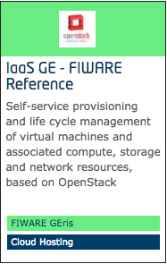

IaaS GE – FIWARE Reference Implementation
https://catalogue.fiware.org/enablers/iaas-ge-fiware-reference-implementation/documentation
    “We are using OpenStack Vanilla release for the IaaS GE.”
Openstack APIs work:
    Compute APIs
    Block Storage APIs
    Image Service
    Object Storage
There are CLIs writen in Python...

Slide 7
How to locally install the CLIs
# Assuming Python 2.7, pip and virtualenv installed
virtualenv osdemo
source osdemo/bin/activate
pip install python-openstackclient
pip install python-swiftclient

Slide 8
A First Approach to the Installation Process

Slide 9



Installing an Applicacion: Mediawiki (I)

Slide 10
Create a first VM
Virtual Machines – Instances
    Instances are managed by Nova.
We need a few things before deploying an instance
    A Keypair
        In order to be Able to SSH our instances
    Security Groups/Rules
        Because OpenStack acts like a closed Firewall for every instance.

Slide 11
Nova: Key Pairs and Security Groups
# Creating the keypair
nova keypair-add summitkp | tee summitkp && chmod 400 summitkp
# Creating the security group and rules
nova secgroup-create openthings opens_some_ports
nova secgroup-add-rule openthings tcp 22 22 0/0
nova secgroup-add-rule openthings tcp 80 80 0/0
nova secgroup-add-rule openthings icmp -1 -1 0/0
# Creating the security group and rules (What I did!):
nova secgroup-create allopen open_everything
nova secgroup-add-rule allopen tcp 1 65535 0/0
nova secgroup-add-rule allopen ucp 1 65535 0/0
nova secgroup-add-rule allopen icmp -1 -1 0/0

Slide 12
Create a first VM (II)
Boot our first instance with some parameters
    (At least) One network ID to allow networking
    Flavor – The size of the Instance
    Our Security Group – our firewall configuration.
    A Keypair – To SSH our instance
    The base image – I’ll use an Ubuntu in the demos.
Assign a floating IP to some of our instances
    A Floating IP is needed to SSH our instances. We might not be able to SSH private IPs
    1 Floating IP is allowed per User.

Slide 13
Nova: Boot and add a floating IP
# Find the network ID
NETUUID=$(openstack network list | awk '/ node-int-net-01 / {print $2}')
# Boot Virtual Machine
nova boot --nic net-id=$NETUUID --image base_ubuntu_14.04 \
--key-name summitkp \
--security-groups allopen \
--flavor m1.small mydatabase
# Creating a floating IP:
PUBLIC_EXT_NET=public-ext-net-01
openstack floating ip create $PUBLIC_EXT_NET
# Associate the IP to our instance:
nova list floating ip create $PUBLIC_EXT_NET
openstack floating list
nova floating-ip-associate mydatabase 130.206.112.0

Slide 14
Nova: Consoles
# Get console URL
nova get-vnc-console mydatabase novnc
# Creating the security group and rules
nova console-log mydatabase

Slide 15
Cinder: Ephemeral Vs Persistent disks
Compute is thought to Compute
    When Instances die, Ephemeral disks die
Persistent Disk – Block Storage
    Cinder manages Persistent Disks
    The disks, once created can be attached to instances
    Instances must format (once) and mount the disks before use
    Persistent disk will survive Instances.

Slide 16
Cinder: Persistent Disk Creation
# Create a Persistent disk
openstack volume create --size 1 myvolume
openstack volume list
VOLUMEID=$(openstack volume list | awk '/ myvolume / {print $2}')
# Attaching the volume to the instance
nova volume-attach mydatabase $VOLUMEID
# Or attaching at boot time…
nova boot --nic net-id=$NETUUID --image base_ubuntu_14.04 \
--key-name summitkp \
--security-groups allopen \
--block-device-mapping vdb=$VOLUMEID
--flavor m1.small mydatabase

Slide 17
Automate!!!

Slide 18
Automate: Why?
Increase Productivity
    Automated processes reduce defects
    Reduce Human Errors
    Processes are run effortlessly
    Processes are more flexible => Changes are easier
    Increase satisfaction
    … You can write many other things here
… And here.

Slide 19
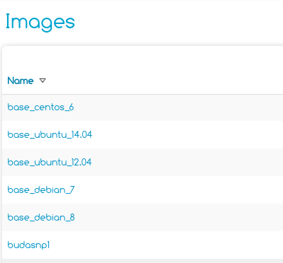
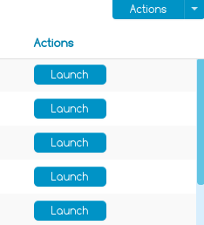

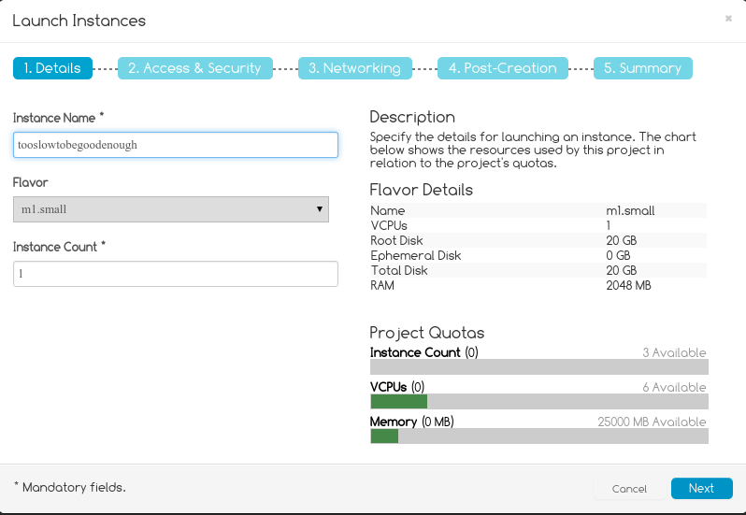
Automate: Using GUI (Cloud Portal)
Easy to use
(maybe... )
Too many clicks
(maybe)...
Too error prone
(almost)...
Impossible automation

Slide 20
Automate: How?
Tools to automate
    Puppet/Chef
        An Agent is required in the instance
    Ansible
        Many features, even some for OpenStack
    Some OpenStack Tools
        Heat / Murano
    Ad Hoc Scripts
        This time it was my option, so I can show some CLI commands

Slide 21

Installing an Applicacion: Mediawiki (II)
kmysql-vol
apache-vol
/var/www/html/wiki/images
/var/lib/mysql

Slide 22
One Installation Process: Database
Create the Persistent Disk (if it doesn’t exists)
Boot the VM attaching the Persistent Disk and injecting a Script
The Script
    Formats the Persistent Disk and mounts it (using /etc/fstab)
        /var/lib/mysql
    Installs MySQL-Server software
    Creates Database and user for the Wiki.

Slide 23
One Installation Process: Apache
Create the Persistent Disk (if it doesn’t exists)
Boot the VM attaching the Persistent Disk and injecting a Script
The Script
    Formats the Persistent Disk
    Installs Apache, php5, libs, etc
    Downloads Wikimedia and untars it /var/www/html
    Downloads SyntaxHighlight_plugin and untars it.
    Mounts the disk (/var/www/html/wiki/images)
Creates a FloatingIP and associates it to the instance

Slide 24
The new boot command for Nova
# Or attaching at boot time…
nova boot --nic net-id=$NETUUID --image base_ubuntu_14.04 \
--key-name summitkp \
--security-groups allopen \
--block-device-mapping vdb=$VOLUMEID
--user-data oneScript
--flavor m1.small mydatabase

Slide 25
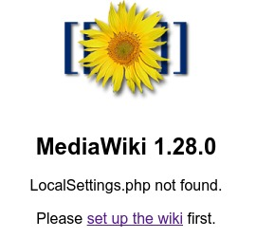
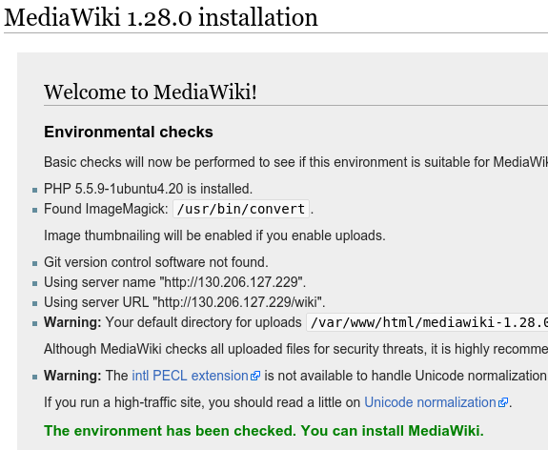
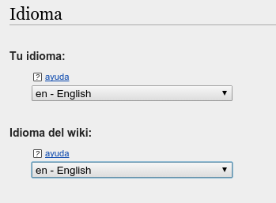
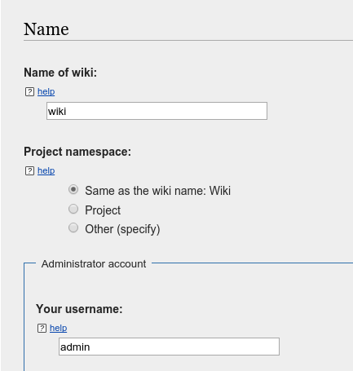
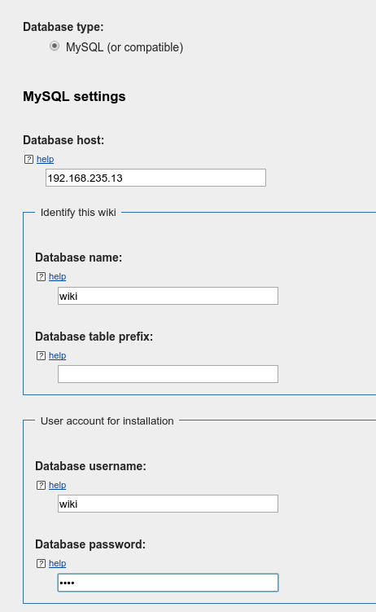
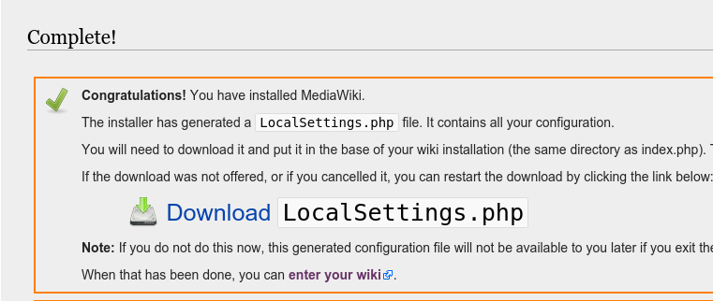
The Mediawiki Wizard

Slide 26
Can’t automate everything... but almost
Mediawiki installation can’t be automated… but
I can automate LocalSettings.php configuration
The Script
    Gets the Public IP of our apache
    Sets the Logo, Extensions of Documents which can be uploaded
    Configures SyntaxHighlight extension
    Uploads LocalSettings.php and logo.jpg

Slide 27
Some other tools: Images and Object Storage

Slide 28
Snapshots from instances
I can take Snapshots of my instances
    So I can boot a preconfigured Instance
    Glance - The image service is used to create Snapshots
I’ve taken an Snapshot of my Database Instance
    The process takes some time...
    It is a complicated process that involves many subprocesses

Slide 29
Image Commands
# Create an Snapshot from an Instance
nova image-create krtmysql krtmysql-snp
# List images
openstack image list
# Delete images
openstack image delete $IMAGE_ID

Slide 30
Object Storage
It stores static Objects
    We can retrieve the objects in the future
    Swift is the reference implementation of FIWARE’s Object Storage GE
        https://catalogue.fiware.org/enablers/object-storage-ge-fiware-implementation
        Objects are Stored in containers
I’ve uploaded my Preconfigured Mediawiki in a .tgz file to Object Store
    Let’s use this in next Mediawiki installations (as a demo)

Slide 31
Swift Commands
# Create a new Container
swift post summit
# Upload an object to the Container
swift upload summit wiki.tgz
# List Containers, list objects from a container
swift list
swift list summit
# Retrieve an object from a container
swift download summit wiki.tgz

Slide 32
Swift Commands (to automate)
# Retrieve an object from a container… In some scripts.
token=($(openstack token issue | \
awk '/ id / || / project_id / {print $4}'))
TOKEN=${token[0]}
TENANT_ID=${token[1]}
URL=http://130.206.112.3:8080/v1
…
# Use the token, and the tenant.
swift --os-auth-token $TOKEN --os-storage-url=$URL/AUTH_$TENANT_ID download summit wiki.tgz

Slide 33
https://github.com/jicarretero/SummitMalaga2016

