Slide 1
Locally run a FIWARE Lab Instance
In another Hypervisor.
José Ignacio Carretero Guarde
FIWARE Cloud & Platform Expert
joseignacio.carrretero@fiware.org
@jicarreterogu

Slide 2
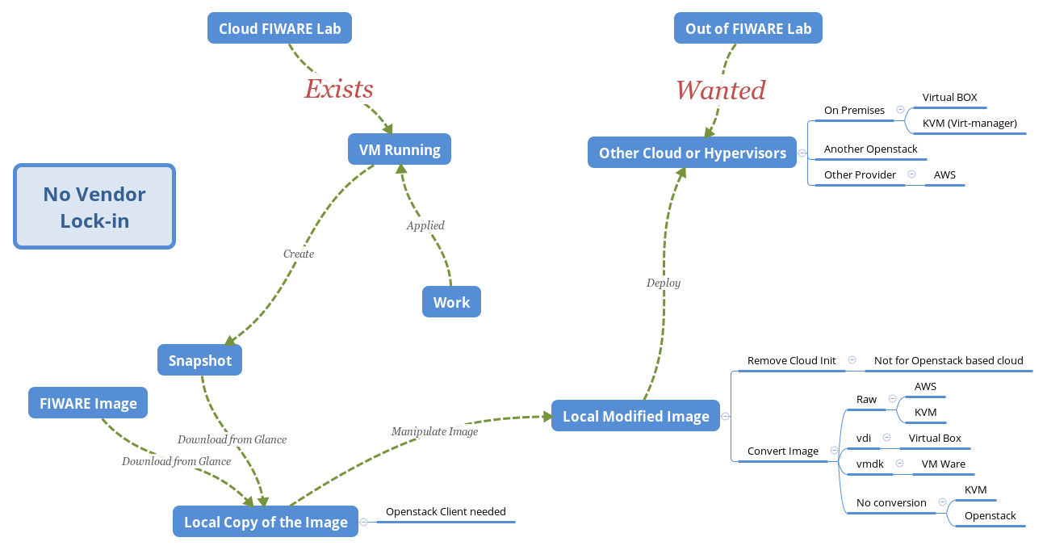
Schema

Slide 3
Deploy an instance in FIWARE Lab.

Slide 4
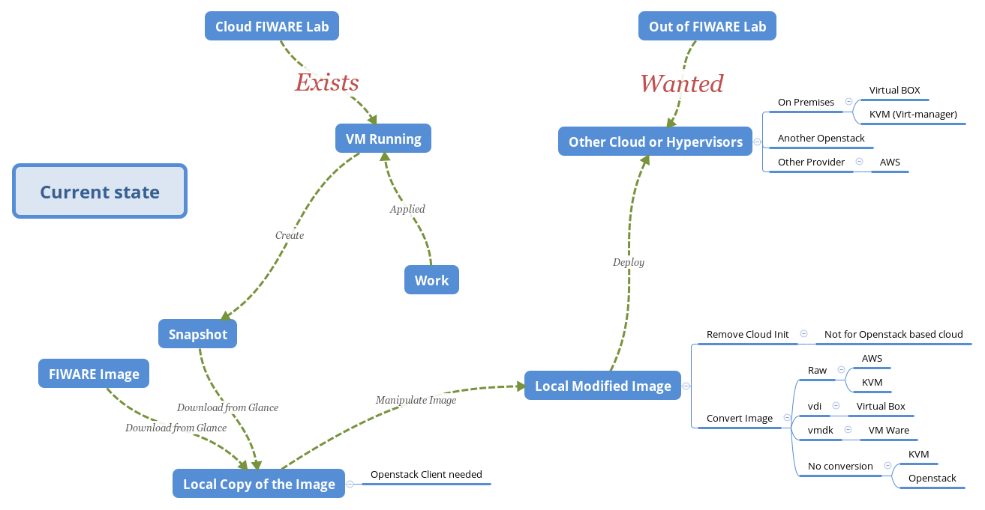

Slide 5
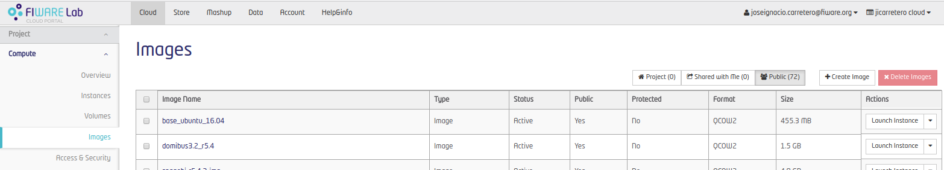
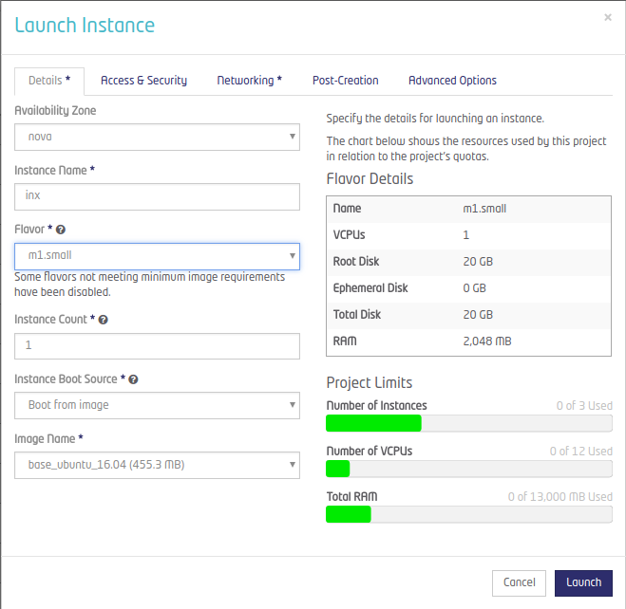
Deploying an Instance in Fw. Lab: A set of steps
Launch new Instance selecting a base image...
Select Image
Select flavor, network, security group, keypair ...
… And eventually there will be a running instance!!!

Slide 6
Inside instance Creation
DHCP Network Configuration.
    Network is configured using DHCP protocol for new Instances.
Cloud Init: Preinstalled Software
    Retrieves Metadata from Openstack Metadata Server.
        Retrieves Public Key and injects for user.
        Retrieves and run configuration scripts.

Slide 7
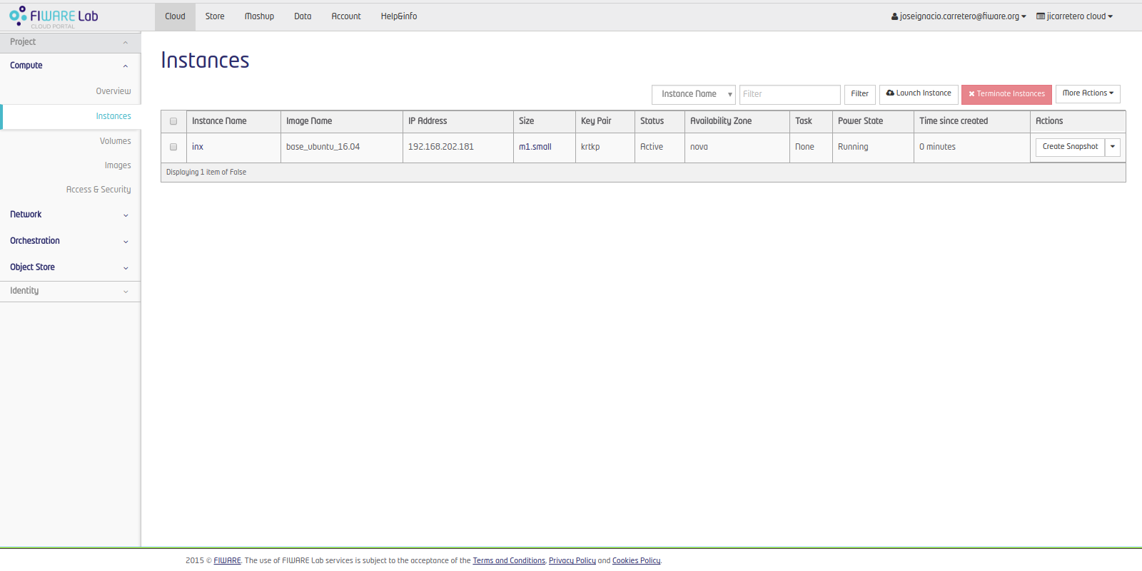
Finally the VM will be up an running.

Slide 8
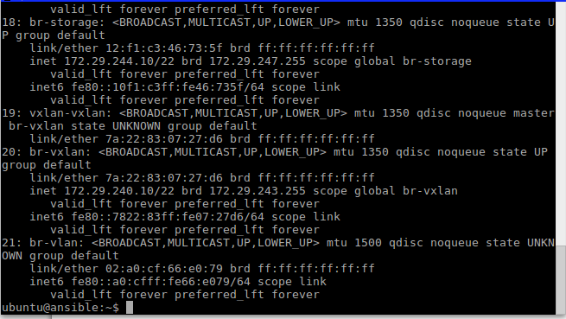
Working with the VM

Slide 9
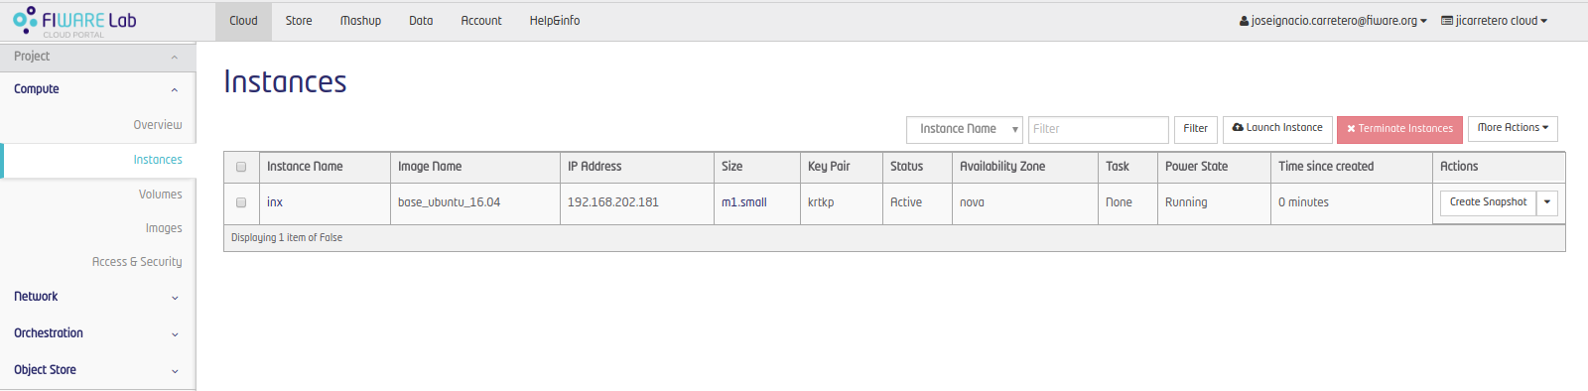
Create a Snapshot of our Working VM
Once the work is done, a snapshot of the VM can be created
    … Another instace can be created from the Snapshot
    … The Snapshot can be downloaded

Slide 10
Preparing the local environment …
Download the Snapshot

Slide 11
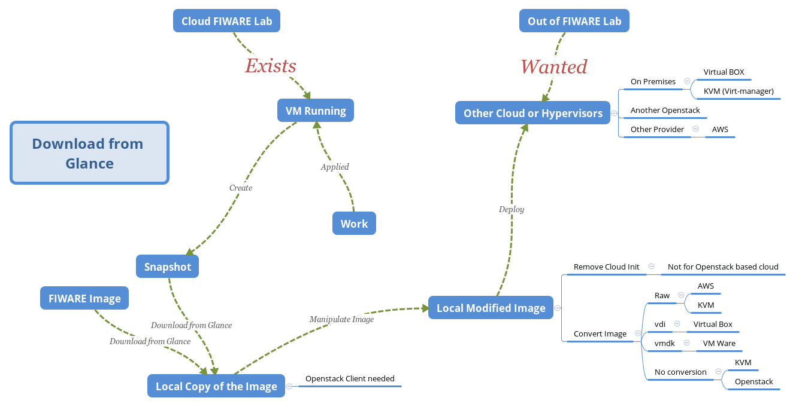

Slide 12

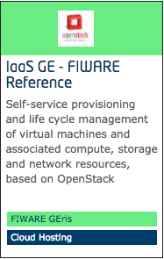

IaaS GE – FIWARE Reference Implementation
https://catalogue.fiware.org/enablers/iaas-ge-fiware-reference-implementation/documentation
    “We are using OpenStack Vanilla release for the IaaS GE.”
Openstack APIs work:
    Compute APIs
    Block Storage APIs
    Image Service (Glance)
    Object Storage
There are CLIs writen in Python...

Slide 13
How to locally install the CLIs
# Assuming Python 2.7, python-dev, pip and virtualenv installed
virtualenv osdemo
source osdemo/bin/activate
pip install python-openstackclient

Slide 14
Define the OS_ variables
# So they can be used later by the Openstack CLI tools
unset OS_TENANT_ID
unset OS_TENANT_NAME
export OS_REGION_NAME="Spain2"
export OS_USERNAME='joseignacio.carretero@fiware.org'
export OS_AUTH_URL=http://cloud.lab.fiware.org:4730
export OS_PROJECT_NAME="jicarretero cloud"
export OS_PROJECT_DOMAIN_ID=default
export OS_USER_DOMAIN_ID=default
export OS_IDENTITY_API_VERSION=3
echo -n password: ; read -s OS_PASSWORD
export OS_PASSWORD

Slide 15
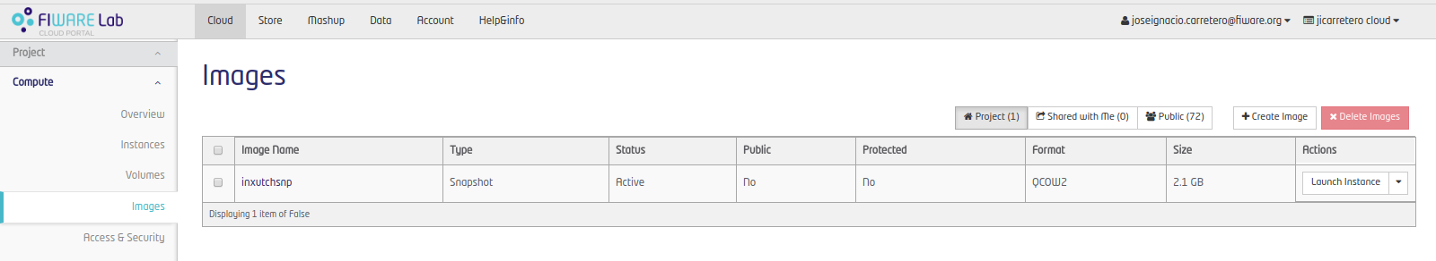
Download the Snapshot of the Running VM
# Download the Snapshot locally – This example’s snapshot
# name is inxutchsnp
# This can take a little long time...
openstack image save inxutchsnp > inxutchsnp.qcow2 &

Slide 16
The Downloaded Image
Will be in QCOW2 Format
    It will work out of the box on KVM, Openstack.
    It will need to be converted in order to work in other Hypervisors like Virtuabox
Cloud Init: Preinstalled Software
    It might be better to have this removed in order to make the instances boot faster (Not for Openstack)

Slide 17
The Downloaded Image (II)
Will be accesible using the same private key as the original instance (If it is builded from a Snapshot)
    Since the file is not deleted in the Snapshot, it’ll be there.
    If a Base Image is downloaded the Public Key must be injected manually.
Will NOT have any Keypair at all if a Base Image from FIWARE Lab is used.
    Maybe the password must be changed before running a new instance.

Slide 18
Locally manipulate the Image
… Image Conversions

Slide 19
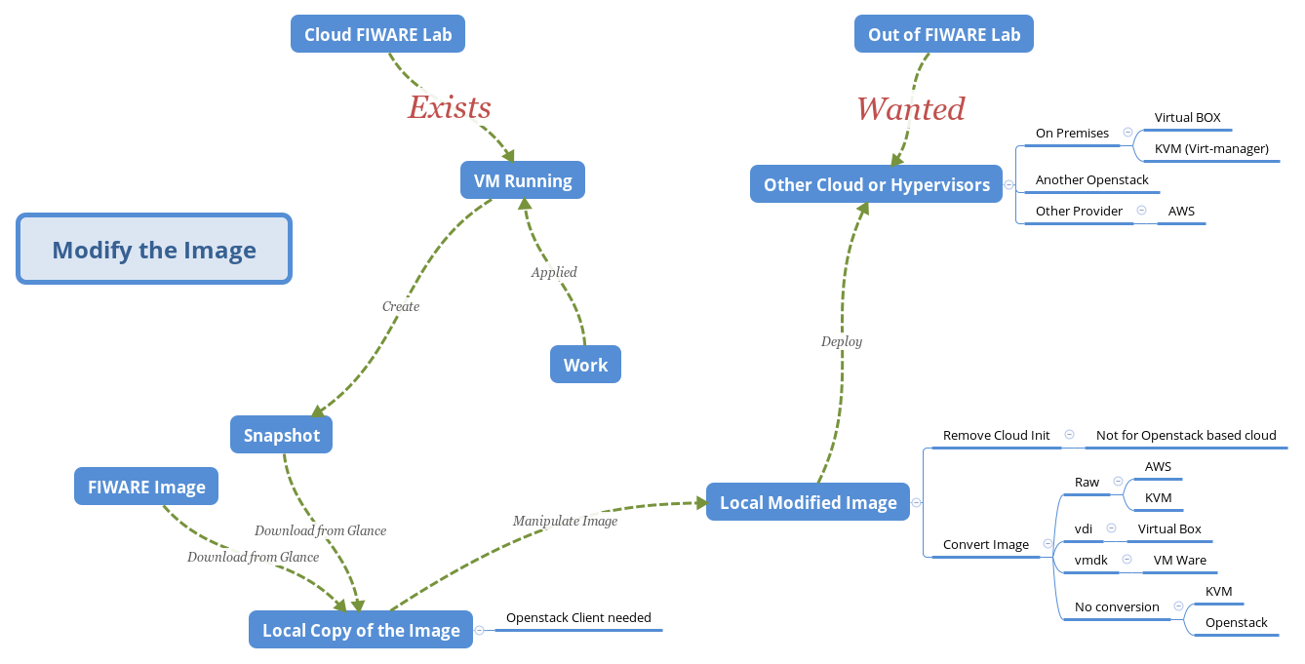

Slide 20
Why modify the Image.
Cloud Init: Preinstalled Software
    This is the Major Software. It’ll search for an Openstack Metadata Server and the VM wont be ready until it is done.
      If the Metadata server is not found, It’ll take a long time to boot before Cloud Init scripts quit from retrying.
    This is not a problem is the target Hypervisor is in another Openstack Based Cloud.
      This does not apply for Openstacks

Slide 21
Locally Manipulate the image:
The image can be locally mounted and manipulated:
# libguestfs-tools should be installed:
guestmount -a ${image} -i ${tempdir}
mount -o bind /dev ${tempdir}/dev
mount -o bind /proc ${tempdir}/proc
mount -o bind /sys ${tempdir}/sys
chroot ${tempdir}

Slide 22
Locally Manipulate the image (II):
Uninstall cloudinit (debian / Ubuntu)
# Remove using Apt
apt-get -y purge cloud-init cloud-guest-utils
Uninstall cloudinit (CentOS)
# Remove using yum
yum remove cloud-init

Slide 23
Locally Manipulate the image (III):
A password to the user(centos/debian/ubuntu) could be set
    The user name depends on the Operating System of the image
# Create the password for the User – Type and retype the password
passwd ubuntu # Or centos or debian

Slide 24
Locally Manipulate the image (IV):
After manipulating, umount “things”
# Clean unmounting is a must
exit ## From chroot…
umount ${tempdir}/dev
umount ${tempdir}/proc
umount ${tempdir}/sys
umount ${tempdir}

Slide 25
Image conversions
Unfortunatelly, most Hypervisors doesn’t work with Qcow2 Format.
    Need to convert the images to the Hypervisor image format.
    Every Hypervisor has its own tools to import Raw images.
Convert qcow2 Image Format to Raw Image format
    Raw format can be exported to other Hypervisors
    Raw format can be exported to other Cloud solutions (i.e. AWS)
# qemu-utils must be installed:
qemu-img convert -f qcow2 -O raw ${qcow2imagefile} ${rawimagefile}

Slide 26
Image conversions (II)
Convert raw Image to VDI (VirtualBox Format)
# qemu-utils must be installed:
qemu-img convert -O vdi ${qcow2_or_raw_imagefile} ${vdi_imagefile}
Convert raw or qcow2 Image to vmdk (vmware Format)
# qemu-utils must be installed:
qemu-img convert -O vmdk ${qcow2_or_raw_imagefile} ${vmdk_imagefile}

Slide 27
Examples Creating new Vms:
Libvirt / Virtmanager (Linux Only)
VirtualBox (almost Universal)

Slide 28
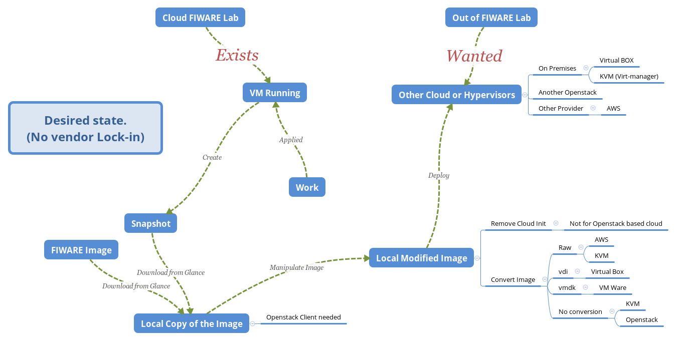

Slide 29
Hypervisor KVM (Kernel-based Virtual Machine)
Free Software For Linux
    Spain Node uses this one (and likely every FIWARE Lab Region)
    Recently, Amazon anounced they were moving to KVM
We will use virtmanager
    A graphical interface which will help us to create a new VM.
The image we downloaded will work:
    Qcow2 format is supported by KVM

Slide 30
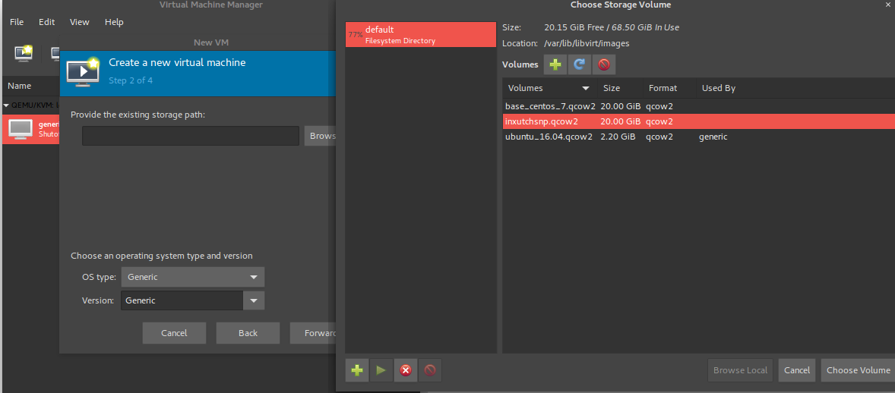
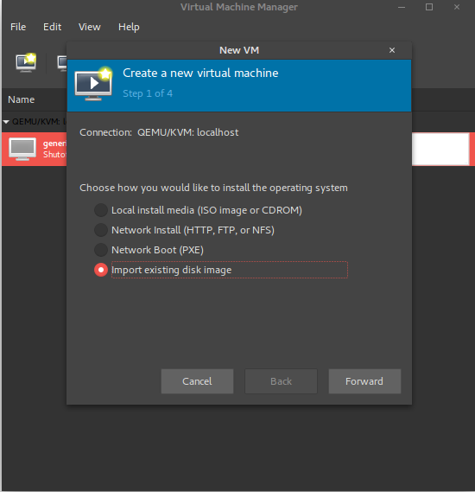
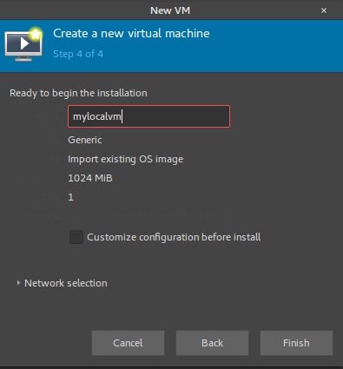
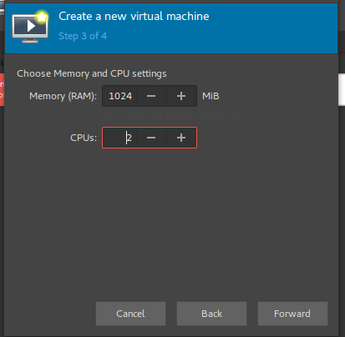
New VM with virt-manager
Choose existing disk
File → New Vm
Some other configurations

Slide 31
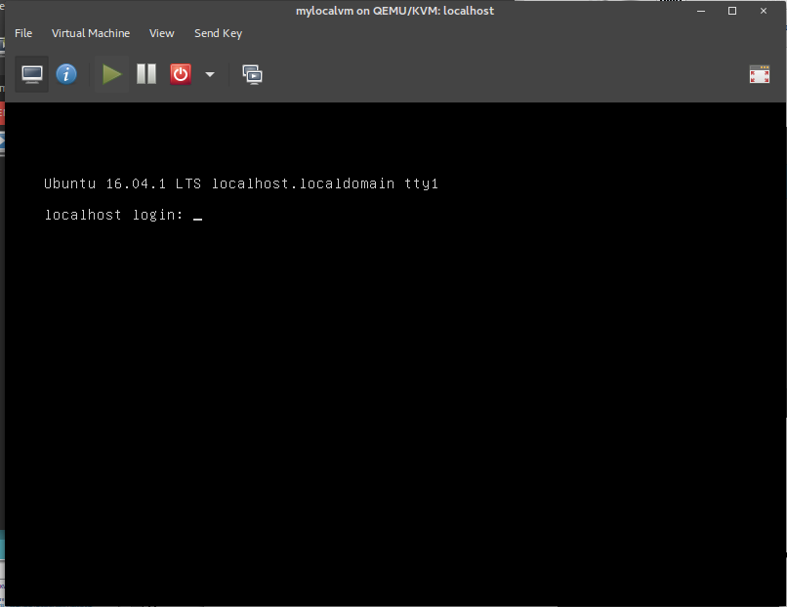
At the end our VM is up..
There are some minor limitations:
  This DHCP server doesn’t provide a name for the VM as Openstack DHCP server does.
  The disk image should be placed in /var/lib/libvirt/images
  The image should be owned by root

Slide 32
Virtual Box
Oracle Virtual Box
    It is free to Use – GPL V2.0
    It is available in the most used Operating Systems.
    It needs qcow2 to vdi conversion.
Quite Tricky migration to Virtual Box, but possible.
    Create password for the user (ubuntu/centos/debian)
    Modify grub.cfg – nomodeset
    Modify network configurations – Maybe “eth0” is not appropiate

Slide 33
Manually change grub
Not a solution itself but a work around to boot the 1st time.
    Prevent the instance hanging on boot.
# libguestfs-tools must be installed:
guestmount -a ${vdi_imagefile} -i ${mount_directory}
sed -i 's|console=tty1 console=ttyS0|nomodeset|g' \
${mount_directory}/boot/grub/grub.cfg \
${mount_directory}/etc/default/grub.d/50-cloudimg-settings.cfg
# Do not forget to umount!!!
umount ${mount_directory}

Slide 34
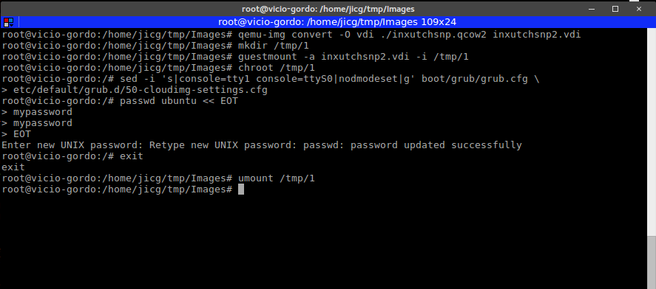
Manually change grub (example)

Slide 35

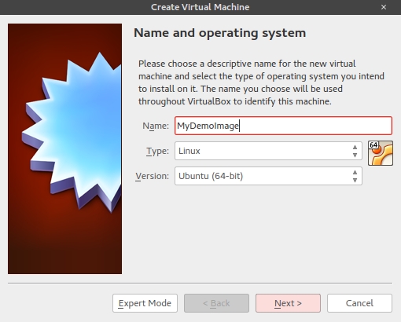
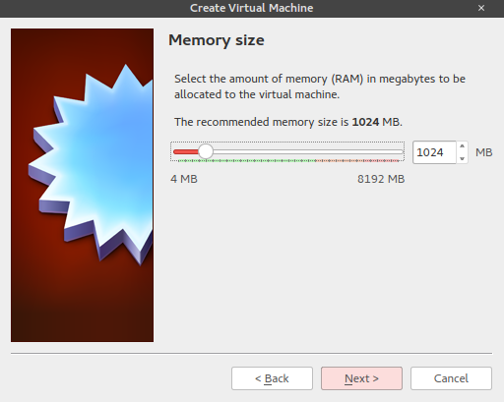

Create Virtual Machine in Virtual Box:

Slide 36
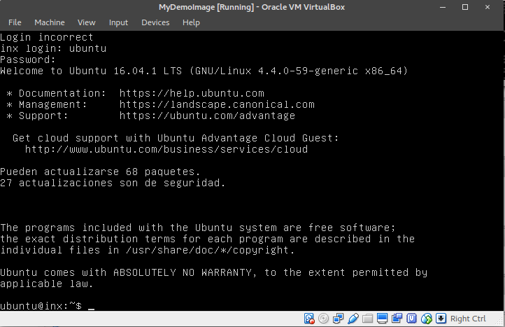
At the end our VM is up..
There can be a problem with the network interface name which can be solved using chroot.
It shoud be considered configuring the hardware of the VM (paravirtualized network, SATA/IDE disk, etc.) – But this is out of the Scope of this presentation.

Slide 37
Modify network configurations
Once the VM boots the 1st time (It might have no network)
    Change the configuration files if needed so (i.e. Ubuntu 16.04, CentOS 7).
# Ubuntu / Debian based images
/etc/network/interfaces
# CentOS based images
/etc/sysconfig/network-scripts/ifcfg-xxx

Slide 38
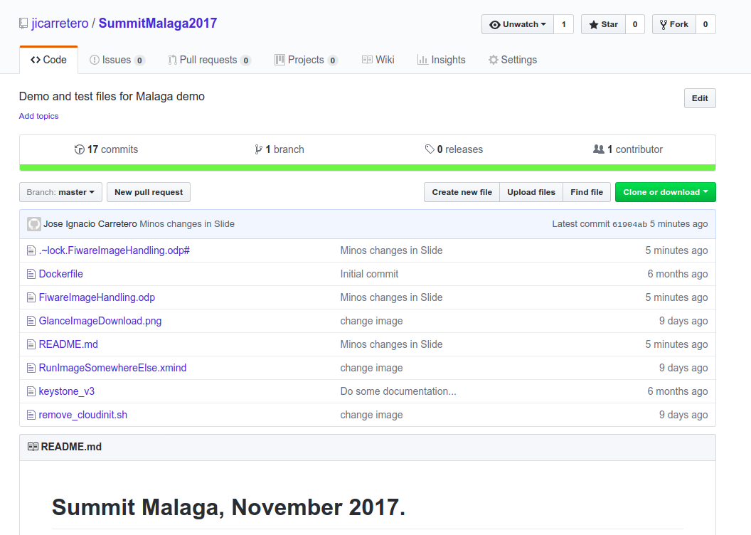
https://github.com/jicarretero/SummitMalaga2017

Slide 39
Thank You!
http://fiware.org
Follow @FIWARE on Twitter

