Slide 1
APAN 5910 | Deep Learning Project
MRI Integrity Lab
Jicheng Ge | jg5013
Notes:
[Sources]
- Project repository and saved experiment artifacts.
[/Sources]

Slide 2
Data hygiene came before modeling
AUDIT RESULT
One non-brain image was excluded explicitly. Standardized-pixel hashes removed leakage-prone copies before the 70/15/15 split; no cross-label duplicate groups remained.
4,600
585
4,014
Readable source files
Duplicate copies removed
Analytical images
2
Notes:
[Sources]
- data/processed/audit_summary.json
- Kaggle Brain Tumor Dataset, Preet Viradiya.
[/Sources]

Slide 3
The experiment protects the clean/manipulated comparison
01 AUDIT
02 PAIR
03 EVALUATE
Deduplicate first
Split original images before any synthetic operation.
Generate pairs
Create deterministic copy-move, occlusion, and noise variants.
Measure change
Score both heads, probability shift, and diagnosis flips.
3
Notes:
[Sources]
- src/mri_integrity_lab/preprocessing.py
- src/mri_integrity_lab/tampering.py
[/Sources]

Slide 4
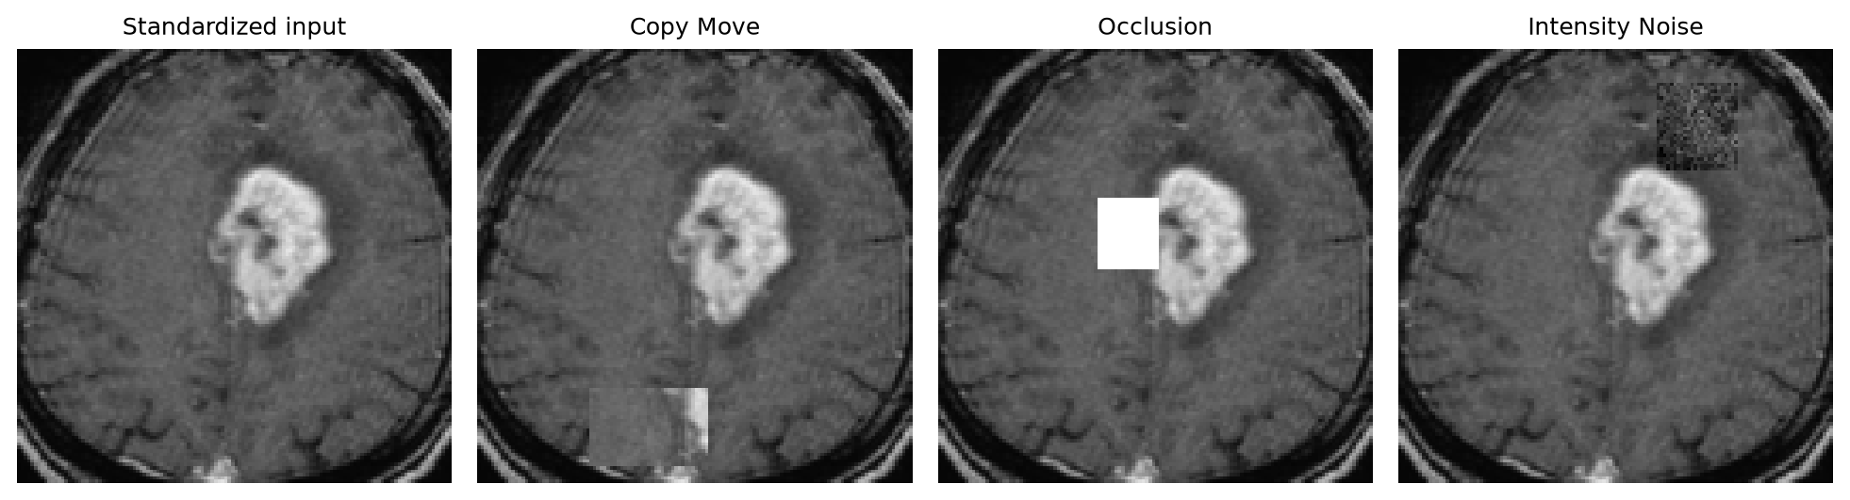
Three controlled stress tests
Three stress tests
Copy-move tests local duplication. Occlusion removes visible evidence. Intensity/noise perturbs texture statistics.
4
Notes:
[Sources]
- reports/figures/tamper_examples.png
- Synthetic variants generated by project code.
[/Sources]

Slide 5
The improved CNN closed the classification gap
HELD-OUT TEST
A deeper batch-normalized encoder replaced the small baseline. Training used only the deduplicated training set; model selection used validation loss.
69.32%
94.36%
0.988
Baseline accuracy
Improved accuracy
Improved ROC-AUC
5
Notes:
[Sources]
- artifacts/baseline_metrics.json
- artifacts/improved_metrics.json
[/Sources]

Slide 6
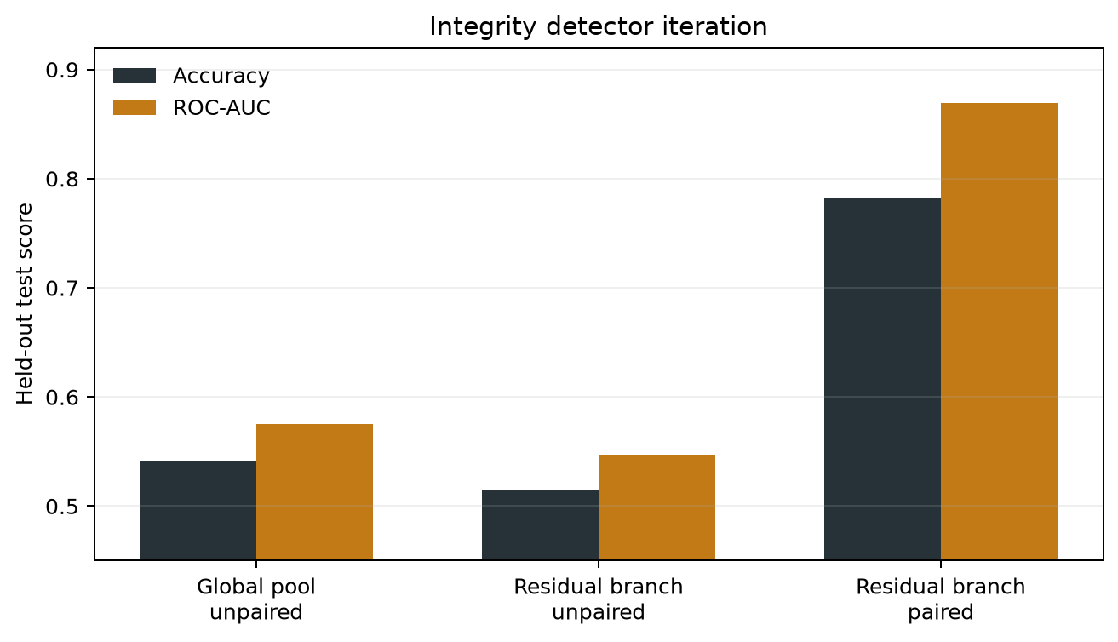
Paired training was decisive
The decisive iteration
A global head stayed near chance. A residual branch alone still failed. Showing clean and manipulated versions of each training image raised integrity ROC-AUC to 0.870.
6
Notes:
[Sources]
- artifacts/v1_global_pool/multitask_metrics.json
- artifacts/v2_residual_unpaired/multitask_metrics.json
- artifacts/multitask_metrics.json
[/Sources]

Slide 7
The final model keeps tumor and integrity evidence together
FINAL HELD-OUT RESULTS
The tumor branch was initialized from the improved model and frozen. The forensic branch trained on paired inputs, and its decision threshold was selected on validation data only.
94.36%
78.28%
4.48%
Clean tumor accuracy
Integrity accuracy
Diagnosis flip rate
7
Notes:
[Sources]
- artifacts/multitask_metrics.json
- 603 held-out clean/manipulated pairs.
[/Sources]

Slide 8
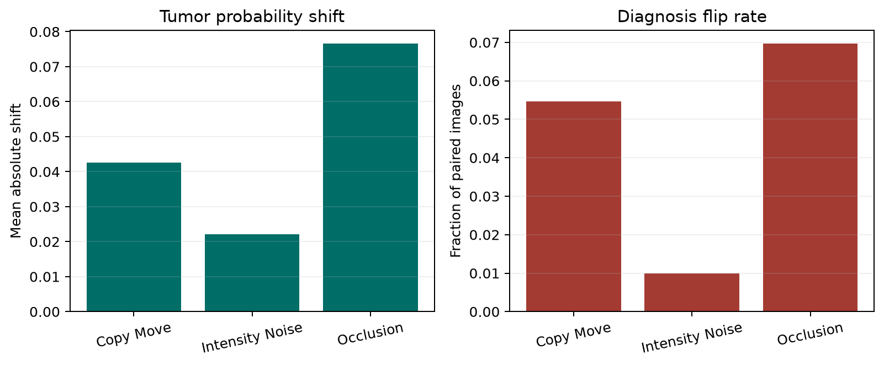
Occlusion was most disruptive
Robustness is not uniform
Across 603 pairs, occlusion caused a 7.65-point mean probability shift and a 6.97% diagnosis flip rate. Intensity/noise was least disruptive in this benchmark.
8
Notes:
[Sources]
- reports/figures/robustness_by_tamper.png
- artifacts/multitask_metrics.json
[/Sources]

Slide 9
The interface binds classification to image quality
01 UPLOAD
02 RUN
03 REVIEW
Standardize input
Decode JPG or PNG and preserve aspect ratio at 128 x 128.
Score both heads
Return tumor probability, integrity risk, and two Grad-CAM views.
Gate interpretation
Mark the tumor result provisional when image risk is uncertain or high.
9
Notes:
[Sources]
- app.py
- src/mri_integrity_lab/inference.py
[/Sources]

Slide 10
RESULT
Tumor first. Integrity always alongside.
94.36% tumor accuracy
0.870 integrity ROC-AUC
Research use only
Notes:
[Sources]
- artifacts/multitask_metrics.json
- Not externally or clinically validated.
[/Sources]

