Slide 1
Chapter 6 The Link layer & LANs

Slide 2
Chapter 6 The Link layer and LANs
our goals:
understand principles behind link layer services:
error detection, correction
sharing a broadcast channel: multiple access
link layer addressing
local area networks: Ethernet, VLANs
instantiation, implementation of various link layer technologies
The The Link layer and LANs

Slide 3
Chapter 6 The Link layer and LANs
6.1 introduction, services
6.2 error detection, correction
6.3 multiple access protocols
6.4 LANs
addressing, ARP
Ethernet
switches
VLANS
6.5 link virtualization: MPLS
6.6 data center networking
6.7 a day in the life of a web request
The The Link layer and LANs

Slide 4
Chapter 6 The Link layer and LANs
6.1 introduction, services
6.2 error detection, correction
6.3 multiple access protocols
6.4 LANs
addressing, ARP
Ethernet
switches
VLANS
6.5 link virtualization: MPLS
6.6 data center networking
6.7 a day in the life of a web request
The The Link layer and LANs

Slide 5

















Link layer: introduction
terminology:
hosts and routers: nodes
communication channels that connect adjacent nodes along communication path: links
wired links
wireless links
LANs
layer-2 packet: frame, encapsulates datagram
data-link layer has responsibility of
transferring datagram from one node
to physically adjacent node over a link
6.1 introduction, services

Slide 6
Link layer: context
datagram transferred by different link protocols over different links:
e.g., Ethernet on first link, frame relay on intermediate links, 802.11 on last link
each link protocol provides different services
e.g., may or may not provide rdt over link
transportation analogy:
trip from whu to Stanford
limo: whu campus to WUH
plane: WUH to SFO
caltrain: SFO to Palo Alto
tourist = datagram
transport segment = communication link
transportation mode = link layer protocol
travel agent = routing algorithm
6.1 introduction, services

Slide 7
Link layer services
framing, link access:
encapsulate datagram into frame, adding header, trailer
channel access if shared medium
"MAC" addresses used in frame headers to identify source, destination
different from IP address!
reliable delivery between adjacent nodes
we learned how to do this already (chapter 3)!
seldom used on low bit-error link (fiber, some twisted pair)
wireless links: high error rates
Q: why both link-level and end-end reliability?
6.1 introduction, services

Slide 8
Link layer services (more)
flow control:
pacing between adjacent sending and receiving nodes
error detection:
errors caused by signal attenuation, noise.
receiver detects presence of errors:
signals sender for retransmission or drops frame
error correction:
receiver identifies and corrects bit error(s) without resorting to retransmission
half-duplex and full-duplex
with half duplex, nodes at both ends of link can transmit, but not at same time
6.1 introduction, services

Slide 9
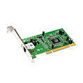
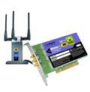

Where is the link layer implemented?
in each and every host
link layer implemented in "adaptor" (aka network interface card NIC) or on a chip
Ethernet card, 802.11 card; Ethernet chipset
implements link, physical layer
attaches into host's system buses
combination of hardware, software, firmware
application
transport
network
link
cpu
memory
link
physical
host
bus
(e.g., PCI)
controller
physical
transmission
network adapter
card
6.1 introduction, services

Slide 10
Adaptors communicating
datagram
datagram
controller
controller
sending host
receiving host
datagram
frame
sending side:
encapsulates datagram in frame
adds error checking bits, rdt, flow control, etc.
receiving side
looks for errors, rdt, flow control, etc.
extracts datagram, passes to upper layer at receiving side
6.1 introduction, services

Slide 11
Chapter 6 The Link layer and LANs
6.1 introduction, services
6.2 error detection, correction
6.3 multiple access protocols
6.4 LANs
addressing, ARP
Ethernet
switches
VLANS
6.5 link virtualization: MPLS
6.6 data center networking
6.7 a day in the life of a web request
The The Link layer and LANs

Slide 12
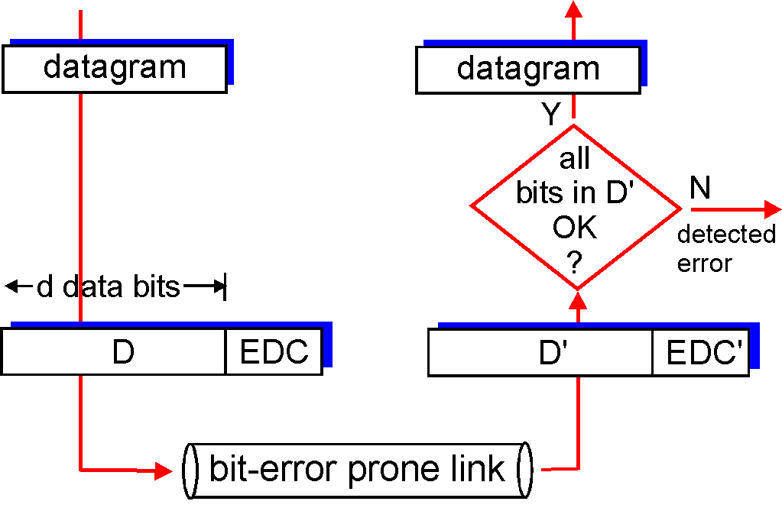
Error detection
EDC= Error Detection and Correction bits (redundancy)
D = Data protected by error checking, may include header fields
Error detection not 100% reliable!
protocol may miss some errors, but rarely
larger EDC field yields better detection and correction
otherwise
6.2 error detection, correction

Slide 13
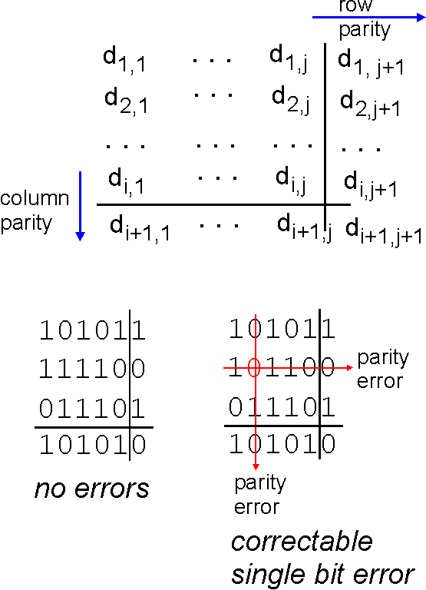
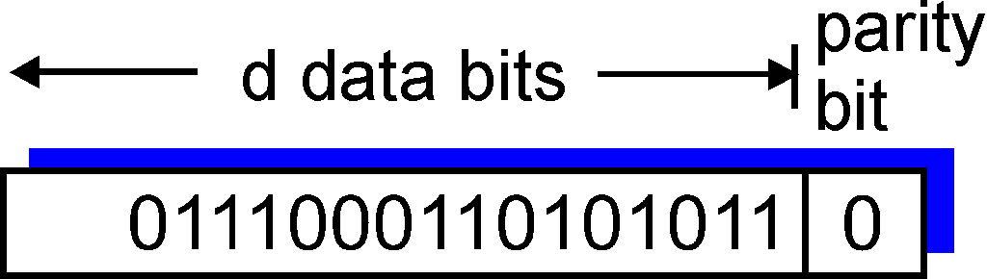
Parity checking
single bit parity:
detect single bit errors
two-dimensional bit parity:
detect and correct single bit errors
0
0
6.2 error detection, correction

Slide 14
Internet checksum (review)
goal: detect "errors" (e.g., flipped bits) in transmitted packet (note: used at transport layer only)
sender:
treat segment contents as sequence of 16-bit integers
checksum: addition (1's complement sum) of segment contents
sender puts checksum value into UDP checksum field
receiver:
compute checksum of received segment
check if computed checksum equals checksum field value:
NO - error detected
YES - no error detected. But maybe errors nonetheless?
6.2 error detection, correction

Slide 15
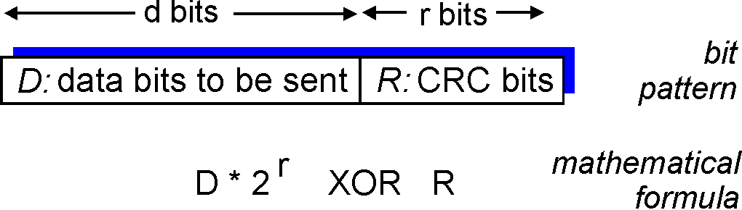
Cyclic redundancy check
more powerful error-detection coding
view data bits, D, as a binary number
choose r+1 bit pattern (generator), G
goal: choose r CRC bits, R, such that
<D,R> exactly divisible by G (modulo 2)
receiver knows G, divides <D,R> by G. If non-zero remainder: error detected!
can detect all burst errors less than r+1 bits
widely used in practice (Ethernet, 802.11 WiFi, ATM)
6.2 error detection, correction

Slide 16
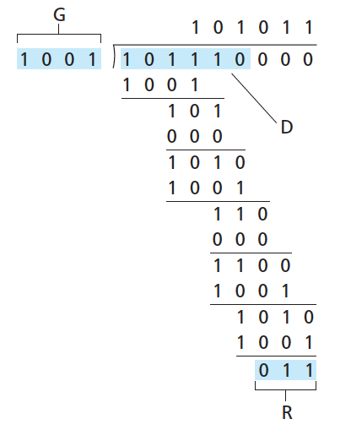
CRC example
want:
D.2^{r} XOR R = nG
equivalently:
D.2^{r} = nG XOR R
equivalently:
if we divide D.2^{r} by G, want remainder R to satisfy:
D.2^{r}
G
R = remainder[ ]
6.2 error detection, correction

Slide 17
Cyclic Redundancy Check
Powerful error detection scheme
Rather than addition, binary division is used → Finite Algebra Theory (Galois Fields)
Can be easily implemented with small amount of hardware
Shift registers
XOR (for addition and subtraction)

Slide 18
A binary code sequence can be viewed as a polynomial in binary
1
0
1
0
0
1
1
WHICH CAN BE VIEWED AS
or

Slide 19
multiplication
1
0
1
0
0
1
1
0
0
0

Slide 20
multiplication
1
0
0
0
1
1
1
1
1
0

Slide 21
addition

Slide 22
Cyclic Redundancy Check
Let us assume k message bits and n bits of redundancy
Associate bits with coefficients of a polynomial 1 0 1 1 0 1 1 1x⁶+0x⁵+1x⁴+1x³+0x²+1x+1 = x⁶+x⁴+x³+x+1
xxxxxxxxxx yyyy
Block of length k+n
k bits
n bits

Slide 23
Cyclic Redundancy Check
Let M(x) be the message polynomial 信息多项式
Let G(x) be the generator polynomial 生成多项式
G(x) is fixed for a given CRC scheme
G(x) is known both by sender and receiver
Create a block polynomial C(x) based on M(x) and G(x) such that C(x) is divisible by G(x)
码元多项式

Slide 24
Cyclic Redundancy Check
Sending
Multiply M(x) by x^{n}
Divide x^{n}M(x) by G(x)
Ignore the quotient and keep the reminder R(x)
Form and send C(x) = x^{n}M(x)+R(x)
Receiving
Receive C ’(x)
Divide C ’(x) by G(x)
Accept if remainder is 0, reject otherwise

Slide 25
Proof of CRC Generation
Remainder 0
Remainder 0
Note: Binary modular addition is equivalent to binary modular subtraction → R(x) + R(x) = 0

Slide 26
Example
Send
M(x) = 110011 → x⁵+x⁴+x+1 (6 bits)
G(x) = 11001 → x⁴+x³+1 (5 bits, n = 4) → 4 bits of redundancy
Form x^{n}M(x) → 110011 0000 → x⁹+x⁸+x⁵+x⁴
Divide x^{n}M(x) by G(x) to find R(x)
Receive
No remainder
→ Accept
= R(x)
Send the block 110011 1001

Slide 27
Properties of CRC
Sent C(x), but received C ’(x) = C(x)+E(x) When will E(x)/G(x) have no remainder, i.e., when does CRC fail to catch an error?
Single Bit Error → E(x) = x^{i} If G(x) has two or more terms, G(x) will not divide E(x)
2 Isolated Single Bit Errors (double errors) E(x) = x^{i}+x^{j}, i > j E(x) = x^{j} (x^{i-j} + 1) Provided that G(x) is not divisible by x, a sufficient condition to detect all double errors is that G(x) does not divide (x^{t} + 1) for any t up to i-j (i.e., block length)

Slide 28
Properties of CRC
Odd Number of Bit Errors If x+1 is a factor of G(x), all odd number of bit errors are detected Proof: Assume an odd number of errors has x+1 as a factor. Then E(x) = (x+1)T(x). Evaluate E(x) for x = 1 → E(x) = E(1) = 1 since there are odd number of terms (x+1) = (1+1) = 0 (x+1)T(x) = (1+1)T(1) = 0 ∴ E(x) ≠ (x+1)T(x)

Slide 29
Properties of CRC
Short Burst Errors (Length t ≤ n, number of redundant bits) E(x) = x^{j}(x^{t-1}+…+1) → Length t, starting at bit position j If G(x) has an x⁰ term and t ≤ n, G(x) will not divide E(x) ∴All errors up to length n are detected
Long Burst Errors (Length t = n+1) Undetectable only if burst error is the same as G(x) G(x) = x^{n} + … + 1 n -1 bits between x^{n} and x⁰ E(x) = 1 + … + 1 must match Probability of not detecting the error is 2^{-(n-1)}
Longer Burst Errors (Length t > n+1) Probability of not detecting the error is 2^{-n}

Slide 30
Properties of CRC
Example:
CRC-12 = x¹²+x¹¹+x³+x²+x+1 CRC-16 = x¹⁶+x¹⁵+x²+1 CRC-CCITT = x¹⁶+x¹²+x⁵+1
CRC-16 and CRC-CCITT catch all
Single and double errors
Odd number of bit errors
Bursts of length 16 or less
99.997% of 17-bit error bursts
99.998% of 18-bit and longer error bursts

Slide 31
Chapter 6 The Link layer and LANs
6.1 introduction, services
6.2 error detection, correction
6.3 multiple access protocols
6.4 LANs
addressing, ARP
Ethernet
switches
VLANS
6.5 link virtualization: MPLS
6.6 data center networking
6.7 a day in the life of a web request
The The Link layer and LANs

Slide 32



Multiple access links, protocols
two types of "links":
point-to-point
PPP for dial-up access
point-to-point link between Ethernet switch, host
broadcast (shared wire or medium)
old-fashioned Ethernet
upstream HFC
802.11 wireless LAN
shared wire (e.g.,
cabled Ethernet)
shared RF
(e.g., 802.11 WiFi)
shared RF
(satellite)
humans at a
cocktail party
(shared air, acoustical)
6.3 multiple access protocols
Notes:
hybrid fiber-coaxial cable

Slide 33
Multiple access protocols
single shared broadcast channel
two or more simultaneous transmissions by nodes: interference
collision if node receives two or more signals at the same time
multiple access protocol
distributed algorithm that determines how nodes share channel, i.e., determine when node can transmit
communication about channel sharing must use channel itself!
no out-of-band channel for coordination
6.3 multiple access protocols

Slide 34
An ideal multiple access protocol
given: broadcast channel of rate R bps
desiderata:
1. when one node wants to transmit, it can send at rate R.
2. when M nodes want to transmit, each can send at average rate R/M
3. fully decentralized:
no special node to coordinate transmissions
no synchronization of clocks, slots
4. simple
6.3 multiple access protocols

Slide 35
MAC protocols: taxonomy
three broad classes:
channel partitioning
divide channel into smaller "pieces" (time slots, frequency, code)
allocate piece to node for exclusive use
random access
channel not divided, allow collisions
"recover" from collisions
"taking turns"
nodes take turns, but nodes with more to send can take longer turns
6.3 multiple access protocols

Slide 36
Channel partitioning MAC protocols: TDMA
TDMA: time division multiple access
access to channel in "rounds"
each station gets fixed length slot (length = packet transmission time) in each round
unused slots go idle
example: 6-station LAN, 1,3,4 have packets to send, slots 2,5,6 idle
6-slot
frame
6-slot
frame
1
3
4
1
3
4
6.3 multiple access protocols

Slide 37
Channel partitioning MAC protocols: FDMA
FDMA: frequency division multiple access
channel spectrum divided into frequency bands
each station assigned fixed frequency band
unused transmission time in frequency bands go idle
example: 6-station LAN, 1,3,4 have packet to send, frequency bands 2,5,6 idle
time
frequency bands
FDM cable
6.3 multiple access protocols

Slide 38
Random access protocols
when node has packet to send
transmit at full channel data rate R.
no a priori coordination among nodes
two or more transmitting nodes ➜ "collision",
random access MAC protocol specifies:
how to detect collisions
how to recover from collisions (e.g., via delayed retransmissions)
examples of random access MAC protocols:
slotted ALOHA
ALOHA
CSMA, CSMA/CD, CSMA/CA
6.3 multiple access protocols

Slide 39
Slotted ALOHA
assumptions:
all frames same size
time divided into equal size slots (time to transmit 1 frame)
nodes start to transmit only slot beginning
nodes are synchronized
if 2 or more nodes transmit in slot, all nodes detect collision
operation:
when node obtains fresh frame, transmits in next slot
if no collision: node can send new frame in next slot
if collision: node retransmits frame in each subsequent slot with prob. p until success
6.3 multiple access protocols

Slide 40
Slotted ALOHA
node 1
1
1
1
1
node 2
2
2
2
node 3
3
3
3
C
E
C
S
E
C
E
S
S
Pros:
single active node can continuously transmit at full rate of channel
highly decentralized: only slots in nodes need to be in sync
simple
Cons:
collisions, wasting slots
idle slots
nodes may be able to detect collision in less than time to transmit packet
clock synchronization
6.3 multiple access protocols
Notes:
Pros 利
Cons 弊
pros and cons 利弊

Slide 41
Slotted ALOHA: efficiency
efficiency: long-run fraction of successful slots (many nodes, all with many frames to send)
max efficiency: find p* that maximizes Np(1-p)^{N-1}
for many nodes, take limit of Np*(1-p*)^{N-1} as N goes to infinity, gives:
max efficiency = 1/e = .37
suppose: N nodes with many frames to send, each transmits in slot with probability p
prob that given node has success in a slot = p(1-p)^{N-1}
prob that any node has a success = Np(1-p)^{N-1}
!
at best: channel
used for useful
transmissions 37%
of time!
6.3 multiple access protocols

Slide 42
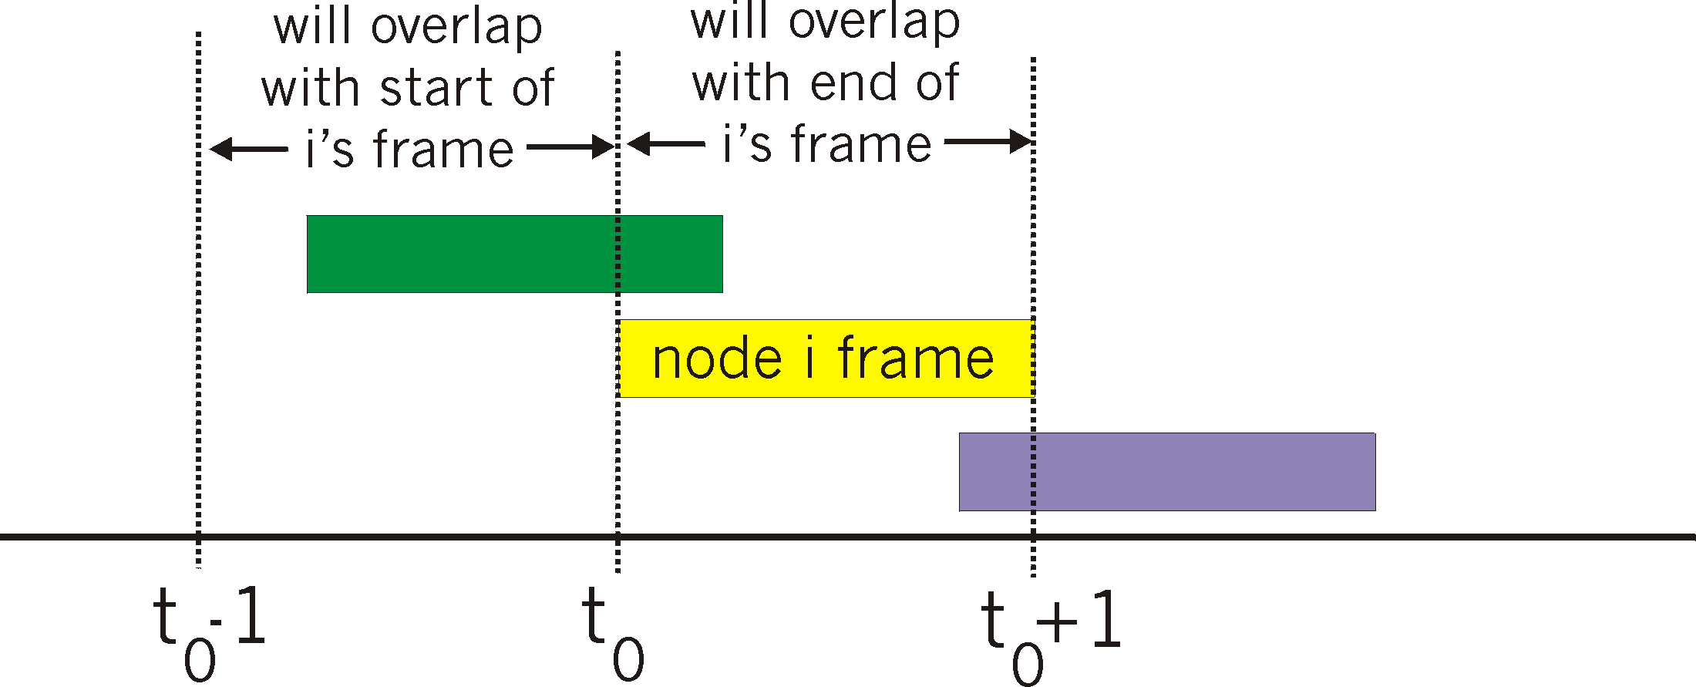
Pure (unslotted) ALOHA
unslotted Aloha: simpler, no synchronization
when frame first arrives
transmit immediately
collision probability increases:
frame sent at t₀ collides with other frames sent in [t₀-1,t₀+1]
6.3 multiple access protocols

Slide 43
Pure ALOHA efficiency
P(success by given node) = P(node transmits) .
P(no other node transmits in [t₀-1,t₀] .
P(no other node transmits in [t₀-1,t₀]
= p . (1-p)^{N-1 .} (1-p)^{N-1}
= p . (1-p)^{2(N-1)}
… choosing optimum p and then letting n
= 1/(2e) = .18
even worse than slotted Aloha!
6.3 multiple access protocols

Slide 44
CSMA (carrier sense multiple access)
CSMA: listen before transmit:
if channel sensed idle: transmit entire frame
if channel sensed busy, defer transmission
human analogy: don't interrupt others!
6.3 multiple access protocols

Slide 45
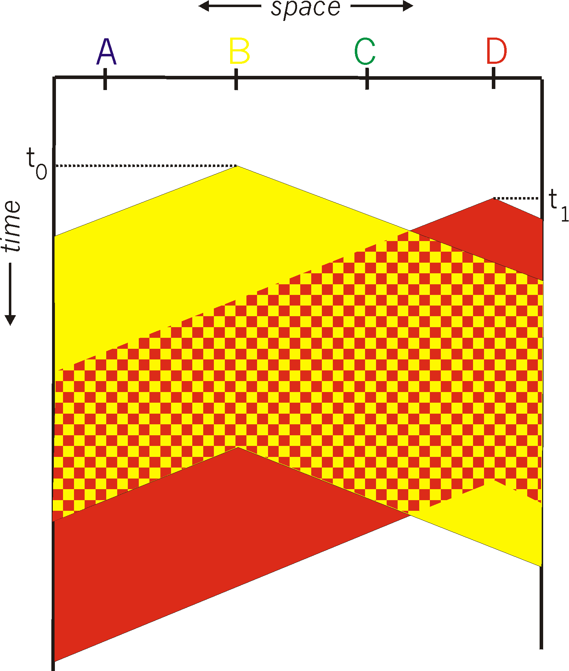
CSMA collisions
spatial layout of nodes
collisions can still occur: propagation delay means two nodes may not hear each other's transmission
collision: entire packet transmission time wasted
distance & propagation delay play role in in determining collision probability
6.3 multiple access protocols

Slide 46
CSMA/CD (collision detection)
CSMA/CD: carrier sensing, deferral as in CSMA
collisions detected within short time
colliding transmissions aborted, reducing channel wastage
collision detection:
easy in wired LANs: measure signal strengths, compare transmitted, received signals
difficult in wireless LANs: received signal strength overwhelmed by local transmission strength
human analogy: the polite conversationalist
6.3 multiple access protocols

Slide 47
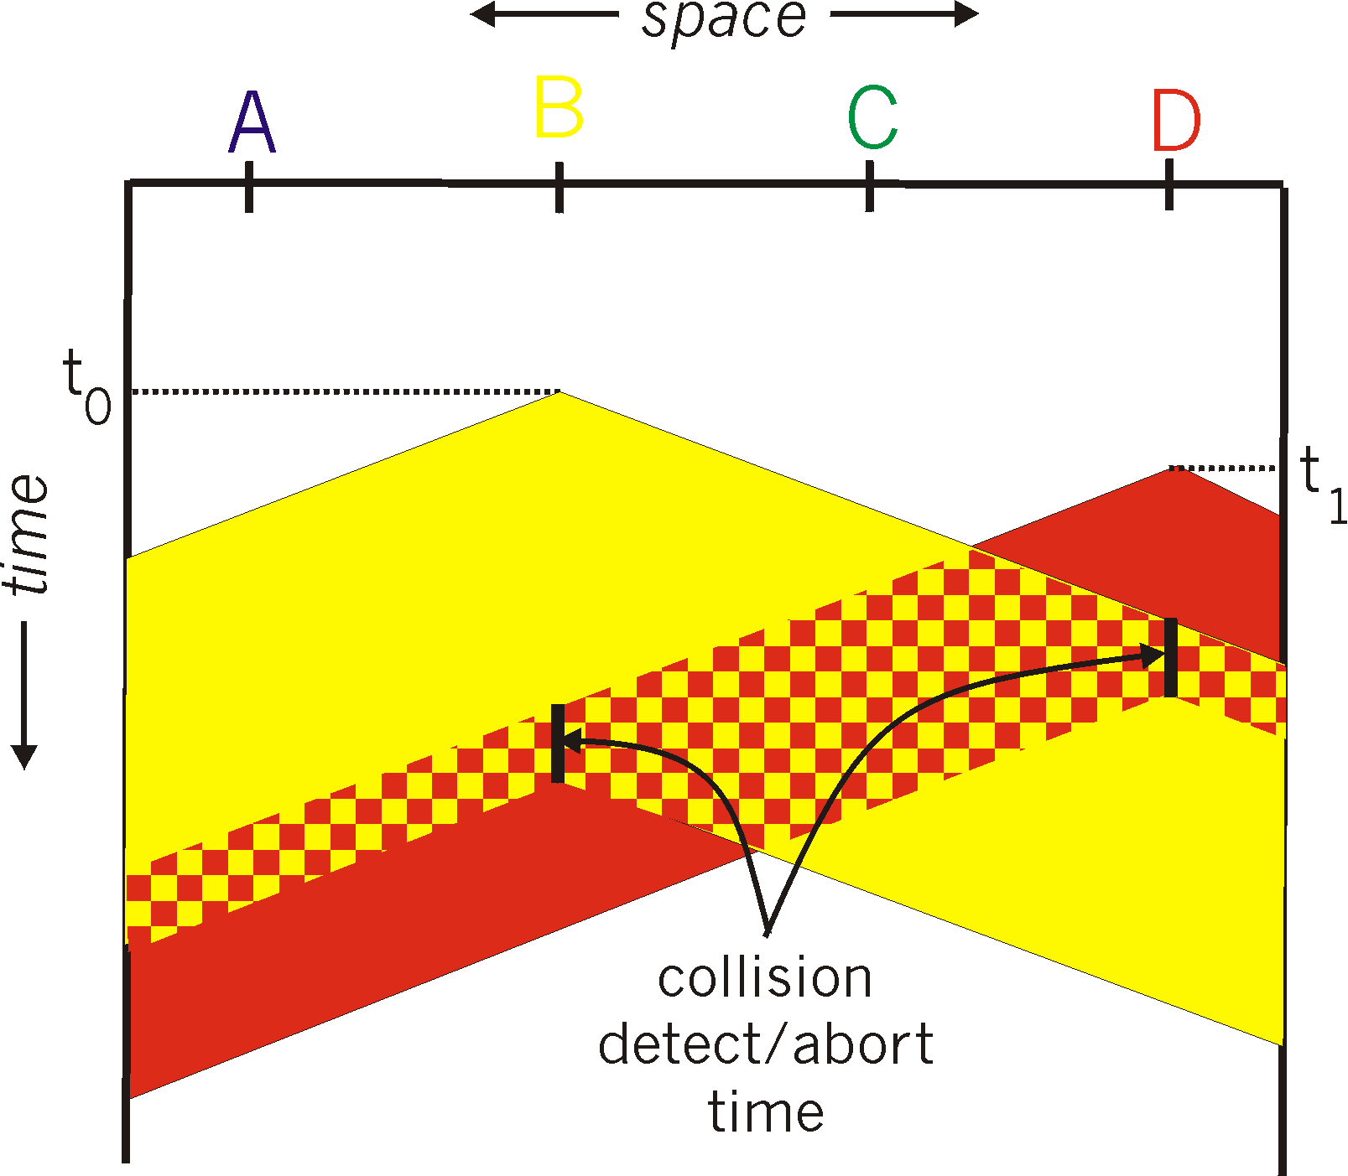
CSMA/CD (collision detection)
spatial layout of nodes
6.3 multiple access protocols

Slide 48
Ethernet CSMA/CD algorithm
1. NIC receives datagram from network layer, creates frame
2. If NIC senses channel idle, starts frame transmission. If NIC senses channel busy, waits until channel idle, then transmits.
3. If NIC transmits entire frame without detecting another transmission, NIC is done with frame !
4. If NIC detects another transmission while transmitting, aborts and sends jam signal
5. After aborting, NIC enters binary (exponential) backoff:
after mth collision, NIC chooses K at random from {0,1,2, …, 2^{m}-1}. NIC waits K·512 bit times, returns to Step 2
longer backoff interval with more collisions
6.3 multiple access protocols

Slide 49
CSMA/CD efficiency
T_{prop} = max prop delay between 2 nodes in LAN
t_{trans} = time to transmit max-size frame
efficiency goes to 1
as t_{prop} goes to 0
as t_{trans} goes to infinity
better performance than ALOHA: and simple, cheap, decentralized!
6.3 multiple access protocols

Slide 50
"Taking turns" MAC protocols
channel partitioning MAC protocols:
share channel efficiently and fairly at high load
inefficient at low load: delay in channel access, 1/N bandwidth allocated even if only 1 active node!
random access MAC protocols
efficient at low load: single node can fully utilize channel
high load: collision overhead
"taking turns" protocols
look for best of both worlds!
6.3 multiple access protocols

Slide 51
"Taking turns" MAC protocols
polling:
master node "invites" slave nodes to transmit in turn
typically used with "dumb" slave devices
concerns:
polling overhead
latency
single point of failure (master)
data
poll
master
data
slaves
6.3 multiple access protocols

Slide 52
"Taking turns" MAC protocols
token passing:
control token passed from one node to next sequentially.
token message
concerns:
token overhead
latency
single point of failure (token)
T
(nothing
to send)
T
data
6.3 multiple access protocols

Slide 53
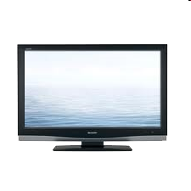


Cable access network
Internet frames, TV channels, control transmitted
downstream at different frequencies
cable headend
…
CMTS
…
splitter
cable
modem
cable modem
termination system
ISP
upstream Internet frames, TV control, transmitted
upstream at different frequencies in time slots
multiple 40Mbps downstream (broadcast) channels
single CMTS transmits into channels
multiple 30 Mbps upstream channels
multiple access: all users contend for certain upstream channel time slots (others assigned)
6.3 multiple access protocols

Slide 54
Cable access network
cable headend
MAP frame for
Interval [t1, t2]
CMTS
Downstream channel i
Upstream channel j
t₁
t₂
Residences with cable modems
Minislots containing
minislots request frames
Assigned minislots containing cable modem
upstream data frames
DOCSIS: data over cable service interface spec
FDM over upstream, downstream frequency channels
TDM upstream: some slots assigned, some have contention
downstream MAP frame: assigns upstream slots
request for upstream slots (and data) transmitted random access (binary backoff) in selected slots
6.3 multiple access protocols

Slide 55
Summary of MAC protocols
channel partitioning, by time, frequency or code
Time Division, Frequency Division
random access (dynamic),
ALOHA, S-ALOHA, CSMA, CSMA/CD
carrier sensing: easy in some technologies (wire), hard in others (wireless)
CSMA/CD used in Ethernet
CSMA/CA used in 802.11
taking turns
polling from central site, token passing
Bluetooth, FDDI, token ring
6.3 multiple access protocols

Slide 56
Chapter 6 The Link layer and LANs
6.1 introduction, services
6.2 error detection, correction
6.3 multiple access protocols
6.4 LANs
addressing, ARP
Ethernet
switches
VLANS
6.5 link virtualization: MPLS
6.6 data center networking
6.7 a day in the life of a web request
The The Link layer and LANs

Slide 57
Chapter 6 The Link layer and LANs
6.1 introduction, services
6.2 error detection, correction
6.3 multiple access protocols
6.4 LANs
addressing, ARP
Ethernet
switches
VLANS
6.5 link virtualization: MPLS
6.6 data center networking
6.7 a day in the life of a web request
The The Link layer and LANs

Slide 58
MAC addresses and ARP
32-bit IP address:
network-layer address for interface
used for layer 3 (network layer) forwarding
MAC (or LAN or physical or Ethernet) address:
function: used 'locally" to get frame from one interface to another physically-connected interface (same network, in IP-addressing sense)
48 bit MAC address (for most LANs) burned in NIC ROM, also sometimes software settable
e.g.: 1A-2F-BB-76-09-AD
hexadecimal (base 16) notation
(each "numeral" represents 4 bits)
6.4 LANs

Slide 59
LAN addresses and ARP
each adapter on LAN has unique LAN address
1A-2F-BB-76-09-AD
LAN
(wired or
wireless)
adapter
71-65-F7-2B-08-53
58-23-D7-FA-20-B0
0C-C4-11-6F-E3-98
6.4 LANs

Slide 60
LAN addresses (more)
MAC address allocation administered by IEEE
manufacturer buys portion of MAC address space (to assure uniqueness)
analogy:
MAC address: like Social Security Number
IP address: like postal address, zip code
MAC flat address ➜ portability
can move LAN card from one LAN to another
IP hierarchical address not portable
address depends on IP subnet to which node is attached
6.4 LANs

Slide 61


ARP: address resolution protocol
Question: how to determine
interface's MAC address, knowing its IP address?
ARP table: each IP node (host, router) on LAN has table
IP/MAC address mappings for some LAN nodes:
< IP address; MAC address; TTL>
TTL (Time To Live): time after which address mapping will be forgotten (typically 20 min)
137.196.7.78
1A-2F-BB-76-09-AD
137.196.7.23
137.196.7.14
LAN
71-65-F7-2B-08-53
58-23-D7-FA-20-B0
0C-C4-11-6F-E3-98
137.196.7.88
6.4 LANs

Slide 62
ARP protocol: same LAN
A wants to send datagram to B
B's MAC address not in A's ARP table.
A broadcasts ARP query packet, containing B's IP address
destination MAC address = FF-FF-FF-FF-FF-FF
all nodes on LAN receive ARP query
B receives ARP packet, replies to A with its (B's) MAC address
frame sent to A's MAC address (unicast)
A caches (saves) IP-to-MAC address pair in its ARP table until information becomes old (times out)
soft state: information that times out (goes away) unless refreshed
ARP is "plug-and-play":
nodes create their ARP tables without intervention from net administrator
6.4 LANs

Slide 63
Addressing: routing to another LAN
walkthrough: send datagram from A to B via R
focus on addressing – at IP (datagram) and MAC layer (frame)
assume A knows B's IP address
assume A knows IP address of first hop router, R (how?)
assume A knows R's MAC address (how?)
A
B
R
111.111.111.111
222.222.222.222
74-29-9C-E8-FF-55
49-BD-D2-C7-56-2A
222.222.222.220
1A-23-F9-CD-06-9B
111.111.111.112
111.111.111.110
222.222.222.221
CC-49-DE-D0-AB-7D
E6-E9-00-17-BB-4B
88-B2-2F-54-1A-0F
6.4 LANs

Slide 64
Addressing: routing to another LAN
A creates IP datagram with IP source A, destination B
A creates link-layer frame with R's MAC address as destination address, frame contains A-to-B IP datagram
MAC src: 74-29-9C-E8-FF-55
MAC dest: E6-E9-00-17-BB-4B
IP
Eth
Phy
IP src: 111.111.111.111
IP dest: 222.222.222.222
A
B
R
111.111.111.111
222.222.222.222
74-29-9C-E8-FF-55
49-BD-D2-C7-56-2A
222.222.222.220
1A-23-F9-CD-06-9B
111.111.111.112
111.111.111.110
222.222.222.221
CC-49-DE-D0-AB-7D
E6-E9-00-17-BB-4B
88-B2-2F-54-1A-0F
6.4 LANs

Slide 65
Addressing: routing to another LAN
frame sent from A to R
frame received at R, datagram removed, passed up to IP
MAC src: 74-29-9C-E8-FF-55
MAC dest: E6-E9-00-17-BB-4B
IP src: 111.111.111.111
IP dest: 222.222.222.222
IP
Eth
Phy
IP src: 111.111.111.111
IP dest: 222.222.222.222
IP
Eth
Phy
A
B
R
111.111.111.111
222.222.222.222
74-29-9C-E8-FF-55
49-BD-D2-C7-56-2A
222.222.222.220
1A-23-F9-CD-06-9B
111.111.111.112
111.111.111.110
222.222.222.221
CC-49-DE-D0-AB-7D
E6-E9-00-17-BB-4B
88-B2-2F-54-1A-0F
6.4 LANs

Slide 66
Addressing: routing to another LAN
R forwards datagram with IP source A, destination B
R creates link-layer frame with B's MAC address as destination address, frame contains A-to-B IP datagram
MAC src: 1A-23-F9-CD-06-9B
MAC dest: 49-BD-D2-C7-56-2A
IP
Eth
Phy
IP
Eth
Phy
IP src: 111.111.111.111
IP dest: 222.222.222.222
A
B
R
111.111.111.111
222.222.222.222
74-29-9C-E8-FF-55
49-BD-D2-C7-56-2A
222.222.222.220
1A-23-F9-CD-06-9B
111.111.111.112
111.111.111.110
222.222.222.221
CC-49-DE-D0-AB-7D
E6-E9-00-17-BB-4B
88-B2-2F-54-1A-0F
6.4 LANs

Slide 67
Addressing: routing to another LAN
R forwards datagram with IP source A, destination B
R creates link-layer frame with B's MAC address as destination address, frame contains A-to-B IP datagram
MAC src: 1A-23-F9-CD-06-9B
MAC dest: 49-BD-D2-C7-56-2A
IP
Eth
Phy
IP
Eth
Phy
IP src: 111.111.111.111
IP dest: 222.222.222.222
A
B
R
111.111.111.111
222.222.222.222
74-29-9C-E8-FF-55
49-BD-D2-C7-56-2A
222.222.222.220
1A-23-F9-CD-06-9B
111.111.111.112
111.111.111.110
222.222.222.221
CC-49-DE-D0-AB-7D
E6-E9-00-17-BB-4B
88-B2-2F-54-1A-0F
6.4 LANs

Slide 68
Addressing: routing to another LAN
R forwards datagram with IP source A, destination B
R creates link-layer frame with B's MAC address as dest, frame contains A-to-B IP datagram
MAC src: 1A-23-F9-CD-06-9B
MAC dest: 49-BD-D2-C7-56-2A
IP src: 111.111.111.111
IP dest: 222.222.222.222
IP
Eth
Phy
A
B
R
111.111.111.111
222.222.222.222
74-29-9C-E8-FF-55
49-BD-D2-C7-56-2A
222.222.222.220
1A-23-F9-CD-06-9B
111.111.111.112
111.111.111.110
222.222.222.221
CC-49-DE-D0-AB-7D
E6-E9-00-17-BB-4B
88-B2-2F-54-1A-0F
6.4 LANs

Slide 69
Chapter 6 The Link layer and LANs
6.1 introduction, services
6.2 error detection, correction
6.3 multiple access protocols
6.4 LANs
addressing, ARP
Ethernet
switches
VLANS
6.5 link virtualization: MPLS
6.6 data center networking
6.7 a day in the life of a web request
The The Link layer and LANs

Slide 70

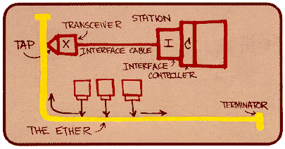
Ethernet
"dominant" wired LAN technology:
single chip, multiple speeds (e.g., Broadcom BCM5761)
first widely used LAN technology
simpler, cheap
kept up with speed race: 10 Mbps – 10 Gbps
Metcalfe's Ethernet sketch
6.4 LANs

Slide 71

Ethernet: physical topology
bus: popular through mid 90s
all nodes in same collision domain (can collide with each other)
star: prevails today
active switch in center
each "spoke" runs a (separate) Ethernet protocol (nodes do not collide with each other)
switch
star
bus: coaxial cable
6.4 LANs

Slide 72
Ethernet frame structure
sending adapter encapsulates IP datagram (or other network layer protocol packet) in Ethernet frame
preamble:
7 bytes with pattern 10101010 followed by one byte with pattern 10101011
used to synchronize receiver, sender clock rates
type
preamble
dest.
address
source
address
data (payload)
CRC
6.4 LANs

Slide 73
Ethernet frame structure (more)
addresses: 6 byte source, destination MAC addresses
if adapter receives frame with matching destination address, or with broadcast address (e.g. ARP packet), it passes data in frame to network layer protocol
otherwise, adapter discards frame
type: indicates higher layer protocol (mostly IP but others possible, e.g., Novell IPX, AppleTalk)
CRC: cyclic redundancy check at receiver
error detected: frame is dropped
type
preamble
dest.
address
source
address
data (payload)
CRC
6.4 LANs

Slide 74
Ethernet: unreliable, connectionless
connectionless: no handshaking between sending and receiving NICs
unreliable: receiving NIC doesn't send acks or nacks to sending NIC
data in dropped frames recovered only if initial sender uses higher layer rdt (e.g., TCP), otherwise dropped data lost
Ethernet's MAC protocol: unslotted CSMA/CD with binary backoff
6.4 LANs

Slide 75
802.3 Ethernet standards: link & physical layers
many different Ethernet standards
common MAC protocol and frame format
different speeds: 2 Mbps, 10 Mbps, 100 Mbps, 1Gbps, 10 Gbps, 40 Gbps
different physical layer media: fiber, cable
application
transport
network
link
physical
MAC protocol
and frame format
100BASE-TX
100BASE-T2
100BASE-FX
100BASE-T4
100BASE-SX
100BASE-BX
copper (twister
pair) physical layer
fiber physical layer
6.4 LANs

Slide 76
Chapter 6 The Link layer and LANs
6.1 introduction, services
6.2 error detection, correction
6.3 multiple access protocols
6.4 LANs
addressing, ARP
Ethernet
switches
VLANS
6.5 link virtualization: MPLS
6.6 data center networking
6.7 a day in the life of a web request
The The Link layer and LANs

Slide 77
Ethernet switch
link-layer device: takes an active role
store, forward Ethernet frames
examine incoming frame's MAC address, selectively forward frame to one-or-more outgoing links when frame is to be forwarded on segment, uses CSMA/CD to access segment
transparent
hosts are unaware of presence of switches
plug-and-play, self-learning
switches do not need to be configured
6.4 LANs

Slide 78
Switch: multiple simultaneous transmissions
hosts have dedicated, direct connection to switch
switches buffer packets
Ethernet protocol used on each incoming link, but no collisions; full duplex
each link is its own collision domain
switching: A-to-A' and B-to-B' can transmit simultaneously, without collisions
A
C'
B
6
1
2
5
4
3
B'
C
A'
switch with six interfaces
(1,2,3,4,5,6)
6.4 LANs

Slide 79
Switch forwarding table
Q: how does switch know A' reachable via interface 4, B' reachable via interface 5?
A
C'
B
A: each switch has a switch table, each entry:
(MAC address of host, interface to reach host, time stamp)
looks like a routing table!
6
1
2
5
4
3
B'
C
Q: how are entries created, maintained in switch table?
something like a routing protocol?
A'
switch with six interfaces
(1,2,3,4,5,6)
6.4 LANs

Slide 80
Switch: self-learning
Source: A
Dest: A'
switch learns which hosts can be reached through which interfaces
when frame received, switch "learns" location of sender: incoming LAN segment
records sender/location pair in switch table
A
A A'
C'
B
6
1
2
5
4
3
B'
C
A'
MAC addr interface TTL
A
1
60
Switch table
(initially empty)
6.4 LANs

Slide 81
Switch: frame filtering/forwarding
when frame received at switch:
1. record incoming link, MAC address of sending host
2. index switch table using MAC destination address
3. if entry found for destination then {
if destination on segment from which frame arrived then drop frame
else forward frame on interface indicated by entry
}
else flood /* forward on all interfaces except arriving
interface */
6.4 LANs

Slide 82
Self-learning, forwarding: example
Source: A
Dest: A'
A
A A'
frame destination, A', location unknown:
flood
C'
B
destination A location known:
6
1
2
selectively send
on just one link
A A'
A A'
A A'
A A'
A A'
5
4
3
B'
C
A' A
A'
MAC addr interface TTL
A
1
60
switch table
(initially empty)
A'
4
60
6.4 LANs

Slide 83

Interconnecting switches
self-learning switches can be connected together:
S₄
S₁
S₃
A
S₂
F
I
B
C
D
E
G
H
Q: sending from A to G - how does S₁ know to forward frame destined to G via S₄ and S₃?
A: self learning! (works exactly the same as in single-switch case!)
6.4 LANs

Slide 84
Self-learning multi-switch example
Suppose C sends frame to I, I responds to C
S₄
S₁
S₃
A
S₂
F
I
B
C
D
E
G
H
Q: show switch tables and packet forwarding in S₁, S₂, S₃, S₄
6.4 LANs

Slide 85
Institutional network
mail server
to external
network
router
web server
IP subnet
6.4 LANs

Slide 86
Switches vs. routers
application
transport
network
link
physical
both are store-and-forward:
routers: network-layer devices (examine network-layer headers)
switches: link-layer devices (examine link-layer headers)
both have forwarding tables:
routers: compute tables using routing algorithms, IP addresses
switches: learn forwarding table using flooding, learning, MAC addresses
datagram
frame
link
physical
frame
switch
network
link
physical
datagram
frame
application
transport
network
link
physical
6.4 LANs

Slide 87


VLANs: motivation
consider:
CS user moves office to EE, but wants connect to CS switch?
single broadcast domain:
all layer-2 broadcast traffic (ARP, DHCP, unknown location of destination MAC address) must cross entire LAN
security/privacy, efficiency issues
Computer
Science
Computer
Engineering
Electrical
Engineering
6.4 LANs

Slide 88
VLANs
port-based VLAN: switch ports grouped (by switch management software) so that single physical switch ……
Virtual Local
Area Network
1
7
9
15
2
8
10
16
switch(es) supporting VLAN capabilities can be configured to define multiple virtual LANS over single physical LAN infrastructure.
…
…
Electrical Engineering
(VLAN ports 1-8)
Computer Science
(VLAN ports 9-15)
… operates as multiple virtual switches
1
7
9
15
2
8
10
16
…
…
Electrical Engineering
(VLAN ports 1-8)
Computer Science
(VLAN ports 9-16)
6.4 LANs

Slide 89
Port-based VLAN
router
traffic isolation: frames to/from ports 1-8 can only reach ports 1-8
can also define VLAN based on MAC addresses of endpoints, rather than switch port
1
7
9
15
2
8
10
16
dynamic membership: ports can be dynamically assigned among VLANs
…
…
Electrical Engineering
(VLAN ports 1-8)
Computer Science
(VLAN ports 9-15)
forwarding between VLANS: done via routing (just as with separate switches)
in practice vendors sell combined switches plus routers
6.4 LANs

Slide 90
VLANS spanning multiple switches
1
7
9
15
1
3
5
7
2
8
10
16
2
4
6
8
…
…
Electrical Engineering
(VLAN ports 1-8)
Computer Science
(VLAN ports 9-15)
Ports 2,3,5 belong to EE VLAN
Ports 4,6,7,8 belong to CS VLAN
trunk port: carries frames between VLANS defined over multiple physical switches
frames forwarded within VLAN between switches can't be vanilla 802.1 frames (must carry VLAN ID info)
802.1q protocol adds/removed additional header fields for frames forwarded between trunk ports
6.4 LANs

Slide 91
802.1Q VLAN frame format
type
preamble
dest.
address
source
address
data (payload)
CRC
802.1 frame
type
preamble
dest.
address
source
address
data (payload)
CRC
802.1Q frame
2-byte Tag Protocol Identifier
(value: 81-00)
Recomputed
CRC
Tag Control Information (12 bit VLAN ID field,
3 bit priority field like IP TOS)
6.4 LANs

Slide 92
Chapter 6 The Link layer and LANs
6.1 introduction, services
6.2 error detection, correction
6.3 multiple access protocols
6.4 LANs
addressing, ARP
Ethernet
switches
VLANS
6.5 link virtualization: MPLS
6.6 data center networking
6.7 a day in the life of a web request
The The Link layer and LANs

Slide 93
Chapter 6 The Link layer and LANs
6.1 introduction, services
6.2 error detection, correction
6.3 multiple access protocols
6.4 LANs
addressing, ARP
Ethernet
switches
VLANS
6.5 link virtualization: MPLS
6.6 data center networking
6.7 a day in the life of a web request
The The Link layer and LANs

Slide 94
Chapter 6 The Link layer and LANs
6.1 introduction, services
6.2 error detection, correction
6.3 multiple access protocols
6.4 LANs
addressing, ARP
Ethernet
switches
VLANS
6.5 link virtualization: MPLS
6.6 data center networking
6.7 a day in the life of a web request
The The Link layer and LANs

Slide 95
Chapter 6: summary
principles behind data link layer services:
error detection, correction
sharing a broadcast channel: multiple access
link layer addressing
instantiation and implementation of various link layer technologies
Ethernet
switched LANS, VLANs
virtualized networks as a link layer: MPLS
synthesis: a day in the life of a web request
The The Link layer and LANs

Slide 96
Chapter 6: let's take a breath
journey down protocol stack complete (except PHY)
solid understanding of networking principles, practice
….. could stop here …. but lots of interesting topics!
wireless
multimedia
security
The The Link layer and LANs

Slide 97
Homework
第6章后作业选做5题
The The Link layer and LANs

