Slide 1
网络与分布式计算
实验课
Networks and Distributed Computing
LAB

Slide 2

Networks and Distributed Computing
LAB
Jicheng Hu
CS, Wuhan University
jicheng @ yahoo . Com
https://github.com/jichenghu
Room E315, E-WING, Building of Computer Science
Phone (office): 027-68776033

Slide 3
NPcap & Wireshark
Wireshark默认匹配安装的是WinPcap,但是WinPcap有个缺点，不能抓取本地回环数据
NPcap是在WinPcap的基础上进行优化开发的，可以抓取本地数据
如果已安装WinPcap的请卸载，最好Wireshark一起卸载掉，重新安装，先安装NPcap，再安装Wireshark
安装地址：NPcap https://github.com/jichenghu/npcap
Wireshark
官方地址： NPcap https://nmap.org/npcap/
The Link Layer and LANs

Slide 4
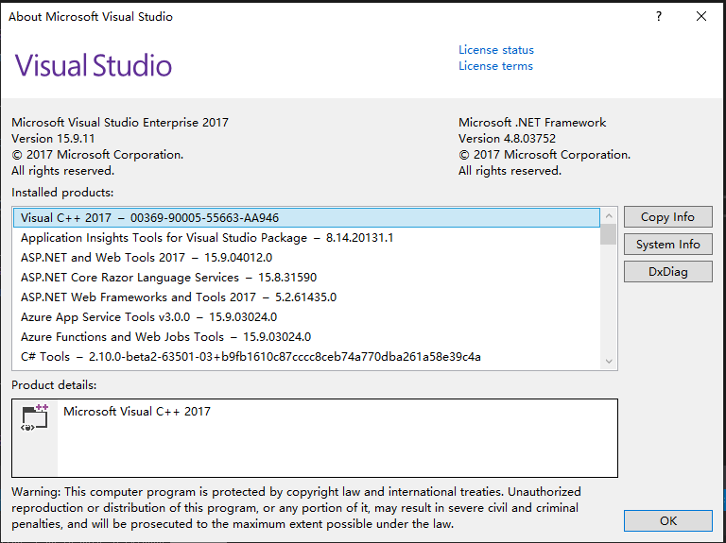
Software Environment
先检查你的VS 2017是否更新到最新的版本
下面的安装过程如果不是最新版本可能无法顺利完成

Slide 5
NPcap Installation
Install WDK
Install NPcap

Slide 6
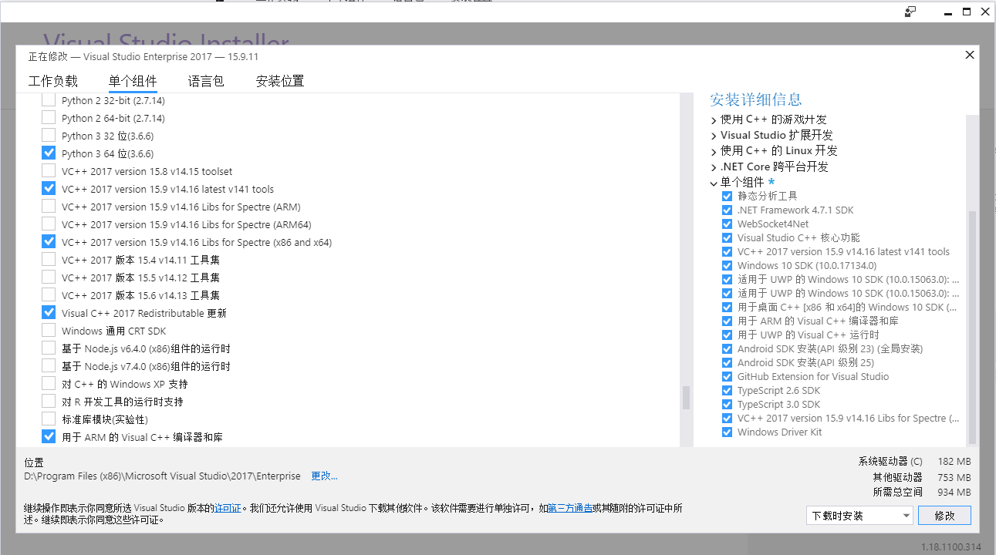
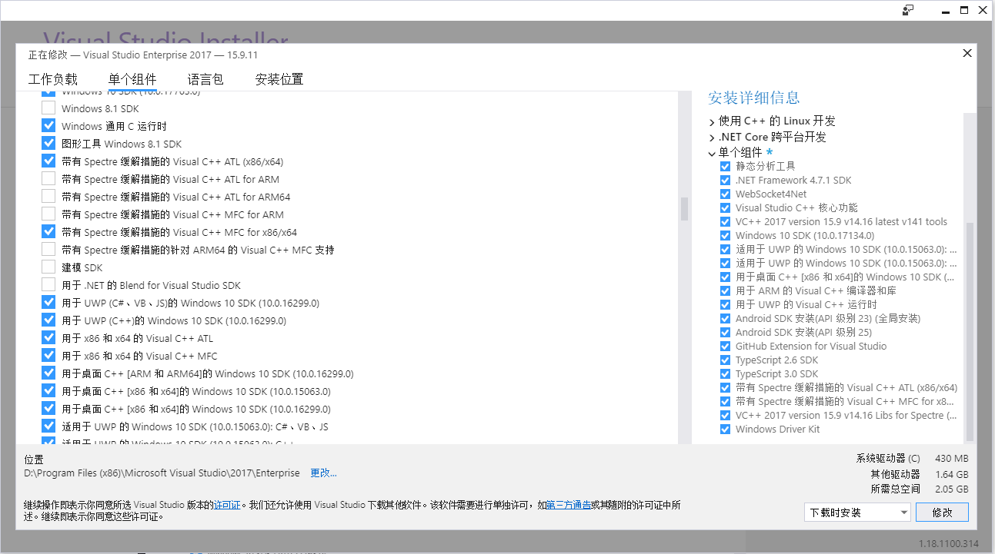
NPcap Installation
Install WDK
Surf the webpage https://docs.microsoft.com/en-us/windows-hardware/drivers/download-the-wdk
Download WDK for Windows 10, version 1903
Setup WDK
Install libs for spectre
Install NPcap

Slide 7
NPcap Installation
Install WDK
Surf the webpage https://docs.microsoft.com/en-us/windows-hardware/drivers/download-the-wdk
Download WDK for Windows 10, version 1903
Setup WDK
Install libs for spectre
Install NPcap
Download Npcap
The VS solution file is at npcap-0.994\packetWin7\vs14
General=>Windows SDK Version=>choose 10.0.17763.0, the version 18362 does not work with my laptop, you may give a try

Slide 8
Build wireShark
Install Visual Studio
corresponding SDK
Install QT5
Install cygwin
python
cmake

Slide 9
Build wireShark
Install Visual Studio
Install QT5
Go to https://www.qt.io/developers/ to download opensource qt 5.12.3
Config QT plugin in VS2017
tools -> extensions and updates -> onlinw -> Qt Visual Studio Tools
Set env QT5_BASE_DIR to be like D:\Qt\Qt5.12.3\5.12.3\msvc2017_64
Install cygwin
python
cmake

Slide 10
Build wireShark
Install Visual Studio
Install QT5
Install cygwin
Perl must be choose to install
Add env WIRESHARK_CYGWIN_INSTALL_PATH to be like D:\cygwin64
python
Cmake

Slide 11
Build wireShark
Install Visual Studio
Install QT5
Install cygwin
python
Cmake
Download cmake: https://cmake.org/download/
Install CMake

Slide 12
Build wireShark
Download wireshark
https://www.wireshark.org/#download click Sourcec Code
download CMakeLists.txt from https://github.com/jichenghu/PPT_networkDistributed
Unzip the source code of wireshark, replace the CMakeLists.txt with the one downloaded in the previous step

Slide 13
Generate wireShark VS projects with CMake
Assume that the source code folder is C:/wireshark_src
Create a different empty folder like C:/wireshark_build
https://www.wireshark.org/#download click Sourcec Code
download CMakeLists.txt from https://github.com/jichenghu/PPT_networkDistributed
Unzip the source code of wireshark, replace the CMakeLists.txt with the one downloaded in the previous step
Add env variable WIRESHARK_LIB_DIR as C:/wireshark_build/wireshark-win64-libs-3.0
Download win_flex and unzip it

Slide 14
Generate wireShark VS projects with CMake
Assume that the source code folder is C:/wireshark_src
Create a different empty folder like C:/wireshark_build
Add env variable WIRESHARK_LIB_DIR as C:/wireshark_build/wireshark-win64-libs-3.0
Download win_flex and unzip it
https://sourceforge.net/projects/winflexbison/files/win_flex_bison3-latest.zip/download

Slide 15
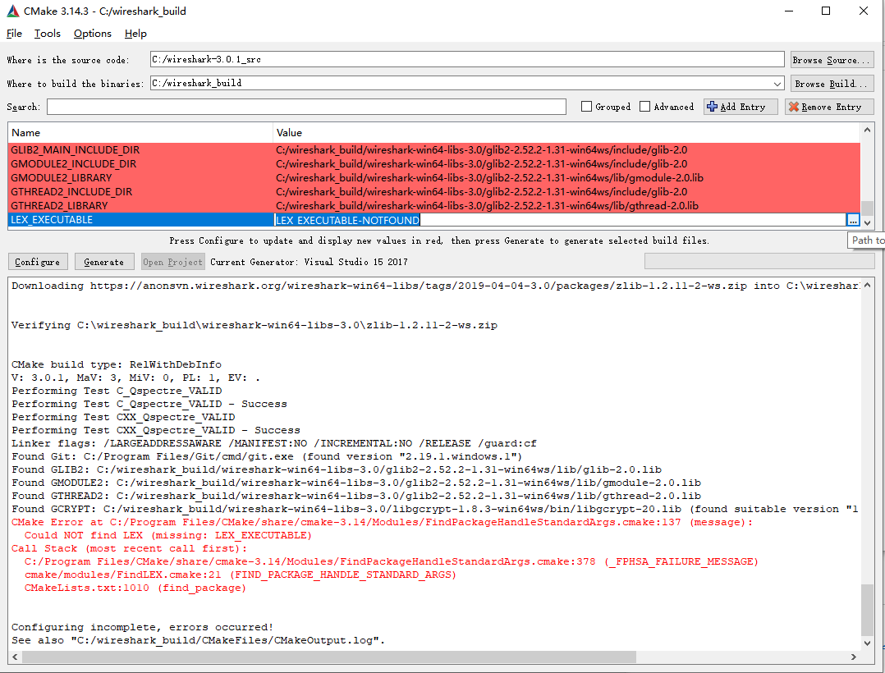
Generate wireShark VS projects with CMake
Assume that the source code folder is C:/wireshark_src
Create a different empty folder like C:/wireshark_build
Add env variable WIRESHARK_LIB_DIR as C:/wireshark_build/wireshark-win64-libs-3.0
Download win_flex and unzip it
Run Cmake, click configure
There will be a cmake error occurs, click the error item LEX_EXECUTABLE-NOTFOUND, and select win_flex.exe
Click configure again, there will be another error YACC_EXECUTABLE_NOTFOUND, click it and select win_bison.exe, click configure one more time
Choose the compiler to be VS2017 x64

Slide 16
Build wireShark
Click wireshark.sln to open the generated VS solution
Build the Executables\wireshark project and set it to be start up project
If everything is OK, we are not ready to run wireshark
We need some dlls …

Slide 17
Run wireShark
Copy the following dlls and subfolder from Qt to ./run/release
Qt5Core.dll
Qt5Gui.dll
Qt5Multimedia.dll
Qt5Network.dll
Qt5PrintSupport.dll
Qt5Widgets.dll
Qt5WinExtras.dll
subfolder snmp/
Copy the following dlls and subfolder from Qt to ./run/debug
Qt5Cored.dll
Qt5Guid.dll
Qt5Multimediad.dll
Qt5Networkd.dll
Qt5PrintSupportd.dll
Qt5Widgetsd.dll
Qt5WinExtrasd.dll
subfolder snmp/
Subfolder Qt/5.12.3/msvc2017_64/plugins/platforms/
All done !

