Slide 1
Chapter 3 Transport Layer

Slide 2
Chapter 3 Transport Layer
our goals:
understand principles behind transport layer services:
multiplexing, demultiplexing
reliable data transfer
flow control
congestion control
learn about Internet transport layer protocols:
UDP: connectionless transport
TCP: connection-oriented reliable transport
TCP congestion control

Slide 3
Chapter 3 Transport Layer
3.1 transport-layer services
3.2 multiplexing and demultiplexing
3.3 connectionless transport: UDP
3.4 principles of reliable data transfer
3.5 connection-oriented transport: TCP
segment structure
reliable data transfer
flow control
connection management
3.6 principles of congestion control
3.7 TCP congestion control
Application Layer

Slide 4
Chapter 3 Transport Layer
3.1 transport-layer services
3.2 multiplexing and demultiplexing
3.3 connectionless transport: UDP
3.4 principles of reliable data transfer
3.5 connection-oriented transport: TCP
segment structure
reliable data transfer
flow control
connection management
3.6 principles of congestion control
3.7 TCP congestion control
Application Layer

Slide 5

















Transport services and protocols
application
transport
network
data link
physical
provide logical communication between app processes running on different hosts
transport protocols run in end systems
send side: breaks app messages into segments, passes to network layer
rcv side: reassembles segments into messages, passes to app layer
more than one transport protocol available to apps
Internet: TCP and UDP
logical end-end transport
application
transport
network
data link
physical
3.1 transport-layer services

Slide 6
Transport vs. network layer
network layer: logical communication between hosts
transport layer: logical communication between processes
relies on, enhances, network layer services
household analogy:
12 kids in Ann's house sending letters to 12 kids in Bill's house:
hosts = houses
processes = kids
app messages = letters in envelopes
transport protocol = Ann and Bill who demux to in-house siblings
network-layer protocol = postal service
3.1 transport-layer services

Slide 7
Internet transport-layer protocols
reliable, in-order delivery (TCP)
congestion control
flow control
connection setup
unreliable, unordered delivery: UDP
no-frills extension of “best-effort” IP
services not available:
delay guarantees
bandwidth guarantees
application
transport
network
data link
physical
network
data link
physical
network
data link
physical
network
data link
physical
logical end-end transport
network
data link
physical
network
data link
physical
network
data link
physical
network
data link
physical
application
transport
network
data link
physical
3.1 transport-layer services

Slide 8
Chapter 3 Transport Layer
3.1 transport-layer services
3.2 multiplexing and demultiplexing
3.3 connectionless transport: UDP
3.4 principles of reliable data transfer
3.5 connection-oriented transport: TCP
segment structure
reliable data transfer
flow control
connection management
3.6 principles of congestion control
3.7 TCP congestion control
Application Layer

Slide 9

Multiplexing/demultiplexing
multiplexing at sender:
handle data from multiple
sockets, add transport header (later used for demultiplexing)
demultiplexing at receiver:
use header info to deliver
received segments to correct
socket
application
application
P1
P2
application
socket
P3
transport
P4
process
transport
network
transport
network
link
network
link
physical
link
physical
physical
3.2 multiplexing and demultiplexing

Slide 10
How demultiplexing works
32 bits
host receives IP datagrams
each datagram has source IP address, destination IP address
each datagram carries one transport-layer segment
each segment has source, destination port number
host uses IP addresses & port numbers to direct segment to appropriate socket
source port #
dest port #
other header fields
application
data
(payload)
TCP/UDP segment format
3.2 multiplexing and demultiplexing

Slide 11
Connectionless demultiplexing
recall: when creating datagram to send into UDP socket, must specify
destination IP address
destination port #
recall: created socket has host-local port #:
DatagramSocket mySocket1 = new DatagramSocket(12534);
when host receives UDP segment:
checks destination port # in segment
directs UDP segment to socket with that port #
IP datagrams with same dest. port #, but different source IP addresses and/or source port numbers will be directed to same socket at dest
3.2 multiplexing and demultiplexing

Slide 12
Connectionless demux: example
DatagramSocket serverSocket = new DatagramSocket
(6428);
DatagramSocket mySocket2 = new DatagramSocket
(9157);
DatagramSocket mySocket1 = new DatagramSocket (5775);
application
application
P1
application
P3
P4
transport
transport
network
transport
network
link
network
link
physical
link
physical
physical
source port: 6428
dest port: 9157
source port: ?
dest port: ?
source port: 9157
dest port: 6428
source port: ?
dest port: ?
3.2 multiplexing and demultiplexing

Slide 13
Connection-oriented demux
TCP socket identified by 4-tuple:
source IP address
source port number
dest IP address
dest port number
demux: receiver uses all four values to direct segment to appropriate socket
server host may support many simultaneous TCP sockets:
each socket identified by its own 4-tuple
web servers have different sockets for each connecting client
non-persistent HTTP will have different socket for each request
3.2 multiplexing and demultiplexing

Slide 14
Connection-oriented demux: example
application
application
P4
P5
P6
application
P3
P2
P3
transport
transport
network
transport
network
link
network
link
physical
link
physical
server: IP address B
physical
host: IP address A
source IP,port: B,80
dest IP,port: A,9157
host: IP address C
source IP,port: C,5775
dest IP,port: B,80
source IP,port: A,9157
dest IP, port: B,80
source IP,port: C,9157
dest IP,port: B,80
three segments, all destined to IP address: B,
dest port: 80 are demultiplexed to different sockets
3.2 multiplexing and demultiplexing

Slide 15
Connection-oriented demux: example
threaded server
application
application
application
P4
P3
P3
P2
transport
transport
network
transport
network
link
network
link
physical
link
physical
server: IP address B
physical
host: IP address A
source IP,port: B,80
dest IP,port: A,9157
host: IP address C
source IP,port: C,5775
dest IP,port: B,80
source IP,port: A,9157
dest IP, port: B,80
source IP,port: C,9157
dest IP,port: B,80
3.2 multiplexing and demultiplexing

Slide 16
Chapter 3 Transport Layer
3.1 transport-layer services
3.2 multiplexing and demultiplexing
3.3 connectionless transport: UDP
3.4 principles of reliable data transfer
3.5 connection-oriented transport: TCP
segment structure
reliable data transfer
flow control
connection management
3.6 principles of congestion control
3.7 TCP congestion control
Application Layer

Slide 17
UDP: User Datagram Protocol [RFC 768]
“no frills,” “bare bones” Internet transport protocol
“best effort” service, UDP segments may be:
lost
delivered out-of-order to app
connectionless:
no handshaking between UDP sender, receiver
each UDP segment handled independently of others
UDP use:
streaming multimedia apps (loss tolerant, rate sensitive)
DNS
SNMP
reliable transfer over UDP:
add reliability at application layer
application-specific error recovery!
3.3 connectionless transport: UDP
Notes:
SNMP：simple network management protocol, application layer

Slide 18
UDP: segment header
length, in bytes of UDP segment, including header
32 bits
source port #
dest port #
length
checksum
why is there a UDP?
no connection establishment (which can add delay)
simple: no connection state at sender, receiver
small header size
no congestion control: UDP can blast away as fast as desired
application
data
(payload)
UDP segment format
3.3 connectionless transport: UDP

Slide 19
UDP checksum
Goal: detect “errors” (e.g., flipped bits) in transmitted segment
receiver:
compute checksum of received segment
check if computed checksum equals checksum field value:
NO - error detected
YES - no error detected. But maybe errors nonetheless? More later ….
sender:
treat segment contents, including header fields, as sequence of 16-bit integers
checksum: addition (one's complement sum) of segment contents
sender puts checksum value into UDP checksum field
3.3 connectionless transport: UDP

Slide 20
Internet checksum: example
example: add two 16-bit integers
1 1 1 1 0 0 1 1 0 0 1 1 0 0 1 1 0
1 1 1 0 1 0 1 0 1 0 1 0 1 0 1 0 1
1 1 0 1 1 1 0 1 1 1 0 1 1 1 0 1 1
1 1 0 1 1 1 0 1 1 1 0 1 1 1 1 0 0
0 0 1 0 0 0 1 0 0 0 1 0 0 0 0 1 1
wraparound
1
sum
checksum
Note: when adding numbers, a carryout from the most significant bit needs to be added to the result
https://www.cnblogs.com/noble/p/4144139.html
* Check out the online interactive exercises for more examples: http://gaia.cs.umass.edu/kurose_ross/interactive/
3.3 connectionless transport: UDP
Notes:
Kurose and Ross forgot to say anything about wrapping the carry and adding it to low order bit
wrapped around4

Slide 21
Chapter 3 Transport Layer
3.1 transport-layer services
3.2 multiplexing and demultiplexing
3.3 connectionless transport: UDP
3.4 principles of reliable data transfer
3.5 connection-oriented transport: TCP
segment structure
reliable data transfer
flow control
connection management
3.6 principles of congestion control
3.7 TCP congestion control
Application Layer

Slide 22
Principles of reliable data transfer
important in application, transport, link layers
top-10 list of important networking topics!
application
layer
sending
process
receiver
process
reliable channel
data
data
transport
layer
characteristics of unreliable channel will determine complexity of reliable data transfer protocol (rdt)
3.4 principles of reliable data transfer

Slide 23
Principles of reliable data transfer
important in application, transport, link layers
top-10 list of important networking topics!
application
layer
sending
process
receiver
process
reliable channel
data
data
transport
layer
characteristics of unreliable channel will determine complexity of reliable data transfer protocol (rdt)
3.4 principles of reliable data transfer

Slide 24
Principles of reliable data transfer
important in application, transport, link layers
top-10 list of important networking topics!
application
layer
sending
process
receiver
process
reliable channel
data
data
transport
layer
characteristics of unreliable channel will determine complexity of reliable data transfer protocol (rdt)
3.4 principles of reliable data transfer

Slide 25
Principles of reliable data transfer
important in application, transport, link layers
top-10 list of important networking topics!
application
layer
sending
process
receiver
process
reliable channel
data
data
transport
layer
unreliable channel
network
layer
(a) provided service
(b) Service implementation
characteristics of unreliable channel will determine complexity of reliable data transfer protocol (rdt)
3.4 principles of reliable data transfer

Slide 26
Principles of reliable data transfer
important in application, transport, link layers
top-10 list of important networking topics!
application
layer
sending
process
receiver
process
reliable channel
data
data
transport
layer
rdt_send ( )
data
data
deliver_data ( )
reliable data
transfer protocol
(sending side)
reliable data
transfer protocol
(receiving side)
unreliable channel
udt_send ( )
rdt_rcv ( )
network
layer
(a) provided service
(b) Service implementation
characteristics of unreliable channel will determine complexity of reliable data transfer protocol (rdt)
3.4 principles of reliable data transfer

Slide 27
Reliable data transfer: getting started
rdt_send(): called from above, (e.g., by app.). Passed data to
deliver to receiver upper layer
deliver_data(): called by rdt to deliver data to upper
send
side
rdt_send ( )
data
data
deliver_data ( )
receive
side
reliable data
transfer protocol
(sending side)
reliable data
transfer protocol
(receiving side)
unreliable channel
udt_send ( )
rdt_rcv ( )
udt_send(): called by rdt,
to transfer packet over
unreliable channel to receiver
rdt_rcv(): called when packet arrives on rcv-side of channel
3.4 principles of reliable data transfer

Slide 28
Reliable data transfer: getting started
we'll:
incrementally develop sender, receiver sides of reliable data transfer protocol (rdt)
consider only unidirectional data transfer
but control info will flow on both directions!
use finite state machines (FSM) to specify sender, receiver
event causing state transition
actions taken on state transition
state: when in this “state” next state uniquely determined by next event
state
1
state
2
event
actions
3.4 principles of reliable data transfer

Slide 29
rdt1.0: reliable transfer over a reliable channel
underlying channel perfectly reliable
no bit errors
no loss of packets
separate FSMs for sender, receiver:
sender sends data into underlying channel
receiver reads data from underlying channel
Wait for call from above
rdt_send(data)
Wait for call from below
rdt_rcv(packet)
extract (packet,data)
deliver_data(data)
packet = make_pkt(data)
udt_send(packet)
sender
receiver
3.4 principles of reliable data transfer

Slide 30
rdt2.0: channel with bit errors
underlying channel may flip bits in packet
checksum to detect bit errors
the question: how to recover from errors:
acknowledgements (ACKs): receiver explicitly tells sender that pkt received OK
negative acknowledgements (NAKs): receiver explicitly tells sender that pkt had errors
sender retransmits pkt on receipt of NAK
new mechanisms in rdt2.0 (beyond rdt1.0):
error detection
receiver feedback: control msgs (ACK,NAK) rcvr->sender
How do humans recover from “errors”
during conversation?
3.4 principles of reliable data transfer

Slide 31
rdt2.0: FSM specification
rdt_send(data)
sndpkt = make_pkt(data, checksum)
udt_send(sndpkt)
receiver
rdt_rcv(rcvpkt) &&
isNAK(rcvpkt)
Wait for call from above
Wait for ACK or NAK
rdt_rcv(rcvpkt) &&
corrupt(rcvpkt)
udt_send(sndpkt)
udt_send(NAK)
rdt_rcv(rcvpkt) && isACK(rcvpkt)
Λ
Wait for call from below
sender
rdt_rcv(rcvpkt) &&
notcorrupt(rcvpkt)
extract(rcvpkt,data)
deliver_data(data)
udt_send(ACK)
3.4 principles of reliable data transfer

Slide 32
rdt2.0: operation with no errors
rdt_send(data)
snkpkt = make_pkt(data, checksum)
udt_send(sndpkt)
rdt_rcv(rcvpkt) &&
isNAK(rcvpkt)
Wait for call from above
Wait for ACK or NAK
rdt_rcv(rcvpkt) &&
corrupt(rcvpkt)
udt_send(sndpkt)
udt_send(NAK)
rdt_rcv(rcvpkt) && isACK(rcvpkt)
Wait for call from below
Λ
rdt_rcv(rcvpkt) &&
notcorrupt(rcvpkt)
extract(rcvpkt,data)
deliver_data(data)
udt_send(ACK)
3.4 principles of reliable data transfer

Slide 33
rdt2.0: error scenario
rdt_send(data)
snkpkt = make_pkt(data, checksum)
udt_send(sndpkt)
rdt_rcv(rcvpkt) &&
isNAK(rcvpkt)
Wait for call from above
Wait for ACK or NAK
rdt_rcv(rcvpkt) &&
corrupt(rcvpkt)
udt_send(sndpkt)
udt_send(NAK)
rdt_rcv(rcvpkt) && isACK(rcvpkt)
Wait for call from below
Λ
rdt_rcv(rcvpkt) &&
notcorrupt(rcvpkt)
extract(rcvpkt,data)
deliver_data(data)
udt_send(ACK)
3.4 principles of reliable data transfer

Slide 34
rdt2.0 has a fatal flaw!
what happens if ACK/NAK corrupted?
sender doesn't know what happened at receiver!
can't just retransmit: possible duplicate
handling duplicates:
sender retransmits current pkt if ACK/NAK corrupted
sender adds sequence number to each pkt
receiver discards (doesn't deliver up) duplicate pkt
stop and wait
sender sends one packet,
then waits for receiver
response
3.4 principles of reliable data transfer

Slide 35
rdt2.1: sender, handles garbled ACK/NAKs
rdt_send(data)
sndpkt = make_pkt(0, data, checksum)
udt_send(sndpkt)
rdt_rcv(rcvpkt) &&
( corrupt(rcvpkt) ||
isNAK(rcvpkt) )
Wait for call 0 from above
Wait for ACK or NAK 0
udt_send(sndpkt)
rdt_rcv(rcvpkt)
&& notcorrupt(rcvpkt)
&& isACK(rcvpkt)
rdt_rcv(rcvpkt)
&& notcorrupt(rcvpkt)
&& isACK(rcvpkt)
Λ
Λ
Wait for ACK or NAK 1
Wait for
call 1 from above
rdt_rcv(rcvpkt) &&
( corrupt(rcvpkt) ||
isNAK(rcvpkt) )
rdt_send(data)
udt_send(sndpkt)
sndpkt = make_pkt(1, data, checksum)
udt_send(sndpkt)
3.4 principles of reliable data transfer
Notes:
garbley gook
gobbledygook

Slide 36
rdt2.1: receiver, handles garbled ACK/NAKs
rdt_rcv(rcvpkt) && notcorrupt(rcvpkt)
&& has_seq0(rcvpkt)
extract(rcvpkt,data)
deliver_data(data)
sndpkt = make_pkt(ACK, chksum)
udt_send(sndpkt)
rdt_rcv(rcvpkt) && (corrupt(rcvpkt)
rdt_rcv(rcvpkt) && (corrupt(rcvpkt)
sndpkt = make_pkt(NAK, chksum)
udt_send(sndpkt)
sndpkt = make_pkt(NAK, chksum)
udt_send(sndpkt)
Wait for
0 from below
Wait for
1 from below
rdt_rcv(rcvpkt) &&
not corrupt(rcvpkt) &&
has_seq1(rcvpkt)
rdt_rcv(rcvpkt) &&
not corrupt(rcvpkt) &&
has_seq0(rcvpkt)
sndpkt = make_pkt(ACK, chksum)
udt_send(sndpkt)
sndpkt = make_pkt(ACK, chksum)
udt_send(sndpkt)
rdt_rcv(rcvpkt) && notcorrupt(rcvpkt)
&& has_seq1(rcvpkt)
extract(rcvpkt,data)
deliver_data(data)
sndpkt = make_pkt(ACK, chksum)
udt_send(sndpkt)
3.4 principles of reliable data transfer

Slide 37
rdt2.1: discussion
sender:
seq # added to pkt
two seq. #'s (0,1) will suffice. Why?
must check if received ACK/NAK corrupted
twice as many states
state must “remember” whether “expected” pkt should have seq # of 0 or 1
receiver:
must check if received packet is duplicate
state indicates whether 0 or 1 is expected pkt seq #
note: receiver can not know if its last ACK/NAK received OK at sender
3.4 principles of reliable data transfer

Slide 38
rdt2.2: a NAK-free protocol
same functionality as rdt2.1, using ACKs only
instead of NAK, receiver sends ACK for last pkt received OK
receiver must explicitly include seq # of pkt being ACKed
duplicate ACK at sender results in same action as NAK: retransmit current pkt
3.4 principles of reliable data transfer

Slide 39
rdt2.2: sender, receiver fragments
rdt_send(data)
sndpkt = make_pkt(0, data, checksum)
udt_send(sndpkt)
rdt_rcv(rcvpkt) &&
( corrupt(rcvpkt) ||
isACK(rcvpkt,1) )
Wait for call 0 from above
Wait for ACK
0
udt_send(sndpkt)
sender FSM
fragment
rdt_rcv(rcvpkt)
&& notcorrupt(rcvpkt)
&& isACK(rcvpkt,0)
rdt_rcv(rcvpkt) &&
(corrupt(rcvpkt) ||
has_seq1(rcvpkt))
Λ
Wait for
0 from below
receiver FSM
fragment
udt_send(sndpkt)
rdt_rcv(rcvpkt) && notcorrupt(rcvpkt)
&& has_seq1(rcvpkt)
extract(rcvpkt,data)
deliver_data(data)
sndpkt = make_pkt(ACK1, chksum)
udt_send(sndpkt)
3.4 principles of reliable data transfer

Slide 40
rdt3.0: channels with errors and loss
new assumption: underlying channel can also lose packets (data, ACKs)
checksum, seq. #, ACKs, retransmissions will be of help … but not enough
approach: sender waits “reasonable” amount of time for ACK
retransmits if no ACK received in this time
if pkt (or ACK) just delayed (not lost):
retransmission will be duplicate, but seq. #'s already handles this
receiver must specify seq # of pkt being ACKed
requires countdown timer
3.4 principles of reliable data transfer

Slide 41
rdt3.0 sender
rdt_send(data)
rdt_rcv(rcvpkt) &&
( corrupt(rcvpkt) ||
isACK(rcvpkt,1) )
sndpkt = make_pkt(0, data, checksum)
udt_send(sndpkt)
start_timer
rdt_rcv(rcvpkt)
Λ
Λ
Wait for
call 0from above
Wait for ACK0
timeout
udt_send(sndpkt)
start_timer
rdt_rcv(rcvpkt)
&& notcorrupt(rcvpkt)
&& isACK(rcvpkt,1)
rdt_rcv(rcvpkt)
&& notcorrupt(rcvpkt)
&& isACK(rcvpkt,0)
stop_timer
stop_timer
Wait for ACK1
Wait for
call 1 from above
timeout
udt_send(sndpkt)
start_timer
rdt_rcv(rcvpkt)
rdt_send(data)
Λ
rdt_rcv(rcvpkt) &&
( corrupt(rcvpkt) ||
isACK(rcvpkt,0) )
sndpkt = make_pkt(1, data, checksum)
udt_send(sndpkt)
start_timer
Λ
3.4 principles of reliable data transfer

Slide 42

rdt3.0 in action
sender
receiver
sender
receiver
send pkt0
pkt0
send pkt0
pkt0
rcv pkt0
rcv pkt0
ack0
send ack0
ack0
send ack0
rcv ack0
rcv ack0
send pkt1
pkt1
send pkt1
pkt1
rcv pkt1
X
ack1
send ack1
loss
rcv ack1
send pkt0
pkt0
rcv pkt0
timeout
resend pkt1
ack0
send ack0
pkt1
rcv pkt1
ack1
send ack1
rcv ack1
send pkt0
pkt0
(a) no loss
rcv pkt0
ack0
send ack0
(b) packet loss
3.4 principles of reliable data transfer

Slide 43
rdt3.0 in action
sender
receiver
sender
receiver
send pkt0
pkt0
send pkt0
pkt0
rcv pkt0
rcv pkt0
ack0
send ack0
send ack0
rcv ack0
ack0
send pkt1
pkt1
rcv ack0
rcv pkt1
send pkt1
pkt1
send ack1
rcv pkt1
ack1
send ack1
ack1
X
loss
timeout
resend pkt1
pkt1
rcv pkt1
timeout
resend pkt1
rcv ack1
pkt1
rcv pkt1
pkt0
(detect duplicate)
send pkt0
send ack1
ack1
(detect duplicate)
ack1
rcv pkt0
rcv ack1
send ack1
rcv ack1
ack0
send ack0
pkt0
send pkt0
pkt0
send pkt0
rcv pkt0
rcv pkt0
ack0
(detect duplicate)
ack0
send ack0
send ack0
(c) ACK loss
(d) premature timeout/ delayed ACK
3.4 principles of reliable data transfer

Slide 44
Performance of rdt3.0
rdt3.0 is correct, but performance stinks
e.g.: 1 Gbps link, 15 ms prop. delay, 8000 bit packet:
L
8000 bits
D_{trans} =
=
=
8 microsecs
R
10⁹ bits/sec
U _{sender}: utilization – fraction of time sender busy sending
if RTT=30 msec, 1KB pkt every 30 msec: 33kB/sec thruput over 1 Gbps link
network protocol limits use of physical resources!
3.4 principles of reliable data transfer

Slide 45
rdt3.0: stop-and-wait operation
sender
receiver
first packet bit transmitted, t = 0
last packet bit transmitted, t = L / R
first packet bit arrives
RTT
last packet bit arrives, send ACK
ACK arrives, send next
packet, t = RTT + L / R
3.4 principles of reliable data transfer

Slide 46
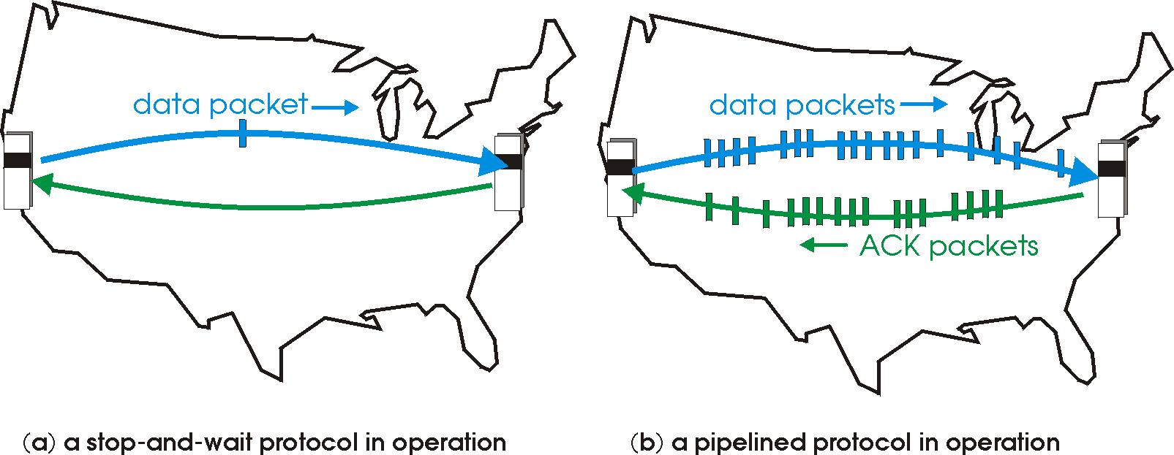

Pipelined protocols
pipelining: sender allows multiple, “in-flight”, yet-to-be-acknowledged pkts
range of sequence numbers must be increased
buffering at sender and/or receiver
two generic forms of pipelined protocols: go-Back-N, selective repeat
3.4 principles of reliable data transfer

Slide 47
Pipelining: increased utilization
sender
receiver
first packet bit transmitted, t = 0
last bit transmitted, t = L / R
first packet bit arrives
RTT
last packet bit arrives, send ACK
last bit of 2nd packet arrives, send ACK
last bit of 3rd packet arrives, send ACK
ACK arrives, send next
packet, t = RTT + L / R
3-packet pipelining increases
utilization by a factor of 3!
3.4 principles of reliable data transfer

Slide 48
Pipelined protocols: overview
Go-back-N:
sender can have up to N unacked packets in pipeline
receiver only sends cumulative ack
doesn't ack packet if there's a gap
sender has timer for oldest unacked packet
when timer expires, retransmit all unacked packets
Selective Repeat:
sender can have up to N unack'ed packets in pipeline
rcvr sends individual ack for each packet
sender maintains timer for each unacked packet
when timer expires, retransmit only that unacked packet
3.4 principles of reliable data transfer

Slide 49
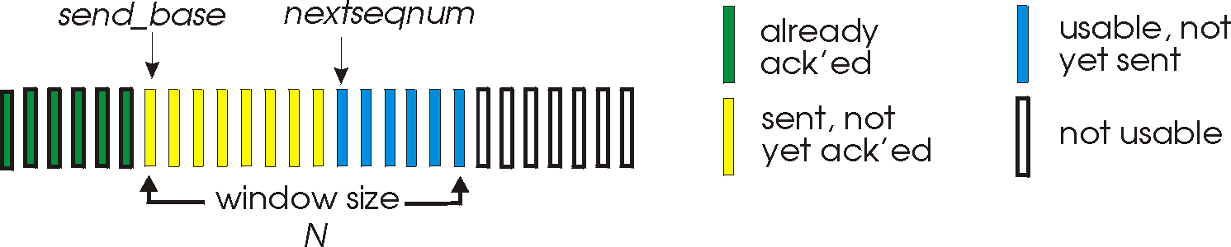
Go-Back-N: sender
k-bit seq # in pkt header
“window” of up to N, consecutive unack'ed pkts allowed
ACK(n): ACKs all pkts up to, including seq # n - “cumulative ACK”
may receive duplicate ACKs (see receiver)
timer for oldest in-flight pkt
timeout(n): retransmit packet n and all higher seq # pkts in window
3.4 principles of reliable data transfer

Slide 50
GBN: sender extended FSM
rdt_send(data)
if (nextseqnum < base+N) {
sndpkt[nextseqnum] = make_pkt(nextseqnum,data,chksum)
udt_send(sndpkt[nextseqnum])
if (base == nextseqnum)
start_timer
nextseqnum++
}
else
refuse_data(data)
Λ
base=1
nextseqnum=1
timeout
Wait
start_timer
udt_send(sndpkt[base])
udt_send(sndpkt[base+1])
…
udt_send(sndpkt[nextseqnum-1])
rdt_rcv(rcvpkt)
&& corrupt(rcvpkt)
rdt_rcv(rcvpkt) &&
notcorrupt(rcvpkt)
base = getacknum(rcvpkt)+1
If (base == nextseqnum)
stop_timer
else
start_timer
3.4 principles of reliable data transfer

Slide 51
GBN: receiver extended FSM
default
udt_send(sndpkt)
rdt_rcv(rcvpkt)
&& notcurrupt(rcvpkt)
&& hasseqnum(rcvpkt,expectedseqnum)
Λ
Wait
extract(rcvpkt,data)
deliver_data(data)
sndpkt = make_pkt(expectedseqnum,ACK,chksum)
udt_send(sndpkt)
expectedseqnum++
expectedseqnum=1
sndpkt =
make_pkt(expectedseqnum,ACK,chksum)
ACK-only: always send ACK for correctly-received pkt with highest in-order seq #
may generate duplicate ACKs
need only remember expectedseqnum
out-of-order pkt:
discard (don't buffer): no receiver buffering!
re-ACK pkt with highest in-order seq #
3.4 principles of reliable data transfer

Slide 52
GBN in action
sender window (N=4)
sender
receiver
0 1 2 3 4 5 6 7 8
send pkt0
send pkt1
send pkt2
send pkt3
(wait)
0 1 2 3 4 5 6 7 8
receive pkt0, send ack0
receive pkt1, send ack1
receive pkt3, discard,
(re)send ack1
0 1 2 3 4 5 6 7 8
X
0 1 2 3 4 5 6 7 8
loss
0 1 2 3 4 5 6 7 8
rcv ack0, send pkt4
rcv ack1, send pkt5
0 1 2 3 4 5 6 7 8
receive pkt4, discard,
(re)send ack1
ignore duplicate ACK
receive pkt5, discard,
(re)send ack1
pkt 2 timeout
0 1 2 3 4 5 6 7 8
send pkt2
send pkt3
send pkt4
send pkt5
0 1 2 3 4 5 6 7 8
0 1 2 3 4 5 6 7 8
rcv pkt2, deliver, send ack2
rcv pkt3, deliver, send ack3
rcv pkt4, deliver, send ack4
rcv pkt5, deliver, send ack5
0 1 2 3 4 5 6 7 8
3.4 principles of reliable data transfer

Slide 53
Selective repeat
receiver individually acknowledges all correctly received pkts
buffers pkts, as needed, for eventual in-order delivery to upper layer
sender only resends pkts for which ACK not received
sender timer for each unACKed pkt
sender window
N consecutive seq #'s
limits seq #s of sent, unACKed pkts
3.4 principles of reliable data transfer

Slide 54
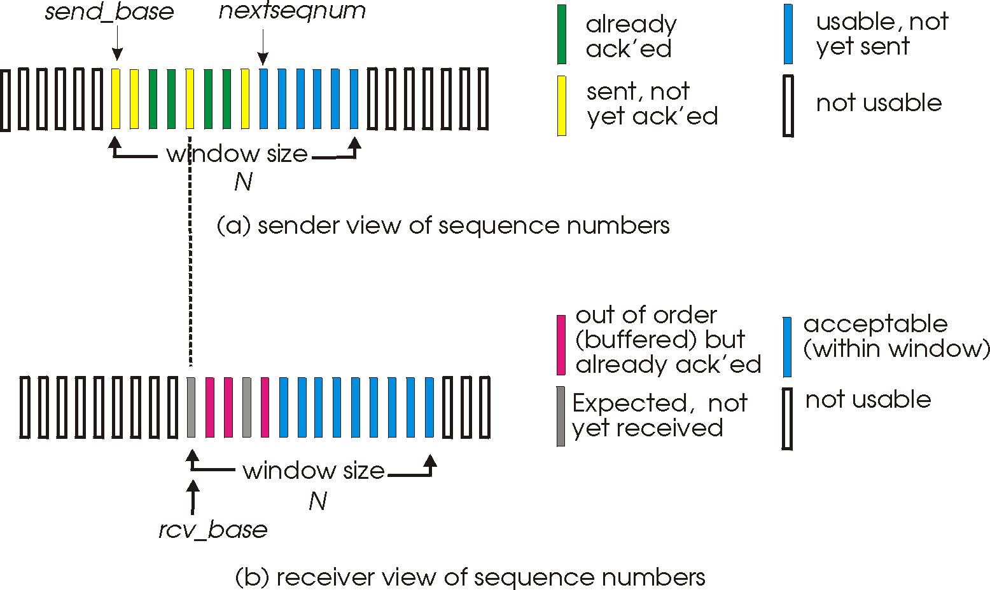
Selective repeat: sender, receiver windows
3.4 principles of reliable data transfer

Slide 55
Selective repeat
sender
receiver
data from above:
if next available seq # in window, send pkt
timeout(n):
resend pkt n, restart timer
ACK(n) in [sendbase,sendbase+N]:
mark pkt n as received
if n smallest unACKed pkt, advance window base to next unACKed seq #
pkt n in [rcvbase, rcvbase+N-1]
send ACK(n)
out-of-order: buffer
in-order: deliver (also deliver buffered, in-order pkts), advance window to next not-yet-received pkt
pkt n in [rcvbase-N,rcvbase-1]
ACK(n)
otherwise:
ignore
3.4 principles of reliable data transfer

Slide 56
Selective repeat in action
sender window (N=4)
sender
receiver
0 1 2 3 4 5 6 7 8
send pkt0
send pkt1
send pkt2
send pkt3
(wait)
0 1 2 3 4 5 6 7 8
receive pkt0, send ack0
receive pkt1, send ack1
receive pkt3, buffer,
send ack3
0 1 2 3 4 5 6 7 8
X
0 1 2 3 4 5 6 7 8
loss
0 1 2 3 4 5 6 7 8
rcv ack0, send pkt4
rcv ack1, send pkt5
0 1 2 3 4 5 6 7 8
receive pkt4, buffer,
send ack4
record ack3 arrived
receive pkt5, buffer,
send ack5
pkt 2 timeout
0 1 2 3 4 5 6 7 8
send pkt2
0 1 2 3 4 5 6 7 8
record ack4 arrived
0 1 2 3 4 5 6 7 8
rcv pkt2; deliver pkt2,
pkt3, pkt4, pkt5; send ack2
record ack5 arrived
0 1 2 3 4 5 6 7 8
Q: what happens when ack2 arrives?
3.4 principles of reliable data transfer

Slide 57

Selective repeat: dilemma
sender window
(after receipt)
receiver window
(after receipt)
0 1 2 3 0 1 2
pkt0
0 1 2 3 0 1 2
pkt1
0 1 2 3 0 1 2
example:
seq #'s: 0, 1, 2, 3
window size=3
0 1 2 3 0 1 2
pkt2
0 1 2 3 0 1 2
0 1 2 3 0 1 2
0 1 2 3 0 1 2
pkt3
X
0 1 2 3 0 1 2
pkt0
will accept packet
with seq number 0
receiver sees no difference in two scenarios!
duplicate data accepted as new in (b)
Q: what relationship between seq # size and window size to avoid problem in (b)?
(a) no problem
receiver can't see sender side.
receiver behavior identical in both cases!
something's (very) wrong!
0 1 2 3 0 1 2
pkt0
0 1 2 3 0 1 2
pkt1
0 1 2 3 0 1 2
0 1 2 3 0 1 2
pkt2
0 1 2 3 0 1 2
X
0 1 2 3 0 1 2
X
timeout
retransmit pkt0
X
0 1 2 3 0 1 2
pkt0
will accept packet
with seq number 0
(b) oops!
3.4 principles of reliable data transfer

Slide 58
Homework
Application Layer

