Slide 1
网络与分布式计算
实验课
Networks and Distributed Computing
LAB

Slide 2

Networks and Distributed Computing
LAB
Jicheng Hu
CS, Wuhan University
jicheng @ yahoo . Com
https://github.com/jichenghu
Room E315, E-WING, Building of Computer Science
Phone (office): 027-68776033

Slide 3
NPcap & Wireshark
Wireshark默认匹配安装的是WinPcap,但是WinPcap有个缺点，不能抓取本地回环数据
NPcap是在WinPcap的基础上进行优化开发的，可以抓取本地数据
如果已安装WinPcap的请卸载，最好Wireshark一起卸载掉，重新安装，先安装NPcap，再安装Wireshark
安装地址：NPcap https://github.com/jichenghu/npcap
Wireshark
官方地址： NPcap https://nmap.org/npcap/
The Link Layer and LANs

Slide 4
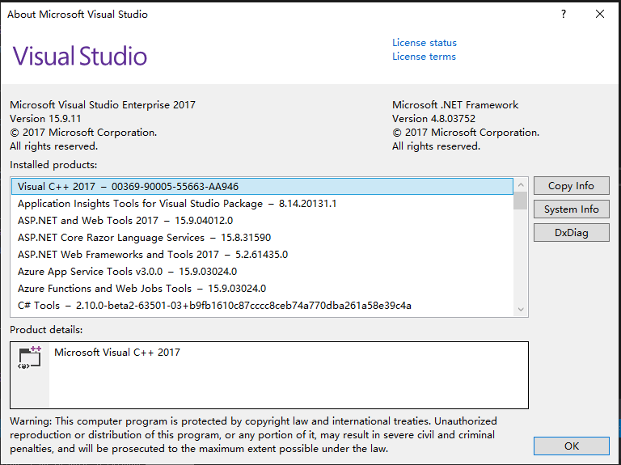
Software Environment
先检查你的VS 2017是否更新到最新的版本
下面的安装过程如果不是最新版本可能无法顺利完成

Slide 5
NPcap Installation
Install WDK
Install NPcap

Slide 6
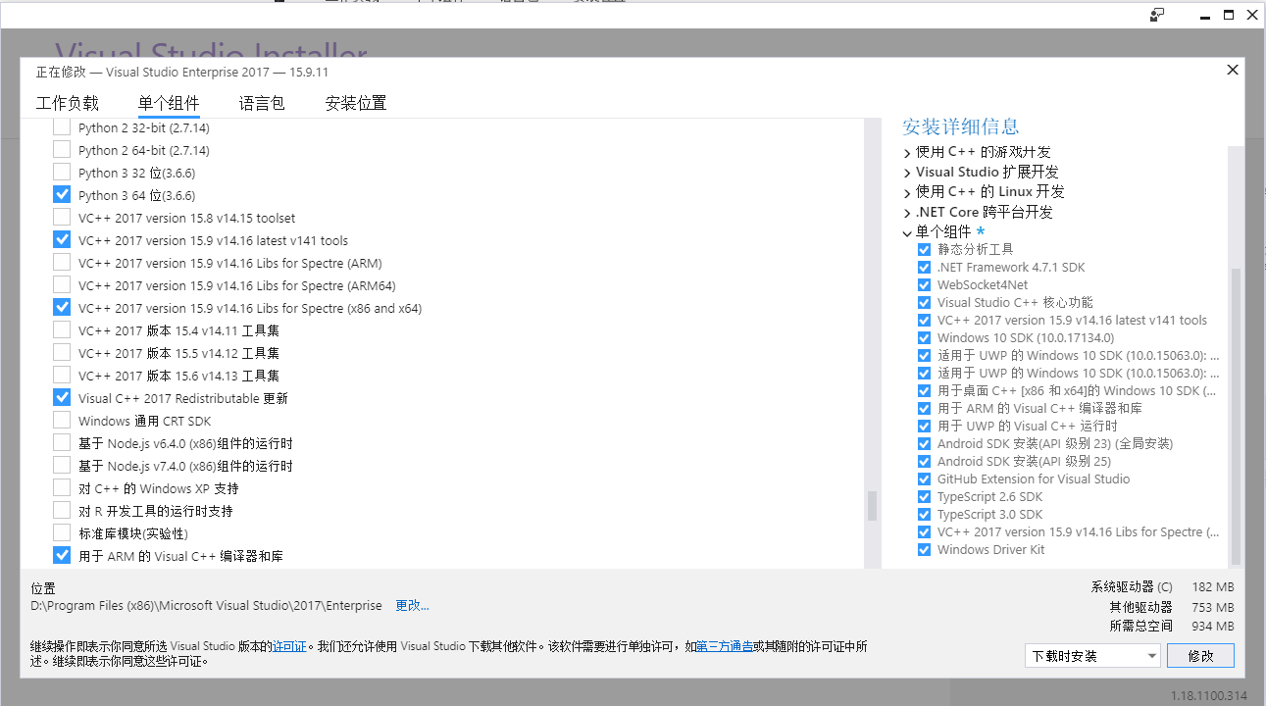
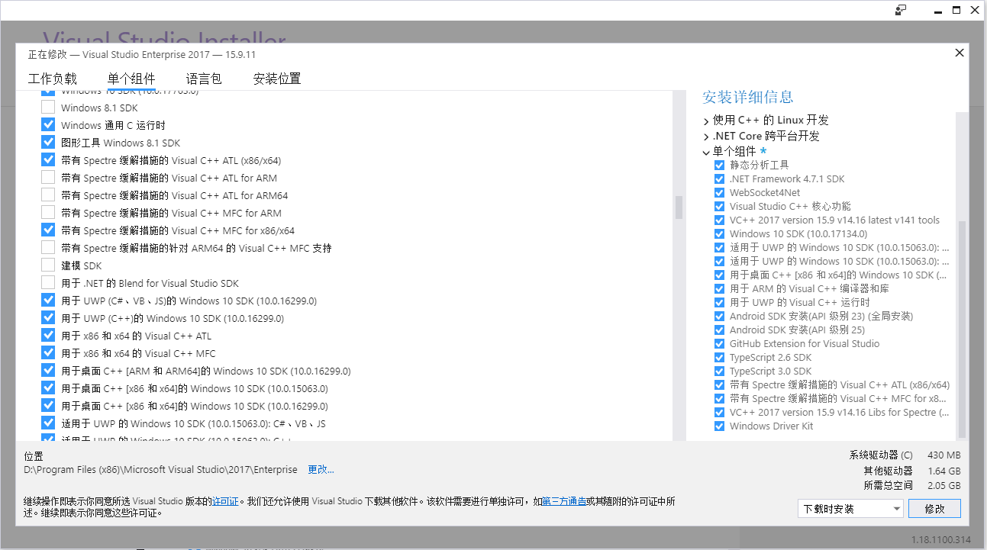
NPcap Installation
Install WDK
Surf the webpage https://docs.microsoft.com/en-us/windows-hardware/drivers/download-the-wdk
Download WDK for Windows 10, version 1903
Setup WDK
Install libs for spectre
Install NPcap

Slide 7
NPcap Installation
Install WDK
Surf the webpage https://docs.microsoft.com/en-us/windows-hardware/drivers/download-the-wdk
Download WDK for Windows 10, version 1903
Setup WDK
Install libs for spectre
Install NPcap
Download Npcap
The VS solution file is at npcap-0.994\packetWin7\vs14
General=>Windows SDK Version=>choose 10.0.17763.0, the version 18362 does not work with my naptop, you may give a try

Slide 8
Build wireShark
Install Visual Studio
corresponding SDK
Install QT5
Install cygwin
python
cmake

Slide 9
Build wireShark
Install Visual Studio
Install QT5
Go to https://www.qt.io/developers/ to download opensource qt 5.12.3
Config QT plugin in VS2017
tools -> extensions and updates -> onlinw -> Qt Visual Studio Tools
Set env QT5_BASE_DIR to be like D:\Qt\Qt5.12.3\5.12.3\msvc2017_64
Install cygwin
python
cmake

Slide 10
Build wireShark
Install Visual Studio
Install QT5
Install cygwin
python
Cmake
Download cmake: https://cmake.org/download/

