Slide 1

Compiler-Assisted Overlapping of Communication and Computation in MPI Applications

Slide 2
Optimization challenges
Safety constraints
Accuracy of the data dependence analysis
Inter-procedural analysis
Runtime code path and data access patterns
Profitability constraints
Hide communication overhead
Non-blocking could be slower than blocking communication
Require more buffers
Distribution of MPI_Test
When too few: insufficient to complete communication
When too many: slowdown the computation

Slide 3
Outline
Optimization workflow
Hot path extraction and profitability analysis
Safety analysis with annotation
Tuning MPI_Test
Experiment results
Related work

Slide 4
CCO optimization workflow
Input program
Input data and
number of processes
Analytical
performance modeling
(Using Roofline and LogGP models)
Bayesian execution tree
CCO analysis
(Profitability analysis & Safety analysis
with annotation-based inlining)
Optimization configuration
CCO optimization and tuning MPI_Test
Optimized code

Slide 5

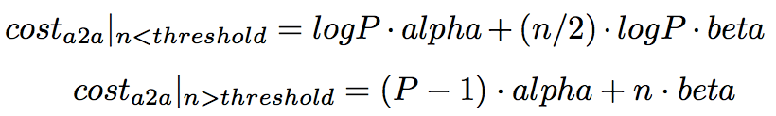

LogGP communication model
Model communication cost of messages
Pt2pt
alpha: startup cost per message
beta: reciprocal of bandwidth, i.e. cost per byte for long messages
All2all
In general
Communication cost does not include wait time between unbalanced processes

Slide 6
Profitability analysis
Find global communication hot spots
Find enclosing loop for each hot spot
Find local computation hot spots
main()
NAS FT (1D layout)
54s
loop x6
1.6s
0.02s
evolve(x1)
fft(x1, x2)
checksum(x2)
Example BET of NAS FT
branch 0D
0%
branch 1D
100%
branch 2D
0%
5.4s
4.2s
39s
4.5s
cffts1(x1)
cffts2(x1)
transpose(x1, x2)
cffts1(x1)
1.7s
37s
0.01s
transpose_local(x1)
MPI_Alltoal(x1, x2)
transpose_finish(x2)

Slide 7
Communication hot path of NAS FT
Clear separation of computation and communication
Comp => Comm => Comp => …
Easy to implement and maintain
Reuse buffers across iterations
Communication hot spots
MPI blocking communication
Point-to-point
Collective
Computation hot spots
Loops of CPU or memory intensive arithmetic computation
NAS FT (1D layout)
In
Loop
Computation
Before (I)
MPI_Alltoall (I)
Loop
(I = 1 … N)
Loop
Computation
After (I)
Out

Slide 8
Overlap computation and communication in the loop
Replace blocking MPI_Alltoall by MPI_Ialltoall and MPI_Wait
Reorder Before/After/MPI_Ialltoall/MPI_Wait if dependence allowed
Overlap Alltoal2 with Before3 and After1
Before1
Ialltoall1
Wait1
After1
Iteration 1
Before2
Ialltoall2
Wait2
Iteration 2
Before3
Ialltoall3
Iteration 3

Slide 9
Hot path of NAS FT after applying CCO
…
Safety constraints to reorder computation and communication
No dependence edges
Before(I) => MPI_Wait(I-?)
Before(I) => After(I-?)
Challenges
Inter-procedural
Dynamic control and data flow
Loop
Before (I)
Computation
MPI_Wait (I-1)
Loop
(I = 2 … N)
MPI_Ialltoall (I)
Loop
Computation
After (I-1)
…

Slide 10
Safety analysis with annotation-based inlining
Apply annotation-based inlining to enhance accuracy of dependence analysis
Select branches taken
NAS FT: 0D, 1D, or 2D layout is runtime-dependent
Express memory side effects for MPI API through array accesses
MPICH source code is encapsulated and hidden from compiler
Normalize array dimensions
Arrays used by computation and communication could have different dimensions

Slide 11
Program transformation
Outline and specialize function calls based on the location of the communication (Before(I), After(I), Comm(I))
Reorder communication and computation
…
I = 2 … N
I = 1 … N
In
In
I = 1 … N
Before (I)
In
Before (I)
Before (I)
Wait (I-1)
Icomm (I)
Comm (I)
Icomm (I)
Wait(I)
After (I)
After (I-1)
After (I)
Out
Out
Out
…

Slide 12
Insert MPI_Test into computation hot spots
…
Loop
Insert MPI_Test into computation loops with tunable Freq
MPI_Test
Before (I)
Computation
Loop I = 1 … N
If I % Freq == 0
MPI_Test
Computation
MPI_Wait (I-1)
Loop
(I = 2 … N)
MPI_Ialltoall (I)
Loop
MPI_Test
After (I-1)
Computation
…

Slide 13
Tuning MPI_Test frequency
Optimal distribution of MPI_Test
Evenly distributed of MPI_Test in the computation time
Communication operation is divided into network requests with roughly the same length
Making progress is needed by each request
Prune search space using modeled runtime
Constraints between different frequencies
Tune frequency with binary search
Runtime will monotonic increasing when the frequency is increasing/decreasing from the optimal value
…
MPI_Ialltoall
Loop I = 1 … L₁
If I % Freq₁ == 0
MPI_Test
Computation1
Loop I = 1 … L₂
If I % Freq₂ == 0
MPI_Test
Computation₂
…
Loop I = 1 … L_{N}
If I % Freq_{N} == 0
MPI_Test
Computation_{N}
MPI_Wait
…

Slide 14
Experiment design
Clusters and compilers
Intel Xeon x86 cluster, Infiniband, 2.6GHz (hyper threading disabled), 64GB RAM, ICC/IFort 13.1
Intel Xeon x64 cluster, 1 Gbps Ethernet, 3.2GHz, 16GB RAM, GCC/Gfortran 4.4.7
MPICH 3.1.1
Nodes: 2 ~ 9, 1 process per node
NAS Parallel Benchmark (NPB) 3.3.1, excluding DT and EP
Profilers: Tau and Instrumented timers

Slide 15
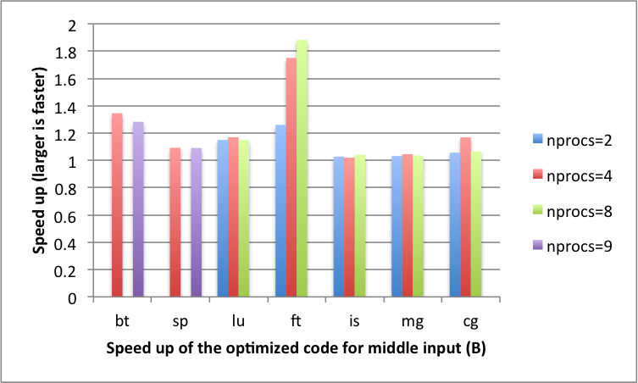
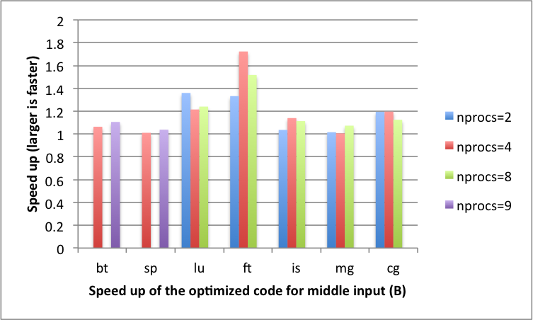
Optimization speedup
Relative execution time for NPB 3.1.1 (excluding DT and EP)
Intel Xeon x86 cluster (Infiniband)
Up to x1.84 faster
Intel Xeon x64 cluster (1 Gbps Ethernet)
Up to x1.79 faster
Intel x86 (class B)
Intel x64 (class B)

Slide 16
Future work
Automate the program transformation
Support more CCO patterns
Model multiple cores on single node and the unbalanced communication time

Slide 17
Backup slides

Slide 18
Related work
MPI-aware compiler optimization
Transformations to Parallel Codes for Communication-Computation Overlap, SC’05,
Exact Dependence Analysis for Increased Communication Overlap, EuroMPI’12
Model-based approaches
Automatic Transformation for Overlapping Communication and Computation, NPC’08
Overlapping with threads
Overlapping Communication and Computation with OpenMP and MPI, SP’01
Overlapping for one-sided communication
Optimizing Bandwidth Limited Problems Using One-sided Communication and Overlap, IPDPS’06

