Slide 1
Compiler-Assisted Overlapping of Communication and Computation in MPI Applications
Jichi Guo Qing Yi
University of Colorado, Colorado Springs
Jiayuan Meng Google Inc
Junchao Zhang Pavan Balaji
Argonne National Laboratory

Slide 2
Overlapping computation and communication
Goal: enhance performance portability of MPI applications
Network communication latency unpredictable a priori
No longer true --- equal work means equal time
Approach: overlap computation and communication from different loop iterations
Overlap Alltoal2 with Before3 and After1
Before1
Ialltoall1
Wait1
After1
Iteration 1
Before2
Ialltoall2
Wait2
Iteration 2
Before3
Ialltoall3
Iteration 3

Slide 3
Compiler Optimization challenges
Profitability --- where to optimize?
Where are the expensive communications?
Need to take sufficiently long to be overlapped
Is overlapping necessary?
Blocking communication is faster on fast network connections
Safety: are there computations to overlap?
Cannot violate dependence constraints
Need inter-procedural analysis
Need to consider runtime code path and data access patterns
How to perform the optimization?
May require replication of communication buffers
Need to insert MPI_Test at the right frequency to avoid slowdowns

Slide 4
Outline
Optimization workflow
Hot path extraction and profitability analysis
Safety analysis with annotation
Tuning MPI_Test
Experiment results
Related work

Slide 5
Optimization Workflow
Input program
Input data and
number of processes
Analytical
performance modeling
(Using Roofline and LogGP models)
Bayesian execution tree
CCO analysis
(Profitability analysis & Safety analysis
with procedural annotation & inlining)
Optimization configuration
CCO optimization and tuning MPI_Test
Optimized code

Slide 6
Analytical Performance Modeling
Find global communication hot spots
Through extensions to the Skope framework by Guo and Meng et. al
For each communication hot spot
Find its enclosing loops
Find local computation in the loops
main()
54s
NAS FT (1D layout)
loop x6
1.6s
0.02s
evolve(x1)
fft(x1, x2)
checksum(x2)
branch 0D
0%
branch 1D
100%
branch 2D
0%
5.4s
4.2s
39s
4.5s
cffts1(x1)
cffts2(x1)
transpose(x1, x2)
cffts1(x1)
1.7s
37s
0.01s
transpose_local(x1)
MPI_Alltoal(x1, x2)
transpose_finish(x2)

Slide 7

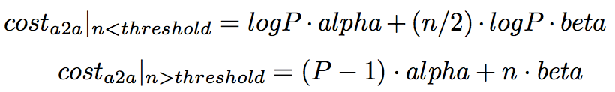

Modeling Communication Cost
Point-to-point
alpha: startup cost per message
beta: reciprocal of bandwidth, i.e. cost per byte for long messages
All2all
In general
Communication cost does not include wait time between unbalanced processes

Slide 8
Example Hot Communication path
Communication hot spots
MPI blocking communication
Point-to-point
Collective
Computation hot spots
Loops of CPU or memory intensive arithmetic computation
Clear separation of computation and communication
Comp => Comm => Comp => …
Reuse buffers across iterations
NAS FT (1D layout)
In
Loop
Computation
Before (I)
MPI_Alltoall (I)
Loop
(I = 1 … N)
Loop
Computation
After (I)
Out

Slide 9
Overlap computation and communication in the loop
Replace blocking MPI_Alltoall by MPI_Ialltoall and MPI_Wait
Reorder Before/After/MPI_Ialltoall/MPI_Wait if dependence allowed
Overlap Alltoal2 with Before3 and After1
Before1
Ialltoall1
Wait1
After1
Iteration 1
Before2
Ialltoall2
Wait2
Iteration 2
Before3
Ialltoall3
Iteration 3

Slide 10
Optimized NAS FT
…
Reorder computation and communication
Need dependence analysis
Before(I) => MPI_Wait(I-?)
Before(I) => After(I-?)
Challenges
Cross procedure boundaries
Dynamic control and data flow
Loop
Before (I)
Computation
MPI_Wait (I-1)
Loop
(I = 2 … N)
MPI_Ialltoall (I)
Loop
Computation
After (I-1)
…

Slide 11
Safety analysis
Inline procedure calls inside the optimization target loop
Use operational developer annotations to enhance accuracy of dependence analysis
Select branches taken at runtime
NAS FT: 0D, 1D, or 2D layout is runtime-dependent
Express memory side effects for MPI API through array accesses
MPICH source code is encapsulated and hidden from compiler
Normalize array dimensions
Arrays used by computation and communication could have different dimensions

Slide 12
Program transformation
Outline and specialize function calls based on the location of the communication (Before(I), After(I), Comm(I))
Reorder communication and computation
…
I = 2 … N
I = 1 … N
In
In
I = 1 … N
Before (I)
In
Before (I)
Before (I)
Wait (I-1)
Icomm (I)
Comm (I)
Icomm (I)
Wait(I)
After (I)
After (I-1)
After (I)
Out
Out
Out
…

Slide 13
Insert MPI_Test into computation hot spots
…
Loop
Insert MPI_Test into computation loops with tunable Freq
MPI_Test
Before (I)
Computation
Loop I = 1 … N
If I % Freq == 0
MPI_Test
Computation
MPI_Wait (I-1)
Loop
(I = 2 … N)
MPI_Ialltoall (I)
Loop
MPI_Test
After (I-1)
Computation
…

Slide 14
Empirical Tuning of MPI_Test frequency
Insertion of MPI_Test
Evenly distribute MPI_Test in the computation
Communication operation is divided into network requests with roughly the same length
Making progress is needed by each request
Prune search space using modeled runtime
Constraints between different frequencies
Tune frequency with binary search
Runtime will monotonic increasing when the frequency is increasing/decreasing from the optimal value
…
MPI_Ialltoall
Loop I = 1 … L₁
If I % Freq₁ == 0
MPI_Test
Computation1
Loop I = 1 … L₂
If I % Freq₂ == 0
MPI_Test
Computation₂
…
Loop I = 1 … L_{N}
If I % Freq_{N} == 0
MPI_Test
Computation_{N}
MPI_Wait
…

Slide 15
Experimental design
Clusters and compilers
Intel Xeon x86 cluster, Infiniband, 2.6GHz (hyper threading disabled), 64GB RAM, ICC/IFort 13.1
Intel Xeon x64 cluster, 1 Gbps Ethernet, 3.2GHz, 16GB RAM, GCC/Gfortran 4.4.7
MPICH 3.1.1
Nodes: 2 ~ 9, 1 process per node
NAS Parallel Benchmark (NPB) 3.3.1, excluding DT and EP
Profilers: Tau and Instrumented timers

Slide 16
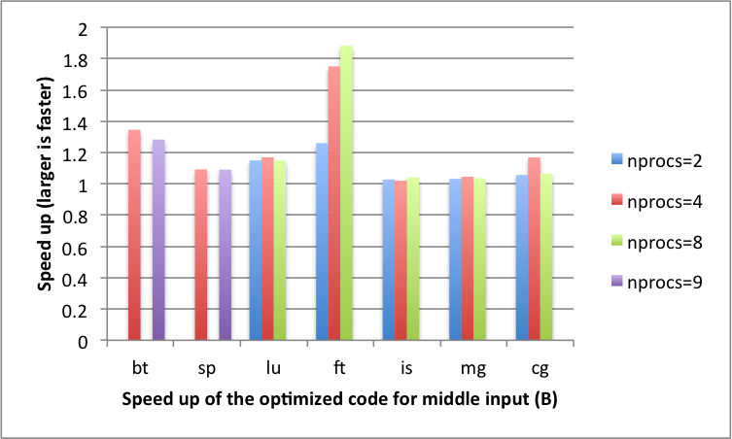
Optimization speedup
Relative execution time for NPB 3.1.1 (excluding DT and EP)
Intel Xeon x86 cluster (Infiniband): up to 1.84x faster

Slide 17
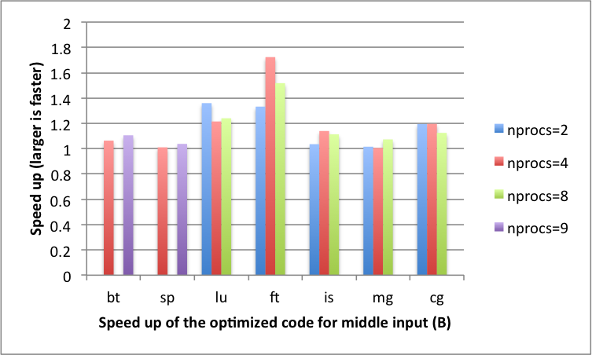
Optimization speedup
Relative execution time for NPB 3.1.1 (excluding DT and EP)
Intel Xeon x64 cluster (1 Gbps Ethernet): Up to 1.79x faster

Slide 18
Future work
Automate the program transformation
Support more CCO patterns
Model multiple cores on single node and the unbalanced communication time

Slide 19
Backup slides

Slide 20
Related work
MPI-aware compiler optimization
Transformations to Parallel Codes for Communication-Computation Overlap, SC’05,
Exact Dependence Analysis for Increased Communication Overlap, EuroMPI’12
Model-based approaches
Automatic Transformation for Overlapping Communication and Computation, NPC’08
Overlapping with threads
Overlapping Communication and Computation with OpenMP and MPI, SP’01
Overlapping for one-sided communication
Optimizing Bandwidth Limited Problems Using One-sided Communication and Overlap, IPDPS’06

