Slide 1
Input program
Input data and
number of processes
Analytical
performance modeling
Modeled performance characteristics
CCO analysis
Optimization configuration
CCO optimization and tuning
Optimized code

Slide 2
Input program
Input data and
number of processes
Analytical
performance modeling
Bayesian execution tree
CCO analysis
Optimization configuration
CCO optimization and tuning
Optimized code

Slide 3
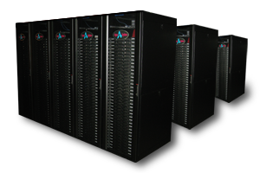
Input program
Input data and
number of processes
Analytical
performance modeling
Bayesian execution tree
CCO analysis
Optimization configuration
CCO optimization
Optimized code with parameterized MPI_Test
Empirical tuning
Optimized code

Slide 4
Source code
Input data and
number of processes
Analytical
performance modeling
Roofline and
LogGP models
Execution flow model
CCO analysis
CCO decision
CCO optimization
and tuning
Target platform
Optimized code

Slide 5
Source code
Input data and number of processes
Analytical modeling
Roofline and
LogGP models
Execution flow model
CCO analysis
CCO structure
CCO optimization
Parameterized code
Tuning
Target platform
Optimized code

Slide 6
Input
Source code
Input data
Number of processes
Execution flow modeling
Bayesian execution tree
Hot region analysis
Hot communication
and computation
Roofline and LogGP models
Overlap analysis
Output
Overlap structure

Slide 7
Input
Source code
Input data
Number of processes
Automatic branch profiling + Execution flow modeling
Intermediate representation of the execution flow (BET)
Performance projection and hot region analysis
Roofline and LogGP models
Communication and computation hot spots
Overlap optimization analysis
Computation and computation to overlap
Places to insert MPI_Test
Output

Slide 8
Input
Source code
Input data
Runtime parameters
Automatic branch profiling + Execution flow modeling
Intermediate representation of the execution flow (BET)
Performance projection and hot region analysis
Roofline and LogGP models
Communication and computation hot spots
Overlap optimization analysis
Output
Loops with optimization hints to overlap

