Slide 1

Compiler-Assisted Overlapping of Communication and Computation in MPI Applications

Slide 2
Optimization challenges
Safety constraints
Accuracy of the data dependence analysis
Inter-procedural analysis
Runtime code path and data access patterns
Profitability constraints
Hide communication overhead
Non-blocking could be slower than blocking communication
Require more buffers
Distribution of MPI_Test
When too few: insufficient to complete communication
When too many: slowdown the computation
Notes:
22min
There are two key challenges of CCO
First, whether it is safe.
It is challenging for accurate dep
Second, profitability
Overhead, and enough
Additional, MPI_Test make progress during computation
Two optimization challenges
Correctness do not change semantics, lack of higher level semantics
Profitable

Slide 3
Outline
Optimization workflow
Hot path extraction and profitability analysis
Safety analysis with annotation
Tuning MPI_Test
Experiment results
Related work
Notes:
4min
Here’s the outline
I am first cover two key approaches
Then I will introduce my work that combining two approaches together to promoting the overlapping
-----
My two key approaches are …
Then, I developed an optimization approach that combines two approaches to …
----
Draft:
To achieve that goal,
my thesis developed a source-to-source optimization approach that will
identify the performance bottleneck of the application
and use compiler technique to optimize the bottleneck.
To understand both the software and hardware,
my approach essentially uses analytical performance modeling
to model the performance of the software and hardware
to identify the performance bottleneck of the application;
and integrates domain knowledge from developers and profilers
by first summarizing these knowledge into human-readable notations,
and then using them to improve the modeling and optimization.
----
Transition: My thesis statements => my approach
Key
Thesis statement
To be more specific,
This thesis developed an optimization approach
To understand software and hardware
Analytical performance modeling
Integrate domain knowledge

Slide 4
CCO optimization workflow
Input program
Input data and
number of processes
Analytical
performance modeling
(Using Roofline and LogGP models)
Bayesian execution tree
CCO analysis
(Profitability analysis & Safety analysis
with annotation-based inlining)
Optimization configuration
CCO optimization and tuning MPI_Test
Optimized code
Notes:
23min
Workflow
Three components
Reuse roofline
Annotation inlining for procedure
Three components of the entire framework
1. Analytical performance bottlenecks
Model MPI application target behavior
2. annotation-based inlinling identify correctness
3. Manually tuning MPI_Test

Slide 5

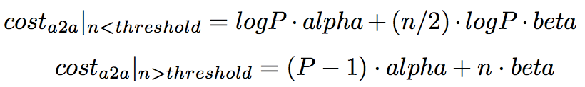

LogGP communication model
Model communication cost of messages
Pt2pt
alpha: startup cost per message
beta: reciprocal of bandwidth, i.e. cost per byte for long messages
All2all
In general
Communication cost does not include wait time between unbalanced processes
Notes:
24min
LogGP is used
LogGP model used by analytical performance modeling to replace roofline model
It could estimate communication time for p2p and a2a given P, n, network latencies and thresholds
The equations cannot model the unbalanced wait time

Slide 6
Profitability analysis
Find global communication hot spots
Find enclosing loop for each hot spot
Find local computation hot spots
main()
NAS FT (1D layout)
54s
loop x6
1.6s
0.02s
evolve(x1)
fft(x1, x2)
checksum(x2)
Example BET of NAS FT
branch 0D
0%
branch 1D
100%
branch 2D
0%
5.4s
4.2s
39s
4.5s
cffts1(x1)
cffts2(x1)
transpose(x1, x2)
cffts1(x1)
1.7s
37s
0.01s
transpose_local(x1)
MPI_Alltoal(x1, x2)
transpose_finish(x2)
Notes:
24min
BET constructed for FT
Communication time
First global
Then enclosing
Then local for MPI_Test

Slide 7
Communication hot path of NAS FT
Clear separation of computation and communication
Comp => Comm => Comp => …
Easy to implement and maintain
Reuse buffers across iterations
Communication hot spots
MPI blocking communication
Point-to-point
Collective
Computation hot spots
Loops of CPU or memory intensive arithmetic computation
NAS FT (1D layout)
In
Loop
Computation
Before (I)
MPI_Alltoall (I)
Loop
(I = 1 … N)
Loop
Computation
After (I)
Out
Notes:
25min
Simplified hot path of NAS FT, alltoall divide loop into computation before/after
Common in NPB, clear separation
Blocking communication
Computation hot spots
I studied NPB, a popular MPI benchmark, to find communication patterns.
Here’s an example of NAS FT.
It has clear separation of comm and comp.
The hot comm is blocking p2p or a2a.
The hot comp is memory/CPU loops.
-------
Draft:
To find out how the communication look like, I studied the NAS Parallel Benchmark or NPB.
Here’s an example hot path of NAS FT, which I found common in NPB applications.
The workflow is decoupled into iterations of computation and communication.
----
----

Slide 8
Overlap computation and communication in the loop
Replace blocking MPI_Alltoall by MPI_Ialltoall and MPI_Wait
Reorder Before/After/MPI_Ialltoall/MPI_Wait if dependence allowed
Overlap Alltoal2 with Before3 and After1
Before1
Ialltoall1
Wait1
After1
Iteration 1
Before2
Ialltoall2
Wait2
Iteration 2
Before3
Ialltoall3
Iteration 3
Notes:
26min
One way to overlap
Shift iterations
One way to overlap them is to replace blocking to non-blocking, and shift the loop iterations
So that the communication in the current iteration can be overlapped with computation in previous/next iterations

Slide 9
Hot path of NAS FT after applying CCO
…
Safety constraints to reorder computation and communication
No dependence edges
Before(I) => MPI_Wait(I-?)
Before(I) => After(I-?)
Challenges
Inter-procedural
Dynamic control and data flow
Loop
Before (I)
Computation
MPI_Wait (I-1)
Loop
(I = 2 … N)
MPI_Ialltoall (I)
Loop
Computation
After (I-1)
…
Notes:
26min
After reordering, loop like this
Dependence constraints
It could be analyzed using classical loop analysis.
But inter-procedural and dynamic
Loop structure after overlapping computation and communication

Slide 10
Safety analysis with annotation-based inlining
Apply annotation-based inlining to enhance accuracy of dependence analysis
Select branches taken
NAS FT: 0D, 1D, or 2D layout is runtime-dependent
Express memory side effects for MPI API through array accesses
MPICH source code is encapsulated and hidden from compiler
Normalize array dimensions
Arrays used by computation and communication could have different dimensions
Notes:
27min
I used annotation based inlining
Code path
Memory side effect
Normalize array access in the same dimension
The safety analysis first apply annotation based inlining to integrate domain knowledge, and then apply classical loop dependence analysis
The domain knowledge include: …

Slide 11
Program transformation
Outline and specialize function calls based on the location of the communication (Before(I), After(I), Comm(I))
Reorder communication and computation
…
I = 2 … N
I = 1 … N
In
In
I = 1 … N
Before (I)
In
Before (I)
Before (I)
Wait (I-1)
Icomm (I)
Comm (I)
Icomm (I)
Wait(I)
After (I)
After (I-1)
After (I)
Out
Out
Out
…
Notes:
28min
Programming transformation include two major steps
Specialize into
Reorder

Slide 12
Insert MPI_Test into computation hot spots
…
Loop
Insert MPI_Test into computation loops with tunable Freq
MPI_Test
Before (I)
Computation
Loop I = 1 … N
If I % Freq == 0
MPI_Test
Computation
MPI_Wait (I-1)
Loop
(I = 2 … N)
MPI_Ialltoall (I)
Loop
MPI_Test
After (I-1)
Computation
…
Notes:
28min
To make progress during communication, insert MPI_Test into
If the hot spot is a loop, insert Freq
Additionally, MPI_Test is needed
What MPI_Test does and where to insert MPI_Test

Slide 13
Tuning MPI_Test frequency
Optimal distribution of MPI_Test
Evenly distributed of MPI_Test in the computation time
Communication operation is divided into network requests with roughly the same length
Making progress is needed by each request
Prune search space using modeled runtime
Constraints between different frequencies
Tune frequency with binary search
Runtime will monotonic increasing when the frequency is increasing/decreasing from the optimal value
…
MPI_Ialltoall
Loop I = 1 … L₁
If I % Freq₁ == 0
MPI_Test
Computation1
Loop I = 1 … L₂
If I % Freq₂ == 0
MPI_Test
Computation₂
…
Loop I = 1 … L_{N}
If I % Freq_{N} == 0
MPI_Test
Computation_{N}
MPI_Wait
…
Notes:
29min
Multiple frequency
Evenly distribute
Prune, almost same time
Tune with binary search

Slide 14
Experiment design
Clusters and compilers
Intel Xeon x86 cluster, Infiniband, 2.6GHz (hyper threading disabled), 64GB RAM, ICC/IFort 13.1
Intel Xeon x64 cluster, 1 Gbps Ethernet, 3.2GHz, 16GB RAM, GCC/Gfortran 4.4.7
MPICH 3.1.1
Nodes: 2 ~ 9, 1 process per node
NAS Parallel Benchmark (NPB) 3.3.1, excluding DT and EP
Profilers: Tau and Instrumented timers
Notes:
30min
To evaluate the effectiveness
Two machines
Since modeling intra-node communication
ANL BLUES: http://www.lcrc.anl.gov/about/Blues UCCS DISCO: http://www.cs.uccs.edu/~xzhou/DISCO/

Slide 15
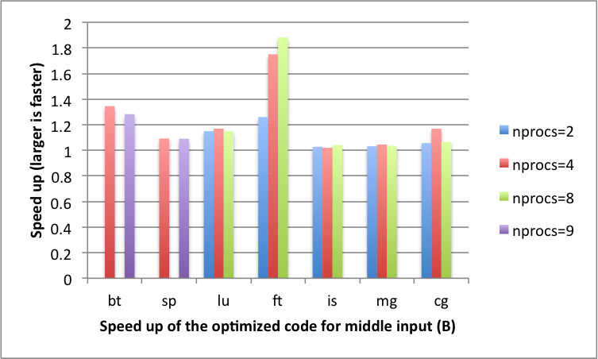
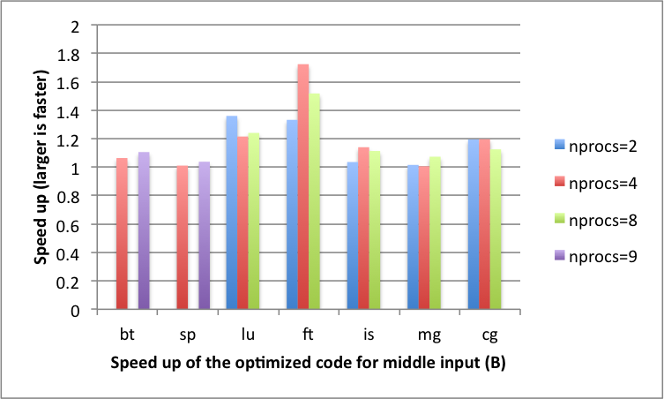
Optimization speedup
Relative execution time for NPB 3.1.1 (excluding DT and EP)
Intel Xeon x86 cluster (Infiniband)
Up to x1.84 faster
Intel Xeon x64 cluster (1 Gbps Ethernet)
Up to x1.79 faster
Intel x86 (class B)
Intel x64 (class B)
Notes:
30min
For both two case, up to 80% speed up

Slide 16
Future work
Automate the program transformation
Support more CCO patterns
Model multiple cores on single node and the unbalanced communication time
Notes:
31min
Written up paper with Dr. Yi, safety analysis, prof analysis
Future work
Auto
More CCO
Multi node

Slide 17
Backup slides

Slide 18
Related work
MPI-aware compiler optimization
Transformations to Parallel Codes for Communication-Computation Overlap, SC’05,
Exact Dependence Analysis for Increased Communication Overlap, EuroMPI’12
Model-based approaches
Automatic Transformation for Overlapping Communication and Computation, NPC’08
Overlapping with threads
Overlapping Communication and Computation with OpenMP and MPI, SP’01
Overlapping for one-sided communication
Optimizing Bandwidth Limited Problems Using One-sided Communication and Overlap, IPDPS’06
Notes:
33min
MPI compiler for safety
Model for profitiablity
Threads
One-side

