Slide 1
Demo: Security groups for Pods
Notes:
First I'll explain how it works and the different components involved, then I'll show a brief example.

Slide 2
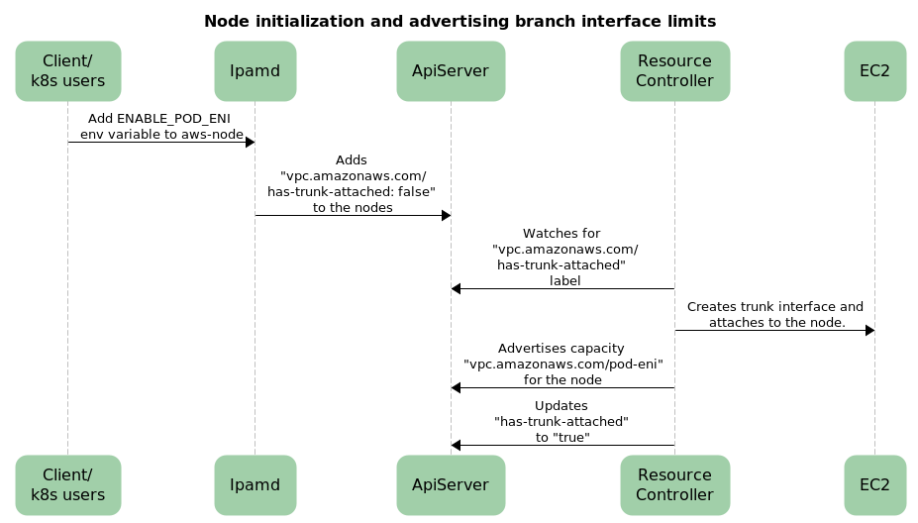
Node initialization
Notes:
When the node is bootstrapped, if it supports ENI trunking, the resource controller will update the vpc.amazonaws.com label from false to true and attach a trunk interface to the node.

Slide 3
Node configuration
Allocatable:
attachable-volumes-aws-ebs: 25
cpu: 1930m
ephemeral-storage: 76224326324
hugepages-1Gi: 0
hugepages-2Mi: 0
memory: 7174832Ki
pods: 29
vpc.amazonaws.com/pod-eni: 9
Notes:
After enabling Pod ENIs, the resource is advertised by the Kubelet. As you can see from this snippet, this instance has 9 pod-enis (or branch enis) available. This is in addition to the 29 pods that can be scheduled on to the instance. Be aware that max-pods for the node does not account for branch ENIs that pods can use. Pods are only assigned a branch ENI if they are part of an AWS SG.

Slide 4
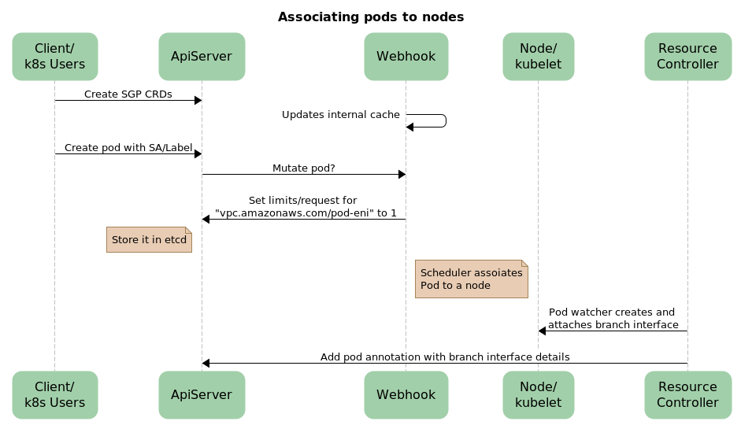
Associating Pods to nodes
Scheduler associates Pod to a node
Notes:
If you schedule a pod with a label/SA matching the selector in the SecurityGroupPolicy a mutating webhook will update the pod’s resources (requests/limits) to reflect that it is being assigned an ENI. Once the scheduler identifies the best node to run the pod on the resource controller attaches a branch interface to that node. It also adds an annotation to the pod with information the CNI will use to configure the pod’s network.

Slide 5
Pod updates
vpc.amazonaws.com/pod-eni: >-
[{"eniId":"eni-09bbcef1a86d9a492","ifAddress":"02:05:9a:f8:75:3b","privateIp":"10.0.1.167","vlanId":1, "subnetCidr":"10.0.1.0/24"}]
Limits:
vpc.amazonaws.com/pod-eni: 1
Requests:
vpc.amazonaws.com/pod-eni: 1
Notes:
This snippet shows the annotation added to the pod by the resource controller. I also shows how the resources for the pod are updated by the webhook.

Slide 6
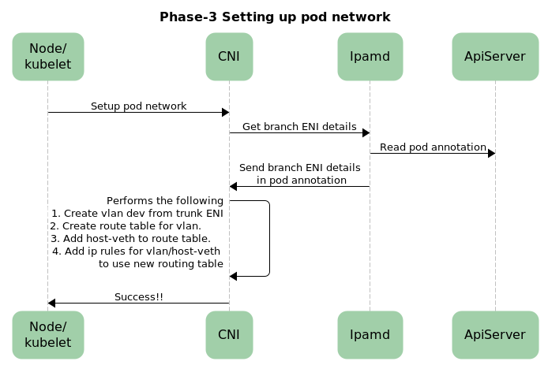
Pod networking
Notes:
In the final step (phase 3), the CNI reads the information in the pod’s annotation to setup the pod’s network. As part of that, the CNI will:
Create vlan 'dev' from trunk ENI
Create route table for vlan
Add host-veth to route table
Add ip rules for vlan/host-veth to use new routing table
You can see these changes for yourself by executing the ip route and ip show commands on the instance and from within the pod.

Slide 7
Network configuration
“Received CNI add request: ContainerID(cf0fdaff53d774851f2e9c5cbb90de7af83eac8150145cc2e2a0229d4e8c33cf) Netns(/proc/29162/ns/net) IfName(eth0) Args(IgnoreUnknown=1;K8S_POD_NAMESPACE=default;K8S_POD_NAME=postgres-test;K8S_POD_INFRA_CONTAINER_ID=cf0fdaff53d774851f2e9c5cbb90de7af83eac8150145cc2e2a0229d4e8c33cf) Path(/opt/cni/bin) argsStdinData({\"cniVersion\":\"0.3.1\",\"mtu\":\"9001\",\"name\":\"aws-cni\",\"pluginLogFile\":\"/var/log/aws-routed-eni/plugin.log\",\"pluginLogLevel\":\"DEBUG\",\"type\":\"aws-cni\",\"vethPrefix\":\"eni\"})"
“MTU value set is 9001:"
“Received add network response for container cf0fdaff53d774851f2e9c5cbb90de7af83eac8150145cc2e2a0229d4e8c33cf interface eth0: Success:true IPv4Addr:\"10.0.1.167\" DeviceNumber:-1 VPCcidrs:\"10.0.0.0/16\" PodVlanId:1 PodENIMAC:\"02:05:9a:f8:75:3b\" PodENISubnetGW:\"10.0.1.1\" ParentIfIndex:3 "
“setupVeth network: disabled IPv6 RA and ICMP redirects on vlan1fabe687443"
“Successfully set host route to be 10.0.1.167/0"
Notes:
This is an excerpt from the CNI logs. It reveals that there was an ENI add request for a container called postgres-test. It also shows the information used to configure the pod’s network. In this instance, the pod is assigned the IP 10.0.1.167.

