Slide 1

AMAZON SALES DATA ANALYSIS

Slide 2
Objective of the Project
The objective of this project is to analyze Amazon sales data to gain insights into sales trends, product performance, and customer behavior. By examining various aspects of the sales data, such as monthly revenue trends, regional sales distribution, and product performance, we aim to identify key drivers of revenue and potential areas for improvement. Additionally, we will build a predictive model to forecast order priorities, helping Amazon optimize its inventory and logistics processes.

Slide 3
Problem Statement :
The key challenges addressed in this project include:
Identifying trends in monthly sales to understand seasonal demand fluctuations.
Analyzing sales distribution across different regions to identify high-performing and underperforming areas.
Evaluating product performance to determine the top revenue-generating products and those with high sales volumes.
Predicting order priorities to optimize inventory management and logistics, ensuring timely delivery and customer satisfaction.
Understanding correlations between different sales factors to make data-driven business decisions.

Slide 4
Introduction
In the era of big data, leveraging sales data effectively can provide a competitive advantage for e-commerce platforms like Amazon. This project involves a comprehensive analysis of Amazon's sales data to uncover valuable insights and address key business questions. By examining sales trends, regional distribution, and product performance, we aim to provide actionable recommendations for improving sales strategies and customer satisfaction.
We start by preprocessing the sales data to ensure accuracy and consistency. Various data exploration techniques are applied to understand the dataset's characteristics and identify any anomalies. Key metrics, such as total revenue and sales quantity, are calculated and analyzed to provide an overview of Amazon's sales performance.
Overall, this project aims to transform raw sales data into meaningful insights, enabling Amazon to enhance its sales strategies, optimize operations, and ultimately improve customer satisfaction.

Slide 5
Dataset
The dataset provides a comprehensive view of global sales transactions across various regions, countries, and product types. It includes detailed information about each transaction, such as the item type, sales channel (online or offline), order priority, order and ship dates, and quantities sold.
Additionally, financial metrics such as unit price, unit cost, total revenue, total cost, and total profit are provided, allowing for in-depth analysis of sales performance and profitability. This dataset is valuable for examining sales trends, understanding market dynamics, and optimizing business strategies across diverse geographical areas and product categories.
The dataset consists of 1,000 rows and 14 columns. Each row represents an individual sales transaction, while the columns capture various details about these transactions, including:
a. Region Country b. Item Type c. Sales Channel d. Order Priority e. Order Date f. Order ID g. Ship Date
h. Units Sold i. Unit Price j. Unit Cost k. Total Revenue l. Total Cost m. Total Profit

Slide 6
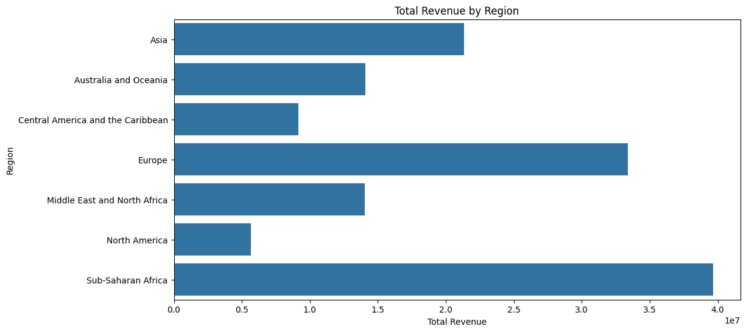
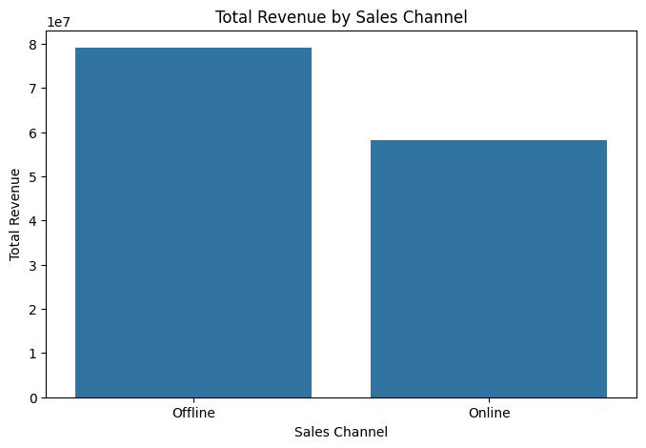
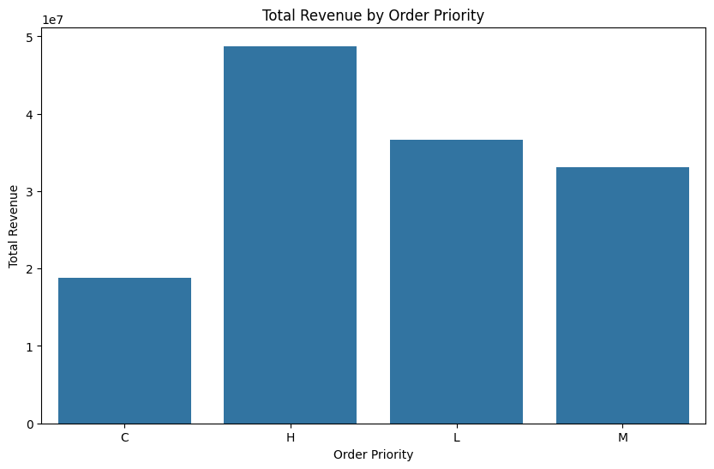
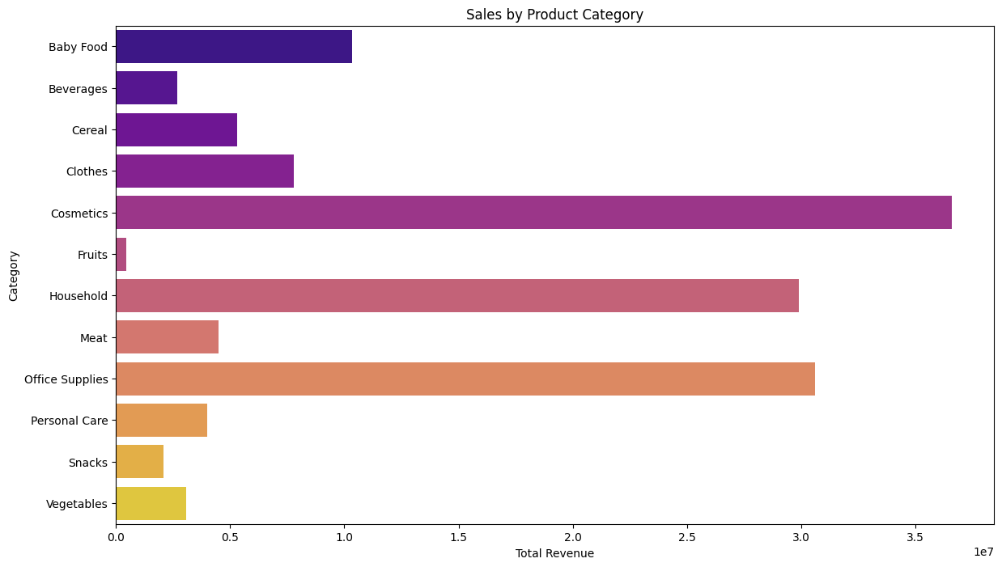
Visualization
After examining our dataset, the next logical step is to delve into various visual representations to uncover valuable insights from our Amazon sales data. By exploring different types of visualizations, we aim to gain a deeper understanding of trends, patterns, and correlations that can provide actionable insights for optimizing our strategies and enhancing sales performance on Amazon.
Here is the sample of some visualization :

Slide 7
Total Revenue by Region
This visualization represents the total revenue generated from sales across different geographical regions. Each region is depicted on the horizontal axis, while the vertical axis indicates the total revenue in monetary units.
Insights:
Revenue Distribution: The chart highlights the distribution of total revenue across various regions, showcasing which regions contribute the most to the overall sales.
Top-Performing Regions: Regions with the highest bars are the top-performing areas in terms of revenue generation. This information is crucial for identifying key markets.
Comparative Analysis: By comparing the height of the bars, we can easily see the disparity in revenue contributions among different regions. This helps in understanding market penetration and the effectiveness of sales strategies in various areas.
Strategic Focus: Regions with lower revenue might require focused marketing efforts or an analysis to understand the underlying factors affecting sales performance.

Slide 8
Total Revenue by Sales Channel
This visualization illustrates the total revenue generated through different sales channels, categorized into online and offline channels. The horizontal axis represents the sales channels, while the vertical axis indicates the total revenue in monetary units.
Insights:
Channel Comparison: The visualization clearly shows the comparison between online and offline sales channels in terms of revenue generation.
Dominant Channel: The sales channel with the higher bar is the dominant channel contributing the most to the total revenue. This helps in identifying which channel is more effective in driving sales.
Revenue Contribution: Understanding the revenue contribution from each channel helps in determining the effectiveness of online versus offline strategies and their impact on overall sales.
Strategic Insights: The data can provide strategic insights into consumer behavior and preferences. For instance, a higher revenue from the online channel may indicate a strong digital presence and effective online marketing strategies.

Slide 9
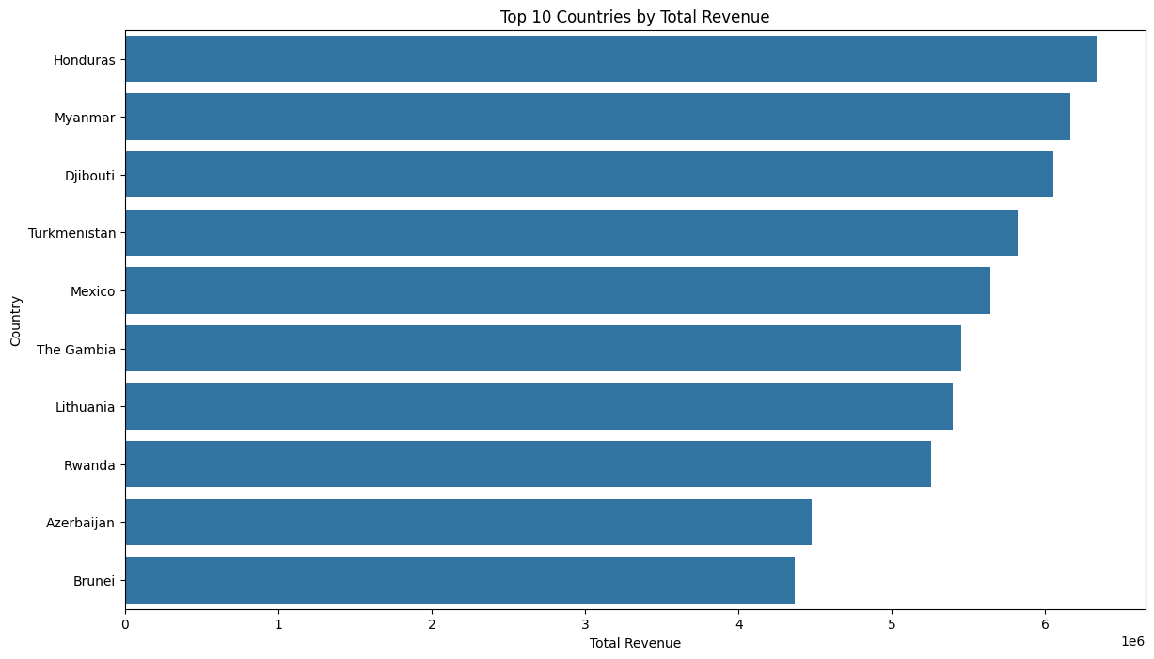
Top 10 Countries by Total Revenue
This visualization displays the top 10 countries ranked by their total revenue generated from sales. Each country is represented on the horizontal axis, while the vertical axis indicates the total revenue in monetary units.
Insights:
Revenue Leaders: The chart highlights the top 10 countries with the highest revenue, providing a clear view of the leading markets.
Revenue Distribution: By comparing the heights of the bars, we can see the distribution of revenue among the top-performing countries. This helps in identifying which countries are the most lucrative.
Market Opportunities: Countries with higher revenue bars are identified as key markets with significant sales potential. This insight is useful for focusing business efforts and resources.
Strategic Planning: Understanding which countries contribute the most to total revenue aids in strategic planning, helping businesses prioritize their efforts in these regions.

Slide 10
Total Revenue by Order Priority
This visualization depicts the total revenue generated from sales categorized by order priority levels. The horizontal axis represents different order priorities (e.g., High, Medium, Low, Critical), while the vertical axis indicates the total revenue in monetary units.
Insights:
Revenue by Priority: The chart shows how total revenue is distributed across various order priority levels, providing insight into which priority categories contribute the most to overall sales.
High-Priority Orders: Orders marked with higher priority (e.g., Critical, High) may show higher revenue, indicating the importance of these categories in generating sales.
Impact of Priority Levels: Understanding the revenue impact of different priority levels helps in evaluating the effectiveness of prioritizing certain orders over others.
Sales Strategy: The data can provide strategic insights into how prioritization affects sales performance and customer satisfaction.

Slide 11
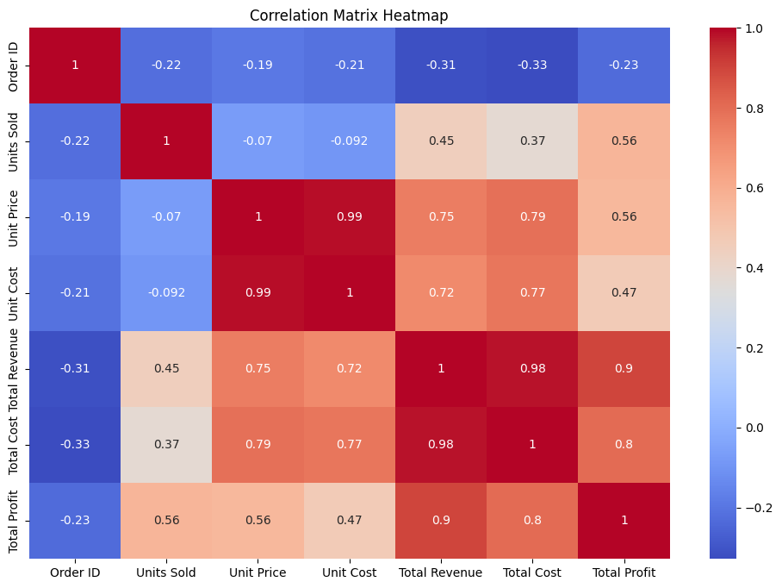
Heatmap for Correlation
This visualization is a heatmap that illustrates the correlation between different numerical variables in the dataset. Each cell in the heatmap represents the correlation coefficient between two variables, with the values ranging from -1 to 1. The color intensity indicates the strength and direction of the correlation, with darker colors representing stronger correlations.
Insights:
Correlation Strength: The heatmap allows for quick identification of strong positive correlations (closer to 1) and strong negative correlations (closer to -1) between variables. Cells with colors closer to the extreme ends of the color scale indicate these strong correlations.
Positive and Negative Correlations: Positive correlations imply that as one variable increases, the other tends to increase as well. Negative correlations suggest that as one variable increases, the other tends to decrease. Neutral correlations (close to 0) indicate little to no linear relationship.
Data Patterns: The heatmap helps in spotting patterns and relationships that might not be immediately evident, providing a comprehensive view of how different variables interact.

Slide 12
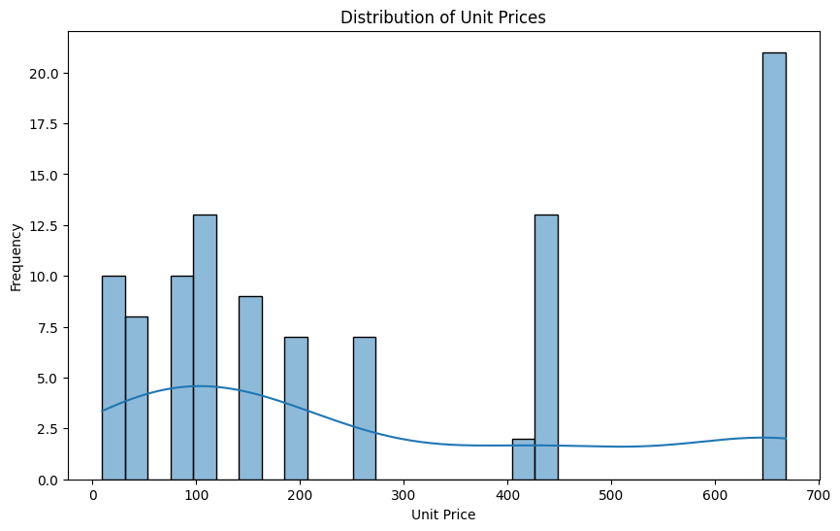
Distribution of Unit Prices
This visualization displays the distribution of unit prices for the items sold. It can be represented as a histogram, density plot, or box plot, showing how unit prices are spread across the dataset. The horizontal axis represents the unit price, while the vertical axis indicates the frequency or density of the items at different price points.
Insights:
Price Range: The chart shows the range of unit prices, highlighting the minimum and maximum prices in the dataset.
Price Distribution: It provides a clear view of how unit prices are distributed, indicating whether most items are clustered around a particular price range or spread out across a wide range.
Central Tendency: The visualization helps in identifying measures of central tendency, such as the mean, median, and mode of the unit prices.
Skewness and Kurtosis: It reveals the skewness of the distribution (whether the prices are skewed to the left or right) and the kurtosis (the peakedness or flatness of the distribution), providing insights into the variability and concentration of unit prices.

Slide 13
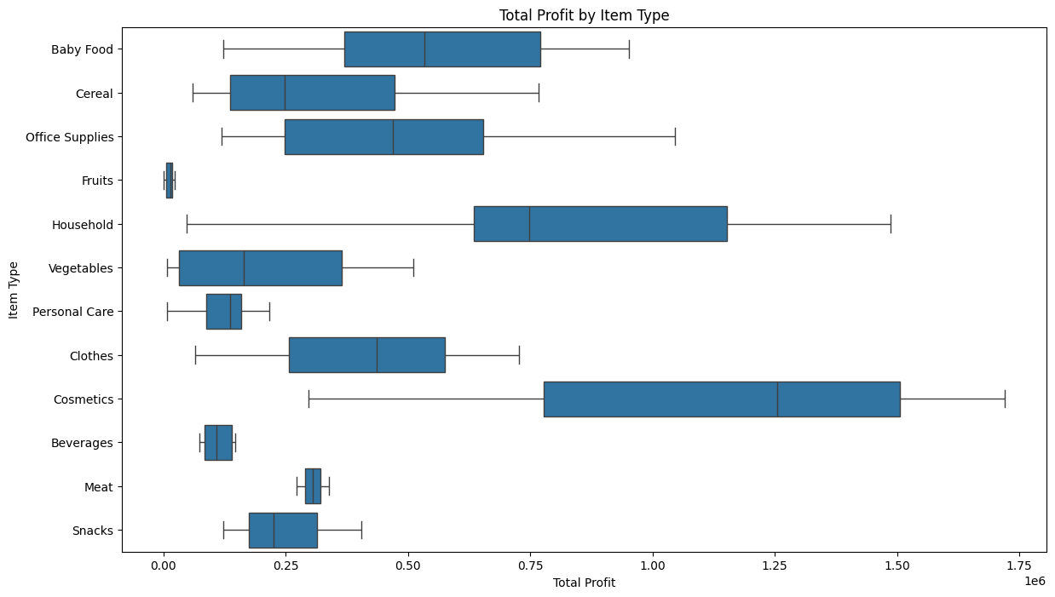
Box Plot of Total Profit by Item Type
This visualization is a box plot that shows the distribution of total profit for different item types. Each box represents the total profit data for a specific item type, displaying key statistics such as the median, quartiles, and potential outliers.
Insights:
Profit Distribution: The box plot reveals how total profit is distributed across different item types, highlighting the range and variability of profits within each category.
Central Tendency: The line within each box indicates the median total profit for that item type, providing a measure of central tendency.
Quartiles: The edges of the box represent the first (Q1) and third (Q3) quartiles, showing the interquartile range (IQR) where the middle 50% of the data lies. This helps in understanding the spread and skewness of the data.
Outliers: Points outside the "whiskers" of the box plot are considered outliers, indicating item types with unusually high or low total profits. These outliers can provide insights into exceptional cases or opportunities for further investigation.
Comparative Analysis: By comparing the boxes, one can identify which item types are more profitable and which ones have higher variability in profits.

Slide 14
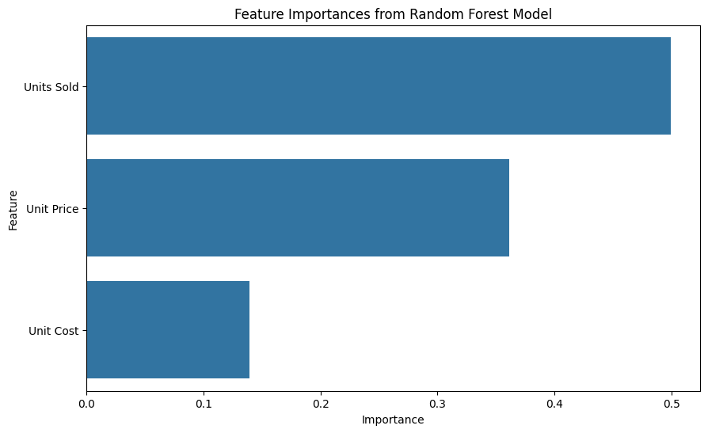
Feature Importance from Random Forest Model
This visualization showcases the importance of various features used in a Random Forest model for predicting a target variable. Each feature's importance is represented as a bar, with the length of the bar indicating the relative importance or contribution of that feature to the model's predictions.
Insights:
Key Features: The chart highlights the most important features that significantly impact the model's predictions. Features with longer bars are more influential in determining the outcome.
Relative Importance: It provides a comparative view of all the features, showing how each one contributes to the model's overall performance. This helps in understanding which variables are most crucial.
Model Transparency: The visualization enhances model transparency by allowing us to see which features drive the predictions, making it easier to interpret and trust the model's results.
Dimensionality Reduction: Less important features, those with shorter bars, can potentially be dropped from the model to reduce complexity without significantly impacting performance.

Slide 15
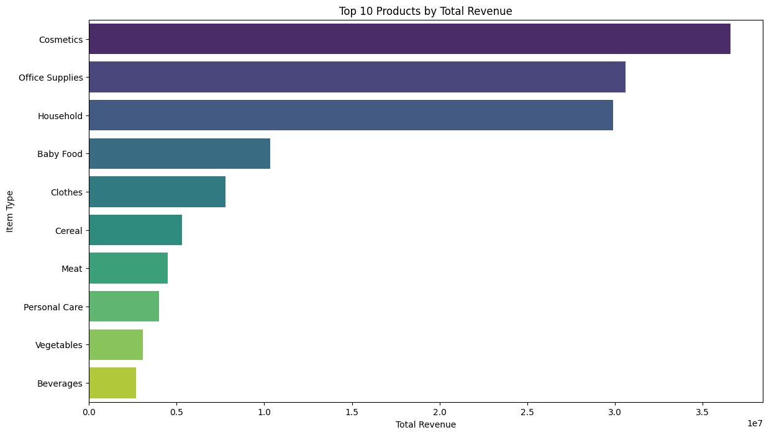
Top 10 Products by Total Revenue
This visualization displays the top 10 products ranked by their total revenue generated from sales. Each product is represented on the horizontal axis, while the vertical axis indicates the total revenue in monetary units.
Insights:
Revenue Leaders: The chart highlights the top 10 products with the highest revenue, providing a clear view of the best-selling items.
Revenue Distribution: By comparing the heights of the bars, we can see the distribution of revenue among the top-performing products, identifying which items are the most lucrative.
Product Performance: Understanding which products generate the most revenue helps in identifying key products that drive the majority of sales.
Market Demand: High-revenue products are indicative of strong market demand, offering insights into consumer preferences and popular items.

Slide 16
Sales by Product Category
This visualization depicts the total sales for each product category. The horizontal axis represents the different product categories, while the vertical axis indicates the total sales in monetary units. Each bar represents the aggregate sales figures for a specific product category.
Insights:
Sales Distribution: The chart shows how sales are distributed across various product categories, highlighting which categories generate the most revenue.
Top Categories: Product categories with higher bars are the top-performing ones in terms of sales, indicating high consumer demand and popularity.
Comparative Analysis: By comparing the heights of the bars, we can easily see the differences in sales performance between categories, helping to identify both strong and underperforming segments.
Market Trends: Understanding sales by product category provides insights into market trends and consumer preferences, guiding business decisions.

Slide 17
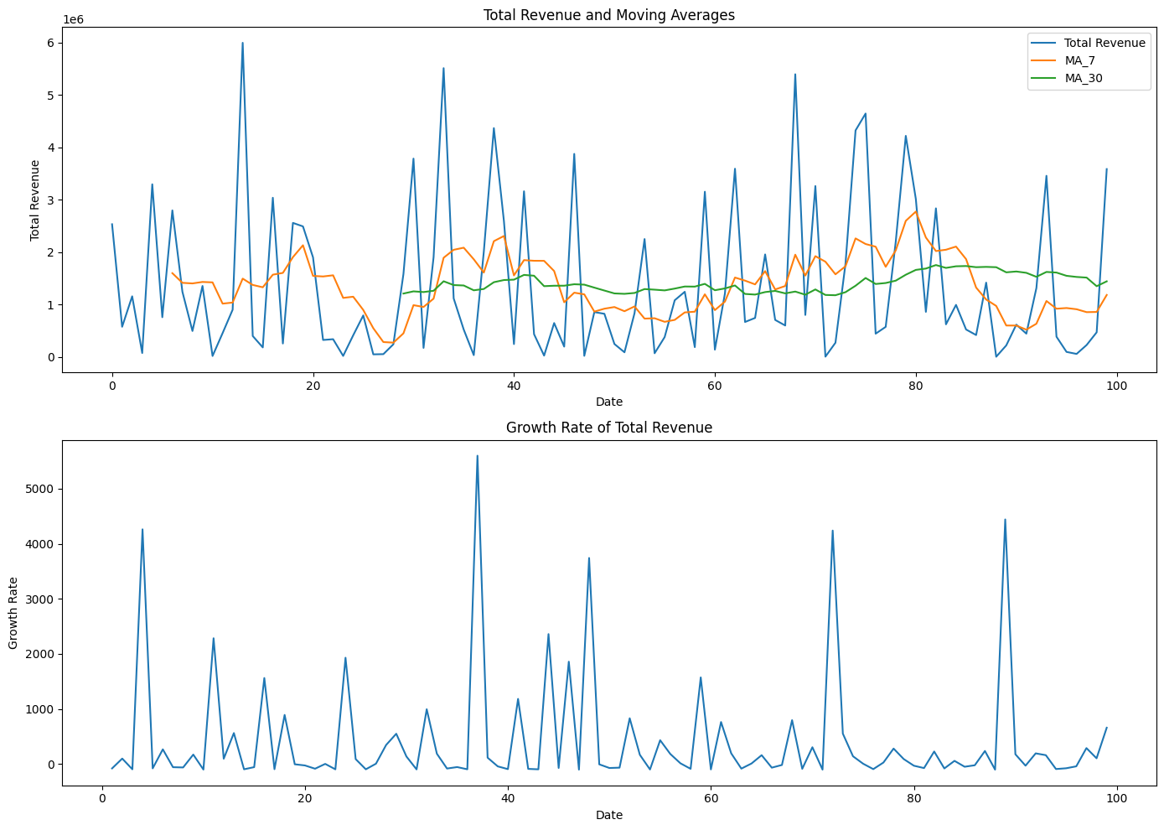
Advanced Feature Engineering with Visualizations
This section focuses on advanced feature engineering techniques, utilizing visualizations to enhance data preprocessing and model building. Feature engineering involves creating new features or transforming existing ones to improve the performance of machine learning models. Visualizations play a crucial role in understanding data patterns, relationships, and distributions, guiding the creation of more informative and predictive features.
Insights:
Feature Correlation: Visualizations such as heatmaps can show correlations between features, helping to identify redundant features or strong relationships that can be leveraged to create new features.
Distribution Analysis: Histograms, density plots, and box plots can reveal the distribution of features, highlighting skewness, outliers, and data ranges. This information is vital for normalization, scaling, or transforming features.
Time Series Trends: Line plots and seasonal decomposition charts can help in analyzing trends and seasonality in time series data, guiding the creation of features like moving averages, lags, and seasonal indicators.
Interaction Effects: Scatter plots and pair plots can identify interaction effects between features, suggesting combinations or polynomial features that may improve model performance.

Slide 18
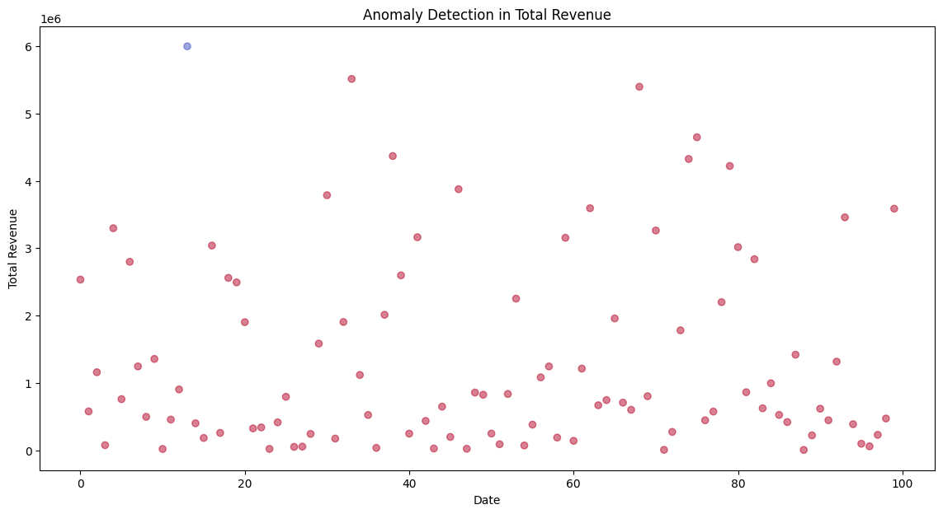
Anomaly Detection
Anomaly detection involves identifying unusual patterns or observations in data that do not conform to expected behavior. These anomalies can be indicative of significant events, errors, or rare occurrences that need further investigation. Visualizations play a crucial role in anomaly detection by providing intuitive and accessible ways to spot deviations from the norm.
Insights:
Identifying Outliers: Visualizations such as box plots, scatter plots, and time series plots help in identifying outliers, which are data points significantly different from the majority of the data.
Pattern Recognition: Line charts and control charts can reveal anomalies in time series data, showing sudden spikes, drops, or trends that deviate from historical patterns.
Multidimensional Analysis: Pair plots and heatmaps can be used to detect anomalies in high-dimensional data by highlighting unusual relationships or correlations between multiple variables.
Density-Based Anomalies: Density plots and contour plots can identify regions of low data density that indicate potential anomalies in continuous data distributions.

Slide 19
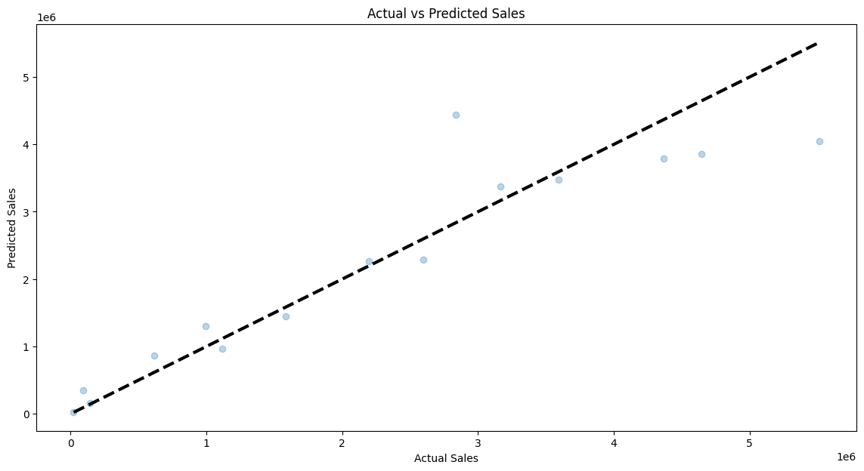
Predictive Modeling
Predictive modeling involves using statistical techniques and machine learning algorithms to create models that can forecast future outcomes based on historical data. These models are trained to identify patterns and relationships in the data, enabling predictions about new or unseen data points. Visualizations play a key role in both the development and evaluation of predictive models, providing insights into model performance and data patterns.
Insights:
Model Performance: Visualizations such as ROC curves, confusion matrices, and lift charts help evaluate the performance of predictive models, showing how well the model distinguishes between different classes or predicts outcomes.
Feature Importance: Bar charts or feature importance plots from algorithms like Random Forest or XGBoost highlight the most influential features, offering insights into which variables most affect the predictions.
Prediction Distribution: Histograms and density plots can display the distribution of predicted values, indicating whether the model's predictions are reasonable and aligned with the expected outcomes.

Slide 20
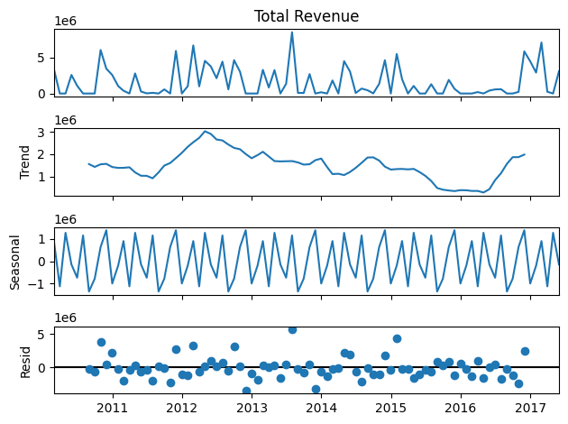
Seasonal Decomposition of Time Series
Seasonal decomposition of time series is a statistical method used to decompose a time series into three main components: trend, seasonality, and residual (or noise). This technique helps in understanding the underlying patterns in the data, making it easier to analyze and forecast future values. Visualizations play a crucial role in interpreting these components and gaining insights into the time series behavior.
Insights:
Trend Component: The trend component captures the long-term progression of the time series, showing the overall direction of the data over time, whether it’s increasing, decreasing, or remaining stable.
Seasonality Component: The seasonality component reveals the repeating patterns or cycles in the data, occurring at regular intervals such as daily, weekly, monthly, or yearly.
Residual Component: The residual component represents the random noise or irregular fluctuations in the data that are not explained by the trend or seasonality components.

Slide 21
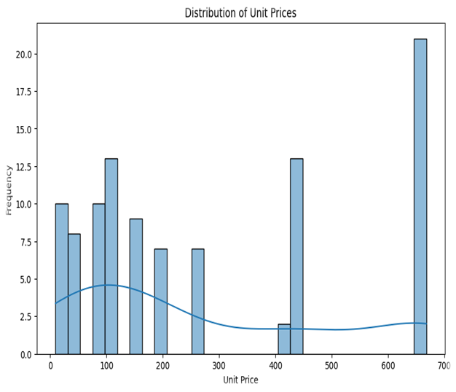

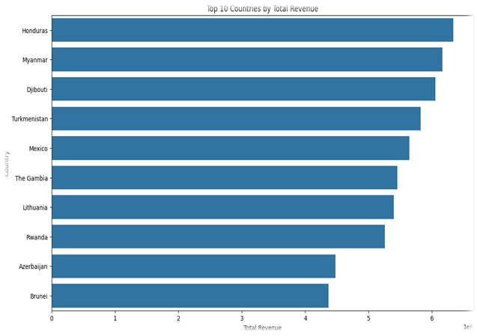
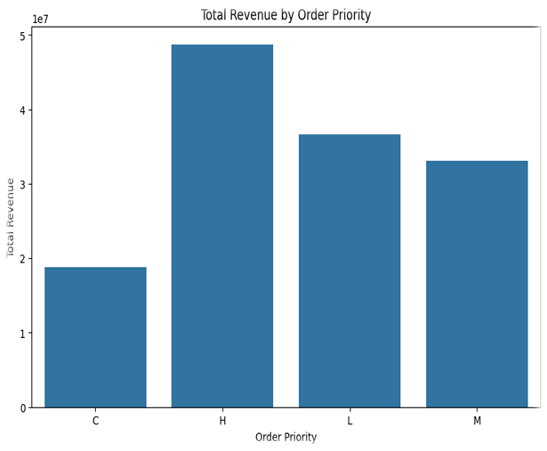
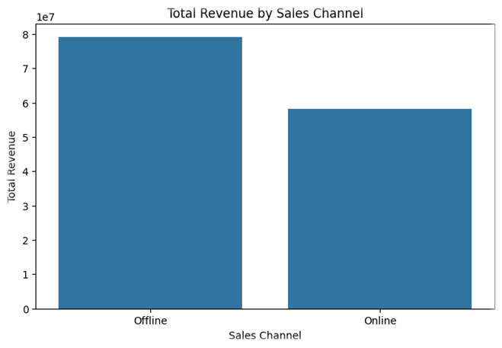
Conclusion
This project involved a detailed analysis of Amazon sales data, leveraging data exploration, visualization, feature engineering, anomaly detection, and predictive modeling to extract valuable insights. Key findings include:
Data Exploration and Visualization: Visual analyses revealed patterns in total revenue by region, sales channel, and product category, and identified top products and countries by revenue.
Feature Engineering: Advanced techniques improved model predictions by identifying important features and creating new ones based on visual insights.
Anomaly Detection: Statistical methods and machine learning identified data anomalies, ensuring data quality and highlighting unusual patterns.
Predictive Modeling: Models were developed to forecast sales and identify key factors influencing performance. Seasonal decomposition provided deeper insights into trends and patterns.
Actionable Insights: The analysis uncovered significant trends, such as seasonal sales peaks and high-revenue products, informing inventory management, marketing strategies, and resource allocation.

Slide 22


