Slide 1

MediMind AI
Under the guidance of
Presented by
Name : Jitu Kumar
Reg. No.: 222025109181
Department : Faculty of Computing And IT
Dr. Ritushree Narayan
Faculty of Computing And IT

Slide 2
CONTENTS
Introduction
Literature Review
Methodology
Result Analysis
Conclusion And Future Scope
References

Slide 3
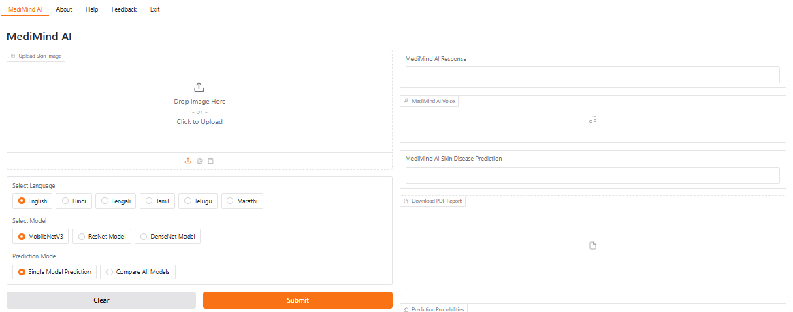
INTRODUCTION
Skin diseases affect millions globally and can lead to physical, emotional, and social challenges if left untreated.
In many regions, especially rural areas, access to qualified dermatologists is limited, leading to delayed or incorrect treatment.
MediMind AI is an intelligent, AI-powered dermatology assistant designed to assist in the early detection of common skin diseases (Acne, Eczema, And Melanoma).
User-friendly interface, and multilingual voice/text interaction to enhance accessibility and reliability.
Figure 1 : MediMind AI Interface

Slide 4
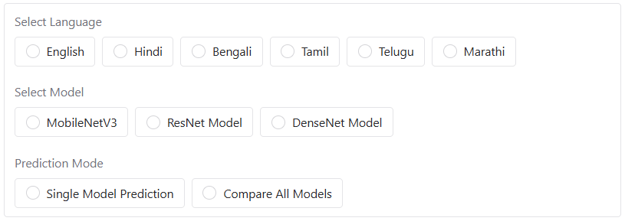
OBJECTIVES
CONTD…
To support multiple skin disease categories: Acne, Eczema, Melanoma, and Unknown (out-of-distribution cases).
To enhance diagnostic accessibility through multilingual voice and text interaction.
To integrate advanced features like Softmax thresholding, PDF report generation, and model comparison.
To deploy the system with a user-friendly Gradio interface, making it practical for both patients and healthcare professionals
Figure 2 : Multilingual Language And Prediction Mode Suppose

Slide 5

RESEARCH GAPS
CONTD…
i. Most public datasets cover only a few skin disease categories, limiting model generalization and robustness.
ii. Lack of AI systems that integrate speech, image, and text modalities for more accurate and insightful diagnosis.
iii. Very few tools offer multilingual voice/text interaction, making them inaccessible to non-English speakers.
iv. PDF medical report generation, creates detailed medical reports for easy doctor review
Figure 3 : Research Gaps

Slide 6
LITERATURE REVIEW
Table No. 1 : Literature Review
SI. No. | Authors | Publication Year | Paper Title | Technology Used | Pros | Cons | Journal Name | Volume | Page No. | DOI
1. | Ahmed Alkuwaiti A ; Nazer K ; Al-Reedy | 2023 | A Review of the Role of Artificial Intelligence in Healthcare | AI in medical imaging, diagnostics, virtual patient care | Comprehensive overview of AI applications in healthcare | Discusses challenges in AI adoption | Frontiers in Digital Health | 5 | 1-15 | https://doi.org/10.3390/jpm13060951
2. | Shuroug A. Alowais, Sahar S. Alghamdi, Nada Alsuhebany, Tariq Alqahtani, Abdulrahman I. Alshaya | 2023 | Revolutionizing Healthcare: The Role of Artificial Intelligence in Clinical Practice | AI in disease diagnosis, treatment recommendations | Up-to-date overview of AI applications | Addresses challenges in AI adoption | BMC Medical Education | 23 | 5-12 | http://doi.org/10.1186/s12909-023-04698-z
3. | Junaid Bajwa, Usman Munir, Aditya Nori, Bryan Williams | 2021 | Artificial Intelligence in Healthcare: Transforming the Practice of Medicine | AI in clinical decision-making | Outlines breakthroughs in AI applications | Discusses roadmap for effective AI systems | npj Digital Medicine | 4 | 3-8 | https://doi.org/10.7861/fhj.2021-0095

Slide 7
LITERATURE REVIEW
CONTD…
4. | Vidhya Rekha Umapathy 1, Suba Rajinikanth B 2, Rajkumar Densingh Samuel Raj 3, Sankalp Yadav 4 | 2023 | Perspective of Artificial Intelligence in Disease Diagnosis: A Review | AI in medical diagnostics | Enhances accuracy and efficiency in diagnosis | Discusses limitations and challenges | Frontiers in Medicine | 10 | 4-10 | https://doi.org/10.7759/cureus.45684
5. | Junaid Bajwa, Usman Munir, Aditya Nori, Bryan Williams | 2021 | Artificial Intelligence in Healthcare: Transforming the Practice of Medicine | AI in clinical decision-making | Outlines breakthroughs in AI applications | Discusses roadmap for effective AI systems | npj Digital Medicine | 4 | 3-8 | https://doi.org/10.7861/fhj.2021-0095

Slide 8
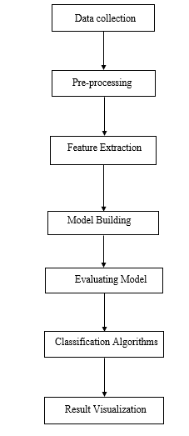
METHODOLOGY
Figure 4 : Block Diagram of System for MediMind AI

Slide 9
CONTD…
METHODOLOGY
Block Diagram of System :
Collect labeled skin disease images for four categories.
Preprocess images by resizing, normalizing, and cleaning.
Extract features using CNNs and train models (MobileNetV3, ResNet50, DenseNet121).
Evaluate results and display predictions, Grad-CAM, and PDF reports.

Slide 10

CONTD…
METHODOLOGY
Models Used :
ii. ResNet50:
Deep model with residual connections
Good balance of accuracy and speed
i. MobileNetV3:
Lightweight and fast model for real-time apps
Optimized for mobile and web deployment
iii. DenseNet121 :
A CNN architecture where each layer is densely connected to every other layer in a feed-forward fashion.
Promotes feature reuse, reduces the number of parameters, and improves accuracy.
Figure 5 : Model Selection

Slide 11
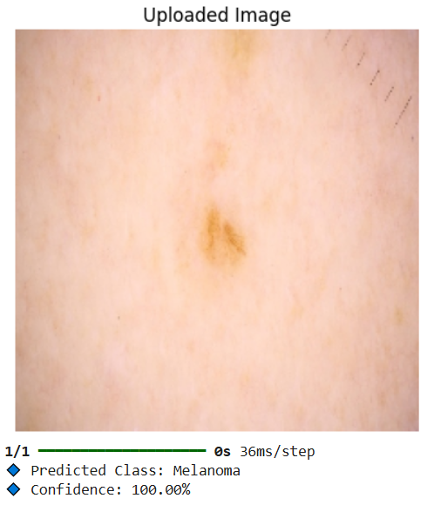
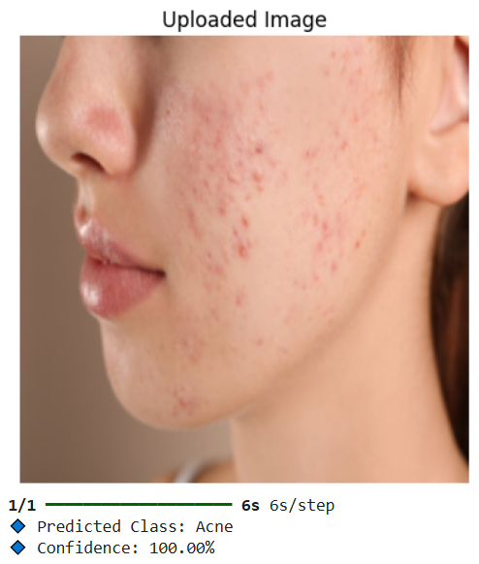
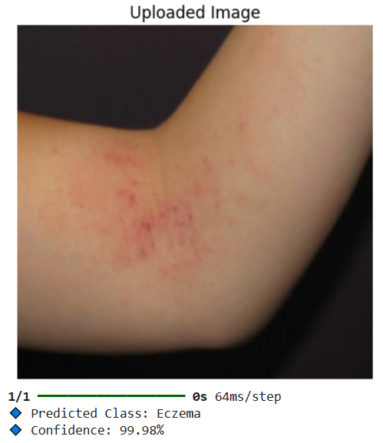
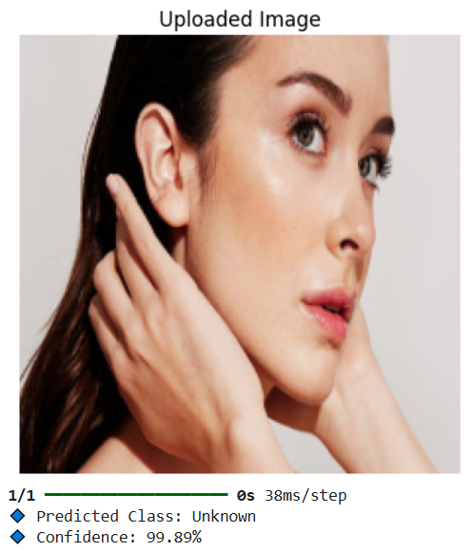
CONTD…
METHODOLOGY
Image Samples :
Figure 6 : Melanoma Prediction
Figure 7: Acne Prediction
Figure 8 : Eczema Prediction
Figure 9 : Unknown Prediction

Slide 12
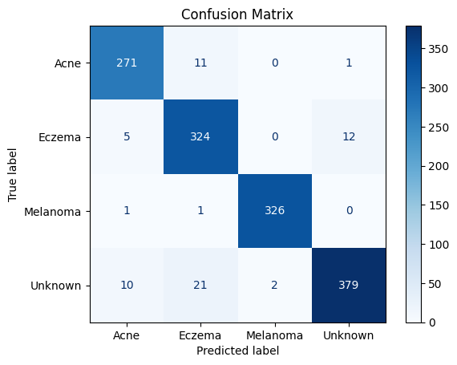
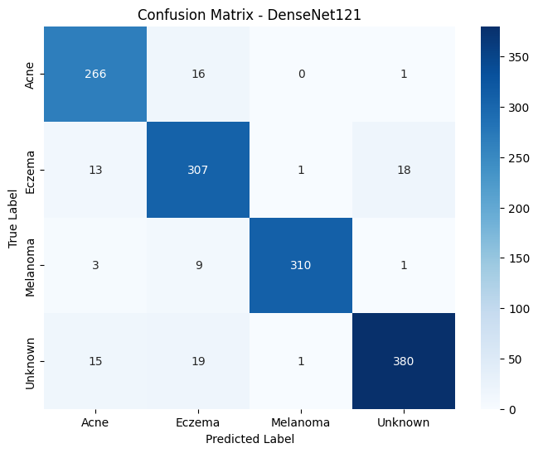
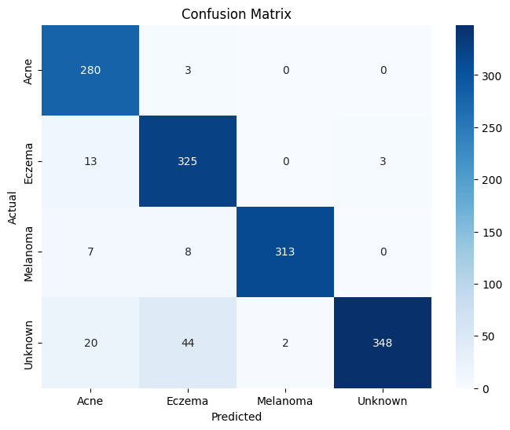
RESULTS AND ANALYSIS
Confusion Matrix
The Confusion Matrix is a powerful tool for evaluating the performance of a classification model. It shows how well the model distinguishes between different categories by comparing actual labels with predicted labels.
Figure 10 : ResNet50 Confusion Matrix
Figure 11 : DenseNet121 Confusion Matrix
Figure 12 : MobileNetV3 Confusion Matrix

Slide 13

RESULTS AND ANALYSIS
Table No. 1 : Model Comparison for MediMind AI
Model | Image Class | Predicted Class | Confidence Score | Prediction Accuracy | Remarks
MobileNetV3 | Acne | Acne | 99.99% | Correct | Accurately identified acne lesions
MobileNetV3 | Eczema | Eczema | 99.98% | Correct | Correctly detected dry and red patches
MobileNetV3 | Melanoma | Melanoma | 99.99% | Correct | Detected asymmetry and pigmentation
MobileNetV3 | Unknown | Unknown | 99.89% | Correct | Successfully handled out-of-distribution
ResNet50 | Acne | Acne | 99.97% | Correct | Detected acne clusters precisely
ResNet50 | Eczema | Eczema | 99.96% | Correct | Differentiated eczema effectively
ResNet50 | Melanoma | Melanoma | 99.98% | Correct | High confidence in melanoma detection
ResNet50 | Unknown | Unknown | 99.85% | Correct | Robust to unknown categories
DenseNet121 | Acne | Acne | 99.98% | Correct | Strong performance in acne identification
DenseNet121 | Eczema | Eczema | 88.20% | Correct | Accurate texture-based eczema detection
DenseNet121 | Melanoma | Melanoma | 99.90% | Correct | Reliable in detecting malignant lesions
DenseNet121 | Unknown | Unknown | 99.87% | Correct | Effectively filtered non-skin distractions

Slide 14
CONTD…
RESULTS AND ANALYSIS
Table No. 2 : Comparison of Existing System vs MediMind AI
S.No. | Metric | Existing System | MediMind AI
 |  |  | MobileNetV3 | ResNet50 | DenseNet121
1. | Precision | 0.88 | 0.93 | 0.94 | 0.90
2. | Recall | 0.85 | 0.93 | 0.94 | 0.90
3. | F1 Score | 0.86 | 0.93 | 0.94 | 0.90
Table 2 shows that all three MediMind AI models outperform the existing baseline in Precision, Recall, and F1 Score. ResNet50 scored highest (0.94), followed by MobileNetV3 (0.93) and DenseNet121 (0.90), confirming the effectiveness of the proposed system.

Slide 15
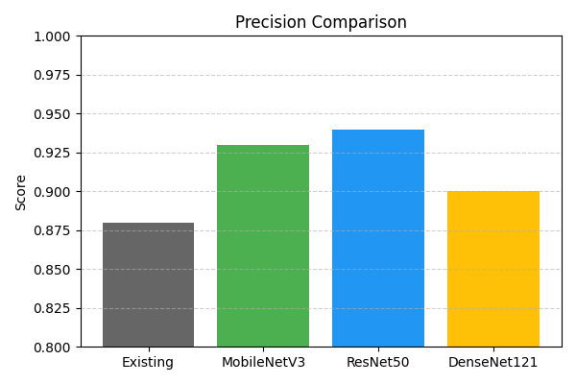
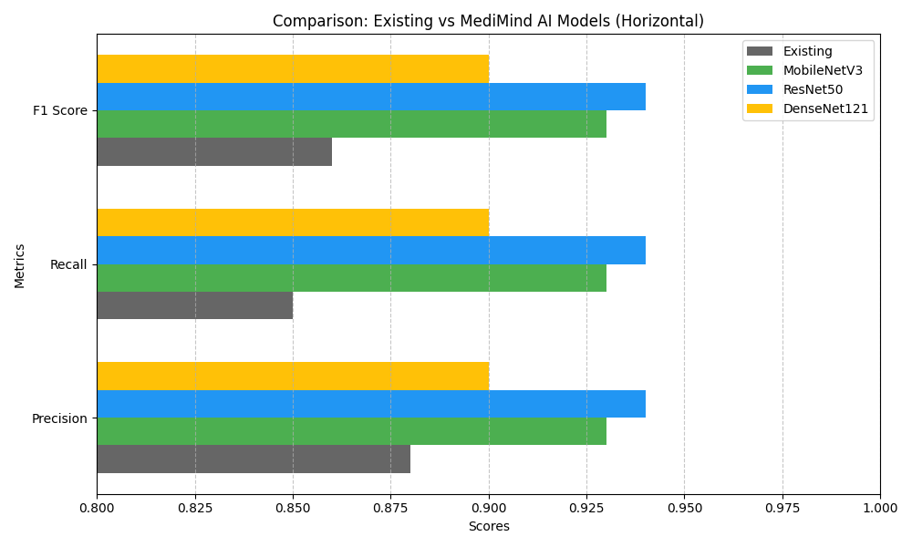
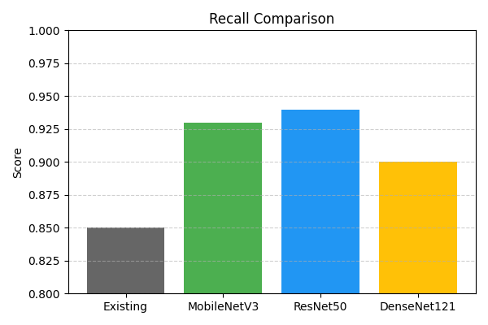
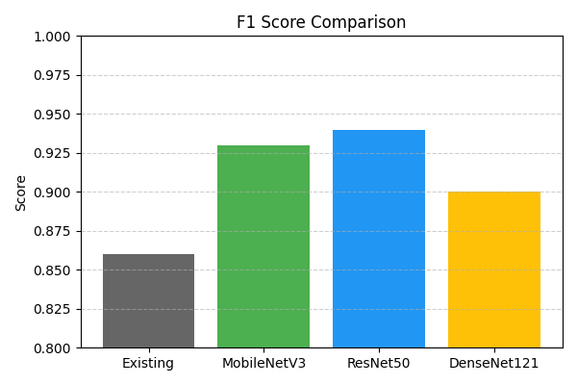
CONTD…
RESULTS AND ANALYSIS
Figure 13 : Precision Comparison
Figure 15 : Recall Comparison
Figure 14 : F1 Score Comparison
Figure 16 : Comparison : Existing VS MediMind AI

Slide 16
CONCLUSION
MediMind AI successfully integrates speech, image, and text processing to aid skin disease diagnosis. Deep learning models like ResNet50, MobileNetV3, and DenseNet121 showed high accuracy in classifying Acne, Eczema, Melanoma, and Unknown cases. The Gradio-based interface enables real-time diagnosis with multilingual support and PDF reporting. The system demonstrates improved performance compared to traditional methods.

Slide 17
FUTURE SCOPE
Expand the model to include more skin disease categories for broader diagnosis. Include a doctor consultation feature or chatbot to connect users with medical professionals. Add a feature to monitor and compare skin condition progress over time using periodic image uploads. Allow users to save and share diagnostic results directly with hospitals or doctors via secure EHR systems.

Slide 18
REFERENCES
A. A. L. C. Amarathunga, E. P. W. C. Ellawala, G. N. Abeysekara, and C. R. J. Amalraj, “Expert system for diagnosis of skin diseases,” International Journal of Scientific & Technology Research, vol. 4, no. 1, pp. 174–178, Jan. 2015.
K. S. Rao, P. S. Yelkar, O. N. Pise, and S. Borde, “Skin Disease Detection using Machine Learning,” International Journal of Engineering Research & Technology (IJERT), vol. 9, no. 3, pp. 1–4, Mar. 2020.
M. Grace, Y. Zhou, Q. Zhang, and S. Zou, “Skin Diseases Identification Using Machine Learning,” International Journal of Creative Research Thoughts (IJCRT), vol. 8, no. 6, pp. 1–7, Jun. 2020.
A. Ray, A. Gupta, and A. Al, “Skin Lesion Classification With Deep Convolutional Neural Network: Process Development and Validation,” JMIR Dermatology, vol. 3, no. 1, p. e18438, May 2020.
K. Polat and K. O. Koc, “Detection of Skin Diseases from Dermoscopy Image Using the Combination of Convolutional Neural Network and One-Versus-All,” Journal of Artificial Intelligence and Systems, vol. 2, pp. 80–97, 2020.

Slide 19
THANK YOU

