Slide 1
Https server setup
報告學生 : 羅俊奕

Slide 2
Https server (simple https server) 程式
# taken from http://www.piware.de/2011/01/creating-an-https-server-in-python/
# generate server.xml with the following command:
# openssl req -new -x509 -keyout server.pem -out server.pem -days 365 -nodes
# run as follows:
# python simple-https-server.py
# then in your browser, visit:
# https://localhost:4443
import BaseHTTPServer, SimpleHTTPServer
import ssl
httpd = BaseHTTPServer.HTTPServer(('localhost', 4443), SimpleHTTPServer.SimpleHTTPRequestHandler)
httpd.socket = ssl.wrap_socket (httpd.socket, certfile='./server.pem', server_side=True)
httpd.serve_forever()

Slide 3
Https Client
import java.net.URL;
import java.io.*;
import javax.net.ssl.HttpsURLConnection;
public class JavaHttpsExample
{
public static void main(String[] args) throws Exception {
String httpsURL = "https://tw.yahoo.com/";
URL myUrl = new URL(httpsURL);
HttpsURLConnection conn = (HttpsURLConnection)myUrl.openConnection();
InputStream is = conn.getInputStream();
InputStreamReader isr = new InputStreamReader(is);
BufferedReader br = new BufferedReader(isr);
String inputLine;
while ((inputLine = br.readLine()) != null) {
System.out.println(inputLine);
}
br.close();
}
}

Slide 4
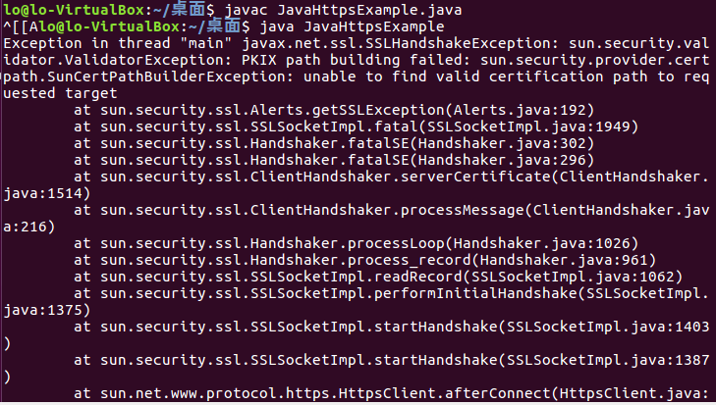
目前問題
Client端無法連進Server因為JAVA得憑證無法過關
但Client 端能使用其他的https url 例如:https://tw.yahoo.com 能夠讀取

Slide 5
問題解決
先找出JAVA 在SSL 的sercurity資料夾位址，找到放置憑證的cacerts 檔案
keytool -list -keystore cacerts 這行命令可以查看全部的憑證
系統會提示您輸入存放區密碼。 預設密碼為 changeit。
openssl x509 -outform der -in your-cert.pem -out your-cert.crt
透過上面命令 將.pem檔案類型轉換.crt
keytool -keystore cacerts -importcert -alias equifaxsecureca –file quifax_Secure_Certificate_Authority.cer
使用這行命令增加你自訂義憑證
補充資料: https://stackoverflow.com/questions/13732826/convert-pem-to-crt-and-key

Slide 6
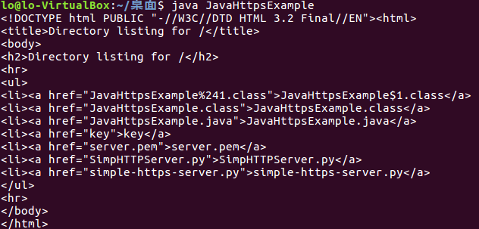
成功畫面

