Slide 1
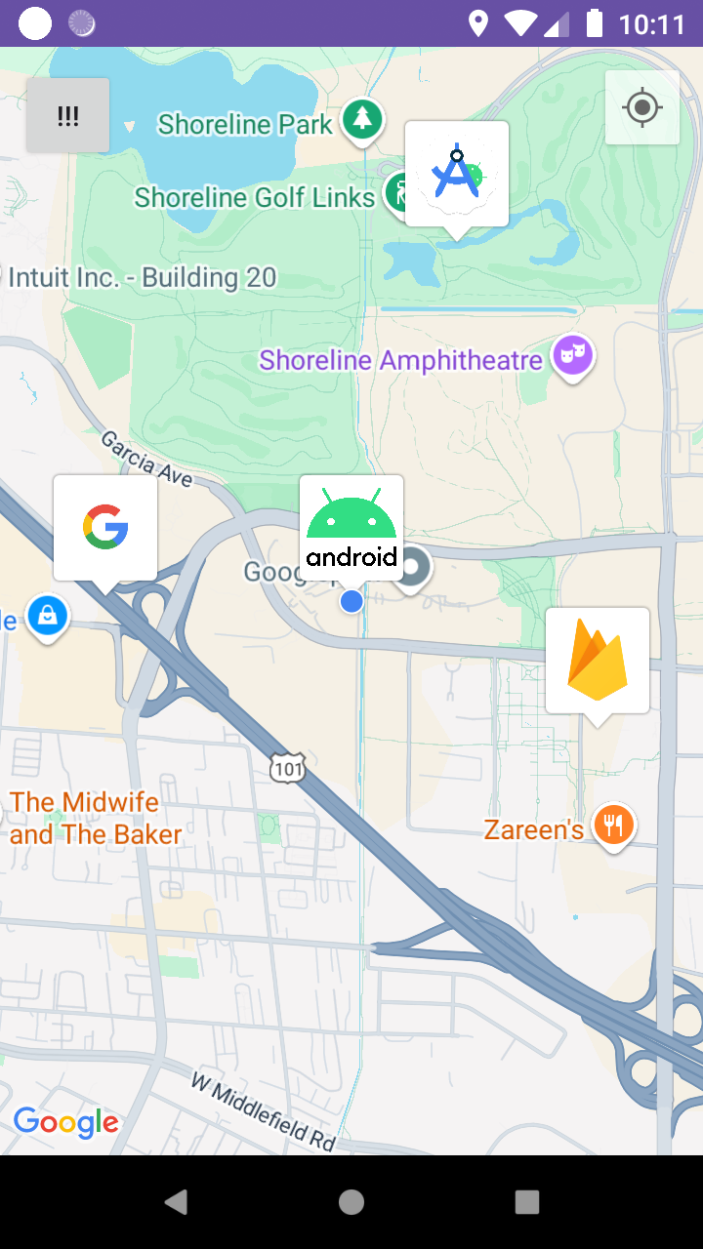
Real-time Positioning System

Slide 2



Development Kit
Google maps API
Android Studio
Firebase

Slide 3
Login
Register
01
02
03
Real-time Positioning
04
Send Rescue Signal
Functionality

Slide 4
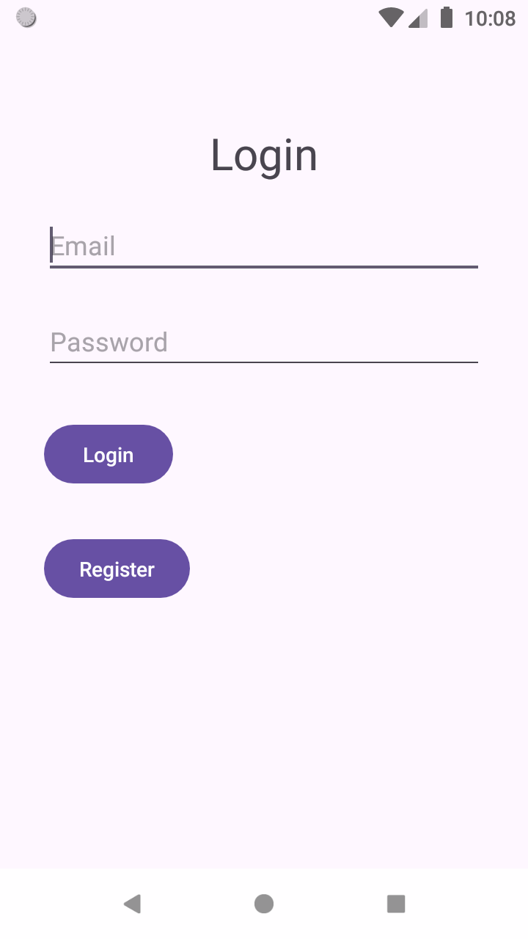
01
Login

Slide 5
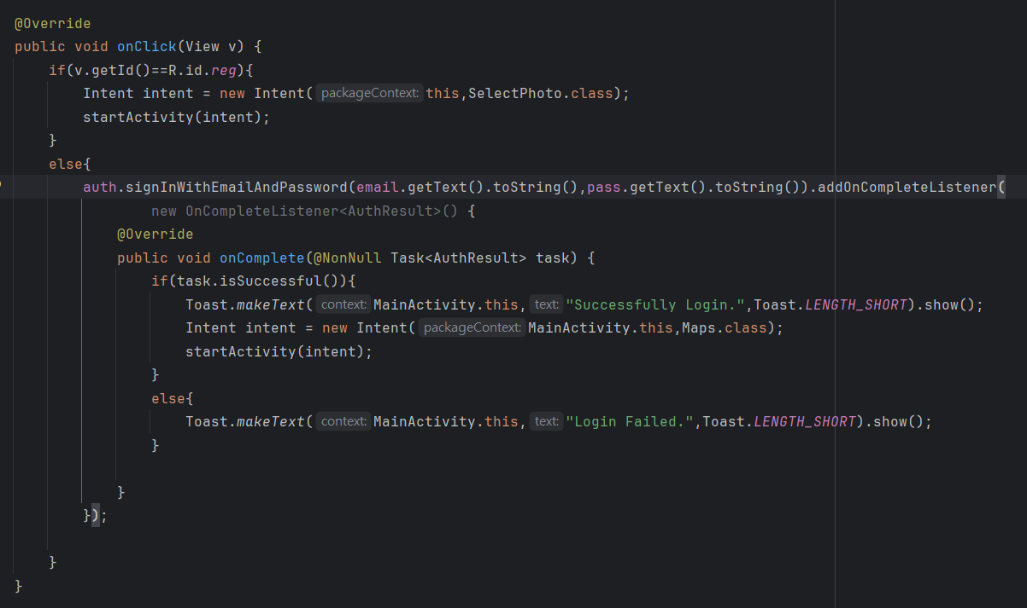
Login

Slide 6
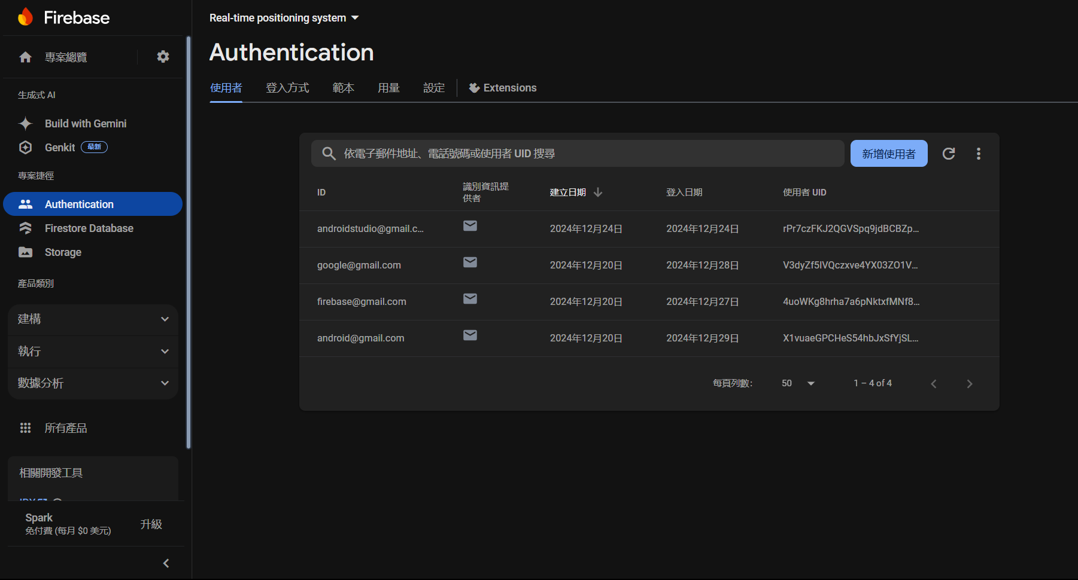
Firebase Authentication

Slide 7
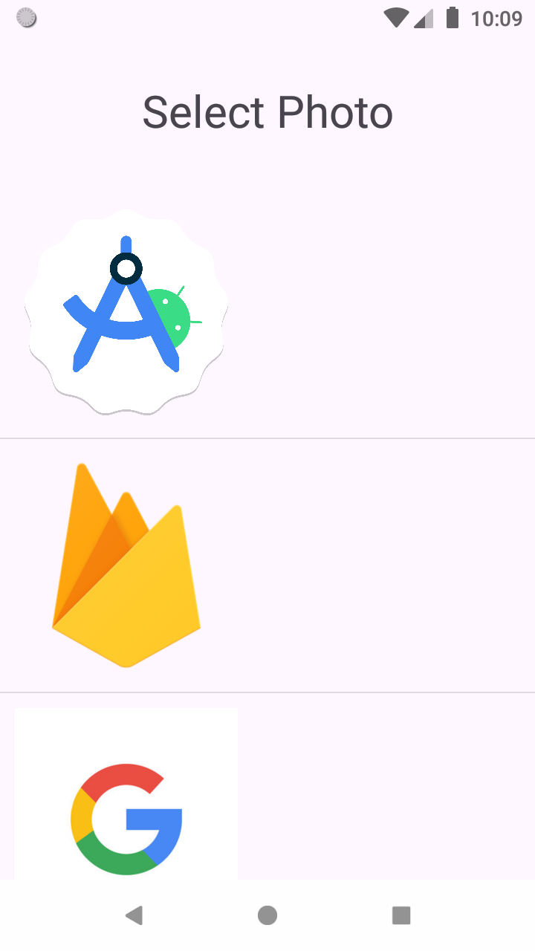
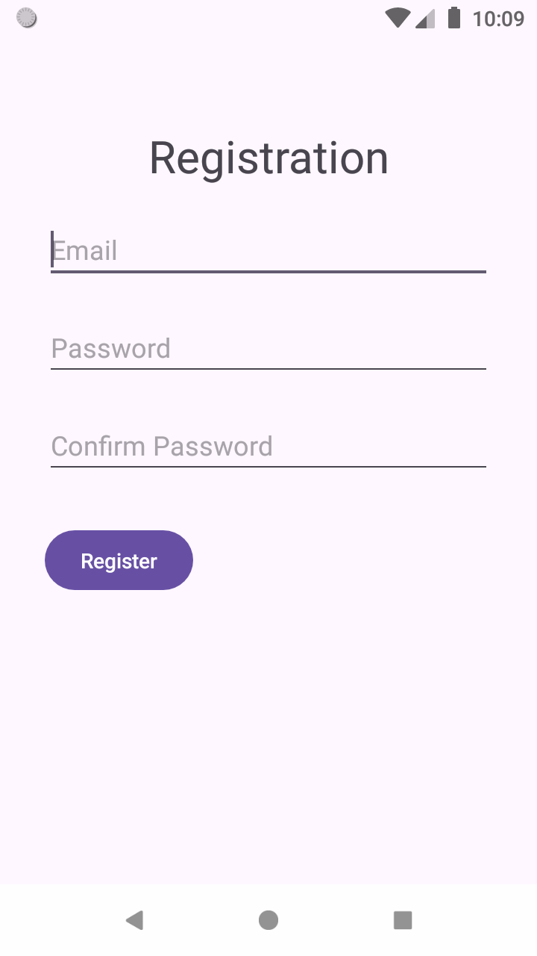
02
Register

Slide 8
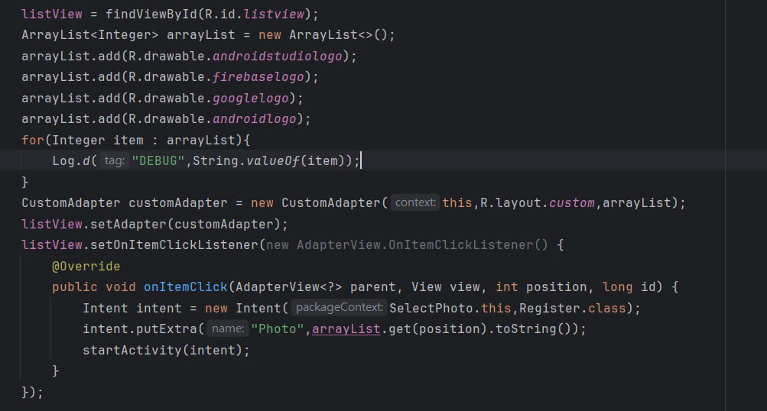
Select Photo

Slide 9
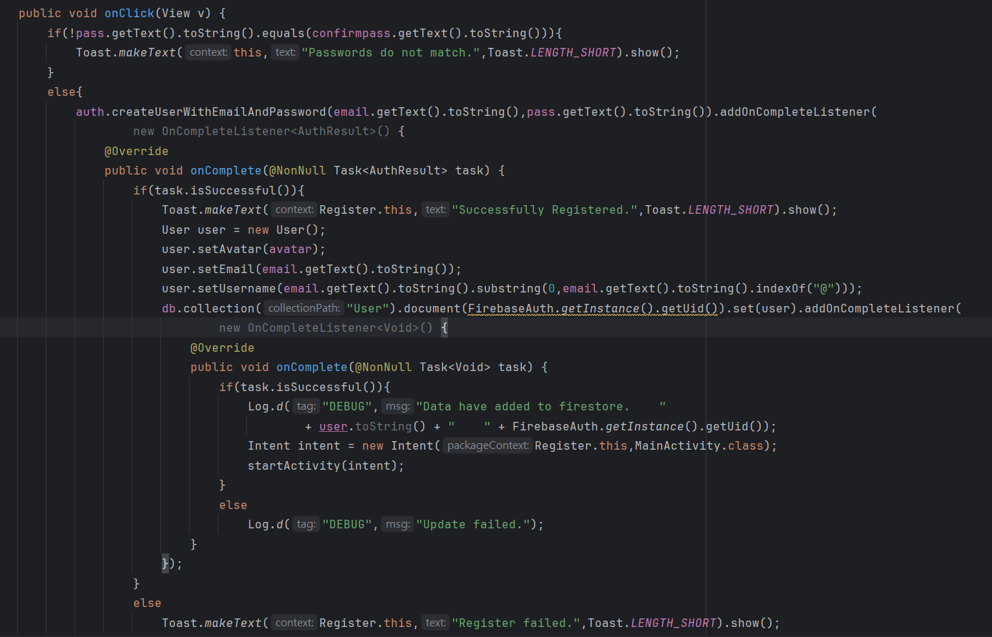
Register

Slide 10
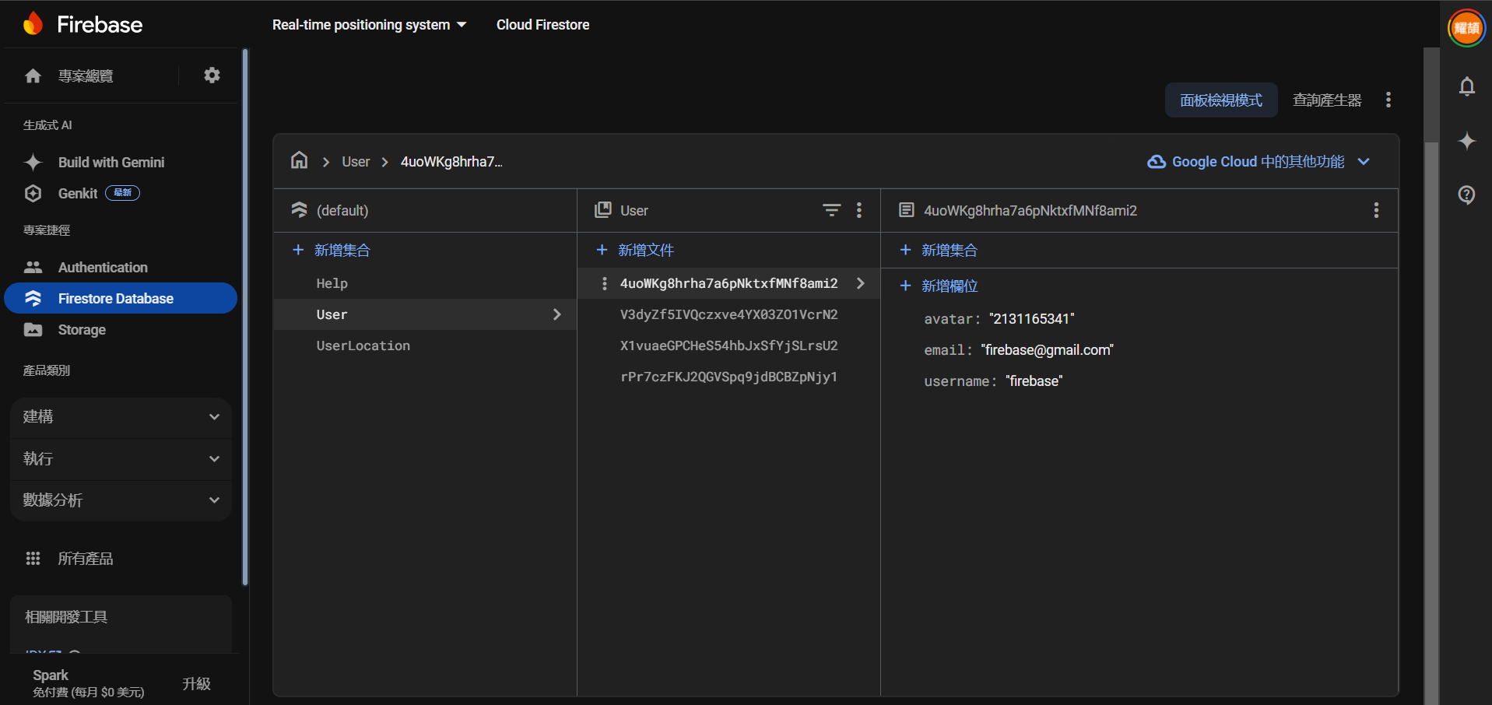
Firebase User collection

Slide 11
03
Real-time Positioning

Slide 12
Procedure
01
03
05
Init Marker
Retrieve Location
02
04
Check
Signal
06
Upload
Location
Download
Location
Display Location
Location Service
Runnable

Slide 13
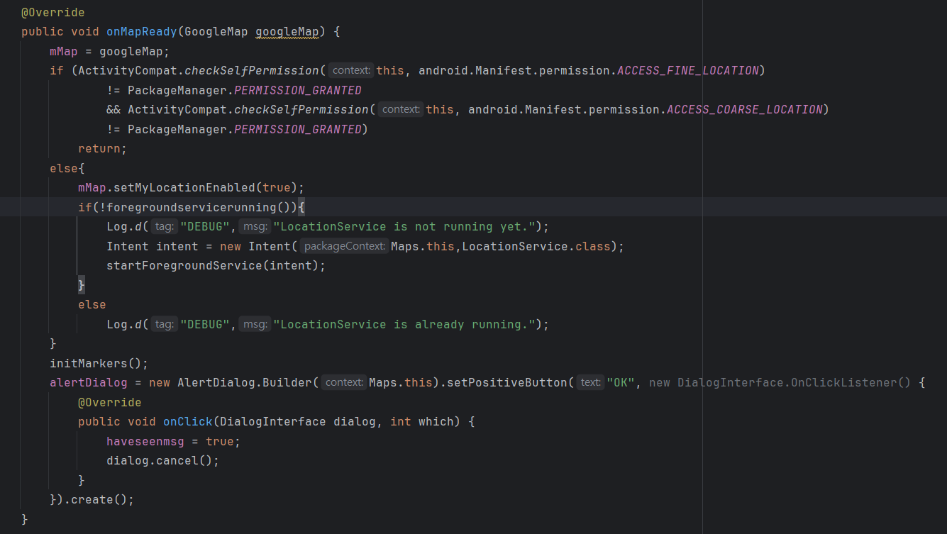
Real-time Positioning

Slide 14
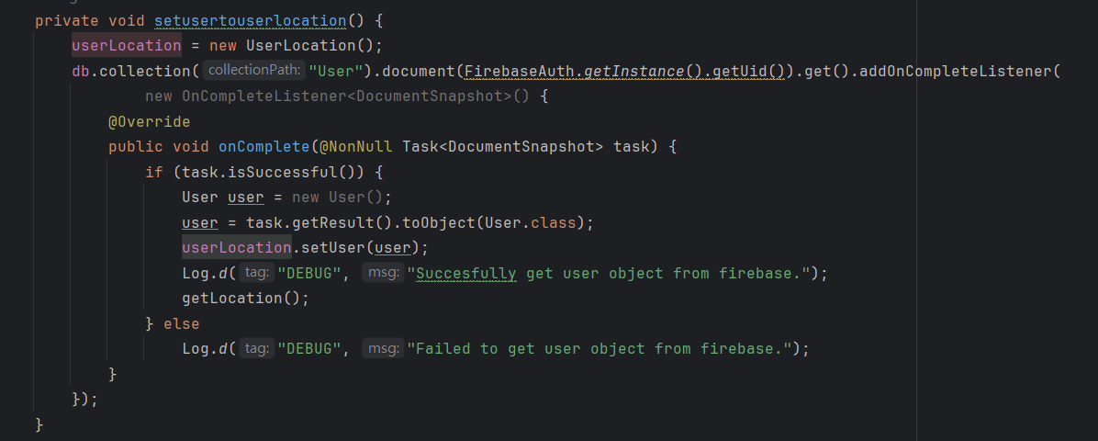
Location Service

Slide 15
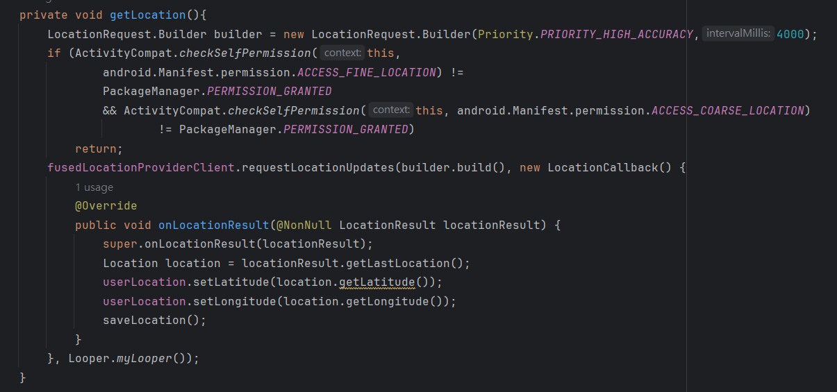

Slide 16
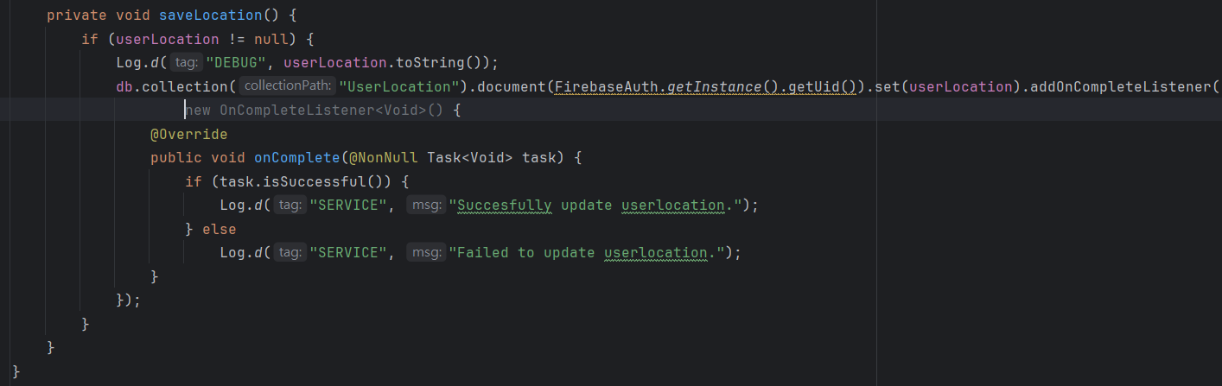

Slide 17
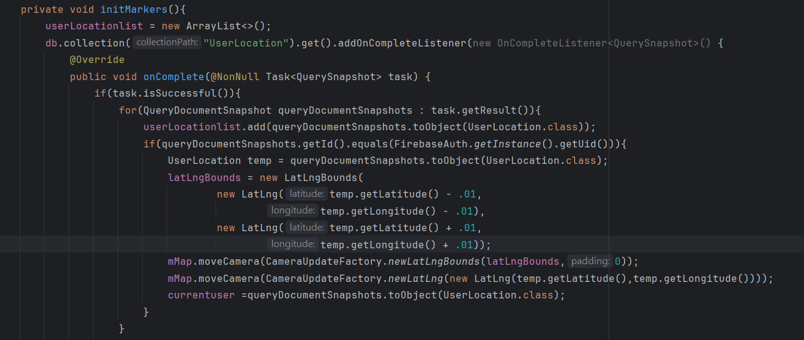
Init Marker

Slide 18
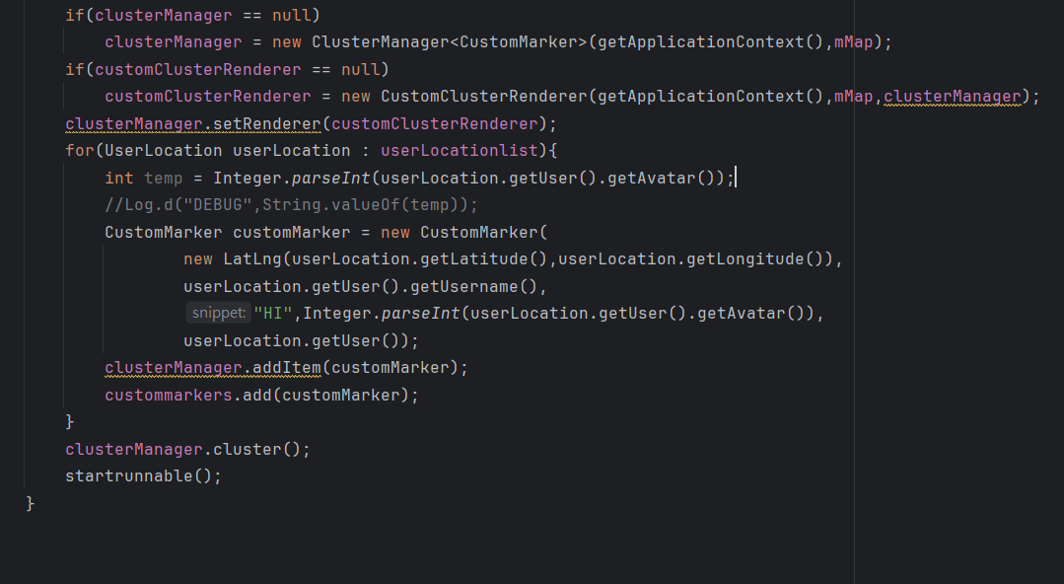

Slide 19
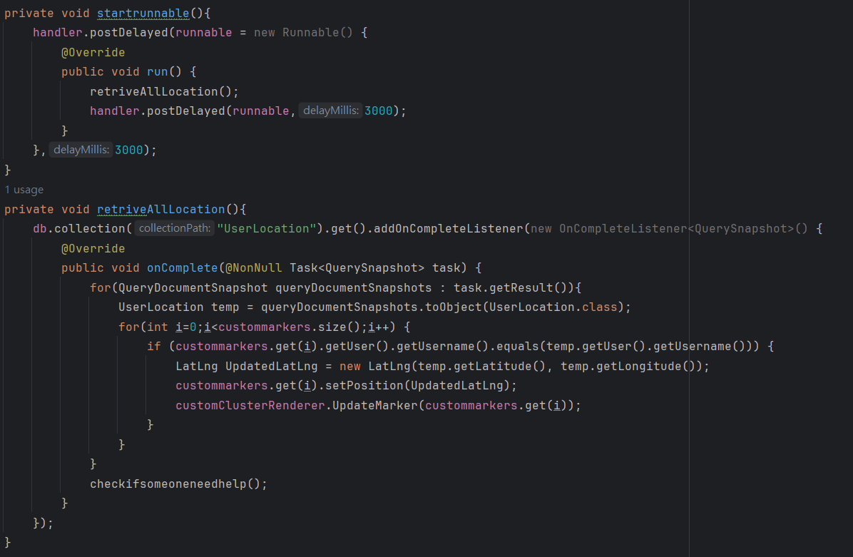
Runnable

Slide 21
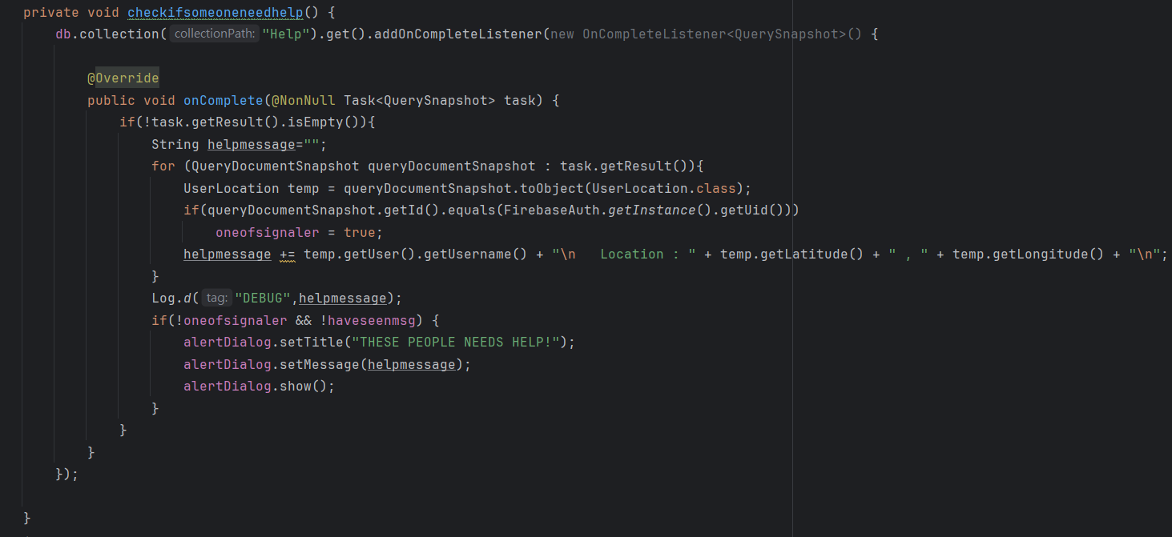

Slide 22
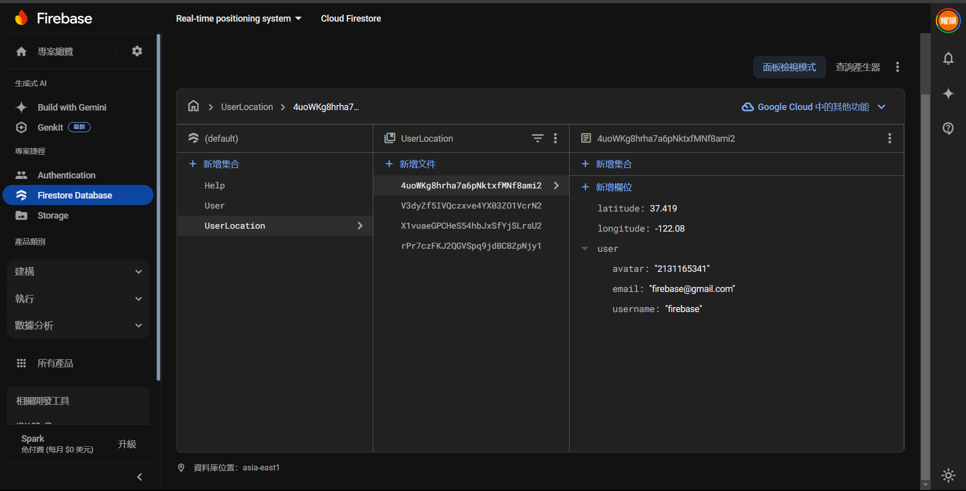
Firebase Location Collection

Slide 23
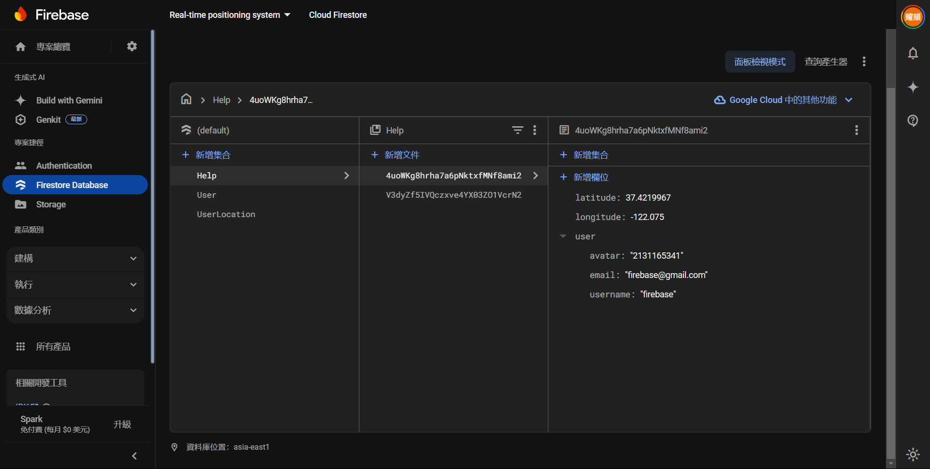
Firebase Help Collection

Slide 24
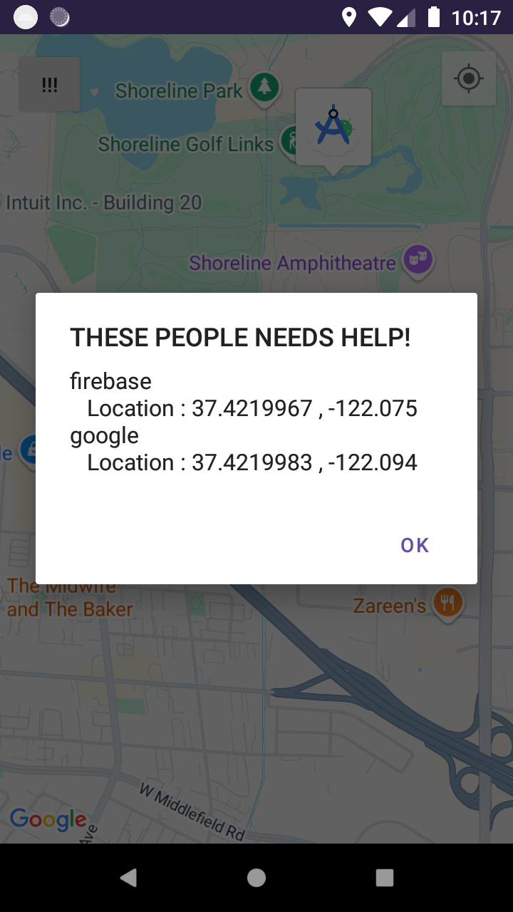
04
Send Rescue Signal

Slide 25
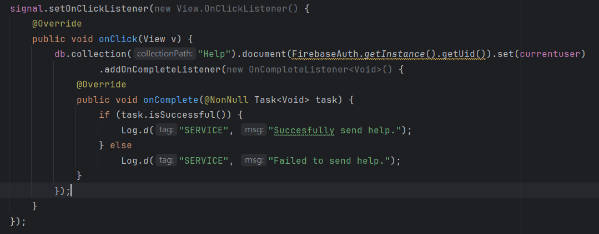
Send Rescue Signal

Slide 26
The End

