Slide 1
Duke VS Opponent Basketball Average Stats (2018)
Jie Cai, Nathan Blaise Lewis, Cody Li, Blaire Zhang

Slide 2
Focus:
How can we use recent Duke & opponent playing statistics to compare strengths/weaknesses?
How can we use these statistics to help Duke come up with tactics against each of the opponent teams?

Slide 3
Data Cleaning:
Focus on Summary Game Statistics for Each Team:
Field goal
3 point
Free throws
Rebounds
Assists
Blocks
Steals
Personal Fouls
*all variables represent average/per game

Slide 4
Data Matching:
Match by opponentid, this way we can see on average how Duke plays against each of the opponent teams individually.
Duke_data
Opponent_data
oppid | fg | … | ast
Elon | 31 | … | 23
NC State | 25 | … | 12
oppid | fg | … | ast
Elon | 26 | … | 15
NC State | 21 | … | 6
Eg. When Duke and Elon plays, on average Duke has 31 field goals and 23 assists per game, while on average Elon has 26 field goals and 15 assists per game.

Slide 5
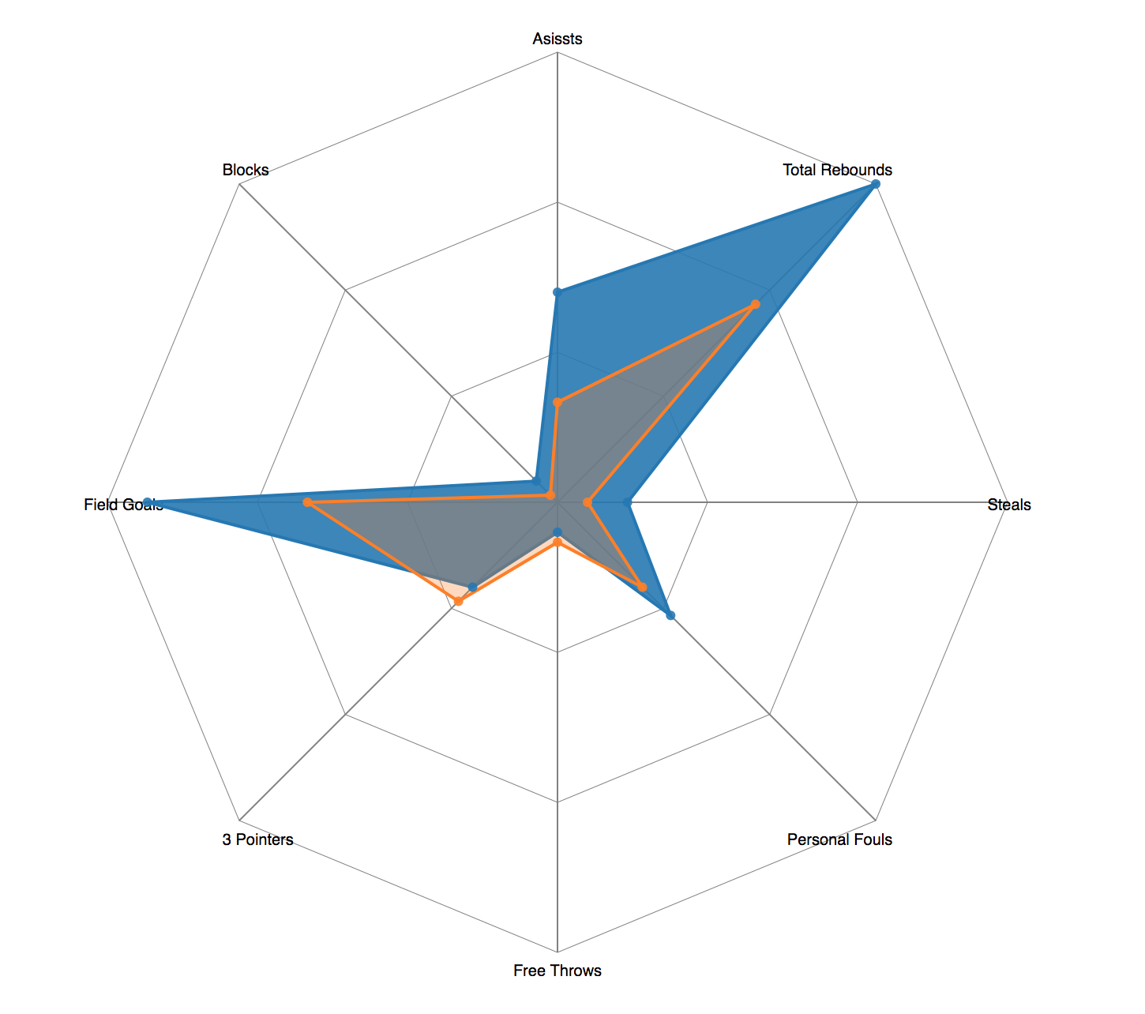
Data Visualization:
Visualization Choice - Radar Graph
Comprehensive of all variables of interest
Clearly compares the strengths & weaknesses of Duke vs opponent team
Overall visually pleasing & simplistic

Slide 6
Web-app Preview:
http://jiecai1997.github.io/

Slide 7
Github Link:
https://github.com/jiecai1997/duke-MBB-hackathon-datavis

