Slide 1
NATURAL WEATHER FORCES
&
SHANGHAI AIR POLLUTION

Slide 2
1. Question/Motivation
Growing up in Shanghai, China, air pollution has been a big concern for everyone in the recent years. Everyone worries about how to tackle air pollution problems without understanding how PM2.5 levels change in the first place. I wanted to address the air pollution problem in an more organic manner:
How do Shanghai’s PM2.5 levels change with natural weather factors, and how can we use these natural mechanisms to tackle air pollution?
This does not suggest that we are trying to manipulate natural weather forces by any means, but using these forces as inspiration for possible solutions.

Slide 3
2. Data Sourcing & Cleaning
Data Source: https://www.kaggle.com/crawford/pm25-data-for-five-chinese-cities
The dataset has Shanghai’s hourly PM2.5 measurements from January 1, 2010 to December 31, 2015. There were 52584 entries total, but I did some data cleaning:
Removing all 2010-2011 entries – Those years had very inconsistent entries with a lot of missing data, mostly because air quality wasn’t a big concern back then. I decided to take out those years completely due to the large amount of missing data. (35064/52584 entries used)
Removing extra PM2.5 measurement sources – There are 3 different stations in Shanghai that measures PM2.5 levels, and they are all located closely. The US consulate measurements are more reliable and consistent (less missing data). I removed the measurements from the other 2 stations. (15/17 variables used)
Removing all remaining missing data entries – Since we’re dealing with a lot of weather factors, they are quite unpredictable from day to day. Additionally, our data were not missing by random, as we would be missing data by chunks of hours and days. Filling in those missing points would not be suitable in our context, so I removed all the NAs. (31804/35064 entries used)
For my final data frame, I used 31804/52584 entries and 15/17 variables.

Slide 4
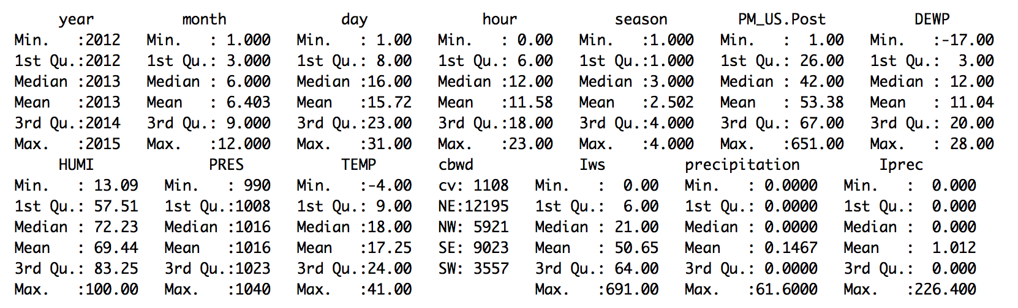

3. Summary Statistics
Year
Month
Day
Hour
Season
PM_US.Post – PM2.5 concentration (ug/m^3) as measured by the US consulate
DEWP - Dew Point (ºC)
HUMI – Humidity (%)
PRES – Pressure (hPa)
TEMP - Temperature (ºC)
Cbwd – Combined Wind Direction (na, NE, SE, SW, NW)
Iws – Cumulated wind speed (m/s)
Precipitation - Hourly Precipitation (mm)
Iprec - Cumulated precipitation (mm)

Slide 5
4. Initial Variables
Year | HUMI – Humidity (%)
Month | PRES – Pressure (hPa)
Day | TEMP – Temperature (ºC)
Hour | Cbwd – Combined Wind Direction (na, NE, SE, SW, NW)
Season | Iws – Cumulated wind speed (m/s)
PM_US.Post - PM2.5 concentration (ug/m^3) as measured by the US consulate | Precipitation - Hourly Precipitation (mm)
DEWP – Dew Point (ºC) | Iprec - Cumulated Precipitation (mm)

Slide 6
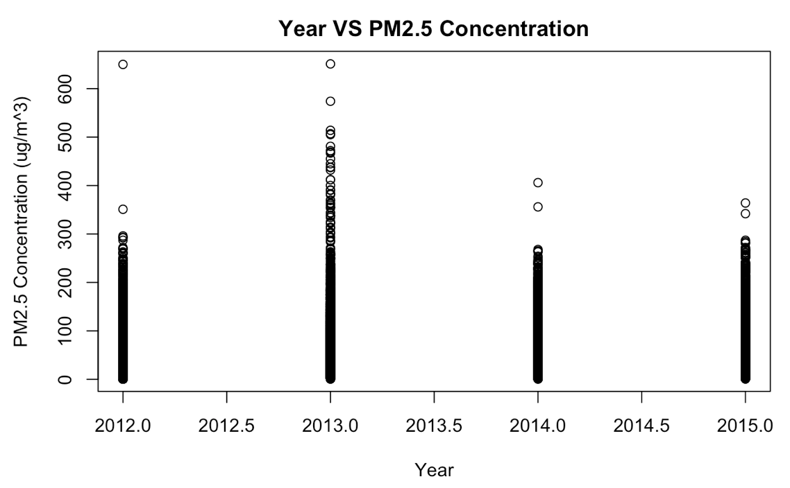
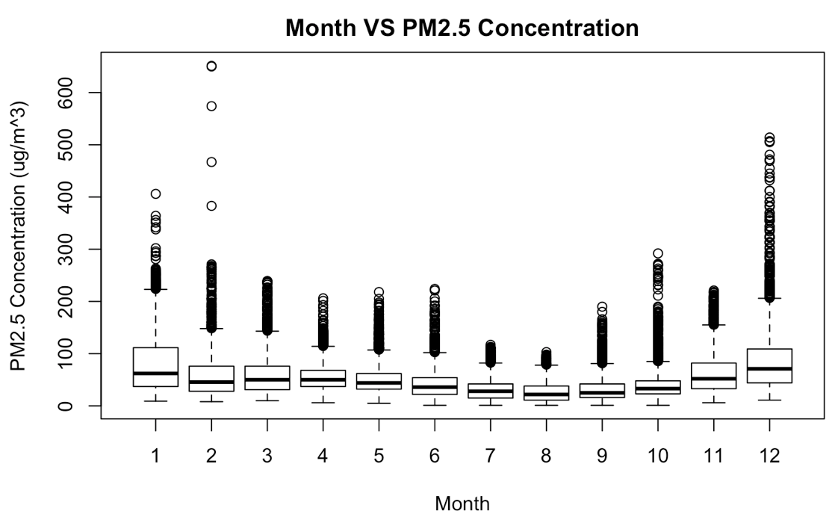
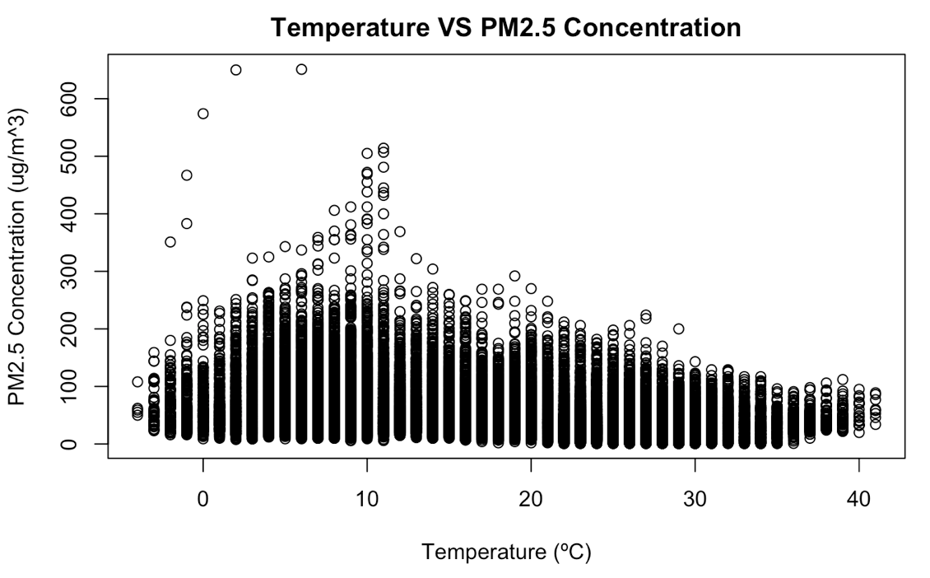
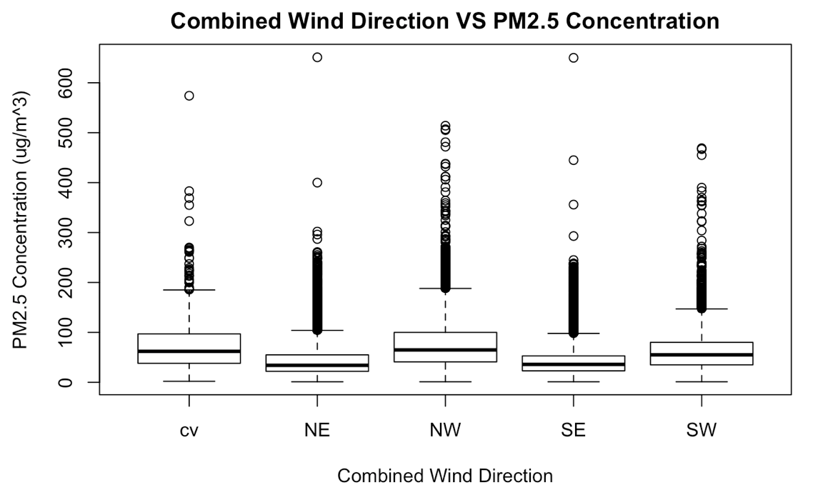
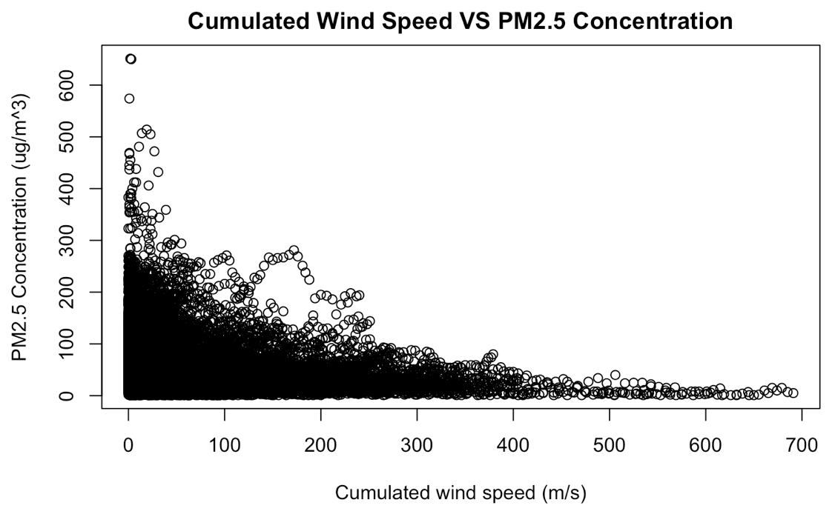
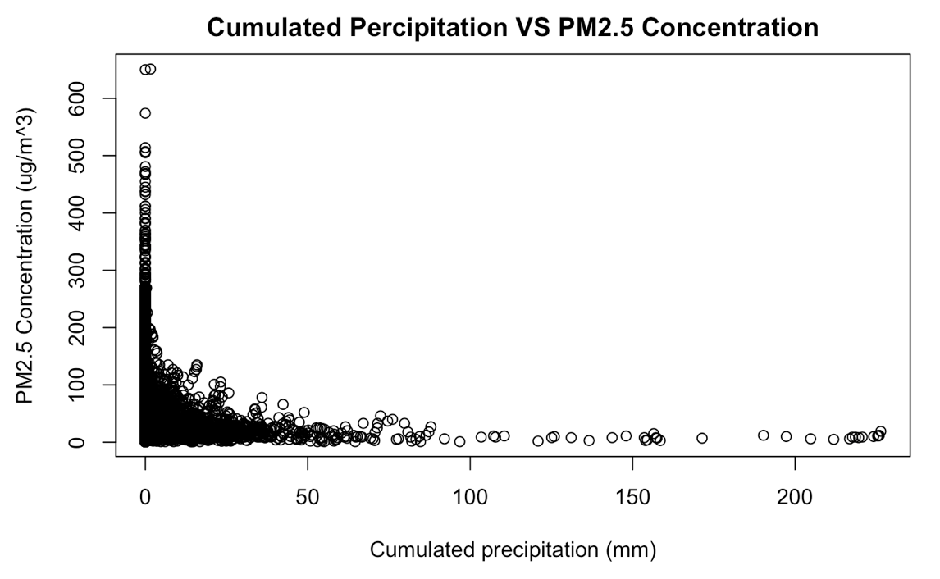
5. Exploratory data analysis

Slide 7
6. Variable Transforming & Re-Centering
Log-y transformation (non-constant variance)
PM2.5 (PM_US.Post) → Log PM2.5 (PM_US.Post.log)
Log-x transformation (non-linearity)
Cumulated Wind Speed (Iws) → Log Cumulated Wind Speed(Iws.log)
Hourly Precipitation (precipitation) → Log Hourly Precipitation (precipitation.log)
Cumulated Precipitation (Iprec) → Log Cumulated Precipitation (Iprec)
Re-centering x (for interpretation)
Year 2012-2015 (year) → year 0-3, year 2012 as baseline (year.n)
Dew point (DEWP) → Dew point mean-centered, average dew point as baseline (DEWP.c)
Humidity (HUMI) → Humidity mean-centered, average humidity as baseline (HUMI.c)
Pressure (PRES) → Dew point mean-centered, average pressure as baseline (PRES.c)
Temperature (DEWP) → Temperature mean-centered, average temperature as baseline (TEMP.c)
Continuous to Categorical
Month → as.factor(month)
Hour → rushhour [7-10, 16-19] & non-rushhour [!(7-10, 16-19)]

Slide 8
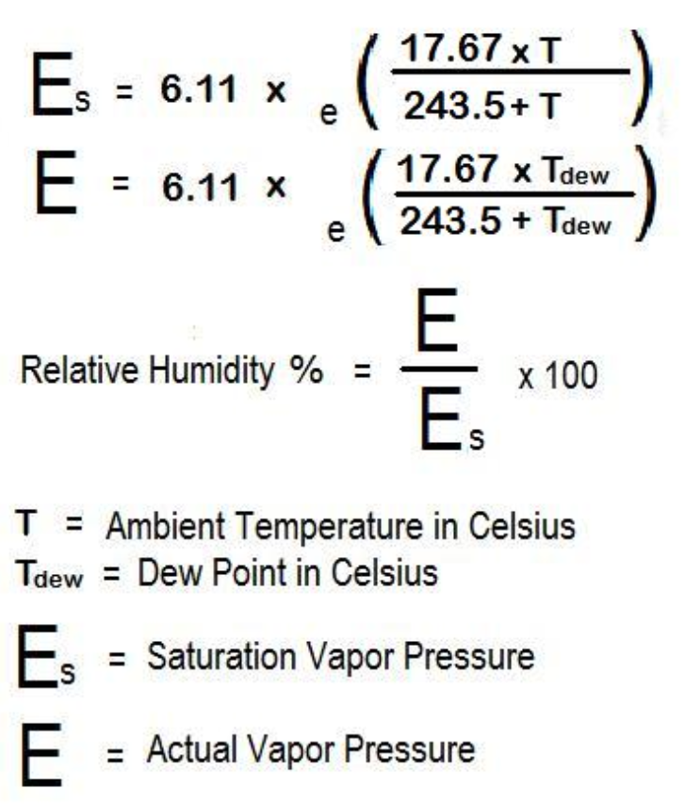
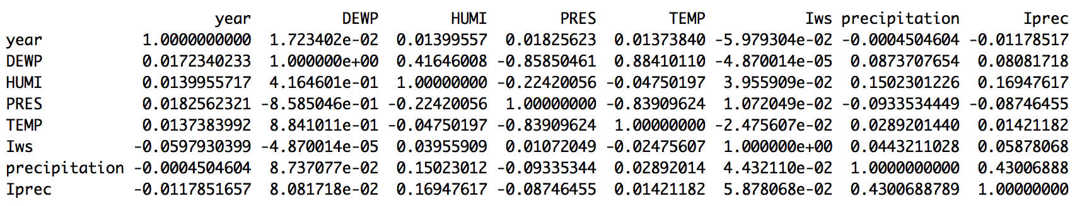
7. Multicollinearity
Variables considered removing (due to multicollinearity)
Pressure
Humidity
Temperature
The three variables above have correlations (r>|0.8|) with one another. This is expected as the three factors are scientifically related to one another. However, none of the SEs were inflated, so we didn’t remove either of them.
Source: https://www.calcunation.com/calculator/humidity.JPG

Slide 9
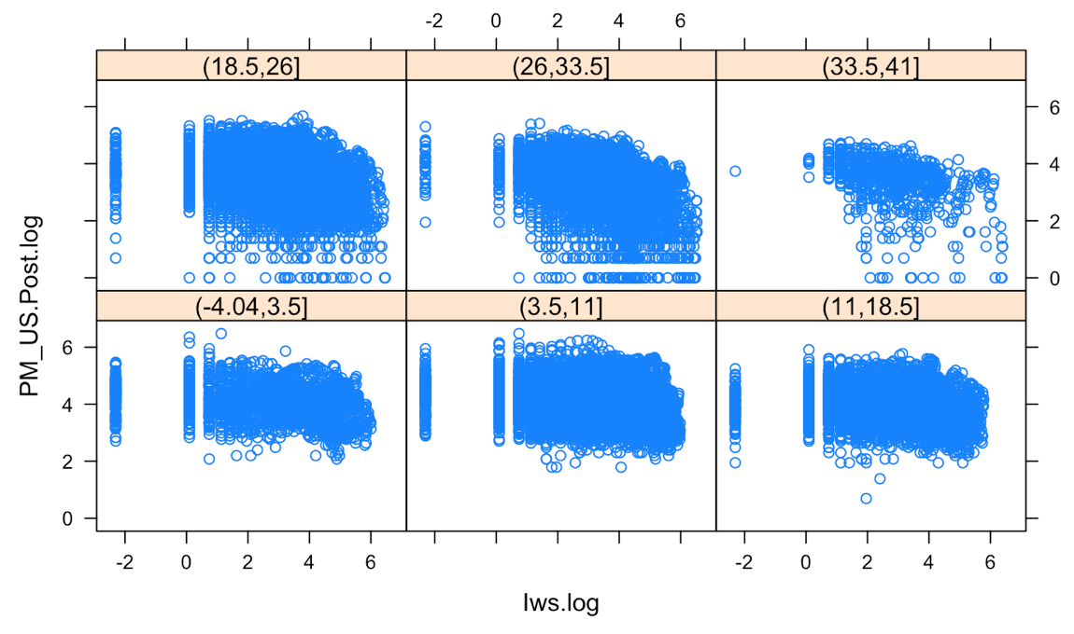
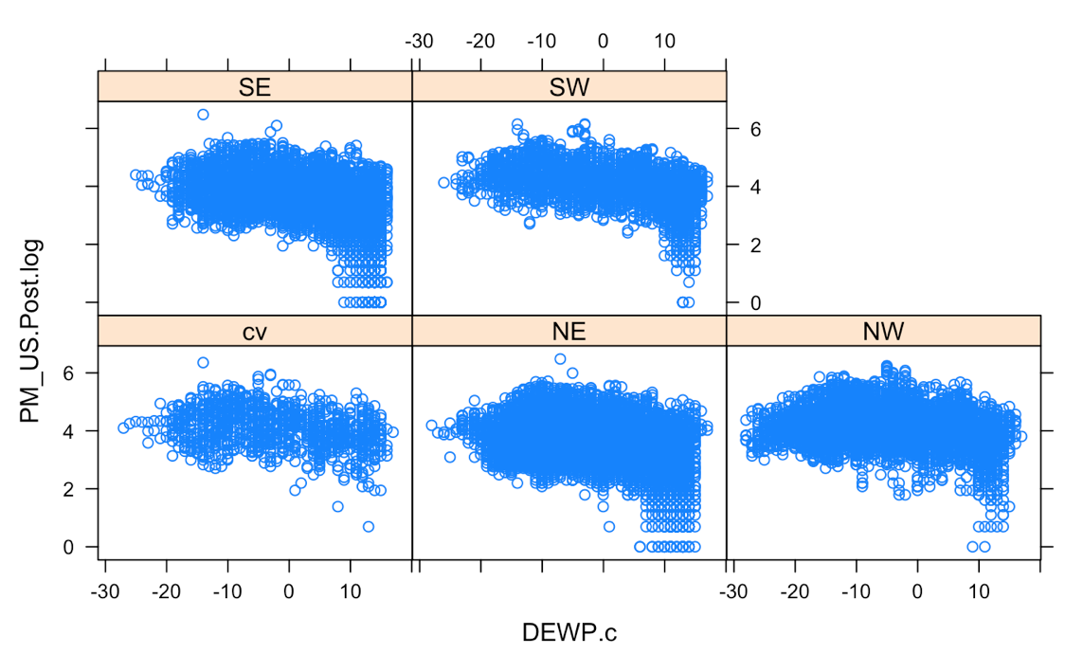
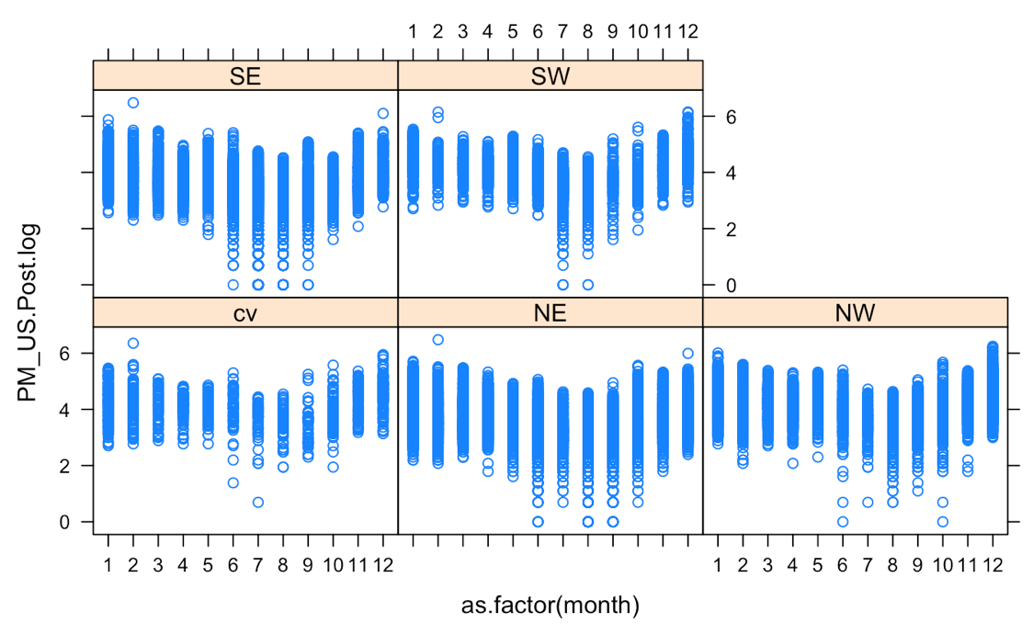
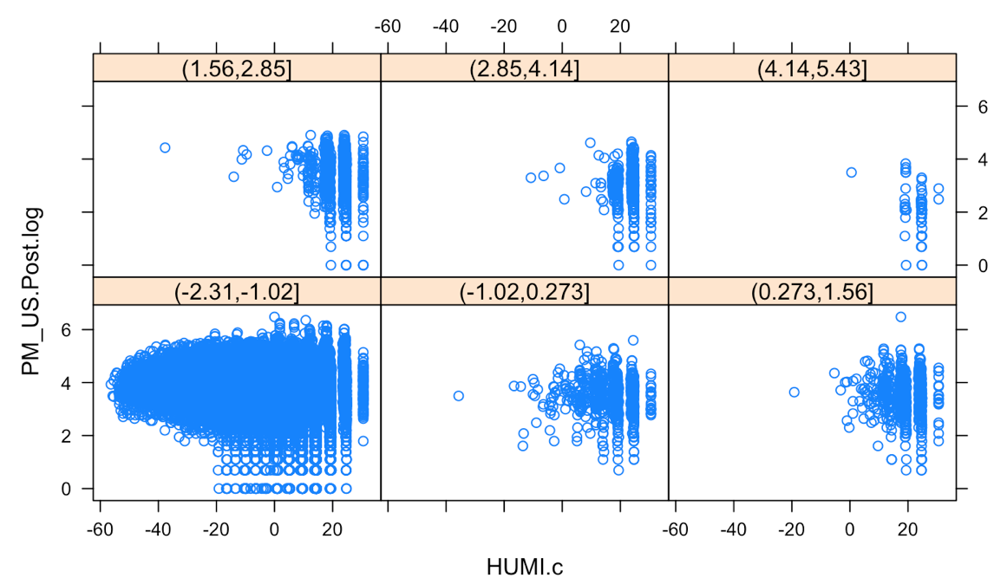
8. Interactions
I tried using xy-plots for almost all of the variables. None of the variables had any interactions. I expected there to be at least some due to how different weather factors affect each other, but the plots show that this is not the case. Below are some of the selected xy plots.

Slide 10
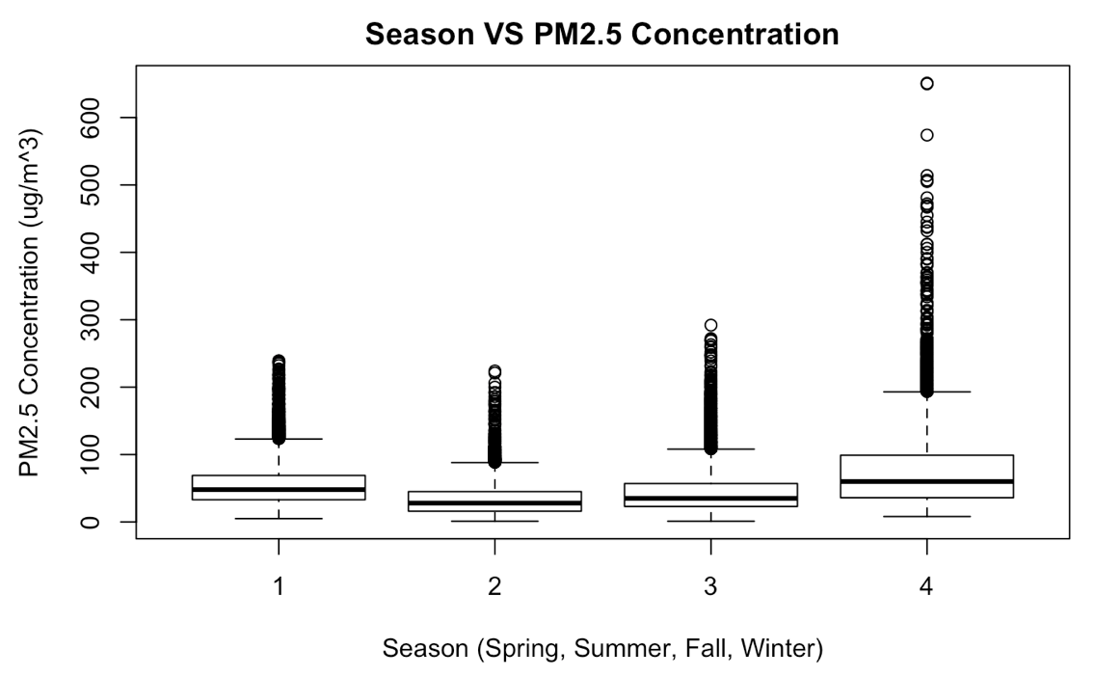
9. Other Variables Removed
Variables removed (by logic)
Day – day of the month didn’t have any impact, as expected
Season – because of the similarity between season and months, putting both variables within a regression actually caused errors. A regression with month had more accurate results (since it has more levels) and a higher R^2, so I removed season.
Removal testing methods
ANOVA (manual) – I tried testing to see if any of the multicollinearity variables could be removed this way. None were
Backward Selection (automatic) – Using R’s built-in backward selection, none of the variables were able to be removed except for the ones I removed due to logic.

Slide 11
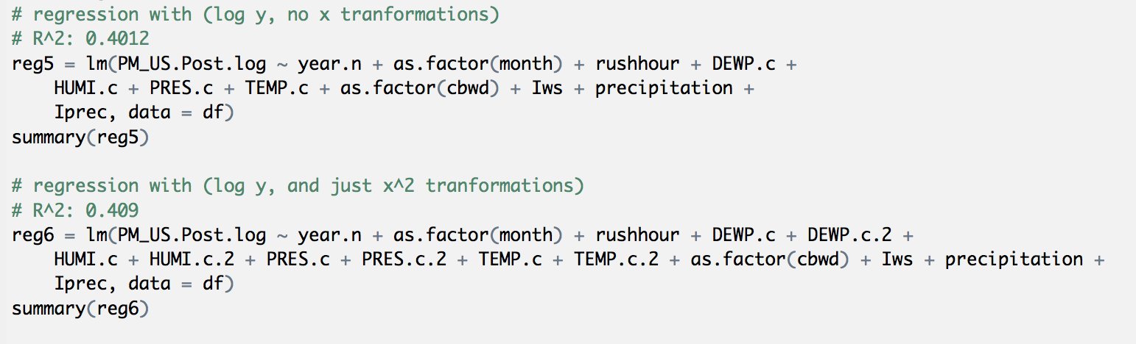
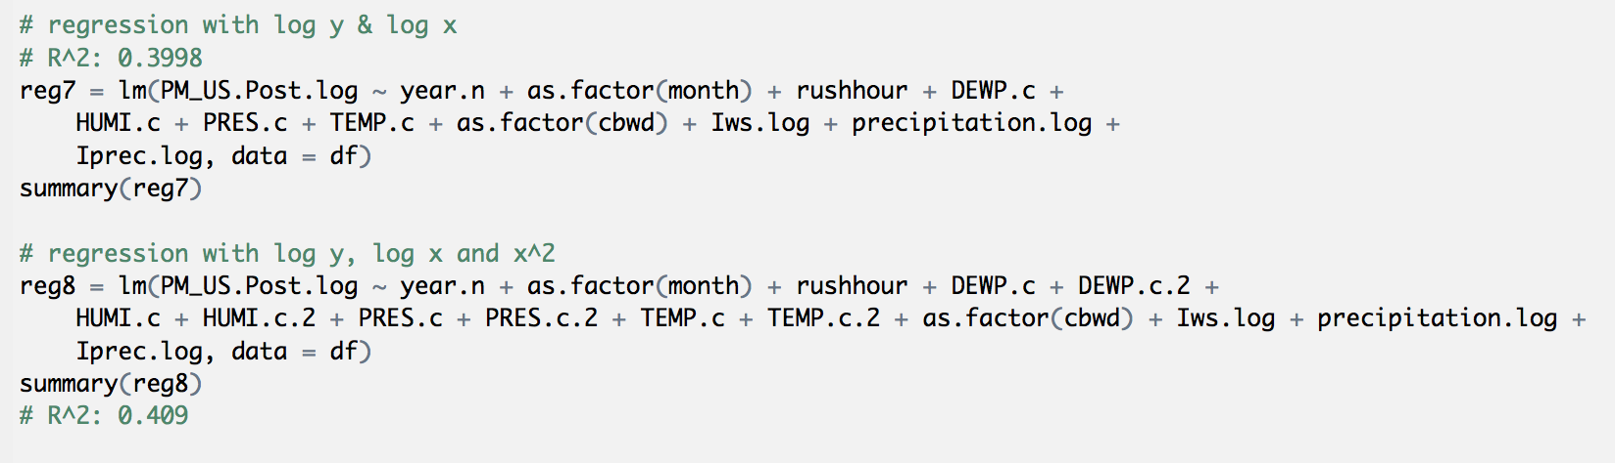
10. Regressions Attempted

Slide 12
11. Final Variables
Year.n – year, with 2012 as the baseline | HUMI.c – Humidity (%), mean centered
As.factor(Month) – month as categorical variable | PRES.c – Pressure (hPa), mean centered
As.factor(Hour) – hour as categorical variable | TEMP.c – Temperature (ºC), mean ceneterd
PM_US.Post.log - PM2.5 concentration (ug/m^3) as measured by the US consulate, logged | As.factor(Cbwd) – Combined Wind Direction (na, NE, SE, SW, NW)
Rushhour – binary variable indicating rushhour or non-rushhour | Iws.log – Cumulated wind speed (m/s), logged
DEWP.c – Dew Point (ºC), mean centered | Precipitation.log - Hourly Precipitation (mm), logged
 | Iprec.log - Cumulated Precipitation (mm), logged

Slide 13
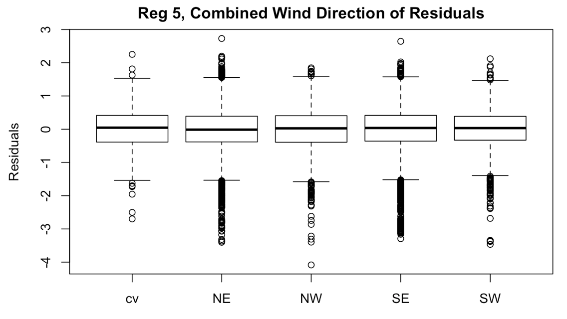
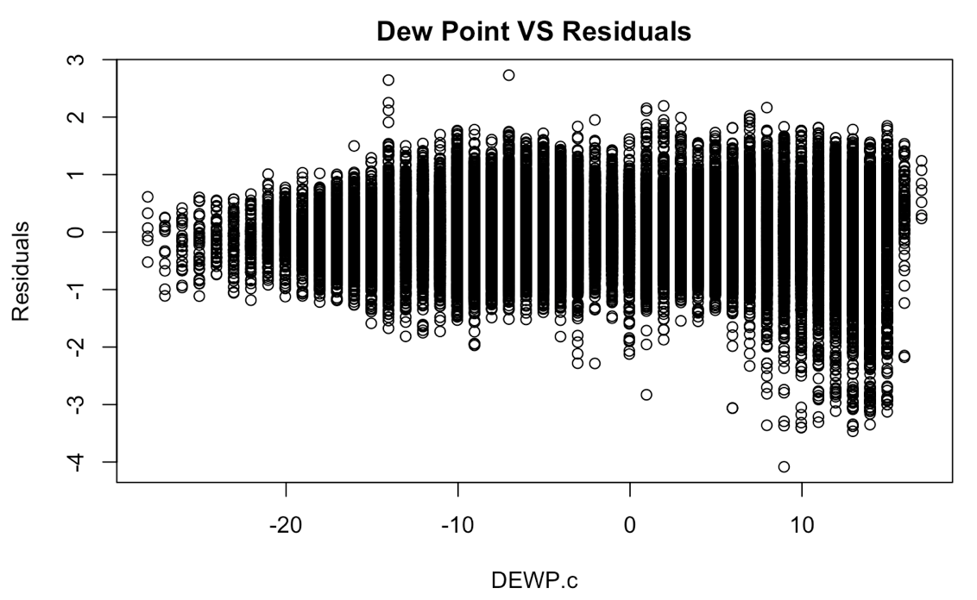
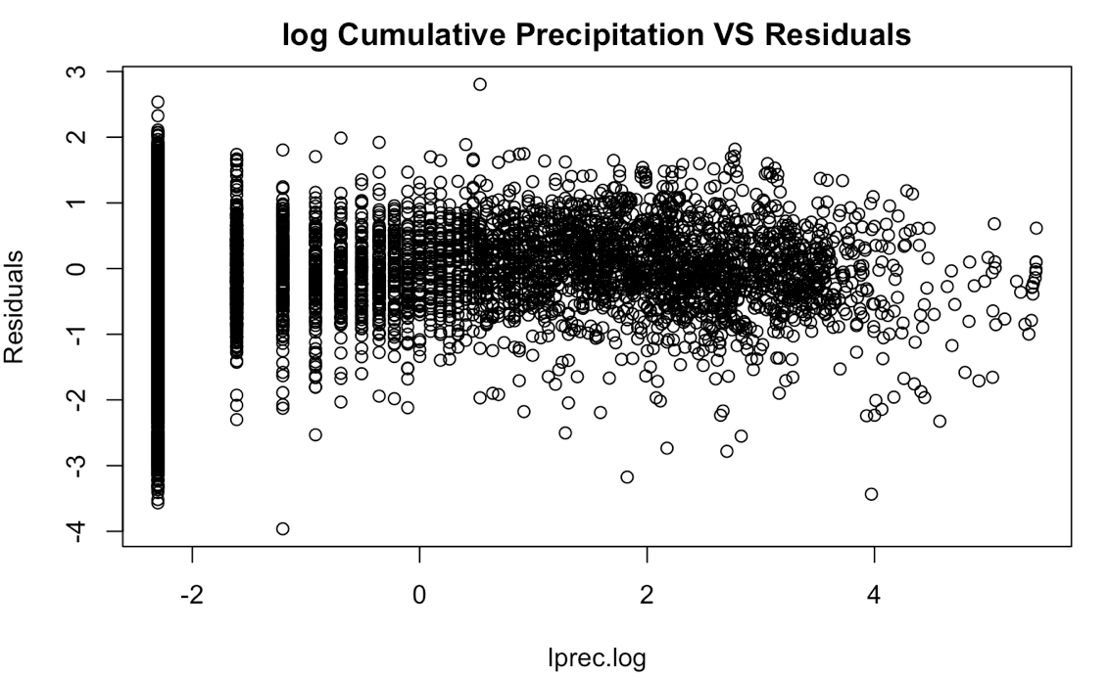
12. Residual Plots
Residuals ~ Categorical x variables = These look great.
Residuals ~ untransformed continuous x variables = these all seem to have a little hook, but they’re not significant enough, and they look better than the residual plots of the x^2 terms.
Residuals ~ logged continuous x variables = These seem to have a larger range near the negative values, but this is expected due to the large amount of data at the smaller x-values, which would lead to a larger range of residuals.

Slide 14
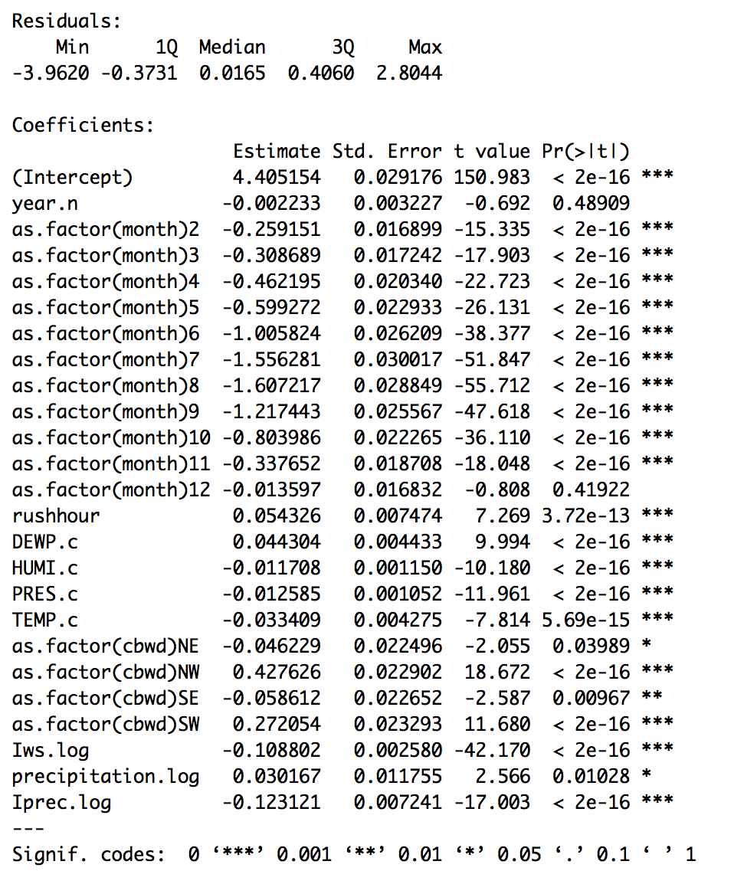
13. Final Regression
regFINAL = lm(formula = PM_US.Post.log ~ year.n + as.factor(month) + rushhour + DEWP.c + HUMI.c + PRES.c + TEMP.c + as.factor(cbwd) + Iws.log + precipitation.log + Iprec.log, data = df)
Variable transformations include the following:
log y
continuous to categorical x
Mean-centered x
Log x

Slide 15
14. Variable Interpretations (selected)
Variable | Value (after manipulation) | 95% CI | Interpretation
Intercept | 81.87 | 77.32, 86.69 | For a baseline day (Year 2012, January, Non-rushhour, Average dew point, humidity, pressure & temperature, No noticeable winds, No hourly precipitation, No cumulated precipitation), we except the PM2.5 Concentration to be …
Year.n | 99.78% | 77.32%, 86.69%) | With each passing year, holding all else contant, we expect the PM2.5 Concentration to be …% of the previous year
As.factor(month)2… as.factor(month)12 | multiple | multple | Holding all else constant, we expect the the average PM2.5 Concentration in … month to be …% of Janurary
rushhour | 105.58% | 104.05%, 107.14% | Holding all else constant, we expect the the average PM2.5 Concentration during rush hours to be …% of that during non-rush hours
DEWP.c | 104.53% | 104.05%, 107.14% | Holding all else constant, we expect the the average PM2.5 Concentration to be …% for every 1ºC increase in dew point.
HUMI.c | 98.83% | 98.61%, 99.06% | Holding all else constant, we expect the the average PM2.5 Concentration to be …% for every 1% increase in humidity
PRES.c | 98.75% | 98.61%, 99.06% | Holding all else constant, we expect the the average PM2.5 Concentration to be …% for every 1hPa increase in presssure.
TEMP.c | 96.71% | 95.91%, 97.52% | Holding all else constant, we expect the the average PM2.5 Concentration to be …% for every 1ªC increase in temperature
As.factor(cbwd)NE… as.factor(cbwd)NW | multiple | multiple | Holding all else constant, we expect the the average PM2.5 Concentration for … winds to be …% of non-directional winds

Slide 16
15. Overall Interpretations & Answer
These doesn't seem to be a big difference in average PM levels with an increase in years, a topic I know a lot of people are concerned about.
In terms of seasons and months, the PM2.5 levels are significantly higher in winter months, and significantly lower during summer months, with July being the least polluted month and January (baseline) being the most polluted month.
Dew point is positively correlated with PM2.5 levels, while humidity, pressure and temperature are all negatively correlated with PM2.5 levels.
Eastern winds leads to a slight decrease in PM2.5 levels, while Western winds lead to a great increase in PM2.5 levels, all in comparison to non-directional winds.
Cumulated wind speeds and precipitation levels cause a slight decrease in PM2.5 levels, while hourly precipitations cause a slight increase in PM2.5 levels.

Slide 17
16. Limitations & Moving Foward
It was difficult to decide whether to treat years as a continuous or a categorical variable, espeically given the few amount of years that were in this data. In the end, I treated it as a continuous variable because I wanted to answer a popular question as to whether "pollution levels got better or worse over the years". We would be able to answer this question a lot better if we had more years of data.
We were not able to fill in the missing data because of the data's context. The numbers were definitely not missing at random, as numbers were missing by chunks of hours or even days. Furthermore, because various aspects of weather vary a lot day to day, we cannot really fill in missing weather data by depending purely on other similar weather factors.
Though the dataset is pretty much a time series, for my model I had to ignore that aspect to make sure I based my analysis of PM2.5 levels based purely on the values of different x variables without respect to time. In comparison, many of these variables can be measured as a change over time if treated like a time series.
I was very surprised at the coefficients for combined wind directions. Shanghai borders the Yellow Sea on the city's east, while the rest of the country lies on its West. Intuitively, I would expect winds blowing from East to West to decrease PM2.5 levels since it's sweeping in clearn air from the oceans, while West to East winds to increase pollution levels as it comes from other polluted cities in China.

