Slide 1
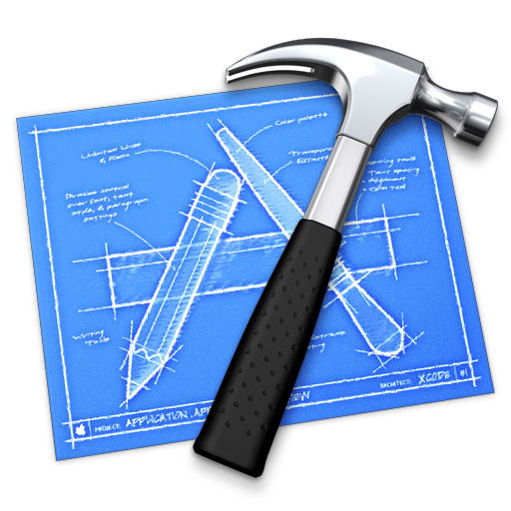
Gesture Recognition
Trinh Minh Cuong
Notes:
http://www.theappcodeblog.com/2011/09/29/iphone-app-development-tutorial-core-data-part-2-one-to-many-relationship/

Slide 2
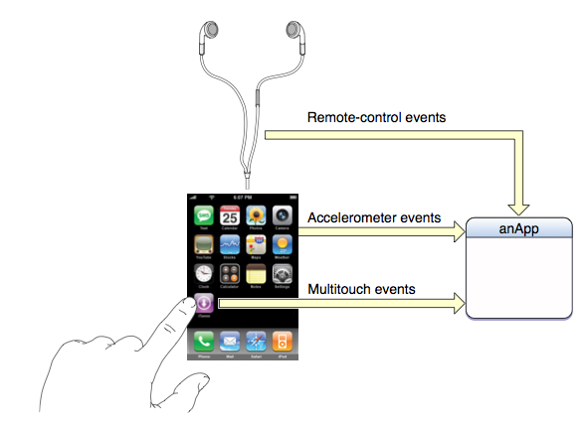
3 Event Types

Slide 3
Two methods
Old & native: override touch handling function of UIResponder
Dev needs to write a lot of code (state machine, if then else if then else… ☹ )
Gesture recognizers:
Many well defined, ready to use gesture recognizers
Can recognize complex gesture or simultaneous gestures.
Can configure how recognizer work

Slide 4
Responding to Touch Events
touchesBegan:withEvent:
touchesMoved:withEvent:
touchesEnded:withEvent:
touchesCancelled:withEvent:
UIResponder
UIViewController
CustomViewController

Slide 5
UIResponder
- (void)touchesBegan:(NSSet *)touches withEvent:(UIEvent *)event;
- (void)touchesMoved:(NSSet *)touches withEvent:(UIEvent *)event;
- (void)touchesEnded:(NSSet *)touches withEvent:(UIEvent *)event;
(void)touchesCancelled:(NSSet *)touches withEvent:(UIEvent *)event;

Slide 6
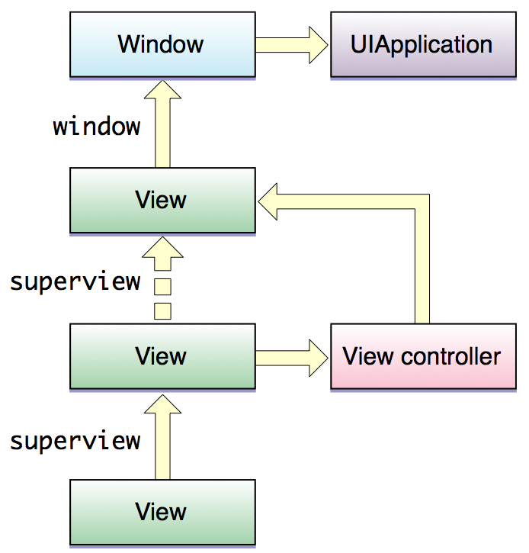
Responder Chain in IOS

Slide 7
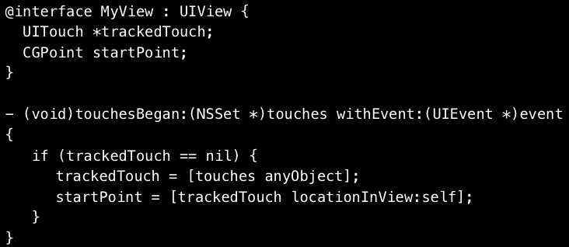

Slide 8
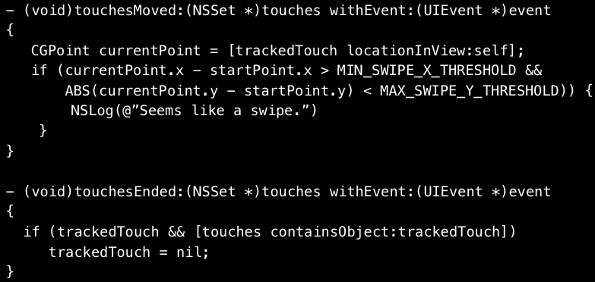

Slide 9
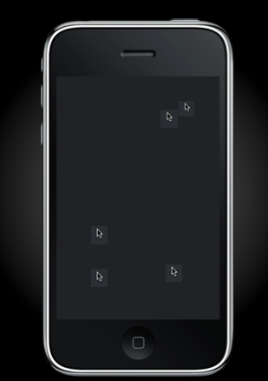
Demo
Gesture Basic
Touches Classic
Problems:
Hard to write because limited precision, two many simultaneous inputs
Ambiguity: dễ nhầm lẫn ☹

Slide 10
UIGestureRecognizer

Slide 11
UIGestureRecognizer có mấy loại cơ bản
Abstract base class UITapGestureRecognizer
Many concrete subclasses
UITapGestureRecognizer
UIPinchGestureRecognizer
UISwipeGestureRecognizer
UIPanGestureRecognizer
UILongPressGestureRecognizer
UIRotationGestureRecognizer
Custom subclasses encouraged

Slide 12
Steps to configure UIGestureRecognizer
//1. Khởi tạo UIGestureRecognizer
UITapGestureRecognizer *tapRecognizer = [[UITapGestureRecognizer alloc] initWithTarget:self action:@selector(tapHandler:)];
//2. Cấu hình UIGestureRecognizer
tapRecognizer.numberOfTapsRequired = 1;
tapRecognizer.numberOfTouchesRequired = 2;
//3. Gắn UIGestureRecognizer vào một UIView cụ thể
[redSquare addGestureRecognizer:tapRecognizer];

Slide 13
@interface UIView (UIViewGestureRecognizers)
@property(nonatomic,copy) NSArray *gestureRecognizers;
- (void)addGestureRecognizer:(UIGestureRecognizer*)gestureRecognizer;
- (void)removeGestureRecognizer:(UIGestureRecognizer*)gestureRecognizer;
@end

Slide 14
UIGestureRecognizer
Touch handling vs Built-in gesture recognizer
Instantiate and configure a predefined UIGestureRecognizer
Designate one or more handlers
Add recognizer to a view
One UITouch per finger
UIView hit test
Responder delivery

Slide 15
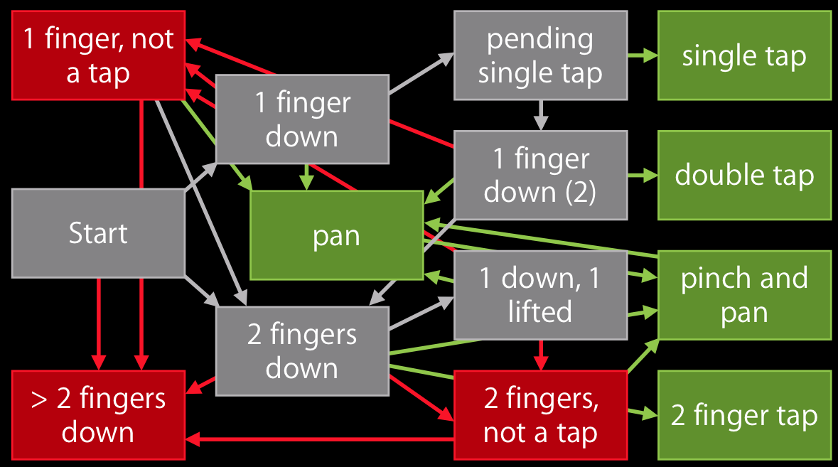

Slide 16
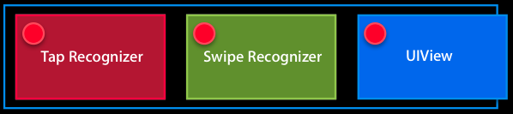
GestureRecognizer hoạt động thế nào?
Configure to recognize several gestures at same time
But infact …

Slide 17
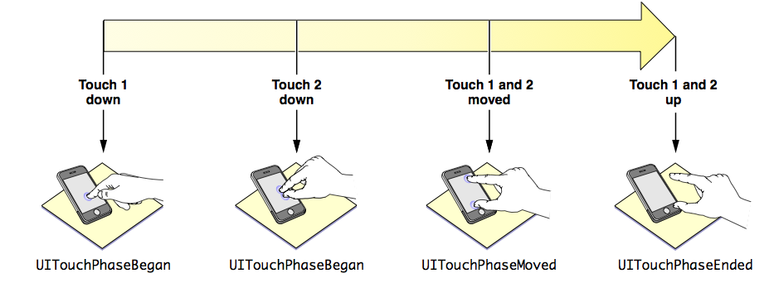
Các trạng thái

Slide 18
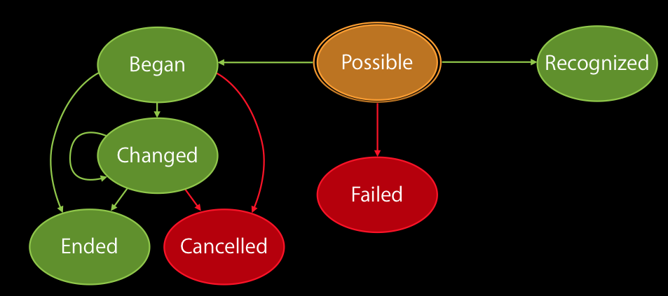

Slide 19
Các trạng thái nhận dạng
typedef NS_ENUM(NSInteger, UIGestureRecognizerState) {
UIGestureRecognizerStatePossible,
UIGestureRecognizerStateBegan,
UIGestureRecognizerStateChanged,
UIGestureRecognizerStateEnded, UIGestureRecognizerStateCancelled,
UIGestureRecognizerStateFailed,
UIGestureRecognizerStateRecognized = UIGestureRecognizerStateEnded
};

Slide 20
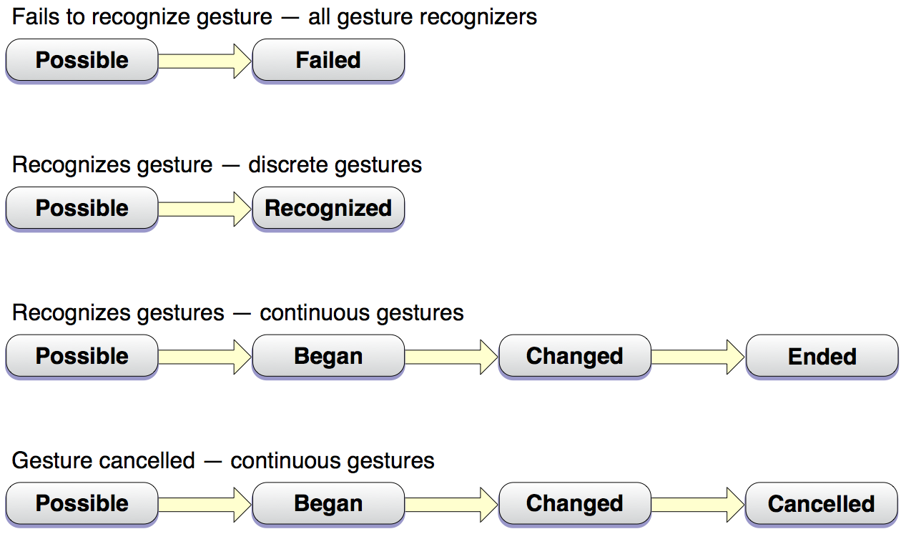

Slide 21
UIGestureRecognizerDelegate
Tinh chỉnh cách ứng dụng nhận dạng tương tác hay bỏ qua
- (BOOL)gestureRecognizerShouldBegin:(UIGestureRecognizer *)gestureRecognizer;
- (BOOL)gestureRecognizer:(UIGestureRecognizer *)gestureRecognizer shouldRecognizeSimultaneouslyWithGestureRecognizer:(UIGestureRecognizer *)otherGestureRecognizer;
- (BOOL)gestureRecognizer:(UIGestureRecognizer *)gestureRecognizer shouldReceiveTouch:(UITouch *)touch;

Slide 22
(BOOL)gestureRecognizerShouldBegin:(UIGestureRecognizer *)gestureRecognizer;
Trả về YES: nếu muốn kích hoạt recoginzer
Trả về NO: tương đương với việc chuyển từ trạng thái UIGestureRecognizerStatePossible (có thể) sang UIGestureRecognizerStateFailed (không nhận dạng thành công)

Slide 23
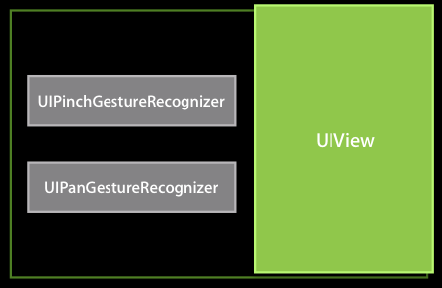

Slide 24
- (BOOL)gestureRecognizer:(UIGestureRecognizer *)gestureRecognizer shouldRecognizeSimultaneouslyWithGestureRecognizer:(UIGestureRecognizer *)otherGestureRecognizer;
Dùng khi có hai bộ nhận dạng có thể được kích hoạt đồng thời,
Trả về NO: để kích hoạt cái này, bỏ cái kia
Trả về YES: cho phép hai bộ nhận dạng cùng chạy

Slide 25
- (BOOL)gestureRecognizer:(UIGestureRecognizer *)gestureRecognizer shouldReceiveTouch:(UITouch *)touch;
Trả về No khi muốn tắt bộ nhận dạng đối với một Touch thỏa mãn điều kiện nào đó, ví dụ:
Touch vào một vùng nào đó trên màn hình, thì không kích hoạt nhận dạng

Slide 26

UIImageView
Need to enable: User Interaction & Multiple Touch

Slide 27
Tap vs Touch
UITapGestureRecognizer *tapRecognizer = [[UITapGestureRecognizer alloc] initWithTarget:self action:@selector(tapHandler:)];
tapRecognizer.numberOfTapsRequired = 1;
tapRecognizer.numberOfTouchesRequired = 2;
[redSquare addGestureRecognizer:tapRecognizer];

Slide 28
Hứng sự kiện Tap
- (IBAction)handleTapFrom:(UITapGestureRecognizer *)recognizer {
CGPoint location = [recognizer locationInView:self.view];
}

Slide 29
Hứng sự kiện xoay
- (IBAction)handleRotationFrom:(UIRotationGestureRecognizer *)recognizer {
CGAffineTransform transform = CGAffineTransformMakeRotation([recognizer rotation]);
self.imageView.transform = transform;
[self showImageWithText:@"rotation" atPoint:location];
[UIView animateWithDuration:0.65 animations:^{
self.imageView.alpha = 0.0;
self.imageView.transform = CGAffineTransformIdentity;
}];
}

Slide 30
CGAffineTransform
A matrix used for affine transformations.
A transformation specifies how points in one coordinate system map to points in another coordinate system. Scaling, rotation, translation, skewing are possible.
CGAffineTransform

Slide 31
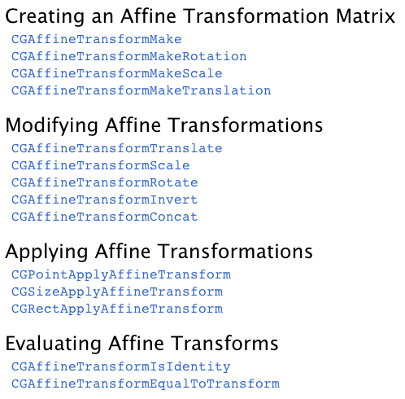

Slide 32
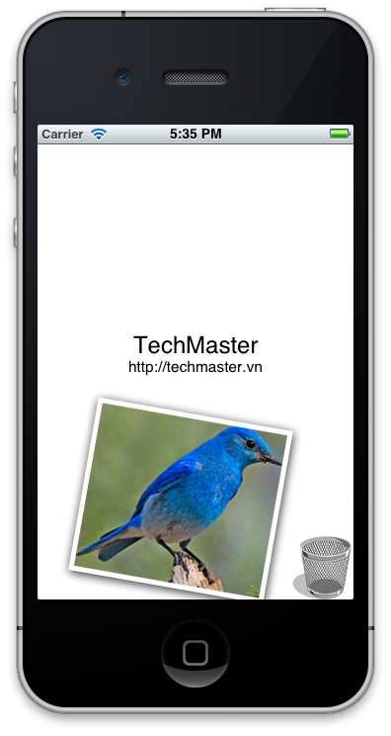
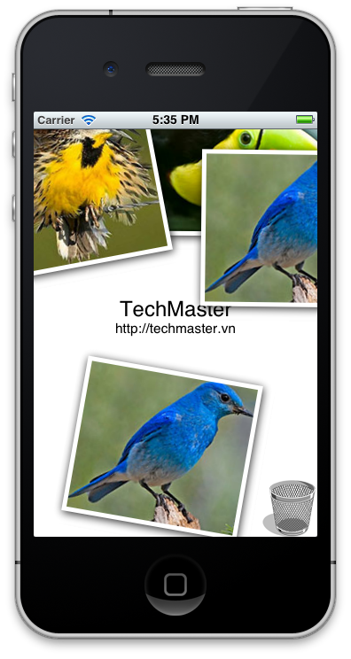
Nhiệm vụ
Hứng sự kiện user chạm , tạo một bức ảnh mới, góc nghiêng bất kỳ
Ấn vào sọt rác thì xóa tất cả ảnh trên màn hình, kèm theo âm thanh xóa rác

Slide 33
Gợi ý
Phải sử dụng 2 thư viện
AVFoundation và QuartzCore
Hứng sự kiện Tap rất đơn giản nhưng phải tránh xung đột với sự kiện ấn vào nút thùng rác.

Slide 34
tránh xung đột với sự kiện ấn nút
- (BOOL)gestureRecognizer:(UIGestureRecognizer *)gestureRecognizer shouldReceiveTouch:(UITouch *)touch
{
if ((touch.view == trashButton)) {
return NO;
}
return YES;
}

Slide 35
#import "UIImageView+Photo.h"
#import <QuartzCore/QuartzCore.h>
@implementation UIImageView (Photo)
- (void) makeItCool
{
[self.layer setMasksToBounds:NO];
[self.layer setBorderWidth:5.0f];
[self.layer setBorderColor:[[UIColor whiteColor] CGColor]];
[self.layer setShadowRadius:5.0f];
[self.layer setShadowOpacity:.85f];
[self.layer setShadowOffset:CGSizeMake(1.0f, 2.0f)];
[self.layer setShadowColor:[[UIColor blackColor] CGColor]];
[self.layer setShouldRasterize:YES];
[self.layer setMasksToBounds:NO];
CGAffineTransform transform =
CGAffineTransformMakeRotation(((float)rand()/RAND_MAX - 0.5)*0.4);
self.transform = transform;
}
@end

Slide 36
Hoạt hình với UIView
[UIView animateWithDuration:1.0f
animations:^(void)
{
…
}
completion:^(BOOL finished)
{
…
}];

