Slide 1
CoreData 2
cuong@techmaster.vn

Slide 2
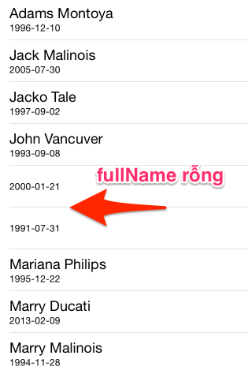
Lỗi hôm trước

Slide 3
Cách xử lý trong file Person+
- (void) awakeFromFetch {
[super awakeFromFetch];
self.fullName = [NSString stringWithFormat:@"%@ %@", self.firstName, self.lastName];
}
- (void)didSave;
{
[super didSave];
self.fullName = [NSString stringWithFormat:@"%@ %@", self.firstName, self.lastName];
}

Slide 4
NSFetchedResultsController
You use a fetched results controller to efficiently manage the results returned from a Core Data fetch request to provide data for a UITableView object.
While table views can be used in several ways, fetched results controllers are primarily intended to assist you with a master list view. UITableView expects its data source to provide cells as an array of sections made up of rows. You configure a fetch results controller using a fetch request that specifies the entity, an array containing at least one sort ordering, and optionally a filter predicate. The fetched results controller efficiently analyzes the result of the fetch request and computes all the information about sections in the result set. It also computes all the information for the index based on the result set.

Slide 5
NSFetchedResultsController
In addition, fetched results controllers provide the following features:
Optionally monitor changes to objects in the associated managed object context, and report changes in the results set to its delegate (see “The Controller’s Delegate”).
Optionally cache the results of its computation so that if the same data is subsequently re-displayed, the work does not have to be repeated (see “The Cache”).

Slide 6
Sử dụng NSFetchedResultsController
@interface MainScreenVC () <NSFetchedResultsControllerDelegate>
{
}
@property (strong, nonatomic) NSFetchedResultsController *fetchedResultsController;
@end

Slide 7
CoreData: FATAL ERROR: The persistent cache of section information does not match the current configuration. You have illegally mutated the NSFetchedResultsController's fetch request, its predicate, or its sort descriptor without either disabling caching or using +deleteCacheWithName:

Slide 8
Tuts
http://iosdevblog.com/tag/nsfetchedresultscontroller/

Slide 9
Binary

