Slide 1
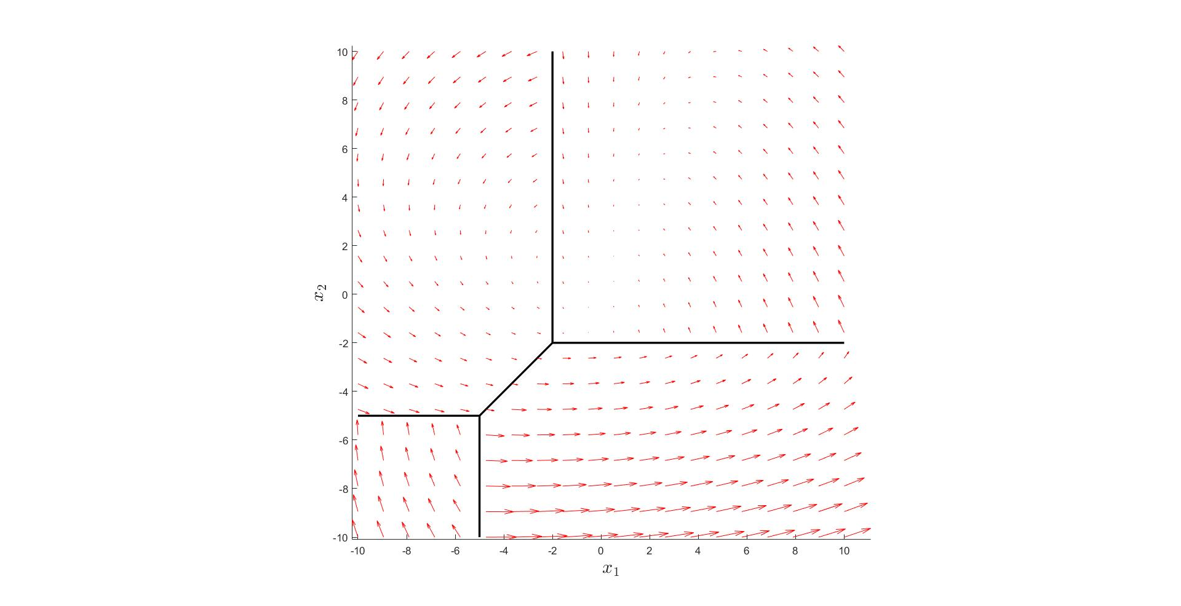




$$ℛ_{4}$$
$$ℛ_{2}$$
$$ℛ_{3}$$
$$ℛ_{1}$$

Slide 2
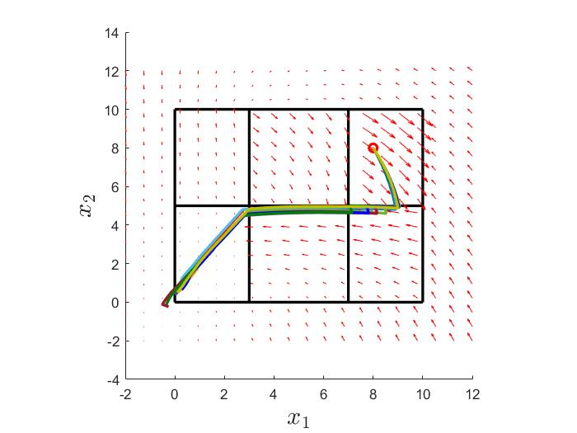







$$ℛ_{7}$$
$$ℛ_{1}$$
$$ℛ_{2}$$
$$ℛ_{3}$$
$$ℛ_{4}$$
$$ℛ_{5}$$
$$ℛ_{6}$$

