Slide 1
To connect smart home products
HTTP Post
Unity
Wemo Switch
IFTTT
Webhook
Light
HTTP Post
Unity
Node-Red

Slide 2
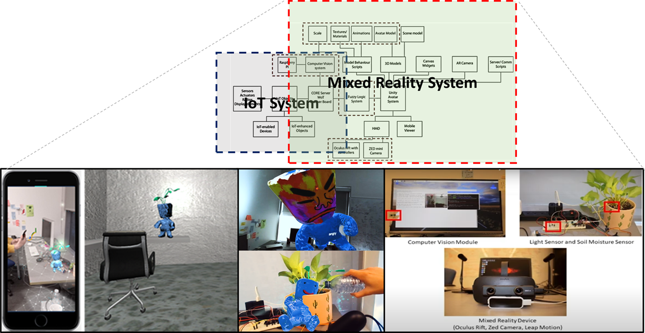

Slide 3
