Slide 1
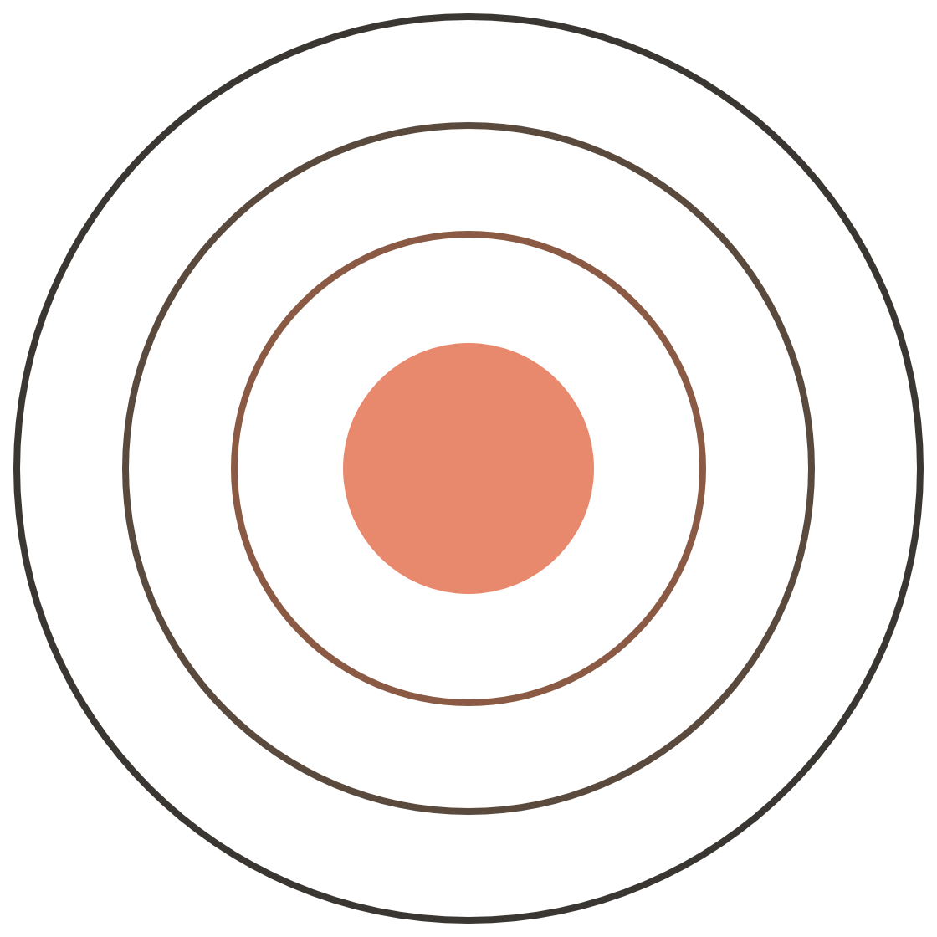
From chatbot
to coworker
NRT AGENTIC AI · FRIDAY 9 OCTOBER 2026
The Claude landscape — and one physics problem, solved four ways
Prof. Murillo · NRT Agentic AI
1 / 59
Notes:
Plan for today: (1) recap last week and put it on a map, (2) a tour of the interfaces, (3) one research problem run in four setups. Watch for the blue Checkpoint slides — that is where we stop and you do something. The four rings are the four setups: each adds a layer of context around the same model.

Slide 2
Today, in six parts
OUTLINE
1
The landscape
What agents are, and how fast the tools change
2
Four interfaces
Chat, Cowork, desktop Code and terminal: what each can reach and remember
3
The example, as an experiment
One physics problem, and how to compare tools on it fairly
4
Hands-on
You try each interface on a piece of the problem
5
Results
Four setups, scored against the answer key
6
Your turn
Your group project
The order is deliberate: ideas first, then the example and how to study it, then your hands, then the evidence.
2 / 59
Notes:
Read the six parts aloud. Parts 1–2 are concepts; Part 3 turns them into an experiment design; Part 4 puts the tools in students' hands; Part 5 shows the evidence; Part 6 hands the method to them. A divider with this strip appears at the start of each part, so anyone watching the video later can see where they are.

Slide 3
The agentic ecosystem, October 2026
SETTING THE STAGE
ANTHROPIC
OPENAI
GOOGLE
MICROSOFT & OTHERS
Apps
Claude: chat + Cowork (merging), Code tab
ChatGPT desktop app: Chat, Work, Codex
Gemini app · Antigravity 2.0 desktop
Microsoft Copilot · Cursor · GitHub Copilot
Terminal agents
Claude Code
Codex CLI
Antigravity CLI (agy) — replaced Gemini CLI in June
Open source: OpenHands, Aider, …
Build-your-own SDKs
Claude Agent SDK
OpenAI Agents SDK
Google ADK · Antigravity SDK
Microsoft Agent Framework · AWS Strands
Open frameworks — any model
LangGraph · CrewAI · LlamaIndex · Pydantic AI · smolagents · …
Protocols — how pieces connect
MCP (agents ↔ tools) · A2A (agent ↔ agent)
Dark cells = today
One corner of one column. The frameworks and protocols come later in the course.
3 / 59
Notes:
Set expectations: today is deliberately narrow — Anthropic's apps and terminal agent. Read the grid by rows: every big lab now ships the same three layers (an app, a terminal agent, an SDK to build your own), and model-agnostic frameworks like LangGraph and CrewAI sit across all of them. MCP and A2A are the plumbing. Names move fast — this grid is dated October 2026: OpenAI merged Codex into one ChatGPT desktop app with Chat and Work in July; Google replaced Gemini CLI with Antigravity CLI in June; Microsoft merged AutoGen and Semantic Kernel into Agent Framework. Expect some of it to be stale by the end of term — that's the theme of the next few slides.

Slide 4



The agent loop
LAST WEEK WITH PROF. HOU, IN ONE PICTURE
Goal
Plan
Act
Observe
You say what done looks like
It breaks the work into steps
It calls a tool: edit, run, search
It reads the result, then decides
repeat until the goal is met — or a human steps in
Last week you saw this loop run in three places: the browser, the CLI, and Cowork. Today: what changes from one place to the next — and why it matters.
4 / 59
Notes:
Recap of Prof. Jie Hou's session. [CONFIRM with Jie: browser, CLI, Cowork?] A chatbot answers once; an agent runs this loop — it acts with tools, looks at what happened, and goes again. Ask: in last week's Claude Code session, which tool calls did you see in the Act box? Bridge: the two things that vary across today's interfaces are reach (what Act can touch) and memory (what persists). That's the next big map.

Slide 5
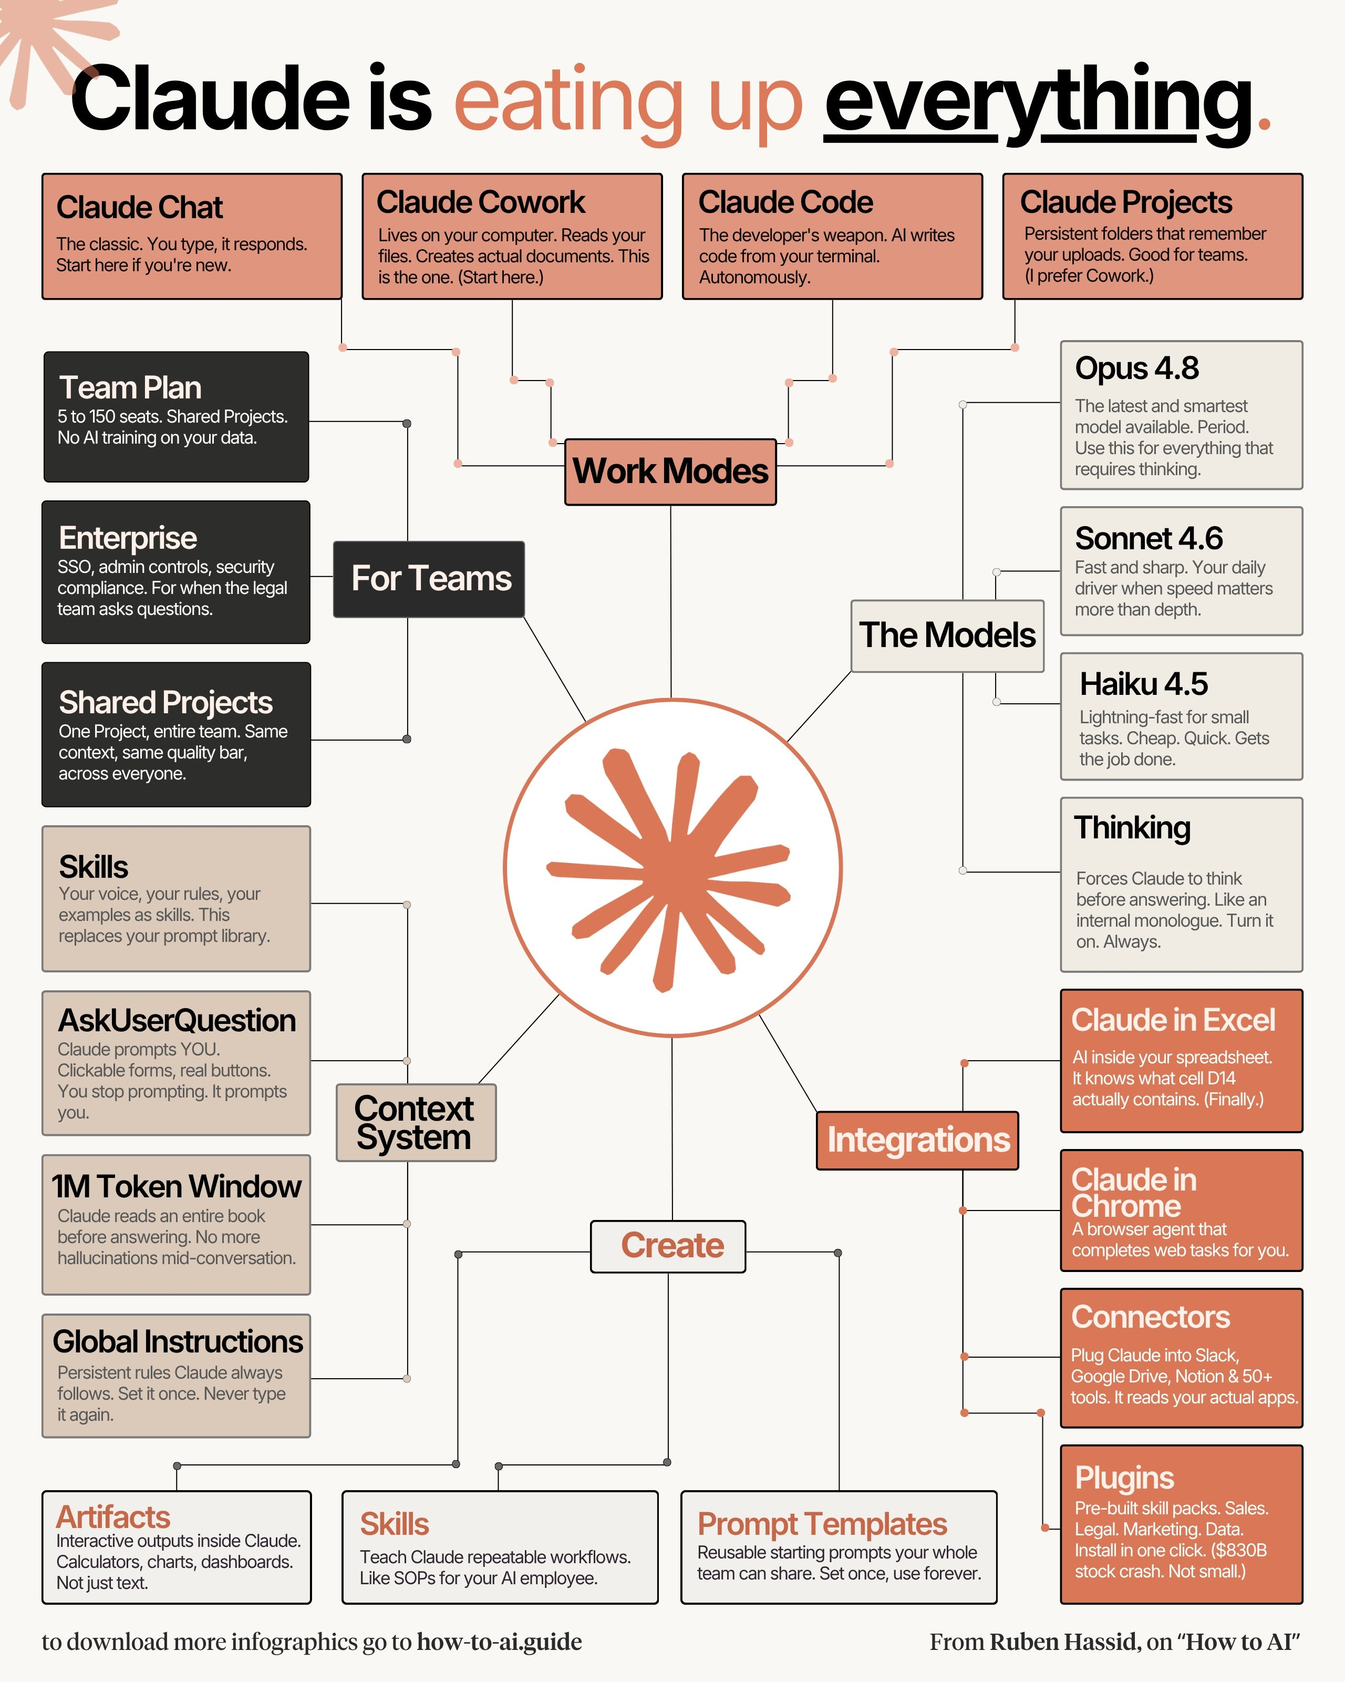
agent = model + harness
A MAP SOMEONE ELSE DREW — AND A DEFINITION
the model
On this map, only one branch is the model (boxed). Every other branch — work modes, context, integrations, create — is harness.
HARNESS
Everything around the model that makes it an agent: the loop, the tools it can call, what it can reach, what it remembers, and how you approve its actions.
NOT TO BE CONFUSED WITH
An evaluation harness: the code that runs a benchmark against a model. Same word, different job.
Infographic: Ruben Hassid, “How to AI” (how-to-ai.guide)
5 / 59
Notes:
Two jobs for this slide. (1) Orientation: give them 30 seconds with the whole map; which branches did we use last week? (2) Vocabulary. 'Harness' is used loosely; here is the definition we'll use all term: agent = model + harness. On this map only the Models branch is the model; everything else is harness. The whole lecture follows from this: the same model sits inside different harnesses (chat, Cowork, Claude Code), and the experiment holds the model fixed while changing the harness. In the wild: Google describes its Antigravity CLI and desktop app as sharing one agent harness; Anthropic packages Claude Code's harness as the Claude Agent SDK. The confusion: in evaluation work, 'harness' means the code that runs a benchmark (e.g., an eval harness) — unrelated. Then: let's zoom in and fact-check the map.

Slide 6

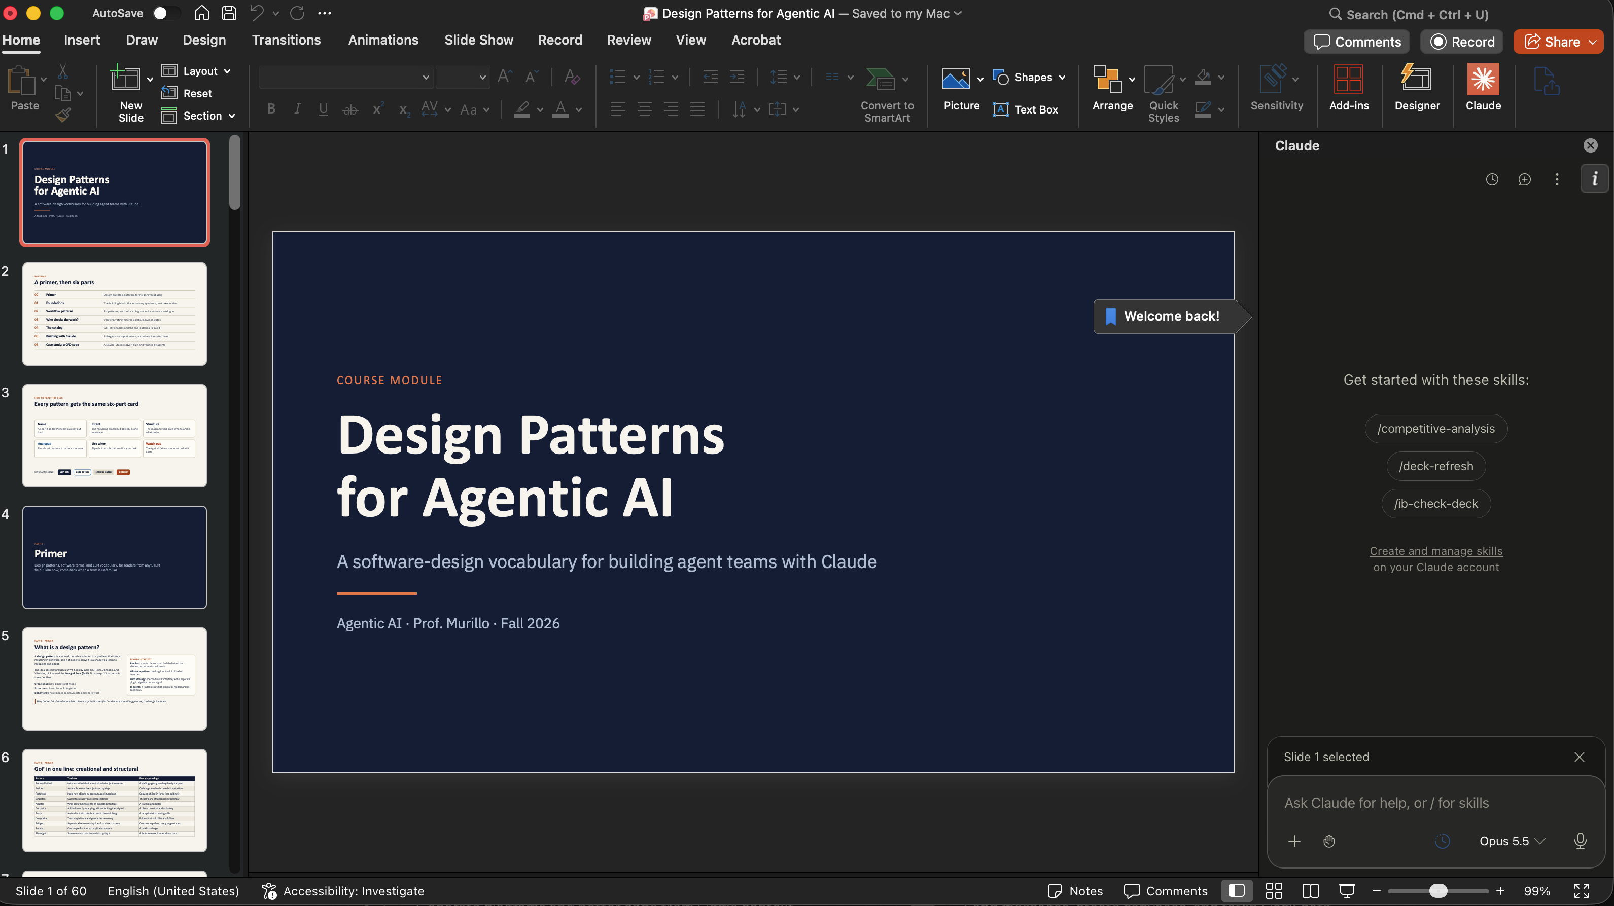




Claude where you already work
THE CLAUDE FAMILY
PowerPoint
A side panel in your deck — with skills like /deck-refresh
Chrome
A browsing agent that clicks, reads and fills in forms
Excel
Works inside your spreadsheet, cell by cell
Design
A canvas for mockups, posters and visuals
Slack
Tag @Claude in a thread to hand off a task
6 / 59
Notes:
Screenshot: Claude in PowerPoint on another deck of mine — a side panel that knows which slide is selected, with skills offered as slash commands. Same model, same loop; 'Act' now means editing slides in place. Chrome, Excel, Design (canvas) and Slack (Claude Tag) work the same way. Cowork can drive several of these as tools — the walls between rooms are getting thinner.

Slide 7
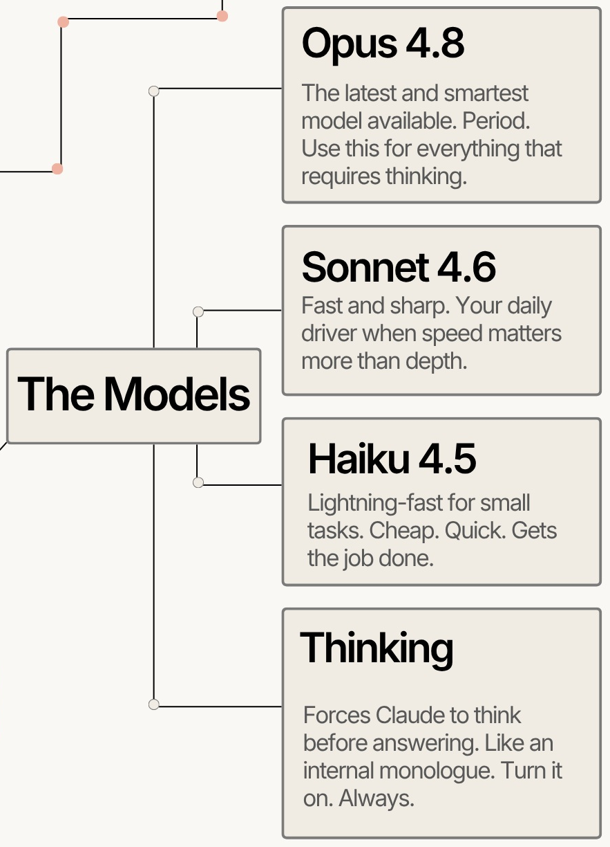
Fact-check the models panel
CHECKPOINT 1 · 3 MINUTES
Find three claims that are out of date — or were never quite right. Then: how would you get an agent to check them for you?
1
2
3
7 / 59
Notes:
Ask, discuss, then reveal the next slide. Answers to draw out (as of early October 2026 — re-check before class): (1) Version names are stale: current public models are Claude Opus 5.5, Sonnet 5.5 and Haiku 4.5. (2) 'Smartest. Period.' — there is now a Mythos tier above Opus (Claude Fable 5.1 publicly; Mythos models in limited preview). (3) 'Thinking: turn it on. Always.' — extended thinking costs latency and tokens; for quick lookups it's wasted. Choose per task. Meta-point: anything with a version number goes stale. Agentic answer to the second question: tell the agent to verify against the official docs with search, and to cite what it found.

Slide 8
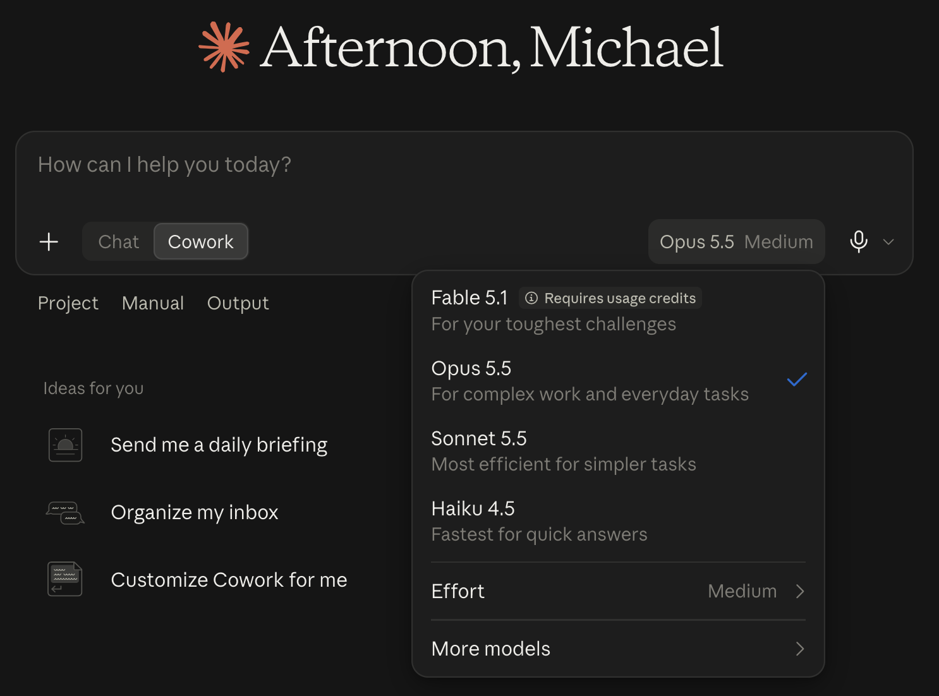

What the models panel gets wrong
CHECKPOINT 1 · ANSWERS
“Opus 4.8”, “Sonnet 4.6”
Version numbers go stale fast. Today’s picker lists Opus 5.5, Sonnet 5.5 and Haiku 4.5.
“The latest and smartest model. Period.”
There is now a tier above Opus: Fable 5.1, “for your toughest challenges” — and it needs usage credits.
“Thinking: turn it on. Always.”
Version numbers are claims to verify. Ask the agent to check the official docs and cite what it finds.
It is a dial now — the Effort setting. Worth turning up for a derivation; wasted on a lookup.
8 / 59
Notes:
Reveal after discussion. The screenshot is the evidence: the model picker in the app on 4 October 2026. (1) Opus 5.5, Sonnet 5.5, Haiku 4.5 are the current lineup. (2) Fable 5.1 sits above Opus — a Mythos-tier model; Fable carries extra safeguards and is publicly available with usage credits, while Mythos Preview itself is limited to partner organizations (Project Glasswing). (3) There is no simple thinking on/off here: Effort is a dial. More effort costs time and tokens; choose per task. For the video audience: the infographic isn't bad — a snapshot of a fast-moving product is a hypothesis, and agents with search can test it.

Slide 9
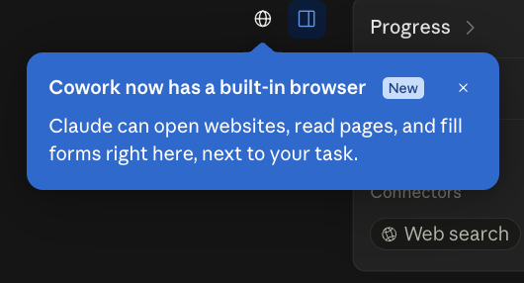
This just changed.
MEANWHILE, WHILE I MADE THESE SLIDES…
Cowork gained a built-in browser. One slide in this very deck was already out of date — a few hours after I wrote it.
Sun 4 Oct 2026 · 6:13 pm
9 / 59
Notes:
The Checkpoint 1 lesson, live. The infographic was wrong about model names; this deck was wrong about Cowork within an afternoon — the Cowork slide originally said it browses only via Claude in Chrome. Screenshot taken Sunday 4 October 2026 at 6:13 pm. Ask: by Friday, what else here will be stale? (Answer for the video: probably something. Verify, don't memorize.) If anything else changes before class, swap it in here.

Slide 10
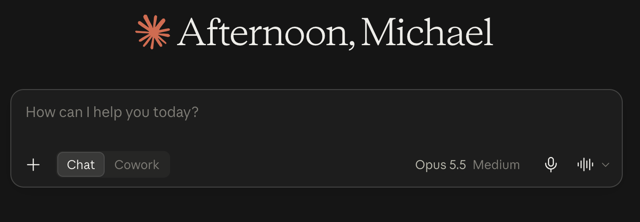
Chat and Cowork are becoming one box.
AND THIS IS CHANGING RIGHT NOW
WHAT I STILL SEE (4 OCT)
Announced 16 September 2026. Rolling out to Pro and Max first — on web, desktop and mobile — with other plans to follow. Once an account switches, it can’t switch back.
WHAT MANY OF YOU MAY SEE
One message box. No Chat / Cowork buttons.
FOR TODAY
Work on local folders, the built-in browser and computer use still go through the desktop app.
No toggle in your app? You have the new version. Just ask — Claude decides whether to answer or start a task.
10 / 59
Notes:
Source: Anthropic Help Center, 'Claude Cowork and chat are one Claude' (announced 16 Sep 2026). Rolling out in stages to Pro and Max on web, desktop and mobile; other plans follow; accounts on the same plan get it at different times; no switching back. Also in the new experience: no web-search toggle (Claude searches when it helps); Cowork's Global instructions moved to Settings > General > Instructions for Claude; local files, the built-in browser and computer use only work while the desktop app is open. Practical consequence for this class: students will see two different UIs. The Chat and Cowork slides still describe real capabilities — only the button differs.

Slide 11
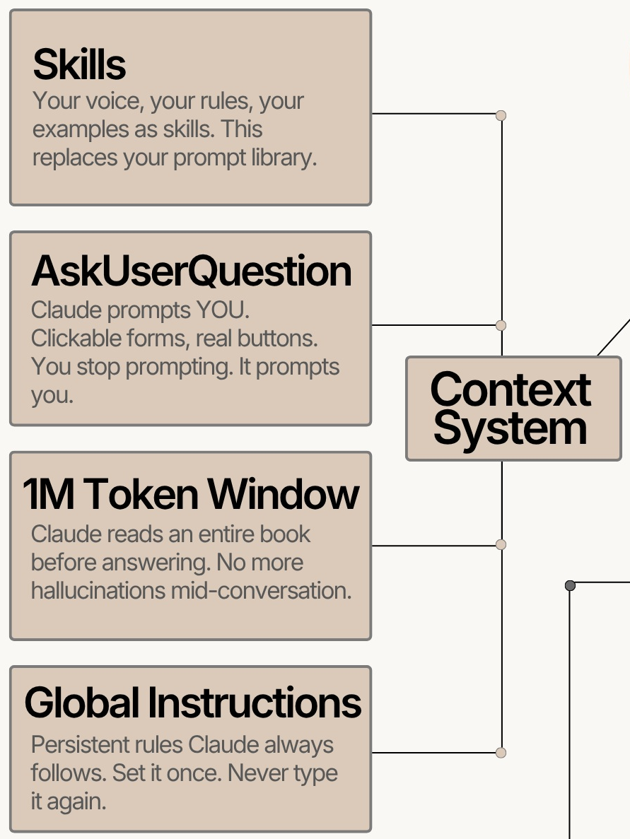
True, half-true, or false?
CHECKPOINT 2 · 3 MINUTES
Pick one card on the right and defend your verdict in a sentence. Three to argue about:
1
Does a bigger context window stop hallucinations?
2
What is a skill, mechanically?
3
Where do “global instructions” live in Claude Code?
11 / 59
Notes:
Ask, discuss, then reveal the next slide. (1) False as stated. A large window means the model can see more; it does not make it right. Long contexts can also bury the key detail. Reliability comes from checks — the theme of our example. (2) A skill is a folder of instructions (plus optional scripts/examples) that Claude loads when the task matches — closer to an SOP than a prompt library. (3) In CLAUDE.md files: a global one in ~/.claude, and per-project ones in the repo. Our experiment empties the global one on purpose — see the Controls slide. 'AskUserQuestion' is fine: agents asking clarifying questions is real and good.

Slide 12

Context is engineered, not given
CHECKPOINT 2 · ANSWERS
Does a bigger context window stop hallucinations?
What is a skill, mechanically?
Where do “global instructions” live in Claude Code?
A folder of instructions
False
A SKILL.md plus optional scripts and examples. Only a short description sits in context; the rest loads when a task matches.
In CLAUDE.md files
A window is how much it can see, not whether it is right. Reliability comes from checks: tests, symbolic verification, confirmed citations.
~/.claude/CLAUDE.md applies everywhere; a CLAUDE.md in the repo applies to that project. Both are read at the start of every session.
Written-down context — files, rules, skills — is what an agent can re-read. Our physics example tests exactly how much that matters.
12 / 59
Notes:
1) The infographic's '1M tokens ... no more hallucinations' conflates capacity with correctness. A model can misread or ignore something it can see, and very long contexts can bury the key line. 2) Skills use progressive disclosure: the name and description are always visible; the full instructions, scripts and examples load only when relevant. That is why you can have many without flooding the context. They work in Chat, Cowork and Claude Code. 3) In chat, the equivalents are user preferences and Project instructions. AskUserQuestion on the infographic is legitimate: agents asking clarifying questions with clickable options is real and useful. 'Global Instructions: set it once, never type it again' is roughly right — but the experiment deliberately empties the global CLAUDE.md so nothing leaks in.

Slide 13
Four interfaces
PART 2 OF 6
Chat, Cowork, desktop Code and terminal: what each can reach and remember
1
Landscape
2
Interfaces
3
The example
4
Hands-on
5
Results
6
Your turn
13 / 59
Notes:
Part 2: the four interfaces as concepts — what each one is, where it runs, what it can and can't do, and the two dials (reach and memory) that organize them. No hands-on yet; that comes in Part 4.

Slide 14

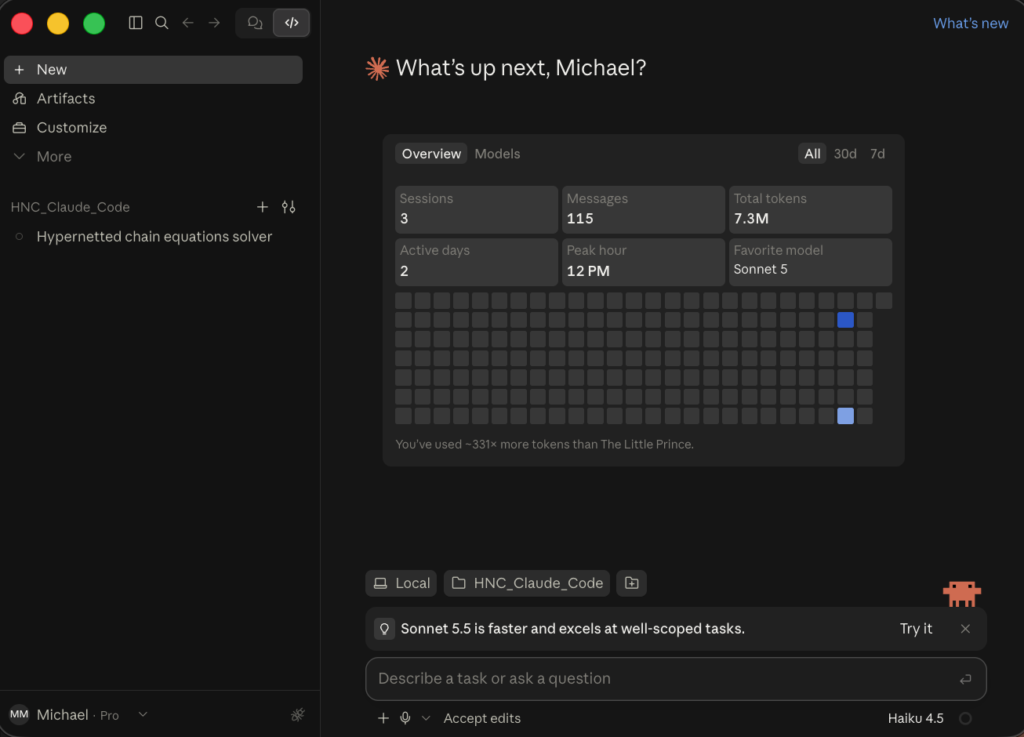
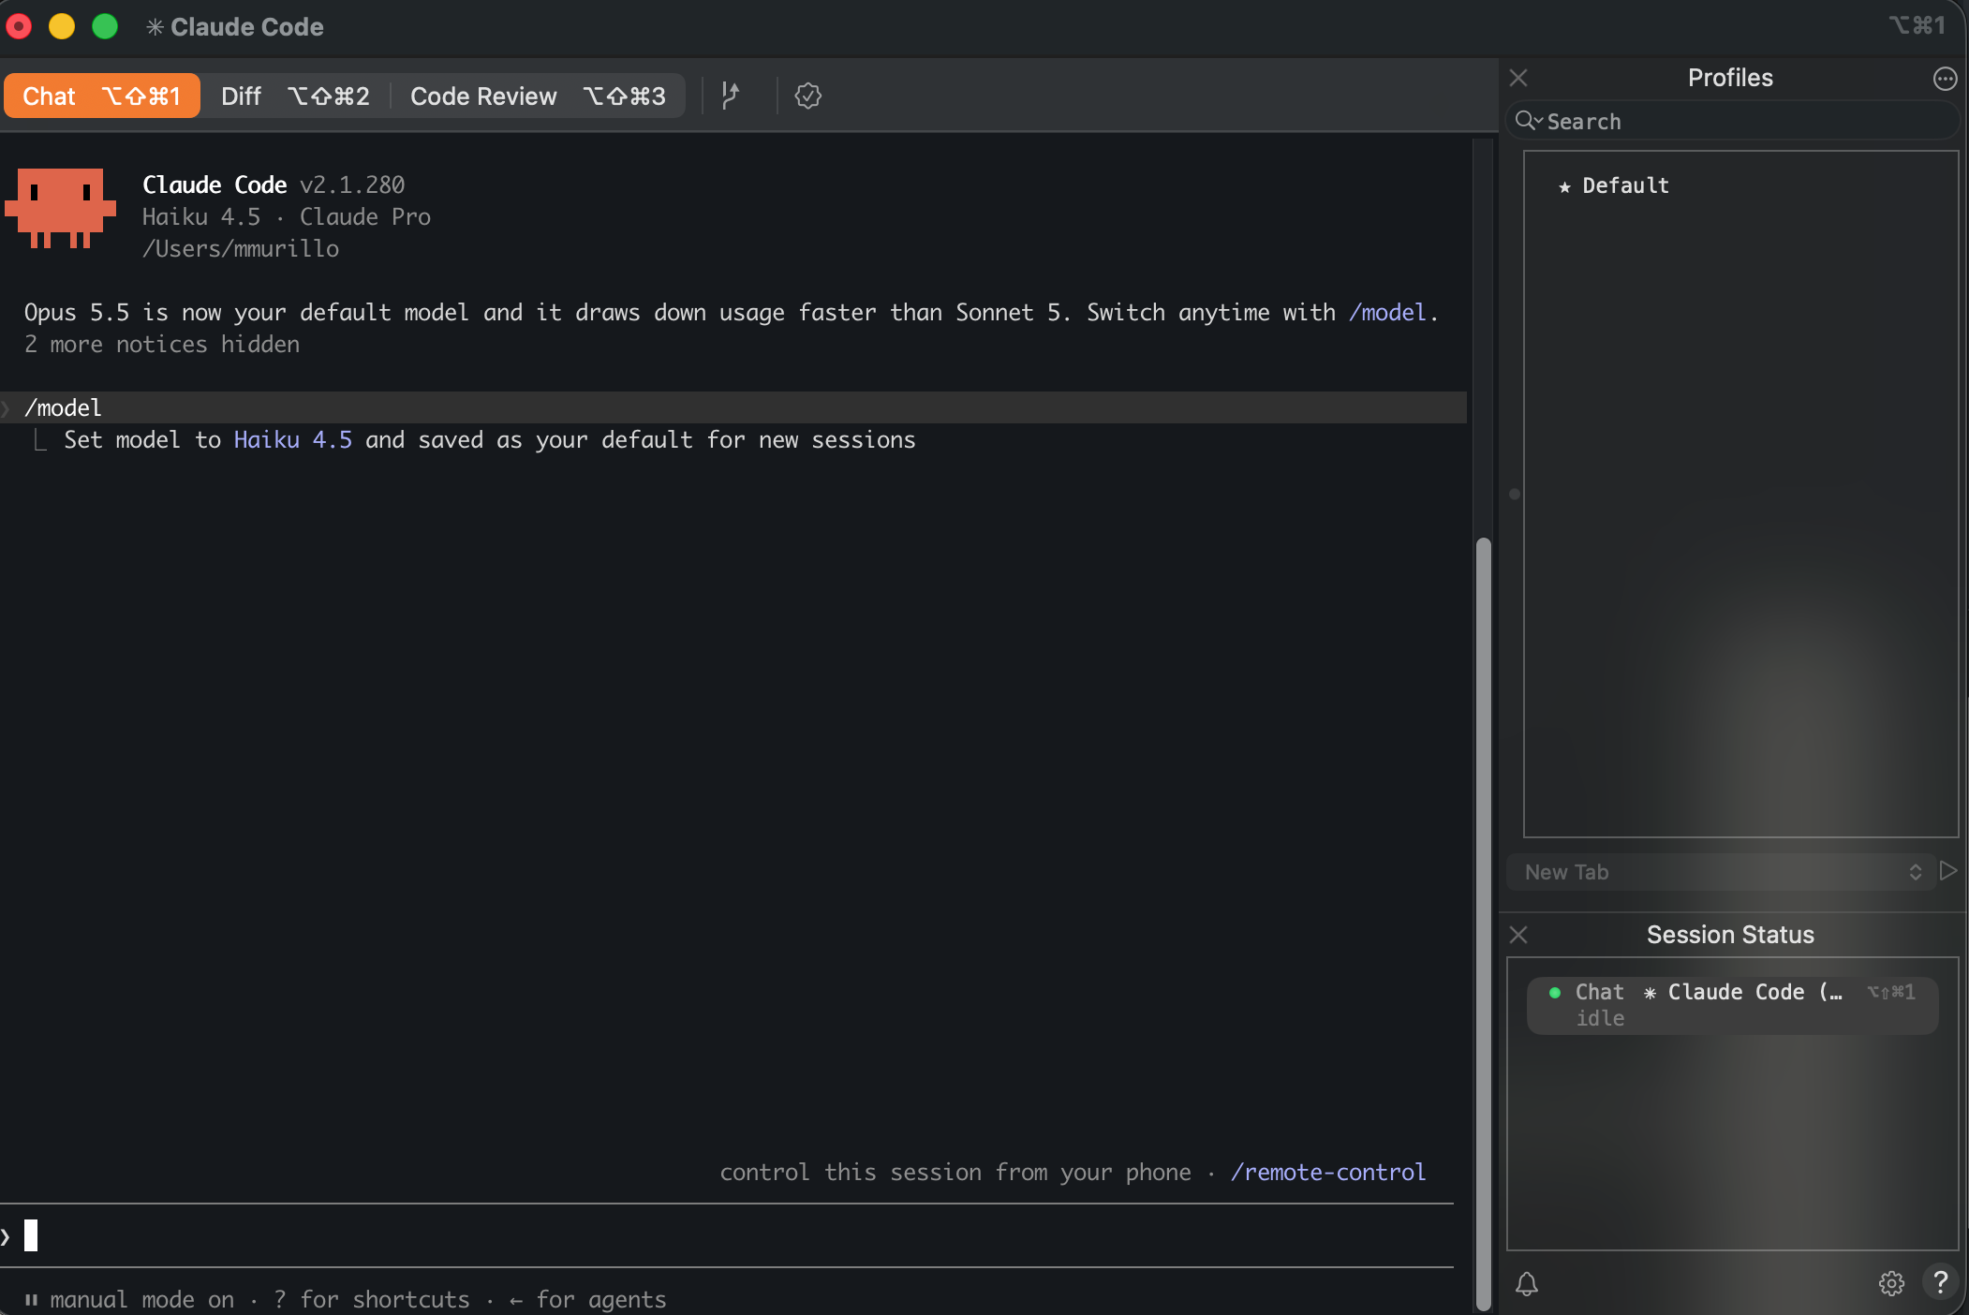
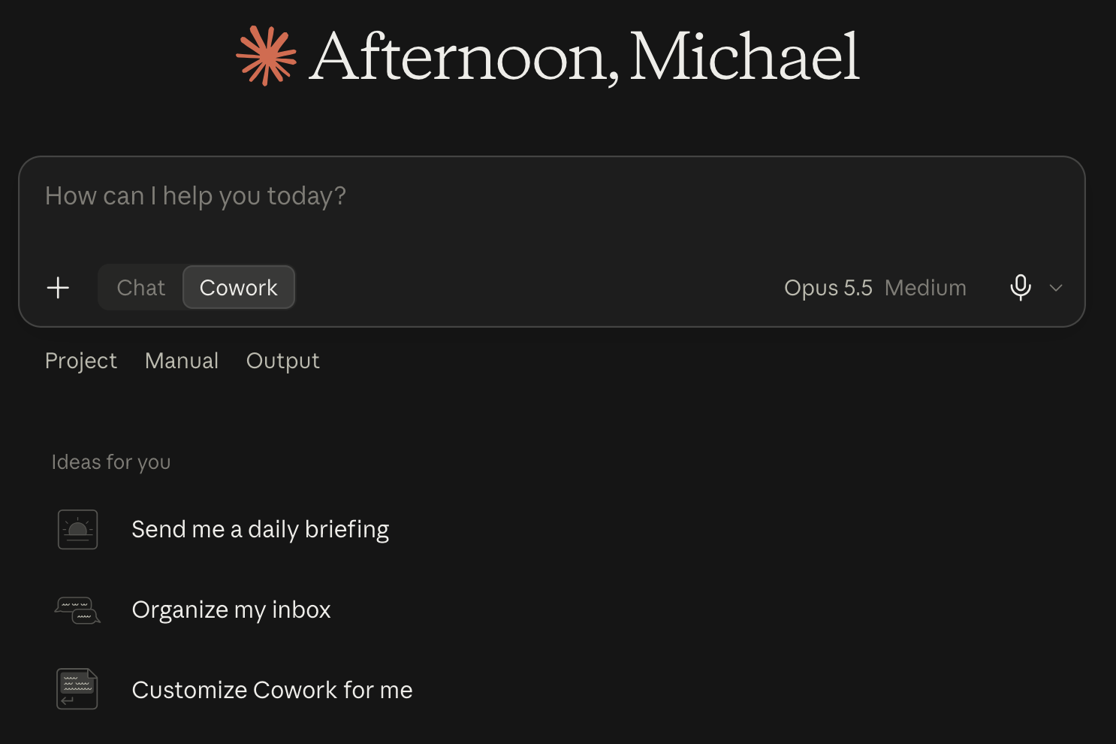

From chatbot to coworker, step by step
INTERFACE TOUR
2
Cowork
1
Chat
3
Desktop Code
4
Terminal
Browser · desktop app · phone
(your folders: desktop app)
Browser · desktop app · phone
Claude desktop app → Code tab
iTerm2, Terminal, or any shell
You ask, it answers. Code runs only in its own sandbox.
Claude Code in a window: your repo, your shell, edits you accept.
The same agent in your terminal: scriptable, steerable from your phone.
Same app, new mode: it works through your files, step by step.
Answers questions
Does the work
14 / 59
Notes:
The dark strip on each card answers 'where do I open this?' — the most common way students get lost. 1 and 2 run in the browser, the desktop app or the phone; but anything that touches files on YOUR computer (step 2's folders) needs the Claude desktop app open. 3 is the Code tab inside the same desktop app. 4 is any terminal program — iTerm2, macOS Terminal, Windows Terminal — where you type `claude`. Then one slide each, then all four side by side.

Slide 15


Claude chat
INTERFACE TOUR · 1 OF 4
claude.ai in a browser, the mobile apps, or the Chat toggle in the desktop app.
REACH FOR IT WHEN
You’re thinking out loud, drafting, or doing a one-off calculation — on any device
IT CAN
IT CAN’T
Explain, draft, and reason through a derivation step by step
See files on your computer unless you upload them
Run Python — SymPy, NumPy, plots — in a sandbox, once code execution is on
Keep its sandbox: files vanish unless it hands you a download
Run your code, your packages, or your tests
Read files you upload, and use connectors you switch on (Drive, Gmail…)
15 / 59
Notes:
Chat is the lowest-reach room. Students often don't know it can run code: with code execution on, it has a Python sandbox with the usual scientific stack, so it CAN run SymPy. What it can't do is touch their machine, and the sandbox is thrown away. Students try it in Part 4.

Slide 16
Cowork
INTERFACE TOUR · 2 OF 4
Browser, desktop app or phone — but working on your folders needs the desktop app. (Merged app: no toggle, just ask.)
REACH FOR IT WHEN
The job is many files and many steps — documents, not a codebase — and you’d rather not use a terminal
IT CAN
IT CAN’T
Read, create and reorganize files in folders you give it
See folders you haven’t given it
Work through long, multi-step tasks — or wait for your OK at each step (Manual)
Stand in for a developer setup: it isn’t wired into your repo, shell and tests
Open websites, read pages and fill in forms in its built-in browser — new this week
Skip your approval on actions you haven’t allowed
16 / 59
Notes:
Same box as chat, with the toggle flipped. The jump from chat: it works on YOUR files. Emphasize permissions — Manual means it waits for approval. Cowork now has a built-in browser (appeared 4 Oct 2026, see the 'This just changed' slide). [Verify on the day: exact folder-picker wording and where Cowork runs code.] Students try it on a folder of PDFs in Part 4.

Slide 17
Claude Code in the desktop app
INTERFACE TOUR · 3 OF 4
The Code tab of the desktop app, pointed at a folder on your machine (“Local”).
REACH FOR IT WHEN
You want Claude Code’s full power in a familiar app window
IT CAN
IT CAN’T
Edit files across your project, with edits you accept or reject
Work outside the folder you chose without asking
Run commands with your Python and packages: scripts, tests, git
Run a command you haven’t approved (in the default modes)
Help much with no project: an empty folder means it starts from zero
Read CLAUDE.md, and use skills and subagents
17 / 59
Notes:
The big jump: it now runs code in YOUR environment — your Python, your SymPy version, your solver. And the result is a file in your folder, not a vanished sandbox. Point at 'Accept edits' in the screenshot: the permission control.

Slide 18
Claude Code in the terminal
INTERFACE TOUR · 4 OF 4
Your terminal: open any folder and type claude. Same agent as the Code tab.
REACH FOR IT WHEN
Long autonomous runs, automation, or you live in the terminal anyway
IT CAN
IT CAN’T
Do everything the Code tab does — it is the same agent
Hold your hand: it’s text-first, so you need to be at home in a shell
Run from scripts with claude -p "…", e.g. a nightly test summary
Show buttons and visual diffs (some terminals and IDEs add them)
Switch models with /model; steer a running session from your phone with /remote-control
Work outside the folder you started in without asking
18 / 59
Notes:
Screenshot: Claude Code v2.1.280. Point out /model, /remote-control, 'manual mode on'. The only real difference from the Code tab is the window — and that the terminal can be scripted (claude -p).

Slide 19
Four interfaces, compared
INTERFACE TOUR · SIDE BY SIDE
 | 1 · Chat | 2 · Cowork | 3 · Desktop Code | 4 · Terminal
Where it runs | Web, phone, app | Desktop app | Desktop app | Terminal
What it can touch | Uploads, a sandbox | Folders you grant | Repo + shell | Repo + shell
Where code runs | Sandbox, if enabled | Its own sandbox | Your Python | Your Python
How you approve | Little to approve | Modes, e.g. Manual | e.g. Accept edits | e.g. manual mode
What persists | Projects, memory, skills | Projects, skills | CLAUDE.md, skills, subagents | CLAUDE.md, skills, subagents
Best for | Thinking, drafting | Multi-step document work | Coding in a window | Long runs, scripting
In my experiment (Part 3) | Setup 1 | — | Setups 2–4 | Setups 2–4
Columns 3 and 4 are the same agent — pick the window you prefer.
19 / 59
Notes:
Repeat of the tour, side by side. The real jumps are 1 → 2 (it can touch your files) and 2 → 3 (it runs code in your own environment). The comparison students should leave with. Read across rows, not down columns: what it can touch is the big differentiator. The approval row is grounded in the screenshots — Cowork's Manual option, the Code tab's 'Accept edits', the terminal's 'manual mode on'. The last row previews the experiment: setup 1 is chat; setups 2–4 are Claude Code (either window works) with more and more written context. Cowork isn't in the experiment because the task is code and derivations, not documents — ask students whether it should be.

Slide 20
Which room would you use?
CHECKPOINT 3 · 2 MINUTES
More than one answer can be defensible. Be ready to argue yours.
Rename and sort 300 PDFs in your Downloads folder
Refactor a plasma solver until its tests pass
→ ____________
→ ____________
Sanity-check a derivation on your phone, on the bus
Fix the formulas in a grant budget spreadsheet
→ ____________
→ ____________
20 / 59
Notes:
Ask, discuss, then reveal the next slide. Likely answers: (1) Cowork — many local files, no code needed (Claude Code also works if you're comfortable in a terminal). (2) Claude Code — repo, tests, git. (3) Chat on mobile. (4) Claude in Excel — edits in place, sees the actual cells. Push on the disagreements: the interesting cases are where reach and memory trade off.

Slide 21
Pick the room by what the agent must touch
CHECKPOINT 3 · ANSWERS
Rename and sort 300 PDFs in Downloads
Refactor a plasma solver until its tests pass
→ Cowork
→ Claude Code
Local files, many steps, no code required. Claude Code works too if you live in a terminal.
It needs the repo, a shell, the test suite and git — so it can run the tests and iterate until they pass.
Sanity-check a derivation on the bus
Fix the formulas in a grant budget
→ Chat, on your phone
→ Claude in Excel
Pure reasoning: nothing to touch. (Claude Code sessions can also be steered remotely from the phone.)
It works on the actual cells and formulas in place, not on a pasted copy that you must then paste back.
21 / 59
Notes:
The organizing question behind every answer is: what does the agent need to touch to do this job? That is the first of two dials we name on the next slides — reach. Defensible alternatives are fine; what matters is the reasoning. E.g. for the PDFs, Claude Code is a perfectly good answer for a terminal user; for the budget, Cowork with the file is workable, but in-place editing avoids copy-paste errors.

Slide 22

Reach: what can the agent touch?
TWO DIALS · 1 OF 2
Its own sandbox
Browser & apps
Your files
Repo & terminal
1
2
3
4
Runs code in a box that vanishes afterwards
Clicks, reads, fills in forms, edits cells
Reads and writes folders you grant it
Edits code, runs commands, tests and git
Chat
Chrome · Excel · PowerPoint
Cowork
Claude Code
Less it can do — and less it can break
More it can do — and more it can break
22 / 59
Notes:
First dial. Go back to the agent loop: the Act box is a tool call — and the question is what that tool can reach. Walk left to right: chat runs code, but only in a disposable sandbox; browser and app agents act inside web pages, spreadsheets and slides; Cowork works on folders on your own machine; Claude Code has your repo and a shell. The bar at the bottom is the trade-off: power and risk rise together, which is why every step to the right comes with permission prompts and sandboxes. Ask: where on this line was each of last week's three interfaces?

Slide 23
Memory: what persists between sessions?
TWO DIALS · 2 OF 2
↑ lasts longer, reused more
Skills & subagents
Reusable workflows loaded on demand; helpers that work in their own context
Code · Cowork · Chat
CLAUDE.md files
Rules and notes the agent re-reads at the start of every session
Claude Code
Projects & memory
Uploaded files, project instructions, remembered facts about you
Chat · Cowork
Current session only
What you’ve said in this chat or session — gone when you start a new one
Everywhere
Memory here is text the agent re-reads. If it isn’t written down somewhere, the next session doesn’t know it.
23 / 59
Notes:
Second dial, read from the bottom up. Bottom layer: only the current chat or session — whatever you have typed or pasted since you opened it. Start a new chat and it is gone. Projects and chat memory add files and remembered facts. CLAUDE.md files are rules and notes that Claude Code reads at the start of every session — global in ~/.claude and per-project in the repo. Skills are packaged workflows that load when relevant; subagents are delegated helpers with their own context window, so a literature search doesn't clutter the main session. Key message for students: none of this is the model 'learning'. It is all text in files that gets put back into context.

Slide 24
Every interface sits somewhere on this map
TWO DIALS · TOGETHER
↑ memory
Claude Code
Skills & subagents
DISCUSS
Where do you spend most of your time?
CLAUDE.md files
For a research problem, which dial matters more?
Projects & memory
Chat
Cowork
Current session
Chrome · Excel · PPT
reach →
Sandbox
Browser & apps
Your files
Repo & terminal
24 / 59
Notes:
Put the two dials together. Interfaces are dots, roughly placed — argue with the placement, that is the point. Claude Code is drawn as a tall bar: its reach is fixed (your repo and shell), but how much memory it carries is up to you — nothing, a CLAUDE.md, or skills and subagents. Hold that thought: the physics experiment walks right up that bar. Take one or two answers to the discussion questions before moving on.

Slide 25
The example, as an experiment
PART 3 OF 6 · FROM OVERVIEW TO EXAMPLE
Now we use these tools on a real problem. First the problem — then how to compare tools on it fairly.
1
Landscape
2
Interfaces
3
The example
4
Hands-on
5
Results
6
Your turn
25 / 59
Notes:
The hinge of the lecture. Two different 'fours' are coming, so name them now: in Part 4, students try FOUR INTERFACES on small pieces of the problem; in Part 5, my experiment solves the WHOLE problem in FOUR SETUPS of increasing context (chat; Claude Code bare; + notes.md and CLAUDE.md; + skills and subagents). Setup 1 already ran last week. This part designs that experiment before anyone touches a keyboard.

Slide 26
My goal: from a physics problem to a paper
THE EXAMPLE FOR THE REST OF TODAY
THE PROBLEM
SOLVED FOUR WAYS
WRITTEN UP
How does E(x,t) evolve in a 1D plasma?
Chat → Claude Code → + files → + skills
A journal-paper draft
Outline, introduction, and one LaTeX section — target: Journal of Plasma Physics.
Derive it, check every step, and extend it to ions.
The same written brief for every setup.
To compare the four fairly, we run it like an experiment. That design comes right after the physics.
26 / 59
Notes:
State the goal before any physics: a real research problem, solved four ways, ending in a paper draft. It is a problem I've actually been working on. Setup 1 (chat) ran last week; the others follow. The next slide gives the physics in one picture; the details of the brief (seed.md) come later, when we get to the experiment.

Slide 27
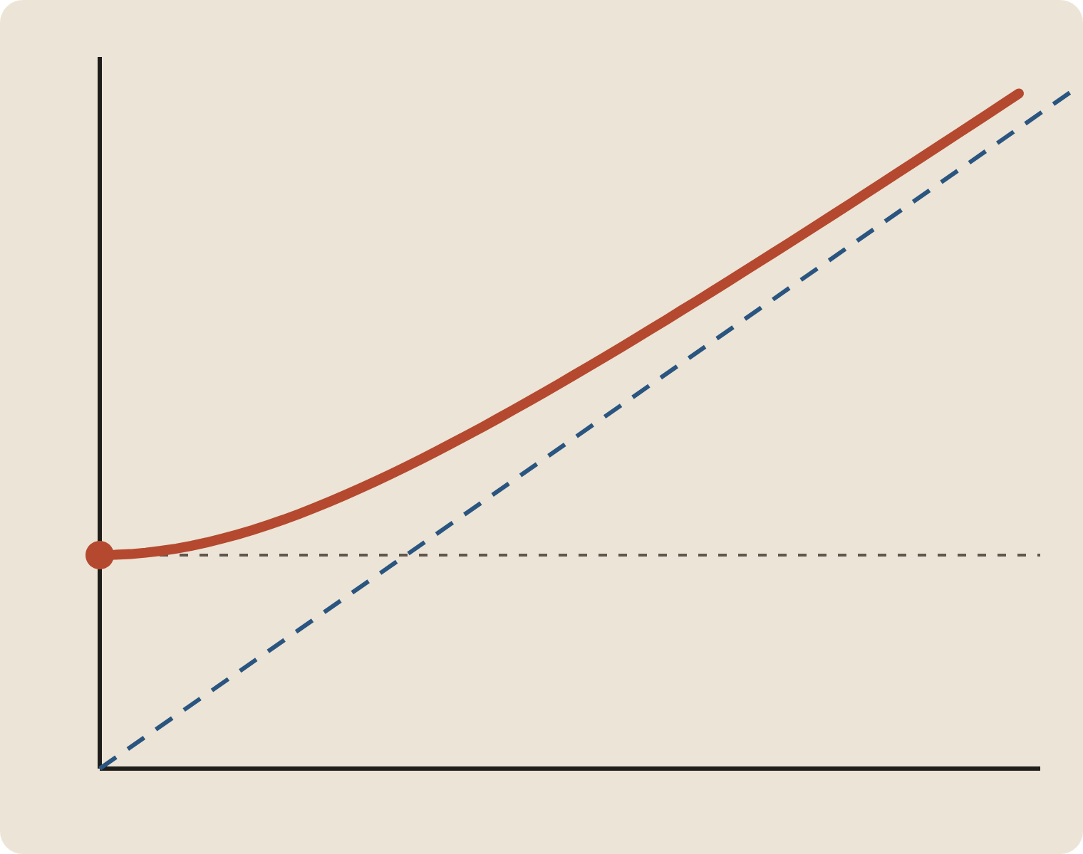
How does E(x,t) evolve in a 1D plasma?
THE EXAMPLE
ω
Electrons: 1D Vlasov–BGK, reduced to a fluid. Ions: a fixed background. Then: mobile ions with screening electrons.
∂ₜ²E + ν ∂ₜE − γv²ₜₕ ∂ₓ²E + ω²ₚ E = 0
slope c = √γ vₜₕ
Our working guess: a damped Klein–Gordon equation. Not yet shown.
ωₚ — the “mass” gap
k
Bohm–Gross: ω² = ω²ₚ + γ k² v²ₜₕ — a massive relativistic particle in disguise
27 / 59
Notes:
The research problem I've been working on. Keep the physics light for this audience: the punchline is that a plasma wave obeys the same equation as a massive relativistic field. The plasma frequency plays the mass, the thermal speed plays c. The question for the agents: derive it, check it, find the exact solution, extend to ions, and find out whether anyone has done this before. Note that seed.md labels all of this as a GUESS — the agents are explicitly invited to overturn it.

Slide 28
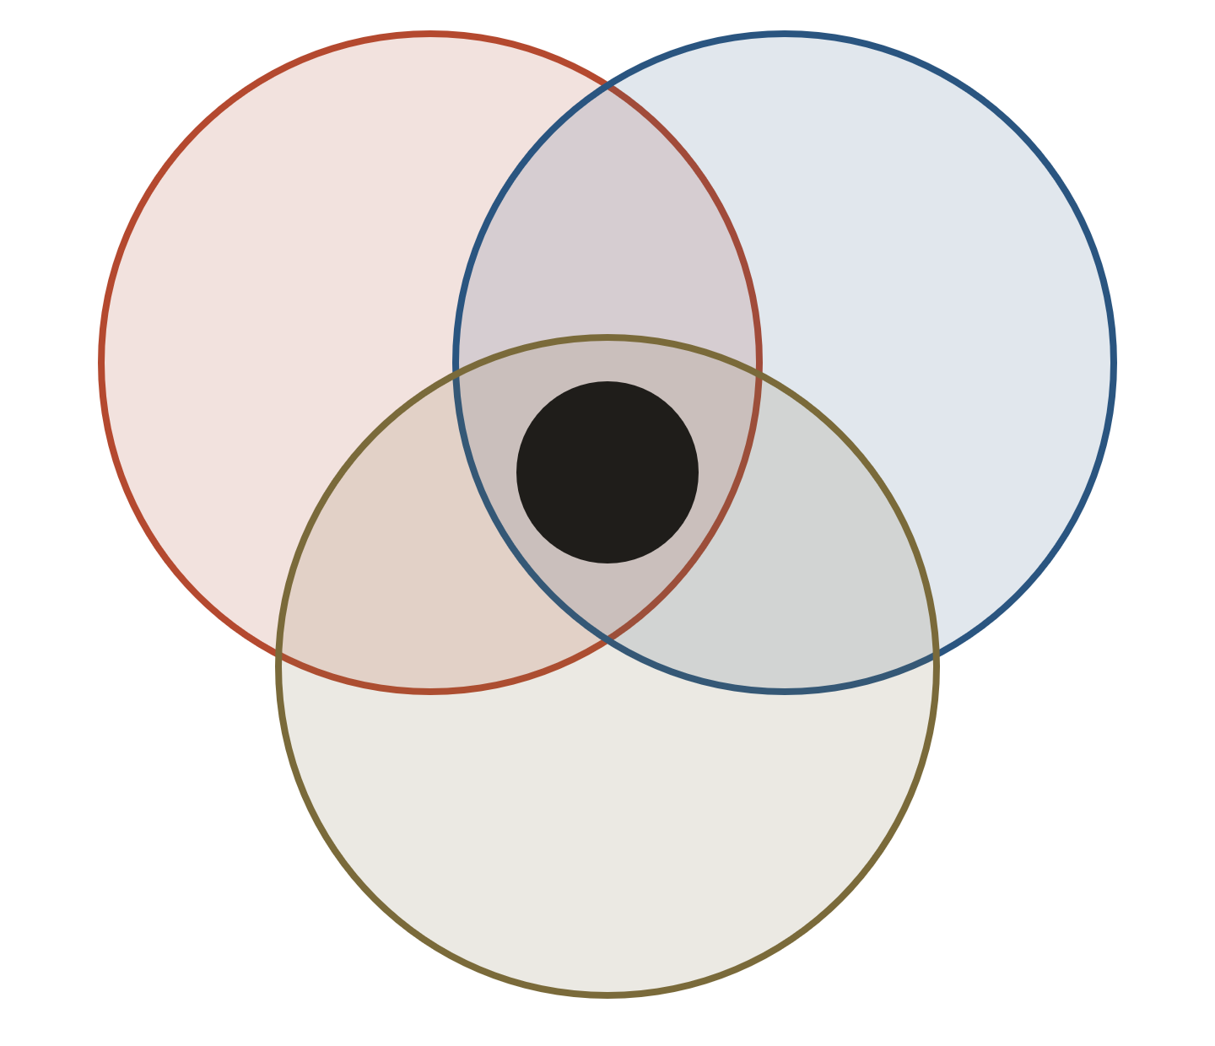
Three communities that rarely cite each other
THE EXAMPLE
BELIEVED
Plasma physics
PDE theory
Each piece exists somewhere in one of these literatures — but no single work pulls them together.
paper
BELIEVED
The damped, electron-screened ion case has not been treated.
SHOWN
Klein–Gordon field theory
Nothing yet. That’s Question 7: search, with evidence, before claiming novelty.
28 / 59
Notes:
Why this is a good test for agents: the risk isn't just wrong algebra, it's literature claims. 'Nobody has done X' is exactly the kind of statement a language model will happily produce without evidence. The seed separates believed from shown and demands search evidence for novelty — watch which setups actually honour that. If time is short, this slide can be skipped; its point returns in Checkpoint 4 (citations) and the results table (novelty verdict).

Slide 29





Run it like an experiment, not a demo
HOW WE’LL STUDY IT
Question
Does a richer harness produce better research — with the model held fixed?
We change
The harness: chat → Claude Code bare → + project files → + skills and subagents
We hold fixed
The brief (seed.md v2), the model and effort, web access, memory, and every setting we can see
We measure
A rubric: results actually checked, §3 errors caught, real citations, novelty evidence, rerunnable figures, draft quality
We keep blind
My original answers sit in answer_key.md. No setup sees it; we score against it afterwards.
We record
A run log per setup: versions, settings, timings, and every follow-up I type
29 / 59
Notes:
This is the frame for everything that follows. A demo shows that a tool can do something; an experiment tells you whether one setup is better than another, and why. Name the parts out loud: one question, one thing we change (the harness), everything else held fixed, a pre-agreed way to measure, a blind answer key, and a written record. The next slides make each row concrete: the brief (seed.md), the controls, what could still go wrong, and the run log.

Slide 30
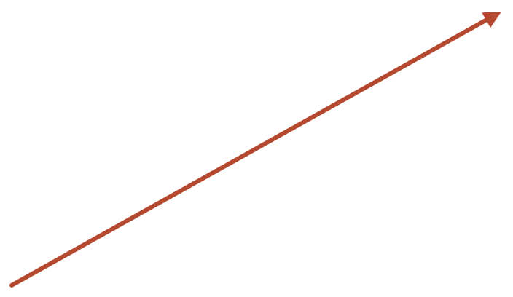

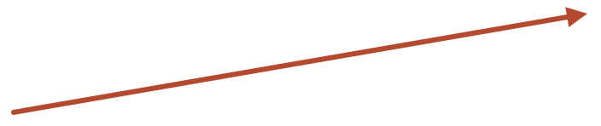
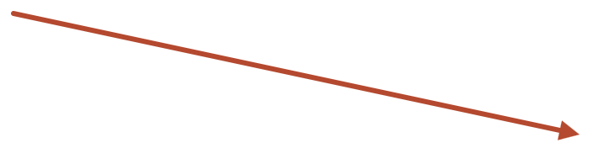
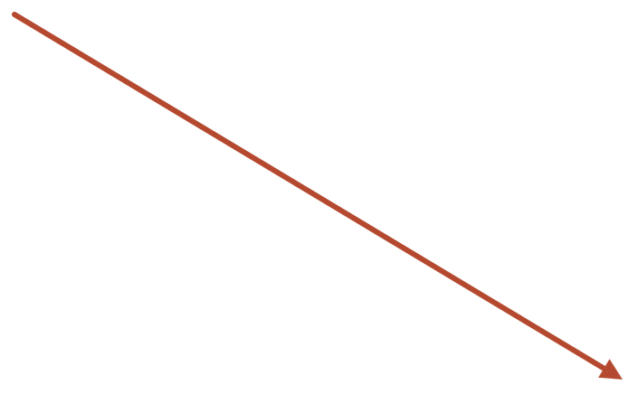
A fixed test for the progression
THE EXAMPLE
To compare setups fairly, each one gets the identical brief. That brief is seed.md — so any difference in results comes from the setup, not from how we asked.
1
Chat
the brief as the opening prompt
seed.md
Claude Code, bare
2
v2 · frozen 3 Oct 2026
the brief as the first message
A written research brief: the problem, our guesses, the questions, the rules.
Claude Code + files
3
the brief split into notes.md and CLAUDE.md
4
Claude Code + skills & agents
as 3, plus skill and subagent files
30 / 59
Notes:
This is where seed.md and the comparison are first introduced — and why the file exists. If I just typed a prompt into each tool, every run would get a slightly different question, and we could not tell whether a better result came from the tool or from the wording. So the problem is written down once, frozen, and delivered to four setups that climb the progression we just toured: chat, then Claude Code with nothing configured, then with project files, then with skills and subagents. Next: the top of the file, read closely, then a section-by-section tour.

Slide 31
One seed, four setups
THE EXPERIMENT
Same Sections 1–7. Same model. Only the packaging changes.
4
+ Skills & subagents
3
As 3, plus skill and agent files
+ Project files
2
+ reusable workflows, delegation
§1–4, 7 → notes.md
§5–6 → CLAUDE.md
Claude Code, bare
1
+ rules that persist across sessions
Seed as the first message
Chat
+ a shell, files, Python
Seed pasted as the opening prompt
Context: one conversation
31 / 59
Notes:
Each step adds one layer on the memory dial. 1: chat, the seed is just a prompt. 2: Claude Code with nothing configured — reach goes up, memory doesn't. 3: the same text split into files the agent re-reads: notes.md for the problem, CLAUDE.md for the rules. 4: add skills (e.g. a 'verify-a-derivation' or 'check-a-citation' skill) and subagents (e.g. a literature searcher with its own context). The content is identical in every case — this isolates the effect of structure.

Slide 32


The four setups, on the map
THE EXPERIMENT
↑ memory
Numbered circles = the four setups we run today
Skills & subagents
4
+ skills & subagents
CLAUDE.md files
3
+ notes.md, CLAUDE.md
Chrome · Excel · PPT
Cowork
Projects & memory
Chat · Projects
Chat, memory off
Current session
1
2
Code, bare
reach →
A sandbox
Browser & apps
Your files
Repo & terminal
32 / 59
Notes:
Callback to the two-dials map from earlier — now with the setups defined. The dashed path is the experiment. Original framing: This is the frame for the whole lecture. Horizontal: what Claude can touch — from its own sandbox, to your browser and apps, to your files, to your repo and terminal. Vertical: what context it carries between sessions — from nothing beyond the current session, up to project files, CLAUDE.md, and finally skills and subagents. The interfaces sit at different points. Our experiment deliberately walks the dashed path: setup 1 is low on both; setup 2 turns up reach; setups 3 and 4 turn up memory while holding reach fixed. Question to plant: which dial matters more for a research problem?

Slide 33
The top of seed.md, read closely
THE BRIEF
# seed.md — Electric-field dynamics in 1D plasmas
①
Frozen
No edits mid-study. Changes become v3, with a note.
<!-- EXPERIMENTER HEADER (not given to any approach)
- Version: v2, 2026-10-03. Freeze before the first… ①
- Detailed results … are WITHHELD → answer_key.md ②
②
Blind
- Every approach receives Sections 1–7, unchanged. ③
My earlier answers are withheld in answer_key.md.
Approach 1 (chat): pasted as the opening prompt
Approach 2 (Code bare): pasted as first message
③
Same content
Approach 3 (+ files): §1–4,7 → notes.md;
Only the packaging changes between setups.
§5–6 → CLAUDE.md
Approach 4 (+ skills/agents): as 3, plus files
- Before each approach: memory paused, chat ④
④
Controlled
search off, ~/.claude/CLAUDE.md empty, same model.
Settings checked before every run.
-->
## 1. Goal ⑤
⑤
The task
Write a journal paper (target: JPP) on how E(x,t)…
Sections 1–7: identical for every setup.
33 / 59
Notes:
Talk through the file itself — it is in the zip as example/seed.md. The experimenter header is the methods section of the study, written before any run: version and freeze date (1), what is withheld and where (2), the rule that the content is identical and only the delivery differs (3), and the controls to set before each run (4). Section 1 onward (5) is the task every setup receives. Lines here are shortened with … to fit; the file has the full text.

Slide 34
Inside seed.md
THE EXAMPLE
—
Experimenter header
Version, packaging per setup, controls. Never shown to any setup.
§1
Goal
A paper on E(x,t) in a 1D plasma that unifies three literatures
§2
Model
Vlasov–BGK electrons, two collision models, closures, screened ions
§3
What we think might be true
Working guesses — Klein–Gordon form, Green function, ion dispersion. Any may be wrong.
§4
Questions
Seven questions, from derivation to novelty
§5
Working rules
Check every result; never invent a citation; keep shown apart from believed
§6
Deliverables
Derivations, literature map, novelty verdict, numerics, paper draft
§7
Out of scope
Experiments, strong coupling, drifting plasmas
34 / 59
Notes:
Walk the file top to bottom. The experimenter header is stripped before any run. §1–2 state the problem. §3 is the interesting design choice: the guesses are labelled as guesses and the agent is told to say plainly if one is wrong. §4 and §6 say what to produce. §5 is the rubric we grade on. §7 keeps it bounded. Later slides refer to sections by number — §3 and §5 most often. The original results, references and numerics are kept in a separate answer_key.md that no setup sees.

Slide 35
A research program, not a single prompt
THE TASK
1
2
3
4
5
Derive
Verify
Search
Simulate
Write
Fluid equations, field equation, Green function — Q1–3, 5–6
Every result checked: SymPy, a known limit, or numerics
Literature in three communities, and novelty verdicts — Q7
Analytic vs numerical E(x,t); ion dispersion across κ
Outline, introduction, one LaTeX section
The working rules from seed.md §5 — these are what we grade:
Never invent a citation
Keep shown apart from believed
Every figure from rerunnable code
35 / 59
Notes:
seed.md asks seven questions and five deliverables. Five stages, and stage 2 is the one most demos skip. The seed requires an independent check for every derived result and tells the agent to say plainly if a guess in the brief is wrong. These rules are the rubric.

Slide 36


Controls: hold everything else fixed
THE EXPERIMENT
Seed frozen
Memory paused
Past-chat search off
Empty CLAUDE.md
Same model
v2, dated. Later edits go in v3.
No carry-over from past chats
The global one in ~/.claude — no hidden rules
For all four runs
“Search and reference chats” — it can’t find my earlier work
answer_key.md holds the original results, references and numerics. No setup sees it. We score every run against it afterwards.
36 / 59
Notes:
This is the slide that turns a demo into an experiment. The seed came from an earlier chat where I already worked much of this out; if memory or chat search were on, the agent could simply retrieve my old answers. Ask: what else could leak? (Answers: your own phrasing in the prompt, files lying around in the working directory, a model update between runs.)

Slide 37
Same knobs, set the same way, in every setup
CONTROLS
Knob | Why it matters | Chat · setup 1 | Claude Code · setups 2–4
Model & effort | Results depend on it | Picker: same model & effort | /model → the same
Memory | Could leak my earlier work | Settings → Memory: both off | Empty ~/.claude/CLAUDE.md
Past chats | My original chat is findable | Past-chat search off | Fresh folder; no --resume
Web search | Literature questions need it | On | Allowed (WebSearch, WebFetch)
Code execution | §5 checks need it | Code on · network off | Runs in your own Python
File access | What it reads is context | No uploads | Only that setup’s folder
Instructions | Hidden rules change behavior | None in Settings or Projects | Only what the setup adds
Your follow-ups | Each one is an intervention | Log every one | Log every one
37 / 59
Notes:
Each row is also a lesson in what these tools can do: if you have to switch it off, it's a capability. Memory and past-chat search could hand the agent my earlier answers. Web search stays on everywhere because Question 7 needs it. Code execution is what makes 'verify with SymPy' real — in chat it's a cloud sandbox without network; in Claude Code it's your own Python. File access: in Claude Code, anything in the folder is context, so the folder must hold only what that setup is supposed to get. The full checklist, with how-to steps, is example/controls.md in the zip. Note: in the merged Chat/Cowork experience there is no web-search toggle — Claude searches when it helps; record which experience you were in.

Slide 38
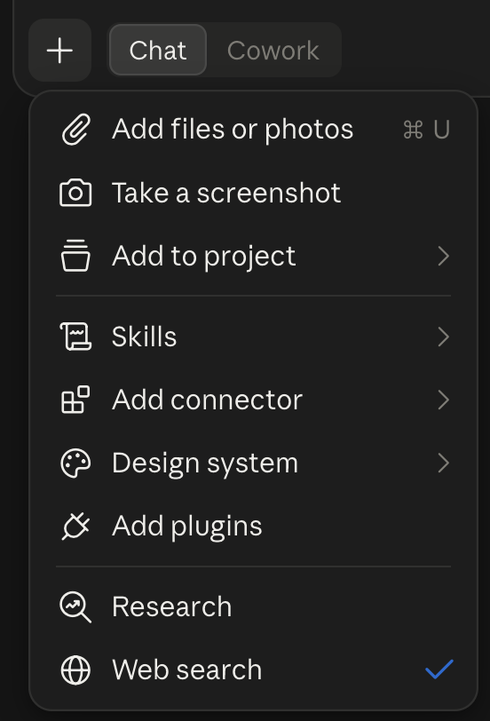
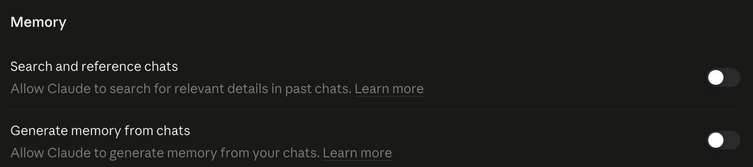
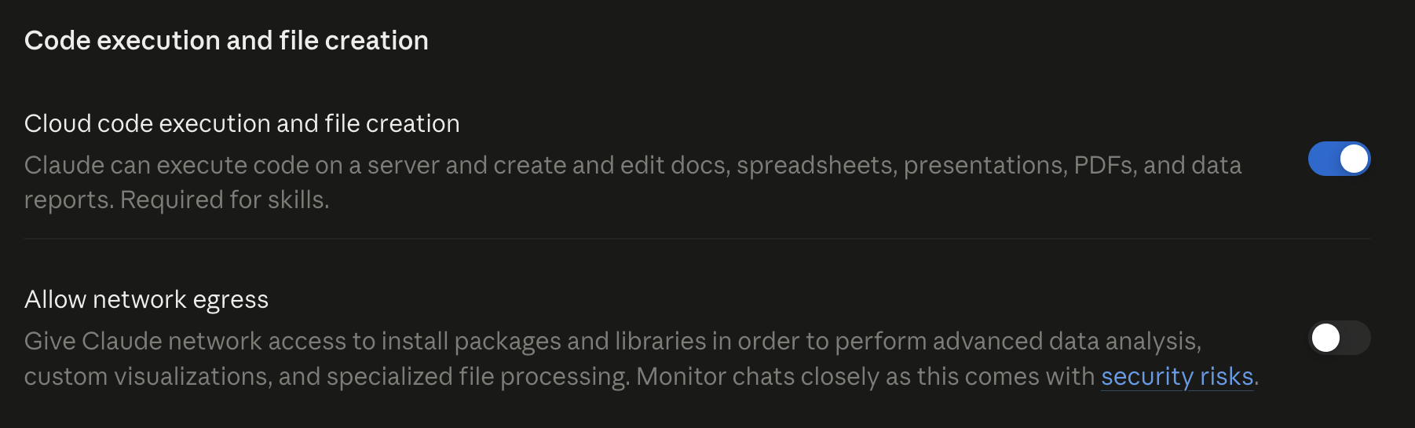
Setup 1, configured: what’s on, what’s off
THE EXPERIMENT · CONTROLS IN PRACTICE
Memory: both OFF
No carry-over from the chat where I first worked this out
Web search ON
The literature questions need it. Research, projects, skills and connectors stay off.
Code ON · network OFF
It can run SymPy, but can’t install anything new
38 / 59
Notes:
Concrete version of the Controls slide, for setup 1 (chat). Memory: both switches off — 'Search and reference chats' would otherwise let Claude find the original conversation where I derived this, and 'Generate memory' would carry facts over. Note the naming: this 'chat search' is past-chat search, not web search. Web search stays ON because Questions 7 and the citation rule need it — the same for every setup. Cloud code execution is ON so chat can actually verify with SymPy; network egress OFF means it can't pip-install anything, which is a real limit worth recording. Model and effort: record them (e.g. Opus 5.5, Medium) and use the same for setups 2–4. For the Claude Code setups the equivalents are: empty ~/.claude/CLAUDE.md, /model to set the same model, and a fresh folder.

Slide 39




What could still bias the comparison
GOOD SCIENCE · THREATS TO VALIDITY
Leakage
Drift
Anything the agent can see is context: memory, past chats, stray files in the folder — even my phrasing. Close every door.
The tools change under us: the Chat/Cowork merge, model updates. Record the version and date of every run.
Intervention
Chance
Every follow-up I type steers the result. Same kickoff message for all; log each nudge, word for word.
One run per setup is n = 1. The same setup can do better or worse next time. Rerun when a difference looks decisive.
When scoring the drafts: hide which setup wrote which, so the grader can’t favor the one they expect to win.
39 / 59
Notes:
Students rarely hear 'threats to validity' outside a methods course; this is a good place. Leakage is the big one for AI experiments, and it is subtle: a README left in the working folder, or a follow-up that hints at the answer, changes what the agent knows. Drift is specific to this field — the merge happened during this very study. Intervention is why the run log records every follow-up verbatim. Chance: language models are stochastic, so one run each is suggestive, not conclusive. Blind scoring: strip setup labels, have a colleague grade.

Slide 40
A run log for every setup
WRITE IT DOWN
IN THE ZIP, UNDER EXAMPLE/
# Run log — setup 1 (chat)
controls.md
date: 2026-10-__
Every knob: how to set it, in chat and in Claude Code
interface: claude.ai chat (Chat/Cowork toggle)
model: Opus 5.5 · effort Medium
run_log_template.md
memory: off · past-chat search off
Fill in one per setup
web/code: search on · code on · network off
brief: seed.md v2, §1–7, pasted once
rubric.md
time: __:__ → __:__
How each run is scored — before we see results
follow-ups: 1. “…” 2. “…”
setup3-files/
outputs: paper-setup1-chat.pdf, transcript
notes.md + CLAUDE.md: seed.md, split
setup4-skills/
… plus two skills and one subagent
40 / 59
Notes:
The run log is the lab notebook. Left: setup 1's log as an example — fill in the blanks from last week's run [confirm the model and effort you used]. Right: the study-design files in the zip. rubric.md is written BEFORE seeing results, which is the point. setup3-files/ shows exactly how seed.md is split for setup 3; setup4-skills/ adds a verify-derivation skill, a check-citation skill, and a literature-scout subagent — a concrete look at what skills and subagents are. Students reuse all of this for their group projects.

Slide 41
Predict before we run it
CHECKPOINT 4 · SHOW OF HANDS
Which setup will… | 1 | 2 | 3 | 4
run a symbolic check without being reminded? | ○ | ○ | ○ | ○
catch what changes when electrons collide with each other, not with ions? | ○ | ○ | ○ | ○
cite a paper it can’t back up? | ○ | ○ | ○ | ○
say plainly that a guess in Section 3 is wrong? | ○ | ○ | ○ | ○
41 / 59
Notes:
Record the votes, then step through the four questions on the next slides, one at a time. Row 2 is the physics trap: a BGK operator that relaxes electrons toward their OWN local Maxwellian conserves momentum, so it adds no drag term to the momentum equation. With a polytropic closure that means no damping at all at this order — damping has to come from the heat flux or higher moments. An agent that just pattern-matches 'collisions → ν' will get this wrong. Row 4: Section 3's guesses are deliberately labelled as unestablished; see whether anyone takes the invitation to correct them.

Slide 42
Which setup will run a symbolic check without being reminded?
CHECKPOINT 4 · QUESTION 1 OF 4 · ANSWER
PREDICTED BEFORE RUNNING · RESULTS IN PART 5
THE ANSWER
Setup 4 most likely; chat least. Every setup is told to check (§5), but only setup 4 has a skill that makes checking a step it runs after every derivation.
1
Chat
Maybe
Can run SymPy, but often just asserts
Claude Code, bare
2
Python at hand; the rule is one line in a long prompt
Maybe
WHY IT MATTERS
“Verified” with no visible code is a claim, not a check. Research needs checks you can rerun.
3
+ project files
Likely
The check rule stays in context
4
+ skills & subagents
Most likely
A skill turns checking into a procedure
42 / 59
Notes:
Step through: read the question, recall the class vote, give the answer and its reasoning, then the per-setup predictions. These are the instructor's predictions made from how each harness is built — the actual outcomes are shown in Part 5.

Slide 43
Which setup will catch what changes when electrons collide with each other, not with ions?
CHECKPOINT 4 · QUESTION 2 OF 4 · ANSWER
PREDICTED BEFORE RUNNING · RESULTS IN PART 5
THE ANSWER
The physics: self-collisions conserve momentum, so there is no −νu drag term — with a polytropic closure, no damping at this order. Expect no clear winner: no harness supplies this insight.
1
Chat
Maybe
Same model, same physics
2
Claude Code, bare
Maybe
More tools, no more insight
3
+ project files
Maybe
WHY IT MATTERS
Rules don’t supply physics
It separates reasoning from recall, and shows what a harness can’t do. Procedure can be scaffolded; insight comes from the model.
4
+ skills & subagents
Maybe
A check might flag it — if it tests momentum
43 / 59
Notes:
Step through: read the question, recall the class vote, give the answer and its reasoning, then the per-setup predictions. These are the instructor's predictions made from how each harness is built — the actual outcomes are shown in Part 5. The key teaching point: no harness supplies physical insight — if all four miss it, that is a finding, not a failure of the experiment.

Slide 44
Which setup will cite a paper it can’t back up?
CHECKPOINT 4 · QUESTION 3 OF 4 · ANSWER
PREDICTED BEFORE RUNNING · RESULTS IN PART 5
THE ANSWER
Chat is most at risk; setup 4 least, with a citation skill and a literature scout that must open every DOI.
1
Chat
Likely
Easy to cite from memory
2
Claude Code, bare
Maybe
WHY IT MATTERS
Can search; nothing forces it to
Here “likely” is the bad outcome. One invented reference can sink a paper — and it’s the failure readers are most likely to miss.
+ project files
3
Maybe
The rule says never invent — but no procedure
4
+ skills & subagents
Unlikely
Skill and scout must open each DOI
44 / 59
Notes:
Step through: read the question, recall the class vote, give the answer and its reasoning, then the per-setup predictions. These are the instructor's predictions made from how each harness is built — the actual outcomes are shown in Part 5. On this question 'likely' is the BAD outcome, so the colors are inverted.

Slide 45
Which setup will say plainly that a guess in Section 3 is wrong?
CHECKPOINT 4 · QUESTION 4 OF 4 · ANSWER
PREDICTED BEFORE RUNNING · RESULTS IN PART 5
THE ANSWER
Setups 3 and 4 most likely. The invitation to challenge the brief sits in CLAUDE.md, always in context, and setup 4 tests each result.
1
Chat
Maybe
The invitation is one line in a long prompt
2
Claude Code, bare
Maybe
Same prompt, more tools
WHY IT MATTERS
+ project files
The brief invites disagreement. A setup that quietly adopts every guess is agreeing, not checking.
3
Likely
The rule stays in context
4
+ skills & subagents
Most likely
Each result gets tested
45 / 59
Notes:
Step through: read the question, recall the class vote, give the answer and its reasoning, then the per-setup predictions. These are the instructor's predictions made from how each harness is built — the actual outcomes are shown in Part 5.

Slide 46
Hands-on
PART 4 OF 6
You try each interface on a piece of the problem
1
Landscape
2
Interfaces
3
The example
4
Hands-on
5
Results
6
Your turn
46 / 59
Notes:
Part 4: hands-on. Students now know the interfaces (Part 2) and why the folder and prompts are set up the way they are (Part 3). Same folder, same prompts, for everyone.

Slide 47
What’s in agentic-ai.zip
FOLLOW ALONG · KEEP THIS SLIDE IN MIND
One folder, so every interface works on the same files.
In ~/agentic-ai/ | What it is | When you use it
README.md | What’s here, plus the before-class checklist | Before class
prompts.md | Prompts 1–6, copy-ready — no typing Greek letters | Every follow-along step
papers/ | 2–3 PDFs | Cowork step · Prompt 3
plasma/ | Empty on purpose — Claude Code fills it | Desktop Code and terminal · Prompts 1, 4–6
example/seed.md | The written brief for my full experiment | The experiment — and your project template
example/controls.md · rubric.md · run_log_template.md | How the study is controlled, scored and recorded | Your group project
example/setup1-chat/ … setup4-skills/ | What each setup receives — and setup 1’s paper draft | When we compare results
47 / 59
Notes:
Blue rows are the experiment’s materials; results from setups 2–4 are added after class. One folder means the terminal can pick up where the desktop app left off. Put this up while students download and unzip; leave it up while they get oriented. The top four rows drive the live follow-along; the blue rows are for the experiment and the homework. seed.md is included in full, including its experimenter header — students will see why on the 'Inside seed.md' slide. The answer key is not in the zip. [Before posting: add the papers/ PDFs and setup 1's paper PDF, and delete the two ADD_FILES_HERE.txt notes.]

Slide 48


Get ready before class
FOLLOW ALONG
Download agentic-ai.zip from the course Drive and unzip it in your home folder.
CHECKLIST
Signed in to the course’s Claude Team account
~ is your home folder: /Users/you on a Mac, C:\Users\you on Windows.
Claude desktop app installed
Cloud code execution on in Settings (for chat)
Give each interface only the folder its step names: papers/ for Cowork, plasma/ for Claude Code.
Python 3 with SymPy
python3 -m pip install sympy
Claude Code installed (for the terminal)
48 / 59
Notes:
Post this with the zip so installs happen before class, not during it. Students are on the course's Claude Team account. The 'only the folder its step names' rule keeps runs comparable and is a first lesson in permissions: an agent can only touch what you give it.

Slide 49
Follow along: chat
TRY IT NOW · 1 OF 4
PROMPT 1 · THE SAME IN EVERY ROOM
Linearize the 1D electron fluid equations (continuity, momentum with pressure γT·n and drag ν, Poisson) and derive one equation for E(x,t). Verify it with SymPy.
1
Open claude.ai or the desktop app. Start a new chat.
2
In Settings, turn on Cloud code execution and file creation:
PROMPT 2 · CHAT
Plot ω(k) for the ν = 0 case and give me the figure as a PNG.
WATCH FOR
Did it really run SymPy? Look for a code block and its output. A sentence saying “verified” is a claim, not a check.
3
From prompts.md, paste Prompt 1. Then Prompt 2.
49 / 59
Notes:
Yes — chat CAN run SymPy, in its sandbox, once code execution is on. Without it, chat does the algebra in prose and may still say 'verified'. That's the first lesson of the shared prompt. Have students check for the tool call. The figure arrives as a download; the sandbox itself is gone after the session.

Slide 50
Follow along: Cowork
TRY IT NOW · 2 OF 4
PROMPT 1 · THE SAME IN EVERY ROOM
Linearize the 1D electron fluid equations (continuity, momentum with pressure γT·n and drag ν, Poisson) and derive one equation for E(x,t). Verify it with SymPy.
1
Check that papers/ holds the PDFs from the course zip.
2
Desktop app → flip the toggle to Cowork (merged app: no toggle) → give it this folder:
PROMPT 3 · COWORK
~/agentic-ai/papers
Read every PDF in this folder. Write papers.md: a table of authors, year, DOI, and whether each is plasma physics, PDE theory, or field theory.
3
Choose Manual, so it waits for your OK at each step.
4
Paste Prompt 3. Then Prompt 1.
WATCH FOR
papers.md appears in your folder. Then ask it to open each DOI in its built-in browser — and check one yourself.
50 / 59
Notes:
The specialty is the file work chat can't do. The shared prompt here: compare with chat — does it run code, and where does the result land? [Verify on the day how Cowork's folder picker is labelled.] The DOI check is a preview of the citation rule in the experiment.

Slide 51
Follow along: desktop Code
TRY IT NOW · 3 OF 4
PROMPT 1 · THE SAME IN EVERY ROOM
Linearize the 1D electron fluid equations (continuity, momentum with pressure γT·n and drag ν, Poisson) and derive one equation for E(x,t). Verify it with SymPy.
1
Desktop app → Code tab → Local → choose this folder:
PROMPT 4 · DESKTOP CODE
~/agentic-ai/plasma
Save the derivation as derive_E.py, with a test that checks the ν = 0 limit against Bohm–Gross. Run the test.
2
Paste Prompt 1.
3
If SymPy is missing, it asks to install it. Read the command before you approve.
WATCH FOR
4
Then Prompt 4. Accept or reject each edit.
derive_E.py is still in your folder tomorrow. Chat’s check vanished with its sandbox; this one you can rerun.
51 / 59
Notes:
Answer to 'can earlier rooms run this prompt?': yes — chat and Cowork can run SymPy in their own sandboxes. The difference here: code runs in YOUR Python, with YOUR packages; the result is a file you keep; and it can write a test and run it until it passes. That is what 'verify' should mean in research.

Slide 52
Follow along: terminal
TRY IT NOW · 4 OF 4
PROMPT 5 · INSTEAD OF PROMPT 1
Already done in step 3 — same folder, same files. So:
> Run the test in derive_E.py and
1
Open a terminal. Install Claude Code if you haven’t (link on the course page).
explain the result.
2
Go to the same folder:
PROMPT 6 · TERMINAL
cd ~/agentic-ai/plasma
> /init
3
Start a session:
> Add the screened-ion dispersion and
claude
plot it for three values of κ.
4
Paste Prompt 5, then Prompt 6.
WATCH FOR
/init writes a CLAUDE.md. Open it: that file is memory — every future session in this folder reads it.
52 / 59
Notes:
The point of reusing the folder: the work lives in files, not in a session. The terminal picks up exactly where the Code tab left off. /init is the bridge to the memory dial later in the lecture. Bonus for keen students: claude -p 'run the tests and summarize' from any shell script.

Slide 53
Results
PART 5 OF 6
Four setups, scored against the answer key
1
Landscape
2
Interfaces
3
The example
4
Hands-on
5
Results
6
Your turn
53 / 59
Notes:
Part 5: my experiment's results — the four setups, scored with the rubric fixed in Part 3. Compare with the Checkpoint 4 predictions.

Slide 54
Four runs, side by side
RESULTS
Criterion | 1 · Chat | 2 · Bare | 3 · Files | 4 · Skills
Wall-clock time | [ ] | [ ] | [ ] | [ ]
Results with an independent check | [ ] | [ ] | [ ] | [ ]
Errors in §3 caught | [ ] | [ ] | [ ] | [ ]
Citations confirmed / total | [ ] | [ ] | [ ] | [ ]
Novelty verdict backed by searches | [ ] | [ ] | [ ] | [ ]
Figures from rerunnable code | [ ] | [ ] | [ ] | [ ]
Draft quality (1–5) | [ ] | [ ] | [ ] | [ ]
54 / 59
Notes:
[Fill in from the runs.] Show screenshots or short clips from each run on separate slides if you have time — the transcript of setup 1 vs setup 4 at the same moment is the most persuasive image. Then compare against the Checkpoint 4 predictions.

Slide 55
What each prediction was testing
CHECKPOINT 4 · ANSWERS
Ran a symbolic check unprompted?
Caught the self-collision subtlety?
§5 demands an independent check for every result. Did it open SymPy, take a known limit — or just assert?
BGK relaxation toward the electrons’ own Maxwellian conserves momentum: no −νu drag term. With a polytropic closure, no damping at this order.
Result: [setup __ ]
Result: [setup __ ]
Cited a paper it couldn’t back up?
Questioned the brief’s guesses?
Every reference checked against a DOI or publisher page. “UNCERTAIN” is acceptable; invented is not.
§3 says any guess may be wrong. Did it test each one, or quietly adopt them? Score against answer_key.md.
Result: [setup __ ]
Result: [setup __ ]
55 / 59
Notes:
Placed after the results so predictions were not spoiled. Compare with the votes. Physics detail for card 2: the BGK operator relaxing to the local Maxwellian (built from the electrons' own density, mean velocity and temperature) conserves particle number, momentum and energy. So the momentum moment of the collision term vanishes — there is no −ν n u friction. Contrast with the electron–ion drag model, which relaxes toward a Maxwellian at rest in the ion frame and does give −ν_ei u. With self-collisions, any damping must enter through the heat flux (or other higher moments), which is why the closure choice matters. Card 3: a fabricated citation is the clearest failure mode to show students — open the DOI live if one fails. [Fill in results.]

Slide 56
The model stays fixed. The scaffolding is the variable.
THE TAKEAWAY, AS A HYPOTHESIS
Reach decides what an agent can do. Memory — files, rules, skills — decides whether it does it the way you need.
56 / 59
Notes:
Frame this as what the results table tests, not as a slogan. If setup 2 beat setup 4 on some row, say so — that's interesting too (e.g. too much scaffolding can distract).

Slide 57
Your turn
PART 6 OF 6
Your group project
1
Landscape
2
Interfaces
3
The example
4
Hands-on
5
Results
6
Your turn
57 / 59
Notes:
Part 6: the method becomes theirs — the group assignment and its first step.

Slide 58



Your turn: one problem, solved 4–5 ways
NEXT WEEK’S ASSIGNMENT
Form a group
Solve it 4–5 ways
Present
About five people. Pick a problem you care about — from research, a course, or a hobby.
Climb today’s progression: chat, Cowork, Claude Code bare, + CLAUDE.md, + skills and subagents. Same brief every time.
Slides comparing your runs — about 15 minutes per group, in class next week.
YOUR SLIDES SHOULD SHOW
The problem · how each setup was configured · what each got right and wrong · which setup you’d use again, and why
58 / 59
Notes:
Close with the assignment: the experiment they just saw is the template for their own. Groups of about five; one problem; 4–5 setups climbing the progression; ~15-minute presentations next week. [Confirm the presentation date — Friday 16 October? — and how groups are formed.] Encourage problems where answers can be checked, so the comparison means something.

Slide 59
Your group’s first step: write a seed.md
BEFORE NEXT WEEK
1
2
3
Goal
Working guesses
Rules & deliverables
What the finished thing is, and who it’s for
Labelled as guesses, so the agent may overturn them
How results get checked, and what “done” looks like
Then run it 4–5 ways, and bring 15 minutes of slides on what you found.
59 / 59
Notes:
The assignment’s first step, now that students have seen a seed.md in action. Point them to mine as a template — especially the split between 'what we think might be true' and 'working rules'. [Add submission details and group sign-up.]

