Slide 1
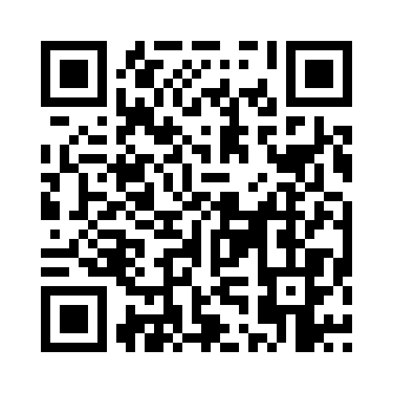
Designing an agent for a task you already do
NRT AGENTIC AI · WEEK 5 · FRIDAY 16 OCTOBER 2026
Scan & Share your homework answers!
Find the Practice Demo
From your five homework answers to a workflow Claude can run again
NRT Hot Topics: Agentic AI · Pattern design I · Jie Hou
1 / 14

Slide 2
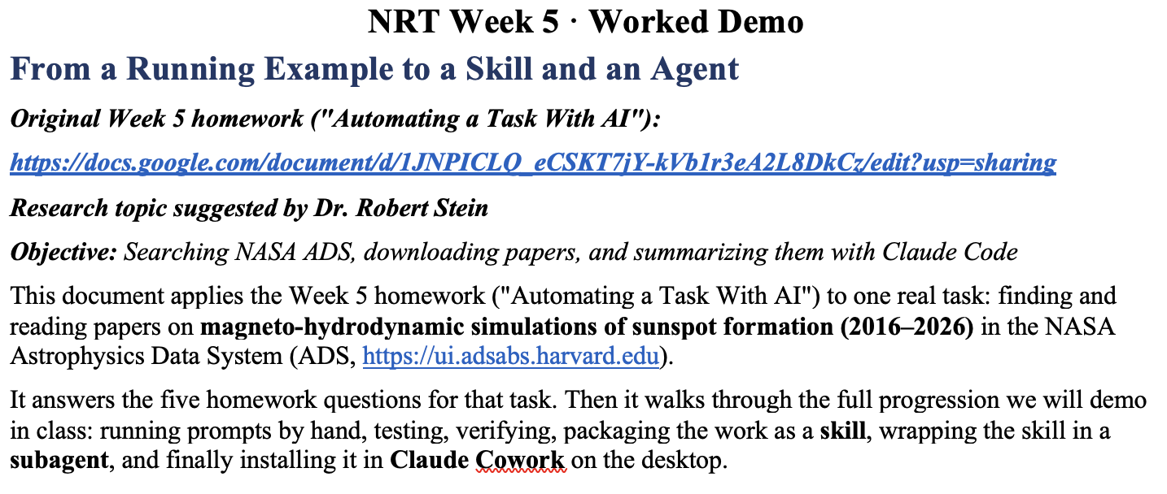
Today’s plan
NRT AGENTIC AI · WEEK 5 · FRIDAY 16 OCTOBER 2026
THIS AFTERNOON
Intro to agent design
Student presentations
3 minutes each
Live demo: Bob’s task
Prompt, test, verify in Claude Code
Work together · 2:30–4:30
Your own task, one step at a time
https://forms.gle/rNY8zydkMairSj5o9
2 / 14

Slide 3
Design the workflow first.
The agent is only one of the boxes.
THE IDEA BEHIND THE HOMEWORK
1 · YOU
2 · INSIDE CLAUDE CODE, BY CONVERSATION
Design the
workflow
Describe
Draft
Polish
Test
Refine
Runnable
workflow
Homework
Questions 1–5
reuse it
next time
repeat until the tests pass
Most steps in a real task belong to you, a script, or a check. Today we decide which box is which, and how you would know if a box got it wrong.
“This does not need an agent” is a perfectly good conclusion.
3 / 14

Slide 4
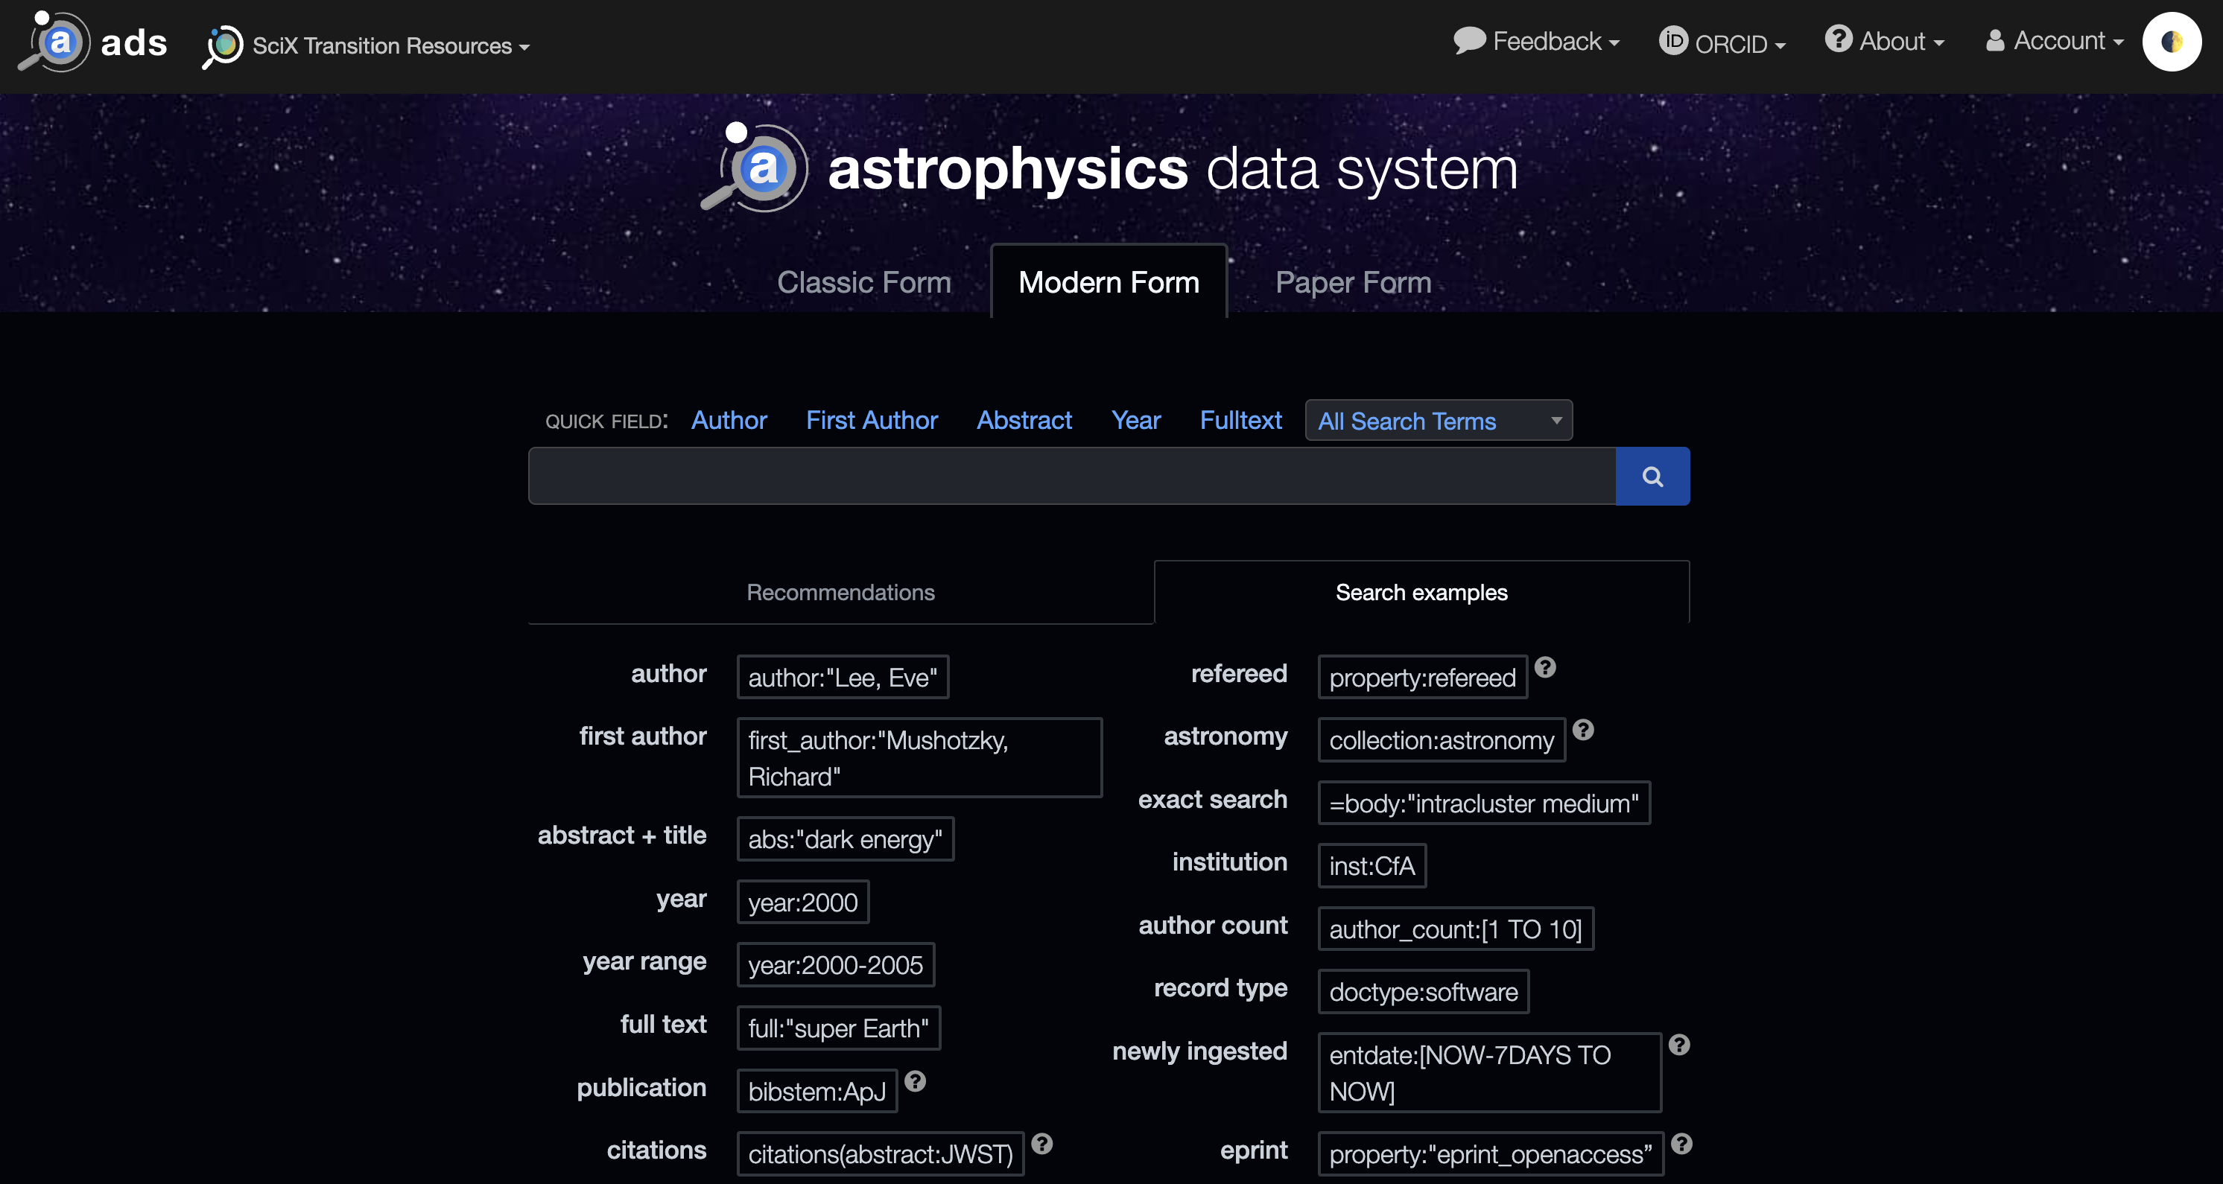
Bob's task: find and read ten years of papers
WORKED EXAMPLE · BOB'S TASK
NASA ADS: ui.adsabs.harvard.edu
free to search, with an API for scripts
BOB'S GOAL
An introduction for a journal paper on MHD simulations of sunspot formation, tracing earlier theories and simulations.
HOW HE DOES IT TODAY
Searches, downloads and reads by hand, or with Claude chat.
TODAY'S DEMO
The first half: search NASA ADS for 2016–2026, download the free PDFs, summarize the core papers.
Writing the LaTeX introduction comes later, built on these summaries.
4 / 14

Slide 5
Every step goes to one of four owners
PATTERN 1 · WHO DOES EACH STEP
You
A script
Claude
A checker
Steps that need your judgment: what the topic really is, what matters, what to keep.
Steps that give the same output for the same input, every time. No AI needed.
Steps that need judgment over text: reading, summarizing, drafting.
A separate, read-only check.
An agent checking its own work is not independent.
IN BOB’S TASK
IN BOB’S TASK
IN BOB’S TASK
IN BOB’S TASK
Choose the keywords. Pick the core papers.
Query the ADS API, save the CSV, download free PDFs.
Summarize each paper, with a page number for every claim.
Compare each claim in a summary with the PDF page.
Rule of thumb: give each step the least machinery that does it reliably.
5 / 14

Slide 6
Package only what you will reuse
PATTERN 2 · HOW MUCH TO BUILD
1
2
3
4
Prompt
Skill
Subagent
Share
One request, typed into Claude.
A folder: SKILL.md with steps and checks, plus scripts. Claude loads it when a request matches.
A separate Claude with its own tools and context. It hands back a short report.
Bundle the skill and agents as a plugin, or upload the skill to Cowork desktop.
WORTH IT WHEN
WORTH IT WHEN
WORTH IT WHEN
WORTH IT WHEN
You do it once, or you are still working out the steps.
The same steps repeat with new inputs. Bob: a new topic every few weeks.
Reading 20 PDFs would flood the main chat,
or you need a separate check.
Someone else will run it, or you want it without a terminal.
Less to build, less to break
More to build, more to break
Climb one rung only when the rung below stops being enough.
6 / 14

Slide 7
Pick the room by what the agent must touch
PATTERN 3 · WHERE IT RUNS
Chat
Cowork
Claude Code
IT CAN TOUCH
IT CAN TOUCH
IT CAN TOUCH
Its own sandbox. Nothing on your machine.
Folders you grant it in the desktop app. No terminal.
Your shell, scripts, environment variables and project folder.
USE IT WHEN
USE IT WHEN
USE IT WHEN
One-off drafting and thinking, or a task that is really one good prompt.
Many files and documents: tidy, summarize, reorganize.
Repeatable pipelines that run code, call an API or need a secret.
BOB’S TASK
It needs an API token, scripts, and files passed between steps, so it runs in Claude Code. The reading and summarizing half also works in Cowork once the PDFs sit in a folder.
7 / 14

Slide 8
The five homework questions are the design spec
YOUR HOMEWORK, READ AS A DESIGN
HOMEWORK QUESTION
WHAT IT DECIDES
1
What do you do?
The goal and what “done” means, so the agent knows when to stop.
2
How do you do it now?
The steps of the pipeline, including the dull copy-and-paste ones.
3
Draw it
The loops: where the time goes and where a check belongs.
4
In, out, who, where
An owner and a room for every step: you, a script, Claude or a checker.
5
What could go wrong?
The checks and the never-touch list that make the output trustworthy.
Claude Code drafts the workflow; you check each decision.
8 / 14

Slide 9
Bob’s task became eight steps with two loops
WORKED EXAMPLE · BOB’S PAPER SEARCH IN NASA ADS
1
2
3
4
5
6
7
8
Topic → keywords
Build the query
Run search, check count
Save the CSV
Download free PDFs
Summarize each paper
Check vs the PDFs
Pick core papers
You
Claude + you
Script
Script
Script + you
Claude
Checker + you
You
key paper missing
wrong claim
3–5 hours
101 → 48 → 39
5 boxes, 0 loops
by hand, every 2–4 weeks, with a new topic each time
records, refereed papers and free PDFs in the real run on 14 Oct
in Bob’s first sketch. Answering Q3 and Q4 found the loops.
9 / 14

Slide 10
Every quiet failure needs a one-minute check
PATTERN 4 · HOW YOU KNOW IT WORKED
IF IT GETS THIS WRONG…
…YOU SPOT IT BY
The query quietly misses key papers, e.g. a missing synonym like “MHD”.
Naming 3 papers you know should appear. All 3 must be in the CSV.
A “PDF” is really an error or cookie page saved as .pdf.
Checking that every file starts with %PDF-, then opening 3 at random.
A summary invents or changes a number.
Requiring a page number for every number, then looking up 2 of them.
NEVER TOUCH
The API token, the downloaded PDFs, and paywalls. A written “never” is only a request; folder permissions and scripts enforce it.
10 / 14

Slide 11
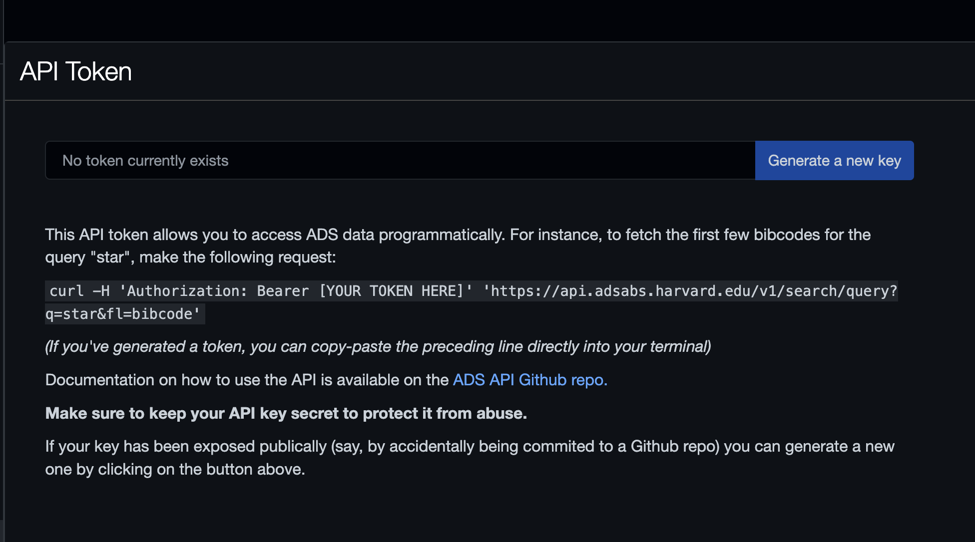
Claude reaches ADS through your API token
BEFORE THE DEMO · ONE-TIME SETUP
1 · GET A TOKEN
NASA ADS: ui.adsabs.harvard.edu
ADS → Account → Settings → API Token → Generate a new key.
2 · SAVE IT IN A FILE
In your project folder, make a file ads_token.txt with the token as its only line. Any text editor works.
3 · TELL CLAUDE THE RULE
“My ADS token is in ads_token.txt. Only scripts may read it. Never print it or show it in the chat.”
ADS account settings: the API Token page
If the token ever appears in the chat, generate a new key.
11 / 14
You do not need to figure out the next steps. Claude will advise you!

Slide 12
Prompt, test, verify, then package
TODAY’S DEMO, STEP BY STEP
MAKE IT WORK
MAKE IT REUSABLE
1
2
3
4
5
6
Prompt by hand
Test
Verify yourself
Skill
Subagents
Share
Paste prompts into Claude Code, one step at a time.
Run test cases. Include one that should fail.
About ten minutes of your own checks.
SKILL.md plus scripts, for the steps that passed.
A worker, and a read-only checker.
Upload to Cowork, or bundle a plugin.
Only steps that pass both the tests and your own check get packaged.
Bring your five answers and one real input file from your task.
12 / 14

Slide 13
Share your task, then build it with Claude
YOUR TURN
PRESENT YOUR TASK · 3 MINUTES
1
Your task
and what “done” looks like
WHILE YOU LISTEN, ASK
Which step would you keep?
Where does their judgment matter?
2
Your steps
and where they loop back
Script, Claude, or nothing?
Does any step really need an agent?
3
The steps you keep
and why they stay with you
How would they notice?
Is the check independent and quick?
4
One quiet failure
and the one-minute check that catches it
Small and slightly boring is better than ambitious.
13 / 14

Slide 14
Pick one: your own task or Bob’s
WORK TOGETHER · 3:30–4:30
OPTION A
OPTION B
Your own task
Bob’s paper search
1 Open Claude Code in a new, empty project folder.
2 Paste your five homework answers.
3 Ask Claude to draft the workflow. Decide which steps stay with you.
1 Scan the QR code for the demo document.
2 Save your token in ads_token.txt (slide 11).
3 Paste the demo prompts one at a time, testing each.
PRACTICE DEMO AND HOMEWORK FORM
Either way: prompt by hand, test, verify, then package.
https://forms.gle/rNY8zydkMairSj5o9
14 / 14

